Slide 1
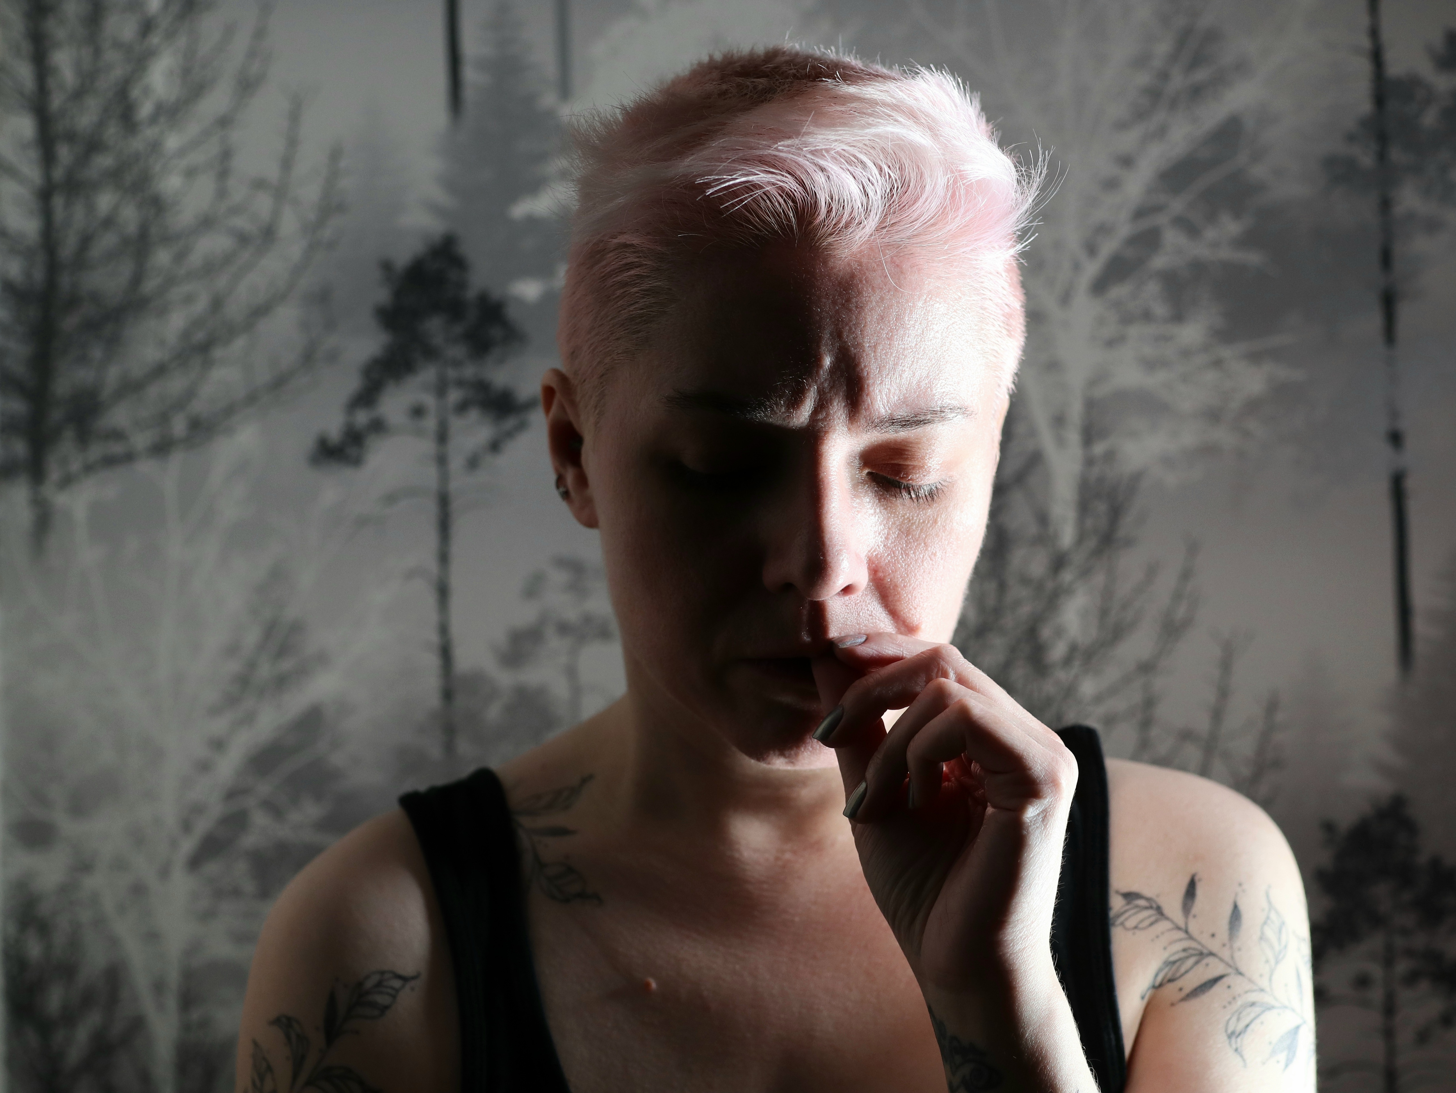

“I don’t know what we should have done differently...”
A QUALITATIVE STUDY ON THE DILEMMAS OF 'TOUGH LOVE' AND TOXIC DRUGS IN BRITISH COLUMBIA, CANADA
Addiction and the Family International Network
Webinar Series, May 12, 2026
Dr. Amy Salmon, University of British Colubmia, Centre for Advancing Health Outcomes
Dr. Steve Esau, Pacific Community Resources Society
Jennifer Hawkins, Centre for Advancing Health Outcomes
Mike Sikora, City of Abbotsford

Slide 2

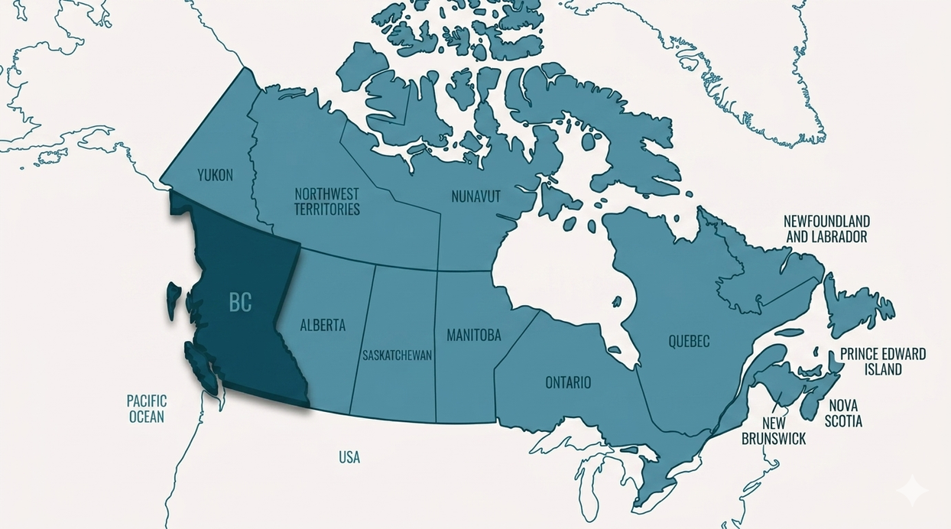
CONTEXT
BRITISH COLUMBIA:
EPICENTRE OF A PUBLIC HEALTH CRISIS
Vancouver, BC | Adrian Yu

Slide 3

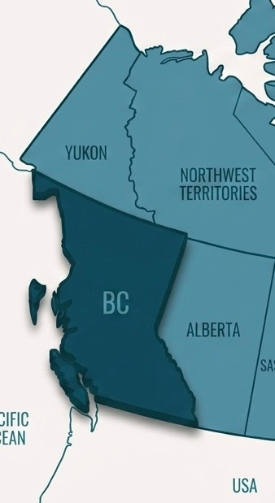
01
CRISIS-LEVEL IMPACTS
Leading Cause of Unnatural Death in BC
> 18,000 people
> 5 people per day
> ABI “shadow crisis”
Reverberating Effects on Family and Loved Ones
> 4-5 people for every person using
> Witnesses, first responders, natural supports
> Trauma, parental loss, excruciating coping dilemmas

Slide 4


02
INCREASING TOXICITY
New Adulterants
> Poly-substanace shift: xylazine, metedomidine, non-medical benzodiazepines, high-potency synthetic opioids
> Severe impacts: extreme sedation, necrotic skin ulcers, anterograde amnesia, severe withdrawal
Increasing Complexities
> Unpredictable and extreme symptoms are difficult to manage in conventional treatment settings, including medication assisted treatment.
> Complexities cause additional stress for AFMs.

Slide 5

03
GOVERNMENT APPROACHES
Lack of Attention to Families
> Little or no mention of family members in major BC government strategy and policy documents
> Funding often subsumed into services for people using substances
Recognizing the Importance of Relationships
> Isoloated treatment modality vs community response
Victoria, BC | Mahnoosh Mamoodi

Slide 6

STUDY SETTING
THE FRASER EAST
01
High Rates of Overdose, Fewer Services
02
Religiously and Culturally Conservative
03
Predominance of Tough Love Language
Fraser Valley, BC

Slide 7
METHODOLOGY & STUDY DESIGN
COMMUNITY-BASED, PARTICIPATORY ACTION RESEARCH
Team
01
> Initiated by community members
> Included public health leaders, municipal government decision-makers, non-profit service providers, and people with lived and living experience of addiction, toxic drug poisonings, and a family member’s substance use
Timeline
02
> 2017-2018: Study Design
> 2019-2020: First Qualitative Study
> 2020-2022: Second Qualitative Study
> 2022-2026: Intervention Design and Feasibility Testing
Fraser Valley, BC

Slide 8

FIRST QUALITATIVE STUDY
Using Alone
> “Risks” were not unidimensional.
> Participants expressed a need to balance safety with financial and social risks.
Increasing Isolation & Risk
> Participants expressed feelings of shame and the need to hide their substance use.
> Participants described deteriorating relationships and increasingly high-risk drug use.
Geoffroy Hauwen

Slide 9
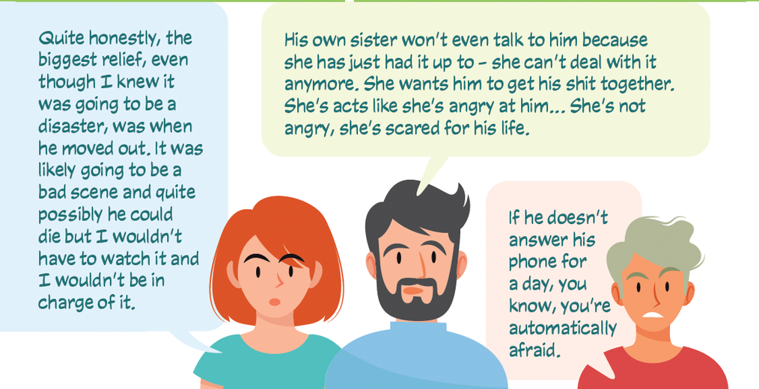
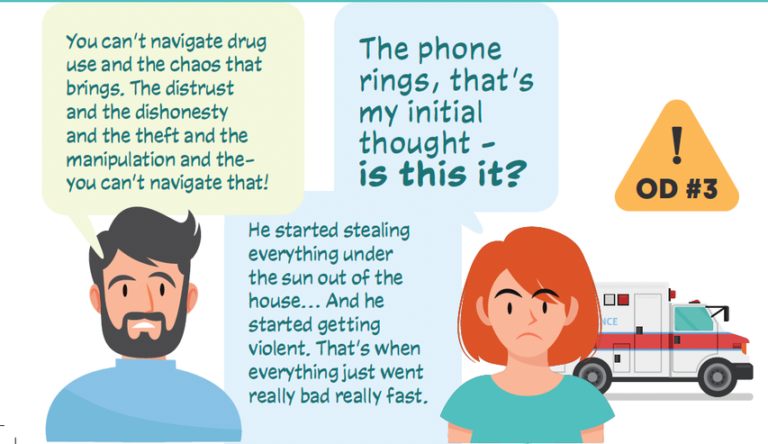
SECOND QUALITATIVE STUDY
Context of Toxic Drug Crisis
> Pervasive fear, uncertainty, stress
> Agonized decisions on how to interact with loved one
Supports & Services
> Encounters with formal supports often brought more stress (delays, fragmentation, stigma, lack).
> Peers with similar lived experience were perceived as helpful.

Slide 10
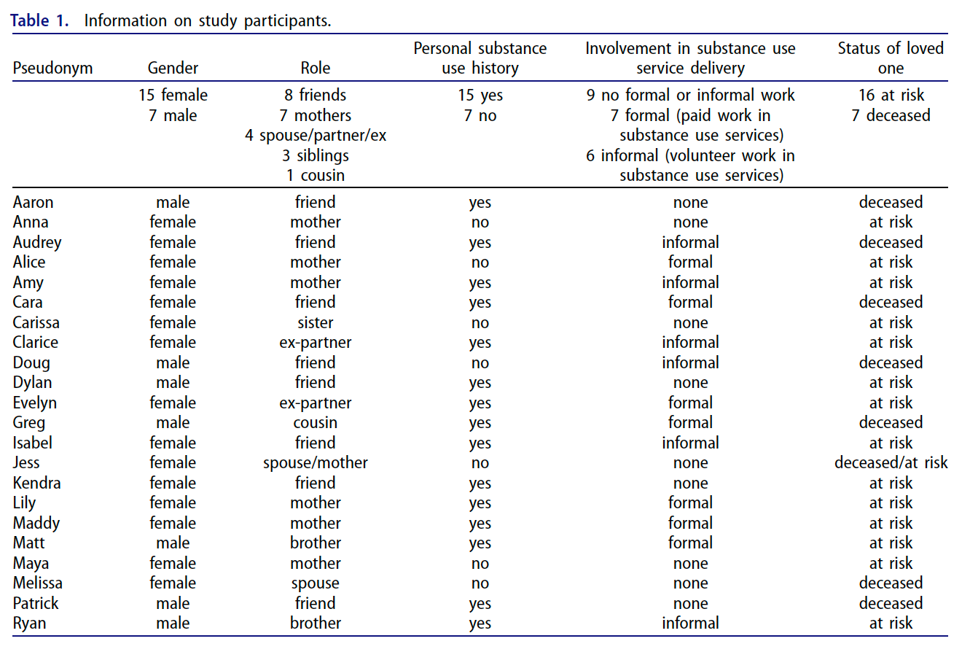
METHODS
SECONDARYANALYSIS:
TOUGH LOVE
01
Data Collection
> Purposive and snowball sampling
> 22 participants
02
Tough Love Data Analysis
> Six researchers
> Social constructivist lens
> Reflexive thematic analysis
> Collaborative development of themes
Hawkins, J., Salmon, A., Fernando, S., Battle, C., Esau, S., Snyder, D., & Sikora, M. (2026). ‘I don’t know what we should have done differently’: A qualitative study on the dilemmas of ‘tough love’ and toxic drugs in British Columbia, Canada. Drugs: Education, Prevention and Policy, 33(2), 156–165. https://doi.org/10.1080/09687637.2025.2493140

Slide 11

FINDINGS
WHAT DO I DO?
TOUGH LOVE & CONFOUNDING DILEMMAS
Varying Definitions
01
> Perceptions of tough love differed widely.
> Nearly all descriptions involved some form of withdrawal from the loved one, with varying degrees of severity.
02
Excruciating Decisions, 3 Mediating Factors
> Perceived potential outomes
> Beliefs, attitudes and values
> Available personal assets and social capital

Slide 12

PERCEIVED POTENTIAL OUTCOMES
Substance Use Linked with Chaos
01
> Concern for safety of self or others
> Withdrawal of support in response to perceived danger
He was owing people money, we were living off of my paychecks and getting further and further into debt. And I’d wake up in the morning, and he’d be ranting and raving with a blowtorch over the burner, and he flooded the basement because he’d forgotten pants in the sink. And it was just – it was a lot of craziness. And my son said to me, ‘I need a break’. And so you know, when your 10-year-old is saying that to you, things are too crazy. So we left.
– Melissa
Nicco Macaspac

Slide 13
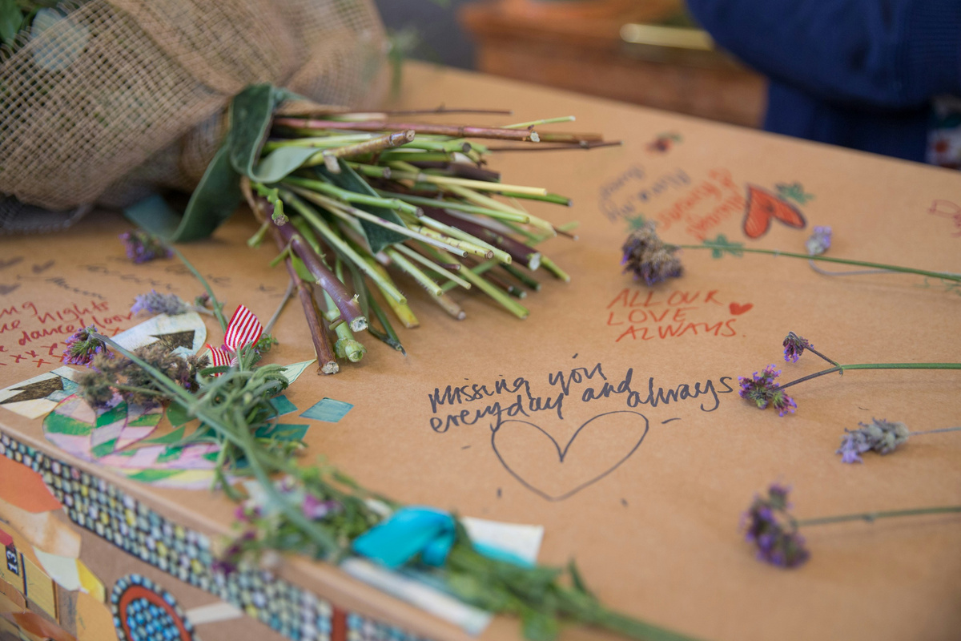
PERCEIVED POTENTIAL OUTCOMES
Tough Love Linked with Rejection
02
> Concern loved one would feel abandoned or rejected
> Worry about loved one becoming homeless or turning to sex work
> Fear of addiction becoming worse and losing their person to overdose
I didn’t do tough love. She would’ve ended up somewhere that she shouldn’t have been but the only reason why she’s there is because I didn’t open the door. I even know a mother that said that at the funeral of her child. The day before, the child was at the door and she wouldn’t let him in, right, and he died. And I said I will never be one of those parents. I will never do that. I don’t want to be at my daughter’s coffin and saying I should’ve let her in, right. – Amy

Slide 14

BELIEFS, ATTITUDES & VALUES
01
The Nature of Substance Use
> Perceived as ultimately harmful
> Desired change in loved one’s use
02
The Need for Love and Compassion
> Belief in compassion and love
> Often created ambiguity and internal tension
Egor Vikhrev
So tough love is, I am not going to let you rob me anymore, so you don’t get to live under this house anymore. Doesn’t mean we love the person less. But in their eyes, now they’ve been rejected, they’ve been abandoned. Their core fears of not being lovable, not being good enough are all going to come into play, which is going to feed the addiction. – Maddy

Slide 15

BELIEFS, ATTITUDES & VALUES
03
The Need for Accountability
> Loved ones were largely believed capable of some degree of choice or agency.
> Participants valued accountability and consequences, depending on the loved one’s capacity.
> Often involved inner conflict and dissonance.
Conner Bowe
There has to be a level of accountability or responsibility in your own direction. I’ve seen that in my own life, tough love. When you make a stupid decision, guess what, there’s consequences for that. Now, if I’m in a position to reduce the impact of those consequences so it doesn’t knock you right off your journey, then you’d better damn well be sure I’m going to do that. – Matt

Slide 16

Internal Dissonance
I understand now, looking back, that I was absolutely enabling him. Even though I had really good intentions, I loved him. I didn’t want to put him out on the street. And looking back, I don’t really know what I should have done differently. – Maddy
I tried everything under my power to do it a not tough love approach way, and it didn’t work. And the only time that I even got him to consider going to rehab was when I went and stayed at my mom’s place and said you need to get help because we’re scared because things are getting too crazy. And did it get him to treatment? It did get him to treatment. But did it keep him alive? It didn’t keep him alive. – Melissa

Slide 17
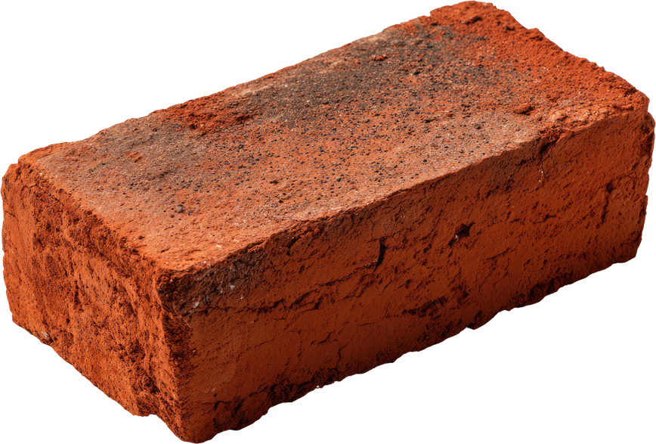
AVAILABLE PERSONAL ASSETS
01
Social Capital
> Lived experience
> Education on addiction
> Spirituality and personal faith
> Relationships and community
> Professional support
> Not always positive...
People at church are just wonderful. The pastor is awesome and stuff and they just remind me that I am loved and, you know, Jesus is there for me. – Audrey
Marriage gets rocky at times; the relationship is super tough between my son and the rest of the family. We all seem to handle things differently. – Maya

Slide 18

AVAILABLE PERSONAL ASSETS
02
Boundaries as an Asset
> Tough love concepts often led to confusion or inner conflict.
> In contrast, the concept of “boundaries” seemed to offer clarity and comfort.
To me, tough love, it just seems extreme. But that’s the only tough love that I’m aware of. I think that setting healthy boundaries as a support or as a family member or friends, setting boundaries and sticking to them is obviously a very healthy thing to do. – Evelyn
I do not believe in tough love as it’s often preached, which is telling your loved ones, ‘Get your shit together and then come talk to me.’ I think for the most part it just damages people more and isolates them more. I think tough love is having good boundaries. – Alice

Slide 19

DISCUSSION
TOUGH LOVE IN A TIME OF CRISIS: “THE NEW ROCK BOTTOM IS DEATH”
Substance Use Terminology
01
> Spectrum of use
> Motivation for Change
BENEFICIAL
HARMFUL

Slide 20

DISCUSSION
02
Relationship, The True Healer
> Substance Use Correlation to Relationship and Rock Bottom

Slide 21
Addiction and the Family International Network Webinar Series, May 12, 2026
THANK YOU.
Contact:
Jennifer Hawkins
jhawkins@advancinghealth.ubc.ca

