Slide 1






The Family and Friend Support Program
Co-design process, pilot study, and future directions
Presented by Dr Steph Kershaw, Dr Dara Sampson, Jessica Deng

Slide 2
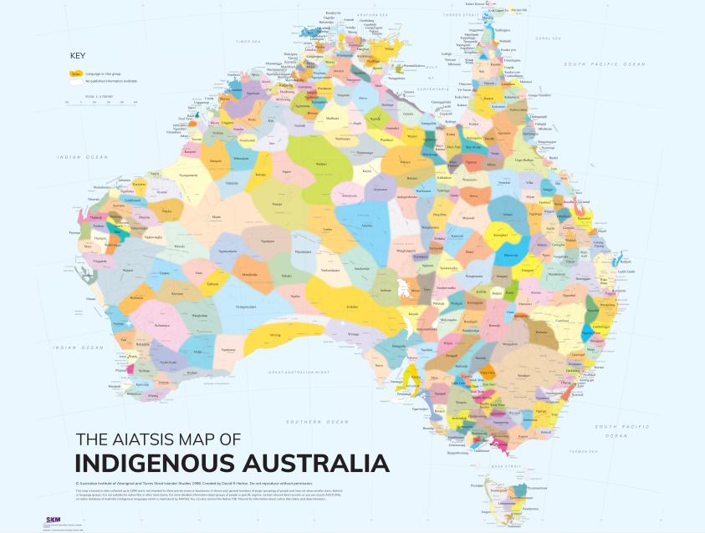
Acknowledgement of Country
We would like to acknowledge and pay respects to the traditional owners of the land on which we work: the Gadigal people of the Eora Nation. It is upon their ancestral lands that the University of Sydney is built.
As we share our own knowledge, teaching, learning and research practices within this University we also pay respect to the knowledge embedded forever within the Aboriginal Custodianship of Country.
The Matilda Centre is committed to embracing diversity and eliminating all forms of discrimination. The Matilda Centre welcomes all people irrespective of ethnicity, lifestyle choice, faith, sexual orientation and gender identity.
Notes:
Before we begin, I would like to acknowledge and pay respect to the traditional owners of the land on which we meet: the Gadigal people of the Eora Nation. It is upon their ancestral lands that the University of Sydney is built.
As we share our own knowledge, teaching, learning and research practices within this university may we also pay respect to the knowledge embedded forever within the Aboriginal Custodianship of Country.
We are committed to embracing diversity and eliminating all forms of discrimination and welcome all people irrespective of ethnicity, lifestyle choice, faith, sexual orientation and gender identity.

Slide 3





Slide 4
Project Development
Presented by Dr Dara Sampson

Slide 5

FFSP Program Background
Systematic Review of the available literature.
Online survey + 17 Interviews with people who had/have a lived experience of a loved one who uses alcohol/other drugs.
Daughters, partners, a sibling, an ex-partner, a friend, a son and a grandson
Notes:
Seventeen of the anticipated twenty-five interviews have been completed, as of 3/10/19.
Interviews were done via telephone and lasted an average of one hour.
Of those people interviewed four were daughters and four were partners.
The remaining nine interviewees’ relationship to the substance user included sibling, ex-partner, friend, grandson and son.
The substances used (by frequency) were alcohol (identified by ten of those interviewed), cannabis, ice, poly-drug usage, prescription opiates and heroin.
Of interest here, although participants (generally) identified one drug at point of initial contact, it became clear whilst conducting the interviews there was often poly-substance usage, including ice.

Slide 6
AFFM (e.g. family, family member, significant other, spouse, wife, husband, sibling, friend, and caregiver)
Alcohol/other Substance of use (e.g. methamphetamine, other stimulants, other non-stimulant substances of abuse)
Psychosocial intervention (e.g. psychosocial intervention/treatment/therapy/support, psychological intervention/therapy/treatment/support, counselling, self-help, and bibliotherapy).
Systematic review
Notes:
To complement the quantitative and qualitative information from obtained from AFFM’s a literature review on the effective interventions for family and other caregivers of a person with methamphetamine was conducted.

Slide 7
Search Strategy
Parents, grandparents, family, sibilings, peers, caregivers, spouses, partners
Methamphetamine
Cocaine
Alcohol, cannabis, illicit drugs
Social support, counselling, self-help, psychotherapy, intervention, treatment
Embase, PsycINFO, CINAHL, Cochrane, Scopus, Informit Health Collection.
PROSPERO Registration Number CRD42017056304 (http://www.crd.york.ac.uk/PROSPERO)
Systematic review
Notes:
Effective interventions summarised:
20829 references imported for screening
22 duplicates removed
20807 studies screened against title and abstract
20110 studies excluded
697 studies assessed for full-text eligibility
645 studies excluded
223 3. Not an intervention for AFMs
152 4. AFM is a child
100 1. No pre-and post data reported
90 1. and 3.
45 1. and 2. and 3.
15 2. FM not using substances
11 1. and 2.
5 No pre- post- data reported
3 Not an intervention for AFMs
1 FM not using substances
0 studies ongoing
0 studies awaiting classification
52 studies included

Slide 8
Drug education (Bamburg et al., 2008)
Coping skills, self evaluation and goal setting, communication skills (Gance-Cleveland, 2004)
Development of effective coping, increasing hope and life enjoyment regardless of substance user’s actions (Gethin et al., 2016)
Education on effects of substance use on families, focus on personal wellbeing (Platter, 2011)
Self paced, online skills training (Rychtarik et al., 2015)
Motivational interviewing, CBT, toolbox of strategies and activities for challenging times (Templeton, 2014)
Systematic review
Notes:
Effective elements of evidenced base interventions incorporated in the Family and Friend Support Program are summarised below

Slide 9
Improving communication skills (Kondo et al., 2009)
Accepting responsibility for their own actions (Friedmann, 1996)
Provision of drug information (Galanter et al, 1984)
Decision making, receive feedback about changes in mood and health (Gustafson et al., 2012)
Managing negative emotions, improving AFFM coping skills (Hansson et al., 2004)
Breaking barriers of societal stigma (Li et al, 2014)
Systematic review: Effective interventions

Slide 10
Online surveys and interviews
Facebook recruitment strategy
45 people completed the online survey.
90% identified as female.
Average age 46 years (18-70 years).
3 people identified as Aboriginal and/or Torres Strait Islander.
Overwhelming majority reported multiple concerns with alcohol/other drug use.
Primary concern
Alcohol = 58%
Cannabis = 16%
Ice = 15%
Heroin = 7%
Prescription opiates = 4%
17 telephone interviews were completed.
9 were mothers of someone who uses ice.
Others were siblings, fiancés, husbands, brothers, flat-mates or in-laws.
Notes:
a total of 520 people responded to the online advertisement with 371 agreeing to continue to the survey. A total of 45 completed the survey. Of the survey completers, 41 were female (90 %) with an average age of 46 years (range 14 – 70), and three identified as being of Aboriginal/Torres Strait Islander descent. The majority of completers were partners (n = 10), five were siblings, three were fathers, mothers and friends respectively. The remainder were adult (?) children and other relationships not specified. Very few responders reported problematic use of only alcohol or one specific drug type, with many concerned about polysubstance use. The survey asked responders to identify one drug type at the outset, and the majority reported problematic use of alcohol (n= 26), followed by cannabis (n = 7), heroin (n = 3), prescription opiates (n = 2) and other drugs (n = 7, crystal methamphetamine).

Slide 11
What concerns you?
Negative impact on relationship with family and friends, including relationship breakdown and loss of custody of children
Concerns about long term impacts of chronic use on physical and mental health
Change in mood and cognition, including inability to function in activities of daily living
Verbal and physical abuse, unpredictability, paranoia and aggression.
Consequences of criminal activity including loss of license.

Slide 12
What concerns you?
“Daily drinking and smoking marijuana, to the point he just seems numb, and content to be wasted on a daily basis….. I can barely remember what our relationship was like years ago”
“She has let go of looking after things about the house. She gets drunk to the point of incoherence and remembers nothing the next day.”
Notes:
To date, a total of 520 people responded to the online advertisement with 371 agreeing to continue to the survey. A total of 45 completed the survey. Of the survey completers, 41 were female (90 %) with an average age of 46 years (range 14 – 70), and three identified as being of Aboriginal/Torres Strait Islander descent. The majority of completers were partners (n = 10), five were siblings, three were fathers, mothers and friends respectively. The remainder were adult (?) children and other relationships not specified. Very few responders reported problematic use of only alcohol or one specific drug type, with many concerned about polysubstance use. The survey asked responders to identify one drug type at the outset, and the majority reported problematic use of alcohol (n= 26), followed by cannabis (n = 7), heroin (n = 3), prescription opiates (n = 2) and other drugs (n = 7, crystal methamphetamine).

Slide 13
What has life been like for you?
Dependency causes financial strain
The burden of additional parental/familial responsibility
Instability in home life
Physical and psychological stress of supporting someone
Mental health issues including depression and anxiety
Loss of partner, parent and grief around same
Loss of trust, anger and resentment
Chaotic
Feelings of embarrassment and shame.
Notes:
Consistent across all interviews were experiences of emotional strain and stress, impacts on mental health and widespread impacts on relationships and families. Elevated levels of psychological distress were evident, including depression, anxiety, trauma and grief. The people who completed the online survey reported attempting to cope in a variety of ways, many stating that they had exhausted most options with limited success. The majority of responders reported their situation could improve, with most stating that getting support and treatment for the user themselves as key to improving their own situation. While many respondents could identify a need for emotional, practical and financial support for themselves, their priority was ensuring that their addicted loved one access the support they needed.

Slide 14
What has life been like for you?
“His alcohol dependency puts stress on me financially as I am the one who budgets and pays bills”
“Depressing. Destroying. I constantly feel like I’m the only responsible adult able to look after our two young children…….you never know what you are going to come home to”.
“I have been under extreme emotional and mental stress trying to provide support to someone who gives me little support or consideration in return.”
“Although M ensured my family did not go without food, clothing or housing, it felt as if we were missing a father in the emotional/attachment side aspects of childhood”.
“It makes me anxious and I hate being here”
“Like a roller coaster that you can’t get off.”
Notes:
To date, a total of 520 people responded to the online advertisement with 371 agreeing to continue to the survey. A total of 45 completed the survey. Of the survey completers, 41 were female (90 %) with an average age of 46 years (range 14 – 70), and three identified as being of Aboriginal/Torres Strait Islander descent. The majority of completers were partners (n = 10), five were siblings, three were fathers, mothers and friends respectively. The remainder were adult (?) children and other relationships not specified. Very few responders reported problematic use of only alcohol or one specific drug type, with many concerned about polysubstance use. The survey asked responders to identify one drug type at the outset, and the majority reported problematic use of alcohol (n= 26), followed by cannabis (n = 7), heroin (n = 3), prescription opiates (n = 2) and other drugs (n = 7, crystal methamphetamine).

Slide 15
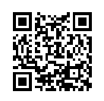
Key themes from interviews (N=17): Grief and Loss
Loss
Participant 8:“And I always get the same thing. Always “I’m not going to do it anymore”. It’s ruined my life. I just want my family back. I just want my son back”
Stigma
Participant 7:“What I found out very early on is that you can’t trust anyone… you have to be very selective on who knows about this… extremely selective. Because people are very judging.”
Lack of support
Participant 8:“I rang the police station, they told me to ring the MST team. I rang the MST team, they told me to ring somewhere else. I rang somewhere else, they told me it was the police’s responsibility. I rang back the police, they told me it wasn’t their responsibility. Thirty phone calls later…. Nobody was responsible”
Coping in sharing personal experiences
Participant 1:“When this tragedy happened, we all looked at each other and went, yeah this can shatter families. This won’t shatter our family. There’s got to be something good that comes out of a tragedy”
Notes:
The thematic analysis highlighted common areas of concern and experience. Key themes emerged from the thematic analysis, namely loss, stigma, support (or lack thereof), ways of coping through sharing personal experiences. The pre-eminent theme was that of grief and loss. Concepts of ambiguous loss, disenfranchised grief, and narrative constructivist approaches to understanding loss were applied to the analysis of results. Loss was often compounded by social constructions and stigma attached to ice usage, which extended to the people caring for friends and family members as well.
Participants living with or supporting loved ones using ice spoke of not telling anyone how they felt because of the fear of social judgement. For a person losing the sense of someone they love, it can be unhelpful to also add the management of the expectations of others. It is di cult to make meaning because of the mixed messages received - blame attribution, guilt, and lack of ‘logical’ explanation as to why they are continuing to support a person with this particular addiction. While the sample size for this research is relatively small (seventeen participants) the majority of respondents’ stories included loss which was not linear in nature.

Slide 16
Family and Friends Support Program
Presented by Dr Steph Kershaw

Slide 17
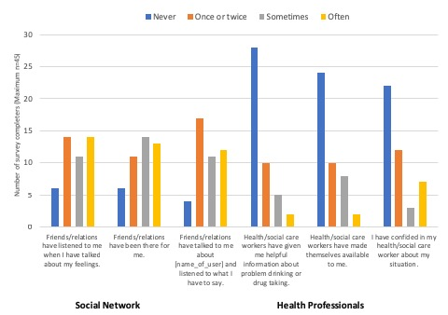
Supports available and accessed
N=45
Notes:
Despite the intentions and openness to utilising a variety networks survey respondents demonstrated variable success with families and friends when they did engage with them or access them for support. In contrast, it was rarer that respondents experienced success and support as a result of tseeking help from health professionals.
As indicated in Figure 2, in the past three months, across all drug types, AFFMs either ‘once or twice’ (n=14/45), or ‘often’ (n = 14/45) found that members of their social network listened to them, ‘sometimes’ talk about their feelings felt that their friends and relatives had been there for them ‘sometimes’ (n=14/45) or ‘often’ (n = 13), and only once or twice felt that they listened to the AFFM talk about the person in their lives using alcohol and/or other drugs.
A significant number of AFFMs had never confided in health/social care workers about their situation in the last three months (n=22/45), felt that health/social care workers had never made themselves available to the AFFM (n=24/45), and had never given the AFFM helpful information about problem drinking or drug taking (n=28/45).

Slide 18
What could help you?
Support groups are important, face to face or online.
Additional counselling support, especially for families
Additional case management support for the user to ease the burden on carers.
Financial and practical support
Notes:
To date, a total of 520 people responded to the online advertisement with 371 agreeing to continue to the survey. A total of 45 completed the survey. Of the survey completers, 41 were female (90 %) with an average age of 46 years (range 14 – 70), and three identified as being of Aboriginal/Torres Strait Islander descent. The majority of completers were partners (n = 10), five were siblings, three were fathers, mothers and friends respectively. The remainder were adult (?) children and other relationships not specified. Very few responders reported problematic use of only alcohol or one specific drug type, with many concerned about polysubstance use. The survey asked responders to identify one drug type at the outset, and the majority reported problematic use of alcohol (n= 26), followed by cannabis (n = 7), heroin (n = 3), prescription opiates (n = 2) and other drugs (n = 7, crystal methamphetamine).

Slide 19
What could help you?
“I would love to have more access to information and support services that can assist me with dealing with my partner’s drug use”
“Being able to attend a support group would help, in person or online.”
“Professional consultation with someone who REALLY knows what it’s like…”
“Better information on how to deal with the situation.”
Notes:
To date, a total of 520 people responded to the online advertisement with 371 agreeing to continue to the survey. A total of 45 completed the survey. Of the survey completers, 41 were female (90 %) with an average age of 46 years (range 14 – 70), and three identified as being of Aboriginal/Torres Strait Islander descent. The majority of completers were partners (n = 10), five were siblings, three were fathers, mothers and friends respectively. The remainder were adult (?) children and other relationships not specified. Very few responders reported problematic use of only alcohol or one specific drug type, with many concerned about polysubstance use. The survey asked responders to identify one drug type at the outset, and the majority reported problematic use of alcohol (n= 26), followed by cannabis (n = 7), heroin (n = 3), prescription opiates (n = 2) and other drugs (n = 7, crystal methamphetamine).

Slide 20
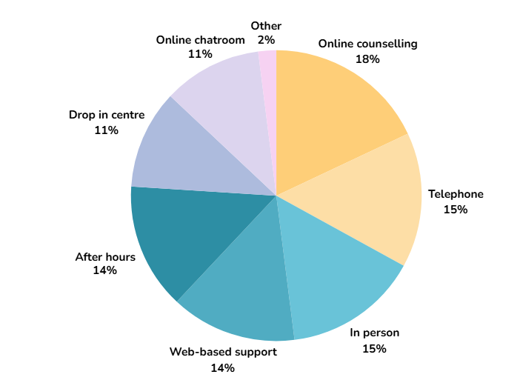
WHEN, WHERE, HOW WOULD YOU LIKE TO RECEIVE SUPPORT? N=45
Notes:
In general, there was support for online counselling, web based support and online chat rooms for AFFMs, as indicated in Figure 1. AFFMs endorsed many avenues and professionals for providing support with the majority endorsing trusted, trained health professionals (n = 29), including those working in Drug and Alcohol services specifically (n = 28). Of interest, people who had similar experiences to themselves ( n = 28) were also highly endorsed by AFFMs, indicating the high potential and importance of support packages that integrate peer support and ‘real life’ stories drawn from people with similar experiences.

Slide 21

FFSP - “Live with it not in it”
Notes:
One of the first things you will notice as you start the program is that we make mention of a sailboat. It may seem odd that we refer to this, but many family members and friends who are supporting someone who is using alcohol/drugs have told us stories that seem akin to sailing the ocean - at times it can be all smooth sailing, and at others, the conditions can be unpredictable, dangerous and can wreak havoc and destruction on the lives of the people on board. We’ve decided to use this sailboat as a way of understanding your experience so you’ll see it referenced at various times throughout the program.

Slide 22
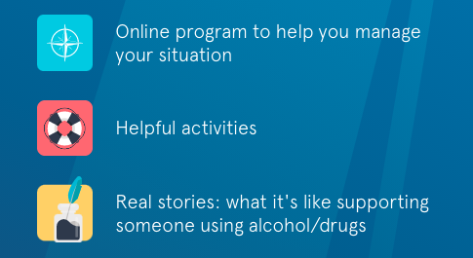
FFSP - Overall Program Features
www.ffsp-aod.com.au
Notes:
Program includes: Instructional videos about “living with it not in it” – Narrated by Clinical Psychologist , summary videos at the end of the core modules, Over 20 interactivities, Based on a nautical metaphor, over 40 quotes from interviews used in the program

Slide 23
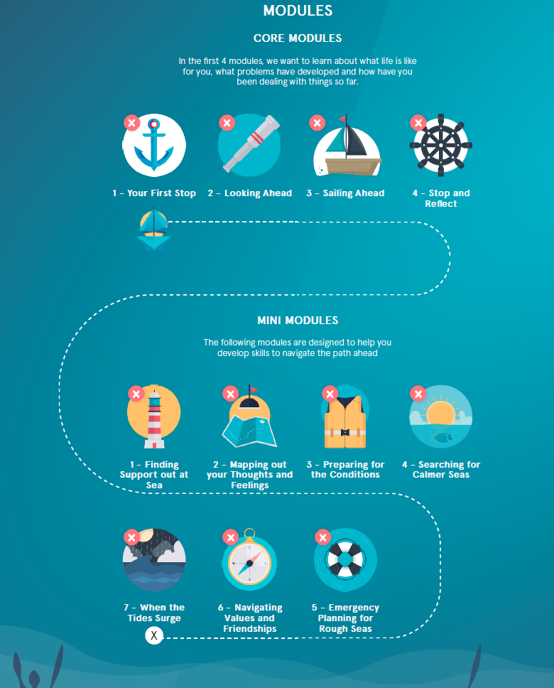
FFSP
Online Program
www.ffsp-aod.com.au
Notes:
Mini Modules: skill based modules. The mindfulness based mini module is broken into 4 parts for 4 weeks.

Slide 24
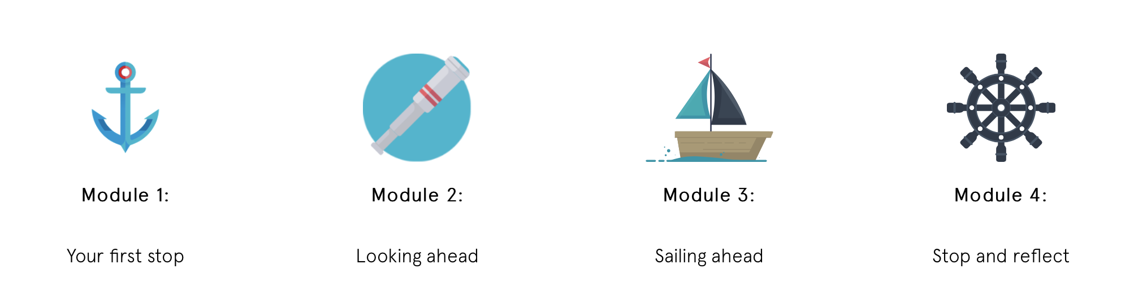
FFSP - Online Program CORE MODULES
www.ffsp-aod.com.au
Notes:
On your FFSP home page you will also see a number of icons, each representing a different module of the program. The first four ‘core’ modules of the program are designed to be completed first to help you understand your sailing journey and what it has been like for you. The Mini Modules focus more on navigating this journey, by introducing you to skills that will help you to manage the challenges of supporting someone who is drinking or using drugs. Of course, how you choose to approach the program is up to you and we don’t want you to feel restricted to a prescribed order if there are specific modules that stand out to you or that focus on what you need help with most right now.
Core Modules
1: Your First Stop - Find out what's important to you right now 2: Looking Ahead - Navigating what's troubling you 3: Sailing Ahead - Learn how to manage things 4: Stop and Reflect - Where to from here...

Slide 25
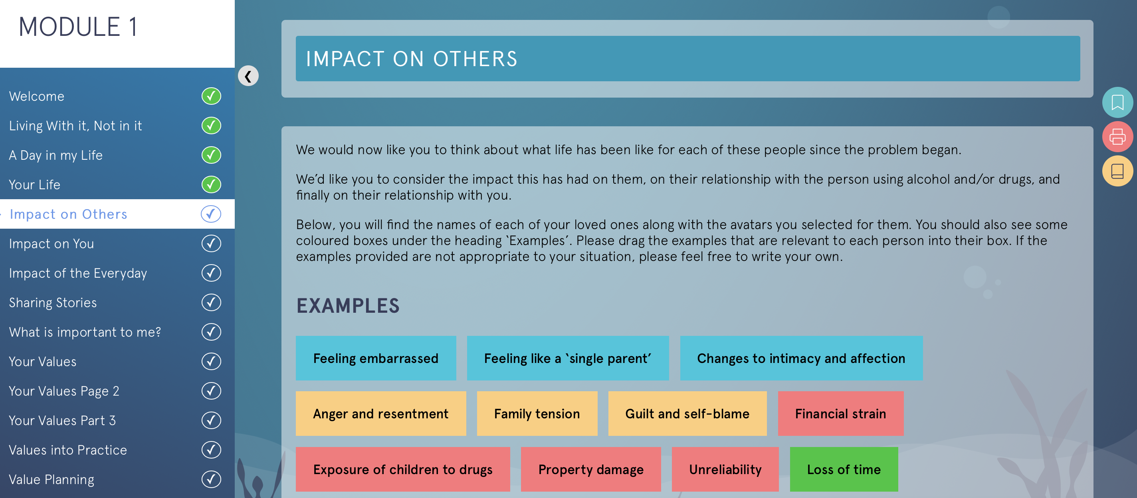
FFSP - Online Program CORE MODULES
www.ffsp-aod.com.au
Notes:
On your FFSP home page you will also see a number of icons, each representing a different module of the program. The first four ‘core’ modules of the program are designed to be completed first to help you understand your sailing journey and what it has been like for you. The Mini Modules focus more on navigating this journey, by introducing you to skills that will help you to manage the challenges of supporting someone who is drinking or using drugs. Of course, how you choose to approach the program is up to you and we don’t want you to feel restricted to a prescribed order if there are specific modules that stand out to you or that focus on what you need help with most right now.
Core Modules
1: Your First Stop - Find out what's important to you right now 2: Looking Ahead - Navigating what's troubling you 3: Sailing Ahead - Learn how to manage things 4: Stop and Reflect - Where to from here...

Slide 26
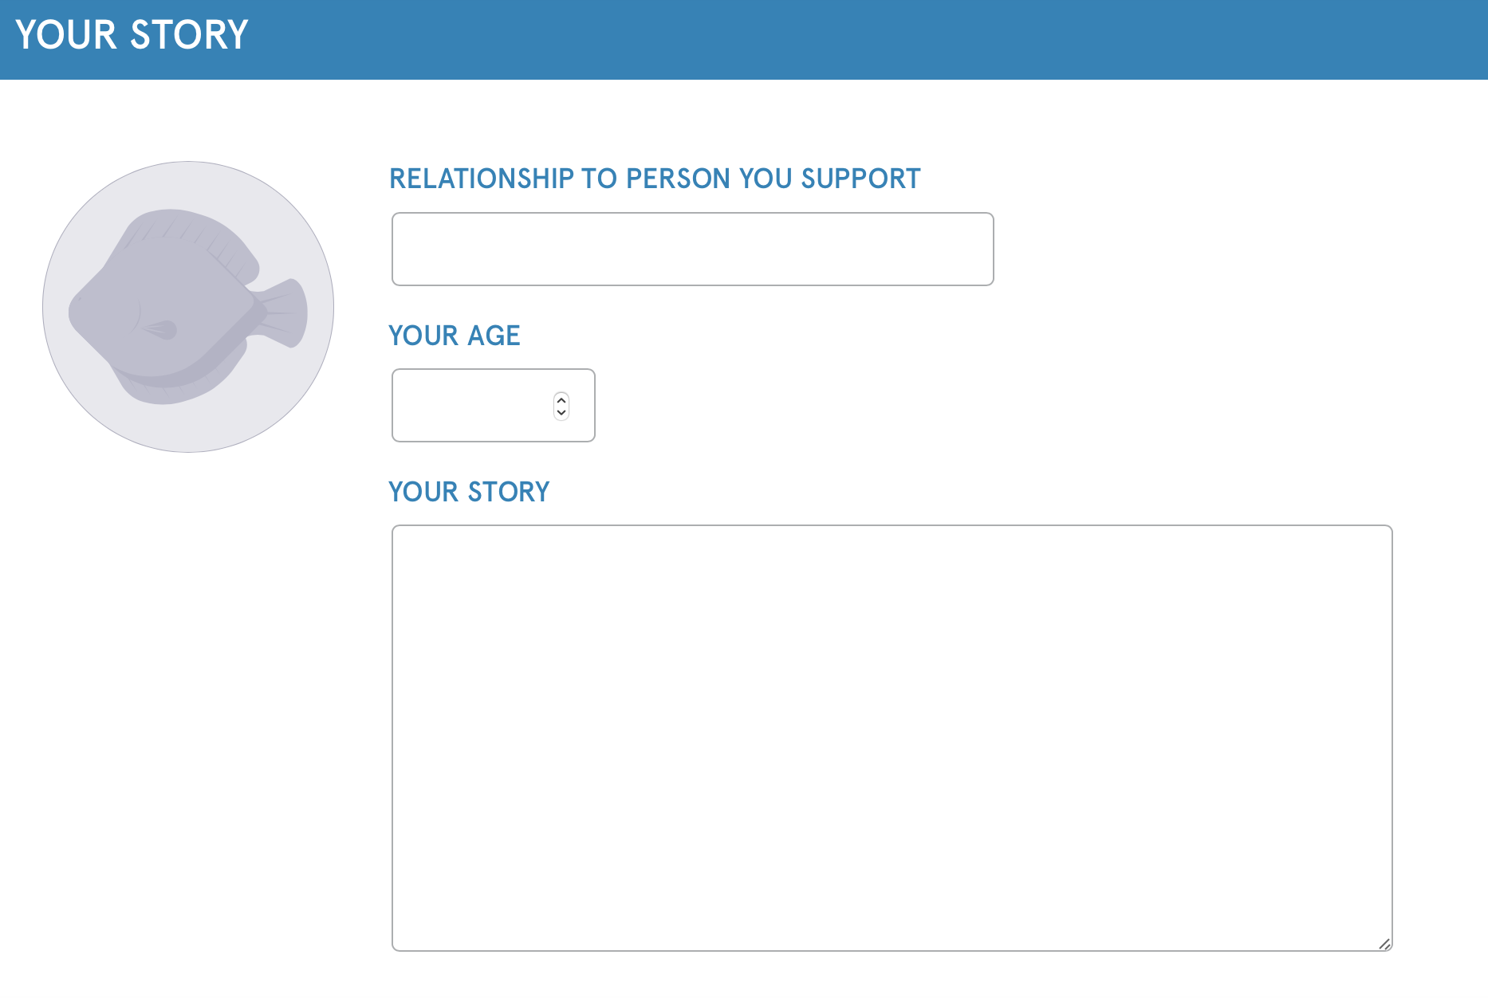
FFSP - Online Program CORE MODULES
www.ffsp-aod.com.au
Notes:
On your FFSP home page you will also see a number of icons, each representing a different module of the program. The first four ‘core’ modules of the program are designed to be completed first to help you understand your sailing journey and what it has been like for you. The Mini Modules focus more on navigating this journey, by introducing you to skills that will help you to manage the challenges of supporting someone who is drinking or using drugs. Of course, how you choose to approach the program is up to you and we don’t want you to feel restricted to a prescribed order if there are specific modules that stand out to you or that focus on what you need help with most right now.
Core Modules
1: Your First Stop - Find out what's important to you right now 2: Looking Ahead - Navigating what's troubling you 3: Sailing Ahead - Learn how to manage things 4: Stop and Reflect - Where to from here...

Slide 27
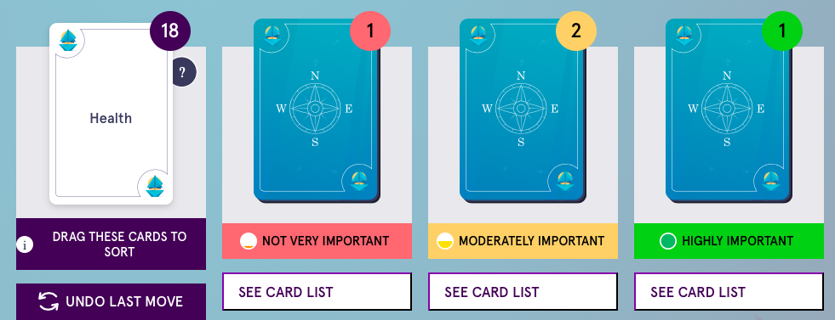
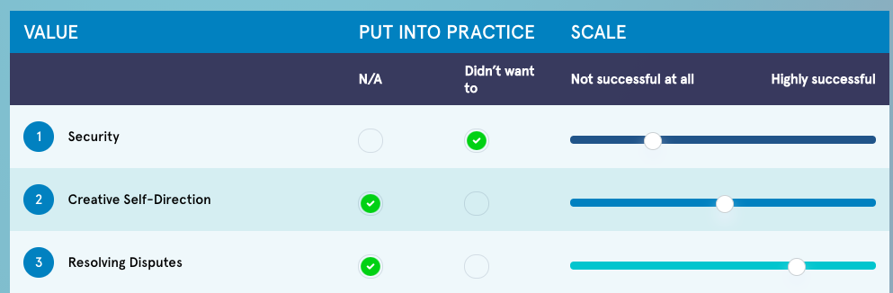
Identifying Values
Notes:
5 step interactive activity, Identifying values, evaluating importance and planning to putting values into practice
22 cards to sort into 3 categories
Terrific!
Our next task is to really focus on the values you have sorted into the third pile - those of the highest importance to you. Take a look below to see which values these are.
Please select just 5 items by clicking the button in the 'Top 5' column to select it. Those that are selected will show a green and white tick.
It can be difficult to decide which are your most important values, so please take your time.
You will now see that there is a question next to each of these 5 values. Please go through each value on the list, and indicate whether you have wanted to put this value into practice over the last 3 months.
Please note: this is not whether you have actually put this into practice in the last 3 months, but whether you have wanted to. For those that you have checked, you will be asked to rank how successful you have been at putting that value into practice on a scale of 1 (not at all successful) to 5 (highly successful). Go through and do this for each of your 5 most important values.
From Module 2 onwards you will have the opportunity to complete an activity to see how closely your life is aligned with your values at that time. This a reminder about what is most important to you.
Over the course of the Family and Friend Support Program, we are going to remind you to regularly revisit these values, and assess whether the choices you are making, and how you are living your life fits with what is most important to you.
Now we are going to work with those ratings you just made to see if we can help you put some of these principles into practice via the activities and other actions you are doing each day
We now ask you to pick a value that you would like to put into practice over the next week.
It could be something that you have already had success with (those you rated as mid to highly successful), or, it could be one of those values that you have wanted to put into practice, but haven’t successfully done so before (the values you rated as not successful).
Select a value from the list that you would like to put into practice this week.

Slide 28
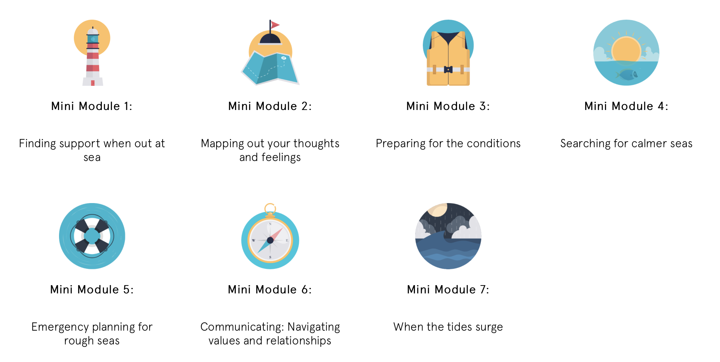
Online Program MINI MODULES
Notes:
The modules are designed to be flexible and you can work through them at your own pace. Any changes or progress that you make will be automatically saved for you to pick up where you left off the next time that you login. We’d recommend that you do no more than one module at a time, leaving at least a few days, or ideally a week between each module. This will give you time to think about the content and practice any skills or strategies that you learn. If you have a GP or counsellor you may want to discuss your progress through the program with them.
Mini Modules
Find people and activities to support you
Learn how to manage unhelpful thought patterns
Learn to manage your worries
Mindfulness activities to help you cope
Make a plan to use in times of emergency
Learn to communicate more effectively
How to keep yourself and others safe

Slide 29
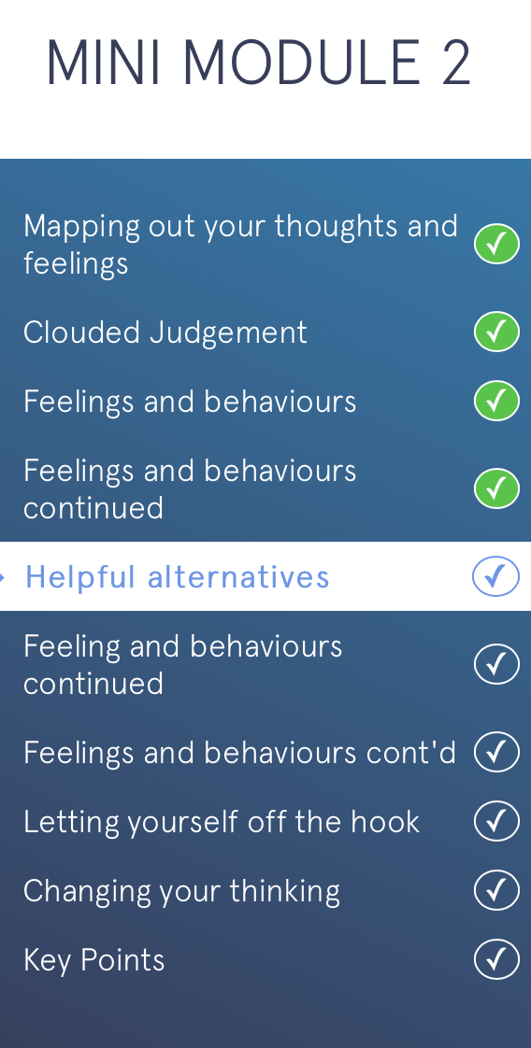
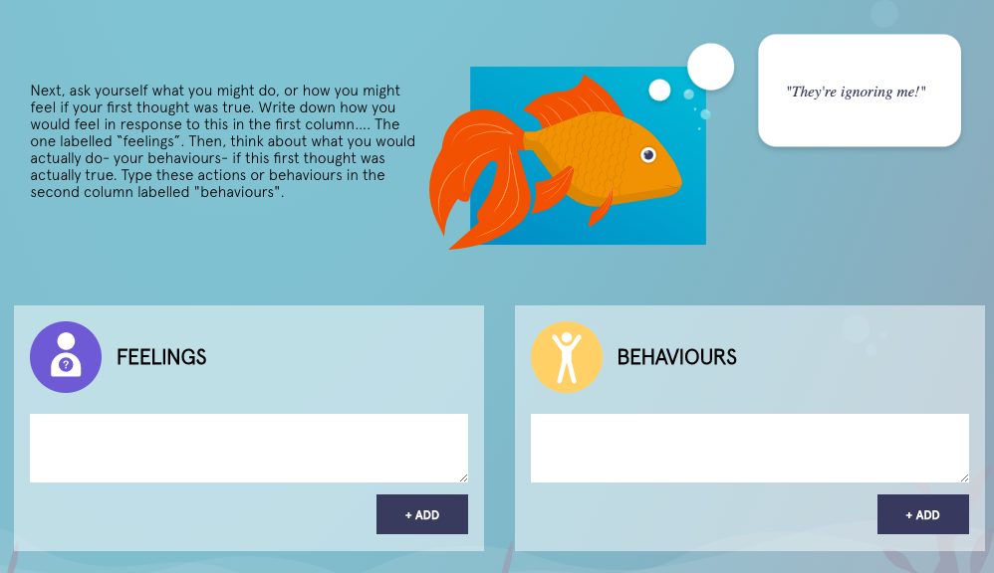
Cognitive Behaviour Therapy

Slide 30
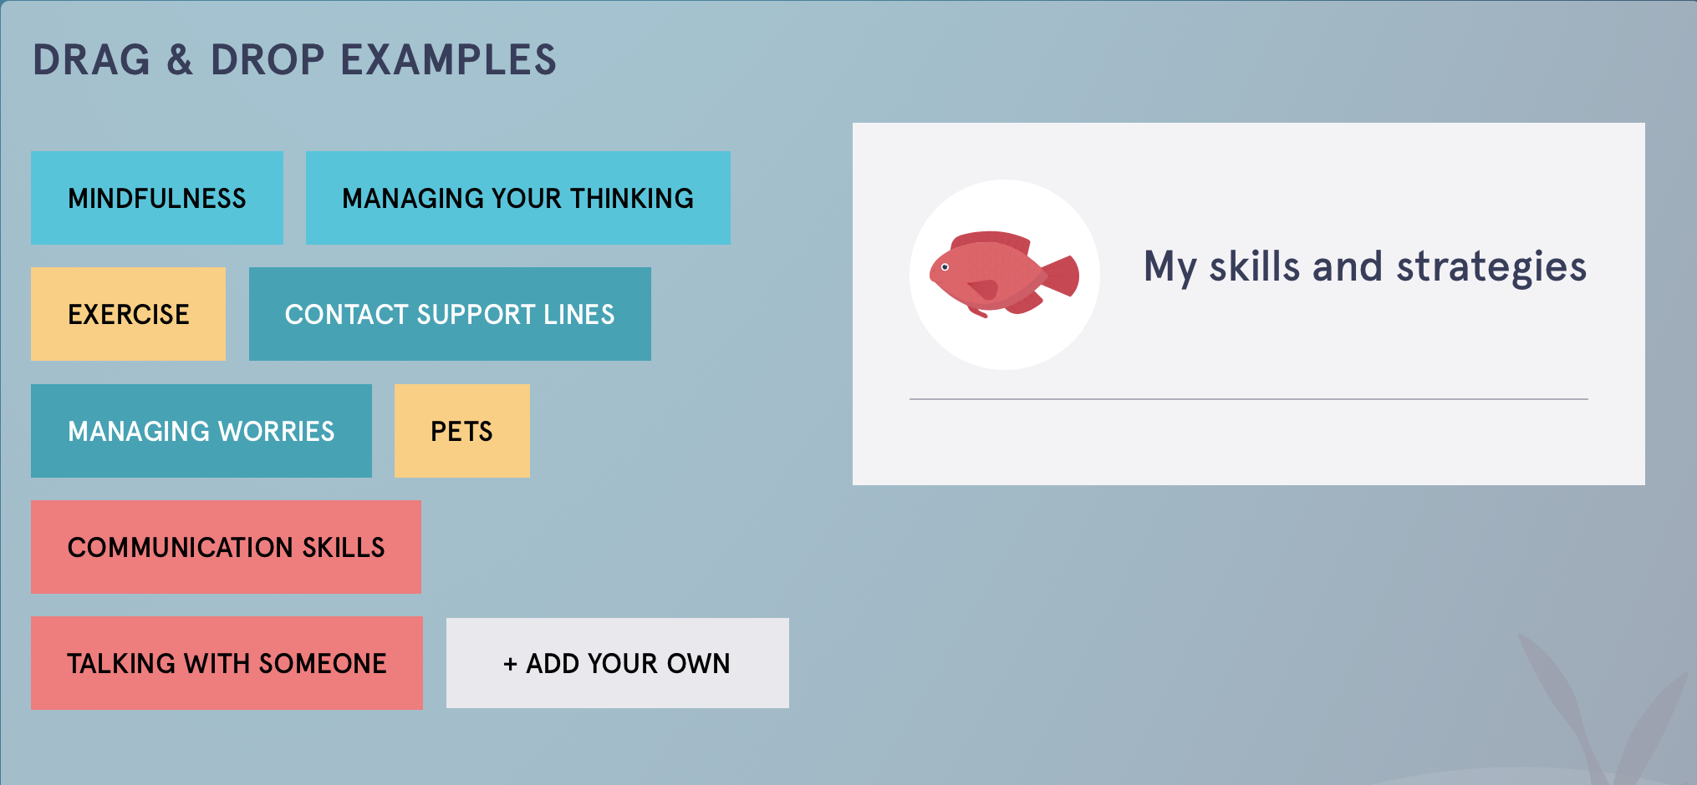
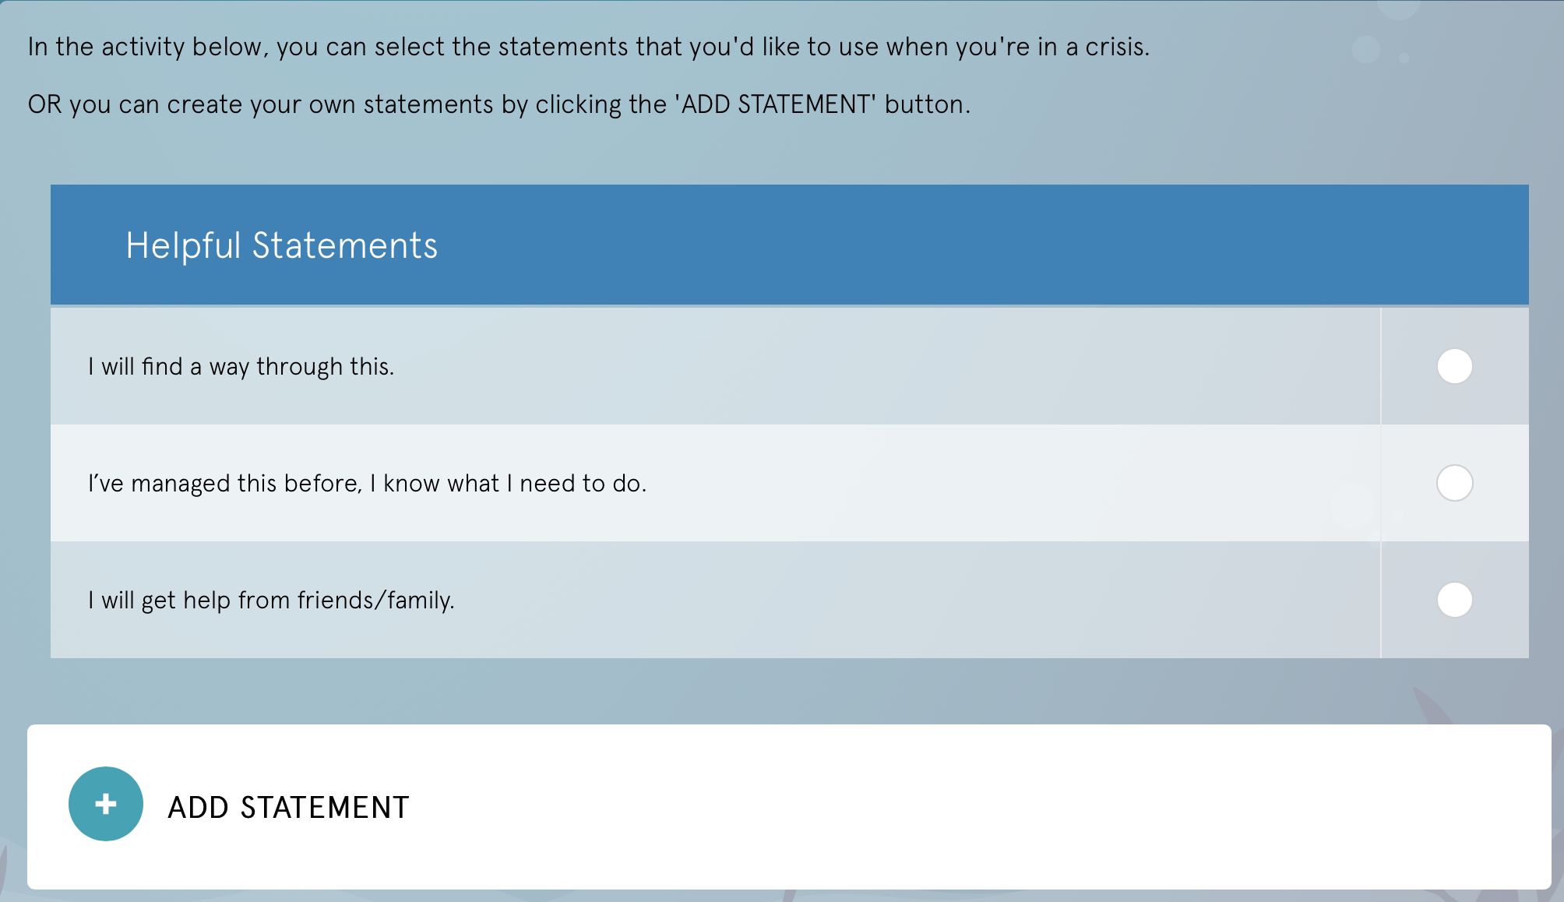
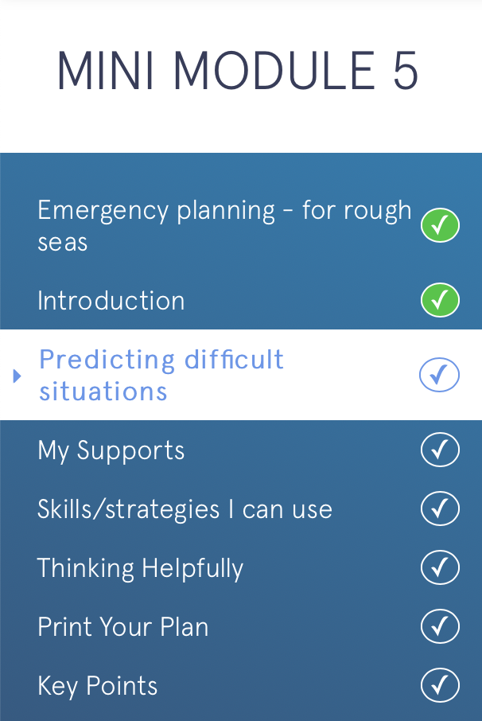
Identifying and Managing Difficult Situations
Notes:
This interactivity involves example situations based on participant interviews and the ability for participants to think about and add in their own examples.
The first thing to do when developing an Emergency Action Plan is to think of situations that might come up for you whilst supporting someone who is using alcohol and/or other drugs. You may already have some situations in mind, including those you have already faced as well as potential scenarios that could arise in the future.
Try to think of as many as you can; the more things you plan for, the better equipped you will be if these situations arise.

Slide 31
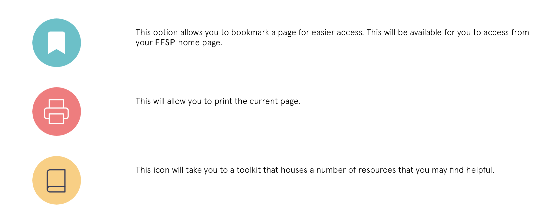
Online Program ADDITIONAL FEATURES
www.ffsp-aod.com.au

Slide 32
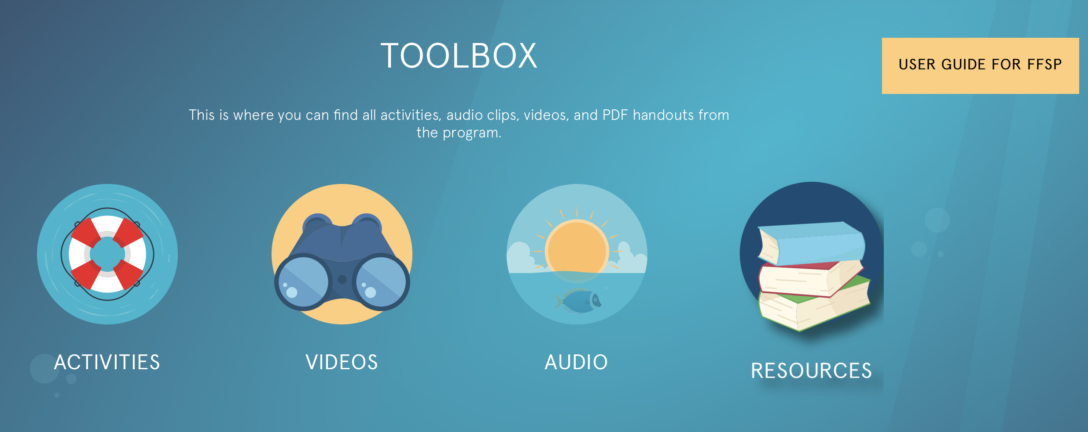
Helpful Activities
www.ffsp-aod.com.au
Notes:
Activities:
When you complete a module, you will be able to find all resources from that module in your Toolbox.

Slide 33
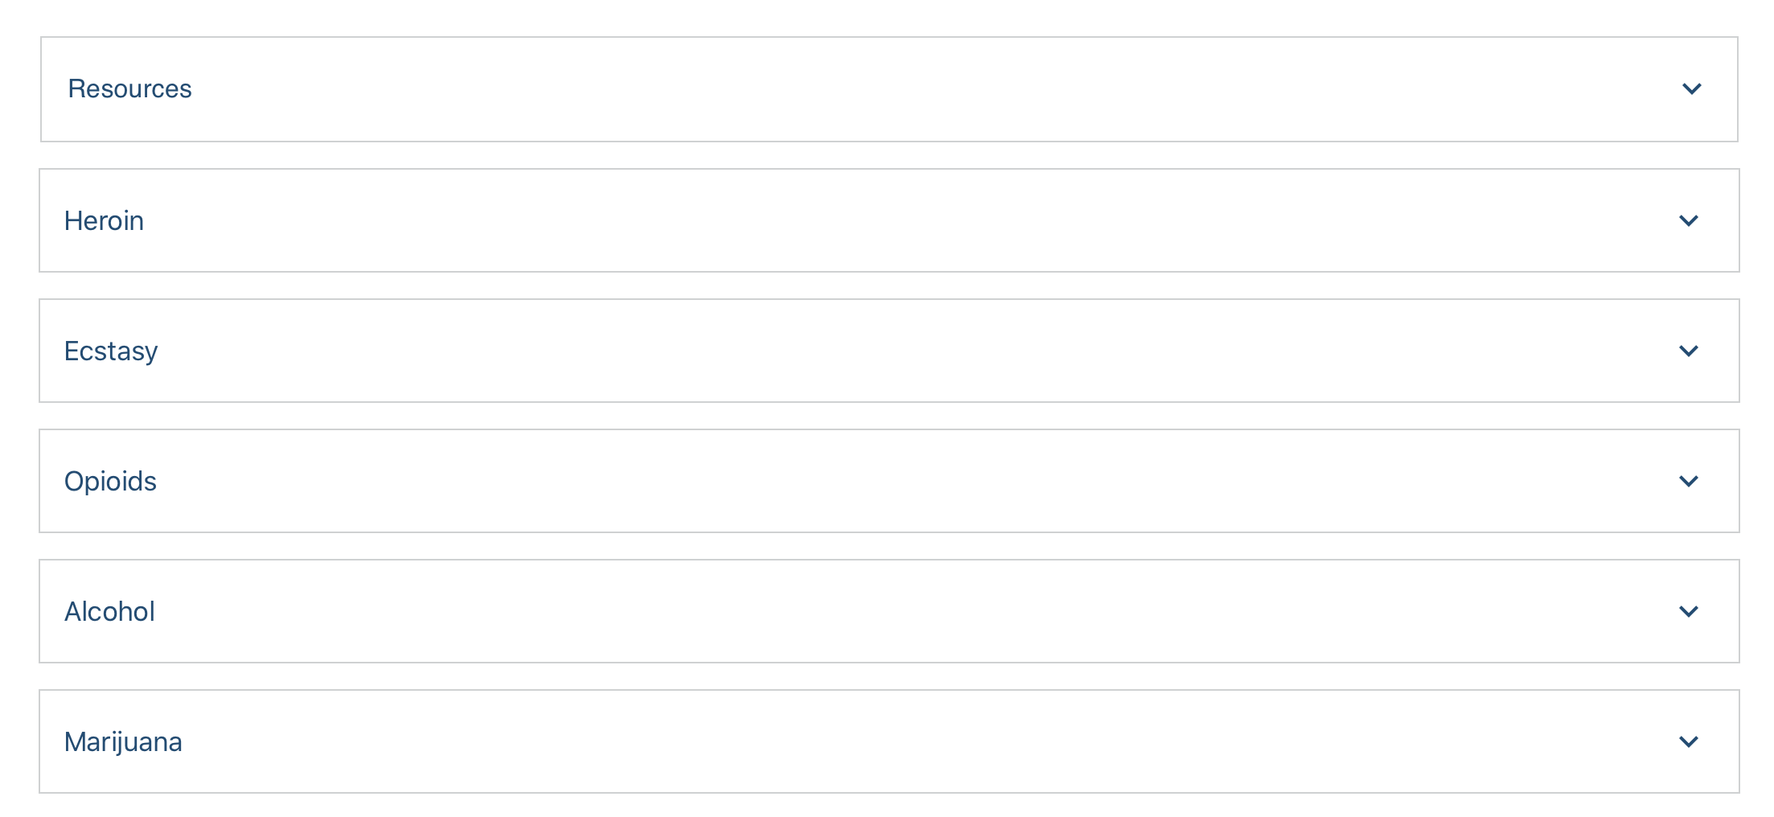
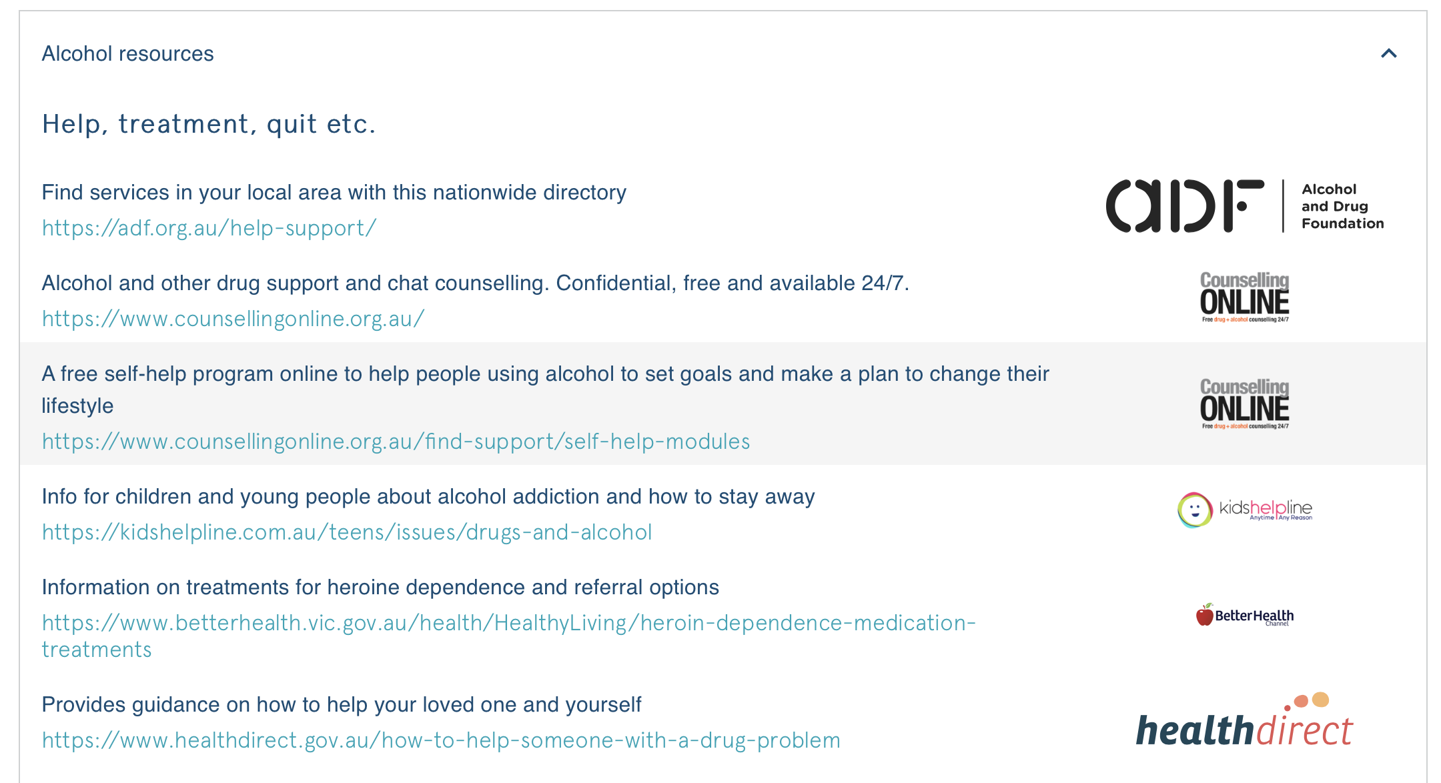
Helpful Activities
“I would love to have more access to information and support services that can assist me with dealing with my partner’s drug use”
Notes:
The majority of responders reported their situation could improve, with most stating that getting support and treatment for the user themselves as key to improving their own situation. While many respondents could identify a need for emotional, practical and financial support for themselves, their priority was ensuring that their addicted loved one access the support they needed.

Slide 34
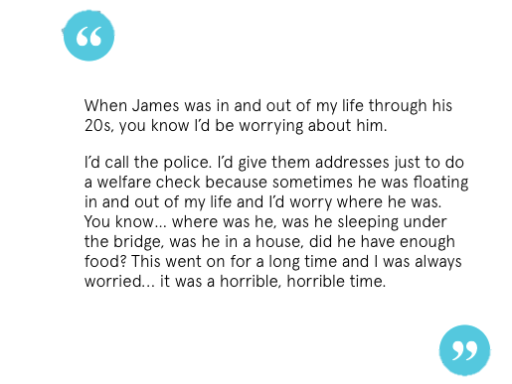
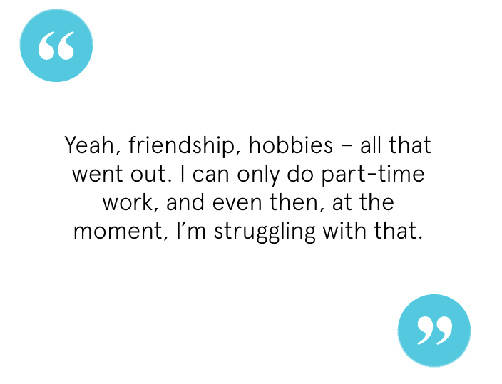
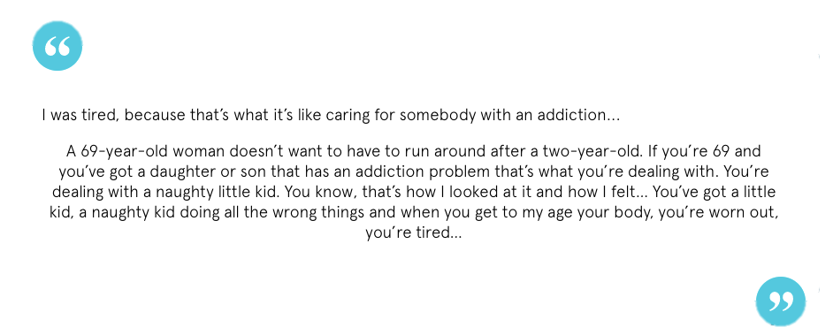

FFSP - Real Stories
Quotes interviews with family and friends
Opportunity to share their own story
Notes:
17 interviews were conducted with Family members-
Given opportunity to share their own story, and read other stories from other members of the program
Feature throughout the program – over 40 quotes

Slide 35
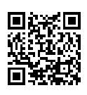
Pilot Evaluation
Presented by Jessica Deng

Slide 36


Pilot Study
Evaluate the usability, acceptability and feasibility of AOD FFSP as an online support intervention for AFFM’s
Assess AFFM’s experiences of caring for a loved one using AOD across Australia
Notes:
The primary aim of this pilot study was to assess usability, acceptability, and feasibility of the program. A secondary aim was to capture a cross-sectional snapshot of family and friends’ experiences of caring for a loved one using AOD.

Slide 37
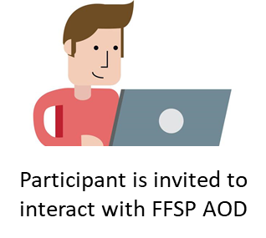

Methods
Recruitment:
Family members and friends supporting a loved one using AOD
Baseline Survey
Post Program Survey
(10 weeks post baseline)
Follow-Up Survey
(14 weeks post baseline)
Measurements:
Demographics
Kessler-10 (K10) and Adapted Short Questionnaire for Family Members (Affected by Addiction; SQFM (AA)) scales
Repeated baseline measurements + barriers to help-seeking + site usability and feedback questions
+
Optional: An additional in-depth interview with a research team member
Notes:
From November to December in 2021, participants across Australia were invited to complete three online cross-sectional surveys. The baseline survey assessed distress levels and the impact of caring for a loved one using AOD. Participants were then invited to interact with program modules over 10 weeks.
CLICK
Post program and follow up measures assessed usability and acceptability of the program as well as help-seeking barriers.
Semi-structured interviews were also conducted.

Slide 38
Results - Demographics
Baseline Survey
Post Program Survey
(10 weeks post baseline)
Follow-Up Survey
(14 weeks post baseline)
17 people (13%) said they had accessed FFSP between Baseline and Post-Program surveys
N = 49
N = 32
N = 131
Semi-structured interviews
N = 5
Notes:
In total, we had 131 friends and family members complete the baseline survey. Of those participants, 13% reported accessing the program.
49 people completed the post program survey, and 32 completed the follow up. 5 participants volunteered to take part in in-depth interviews with a clinical psychologist or social worker on the research team.
The study was originally designed with the intention of assessing changes in outcomes across time however due to the small sample of people who reported accessing the program, this analysis wasn’t possible.

Slide 39
Results - Demographics
Baseline Survey
Post Program Survey
(10 weeks post baseline)
Follow-Up Survey
(14 weeks post baseline)
17 people (13%) said they had accessed FFSP between Baseline and Post-Program surveys
N = 49
N = 32
N = 131
Demographics:
Female (80.2%); 51±12.7 (STD) years
Notes:
Majority of our baseline sample identified as female and the average age was 52 years. 52% of participants were from metro areas in Australia, and 77% of people reported accessing the internet on their smartphone.

Slide 40
Results - Demographics
Notes:
The most common relationship of the loved one using AOD was a child (38.2%) and the most reported substance of concern was crystal methamphetamine (48.9%). Despite relatively low self-reported prevalence rates in the community, it’s interesting to note that crystal methamphetamine is one of the most stigmatized drugs and is also a drug with wide reaching impacts. Our sample reflects the finding from the most recent national Drug Strategy Household Survey that people were most likely to select methamphetamine use as the most serious concern for the community, reflecting its nomination as the most likely drug to be involved in ‘a drug problem’.

Slide 41
Results – Psychological Distress (K-10)
Total sample:
 | Baseline (N = 131) | Post Program (N = 49) | Follow Up (N = 32)
Mean | 28.4 | 24.4 | 23.8
STD | 8.6 | 9.6 | 10.3
Those who accessed the program:
 | Baseline (N = 17) | Post Program (N = 17) | Follow Up (N = 11)
Mean | 31.6 | 29.5 | 29.4
STD | 10.3 | 9.8 | 10.9
Notes:
Although we couldn’t run analyses on changes in K-10 scores across time due to the small sample sizes, we noted that on average participants scored moderate to high levels of psychological distress which is reflective of other qualitative and quantitative research indicating elevated risk for emotional difficulties among affected friends and family members.

Slide 42
Results – Physical and emotional symptoms
Notes:
Similarly, the vast majority of participants at baseline reported a range of physical and emotional symptoms over the past 3 months including sleep difficulties, irritability and worrying.

Slide 43
Results – Impact of loved one’s AOD use
Notes:
In terms of the impact of their loved one’s AOD…
Among our baseline sample…More than half the participants reported that their loved one’s AOD use has at least sometimes impact family or social occasions, led to fights or arguments, and affected the family’s finances – all very much in line with the existing literature indicating the wide-reaching impacts of alcohol and other drug use.

Slide 44
Results – Informal and formal support
Notes:
In terms of seeking support, most participants reported that they sometimes or often received helpful support from friends and family, and whilst this is quite a promising finding, this contrasts with the fact that the majority reported never receiving or accessing helpful support from health workers. This seems to reflect a sentiment among friends and family members that isn’t uncommon in the literature where people don’t know or aren’t able to find helpful formal services to meet their needs. Of course there’s a lot more to be explored and unpacked here that wasn’t the focus of our study but the important takeaway for us that there is still a gap in the provision of formal support services for this group that is actually accessible and helpful.

Slide 45
Results – Barriers to help-seeking
*Note: Participants were able to select multiple responses.
Notes:
When asked about the reasons why people did not seek help in the past, participants highlighted financial difficulties, a lack of need and preferring to manage on their own. Notably, some participants identified previously asking for help but not receiving it or having negative experiences when they did.

Slide 46
Results – Usability and acceptability
Average System Usability Scale score was 70 (STD 18, N = 17) which is above average compared to 500 other websites.
35% of participants felt either very or moderately confident when faced with AOD related issues after interacting with FFSP.
41% of participants felt that the activities were either very helpful or moderately helpful.
71.5% of participants would recommend FFSP to others.
Notes:
From the 17 people who reported engaging with the program, the average usability score for the FFSP was 70 which is just above the average of 68 compared to 500 other websites. An average score indicates good usability but definitely room for improvement.
CLICK
We also found that about a third of people felt either very or moderately confident when faced with AOD related issues after interacting with the program.
CLICK
And 41% of participants felt that the activities were either very or moderately helpful.
CLICK
The majority (71.5%) of participants rated that they would be likely recommend FFSP to others who might be in similar positions to them.

Slide 47
Results – Usability and acceptability
Notes:
The majority of participants felt it was very or moderately easy to find the information they wanted and understand the information.

Slide 48
Results – Qualitative feedback
When asked for general feedback on the program
More stories of what being a friend or family support person might involve.
[I accessed FFSP] to know that I am not alone and feel validated.
I found the content on the site quite good
Those little vignettes of people's experience, they’re quite important
…learning to keep yourself in good shape so that you can help somebody else is extremely good
There was just so much information, it required considerable time to work through.
Notes:
Feedback on the content of the program was generally positive, with people especially liking lived experience stories and wanted more of from peer voices to overcome the feelings of isolation often accompanies their carer and support role. One specific area of improvement was the amount and density of content which can be a barrier for this population who are often time-poor and managing other life stressors.

Slide 49
Results – Qualitative feedback
Overcoming stigma and shame
There is a big role for online support to play because it helps people not feel so bad ... half the problem is, people don’t tell anyone because it’s so shameful, particularly once they’re an adult
It’s extremely comforting, for a while anyway, to find that there is somebody else who is just like you.
Notes:
Particiapants also highlighted the need for programs like FFSP to address stigma and shame by validating their difficulties and normalising asking for help. For example, one participant said:
There is a big role for online support to play because it helps people not feel so bad ... half the problem is, people don’t tell anyone because it’s so shameful, particularly once they’re an adult

Slide 50



Discussion
Overall, FFSP seems to be an acceptable, useful and feasible way to provide accessible, evidence-based support to AFFMs
Limitations
Low engagement
High attrition
Barriers to accessing FFSP included
Perceived lack of need
Time restrictions
Other stressors
Technical difficulties
Notes:
Overall, participants found FFSP easy to use and provided them with relevant, helpful, and validating information in a format that is accessible, flexible and confidential.
CLICK
However, these same conveniences may have contributed to the low engagement and high attrition.
These limitations may also be due to the non-linear nature of AOD use and recovery and acknowledging that this is a hard to reach sample who are heavily burdened and often facing multiple stressors at the same time.
CLICK
This is reflected in the self-reported barriers to accessing the program such as perceived lack of need, time restrictions, other stressors such as illnesses.
We also know that online self-guided interventions often suffer from high drop out rates particularly in real-world settings. So these limitations are likely a pretty accurate reflection of how the program would are in the real world and reinforces the importance of considering how to make the program something people will actually engage with and benefit from amongst the other stressors and demands of life.
Despite this, participants highlighted the importance of just having this kind of tailored online support exist and its role in overcoming stigma and shame around supporting a loved one using AOD.

Slide 51
Future Directions
1. Use feedback to improve and refine the program
2. Conduct large-scale efficacy evaluation across all 4 streams of the Family and Friend Programs
Clinical and non-clinical support
More lived experience stories
Connect with local services
Optimise for mobile
Notes:
We are in the process of using feedback from participants to further improve the program and enhance uptake and adherence including more lived experience vignettes, having non-clinical support such as email reminders as well as looking at connecting with local services and clinicians to position the FFSP as a complementary tool in families and friends’ broader recovery journey.
Other improvements include making sure content is easy to understand and navigate, particularly optimising the user experience for mobile as most people accessed the internet on their phones.
And finally, we hope to use the learnings from this pilot study to guide a future large scale efficacy evaluation of the program.

Slide 52


Acknowledgments
Research team: Prof Frances Kay-Lambkin, Dr Dara Samson, Ms Jenny Geddes, Ms Lauren Rogers, Ms Bronte Speirs, Dr Steph Kershaw, Ms Maddy Keaveny, Prof Cath Chapman, Prof Maree Teesson, Prof Nickie Newton, Ms Jessica Deng
Expert Advisory Group, project partners and collaborators: Prof Dan Lubman, Dr Rick Loos, Dr Milena Heinsch, Dr Jessica Wyllie, A/Prof Jamie Carlson, Ms Gill Velleman, Prof James Orford, Prof Richard Velleman
Funding: Australian Government Department of Health and Aged Care (development and implementation) and Alcohol and Drug Foundation (evaluation)
Notes:
I’d like to acknowledge the research team involved in this project and the original program development, as well as our collaborators. I’d also like to acknowledge the Department of Health and Aged Care and the Alcohol and Drug Foundation (ADF) who have funded the program and pilot study, respectively.

Slide 53

Acknowledgments
Thank you to the many family members and friends who have generously shared their stories and insights, as well as provided feedback on the program!
Notes:
Finally thank you to the many friends and family members who generously shared their unique experiences, stories and insights for this pilot study.

Slide 54






Thank you!
Connect with us
Contact:
Postal Address:
The Matilda Centre, Level 6, Jane Foss Russell building (G02), The University of Sydney NSW 2006, Australia
@TheMatilda_USyd
@TheMatildaUSyd
TheMatildaCentreUSyd
@matildacentreusyd
sydney.edu.au/matilda-centre
Visit FFSP:
www.ffsp.com.au

