Slide 1
Understanding gambling-related harm to affected others: Insights from Australian research
Published November 2025

Slide 2
Presentation outline
Context and why this matters
Our research approach
Aims and methods
What we found
Who is most affected?
What helps or hinders?
What this means for practice
Key implications and recommendations
Conclusion and questions

Slide 3
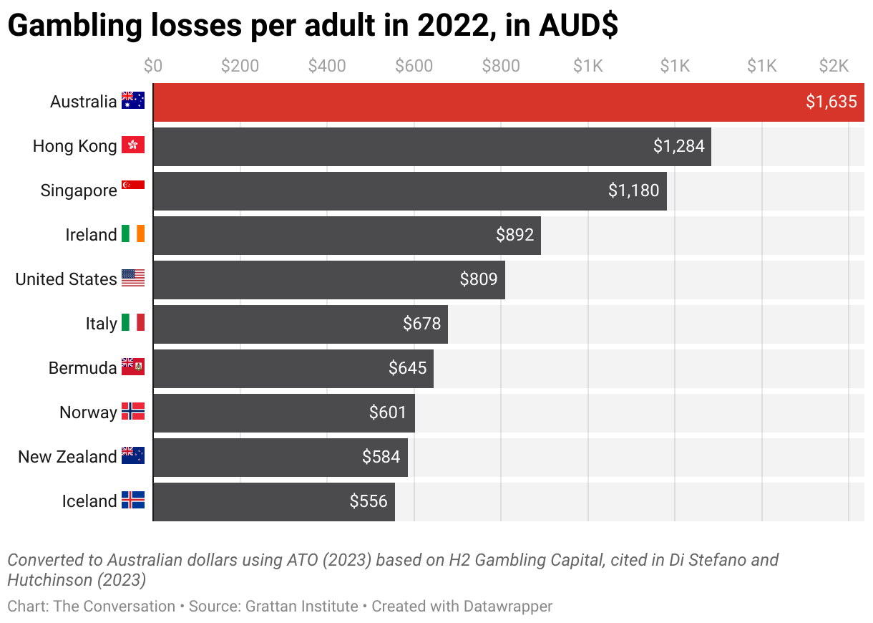
Harm beyond the person who gambles
Australians have the highest per-capita gambling losses in the world
Pokies/slots are associated with over half of the gambling problems in Australia

Slide 4

Affected Others
“A typical problem gambler affects six other.” (Goodwin et al., 2017)
In NSW, 1 in 8 adults are impacted by someone else’s gambling
This can include:
Spouses/partners
Parents
Children (both minor and adult)
Siblings
Close friends
Colleagues

Slide 5
My program of research
PhD (2020 – 2023) examined the impact of gambling problems on the health and wellbeing of affected others
Prior research in Australia focused on small samples of female partners of people seeking treatment
Most people don’t seek treatment
Broader range of AOs
All cross-sectional
Lacked population-level understanding of all AOs

Slide 6
What was found
Large population-representative study of 13,698 Australians:
Financial wellbeing was impacted in virtually all affected others
Other health and wellbeing impacts are more likely when the gambling problem is severe

Slide 7
What was found
Longitudinal study (18 years - 13,661 Australians)
Financial and social wellbeing are directly impacted by the gambling problem
Pre-existing vulnerabilities (general health, life satisfaction)
Gambling problems both cause harm and exacerbate existing vulnerabilities

Slide 8
Aims of the research
Who is most affected?
What relationship type is most at risk of harm?
Does ‘closeness’ matter more than relationship type?
How is this harm related to the affected others’ health and wellbeing?
What helps or hinders?
What is the role of coping styles and social support in the experience of harm and psychological distress?

Slide 9
The study
Sample:
A community survey of 1,131 Australian adults who identified as being close to someone with a gambling problem
Location:
All participants were current residents of NSW
A critical state for gambling research in Australia which contains half the country's electronic gambling machines (pokies/slots), the form of gambling most associated with harm

Slide 10
Measures
The survey included a broad range of validated scales assessing
Gambling harm to affected others (GHS-20-AO)
Psychological Distress (K6)
Health and wellbeing (SF-12, Personal Wellbeing Index)
Coping Styles (Brief Coping Questionnaire)
Social Support (Multidimensional Scale of Perceived Social Support)
In addition, we developed a measure of relationship closeness
The Significant Other Closeness Scale

Slide 11
Significant other closeness scale
Measures four domains of closeness
Emotional closeness
Financial closeness
Shared day-to-day responsibilities
Time spent together
Differentiates between same relationship type

Slide 12
Who is most affected and how?

Slide 13
Harm is commonly experienced
Sample consisted of people close to someone who they believe has had problems with their gambling over the past 12 months
92.5% of these had experienced 1 or more harms from that person’s gambling
70% had experienced 4 or more harms

Slide 14
Harm varied significantly by relationship type
Ex-partners - highest average level of harm.
Followed by current partners, then other family members.
Non-family relationships (e.g., friends, colleagues) reported the lowest levels of harm.
Male family members reported higher harm than female family members

Slide 15
Closeness matters – but not equally for everyone
For partners and ex-partners, harm is high regardless of how close they feel to the person who gambles
For family and non-family members, harm increases with greater closeness
Correlation between harm and domains of closeness (red = significant)
Relationship Type | Emotional Closeness | Financial Closeness | Shared Responsibilities | Time spent together
Current Partner | 0.02 | 0.13 | 0.14 | 0.12
Ex-Partner | 0.02 | 0.02 | 0.08 | 0.06
Family Member | 0.11 | 0.50 | 0.42 | 0.33
Non-Family | 0.50 | 0.35 | 0.42 | 0.4

Slide 16
Interdependence matters more than emotion
We measured four types of closeness: emotional, financial, shared responsibilities, and shared time
The strongest predictors of experiencing harm were:
Having a close financial connection
Having shared day-to-say responsibilities (like parenting or household duties)
Having a close emotional connection on its own did not significantly predict harm after accounting for other factors

Slide 17
The impact of harm on distress
Experiencing gambling-related harm was strongly correlated with higher psychological distress and negative emotions.

Slide 18
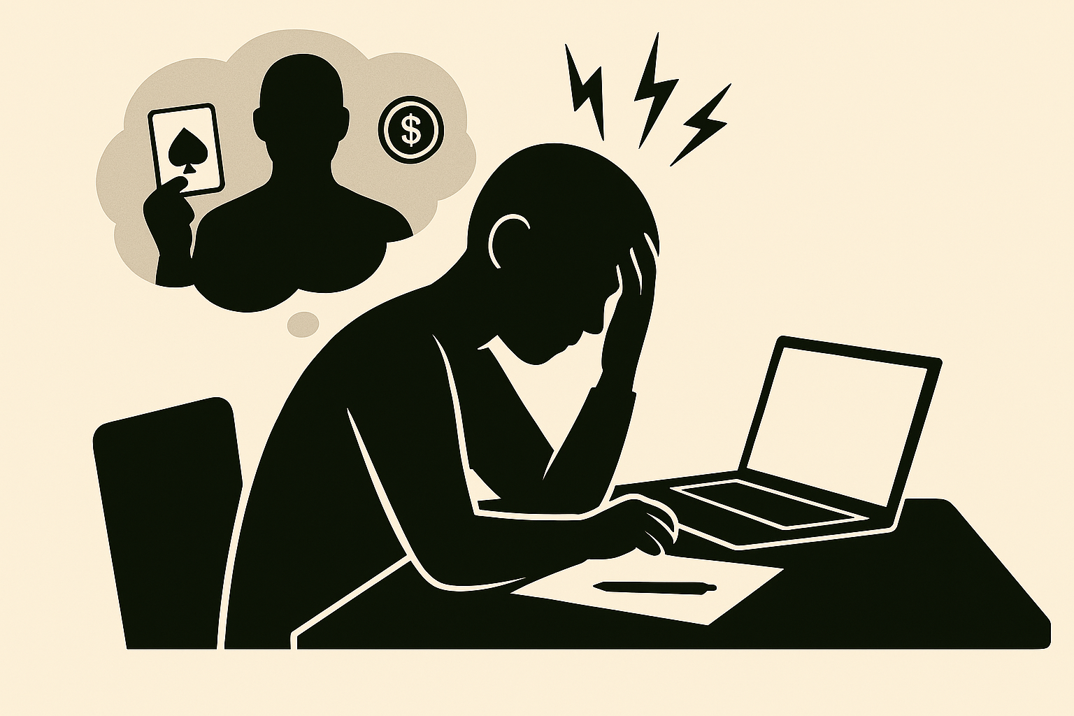
The impact of harm on daily functioning
Strong impact on 'Role Emotion’
measures limitations in being able to perform work or other everyday duties due to emotional problems.
Partners and ex-partners reported the highest levels of this impact
This suggests the distress caused by the gambling problem directly impacts an affected others’ ability to function at their job or manage their responsibilities.

Slide 19
What helps or hinders?

Slide 20
The framework for understanding:
The SSCS Model
To understand the role of individual actions, we used the Stress-Strain-Coping-Support (SSCS) Model (Orford, 2010).
Coping & Support: These are factors that can either worsen or buffer the relationship between the Stress and the Strain
Stressor – the gambling problem
Coping
Social support
Strain – harm and psychological distress

Slide 21
Coping styles
We combined three coping styles into a single 'maladaptive' score:
Engaged Emotional: Arguing, getting moody
Engaged Assertive: Confronting, monitoring actions
Tolerant Inactive: Covering up, lending money.
All linked to negative outcomes
Withdrawal coping
Linked to positive outcomes

Slide 22
Maladaptive coping is linked to more distress
Greater use of these maladaptive coping styles was strongly and positively associated with experiencing more psychological distress.

Slide 23
Maladaptive coping is linked to more harm
Greater use of these maladaptive coping styles was strongly and positively associated with experiencing more harm.

Slide 24
Withdrawal coping
Withdrawal coping involves the affected other gaining independence and prioritising their own activities.
Understood to be an 'adaptive' strategy.
Our initial analysis found that withdrawal was positively correlated with harm and distress.
However, when all factors were combined in the final model, withdrawal coping was no longer a significant predictor of harm or distress.
Withdrawal is not a simple fix and its effects are complex, possibly tangled up with relationship closeness.

Slide 25
Social support is a protective buffer
Measured perceived social support from family, friends, and significant others
More social support associated with significantly less harm and less distress
Aligns with the 'stress-buffering' hypothesis, where support provides resources that mitigate the impact of stressors.

Slide 26
Implications and Conclusion

Slide 27
Key predictors of harm and distress
Significant predictors of a person experiencing harm and distress from another person’s gambling:
Higher severity of the other person's gambling problem
A partner or ex-partner
A closer relationship (in terms of interdependence)
Greater use of maladaptive coping styles
Lower levels of perceived social support

Slide 28
What this means
Affected others experience clinically significant distress
This impact work/study/day-to-day responsibilities
Exacerbates existing issues

Slide 29
Key insights
Distress is disabling
Affected others often meet clinical thresholds for psychological distress
This impacts work, caregiving, and daily functioning
Practical entanglement drives harm
Shared financials and responsibilities - not emotional closeness - are the strongest predictors
Coping matters
Common coping behaviours are linked to worse outcomes
Ex-partners remain vulnerable
Support must include tools for healthier coping
Social support is protective - but often lost
Feeling supported reduced harm and distress
But gambling isolates people

Slide 30




Acknowledgements
My collaborators, and funding body - the Office of Responsible Gambling, NSW
Nerilee Hing
Professor
Matthew Browne
Professor
Matthew Rockloff
Professor
Margo Hilbrecht
PhD

Slide 31
Questions?

