Slide 1


The 5-Step Method
for family members

Slide 2
Section 1
Introductions
AFINet Website
Objectives
Timetable & Materials

Slide 3

Let’s get started
Introductions:
Start off with, “Hello my name is…”
Your role
Number of YEARS WORKING WITH FAMILIES
How do you work with families EG 1-1, phone, group
One thing you want from the course - HOPES and FEARS

Slide 4
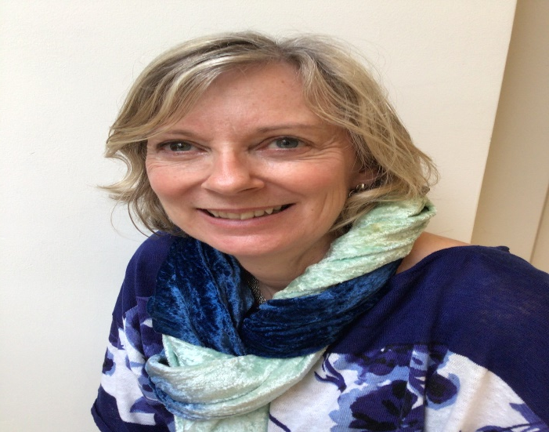
Who are AFINet UK?
http://afinetwork.info/
Richard Velleman
Jim Orford
Lorna Templeton
Gill Velleman
Clinical Psychologists, Researchers, Consultants
AFINet: You can join and access all the materials and videos.
There is a 5-Step Method Page

Slide 5
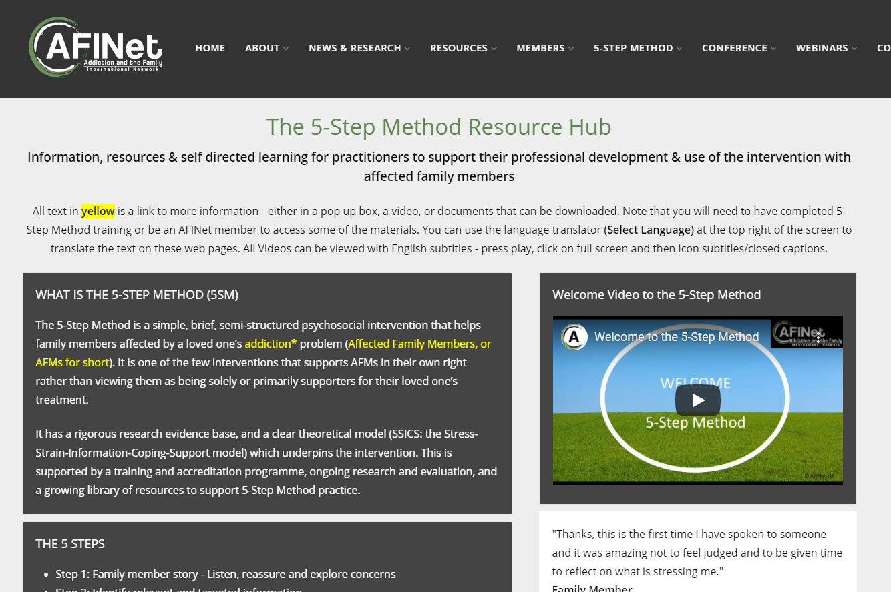
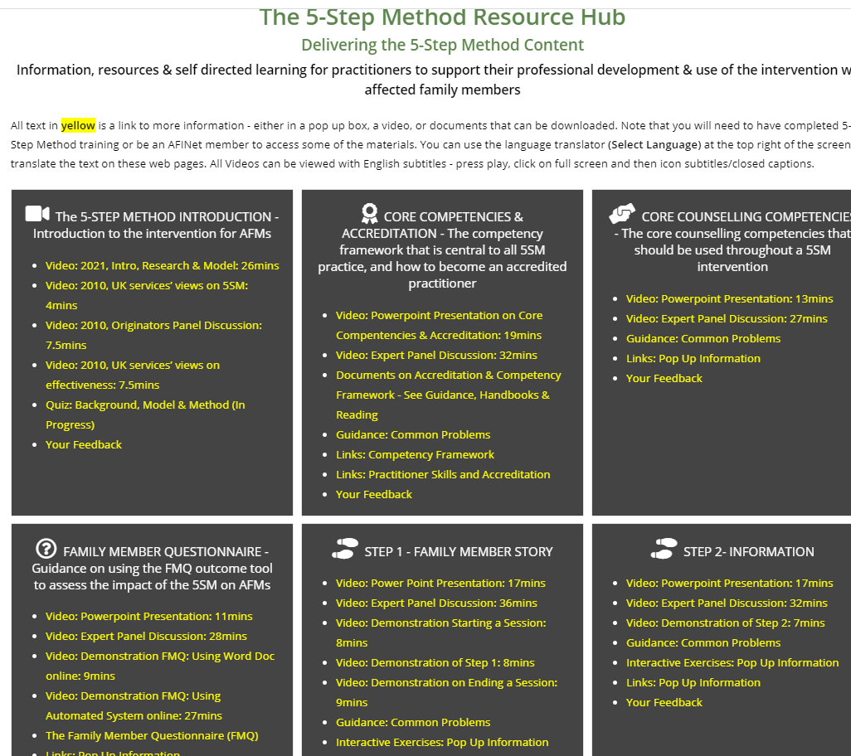
WEBSITE: http://afinetwork.info/5-step-method-resources-introduction

Slide 6
Objectives of the training
Understand the Stress-Strain-Information- Coping-Support model and the 5-Step Method
Understand delivery of the 5-Step Method with adult family members
Skills practice, exercises and discussion to support this
Understand competence and accreditation process and organisational procedures
Knowledge of Extra Resources/Videos on the 5-Step Method Website

Slide 7
Timetable – Day 1
Introductions, Housekeeping and Materials
Introduction to the Stress-Strain-Coping-Support Model & 5-Step Method Research
Break
Counselling skills, Family Member Questionnaire, pre Step 1 and Starting the Session
Lunch
Step 1: Eliciting the Family Member’s story
Giving Feedback and Break
Start Step 2: Providing Information
Review of Day 1

Slide 8
Timetable – Day 2
Finish Step 2 and Break
Step 3: Ways of Responding
Lunch
Step 4: Social Support
Break
Step 5: Additional Needs
Safe Practice & Group work
Accreditation Process & Review of Training

Slide 9

Housekeeping and Ground Rules
Fire
Toilets
Breaks & Energizers
Mobile phone
Time keeping
Participation - Try it out in the practice sessions (But not a therapy session)
One person talking at a time
Respecting the confidentiality of your/your colleagues cases
No question is a silly question
Any issues to return to – Park sheet
Taking Photos – any objections?
Give us feedback
Is there anything else to add?

Slide 10
Training Materials – All on on 5-Step Method Website
Practitioner Handbook & Family Member Self-Help Handbook
1: Copy of Slides
2: Family Member Questionnaire: Instructions for Scoring Assessments & Accreditation
3: Consent Form
4: Scoring Competency
5: Blank Competency Assessment Forms (Two Copies)
6: Competency Assessment Checklist
7: Completed Competency Assessment Form by Expert Assessor
8: 5-Step Competency Assessment DVD Step 1
9: Competency Assessment: Examples of Common Problems and Feedback Statements
10: Evaluation Form
DVD of 5-Step Method Practice (Can be provided) Research Base – research papers conducted on 5-Step Method. Emailed

Slide 11
Section 2
The Evidence Base
The 5-Step Method (5SM)
Impact on Family Members
The Stress Strain Information Coping Support Model (SSICS)
The Research
Family Member Questionnaire
Principles behind 5-Step Method

Slide 12

The 5-Step Method
Step 1: Family member story - Listen, reassure and explore concerns
Step 2: Identify relevant and targeted information
Step 3: Explore ways of coping and responding
Step 4: Explore and enhance support and communication
Step 5: Review previous steps and explore further needs
Derived from the SSICS model and what family members have told us

Slide 13
What do people say about the 5-Step Method?
Practitioners like it: Focused, excellent practical model which is helpful to them
AFMs like it, less stressed, helps cope, social network valuable, focus is on them
Watch Services talk about their experiences
https://www.youtube.com/watch?v=rKUDKyWOa-k&t=8s’
Like the skills-based training & assessment – builds on counselling skills
AFMs like the handbook – “I may be able to make things better for myself”
Both AFMs and Practitioners like that it is research-based, is a structured approach and focuses on empowering AFMs

Slide 14

Small Group Exercise – Impact on family
Each group to discuss ONE relationship
Imagine you are a family member… What is the impact (on you & the family) of having a relative with an alcohol or a drug or a gambling problem on:
1. Partners
2. Parents
3. Children/Siblings
Discuss for 5 mins and each group present your feedback

Slide 15
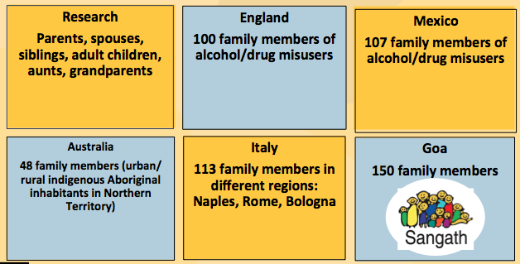
Formative Research - Detailed Interviews on what is was like to be an AFM

Slide 16

What do family members say – the similarities
People say extraordinarily similar things about what it is like to live with someone who has an addiction problem, seemingly irrespective of where they come from.
Difficult to live with their relative
Impact on FMs own life due to aggression, violence
Affected the FMs physical health (sleeping, eating, headaches, gastric problems)
Very common to experience worry, anxiety and depression

Slide 17
Coping
Support
Influence of support: important.
If FMs get more support of the right type: i.e. that they find supportive, then it becomes easier to bear the problems resulting from living in this type of environment
Putting up with it
Distancing from it
AFINet developed a simple model, developed directly from the things that family members have said
Standing up to it

Slide 18
Stress-Strain-Information- Coping-Support
(SSICS) Model
Information:
Knowledge enables feelings of control
Stress:
Family members are stressed due to the impact of a relative’s substance misuse
Strain: Physical or psychological health problems
Coping:
How the family member copes with (responds to) the situation
Support:
The level and quality of social support available to the family member
The SSICS Model is EVIDENCED BASED
and underpins the 5-Step Method

Slide 19
The Model
In the SSICS model
Family members are BOTH part of the solution,
AND also have needs in their own right
Family members are at the heart of the response
SSICS model doesn’t blame families
SSICS describes the harms to individuals and families.
The issue for us was how can these harms be reduced.
This led to the development of the 5-Step Method

Slide 20
SSICS Model
Vital that you understand the model
Can explain the model simply to AFMs
The model links to Competency Framework, and to every Step

Slide 21
The 5-Step Method - A Reminder!
Step 1: Family member story - Listen, reassure and explore concerns
Step 2: Identify relevant and targeted information
Step 3: Explore ways of coping and responding
Step 4: Explore and enhance support and communication
Step 5: Review previous steps and explore further needs
Derived from the SSICS model and what family members have told us

Slide 22

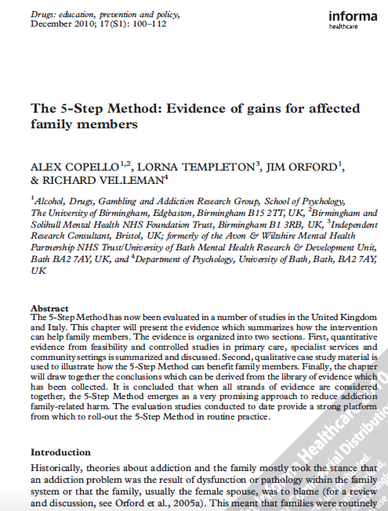

Research evidence – impact on family members
Reduction in Symptoms
Change in coping behaviour
Lessening the impact of the problem
Family members typically show physical and psychological signs and symptoms
Wide ranging signs and symptoms including stress, depression and anxiety
After receiving 5-Step, research has found a significant decrease in both physical and psychological symptoms

Slide 23
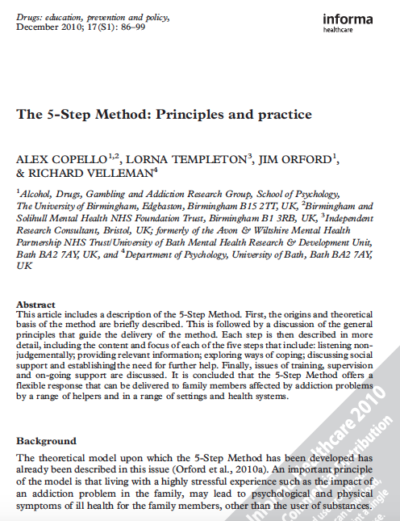
Research evidence – impact on family members
Reduction in symptoms
Change in coping behaviour
Lessening the impact of the problem
Different styles of coping behaviour (engaged, tolerant, withdrawal)
(standing up, putting up, distancing)
Research found a positive and significant change in own coping behaviour and behaviour to family member
Links between coping and health

Slide 24

Research evidence – impact on family members
Reduction in symptoms
Change in coping behaviour
Lessening the impact of problem
Focusing on family member’s own life and needs
Increasing resilience
Increased awareness of effects on others e.g others children and in the family

Slide 25
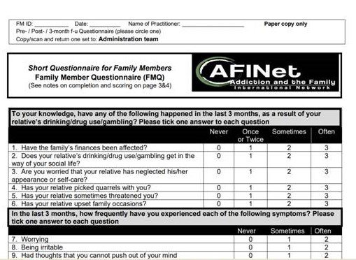
The Family Member Questionnaire
Evidence-based – developed specifically for the 5-Step Method
Therapeutic tool – used and useful throughout the intervention
Research tool to continue to build the evidence base about the 5-Step Method
33 questions covering 5 areas that align with both the 5 Steps & the SSICS model
Engage family members in using the FMQ throughout your work with them

Slide 26
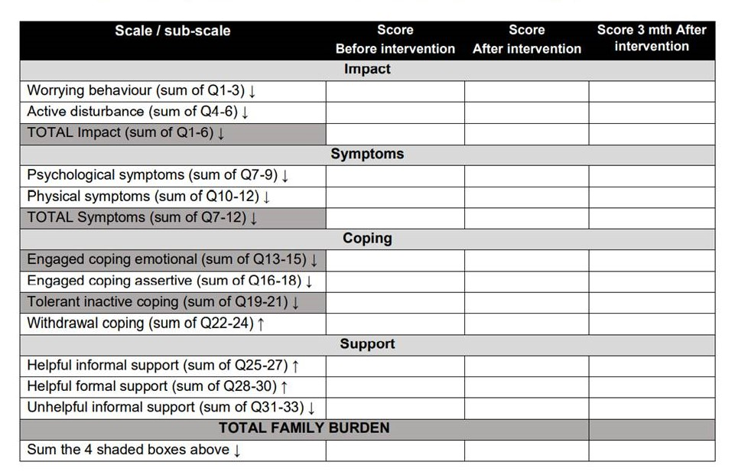
What does the FMQ tell us about how the 5-Step Method can help affected family members?
Key results of the 5-Step Method:
  4 out of 5 family members reported decrease in total family burden
  Decrease in family member symptoms
  Reduction in engaged style of coping
  Increase in positive support
  Decrease in unhelpful support

Slide 27
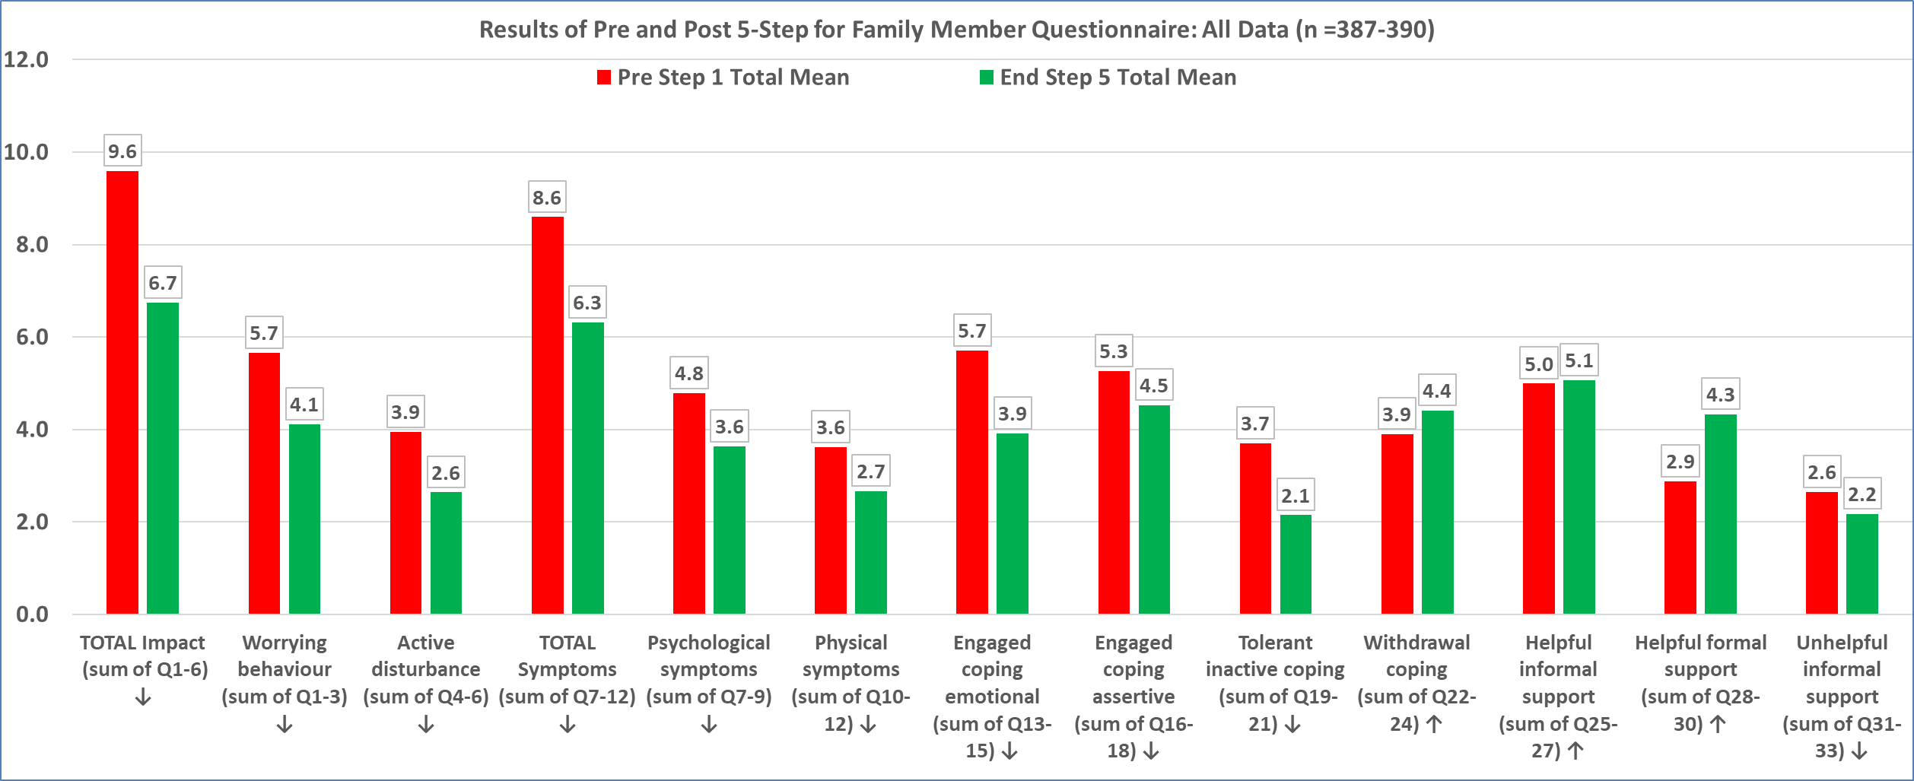
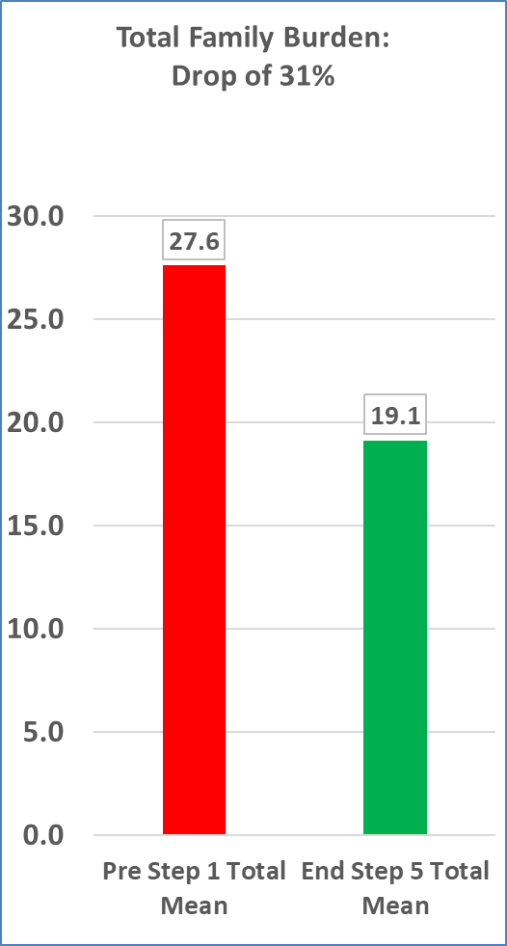
Family Member Questionnaire – International Results

Slide 28

How to use the FMQ to support delivery of 5-Step Method
Ask family members to complete before Step 1 (e.g. part of assessment) & again towards the end of Step 5
If feasible, the FMQ can be completed at 1 or more agreed follow-up points, such as 3, 6, 12 months
Family members should complete as independently as possible & with as little assistance as possible
Family members should select one response per question – the response that most closely relates to their situation
Check it’s been fully & correctly completed
Do not change the FMQ in any way!

Slide 29

Where is the 5-Step Method working?
131 courses run: over 1700 people trained
Ireland (National Scheme)
.
England
Holland
(National Scheme)
Italy
Canada
Hong Kong
Australia
Mexico
Nigeria
India
New Zealand (National Scheme)

Slide 30
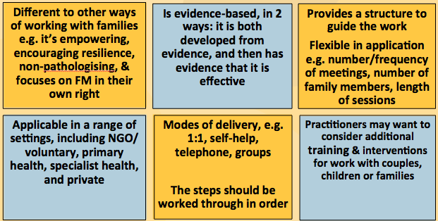
Key principles of 5-Step Method

Slide 31
Evidence: Drug and Alcohol Finding
The headline from this evidence is that simply putting on training courses
“typically fail[s] to sustainably or appreciably improve practice or outcomes, leading to the ‘implementation gap’ between research-tested interventions and real life”, and
that “sending counsellors away on a course is often a waste, without post-workshop feedback on their performance with clients, ideally allied with expert coaching.”
The headline from this evidence is that simply putting on training courses
“typically fail[s] to sustainably or appreciably improve practice or outcomes, leading to the ‘implementation gap’ between research-tested interventions and real life”, and
that “sending counsellors away on a course is often a waste, without post-workshop feedback on their performance with clients, ideally allied with expert coaching.”
So 5SM has developed competency framework and method of expert feedback to make sure there is no implementation gap/training dilution effect…more on this later

Slide 32
Review & Next Steps
1. Can you explain the 5-Steps?
2. Can you explain the SSICS model?
See 5SM Website
Articles
Video of this section
Video Round Table Discussion
3. Can you explain the research and the outcomes?
4. Can you explain why 5SM is different
to other approaches?

Slide 33
Section 3
Introduction to
Competency Framework

Slide 34
What is the Competency Framework?
This matches the SSICS
The practitioner should always be in the control of the process and the family member should be in control of the content.
Competency Framework: 35 competencies, most of which comprise a number of tasks
Each step has 6 competencies = 30
(for each step, 2 competencies cover the beginning & ending of the step)
Set of 5 core (counselling) competencies, to be used throughout the intervention

Slide 35
5-Step Method: Key Processes
Structuring all of the intervention sessions to ensure that everything is covered
Maintaining focus on the affected family member throughout (as opposed to focusing on the relative with the substance use or gambling problem)
Resisting the urge to tell a family member what to do or to try to fix things for them
Applying core counselling skills to each of the Steps

Slide 36
5-Step Method: Competency Based
Table 1: 5-Step Criteria
Key Principle: In reviewing each Step, the key question is: From listening to this recording, have you demonstrated enough skill to become a 5-Step Method Practitioner?
Did you structure the session so that all aspects of the Step being undertaken were covered and did you ask the right questions?
If I just listen to myself and not the Family Member, would I hear evidence of good 5-Step practice?
Table 2: Counselling & Other Skills
Key Principle: Have I demonstrated enough competency in counselling skills?
You may want to ask yourself some questions “Did I create the conditions in the session that allowed the FM to explore the issues?”; “Was there evidence from what the family member said that they felt this was a positive session and would come back”.
See Handout: Common Problems
Gives Good Tips and Guidance and Suggested Sentences

Slide 37
Why is the Competency Framework important?
Constant reminder of all of the competencies/skills required to deliver the whole 5-Step Method intervention
Minimises the ‘training dilution effect’ & ensures practitioners can maintain fidelity to the evidence-based intervention
Supports ongoing professional development & reflective practice (can be used to support clinical supervision)

Slide 38
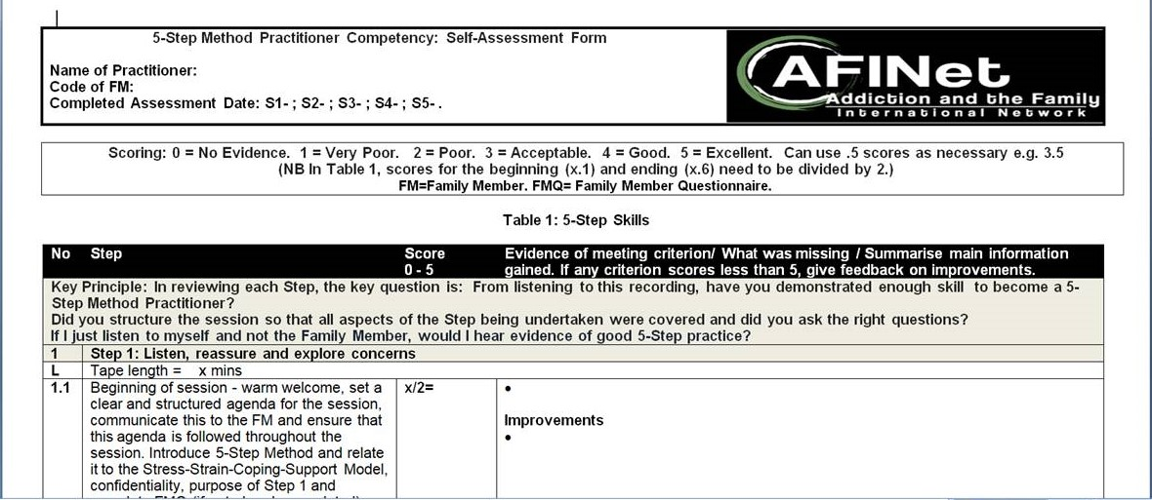
Practitioner Competency Framework

Slide 39
Section 4
Key Counselling Skills

Slide 40
Two sets of Competencies:
The nature of high quality 5-Step Method delivery
Core Counselling Competencies
Sets of Competencies for each of the 5 Steps in the 5-Step Method
Plus

Slide 41
Key Principles behind the Core Counselling Competencies
Would I want to attend a counselling session with this person?
Does the practitioner create the conditions in the session that allows the affected family member to explore the issues?
Is there evidence from what the family member said that they felt it was a positive session and will come back for further sessions?
Does the practitioner demonstrate enough competence in the application of the core counselling skills?

Slide 42
Counselling Skills Evidence Base
Carl Rogers seminal paper (1956) ‘The necessary and sufficient conditions of therapeutic .. change’: | Truax and Carkhuff (1969) – ‘Towards effective counselling and psychotherapy’.
Warmth, Empathy, Genuineness
Later research: more than this is needed: the importance of: careful listening; structure; and help to change

Slide 43

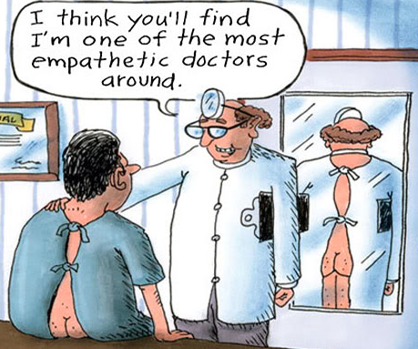

Counselling Skills Evidence Base
Listening
Relationship
These are the most important skills – regardless of the intervention
Careful and active listening, silences, expression of emotions, positive encouragement, expressing hope and optimism
Relationship is key – Family member should feel comfortable with the counsellor (warm, trusting, empathy, respect, genuiness)
Some people are ‘naturals’ at this by virtue of their personalities, values and skills – BUT non-naturals can be trained
See: www.findings.org.uk and see their Alcohol Treatment Matrix
cell B4: Practitioners:
Psychosocial therapies

Slide 44
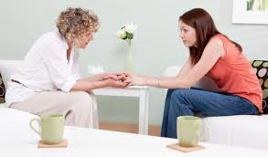
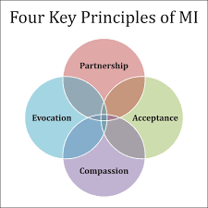
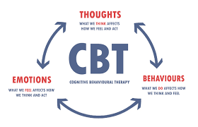
5-Step Method: Counselling Skills Evidence Base
Client-Centred
Careful and active listening; building a warm and trusting relationship
Cognitive Behavioural Therapy (CBT)
Emphasis on Behaviour – what the family member is doing; and
Cognition – what the family members thinking
Motivational Interviewing (MI)
Uses a client-centered style to elicit behaviour change by helping people to explore and resolve ambivalence

Slide 45

What are the Core Counselling Competencies?
Relationship of trust between practitioner & family member
Listening, questions, reflecting, summarising
Expression of emotions & use of silence
Encouragement, reassurance, support & hope
Consider risk & safety of family member & others

Slide 46

Counselling Competencies –
Assessment criteria
1.1 - Make a relationship of trust (warmth, genuineness, and empathy) so that it creates the right conditions for the family member to talk.
1.2 - Careful listening and summarising, the giving of minimal encouragers, the asking of appropriate open and closed questions and probing, reflecting both the verbal and emotional content.
1.3 - Allowing silences, and the expression of emotions - anger, anxiety, depression, sadness: expression of feelings can be cathartic, alter feelings and improve self-esteem.
1.4 - Offering positive encouragement, reassurance and support, reminding people of their strengths, and expressing hope and optimism that change is possible.
1.5 – Management of issues associated with risk and safety if relevant – e.g. domestic abuse and violence, safegaurding concerns and/or mental health or other circumstances of FM and/or key others which contain potential risks.

Slide 47
Section 5
Delivering Online
Preparing for a 5-Step Method Intervention
FMQ
Starting the Session

Slide 48
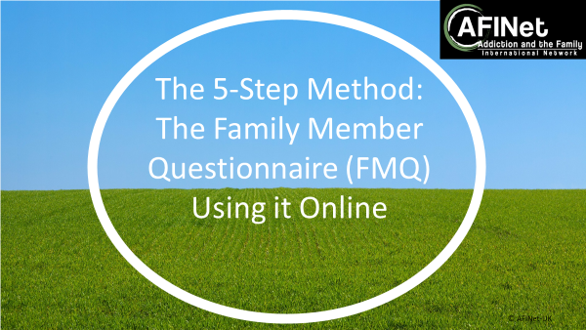
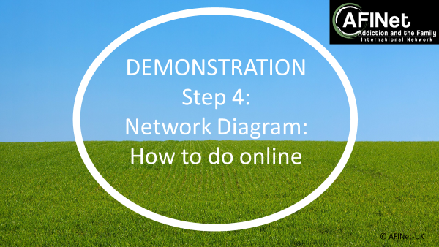
Delivering 5-Step Method Online
,
ON the 5SM Website:
Practitioner’s Online Manual
Family Drug Support, Aotearoa, New Zealand
5-STEP METHOD: Steps to Success
Maahiranga ki te angitu
What do you think the differences might be?
ON the 5SM Website:
Demonstrations of FMQ & Step 4 Network Diagram Online

Slide 49




Pre step 1 & STARTING Step 1: key tips
Practical and preparation issues
Agenda Setting, Introduction to 5-Step and to confidentiality
Use basic counselling skills
Self-help Handbook
May want to pre send Consent/Information Sheet & FMQ to fill in/do on zoom
Ensure you have enough time – up to 75mins, clock in the room, phone off.
Check paper work e.g. Consent Form, FMQ, Self Help Handbook, Competency Form/Checklist
Warm welcome. Four key principles – listen actively, develop empathy, deal with emotions, express and promote realistic optimism
Give copy of self-help handbook and encourage usage. Check safety
Set the agenda- today I’d like to cover x,y
Explain structure/ process – 5 Steps and SSICS model. See handbook.
Explain confidentiality

Slide 50
Benefits of the Family Member Questionnaire
To assess the AFM at the beginning
To help the FM think about/articulate issues
To help and direct all 5 Steps
To show the benefits of the intervention
To help develop the evidence base
Any issues/queries about how to use/introduce?
Exercise in pairs
1 person is Practitioner
1 person is FM
Do FMQ for ‘real’ (5-10 questions then swap) – make sure you ask the name of the family member
Do for 6 minutes each (bell will go)
Feedback to each other then feedback in big group

Slide 51
FMQ - Key Points as a Therapeutic Practice Tool
Important to explain to the Family Member why you are doing the FMQ
Important to explain confidentiality and that no names are shown (only a random number)
Completing it normalising the experiences of the Family Member (if it is on a questionnaire, I can’t be the only person experiencing this)
It aids discussion with the family member about items that they might not have thought relevant or necessary to discuss
Importantly the answers given to the FMQ helps discussion of each of the Steps
Family Members find re-doing it in Step 5 very valuable - it validates the changes they have made
Can use the FMQ on-line and through automated tools such as smarts survey
“The FMQ is indispensable to the 5-Step Method” Practitioner, Republic of Ireland

Slide 52
FMQ- Key Points as a Research Tool
Every family member filling it in adds to the body of evidence
Especially important to get evidence of effectiveness of the Method in routine practice (as opposed to a research trial)
Shows the impact of the Method at all of the individual, team, service, organisational and country levels
It helps for funders to know outcomes
BUT - ensure that you have got the answers to all Qs and to the demographics
AND - organisations need a system in place to record and collate the data

Slide 53
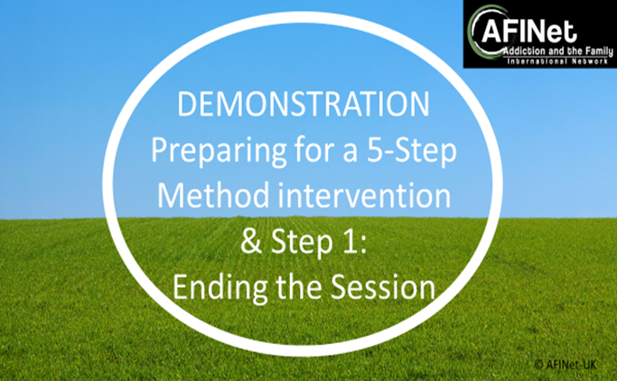
Starting and Ending the Session
Watch and Rate the Trainer Demonstration
Getting the beginning of the session right is vital
Notes:
If time, ask the trainees to practice this part.

Slide 54
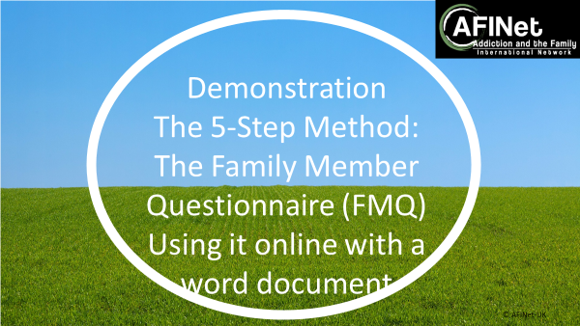
FMQ: 5SM Website
See 5SM Website:
Video Presentation of this Step
Video Expert Panel Discussion
Demonstrations delivering online via word and via online survey
Guidance

Slide 55
Section 6
Step 1
Family Member Story
Listen, reassure and explore concerns

Slide 56

Step 1: Family Member’s story
Coping
Stress
Support
Strain
Information
Family Member “Thanks, this is the first time I have spoken to someone and it was nice not to be judged and to reflect on what was stressing me”
Practitioner “I realised how important it was to fully understand the family member’s story and the impact it had on them, and to not rush the session”
Remember that
the practitioner is in control of the process
but the family member is in charge of the content

Slide 57

Step 1: Other Tips and Key Points
This Step is about identifying the stressors and identifying the strain - the way these stressors affect both this AFM and others in the family.
Remember it may be difficult for the FM to talk, as may fear being blamed and judged. DON’T RUSH and don’t rush TO FIX. Get the STORY.
Remember your core counselling skills – the style you adopt will determine the relationship through all the steps. KEEP ON TRACK by using summarising skills and probing questions.
Some stressors are more common in some groups: e.g. parents feeling a failure, spouses/partners at risk of domestic abuse, children frightened and confused.
Normalise their experience.
Check whether safe to take handbook home. If domestic abuse – THINK SAFETY.
Find out the information needs for this FM so you can prepare for Step 2.

Slide 58
Self Help Handbook Step 1 –
About you and problems you are having
How the behaviour of your relative affects you and your family - stresses
How the behaviour of your relative affects you and your family - health
 | Exercise 1 Think about how the relative’s alcohol, drug or gambling behaviour affects you, and also (if applicable) others close to you/them. Write down some of these problems and the impact on you and others.
Stressful behaviour of your relative |  | How I feel about this | How I think others feel about this
My partner does not spend time with us – his gambling always seems to come first |  | Angry & upset – why do we always seem to come second? | Our children feel neglected & confused
My daughter steals money to fund her drug use |  | I feel that I have to give her money so that she won’t steal and get caught | Angry with her for putting me in this position, and with me for giving her the money
 | Exercise 2 Think about how your relative’s behaviour affects you and (if applicable) others in your family/network. Think about how your physical and mental health, along with your everyday life, has been affected and write down some of these problems or effects, and the impact on you and others.
Health and other problems that I or others have |  | How I feel about this | How I think others feel about this
I sleep really badly & I have started having palpitations |  | I’m exhausted & lose my temper easily | My partner doesn’t understand why I lose my temper so much
I feel really listless and low; I often find myself crying |  | Just wrung out & disinterested in almost everything | My children don’t understand why I don’t want to play with them
Notes:
Exercise 1 examples:
I am concerned about my relative’s health or performance
I find my relative unpleasant or difficult to live with
I feel: anxious / worried, helpless / despairing, low / depressed
Exercise 2 examples:
Drinking more / smoking more / needing more medication
Loss of appetite
Back pain/headaches

Slide 59
Step 1 Competencies - Listen, Reassure, & Explore Concerns
Beginning session – remember, you have a number of tasks to cover: warm welcome, set a clear and structured agenda for the session, communicate this to the FM and ensure that this agenda is followed throughout the session. Introduce 5-Step Method and relate it to the Stress-Strain-Coping-Support Model, confidentiality, purpose of Step 1 and complete FMQ (if not already completed).
Allow FM to describe their situation and tell their story. Listen to and ask about the FM’s concerns, fears and emotions. Ongoing summarising to check understanding of the situation. As necessary, use the FMQ to guide the session.
Identify relevant stresses and how the FM has been affected. As necessary, use FMQ to guide the session.
Gain an overview of family/network structure, and use this to identify how others have been affected by these relevant stresses.
Normalise the experience of FMs; give the FM an indication that they are not alone in their experiences.
Ending session – remember, you have a number of tasks to cover: summarise the main FM issues, use of handbook (and any risk issues with it being taken home). Check if session was helpful. Give purpose of next session on Step 2 and clarify what the information needs might be. Practical issues of contact and date of next session.
Remember the core counselling competencies, self-help handbook, structure, & time management.

Slide 60
Structuring the beginning of each session and each Step
Should take at least 5 minutes.
Welcome family member. Keep any ‘check-in’ as brief as possible. For Step 1, cover or remind about confidentiality, and Complete the FMQ if this has not been done.
Set a clear & structured agenda for the session, explain this structure to the family member so they understand what will happen, ensure good time management throughout.
Give an overview of the Step to be covered, relate it to the SSCS model, and to the 5-Step Method.
Refer to the self-help handbook if appropriate.
Always check risk & safety issues – they can change over sessions.

Slide 61
Structuring the ending of each session and each Step
Should take at least 5 minutes.
Summarise the main issues that have been discussed.
Check how the family member found the session.
Check in about risk if this has not been done.
Agree any ongoing use of the self-help handbook.
Give an overview of the next session.
Make the practical arrangements for the next session (or any follow-up if it is Step 5).
By end of Step 1: start to identify questions & information needs to be covered in Step 2.

Slide 62
Step 1: Assessment- Introducing Scoring and Competency Assessment
Scoring System
0 = No Evidence
1 = Very Poor
2 = Poor
3 = Acceptable
4 = Good
5 = Excellent
Can use .5 scores as necessary e.g. 3.5
Pass is 65% and mainly 3.5’s and above
Tips
See competency sheet and checklist.
Write down the evidence.
Relate what the practitioner is saying to the competence.
If the score is less than 5, state how the practitioner would have to improve in order to get a 5.
See Good Practice Example

Slide 63

Step 1: DVD Skills Practice Assessment
Watch the DVD Clip
The DVD is not perfect and works with straightforward scenarios.
Aims to clearly illustrate the steps.
Produced before we clarified the criteria; and usually no space in such short clips
to demonstrate opening or ending correctly.
All Clips are less than 10mins so account for this in your scoring.
Notice the process of ‘eliciting the story’.
Trainers remind of setting the agenda – see p18 of P Handbook

Slide 64
Step 1: DVD Skills Practice Assessment
While watching Step 1, use one copy
of the blank assessment sheet
to assess Richard’s delivery of Step 1.
Only assess against 1.2, 1.3, 1.4 & 1.5
Group discussion on skills used by Richard in Step 1
See p18 P Handbook
Step 1. See 8 Model DVD Assessment.
Compare yours to handout.
Evidence and Improvements

Slide 65
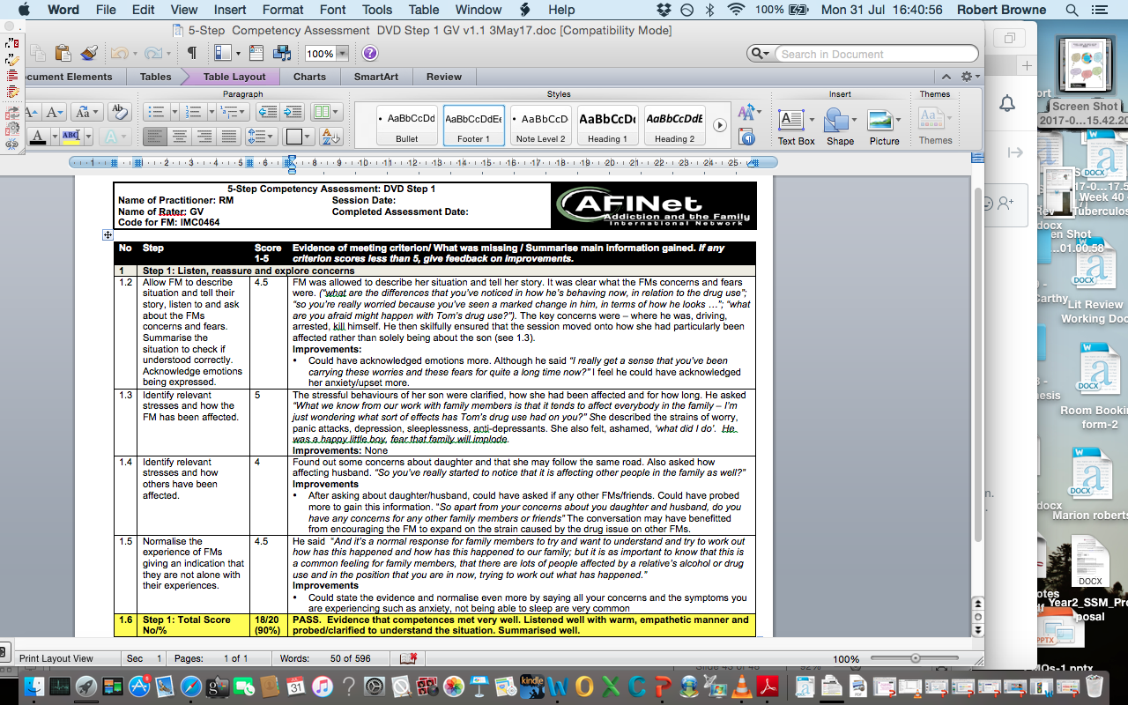
5-Step Competency Assessment DVD Step 1

Slide 66

Step 1: Giving Feedback and Skills Practice
Trainer Demonstration of Feedback
Skills Practice Prepare
Groups of 3: Agree roles: 1. Family Member. 2. Practitioner. 3. Observer
You will swap so everyone will take each role in turn
Practice Step 1, focus on 1.2 & 1.3. Gain an understanding of their situation, acknowledge emotion, identify their stresses and how they have been affected.
Observer should use the assessment sheet as a tool for feedback.
Practice: 8-10 mins (will let you know when time is up); then 3 mins for observer and FM feedback

Slide 67


Step 1: Feedback & 5SM Website
Group feedback
See 5SM Website:
Video Presentation of this Step
Video Expert Panel Discussion
Demonstrations
Guidance
Common Problems

Slide 68
Section 7
Step 2
Providing Relevant and Targeted Information

Slide 69

Step 2: Providing relevant information
Coping
Stress
Support
Strain
Information
Family Member: “I found it really useful to understand about the cycle of change and how common it is for people to relapse - this really helped me….
It also helped to discuss information & techniques to remain calm when talking to my son”
Practitioner: “I really wanted to make sure the information was relevant to the family member, so it was good to have gone over this at the end of Step 1. I also made sure she knew about some key websites giving some accurate information”
Remember that
the practitioner is in control of the process
But the family member is in charge of the content

Slide 70


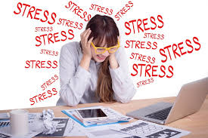

Step 2: Providing Information
Giving Information/ Dispel Myths
Can’t be an alcoholic because…it’s about the problems it causes rather than labelling.
Must hit rock bottom
Evidence from Blue light project on Change Resistant Drinkers /Nudge Factors
Information for FM /Others and User: Cycle of Change can be useful
Reduce stress
Does Step 2 work?
No advice!
Providing information that is targeted and relevant to family members has been show to reduce stress linked to misconceptions or lack of knowledge
Remember that you are providing information and NOT giving advice
Family members report that they feel more in control after Step 2

Slide 71
Step 2 Competencies
Beginning session – remember, you have a number of tasks to cover: warm welcome, set a clear and structured agenda for the session, communicate this to the FM and ensure that this agenda is followed throughout the session. Check if previous session helpful. Give purpose of Step 2 and relate it to the Stress-Strain-Coping-Support Model.
Provide targeted & relevant Addiction-related information, using the elicit, provide, elicit process (see next slide) and discuss this with FM. (About the substances or behaviours involved – e.g. details of drugs, units of alcohol, forms of gambling - or about addiction/dependence – e.g. how difficult it is to give up, reasons for relapse). As necessary, utilise answers to FMQ to guide the session.
Provide targeted & relevant General information, using the elicit, provide, elicit process and discuss this with FM. (About anything not directly addiction related - e.g. anxiety, sleeping and other health issues, housing, debt management, benefits, educational courses). As necessary, utilise answers to FMQ to guide the session.
Identify areas where FM feels other family members may need information - both addiction and general information., and provide targeted & relevant information for them.
Support FM to find out more for themselves about identified issues e.g. FM could use websites, reading, library, organisations, etc.
Ending session – a number of tasks to cover: summarise the main FM issues, use of S-H handbook, check if session was helpful, explain purpose of next session (Step 3). Practical issues of contact and date of next session.
Remember the core counselling competencies, self-help handbook, structure, & time management.

Slide 72
Starting and Ending a Step 2 Session
Getting the start and end of every session ‘right’ is really important, as it gives structure to the sessions; this can aid time management and ensure that you cover all that is required for each Step.
Beginning Step 2: warmly welcome the family member, set a clear and structured agenda for the session, communicate this to the family member and ensure that this agenda is followed throughout the session, check if the previous session (i.e. Step 1) was helpful and if the family member has any questions, and give an overview of Step 2 and how it relates to the Stress-Strain-Coping-Support Model. Maybe see if anything has changed with regards to risk and safety (or elsewhere in session if prefer). | Ending Step 2: get the FM to summarise the main issues that the FM has raised (adding in anything that you thing the FM has missed), check if session was helpful, reiterate the use of the S-H handbook, explain purpose of next session (Step 3) and how it fits into the SSCS Model. cover the practical issues of the date of next session and how to make emergency contact in between if needed.

Slide 73
Step 2: The ‘Elicit, Provide, Elicit’ process
A similar technique to the one used in Motivational Interviewing, it ensures that information is Targeted and Relevant
Elicit
Establish with the FM what their information needs are.
Provide
Provide relevant and targeted information
Elicit
Check with the FM that the information has helped; deal with any further questions that arise.

Slide 74
Step 2: Tips and Key Points
BE PREPARED. Have information that the family member asked for
in Step 1 or that you discussed in relation to the FMQ.
2. Check what the family member already knows.
3. Tailor the information to their need, dispel myths; and empower them to look for themselves. TARGET it.
4. You don’t have to know everything. Can use the practitioner's handbook.
5. Can ask the family member to do exercises in the self help manual.
6. ALWAYS check if domestic abuse – it may not be safe for the family member to take information home.

Slide 75
Self Help Handbook Step 2 –
Increasing your knowledge and understanding
What would help you increase your knowledge?
What you have found out? What has helped?
 | Exercise 3 Think about what questions you might have that would help increase your knowledge and understanding about what is going on. you could look back over step 1, or at the answers you gave to the FMQ, to help you think about questions you have or what information you might want. If you want, write your questions below.
 | Exercise 4 This exercise can help you summarise the information that you have found out, and how helpful this has been. If you find it useful, look back at the questions you wrote down in Exercise 3 and see if they have been answered.
What have I learned?
How has what I have learned helped me? Have I increased my knowledge and understanding?
Do I still have questions and information needs? What can I do about this?
Notes:
Exercise 1 examples:
I am concerned about my relative’s health or performance
I find my relative unpleasant or difficult to live with
I feel: anxious / worried, helpless / despairing, low / depressed
Exercise 2 examples:
Drinking more / smoking more / needing more medication
Loss of appetite
Back pain/headaches

Slide 76
Step 2: DVD Skills Practice Assessment
Watch the DVD clip and use copy
of the assessment sheet to assess
Jan’s delivery of Step 2.
Only assess against 2.2, 2.3 & 2.4
Trainer remind of setting the agenda, see p22 P handbook
Group discussion on skills used by Jan in Step 2
See p22 P Handbook
See Sheet 9:
Common Problems/Feedback Statements
Lowest scores of all 5-Steps.
Not utilise FMQ or prepared from Step 1/ Targeting/ Information on non addiction/Needs of Other FMs/Not empowering

Slide 77
Step 2 – Master Scoring
Criteria | Master Score
Identify/check areas where FM needs more Addiction-related information (about the substances or behaviours involved -details of drugs, units of alcohol, forms of gambling, for example - or about addiction/dependence - e.g. how difficult it is to give up, reasons for relapse etc.), present targeted & relevant information to FM, and discuss this with FM. Utilise results of FMQ to guide the session. | 4.0 - 4.5
Identify/check areas where FM needs more General information (about anything not directly addiction related - e.g. anxiety, sleeping and other health issues, housing, debt management, benefits, educational courses.), present targeted & relevant information to FM, and discuss this with FM. Utilise results of FMQ to guide the session | 3.5 – 4.0
Identify/check areas where FM feels other family members may need information - both addiction and general information. | N/A

Slide 78
Day 2 – Check in
Q and A
How confident are you feeling?
Summary of key issues

Slide 79

Exercise
In small groups, summarise each of the following:
Small Group Exercise
The SSCS Model
5-Step Method
Step 1
Notes:
If you met someone tonight, what did you do today? Summarise on flipchart

Slide 80
Step 2 - Skills Practice
Get into Groups of 3 & agree roles:
Family Member
5-Step Practitioner
Observer
You will swap so everyone will take each role in turn
Practice Step 2, focus on 2.2, 2.3, 2.5. Observer should use the assessment sheet as a tool for feedback. Practice: 8-10 minutes; then 3-5 minutes for feedback for observer
Feedback in larger group – any questions/concerns?

Slide 81
Step 2: Feedback & 5SM Website
Group feedback
See 5SM Website:
Video Presentation of this Step
Video Expert Panel Discussion
Demonstrations
Guidance
Common Problems

Slide 82
Section 8
Step 3
Explore ways of coping and responding

Slide 83

Step 3: Exploring coping and responding
Coping
Stress
Support
Strain
Information
Family Member..” Knowing there was not a right or
wrong way of responding made me feel a lot better.
I felt before that people were blaming me, and that
I was getting it wrong. I now think about my approach and try to remember that I do have options.”
Practitioner..” I felt this session empowered the family member to feel she had choices about how to respond and there was not a right or wrong way but each choice had advantages and disadvantages. Helping her realise and move from TINA to TAAA was a key point.”
Remember that the practitioner is in control of the process and the family member is in charge of the content.

Slide 84
Step 3: Process for exploring coping
Discuss FM’s current ways of coping using examples of recent specific incidents. Discuss the 3 Coping styles.
Explore advantages and disadvantages of the current ways of coping, as perceived by the FM.
Explore with the FM alternative ways of coping, using the same recent specific incidents.
Explore advantages and disadvantages of these new alternative ways of responding.
Help FM move from TINA (There Is No Alternatives) to TAAA (There Are Always Alternatives) – there are always choices.

Slide 85
Self Help Handbook Step 3 – Ways of coping and responding
How you currently respond to a recent situation and how you feel about this
Your responses, what was helpful and unhelpful, what you could do next time
 | Exercise 5 This exercise will help you look at how you currently cope with and respond to your relative and their use of alcohol or other drugs, or their gambling behaviour. Think about some difficult situations that you have experienced recently and write down how you responded, and how you feel about this.
Example of a difficult situation |  | How I responded | How I feel about this
My mum had clearly had a few drinks when I took the grandchildren over for a sleepover |  | There was a row & I left, telling Mum that she can’t see her grandchildren on her own until she’s sorted out her drinking | I have to put my children first but I’m mad with myself for some of the things I said to Mum
My partner turns his phone off so I can’t contact him when he’s in a bookies or arcade. |  | I send angry texts & we usually row when he comes back home. | Frustrated, abandoned, & worried about our finances.
 | Exercise 6 This exercise will help you look at how you cope with and respond to the relative and their alcohol, other drug or gambling behaviours. Think of some recent situations and write down how you coped or responded. Think about what was helpful and unhelpful about each way that you coped or responded. Now for each situation, think about how else you could have responded. Remember TAAA (There Are Always Alternatives). Put down an alternative way of coping or responding against each situation, and then put down what might be helpful and what might be unhelpful about this alternative.
Situation & my response |  | What was helpful | What was unhelpful | Alternative response | Alternative response: what might be helpful | Alternative response: what might be unhelpful

Slide 86
Step 3 Competencies
Beginning session – a number of tasks to cover: warm welcome, set a clear and structured agenda for the session, communicate this to the FM and ensure that this agenda is followed throughout the session. Check if previous session helpful. Give purpose of Step 3 and relate it to the Stress-Strain-Coping-Support Model.
Ask FM about current coping responses. Get specific examples and situations. Discuss the 3 main ways of coping (see next slide). As necessary, use answers to FMQ to guide the session.
Explore advantages and disadvantages of current coping responses to these specific examples and situations.
Explore advantages and disadvantages of alternative ways of coping with these same specific examples and situations.
Facilitate FM to see that there is no right or wrong way of coping. Enable FM to move from TINA (There Is No Alternative) to TAAA (There Are Always Alternatives).
Ending session – a number of tasks to cover: summarise the main FM issues, use of handbook. Check if session was helpful. Give purpose of next session on Step 4. Practical issues of contact and date of next session.
Remember the core counselling competencies, self-help handbook, structure, & time management.

Slide 87
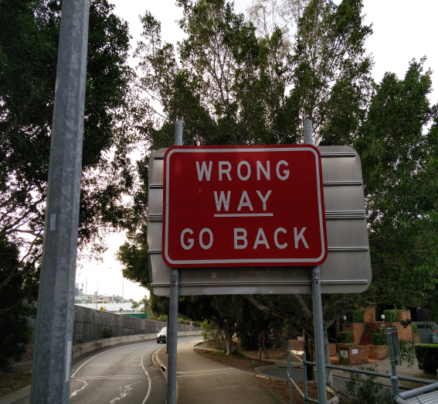
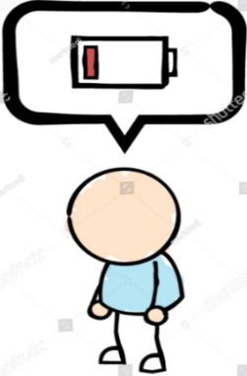


Three Categories of Coping
Standing up to, or getting involved in (Engaged)
Putting up with (Tolerant)
Distancing (Withdrawal)
No right/wrong way
There are pros and cons of each coping style
Some work better in some situations
No ‘right' way to respond
Move from TINA to TAAA
Not doing anything
Minimising the impact of the behaviour
Scared to do anything
Putting relatives needs ahead of their own
Active interaction with the Relative
Trying to control the behaviour/ deal with the problem
Being assertive
Standing up for them
Confronting/giving ultimatums
Taking control of household matters
Avoiding relative as much as possible
Being independent and ‘doing my own thing’
No attempt to change /protect the user

Slide 88
Three Categories of Coping
(lots of examples in Self Help Handbook, Step 3)
 | Engaged | Tolerant | Withdrawal
 | Active interaction with the Relative; Trying to deal with the problem | Put up with; Ease things; Remove negative consequences for the Relative | Increase distance from the Relative
Examples (lots more in Handbook) | Watch Relative’s every move; check up on Relative | Clear up mess; give money; cover up for Relative | Avoid Relative; Be more independent
Advantages | Makes me feel I am doing something positive | Avoids arguments and confrontation | Stops me getting too involved
Dis-advantages | Very stressful; Relative doesn’t like it | Feel taken advantage of | Feel I am rejecting Relative
Overall | There is no RIGHT way to cope; There Are Always Alternatives (TAAA)

Slide 89
Step 3: Tips and Key Points
Discuss with the family member how they cope using SPECIFIC EXAMPLES, the dilemmas that they face, exploring the pros and cons of their responses, considering alternatives.
Family members often struggle to work out what to do for the best – responding therefore raises dilemmas for FMs.
Enable FM to see that there is no ‘best’ way to respond/cope.
Coping responses will vary with both the circumstances & resources
of the family member.
Enable FM to move from TINA to TAAA.
The benefits for the FM to changes in coping cannot be underestimated.

Slide 90
Step 3: Coping responses

Slide 91
Step 3: DVD Skills Practice Assessment
Watch the DVD clip and use copy of the
assessment sheet to assess Richard’s delivery of Step 3.
Only assess against 3.2, 3.3, 3.4 & 3.5
Trainer remind of setting the agenda, see p26 P handbook
Group discussion on skills used by Richard in Step 3
See Sheet 9:
Common Problems/Feedback Statements
Not gaining specifics/not use handbook and going over ways of coping/
Not enough exploration of advantages/disadvantages so FM comes to own conclusions

Slide 92
Step 3 – Master Scoring
Criteria | Master Score
Ask FM about current coping responses. Get specific examples and situations. Discuss the 3 main ways of coping. Utilise results of FMQ to guide the session. | 4.5
Explore advantages and disadvantages of current coping responses. Again, use specific examples and situations. | 4.0
Facilitate FM to see that there is no right or wrong way of coping. | 4.0
Explore advantages and disadvantages of alternative ways of coping, again utilising specific examples and situations | 4.5

Slide 93
STEP 3: TRAINER DEMONSTRATION
TINA to TAAA
There is No Alternative.... to There Are Always Alternatives
What skills did you observe,
what could have been improved?

Slide 94
Step 3: Skills Practice
Get into Groups of 3 & agree roles: Family Member, 5-Step Practitioner, Observer
Practice Step 3, focus on 1-2 ways in which the family member tells you that they cope, gain specific examples, clarify advantages and disadvantages and then help to generate alternatives. Observer should use the assessment sheet as a tool for feedback.
Practice: 8-10 minutes; then 3-5 minutes for feedback for observer
Feedback in larger group – any questions/concerns?

Slide 95
Step 3: Feedback & 5SM Website
Group feedback
See 5SM Website:
Video Presentation of this Step
Video Expert Panel Discussion
Demonstrations
Guidance
Common Problems

Slide 96
Section 9
Step 4
Exploring Support and Communication

Slide 97
Exercise
Group Exercise
Behaviours of friends, family & agencies that family members may find:
Supportive
Unsupportive

Slide 98

Step 4: Exploring support
Coping
Stress
Support
Strain
Information
Family Member ”I found it useful to really take a step back and think about what was helpful to me and how to improve this. From now on, I am going to take more care of myself and prioritise more leisure activities, like going for a short walk most days.”
Practitioner Quote ”This step can be very empowering for the family member as we explore all kinds of support that may be useful from friends, activities, to spiritual support. Also, it’s very useful to discuss what is not helpful and see what action they want to take to reduce this stress.”
Remember that the practitioner is in control of the process and the family member is in charge of the content

Slide 99
Process for exploring support
Build up a full picture of all the support that a FM has around them, drawing a network diagram to summarise all of this information.
‘Support’ covers a lot of dimensions: people, organisations, activities, etc; and a lot of types of support: practical, informational, emotional, social, spiritual, occupational, financial, environmental, intellectual, etc
Explore what the FM finds helpful and unhelpful about all of the people/organisations/activities named on the network diagram.
Explore what the FM can do to improve the positive support (and reduce the negative support) that they have around them, including self-support.
Discuss with the FM what might need to happen to ensure that different family members are able to agree on what approaches might be used, when communicating with the using relative.

Slide 100
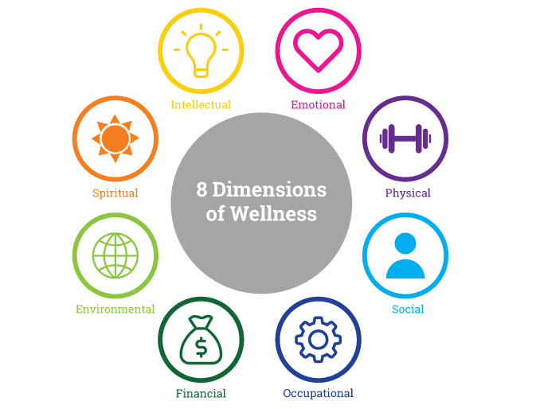
One version of the dimensions of support
www.tudsu.tv

Slide 101



Step 4: Support network
Identify Support
Increase Positive Support
Decrease Unhelpful Support
Communication
Aim is to identify the different types of support that exist, which can come from many sources: individuals, groups, agencies, activities that provide support.
Support the family member to identify the behaviours that they find supportive
Improve positive support and identify new sources of support
Aims to improve support within the family and have an agreed approach when communicating with the relative
Facilitate family member to identify negative support
Once identified, help family member decrease negative support

Slide 102
Step 4 Competencies
Beginning session – a number of tasks to cover: warm welcome, set a clear and structured agenda for the session, communicate this to the FM and ensure that this agenda is followed throughout the session. Check if previous session helpful. Give purpose of Step 4 and relate it to the Stress-Strain-Coping-Support Model
Discussion of who/what/why is helpful and unhelpful in terms of support, utilising a network diagram - to include people, activities, other agencies/groups, and what the FM does to support themselves; and the different types of support each might provide. As necessary, use answers to FMQ to guide the session.
Explore how to develop/continue to develop positive support.
Explore potential new sources of support (could be linked to those named in the network diagram or filling in gaps in support revealed by the diagram).
Discuss how family members can support each other and agree on approaches when communicating with the using relative.
Ending session – a number of tasks to cover: summarise the main FM issues, use of handbook. Check if session was helpful. Give purpose of next session on Step 5. Practical issues of contact and date of next session.
Remember the core counselling competencies, self-help handbook, structure, & time management.

Slide 103
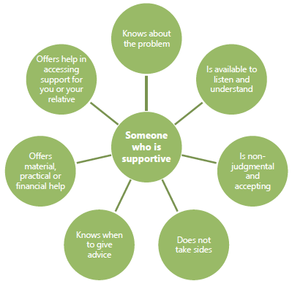
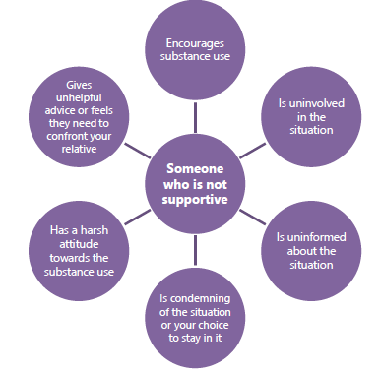
An Example of Someone who is supportive
An Example of Someone who is not supportive

Slide 104
Family members – what do they say can be supportive?
Joining social groups
Meeting friends who listen, are fun
Walking
Reading
Al Anon
Gather info from other AFMs
Exercise

Slide 105
Step 4: Support Diagram - 1
Julia
Mum
+
Sister and Brother-in law
+/-
Running partner
+/-
Walking and Yoga
GP
+/-
Manager at work
Daughter & Son
+
Trainers will now demonstrate an example of drawing a social support network diagram
Network diagram is a key technique to help a discussion about support

Slide 106
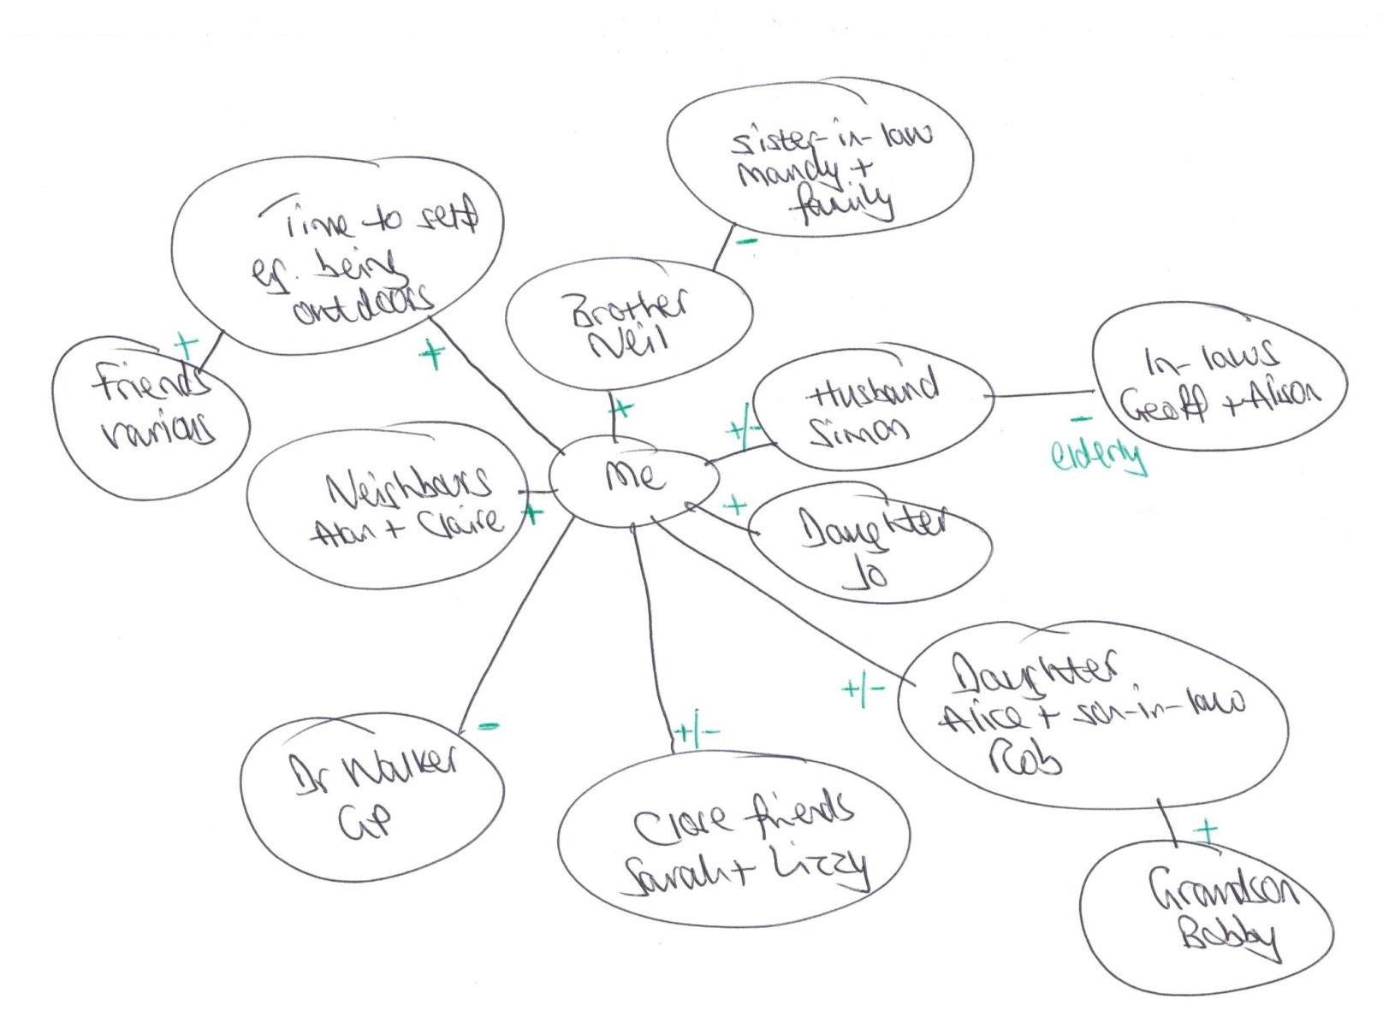
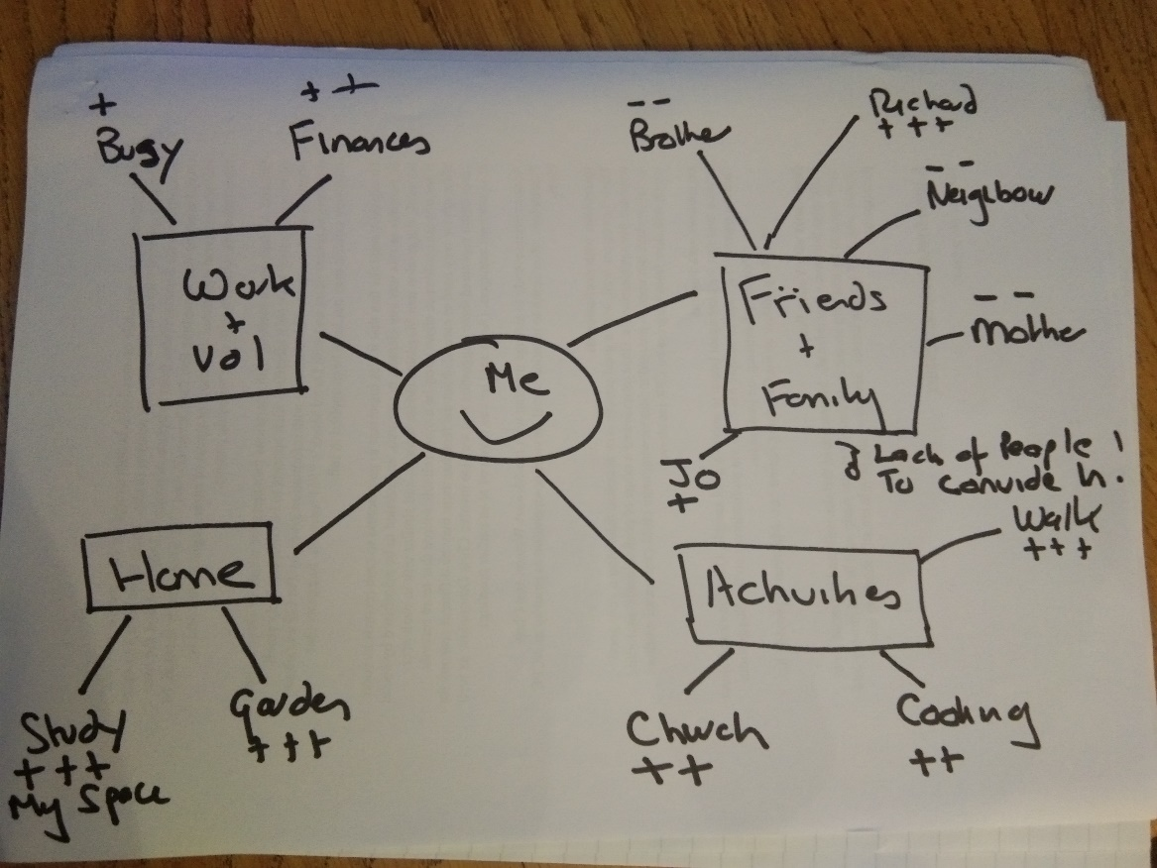
Step 4: Support Diagram 2

Slide 107
Self Help Handbook Step 4 – Getting Help from Other People
How you currently respond to a recent situation and how you feel about this
Thinking about what to do to increase your support
 | Exercise 7: Part 2 Refer back to Exercise 7: Part 1, and use this table to think about what you find helpful & unhelpful about everything that you added to your support network. Think also about what you could do to increase the positive support that you have and decrease the negative support that you have.
Thinking about my social network
Person, activity, organisation |  | What they do | What I find helpful or unhelpful | Increasing positive support and/or decreasing negative support
 | Exercise 8 This exercise will help you to summarise what you have learned about the support that you have around you, and what you are going to take forward to improve your positive support and/or decrease your negative support.
1 | What have I learned about the support that I have around me to help me with my relative?
2 | What are my thoughts on the positive support that I have? Am I happy with this, or are there things that I am going to do to improve this? If so, what am I going to do?
3 | What are my thoughts on the negative support that I have? If there are things that I want to do to change this, then what am I going to do? And what will I do first.

Slide 108
Step 4: Support/Agreed Communication in the family
Video Demonstration
4.5 – Discuss how family members can reach an agreed approach when communicating with the using relative.
What skills do you see?
What could have been improved?
NB. This is NOT about the same communication but AGREED communication

Slide 109
Step 4: Skills Practice
Get into Groups of 3 & agree roles: Family Member, 5-Step Practitioner, Observer
Practice Step 4, draw the social support diagram of the family member, encouraging the person to think beyond the immediate circle outlined in the case scenario. Use whatever techniques you’re familiar with to guide the exercise, e.g. arrows, thickness of lines.
Observer should use the assessment sheet as a tool for feedback. Practice: 8-10 minutes; then 3-5 minutes for feedback for observer
Feedback in larger group – any questions/concerns?

Slide 110
Step 4: DVD Skills Practice Assessment
Watch the DVD clip and use copy of the assessment sheet to assess Jan’s
delivery of Step 4.
Only assess against 4.2, 4.3
Trainer remind of setting the agenda, see p36 P handbook
Group discussion on skills used by Jan in Step 4
See Sheet:
Common Problems/Feedback Statements
Network diagram not covering all aspects of support/ Not covering communication within the family

Slide 111
Step 5: DVD Skills Practice Assessment
Watch DVD clip from all 4 DVD cases
Trainer remind of setting the agenda, see p43 P handbook
Group discussion on skills used by Richard and Jan in Step 5
See p50 in Handbook
See Sheet 9
Common Problems/Feedback Statements
Asking AFM to review and using summarizing skills/Other FMs needs/ Being encouraging over changes to date/
Ensuring all criteria have been covered

Slide 112
Step 4 – Master Scoring
Criteria | Master Score
Beginning of session - warm welcome, set a clear and structured agenda for the session, communicate this to the FM and ensure that this agenda is followed throughout the session. Check if previous session helpful. Give purpose of Step 4 and relate it to the Stress-Strain-Coping-Support Model. | N/A
Discussion of who/what/why is helpful and unhelpful in terms of social support utilising a network diagram - to include people, activities, other agencies/ groups. Utilise results of FMQ to guide the session. | 4.5
Explore how to develop/continue to develop positive social support. | 4.0 – 4.5
Explore potential new sources of support (could be linked to those named in the network diagram or filling in gaps in social support). | N/A
Discuss how family members can support each other and agree on approaches when communicating with the using relative | N/A

Slide 113
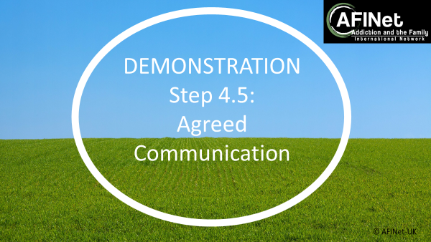
Step 4: Feedback & 5SM Website
Group feedback
See 5SM Website:
Video Presentation of this Step
Video Expert Panel Discussion
Demonstration doing a Network Diagram Online
Demonstrations 4.5- Agreed Communication
Guidance
Common Problems

Slide 114
Section 10
Step 5
Review previous steps and explore further needs

Slide 115

Step 5: Review & further needs
3 key areas to cover:
Review Steps 1-4 in turn.
Explore further needs of the family member, & key others.
Repeat the FMQ, calculate scores & discuss change with the family member.
Family Member “ This has been so helpful, I now feel that I have options on how I cope. I will always worry about my son, but I feel less stressed about it and sleep better. It’s been quite a journey. Thank you so much”
Practitioner “ It is very satisfying to hear what has changed for the family member; and us both realising in redoing the FMQ that they are so much less stressed and are taking action to gain more support”
Remember that the practitioner is in control of the process but the family member is in charge of the content

Slide 116
Step 5 Competencies
Beginning session – a number of tasks to cover: warm welcome, check if previous session helpful, give purpose of Step 5 and link to the SSCS Model, set a clear and structured agenda for the session, communicate this to the FM, and ensure that this agenda is followed throughout the session.
Review Steps 1-4 to explore what FM has found helpful about the sessions and what changes FM has made. FM to summarise key issues and progress to date, with Practitioner adding detail where appropriate.
Discuss FMs need for further help and how this can be actioned.
Discuss help needs of other FMs/key people, and of the using relative, and how these can be actioned.
After this review has been completed, redo FMQ and compare with FMQ from 1st session to identify and reinforce changes.
Ending session – a number of tasks to cover: summarise the main FM issues; check if session was helpful; remind to use handbook; agree post-5-Step work. If possible, inform that will contact in about six weeks to check how they are.
Remember the core counselling competencies, self-help handbook, structure, & time management.

Slide 117
Self Help Handbook Step 5 –
Getting Further Help
Thinking through what other help you and your family need
What have I gained from reading the handbook?
What have I gained from reading the handbook? It can be helpful to look back over the work that you’ve done for Steps 1-4 and think about what, hopefully, has been helpful and changed for the better, as well as where there has been less change for the better. It may be helpful to use the following table to help you review that work that you’ve done.
 | What has been helpful? | What has changed for the better? | What has not changed or been unhelpful?
Step 1 Your Story
Step 2 Information
Step 3 Coping
Step 4 Support
 | Exercise 9 This exercise will help you think about whether you or anyone else needs any further help. You could look back over previous exercises and the FMQ and see if there are any issues that you still feel you need help with, and what you can do about this.
1 | What further help or needs do I have? What can I do to access further help or meet the additional needs that I have?
2 | Does my relative want any help or have any further needs in addition to any help that they may already be getting? What can I do to help this?
3 | Are there key others who want help or have any further needs in addition to any help that they may already be getting? What can I do to help this?

Slide 118
Step 5: Feedback & 5SM Website
Group feedback.
See 5SM Website:
Video Presentation of this Step
Video Expert Panel Discussion
Guidance
Common Problems

Slide 119
Section 11
Accreditation
Practice Issues
Group Work

Slide 120
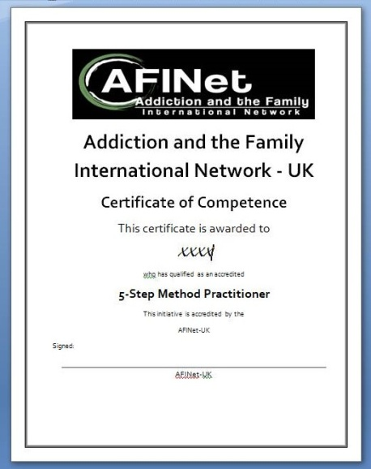
Practitioner Accreditation Process
Complete training & then practice delivering the 5-Step Method
to improve confidence before recording.
Submit audio /video recordings or transcripts of sessions covering all 5 Steps ALONGSIDE a completed self-assessment of each Step, and of the Counselling Skills used, (using the competency framework) with a detailed & evidenced assessment of their practice.
Accredited Assessor assesses both delivery of the 5-Step Method and Counselling Skills, using the same competency framework, & detailed feedback is provided.
Practitioners either pass or have to address an action plan & may be required to undertake, audio-record, and self-assess, another delivery of some or all Steps.
Accredited practitioners can then become accredited trainers and assessors.

Slide 121


Accreditation: Key Tips
5 Recorded Steps
Self Assessment
Prepare & practice
Use the Competency Checklist
Good enough recorder; sound levels; quality levels/set zoom up
Record yourself practicing each of the 5 Steps
Read the guidance tips and common problems sheet
Gain feedback on Step 1 before proceeding to Step 2
Steps can be with different family
Timekeeping and clock
Listen back to your tapes as you go
Critically assess yourself, and get constructive feedback from friends/ peers
You MUST self-assess and optionally peer-assess before submitting - remember evidence and improvements on Competency Assessment Sheet
People dramatically improve
Accreditation Pass: 65% and over AND mainly scores of 3.5 or above.
Practitioners find the feedback and action plan really useful and it really helps to improve practice.
Guidance: See Handouts, on AFINet website

Slide 122

Submission for Accreditation
Submit Step 1 within 2 mths of training.
Feedback given within 10 working days.
Try to submit a Step per month.

Slide 123
Practice issues: Considering safe practice
P 50 – 56 of P handbook
  Domestic abuse, child protection/safeguarding issues & mental health problems
  ASK ABOUT RISK EVERY TIME
Family member safety
  Joint work between family member & relative, or with family units
  Practitioner safety
  Extreme distress/bereavement
  Practitioner Safety
  Information Governance

Slide 124



Practice issues: General Considerations
Organisational Policies
Making links
Supervision
Accreditation
Consider your own organisational policies and procedures when practicing 5-Step Method
Making links with each other and also making links with other local partners
Supervision for practitioners is important
5 recorded Steps to become accredited as a 5-Step Method practitioner

Slide 125
5-Step Method with Groups: Tips & Key Points
Are you good at running groups? Different to being a practitioner! Easier if 2 of you.
Structure even more important.
Ensuring everyone feels comfortable/cultural responsiveness and diversity.
Skills of ensuring equal time/moving on/dealing with difficulties.
Organise/prepare well for each session.
Ground rules.
Some individuals may want 1-1 time - important to manage requests.
The use of a guided relaxation exercise to close the group is useful.

Slide 126
Group Work: Tips on Managing Time
Difficult to achieve Step 1 in a group so think how you are going to manage this
Try to get a lot of the work done in pairs or smaller discussion groups
Use of a flip chart/post its helpful
Stay in control, i.e. don't let the conversation slip into an open sharing group – you are there to facilitate a structured programme of work

Slide 127
5SM Website
See 5SM Website:
Video Presentation of this Section
Video Expert Panel Discussion
Guidance

Slide 128
Review and Evaluation
Q & A
How confident do you feel?
What is your action plan for 5-Step Method?
Evaluation Form 10

Slide 129
THANK YOU!

Slide 130
Lunch Break
Please be back in 45 minutes
Notes:
© Copyright Showeet.com

Slide 131
Coffee Break
Let’s meet back in
15 mins
Notes:
© Copyright Showeet.com

Slide 132
End of Day 1
Flip 1: what you liked/enjoyed
Flip 2: Possible improvements/changes to Day 1

