Slide 1

5-Step Method: Outcomes from Implementation into Routine Practice
Richard Velleman
Sangath | University of Bath | AFINet
2023 AFINet Conference
Rotterdam

Slide 2
Overview
Anonymised amalgamated data from 16 agencies or organisations across 8 countries.
What we did and how we measured it.
Results presented in 4 parts – how AFMs were before starting, before-after comparisons, country- specific changes and demographic variables.
Future analysis plans.
Discussion.
Conclusion – which I will start with! (in case I run out of time!)

Slide 3
Conclusion
AFM
Feedback
Research studies
Practitioner
Feedback
Plus this routine data collection = Powerful evidence
Data collected over more than 20 years
Show NOT a panacea
But these results (on top of feedback from both practitioners and AFMs , plus previous research studies) provide powerful evidence that it works – it helps practitioners and especially helps AFMS

Slide 4
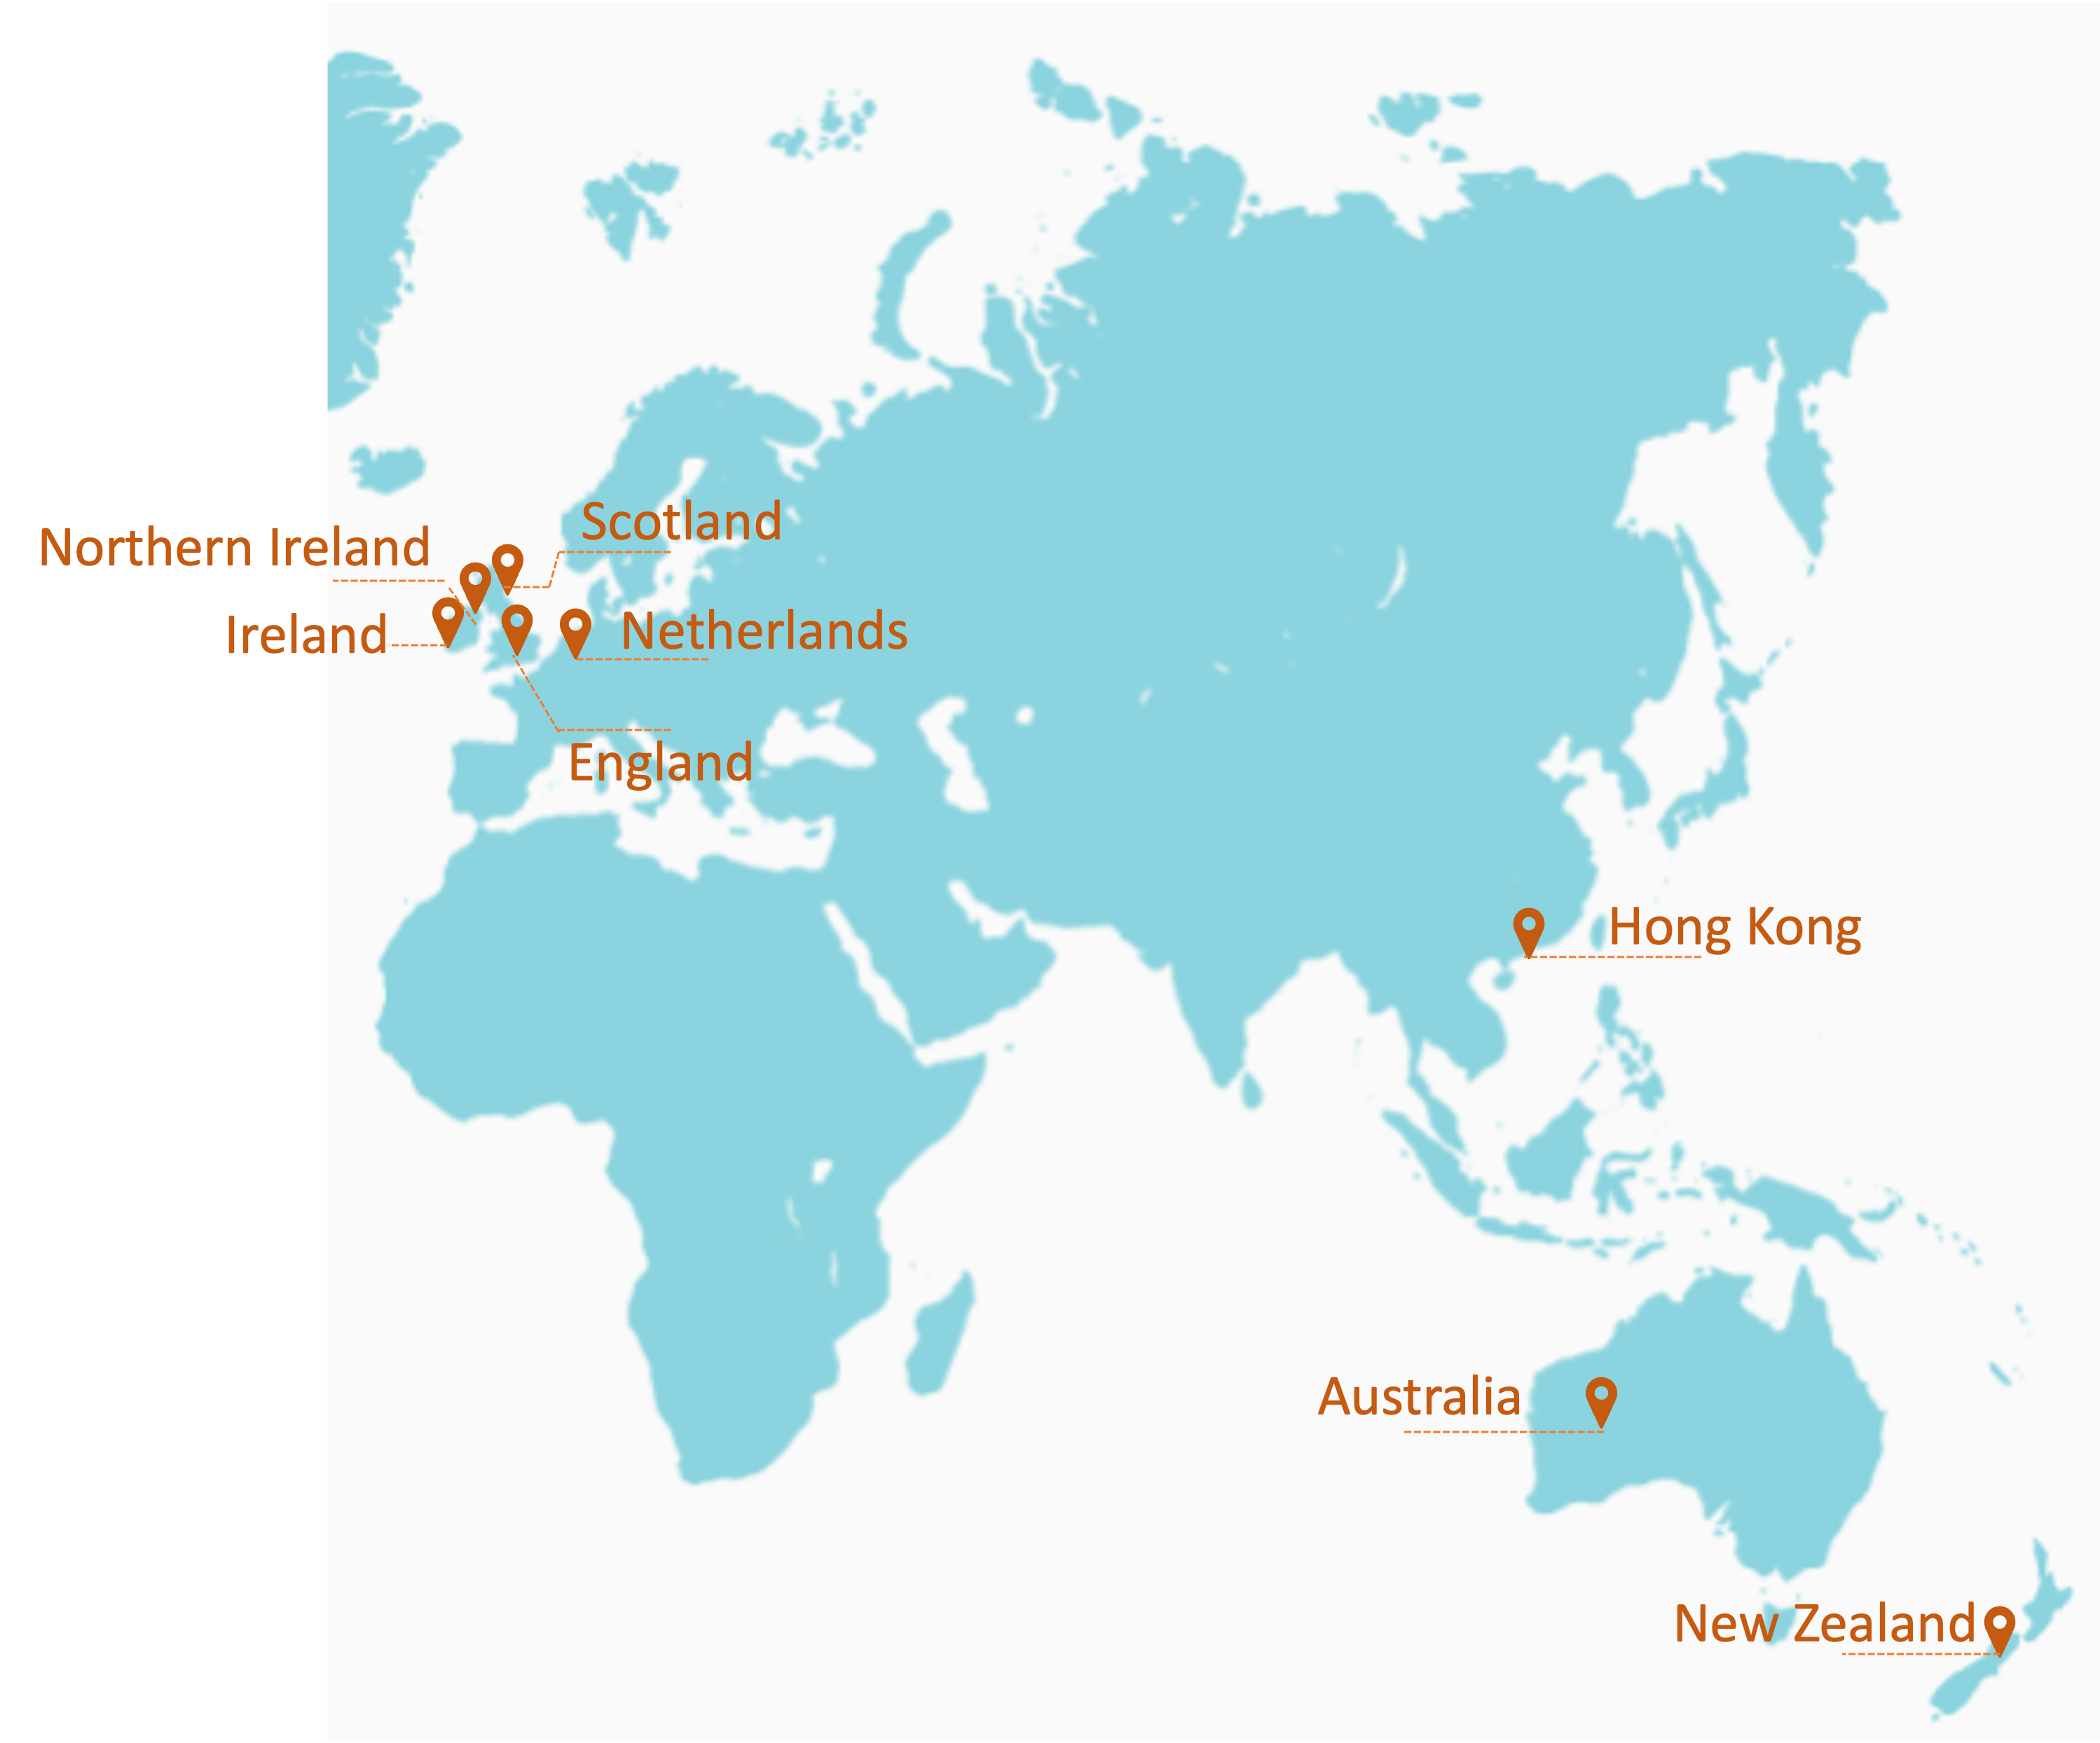
Data sources
No. of countries = 8
No. of agencies = 16
Pre-5-Step Method questionnaires = 1,422
Post-5-Step Method questionnaires = 870

Slide 5
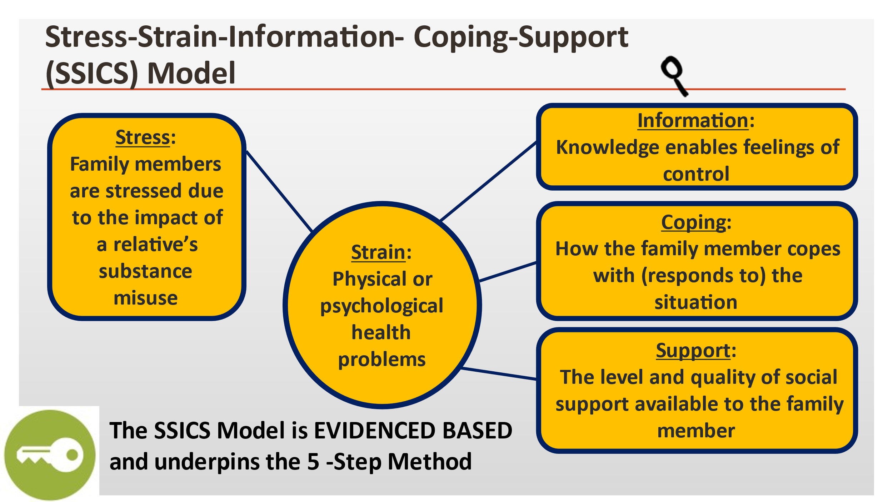
What we do and how we measure it
2 sub-scales
3 Q on each sub-scale
Total 6 Qs
4 sub-scales
3 Q each sub-
scale
Total 12 Qs
2 sub-scales
3 Q each sub-scale
Total 6 Qs
3 sub-scales
3 Q each sub-scale
Total 9 Qs
Total Family Burden is made up from some of the scales and subscales

Slide 6
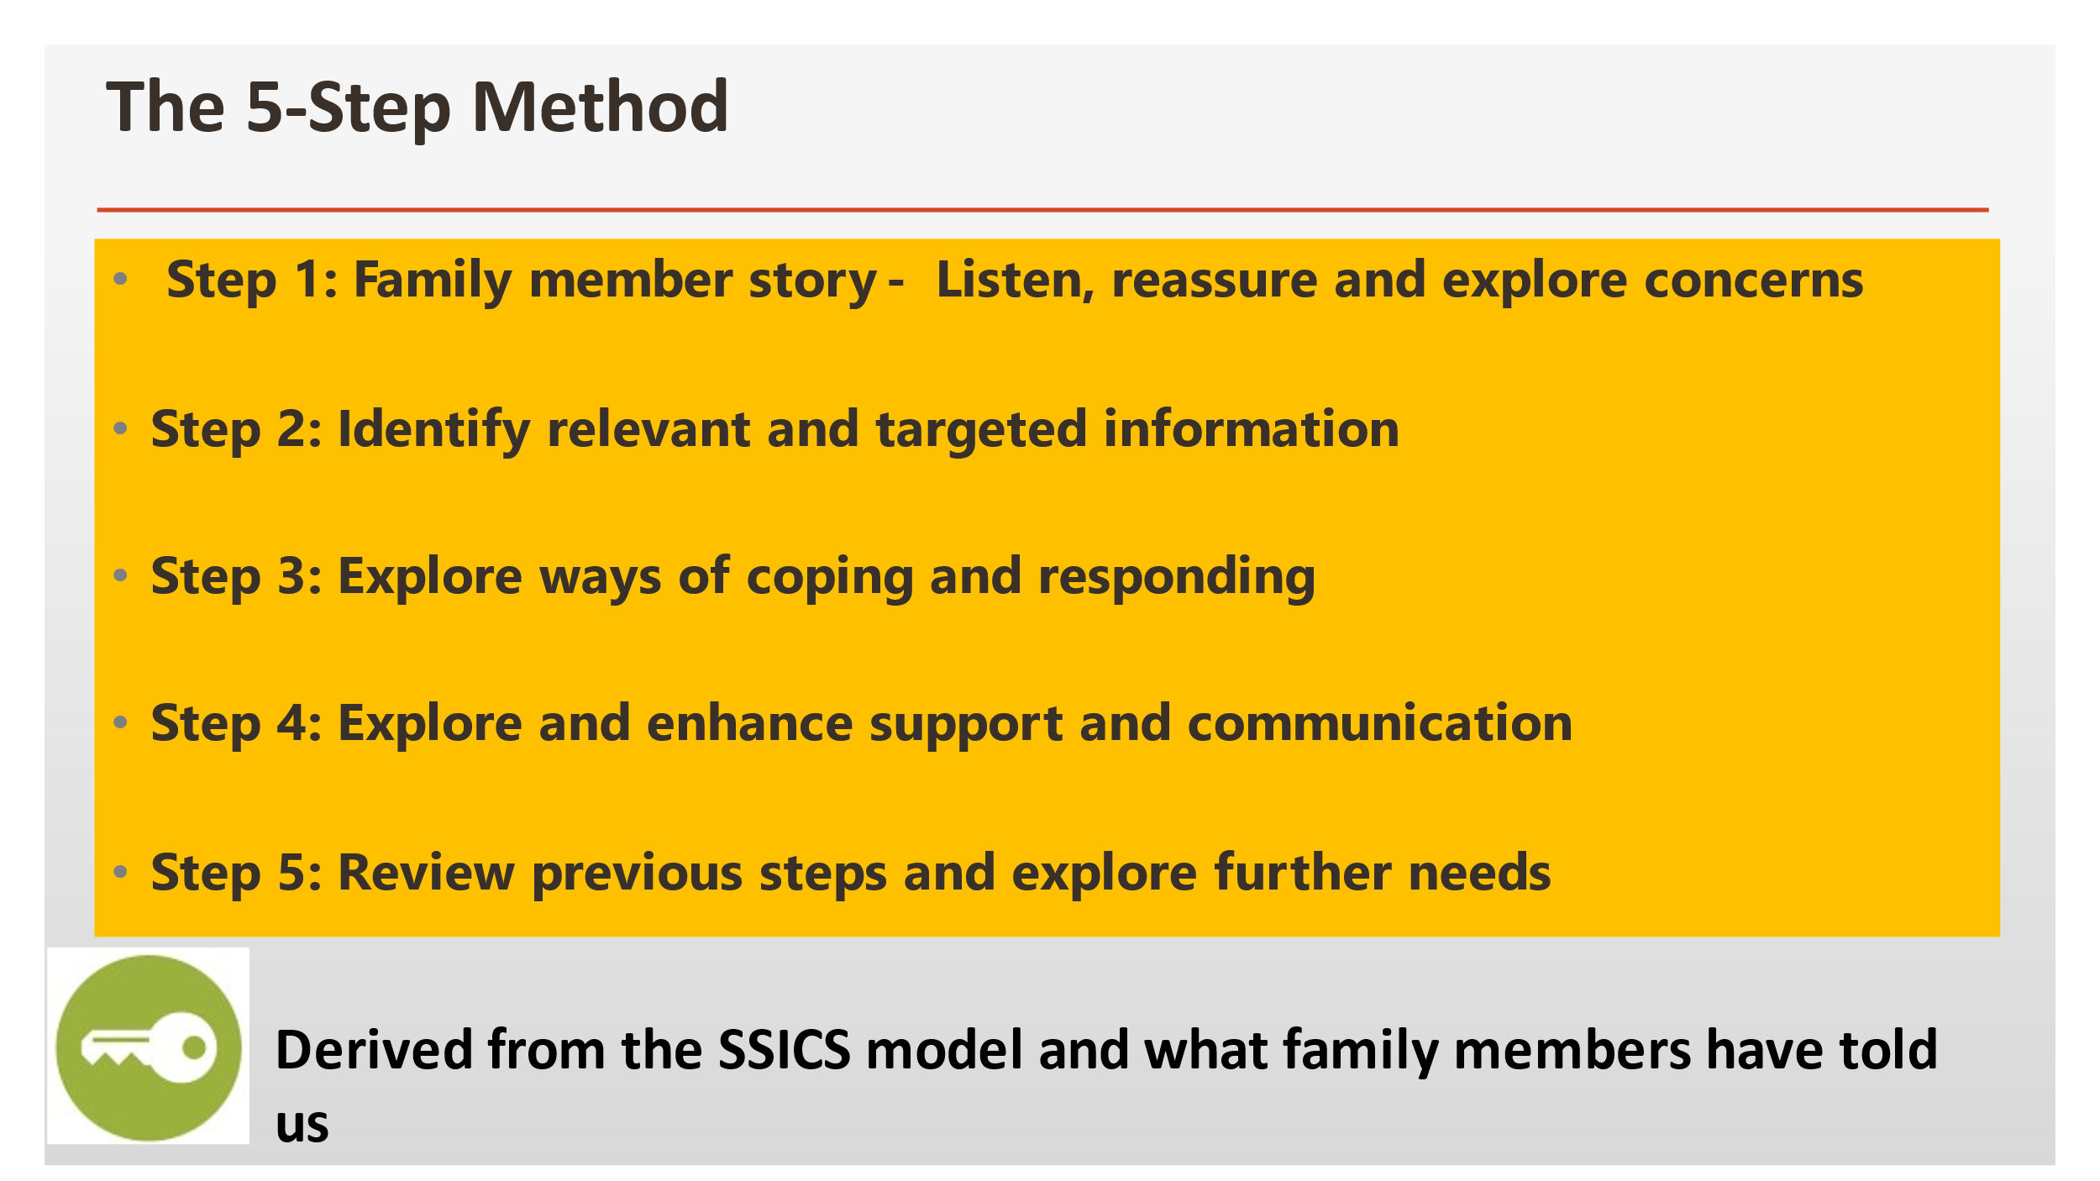
What we do and how we measure it

Slide 7
What we do and how we measure it
Worrying behaviour subscale: 3 questions
e.g., Are you worried that your relative has neglected his/her
appearance or self-care?
1. Stress
Active disturbance subscale: 3 questions
e.g., Has your relative upset family occasions?

Slide 8
What we do and how we measure it
Physical symptoms subscale: 3 questions
e.g., Awakening early and not being able to fall asleep again?
2. Strain
Psychological symptoms subscale: 3 questions
e.g., Worrying?

Slide 9
What we do and how we measure it
Emotionally Engaged Coping subscale: 3 questions
e.g., Started an argument with him/her about his/her drinking/drug
use gambling?
3. Coping
Assertively Engaged Coping subscale: 3 questions
e.g., Made clear to him/her your expectations of what he/she
should do to contribute to the family?
Tolerant-Inactive Coping subscale: 3 questions
e.g., Made excuses for him/her, covered up for him/her?
Withdrawal-Independent Coping subscale: 3 questions
e.g., Sometimes put yourself first by looking after yourself or giving
yourself treats?

Slide 10
What we do and how we measure it
Helpful Informal Support subscale: 3 questions
e.g., Friends/relations have talked to me about my relative and
listened to what I have to say?
4. Support
Helpful Formal Support subscale: 3 questions
e.g., Health/social care workers (including my 5-Step Method practitioner) have made themselves available for me?
Helpful Informal Support subscale: 3 questions
e.g., Friends/relations have said things about my relative that I
do NOT agree with.

Slide 11
What we do and how we measure it
All 6 stress questions
All 6 strain questions
TOTAL
FAMILY
BURDEN
All 3 questions on
Tolerant-inactive coping
All 3 questions on
Emotionally engaged coping

Slide 12
Results
Part 1
 | This sample of 1,422 Family members N = 1,397-1,422 Mean (sd) | Family members attending substance misuse services N = 202–212i Mean (sd) | Family members attending the gambling clinic N = 209–215 Mean (sd)
Worrying Behaviour Impact | 5.62 (2.43) | 5.73 (2.58) | 5.80 (2.40)
Active Disturbance Impact | 3.87 (2.67) | 3.92 (2.71) | 3.16 (2.30)
Total Impact | 9.50 (4.34) | 9.72 (4.67) | 8.96 (3.99)
Psychological Symptoms | 5.16 (1.58) | 4.61 (1.36) | 4.77 (1.33)
Physical Symptoms | 3.85 (2.07) | 3.31 (1.66) | 3.33 (1.88)
Total Symptoms | 9.02 (3.32) | 7.93 (2.71) | 8.09 (2.88)
Emotional-Engaged Coping | 5.65 (2.50) | 6.29 (2.17) | 6.00 (2.51)
Assertive-Engaged Coping | 5.59 (2.78) | 6.30 (2.41) | 6.18 (2.56)
Tolerant-Inactive Coping | 3.61 (2.63) | 4.36 (2.50)* | 3.46 (2.68)
Withdrawal-Independent Coping | 4.21 (2.64) | 3.60 (2.48) | 3.31 (2.41)
Helpful Informal Support | 6.02 (2.79) | Not available | 5.90 (2.67)
Unhelpful Informal Support | 2.48 (2.52) | Not available | 2.26 (2.30)
Helpful Formal Support | 3.11 (2.97) | Not available | 1.36 (2.19)
Total Family Burden | 27.79 (9.64) | 27.72 (10.28) | 26.52 (9.43)

Slide 13
Results – Part 1 continued
 | This sample of 1,422 Family members N = 1,397-1,422 Mean (sd) | Family members attending substance misuse services N = 202–212i Mean (sd) | Family members attending the gambling clinic N = 209–215 Mean (sd)
Total Impact | 9.50 (4.34) | 9.72 (4.67) | 8.96 (3.99)
Total Symptoms | 9.02 (3.32) | 7.93 (2.71) | 8.09 (2.88)
Emotional-Engaged Coping | 5.65 (2.50) | 6.29 (2.17) | 6.00 (2.51)
Helpful Formal Support | 3.11 (2.97) | Not available | 1.36 (2.19)
Total Family Burden | 27.79 (9.64) | 27.72 (10.28) | 26.52 (9.43)

Slide 14
Results
Part 2
 | At start of their 5SM: Mean (sd) | At end of their 5SM: Mean (sd) | t-test N=870-769 | Statistical significance
Worrying Behaviour Impact | 5.52 (2.44) | 3.80 (2.54) | 19.881 | .000
Active Disturbance Impact | 3.79 (2.69) | 2.29 (2.13) | 17.762 | .000
Total Impact | 9.31 (4.39) | 6.09 (4.09) | 22.492 | .000
Psychological Symptoms | 5.19 (1.51) | 3.73 (1.87) | 24.039 | .000
Physical Symptoms | 3.88 (2.01) | 2.67 (1.91) | 17.358 | .000
Total Symptoms | 9.07 (3.21) | 6.40 (3.37) | 23.854 | .000
Emotional-Engaged Coping | 5.56 (2.48) | 3.47 (2.43) | 24.162 | .000
Assertive-Engaged Coping | 5.44 (2.80) | 4.20 (2.81) | 12.645 | .000
Tolerant-Inactive Coping | 3.52 (2.59) | 1.89 (2.06) | 18.291 | .000
Withdrawal-Independent Coping | 4.37 (2.64) | 5.42 (2.56) | -11.487 | .000
Helpful Informal Support | 6.04 (2.81) | 6.30 (2.59) | -2.866 | .004
Unhelpful Informal Support | 2.42 (2.50) | 1.93 (2.33) | 5.797 | .000
Helpful Formal Support | 3.24 (2.95) | 6.28 (3.03) | -24.705 | .000
Total Family Burden | 27.47 (9.45) | 17.89 (9.34) | 28.572 | .000

Slide 15
Results – Part 2
 | At start of their 5SM: Mean (sd) | At end of their 5SM: Mean (sd) | t-test N=870-769 | Statistical significance
Total Impact | 9.31 (4.39) | 6.09 (4.09) | 22.492 | <0.0005
Total Symptoms | 9.07 (3.21) | 6.40 (3.37) | 23.854 | <0.0005
Total Family Burden | 27.47 (9.45) | 17.89 (9.34) | 28.572 | <0.0005

Slide 16
Another way to look at the results – ‘Change Scores’; and the biggest ‘before-after’ changes are:
% Mean (sd)
Overall Impact (Stress)
- 35%
- 3.22 (4.22)
Psychological Symptoms
and Total Symptoms (Strain)
- 29%
-2.67 (3.28)
Engaged-Emotional Coping
- 94%
-2.09 (2.54)
Formal Helpful Support
- 38%
3.03 (3.59)
Total Family Burden
- 35%
-5.95 (9.80)

Slide 17
Results – Part 3
Are there country-specific differences?
Almost NO country differences
[Australia - only 1 ‘before-after’ FMQ]
[Hong Kong – 8 ‘before-after’ FMQ]
Therefore, results for only 6 countries
t-test results comparing ‘before’ with ‘after’ for all of the scales and sub-scales, in each of the 6 countries are all highly statistically significant – all at a probability of p<0.0005 – which means that these are very strong results.

Slide 18
Results – Part 3
Country-specific differences
N. Ireland – Only 31 matched FMQs. Had less strongly statistically
significant results for improvements in
Active Disturbance , Physical Symptoms, Assertively-Engaged Coping.
2) Scotland - Only 36 matched FMQs. Had less strongly statistically significant
results for improvements in Withdrawal Coping.
3) Netherlands – much larger N (189) but still had less strongly statistically significant results for
improvements in physical symptoms.
Only other difference: when one separates all of these samples, the overall numbers in each sample are obviously a lot lower, and one set of results (changes in Informal Helpful Support ) generally stop being statistically significant.
The ONLY country where the changes in Informal Helpful Support were statistically significant was New Zealand.

Slide 19




Results – Part 4
Demographic variables
Affected family member
Relative with the problem
AFM relationship with relative
81%
73%
33%
male
female
Mother
51 years
27%
22.5%
Average age
Wife
female
35 years
8.7%
Average age
Father
8.5%
Son
6.8%
Husband
9.4 years
average approx. time that the AFM had been living with the problem

Slide 20


Results – Part 4
Demographic variables: Ethnicity
England, Scotland, Northern Ireland
Republic of Ireland & Netherlands
Australia
New Zealand
Predominantly white
Predominantly white
6% Aboriginal or
Torres Straights Islanders
[3.8% in General Population]
17% from Te Pou and
15% from FDS
are Maori
[17.2% in general population]
Notes:
Holland – 94% Dutch Netherlands vs 77% in general population.
England - TP – 3% non-White; Leeds – 7% non-White vs England – 18% non-White
Scotland - DWAW – 3% non-White; vs 4.5% in generalpopulation
NI – 100% White vs 3.4% BMEG
Ireland – NFSN – 100% White; C&F – 89% White vs 85.7% in general population

Slide 21




Discussion
We need to do the following:
RCT
(planning in progress)
Work in LMICs
Further analysis
(for demographic
differences)
Compare with data from research trials
(Data gathered through routine practice
v/s
Data gathered by research worker in trial)

Slide 22
Conclusion
AFM
Feedback
Research studies
Practitioner
Feedback
Plus this routine data collection = Powerful evidence
Data collected over more than 20 years
Show NOT a panacea
But these results (on top of feedback from both practitioners and AFMs , plus previous research studies) provide powerful evidence that it works – it helps practitioners and especially helps AFMS

Slide 23
Thank you!
r.d.b.velleman@bath.ac.uk

