Slide 1

Beyond the Symptom:
Families of Adults
with Eating Disorders
in an
Addiction Treatment Setting
by Sylvie Koutsouki, Greece

Slide 2
Where this experience comes from
Our clinical setting
Family Department
Public addiction Treatment service
Psychiatric hospital
Greece
Substance use
Gambling
internet
eating disorder
What can an addiction- informed family approach can offer to this population?

Slide 3

Lens 1
from family resource
to affected family members
Stress strain Coping support
Ambiguous loss

Slide 4

Lens 2
from fixing
to understanding change as a process
stages of change
Motivation vs Resistance
Relapse vs failure
Motivation belongs to the adult child
Parents can support motivation.
They cannot own it
Marathon, not a sprint

Slide 5
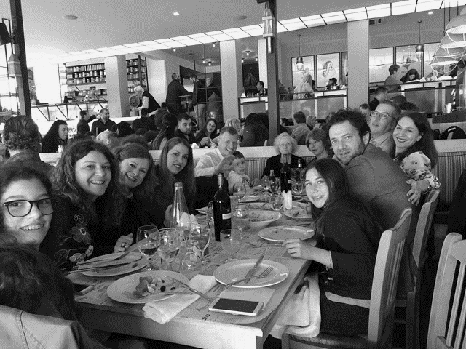

Lens 3
from control to autonomy
Functional analysis
Communication
boundaries
differentiation

Slide 6

Lens 4
Beyond the behaviour
biopsychosocial
Relational
emotional

Slide 7

Lens 5
From past to present
the here and now

Slide 8

What did this mean for the parent?
From guilt → understanding
from monitoring → awareness
From responsibility for the illness → responsibility for one’s own response
From rescuing → supporting
From control → boundaries

Slide 9

What we learned
Limitations
Addiction-informed way of working with family members of adults with eating disorders needs adaptation

Slide 10

Beyond the symptom
When we cannot change the symptom,
we can still change what happens around it

Slide 11

thank you for you attention!

