Slide 1

The burden of blame:
How forgiveness and self- compassion may lead the way to healing
for the family with addiction
by Stavroula Koutsouki, Greece

Slide 2

Working with family members facing addiction
Coping with Addiction's Challenges
The Burden: Objective and Subjective
Overwhelm and Disconnection
Trapped in Blame and Resentment
mixed feelings
Self-Criticism
Stigma's Impact: Shame
The "Not Good Enough" Belief

Slide 3

Shame
Perceived lack of power to meet the standards of one’s ideal self
Sabotage of motivation
Past traumas

Slide 4

The path to recovery
psychoeducation
Self- compassion
self- care
self- forgiveness
Social support
Compassion sent to others, received from others, sent and received from self to self (Gilbert, 2017)

Slide 5

"If you don’t love yourself, you cannot love others.
You will not be able to love others.
If you have no compassion for yourself then you are not able of developing compassion for others.”
-Dalai Lama

Slide 6

self- compassion :
cultivating self- acceptance (Neff, 2003)
By understanding their own emotions and limitations, they can approach the adversity with perspective
self-kindness
common humanity
mindfulness
the ability to show oneself care and understanding during instances of stress, pain or failure
recognizing oneself as part of the universal human experience
the capacity to recognize and observe difficult cognitions and emotions with the awareness that these can shift in balanced awareness
versus
versus
rumination, blaming, self-condemnation and self-criticism
versus
perfection and isolation
autopilot and over- identification

Slide 7

To illustrate…
"The Effectiveness of Self-Compassion Training to Increase the Resilience of Wives Who Have
Drug-Addicted Husbands in the District Area of Aur Medan Maimun” Untario et al, 2020.
"A pilot of a mindfulness based stress reduction intervention for female caregivers
of youth who are experiencing substance use disorders”, Smith et al.,2020
“investigating the effectiveness of compassion- based group therapy on the quality of life, self- esteem and mental health of
Spouses of substance- abusers”, Fard and Heiradi, 2022

Slide 8
Challenging misconceptions
"Peace cannot be kept by force. It can only achieved by understanding."
-Albert Einstein

Slide 9

It is about releasing anger and resentment, guilt and self- blame. It is a gradual and dynamic process.
self- forgiveness
It allows to focus on moving forward.

Slide 10





Fostering a supportive environment for all
Commitment to change
Adult parent-Adult child relationship
Self-care
Boundaries
Awareness

Slide 11
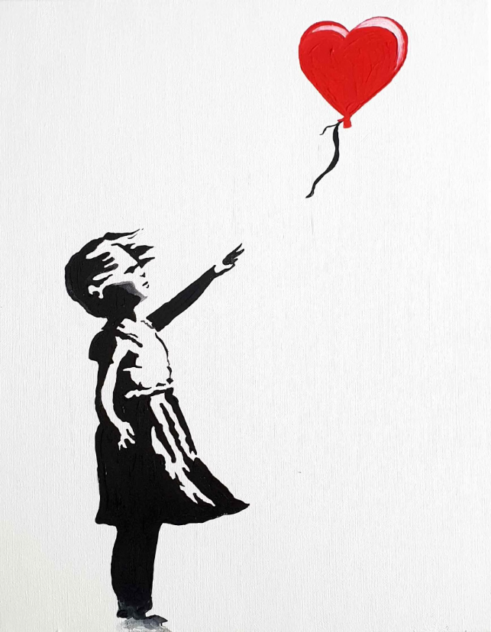
thank you for you attention!

