Slide 1





Exploring perspectives of parents/caregivers in the context of another parent’s substance use and co-producing a book to aid conversations about parental substance use with children: two linked studies
Simon Barrett and Debbie Smart

Slide 2



Background
Parental substance use is a prevalent and substantial public health concern
Impacts upon parent, child and wider family
Most interventions aim to reduce the substance use
Around 500,000 children in England live with a parent or caregiver with has an alcohol or drug dependency
Established evidence for the impact upon affected family members, with dependent aged children being particularly vulnerable
Reducing parental substance misuse is an important means of preventing impact upon families, but many parents don’t access treatment

Slide 3
Developing interventions for substance exposed families: the tale of two projects
Spring
Safe Space
SAFEguarding children in Substance exPosed fAmilies by supporting the non-using CaregivEr
3 focus groups & 7 interviews with practitioners; 19 interviews with affected parents; 5 interviews with children; 2 x co-production workshops
Study exploring Parental substance use and Resilience IN younG people (Cassey Muir, PhD)
Systematic review, 21 interviews with young people; interviews and focus groups with 44 practitioners; prioritisation workshops (13 young people & 94 practitioners)
Notes:
Today I will focus on Safe Space, and in particular the interviews with affected parents, and later Debbie will discuss how the parallel studies were brought together in the development of a book

Slide 4
Participants
Parents
Grandparents
Other caregivers
8 mothers; 2 fathers
4 Grandmothers
1 Sibling, 2 aunts, 1 uncle and 1 other arrangement
Notes:
Recruited from NE England, both urban and rural areas
Caregivers were 16 female and 3 male; aged 25to 65+; children were aged 4 to 17
Alcohol use in 9 families; other drug use in 10; poly substance in 7 families
Some still in contact with parent who uses substances, some separated and no longer in contact

Slide 5
Themes
Challenges when caregiving in the context of a family member's substance use
Interactions with support services
Talking to children about a parent's substance use

Slide 6
Challenges when caregiving in the context of a family member's substance use
It doesn’t seem like it is ever going to end, and I don’t feel like there is a way out of it. I must admit I have hit rock bottom a couple of times and tried to commit suicide. I won’t uproot my kids and take them into a women’s refuge …when you’ve got a family, you’ve got to try and hold it all together. You literally feel like there is no way out of that. Mother, partner uses substances.
I feel really guilty…I thought I was doing them a favor by staying, but I wasn’t. I was letting them witness more arguments. That’s the guilt I carry around. Father, former partner uses substances.
I didn’t plan at 61 years old to have a 4-year-old and an 8-year-old… my life’s changed totally. I felt like I was in the middle balancing all the plates. It was really, really hard because from [welfare service] visits I was left with, “Right, this is what you need to do with [your daughter], and this is what you need to do with the girls”. Grandparent, daughter uses substances.
Notes:
Violence, suicide ideation and attempts, disruption and chaos, relationship problems, cumulative stress
Compounded by additional pressure of keeping family together, caring for children, and caring for or doing right thing by parent who uses substances

Slide 7
I’m just really scared of, you know, having me been on antidepressants and being a single mum, and them going and saying that their dad’s on crack …me and the kids are still in the same place with no help from anyone, no one to talk to about it or anything because, you know, the minute you mention drugs or alcohol, they’re straightaway on your case
I’m here dealing with the kids, still dwelling on the past because I’ve got a lot of anger and hurt, and so have the kids, but he’s in a group meeting getting cheered … and it’s just like, “What about your kids? What about us? Where’s my fucking badge?” Mother, former partner uses substances
Interactions with support
services
If you're fostering, you have to go through all this training. If you're a kinship carer … you get handed your grandchildren who are traumatized. Grandparent, daughter uses substances
Eventually they did send somebody out … to see how things were. She brought the health visitor in as well. But then she closed the case down because she said that I was doing everything right. I wasn't letting [former partner] in. I was safeguarding the children. So, I kind of then felt I was in a worse position - because I was safeguarding nobody else would help me. Mother, former partner uses substances.
Notes:
Perception that services are focused upon person who uses substances; feeling of abandonment from welfare services
‘If you stay with that partner and you try to make it work the support is not there anymore’
Stigma and fear of judgement may mean reaching out for help is difficult

Slide 8
Because I have shielded him from it, there wasn’t a lot [for counsellors] to go on. I’ve kind of kept him in the dark really, I suppose, so they didn’t have a lot to work with. Mother, former partner uses substances.
Talking to children about a parent's substance use
The counsellor doesn’t want to poke it too much because he might have shut it off. So obviously, to try and encourage and help him deal with his feelings, but if he shut it off, she might actually do more damage. Caregivers to nephew, adult sibling uses substances.
I didn’t want to say all these things to them that she was drinking and taking drugs, but social services were adamant that they’ve got to know. I was just saying to them that her mental health is rubbish at the minute. But they [welfare services] wouldn’t have that, so they sat down and told the girls. I felt like they came, within five minutes they’d gone. It was like they chucked a hand grenade in and walked out. Grandparent, daughter uses substances.
I have always been truthful with them, but I haven't told them myself. Somebody else has, and then they would come home and ask me, and I would try and put it in a nice way. But it was hard and hurtful for them. Her social worker has been coming, and they're doing a life story with her… sometimes it's a help when somebody else comes in and talks as well. And you're not the one that's there all the time, for all the blame. Caregiver to niece, adult sibling uses substances.
Notes:
Almost all parents described worries about how and when to talk to children about parental substance use and how this was impacting the family
Dichotomy for some parents about disclosing too much information too soon, and making sure that children get the support that they need and are able to talk with counsellors
When professionals do support, it can be helpful, but it can also create further problems if not handled correctly

Slide 9
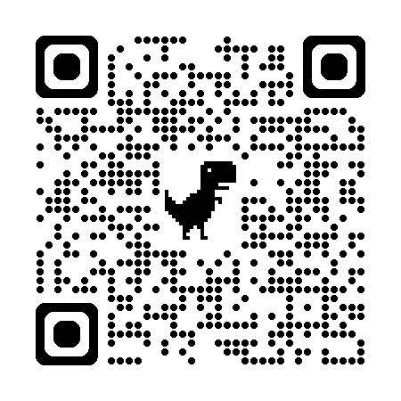
Main Findings
Violence, suicide ideation and attempts, disruption
Balancing needs of traumatized children, their responsibilities toward parent who uses substances, and their own stress
Perception that no support available
Coping alone for many years
Crisis points
Caregivers struggled with knowing when and how to raise issues with children
What to talk about and when?
Story work was appreciated by some caregivers
Hesitancy to seek support
Stigma and judgement
Victim-blaming’ practices, which focus upon the caregiver's ‘failure to protect’
Feeling abandoned by services, or that situation is made worse by their involvement
Notes:
being a caregiver of a dependent aged child could compound the harm that family members experience, and results in cumulative stress and strain. The responsibility of the caregiver to protect the child from direct and indirect exposure to a parent's substance use often aggravated much of their own experiences and could also impact upon their ability to access and benefit from support.
victim-blaming’ practices, which focus upon the caregiver's ‘failure to protect’
many caregivers often perceived there was no support available for them, with services focused upon providing individual treatment to the family member who uses substances. Where support was available, this had often come after coping alone for many years, or only when a crisis point had been reached.
Services need to be family centred where appropriate and trauma informed
Caregivers struggled with knowing when and how to raise the issue with children and often recounted problems arising from children learning this information from a third party or where the caregiver had felt forced to discuss the issue at a time or in a way with which they were not comfortable

Slide 10
Developing interventions for substance exposed families: the tale of two projects
Spring
Safe Space
Study exploring Parental substance use and Resilience IN younG people (Cassey Muir, PhD)
Systematic review, 21 interviews with young people; interviews and focus groups with 44 practitioners; prioritisation workshops (13 young people & 94 practitioners)
SAFEguarding children in Substance exPosed fAmilies by supporting the non-using CaregivEr
3 focus groups & 7 interviews with practitioners; 19 interviews with affected parents; 5 interviews with children; 2 x co-production workshops
Notes:
Today I will focus on Safe Space, and in particular the interviews with affected parents

Slide 11

Findings from the SPRing study …
It can be overwhelming,
with lots of
different
emotions
Knowing I’m not the only one really helps
I feel alone,
I feel different
No one understands

Slide 12
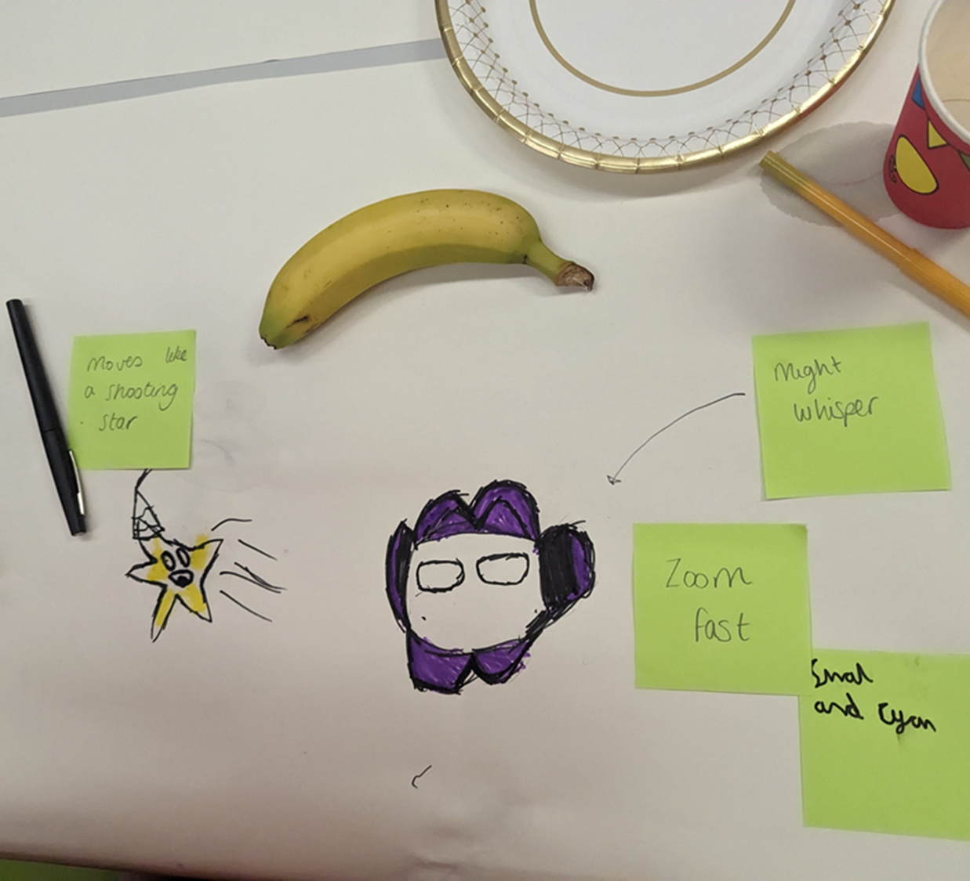
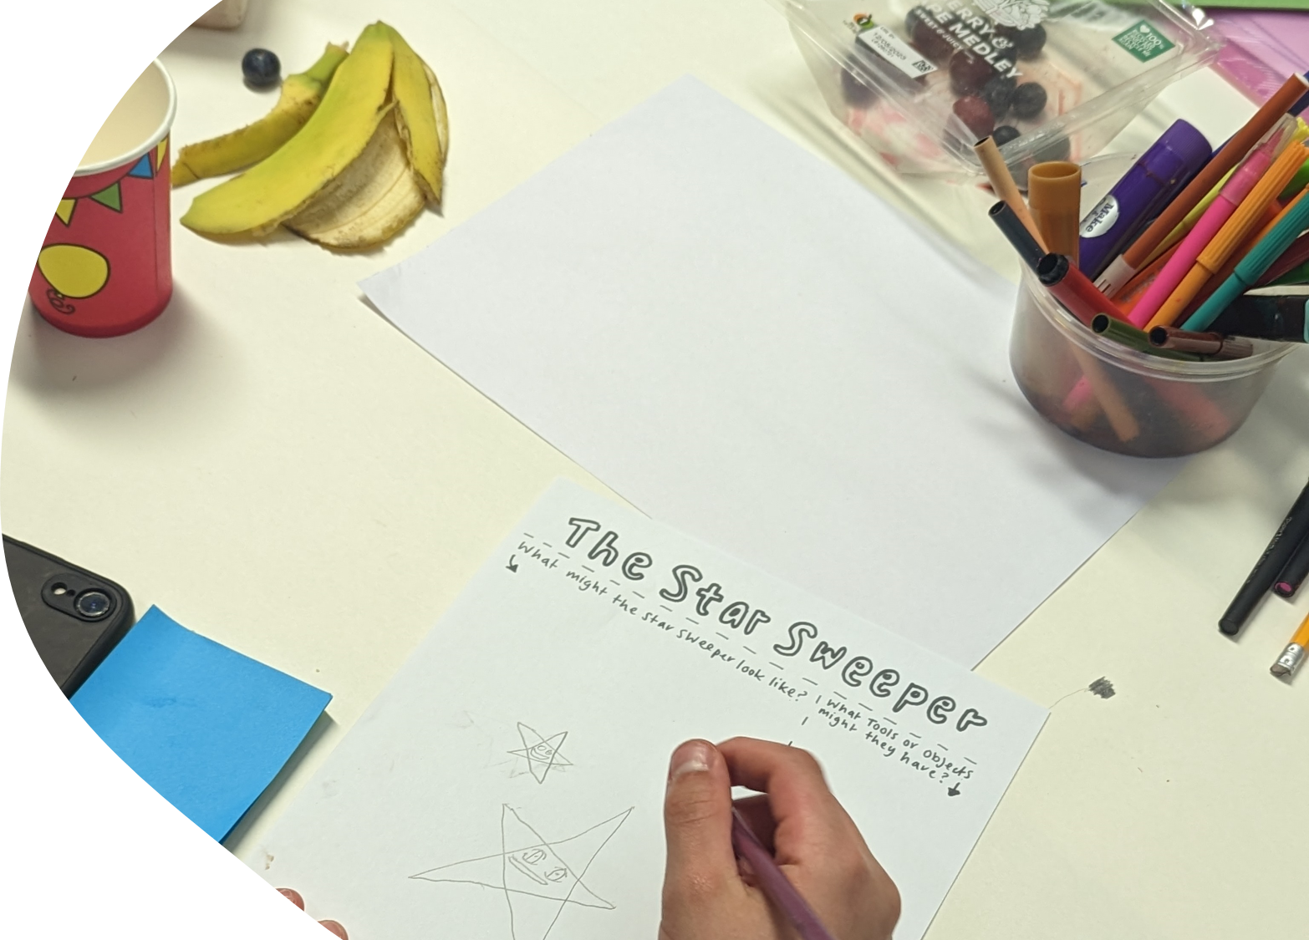

Slide 13
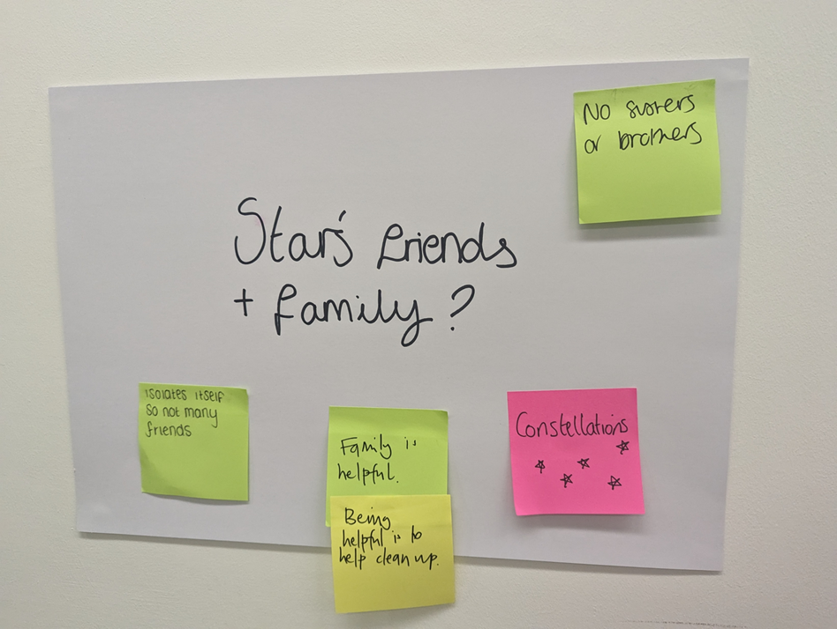
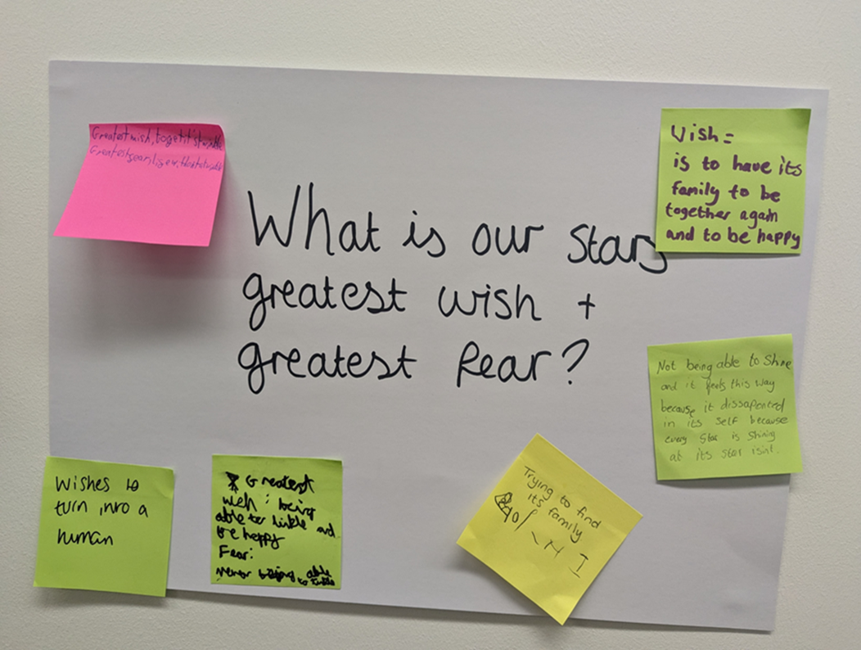
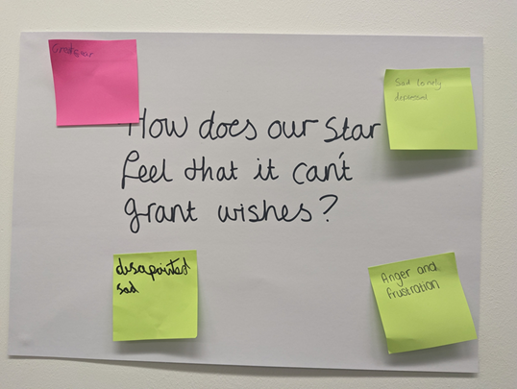

Slide 14
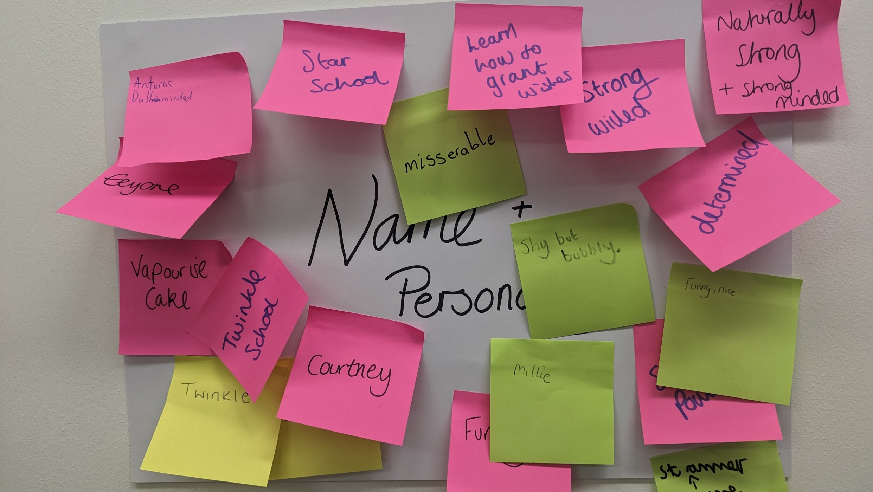

Slide 15
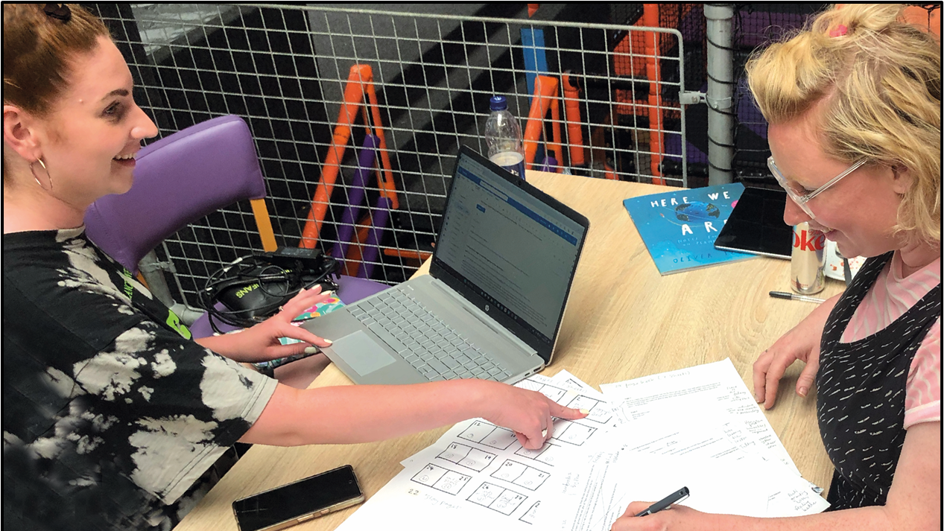


Slide 16
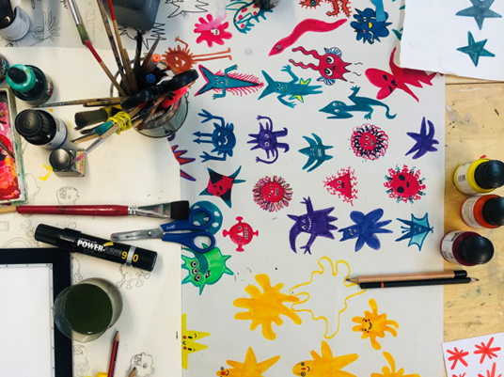
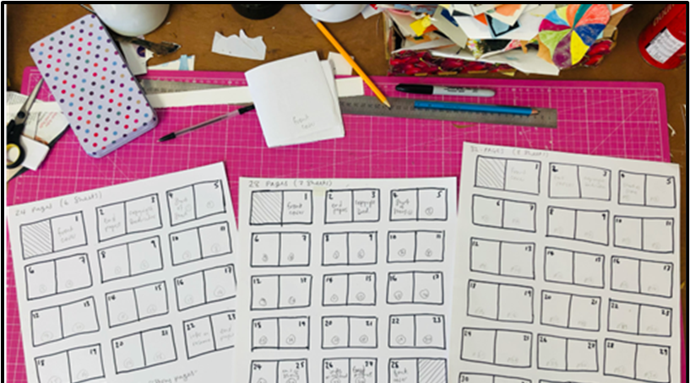
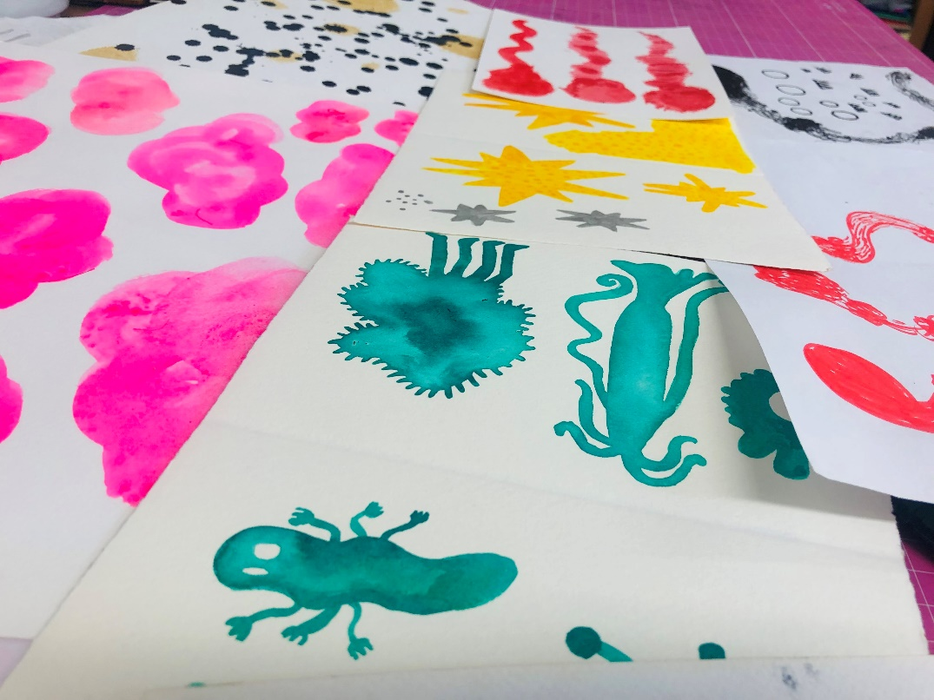

Slide 17



Slide 18
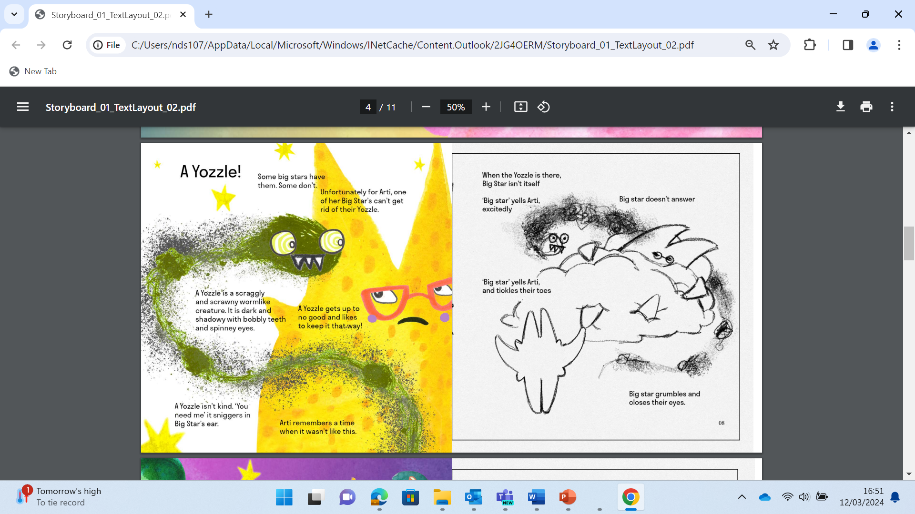

Slide 19


Slide 20
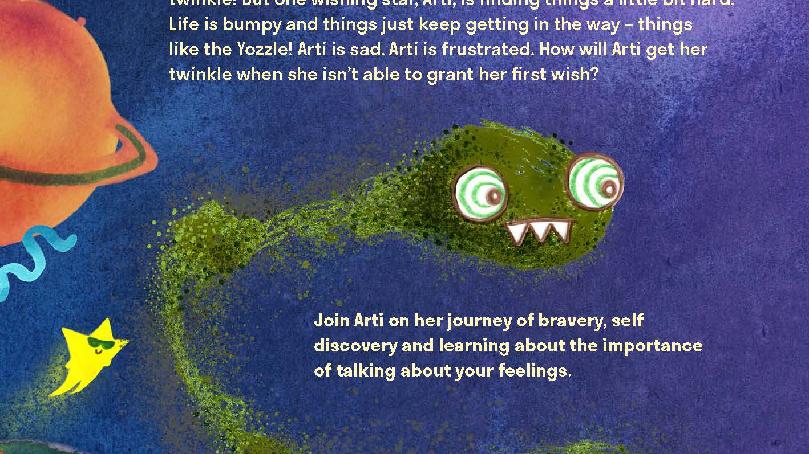

Slide 21
Key messages
Children are not alone, and other children have similar experiences
Children are not responsible for the needs and welfare of adult family members
Speaking to a trusted adult about how you feel can be a positive experience

Slide 22
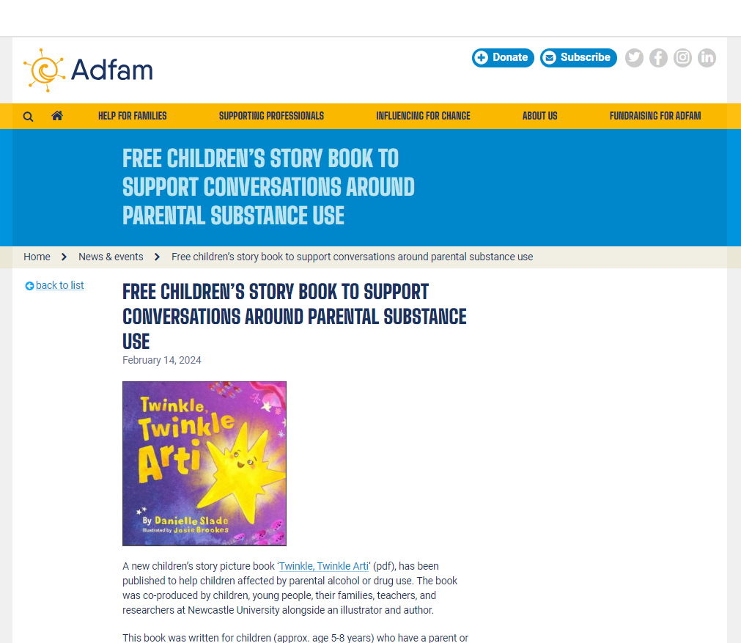
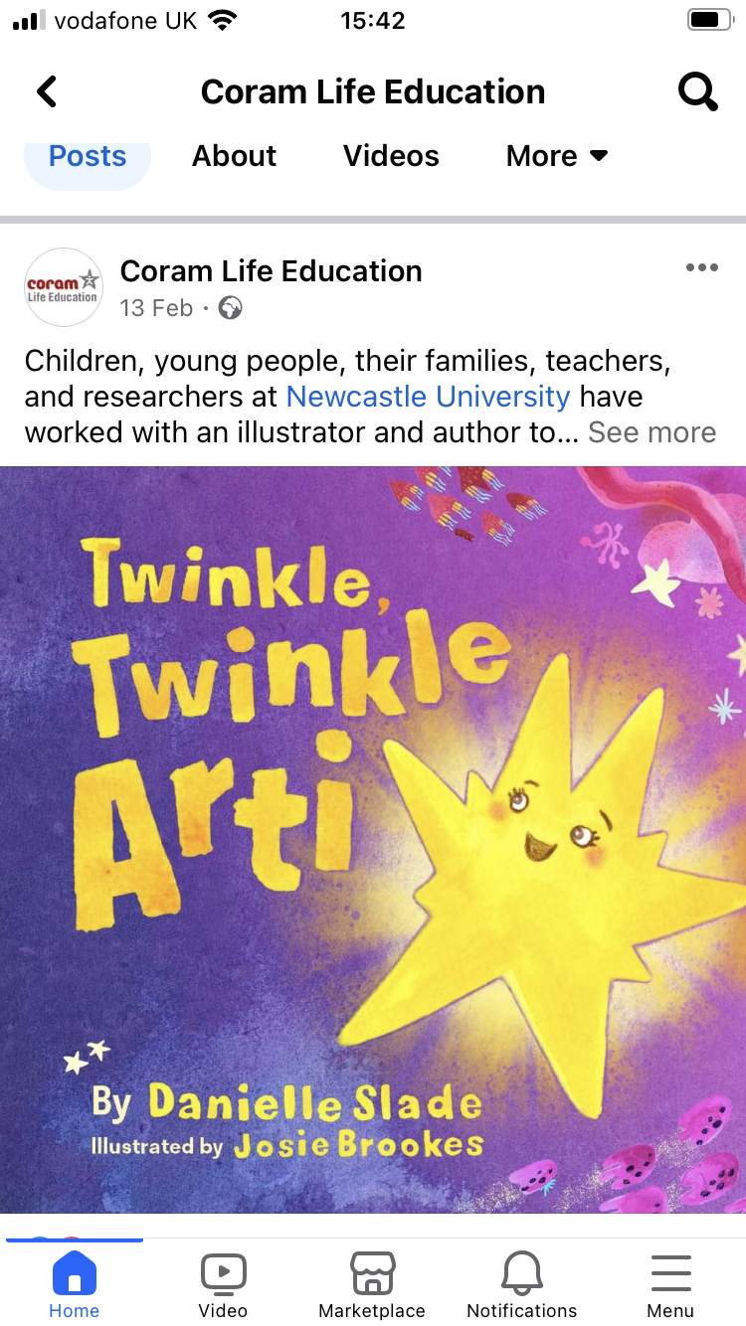
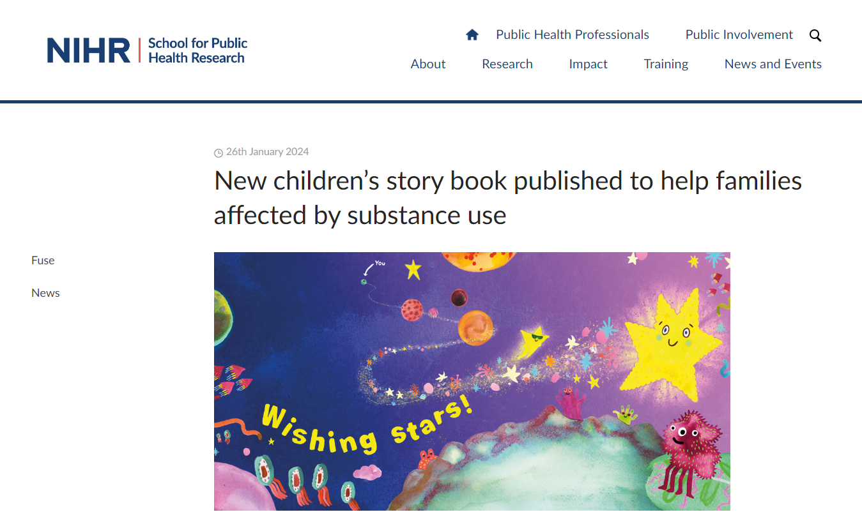
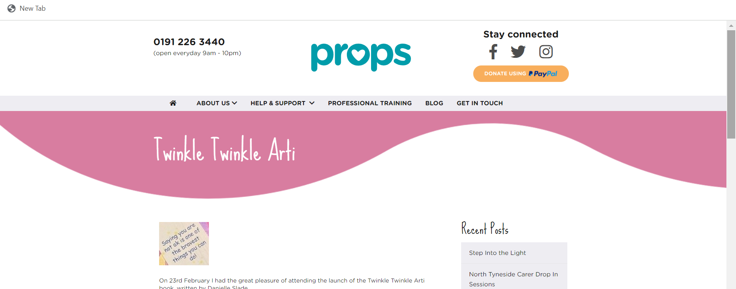
Sharing the story with families & practitioners

Slide 23
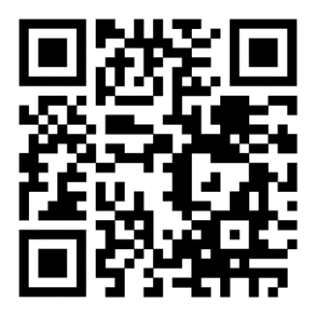
Twinkle twinkle Arti –
read aloud video
https://www.youtube.com/watch?v=s3V-js4zxnw

Slide 24

With thanks
This project is funded by the National Institute for Health and Care Research (NIHR) School for Public Health Research (SPHR) (Grant Reference Number NIHR 204000).
The views expressed are those of the author(s) and not necessarily those of the NIHR or the Department of Health and Social Care.

