Slide 1
Self-initiated Help-seeking Interactions that Enabled Resilient Outcomes Among University Students Raised by Alcohol-Misusing Caregivers in Lesotho
1
Drs. Simbai Mushonga
Department of Gender and Africa Studies, University of the Free State (UFS)

Slide 2
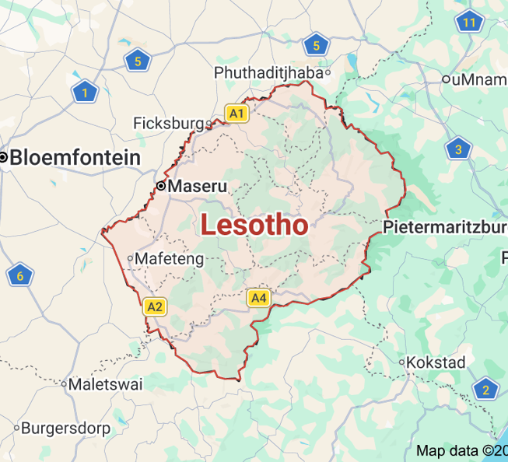
Map of Lesotho
The study was conducted in Lesotho in the belly of (South Africa) (sub-Saharan Africa- Southern Africa) at the only state university in the country, the National University of Lesotho (NUL) (2019-2020). (For my PhD).
Data were collected a few days before the COVID-19 lockdown.
Many of the social issues affecting South Africa, such as poverty, high crime rates, unemployment, and drug and substance abuse, are similarly prevalent in Lesotho.
Population-less than 2million

Slide 3
Introduction
The environment of young people raised by caregivers who misuse alcohol has been characterized by: poor home management, lack of parenting, lack of family communication skills, possible domestic violence, physical violence, decreased family organization, emotional abuse, decreased family cohesion, increased family isolation, and the educational needs of children not being met: Increased family stress, such as illness, work problems, marital strain, financial problems, and frequent family moves (Kühn & Slabbert, 2017; Nancy & Sam Deva Asir, 2014).
Young individuals under such care are usually exposed to numerous psychosocial risks, including psychological, physical, emotional, and sexual maltreatment (Raitasalo et al., 2019).
They often experience rejection, homelessness, educational disruption, limited family resources, and parentification (Velleman & Templeton, 2016).
Interpersonal strains affecting their future, including their sexual relationships and a higher risk of substance misuse, poor academic functioning, and low socioeconomic status (Omkarappa et al., 2019 ; Raitasalo et al., 2019).

Slide 4
Despite the adverse situation
Despite being raised in an adverse environment, some young people adjust well. Their positive outcomes raise the questions at the core of resilience theory (van Breda, 2018a): “What is it about these young people that enabled them to do well?” and “What differentiates these young people from those who succumb to caregiver alcohol misuse?” Thus, rather than focusing on the negative experiences of these young people, like most research on this area, my paper addresses Van Breda’s questions by exploring what interactional processes enable young people raised in families where caregivers misuse alcohol to achieve better outcomes.
This study, therefore, explores how young adults raised by caregivers who misuse alcohol engage in self-initiated help-seeking interactions and how these interactions facilitate better-than-expected outcomes.

Slide 5
Research Method
An exploratory, descriptive, contextual qualitative design was used to collect information on the experiences and interactional resilience processes that enabled University Students Raised by caregivers who misused alcohol in Lesotho to achieve better-than- expected outcomes.
The study recruited 15 undergraduate university students aged 20- 27 years who were raised by caregivers who abused alcohol.
Nine female and six male students volunteered to participate in the study.
Participants were those achieving better grades academically, not misusing substances, and being future-oriented, among other positive attributes.
Purposive and snowball sampling were used to sample students from the Faculty of Social Science from years one to four.
No incentives were provided for participation.
All interviews were conducted by the researcher in spaces that granted participants privacy.

Slide 6
Theoretical Framework: Interactional Resilience (IR) by van Breda (2018)
Builds on social-ecological approach (Ungar, 2012) and person-in-environment (PIE) perspective (Germain, 1981).
Resilience processes operate across multiple levels: cells, individuals, families, communities, organizations, climate, and economy.
van Breda categorizes resilience processes into three groups: Personal factors (e.g., spirituality, optimism), Social environment (e.g., relationships, community safety). Interactions (e.g., teamwork, empathy).
Resilience emerges from dynamic interactions between individuals and their social ecology, not just internal traits or external factors.
Focuses on mediating processes like resilience mechanisms and protective resources that enable better-than-expected outcomes despite adversity.
Emphasizes reciprocal engagements, active help-seeking, and systemic support, especially relevant for youth raised by alcohol-misusing caregivers.
Highlights the importance of meaningful interactions within multilevel systems for fostering resilience.

Slide 7
Data Collection Methods
In-depth face-to-face interviews, combined with a draw-write-and-tell method, were conducted with each participant.
Interviews were held in three phases:
Phases of the interviews:
FIRST PHASE:
Participants were asked to draw and describe their experiences under the care of guardians who misuse alcohol, with further probing used to clarify any points that lacked clarity.
SECOND PHASE: Participants were asked to identify and draw the social-ecological resilience resources (personal, relational, and environmental) that encourage resilient outcomes among them. Clarifications were sought where necessary.
THIRD PHASE: Participants were asked to describe the interactional resilience resources and processes that operate between them and the resilience resources in their social environment (PIE).
Constructive grounded theory was used to analyse data.
The findings of this article were derived from the second and third interviews, where the theme of help-seeking interactions was established.

Slide 8
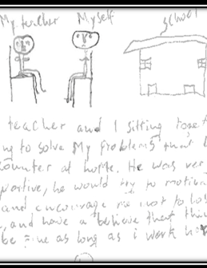
Theme 1: Seeking emotional support and guidance to foster hope and resilience:
EMERGING THEMES
Joe, for instance, said:
There were times when I went to his (Uncle) place, and I told him about the situation, he would just say, " You know, in life things go sideways. Some instances will give you a go-ahead; others will just make you fall behind. So, whatever you do, just make sure that you protect yourself. So, his advice is basically on self-protection. And just to make sure that I continue with my studies as usual. I make sure that these situations don’t impact my studies.
Lizzy shared:
When I’m not okay, I knock on my lecturer’s door and say, ‘Please, I need to talk.’ She always steps in. I told her everything about my past at home, how my father beat me, and how I felt. She would listen, help me process my feelings, and encourage me. Whenever I feel like I might burst, I know I can cry in her office. She’d wipe my tears and tell me, ‘Be confident, you’re a strong girl.”
James added:
"Whenever I faced tough times at home, I would talk to my teacher during breaks. She would listen and tell me that I shouldn’t let my family’s problems define my future. That made me believe I can rise above everything.“
Participants’ responses to support: "Their encouragement made me think, ‘Someone believes in me, so I am good enough.’ It built a new me, more confident and hopeful." (Lizzy)
"Their words gave me courage when I had none left. I realized I could do better and that my future depends on me." (James)

Slide 9
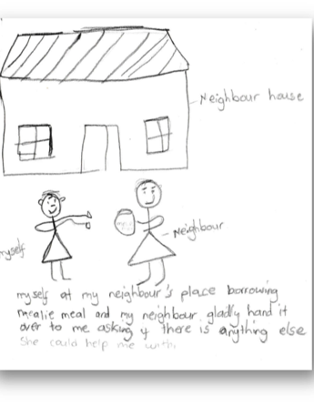
Theme 2: Seeking material support to strengthen resolve and foster belonging
Linnete said: For my entire life, I wanted to move away from my father. I wanted to be myself. I wanted to have peace. I told my mother … my mother, who asked her brother (her mother sought help from her brother to provide Linnette with a safe space), because my father was about to rape me, and my mother had to see that I was moved from my father’s place. My uncle gave me a small room, and it was full of happiness and joy. I was happy in the house."
Ruth Interactions with trusted figures: "When my mother was drinking and couldn’t provide, we (her siblings) would ask our neighbours for help. They’d give us maize-meal, soap, or food without hesitation. Their kindness made us feel loved and supported."Ruth reflected on how her neighbor’s support helped her:When we asked for help, she’d say, ‘Feel free to ask for anything you need,’ and she would help us. Her kindness made us feel we belonged. Even though my mother was not there, the community was responsible for our well-being, and that made a big difference
Matthew recounted: "When I needed money for school, I would ask my uncle. He always responded positively, ‘How much do you need?” and gave us the exact amount. His support helped me stay focused and motivated…. His help allowed me to focus on my studies. Whenever I asked for money, he’d give it immediately. That reassurance made me believe I could succeed despite everything.”

Slide 10
Discussion
The study highlights the importance of social-ecological interactions and self-initiated help-seeking behaviors in fostering resilience among young people raised by alcohol-misusing caregivers in sub-Saharan Africa, specifically Lesotho (this study).
Resilience is viewed as a dynamic process resulting from interactions within one's social environment, aligning with Van Breda’s interactional resilience framework (Van Breda, 2018) and Ungar’s social ecology theory (Ungar, 2012).
Help-seeking involves actively recognizing challenges, accessing support from both formal (professionals, teachers) and informal (family, community members) sources, and disclosing issues (Gebreegziabher, Girma, & Tesfaye, 2019; Almanasef, 2021; Farr, Surtees, Richardson, & Michail, 2021).
Participants reported that seeking emotional guidance and material support from trusted figures enhanced their resilience by fostering hope, self-worth, and a sense of control (Farr et al., 2021; Gebreegziabher et al., 2019).
Supportive interactions with teachers, counselors, and social workers provided reassurance, motivation, and reinforced self-esteem, aiding participants in overcoming adversity (Lizzy; James).
Material support from neighbors and relatives, rooted in the African cultural value of Ubuntu, which emphasizes collective support, interconnectedness, and communal responsibility, reinforced feelings of belonging and resilience (Mushonga, Van Breda, Mushonga, & Grey, 2026; Ewuoso & Hall, 2019).

Slide 11
Limitations and Implications:
Limitations:
The study focused on university students within a single faculty, which limited generalizability. Experiences may vary for young adults in different settings (e.g., working, married, rural areas).
Findings may not represent all resilient young adults who have faced adversity.
Implications:
Young people in adverse environments must develop proactive, hopeful help-seeking behaviors.
Social service practitioners should empower youth by enhancing interpersonal and communication skills.
Incorporating resilience education into school curricula can support young people's coping strategies.
Facilitating network-building and self-advocacy is crucial for fostering agency and belonging.
Community response, characterized by positive reciprocity and Ubuntu principles, emphasizing interconnectedness, compassion, and collective responsibility, can significantly influence access to support; trust-building and stigma reduction are vital.
Community leaders should promote environments in which seeking help is normalized and encouraged, thereby reinforcing collective support systems.
Developing secure, empathetic community environments rooted in Ubuntu fosters a culture of mutual support, where seeking help is seen as a strength, thereby enhancing social resilience and collective well-being.

Slide 12
References
Kühn, J., & Slabbert, I. (2017). The effects of a father's alcohol misuse on the wellbeing of his family: views of social workers. Social Work, 53(3), 409-422.10.15270/52-2-578
Mushonga, S., Van Breda, A., Mushonga, M., & Grey, M. (2026). “I am their child. They are my parents too”: ubuntu and the resilience of university students raised by caregivers who misused alcohol. Journal of Ethnic & Cultural Diversity in Social Work, 35(2), 103-118.10.1080/15313204.2025.2566632
Nancy, A., & Sam Deva Asir, R. M. (2014). A Study on Family Environment among Children of Alcoholics at
Chettikulam, Perambalur District IOSR Journal of Humanities & Social Science, 19(7), 26-32
Omkarappa, D. B., & Rentala, S. (2019). Anxiety, depression, self-esteem among children of alcoholic and nonalcoholic parents. Journal of Family Medicine & Primary Care, 8(2), 604-609.10.4103%2Fjfmpc.jfmpc_282_18
Ungar, M. (2021). Modeling multisystemic resilience. Adaptation and Transformation in Contexts of Change (pp. 6-31): Oxford Press.
Van Breda, A. D. (2018). A critical review of resilience theory and its relevance for social work. Social Work, 54(1), 1-18.10.15270/54-1-611
THANK YOU!!!

