Slide 1
Two CRAFT-based programs in a Swedish context
Ola Siljeholm STAD, Centre for Psychiatry Research,
Department of Clinical Neuroscience
Karolinska Institutet
AFINet online, September 19th, 2024

Slide 2
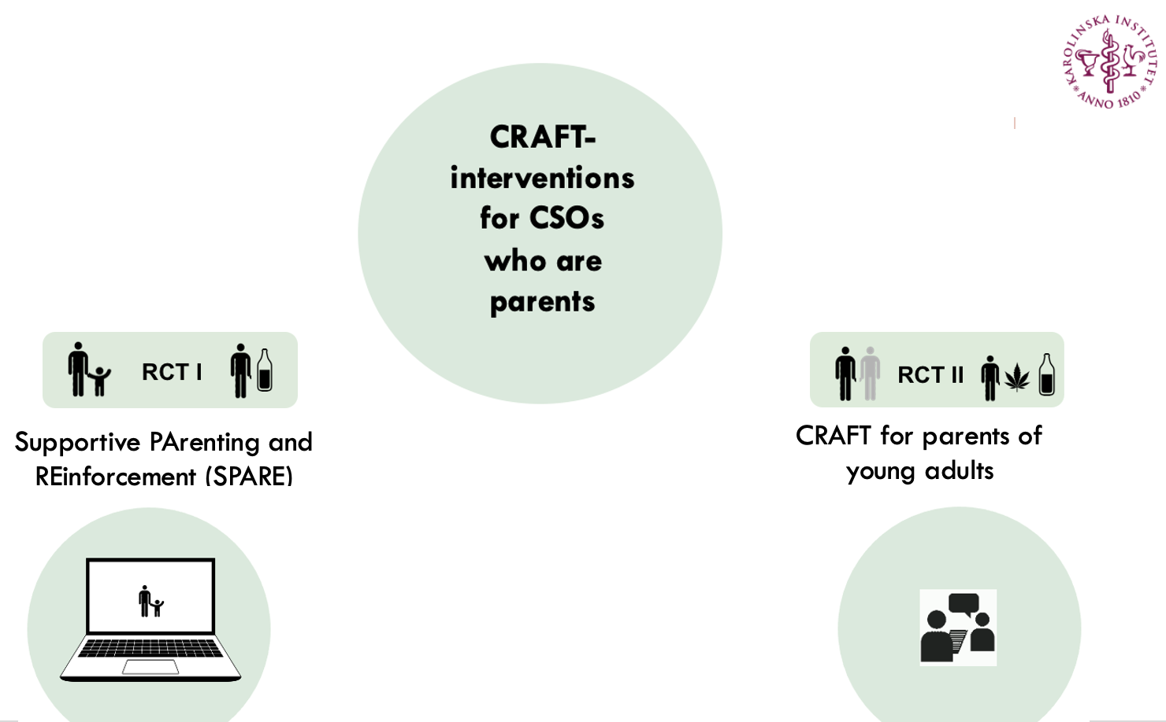

Slide 4
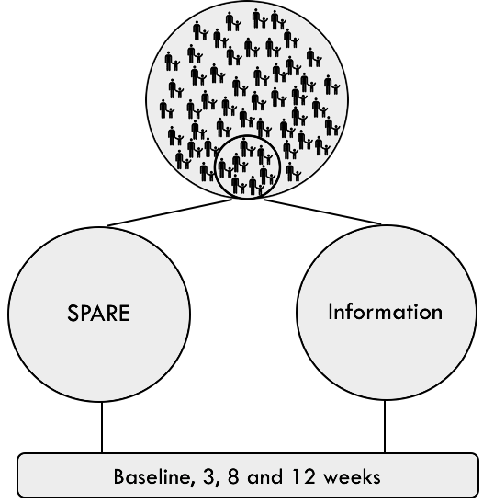
SPARE: Aims and method
Participants
Parents sharing a child (age: 3-11) with a problem drinking co-parent
Aim
Investigate efficacy of SPARE compared to Information Material in improving mental health of children affected by parental alcohol use
Primary outcome
Children’s mental health
Secondary outcomes
CSO’s mental health
CSO’s parental self-efficacy
Co-parent’s alcohol consumption and dependence
Funding: Public Health Agency of Sweden, The Research Council of the Swedish Alcohol Retailing Monopoly (SRA)

Slide 5
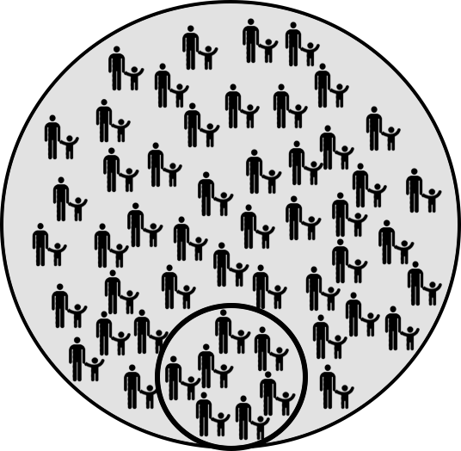
SPARE: Results - Participants
Large proportion of applicants ineligible
Co-parent violence
CSO mental health
CSO in support program

Slide 6
SPARE: Results
Primary outcome: Children’s mental health
No differences between conditions
No significant change over time
Secondary outcomes
No differences between conditions
Improvements in whole sample:
Co-parent alcohol consumption
Co-parent severity of dependence
No change in CSOs’ mental health

Slide 7
SPARE: Conclusions
No evidence that SPARE is more efficacious than information material for improving children’s mental health
CSOs rated their children’s mental health as impaired compared to the general population
Majority of CSOs were ineligible - future studies recommended to focus on CSOs in more affected contexts

Slide 8
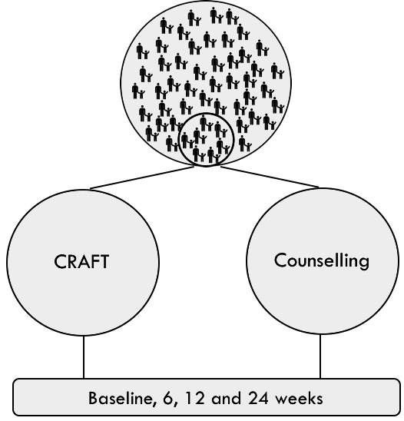
CRAFT for parents: Aims and method
Participants
Parents of a treatment refusing young adult (age: 18-24) with problematic substance use
Aim
Investigate efficacy of CRAFT compared to manualized counselling regarding young adult treatment seeking
Primary outcome
Young adult treatment seeking
Secondary outcomes
Young adult alcohol- and substance use
Parental mental health
Parental self-efficacy
Relationship happiness
Funding: Public Health Agency of Sweden, Stockholm County Council (ALF project)

Slide 9
CRAFT for parents: Interventions
CRAFT
8 individual sessions, 1/week
Each session different themes
Home assignments each week
Counselling
5 individual sessions
Each session different themes
No behavior change home assignments
1 group session, facts about drugs
Face-to-face Videoconference

Slide 10
CRAFT for parents: Results - Participants

Slide 11
CRAFT for parents: Results
Primary outcome
32% of young adults entered treatment
No difference between conditions
No difference between face-to-face vs videoconference

Slide 12
CRAFT for parents: Results
Secondary outcomes
No differences between conditions
Within-group improvements both conditions
Young adult substance use
CRAFT 49.6% reduction
Counselling 32.7% reduction
Parental self-efficacy
Relationship happiness
No change in parental depression, anxiety or stress

Slide 13
CRAFT for parents: Conclusions
No evidence that CRAFT is more efficacious than manualized counselling regarding young adult treatment seeking
Suggested that both CRAFT and the manualized counselling program:
Increase treatment-seeking among young adults with problematic alcohol- or substance use
Decrease young adult use of alcohol and illicit substances
Improve parental self-efficacy
Improve parent – young adult relationship

Slide 14
The end
Thank you!
ola.siljeholm@ki.se

