Slide 1



Cop-Mi in Rotterdam
Talking about the impact of psychiatry and/or addiction on the whole family, both for children in a system of for a partner
Nine de Vries, Youz
Anouk Sijbenga, Indigo

Slide 2
Agenda
Introduction Youz&Indigo
Copmi: recognizition
Practice-based/evidence-based interventions for different age groups

Slide 3

Introduction
Youz offers advice to children and parents from 12-23 about having a parent with mental illness and/or substance abuse
Indigo offers advice to children and parents from 0-12 about having a parent with mental illness and/or substance abuse
Notes:
Youz biedt ondersteuning aan jongeren door zowel op preventief, ambulant en klinische gebied behandeling te bieden. Daarnaast heeft youz ook een afdeling Veldwerk, zij gaan echt de straat op om in contact te komen met jongeren. Youz is een onderdeel van de Antesgroep.
Antes is in 2012 ontstaan na een fusie van Delta en Bouman. Wij zijn actief in de regio Rotterdam-Rijnmond, Nieuwe Waterweg Noord, Drechtsteden, Alblasserwaard-Vijfheerenlanden en de Zuid-Hollandse eilanden. Antes is samen gefuseerd met de Parnassiagroep. Samen zijn zij de specialist op het gebied van psychiatrie en verslavingszorg.
(https://www.antesgroep.nl/over-antes/)

Slide 4
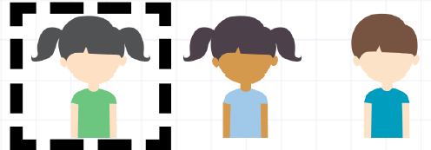
COPMI
1 in 3 children will develop mental health and/or substance problems themselves if they’re COPMI
If both parents have a mental illnes or have addiction problemn; 66% COPMI children will develop problems
(Bool, Van der Zanden, Smit & Bohlmeijer, 2007)
COPMI families have 3 times more chance of child abuse. (Verdurmen, e.a., 2007; Nemesis, 2008)

Slide 5
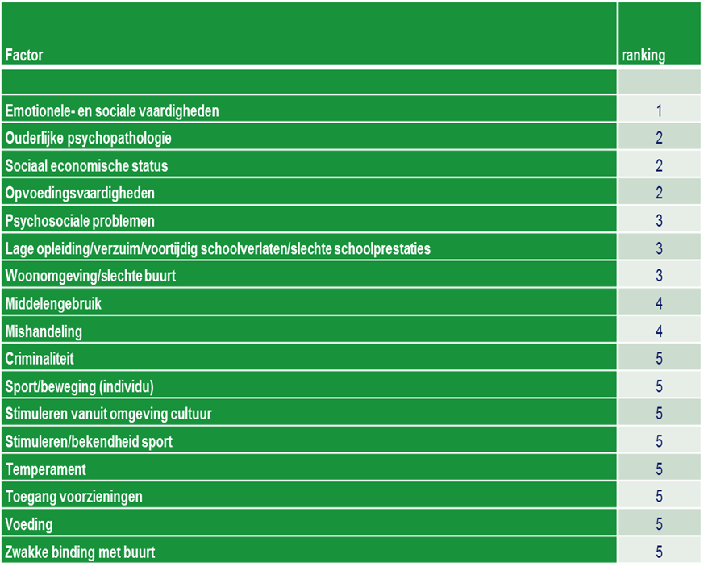


Slide 6
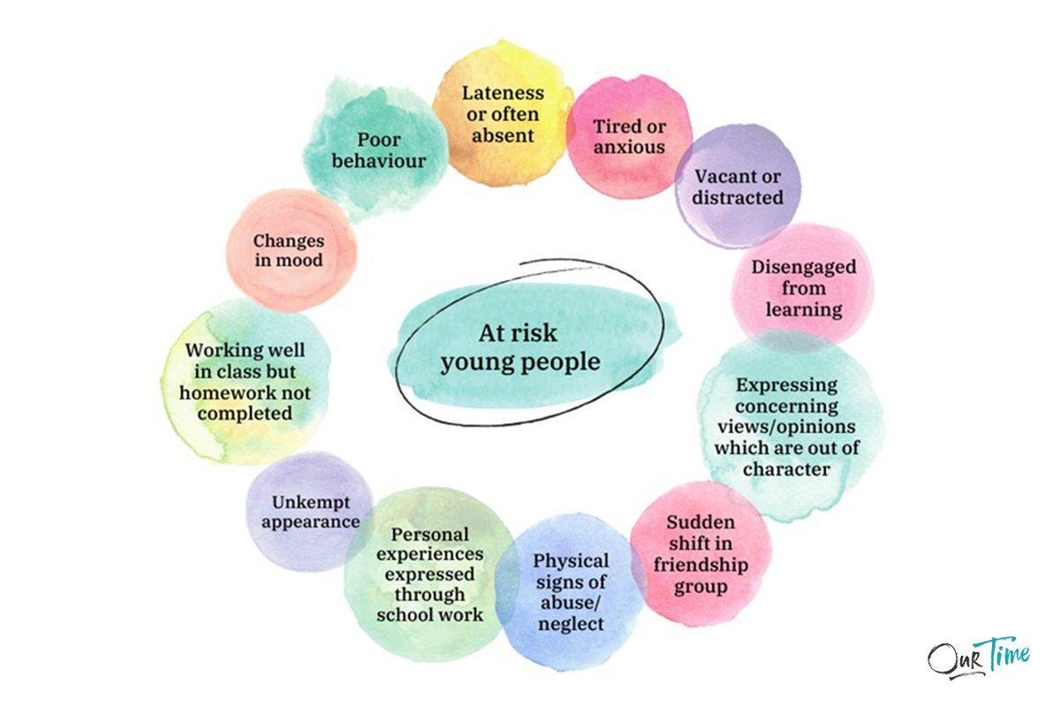
COPMI

Slide 7
Protective factors in COPMI
Warm upbringing
Child who makes good contact with others.
Child who can easily keep up with school.
Confidence
Knowing what's going on at home: Why is there a lot of stress at home?
Notes:
Warm upbringing Child who makes good contact with others. Child who can easily keep up with school. Lots of confidence Knowing what's going on at home: Why is there a lot of stress at home?

Slide 8
Purposes of COPMI interventions
Preventing psychological problems in young people
Breaking isolation/broadening the network
Providing information about psychological and addiction problems (psycho-education)
Learning to recognize and express feelings
Increasing (parenthood) competences
Reduce shame/guilt
Notes:
Preventing psychological problems in young people Breaking isolation/broadening the network Providing information about psychological and addiction problems (psychoeducation) Learning to recognize and express feelings Increasing own competences Reduce shame/guilt

Slide 9

INTAKE :
Do you have children?
YES
1
2
Inquire about a family consultation and hand over a flyer.
Plan a house visit or consultation at the office
Plan a consultations by e-mailing kopp-kov@anteszorg.nl or preventie@indigorijnmond.nl
Max. 5 consultations(covered by health insurance) For example:
With children (sometimes separate consultations, depending on need and age)
With partner
Notes:
Inquire about a family consultation and hand over a flyer.

Slide 10



Free downloads through national COPMI network:
https://www.trimbos.nl/aanbod/webwinkel/?tag=koppkov

Slide 11
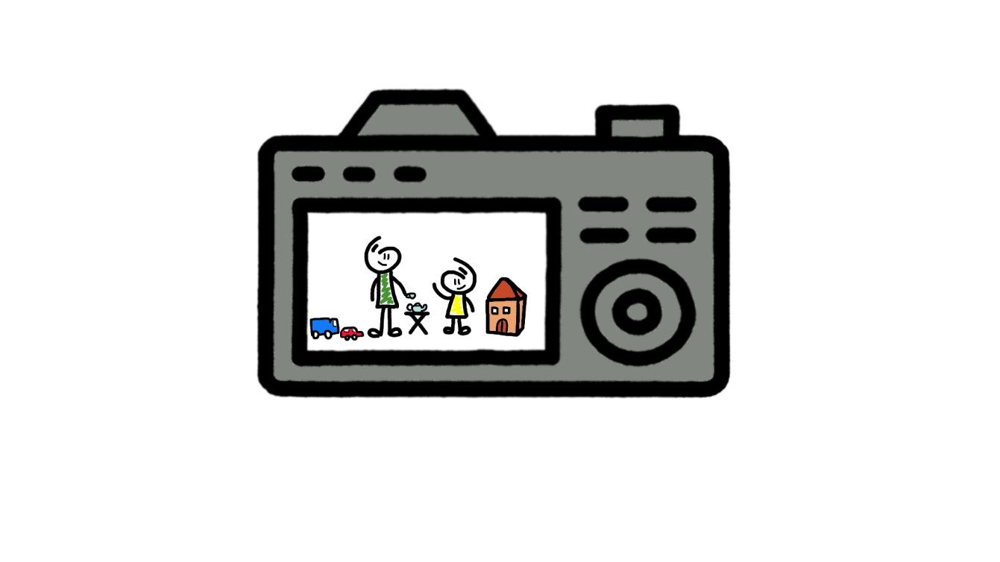
COPMI interventions 0-6 years of age
Seeing yourself in parenting action by filming parenthood situations to get positive feedback ánd gain confidence to enhance attachtment
In Rotterdam:
Parent- Baby Intervention (0-1 jaar)
Parent-Child Interventie (1-6 jaar)

Slide 12
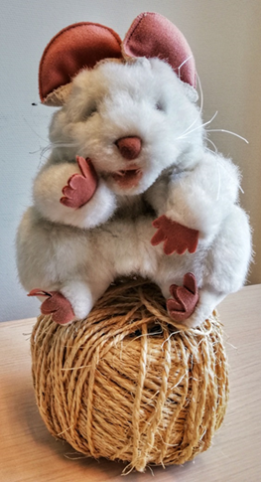
COPMI interventions 4-12 years of age
How to talk to COPMI children: https://sesameworkshop.org/topics/parental-addiction/
(show movie)
In Rotterdam:
Piep zei de Muis (10 x 1,5 uur) > no diagnosis necessary
Billy Boem (10 x 1,5 uur) > no diagnosis necessary
COPMI group (8x1,5 uur)

Slide 13
COPMI Interventions 12-23 years of age
In Rotterdam:
COPMI group 12-15 (8 x 1,5 uur)
COPMI group 16-23 (8 x 1,5 uur)
https://koppoprotterdam.weebly.com/

Slide 14
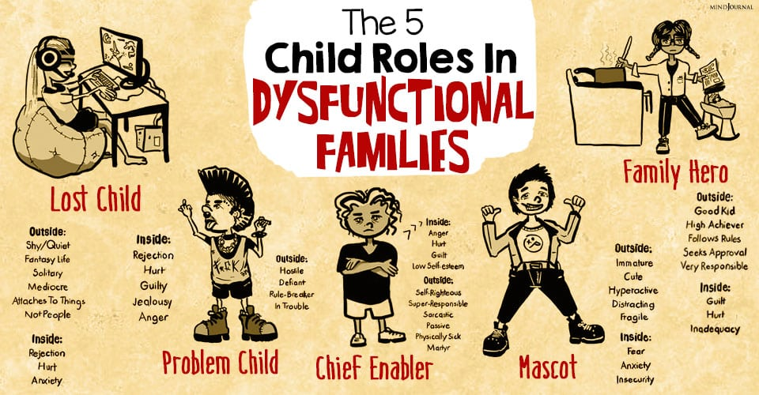
COPMI 12-23 years of age

Slide 15
For Parents
Parenting skills are central in combination with having psychological problems/addiction
Together with other parents to broaden the social network
In Rotterdam:
How to keep in balance (8x1,5 uur)
Notes:
Parenting skills are central in combination with having psychological problems/addiction

Slide 16
For close relatives
How to keep in balance when a close relative is going through a mental illness and/or addiction
Together with other family members to broaden the social network
In Rotterdam:
Psychiatry and/or addiction within the family (8x1,5 uur)
Notes:
Parenting skills are central in combination with having psychological problems/addiction

Slide 17
Signing up?
Always an introductory meeting
It is possible to join a home visit or treatment meeting to provide information
No costs involved, financed by the municipality
No referral letter required
At various locations in Rotterdam and other municipalities
Notes:
Always a non-binding introductory meeting It is possible to join a home visit or treatment meeting to provide information No costs involved, financed by the municipality No file structure No referral letter required At various locations in Rotterdam Ask about courses in other municipalities

Slide 18
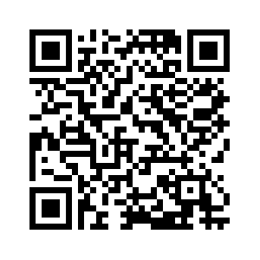
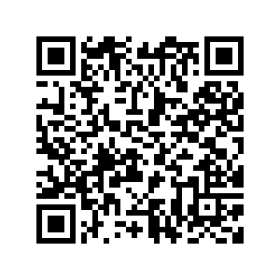
Any Questions?
More information about Indigo
More information about Youz

