Slide 1

AFINET Conference 16 June 2023
Dr Sheila Gilheany, CEO
Strategies to both raise awareness (amongst the public, policy makers, etc) of the experience of affected family members, and overcome barriers (including stigma and self-stigma) to engaging family members in support: Policy, Practice and Research
AFINET Conference 16 June 2023

Slide 2
Creating awareness through advocacy – policy to practice

Slide 3

AAI – independent advocate for reducing alcohol harm
Strategic Plan 2020-2024
Implementation of Public Health (Alcohol) Act 2018
A childhood free from alcohol harm
Services for all affected by alcohol harm
Establishment of a state sponsored Office to lead on alcohol policy
Main funder Health Service Executive, Ireland

Slide 4
Alcohol impact in Ireland
15% of Irish population have an Alcohol Use Disorder
4 deaths from alcohol per day – estimated from Global Burden of Disease
€1.5 billion spent on alcohol related hospital discharges - 11% of health budget excluding emergency care, general practice, psychiatric care, alcohol treatment services
€3.6 billion in wider costs to society

Slide 5

Silent Voices – raising awareness of parental problem alcohol use (PPAU)
Established in 2019 by three individuals with lived experience,
Carol Fawsitt, Marion Rackard, Barbara Whelan.

Slide 6
Alcohol Action Ireland – Silent Voices
Raise awareness
Put forward policy solutions
Work towards a whole-of-government approach
Work in partnership
Recognise the holistic and specific needs of children and adults
Embed the concept of trauma-informed services
Break down barriers between departments and agencies
Create a shared common language and understanding of the issue

Slide 7
Policy Framework
Reducing Harm Supporting Recovery, 2017-2025 – a health led response to drug and alcohol use
Children Policy
Better Outcomes Brighter Futures
First 5
2019: Hidden Harm - Joint strategy from Tusla, Child and Family agency and Health Service Executive
2021 Council of Europe – Research and policy initiative, Pompidou Group
  A set of reports and proposals with the involvement of 11 countries including Ireland
UN Convention on the Rights of the Child

Slide 8
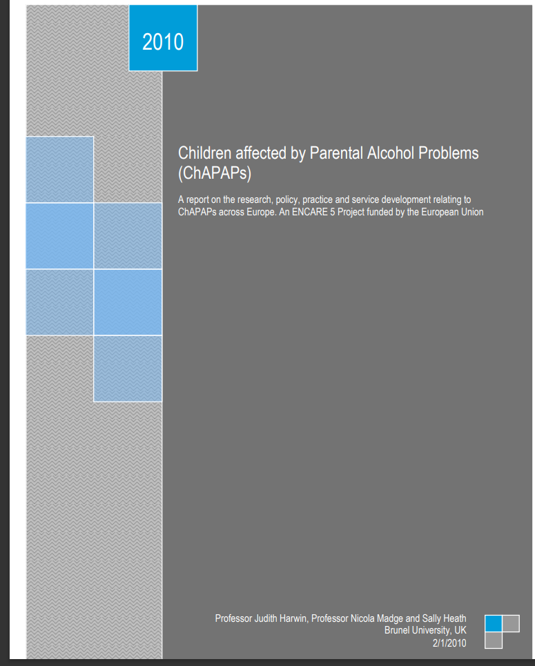
European context
2010 - Children affected by Parental Alcohol Problems (ChAPAPs)
Highlighted political commitment and motivation to view these children as a priority was urgently needed
Need for effective and coherent alcohol policies
Systematic national recording on prevalence of issue
High quality training for all professionals working with children and families

Slide 9
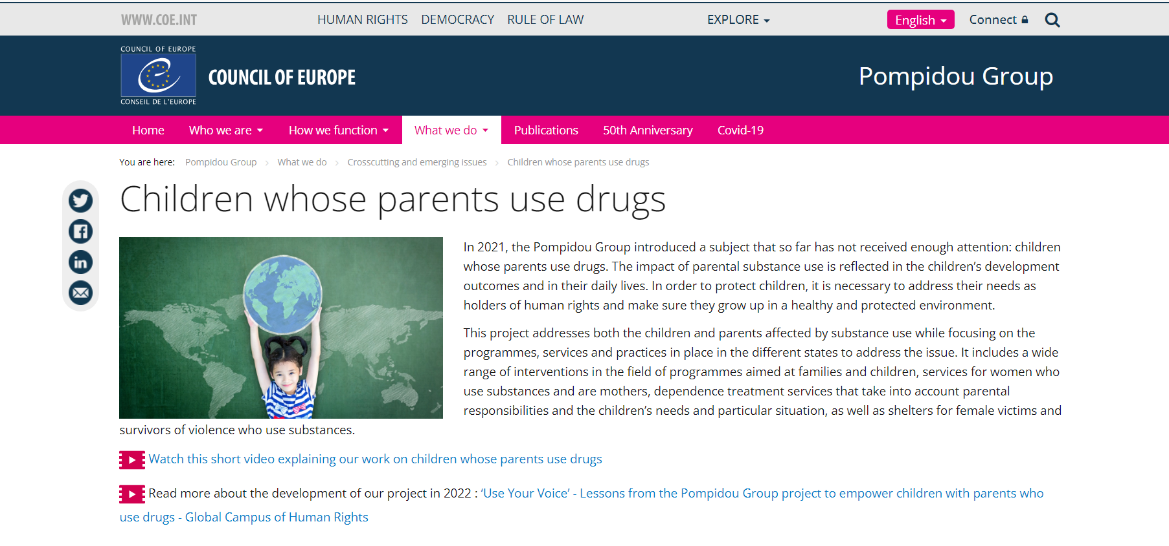
Council of Europe – 2021
Children’s rights focused research and policy

Slide 10
Pompidou Group Report
Improvements from 2010 noted
Activity going on in many countries – including Ireland
  19 practices from 11 countries
Programmes, services and practices in place
  Prevention programmes to intensive interventions with parents/children
Data gathering
  Ireland – treatment services now report re #s of children of clients
Gendered services – pregnancy, domestic violence
Advocacy
However, much more remains to be done – need for integrated strategies

Slide 11

Data
European Monitoring Centre for Drugs and Drug Addiction
  Good up to date material here but unfortunately alcohol data is not collated
World Health Organisation and OECD alcohol reports –
  good but rely on older data
Ireland – Health Research Board – good data on prevalence - EMCDA
  74% of population used alcohol in previous year
    14.8% have an Alcohol Use Disorder (AUD) – nearly 578,000
    90,000 have a severe AUD
  7.4% of population used illegal drugs in previous year
    1.2% of population have Cannabis Use Disorder

Slide 12

Data - gambling
2022 report from Health Research Board
49% of population gambled in previous year
Lottery tickets/scratch card most popular (40%)
2.3% (90,000 adults) are low-risk gamblers,
0.9% (35,000 adults) are moderate-risk gamblers,
0.3% (12,000 adults) are problem gamblers
Marked correlation between problem gambling and substance use (drug use, alcohol use disorder, smoking); 13% of people with an alcohol use disorder are an at-risk or problem gambler compared with 2% of low-risk drinkers.

Slide 13
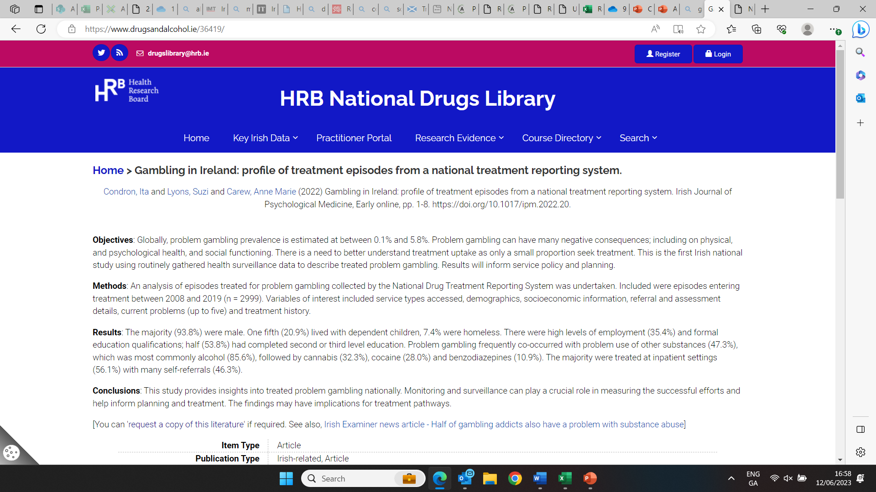
Gambling - treatment
HRB Research May 2022- episodes entering treatment between 2008 and 2019 (n=2999)
94% of cases - male
1 in 5 cases living with dependent children
1 in 2 cases started gambling before the age of 17 years.

Slide 14
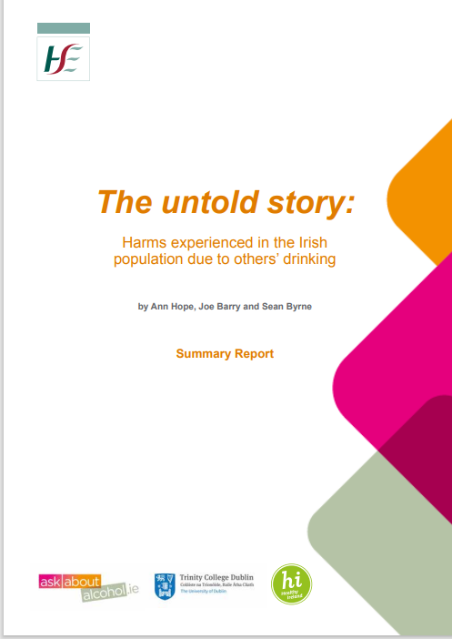
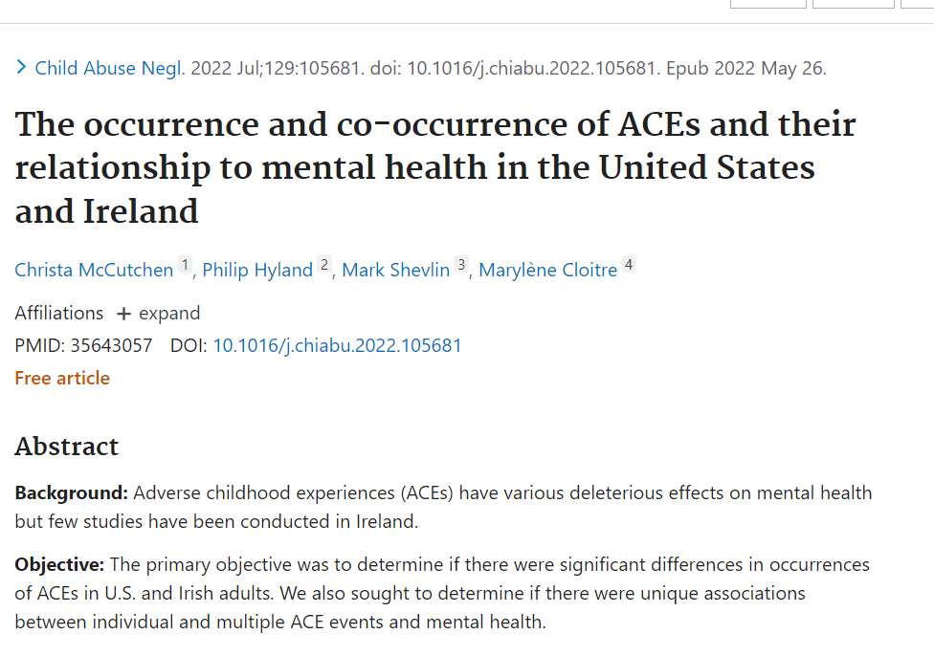
Data - Ireland
Harm to others survey 1 in 6 children impacted by alcohol
  200,000 children, 400,000 adults
ACE prevalence survey Maynooth University
  25% of adults experienced living with a problem drinker as a child - likely includes sibling or other family member
Treatment service data – NDTRS data re affected family members
  42% of those in treatment for alcohol problem have children
  2010-2020 13,744 referrals for family members

Slide 15
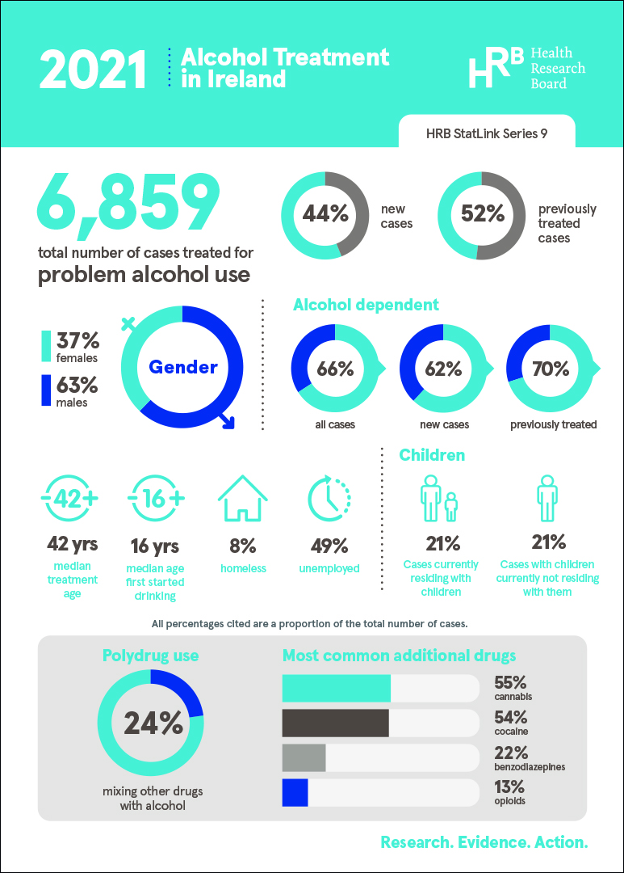
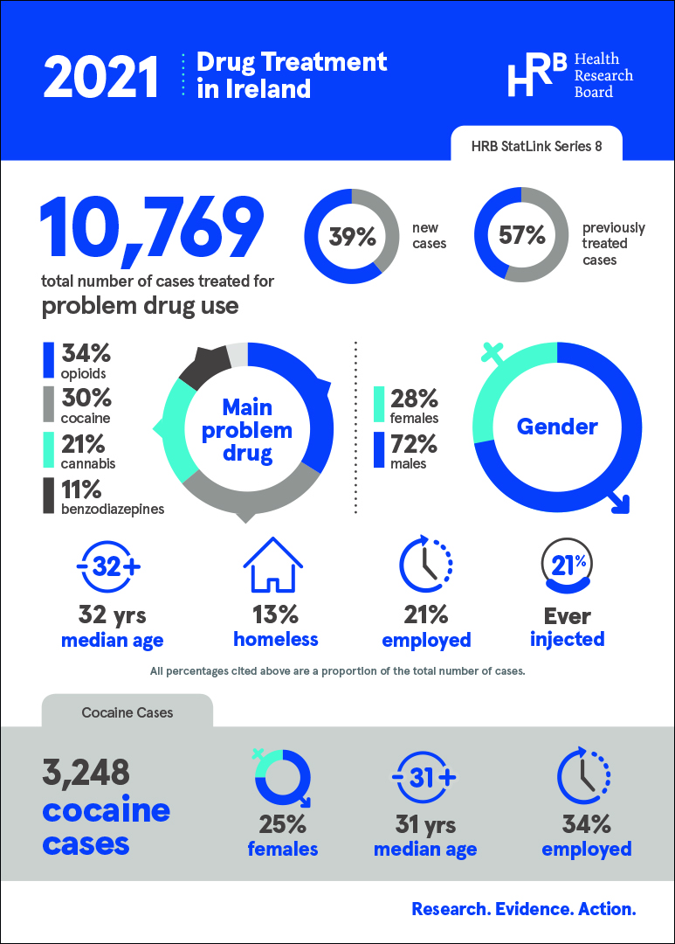

Slide 16
Need for systematic data collection
Alcohol related attendance at hospitals/EDs – are children in the picture?
  In Ireland around 20,000 hospital discharges annually for partially alcohol related conditions
  One third of ED attendances on Saturday nights are alcohol related
Alcohol related crime eg drink driving – are children in the picture?
  8,159 drivers arrested for driving while intoxicated in 2020
Problems in school – is PPAU in the picture?
  Safe haven of school
Behaviour problems – is PPAU in the picture?
Significant concerns re children’s mental health in Ireland - 15,113 prescriptions for antidepressants were issued to children aged 15 and younger last year, up 130 per cent on the 6,541 issued 10 years earlier.
If PPAU - who is in the picture for the child?

Slide 17
Adverse Childhood Experiences
Parental substance used recognised as an ACE for over 20 years
Mental health issues – anger, anxiety, emotional pain
Risky behaviours – substance use, eating disorders, suicide attempts
Toxic stress in childhood- harm the most basic levels of the nervous, endocrine, and immune systems, and changes to the brain from toxic stress can affect such things as attention, impulsive behavior, decision-making, learning, emotion, and response to stress.

Slide 18
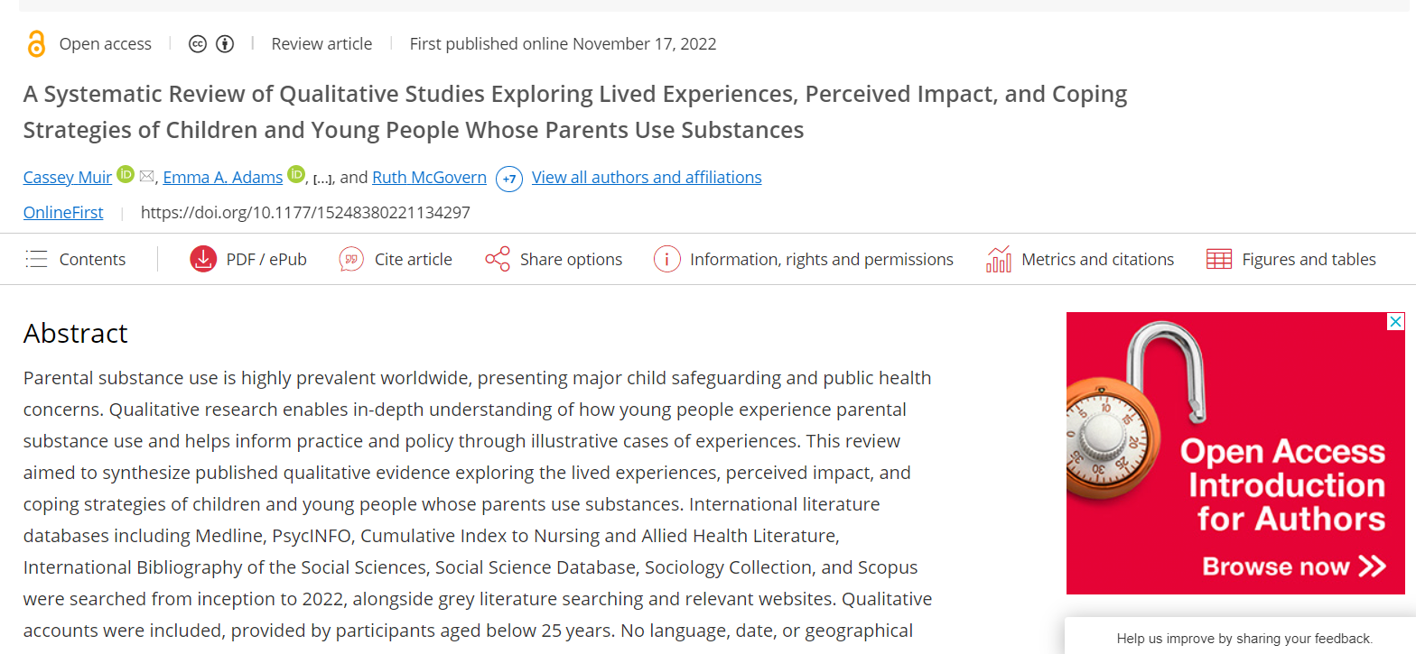
Adverse Childhood Experiences
Recent systematic review of experiences of children living with parents using substances problematically found:
Also exposed to parental intimate partner violence/abuse
Violence and abuse against them directly, siblings or pets
Parental mental health problems
Intergenerational substance use
Family imprisonment
Poor school attendance

Slide 19
ACEs and trauma informed services
Need for ACE framework – Scotland, Wales
  reduce the number of ACEs in Wales;
  make all public services in Wales able to respond effectively to prevent and mitigate the harms from ACEs (be ACE informed); and
  build protective factors and resilience in the population to cope with ACEs which could not be prevented.
  ACE support hub
    work to raise awareness of ACEs in schools has already been shown to make a positive difference in pupil’s behaviour, attendance and educational outcomes.
Ireland - Growing interest
Cork – trauma sensitive city
But much more to be done – eg need for trauma informed national framework for treatment services – individuals and families in their own right

Slide 20
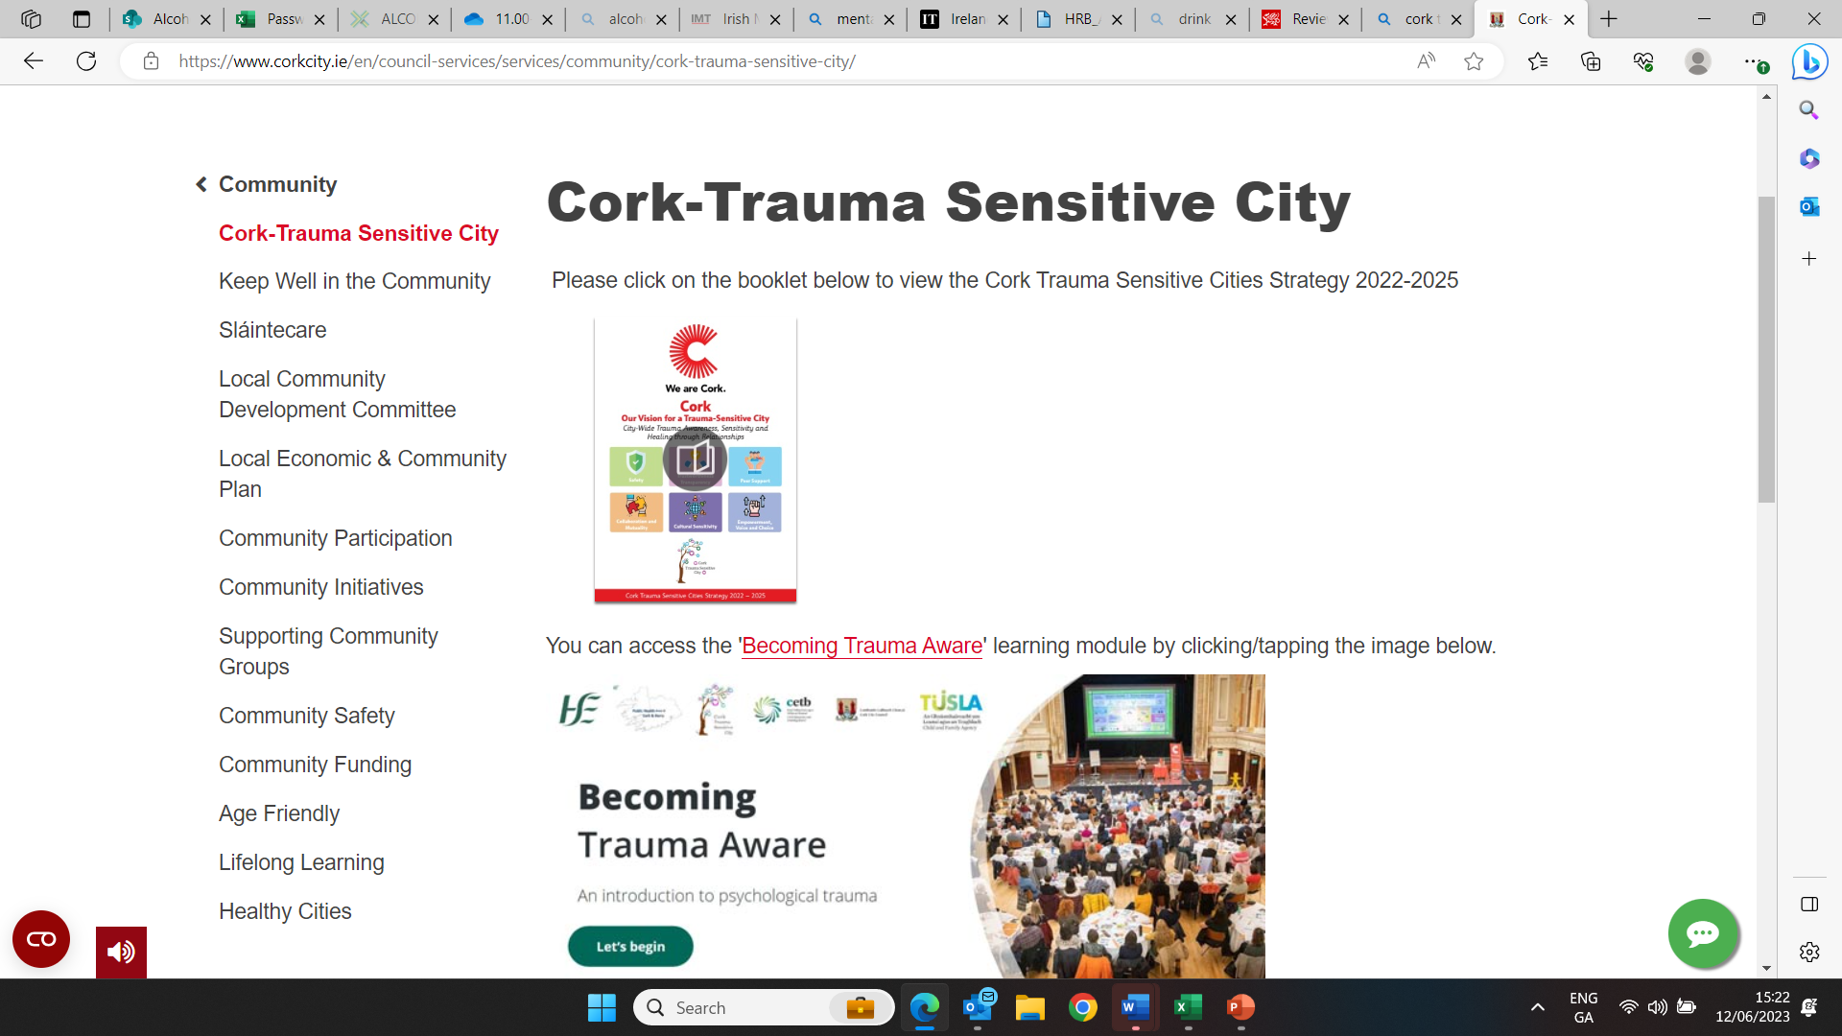
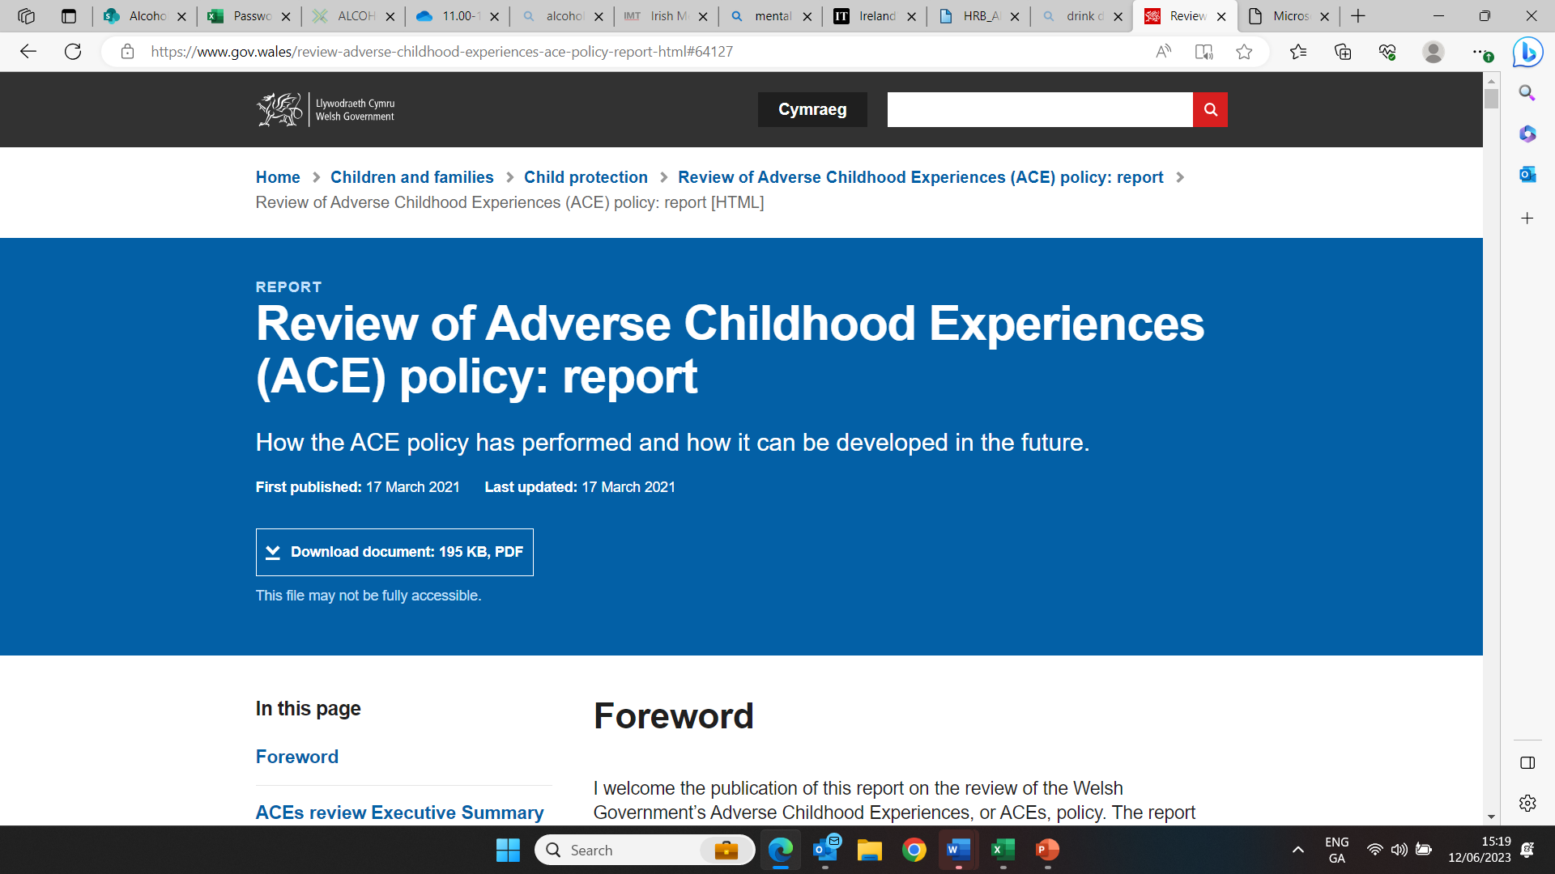
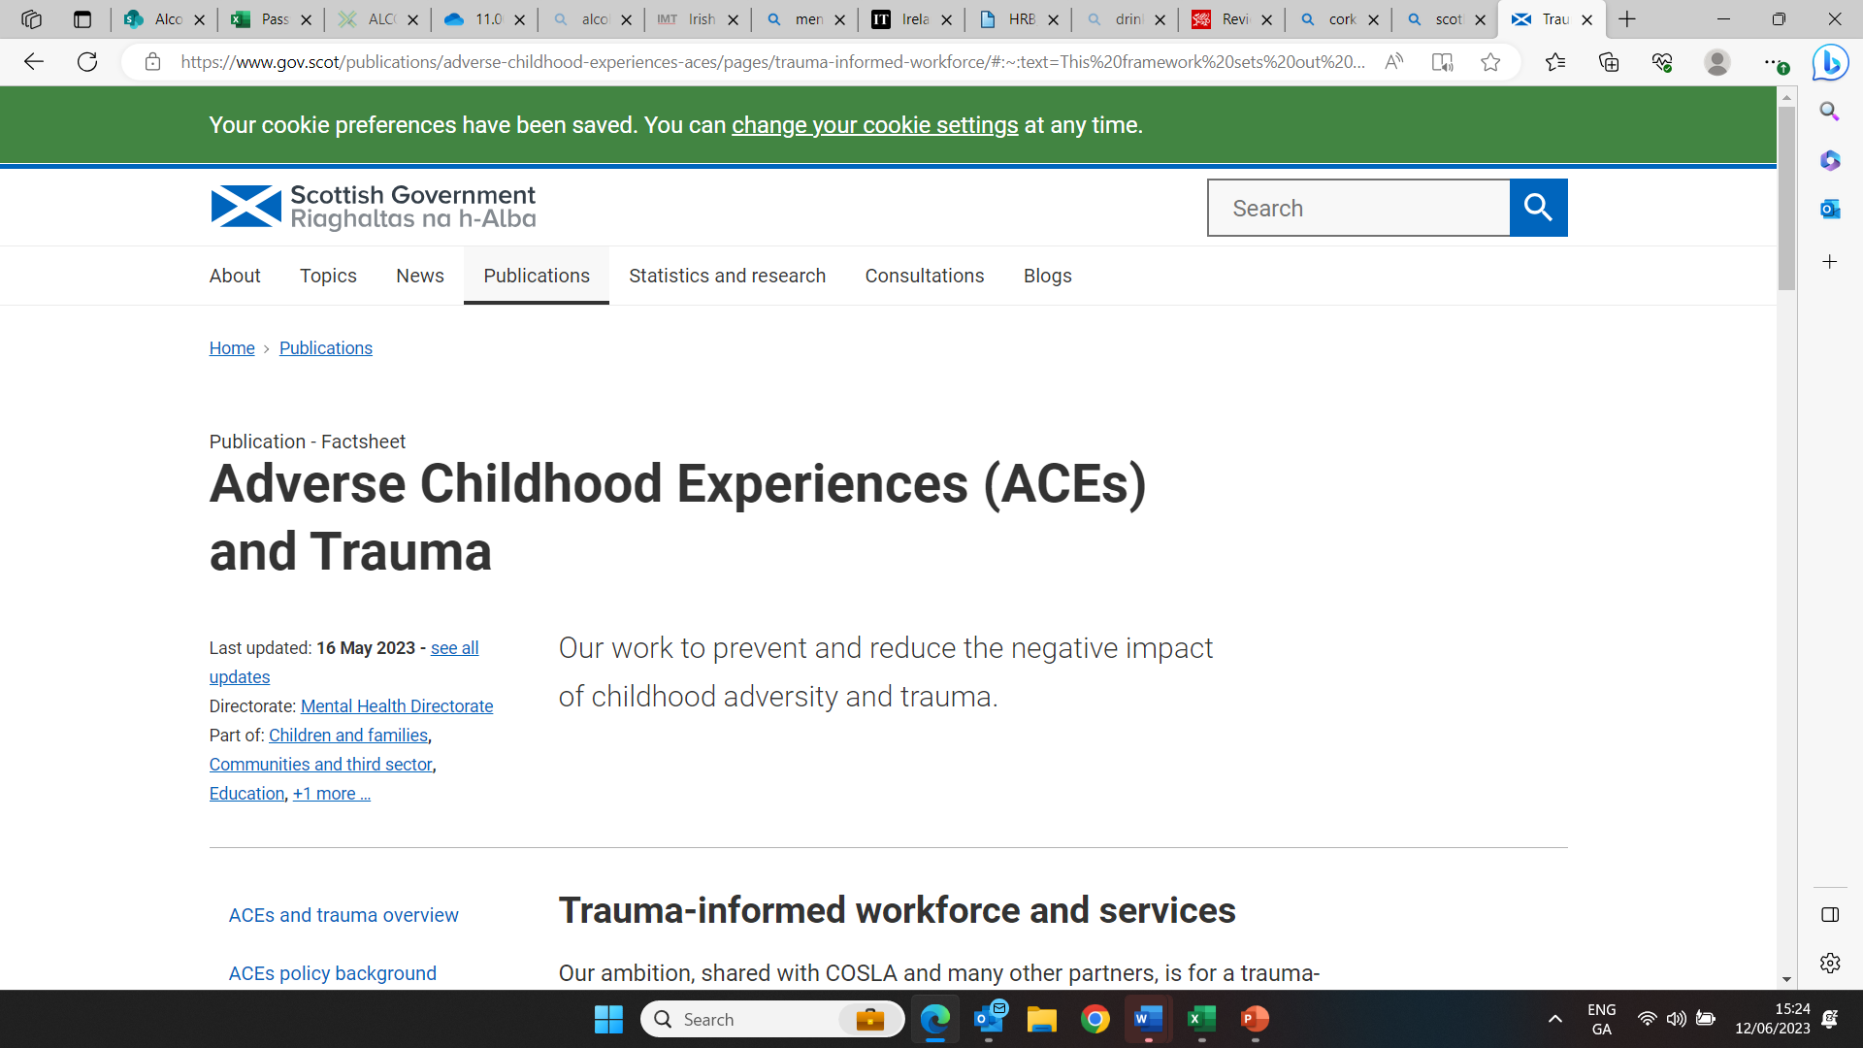

Slide 21


Silent Voices –
Informed by the voice of lived experience
Shared Voices where adult children can share their experiences anonymously. Animated some stories which gives an illustration of some of the trauma experienced.
Research with University College Cork around the experiences of ACOAs as indicated in the Shared Voices and with other interviewees.
This work and the issue of children growing up with the trauma of alcohol harm in the home was recently highlighted by the Special Rapporteur on Child Protection in his annual report.

Slide 22

Education
Expanded this research work into a detailed paper around education issues.
Provided input to professional development courses with teacher’s organisations around Adverse Childhood Experiences attended by over 500.
Where the Light Enters, event with Maynooth University on trauma informed education with key-note speaker Dr Gabor Mate. – 1000 attended
Resources from the event including short videos of good practice in schools have been accessed over 23,000 times.
Maynooth University - developed a website with resources
Trauma Informed Education |

Slide 23
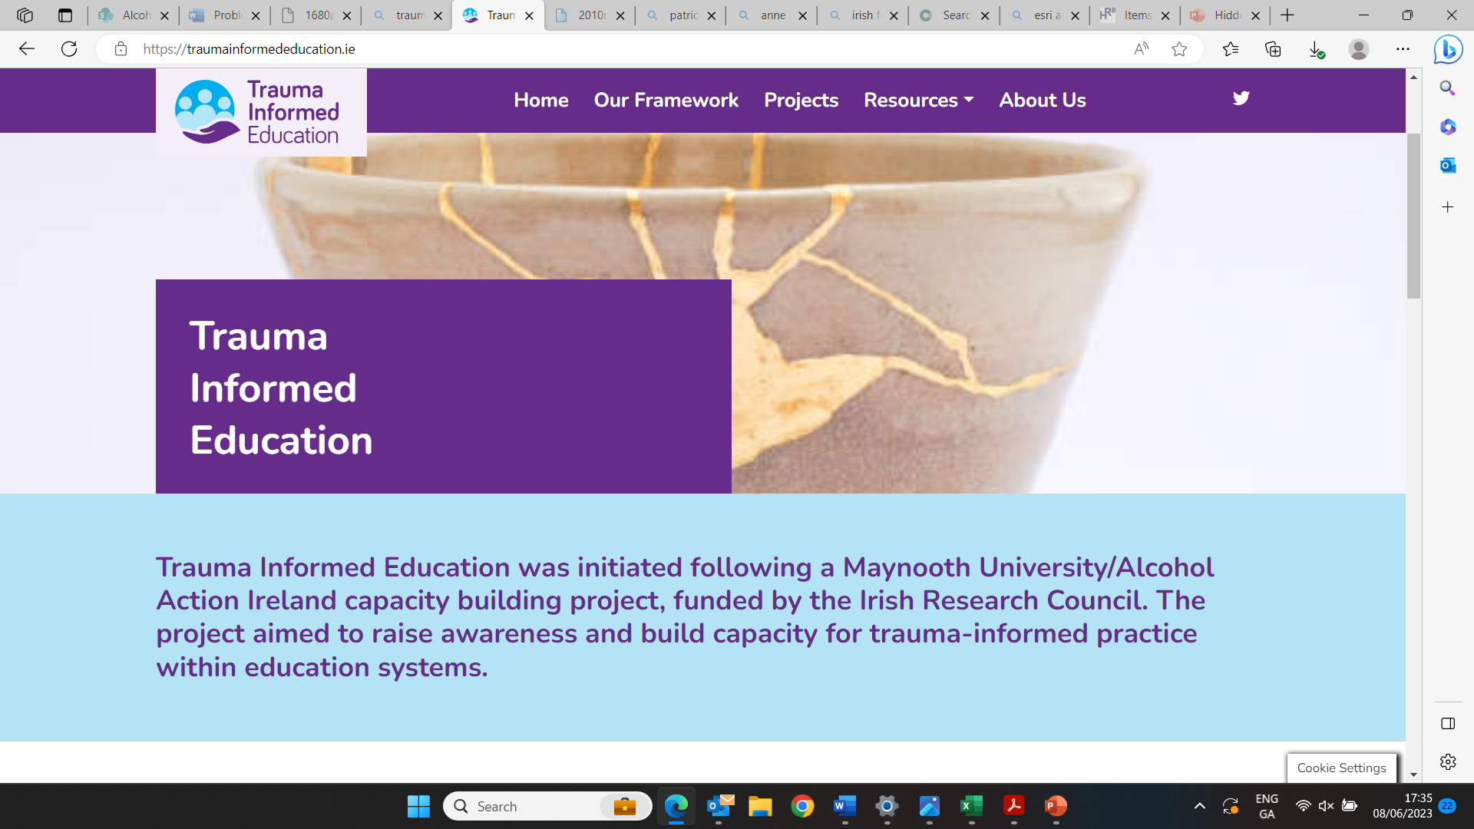

Slide 24
Therapeutic support
Parental problem alcohol use – significant predictor of mental health issues
University College Cork/AAI research – lack of professional knowledge/training
70% of mental health professionals reported that they had not received any PPAU specific training.
92% of participants reported that they would be supportive of all MH professionals being trained to a minimum degree to identify children who experience PPAU.
97% of professionals would support anonymous data collection of the number of clients impacted by PPAU through reporting to a central database such as the Health Research Board

Slide 25
Therapeutic support
Public lecture on Compassion Focussed Therapy as part of our Pathways to Recovery work
Established linkages with professional therapist organisations - training events and videos on issues around addiction and impact on families
Our three co-founders of Silent Voices featured in a panel discussion with well-known author, researcher and therapist, Dr Stephanie Brown of the Addictions Institute who presented at a webinar in our first ‘End the Silence’ week.
Developed a two-part podcast for use by therapists working with ACOAs.

Slide 26
Upcoming workshops for therapists
ACA Trauma Syndrome
Being brought up in home with substance use disorder
May be limits to physical, psychological and emotional availability of one or both parents to meet the developmental needs of the growing child.
The counselling process can bring the impacts of these limitations on the client’s personality development into awareness.
Within the therapeutic alliance these limitations can be reworked to facilitate personal development of the clients and/or effective readjustment.
As a result of this process the enduring and prevailing constraints on the client’s functioning in daily life can be understood.
Exploration of how parental substance use disorder has a particular influence on the emerging personality of the child/client equips the therapist to provide detailed and assured support to the client as they struggle to come to terms with present day problems.

Slide 27
Insight to therapists
Rethinking Addiction: Perspectives on Individual and Family Related Harms
Poll during event – 593 respondents
Are you an adult child of a parent or other family member who has been affected by their alcohol/drug dependency?
  YES 53% NO 47%
How would you say your life has been affected by this experience?
  Mildly 7% Moderately 15% Significantly 31% NA 47%

Slide 28
Highlighting good practice
Stigma – language guide
Pathways to treatment – events/blogs
End the Silence 2022 –
  Parenting under Pressure,
  STEPS to Cope
  Moving Parents and Children Together - MPACT

Slide 29
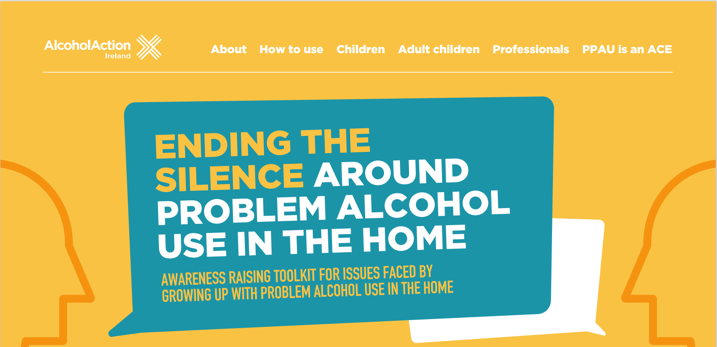
Interactive toolkit

Slide 30
Advocacy
Made multiple detailed submissions to government consultations on issues including
Youth Justice,
EU Child Guarantee,
Draft Report of Ireland to the UN Committee on the Rights of the Child,
Dept of Justice consultation on Domestic, Sexual and Gender-based Violence,
National Model for Parenting Support Services.
Covid and Hidden Harm report
Held workshops and meetings with a range of interested organisations and individuals. From this we developed our manifesto of strategic actions needed.
Met with senior Gov ministers and policy makers
Garnered significant media coverage of this issues with over 150 items in national and regional media as well as our dedicated Silent Voices social media handle.

Slide 31
Partnerships and linkages
Addiction Counsellors of Ireland
AWARE
Children’s Rights Alliance
Drug and Alcohol Taskforces – Dun Laoghaire and Western Region
Irish Association for Counselling and Psychotherapy
Irish National Teachers Organisation
ISPCC
Maynooth University – Dept of Education
Mental Health Ireland
Mental Health Reform
NACOA UK
Office of Children’s Ombudsman
Prevention and Early Intervention Network
University College Cork – Dept of Applied Psychology

Slide 32

Current projects
Annual End the Silence Week – 23-27 Oct 2023
Operation Encompass – data sharing programme, police/school
  immediate support for children who witness domestic violence
Intersectional projects
  Eg National strategy on Domestic, Sexual and Gender Based Violence
  Children included but no mention of alcohol
Developing an 8-week compassion focussed mindfulness course for ACOAs
CPD courses for therapists – Nov 2023
Voice of the Child research

Slide 33
What’s needed?
Whole of government approach
Children’s rights should be at heart of approach
Training for professionals – teachers, social workers, GPs, mental health professionals
Embed trauma-informed concept in all services
Seek out and listen to the voice of children

Slide 34
Thank you
Contact details
Email: Sheila.Gilheany@alcoholactionireland.ie
Web: alcoholireland.ie
Twitter: @AlcoholIreland
Silent Voice @IrelandSilent
End the Silence - https://alcoholireland.ie/campaigns/end-the-silence/

