Slide 1




The Effectiveness of Concerned Significant Other Interventions in the Treatment of Problem Gambling: A Systematic Review
Dr Ruaridh Gill, Dr Finola Sparshott-McDaid, Jessica Lynch & Dr Lynda Russell

Slide 2
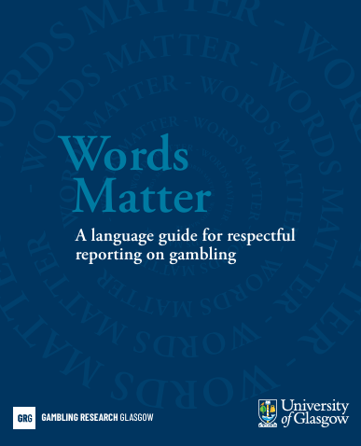
Language
Recognition that the use of the phrase problem gambling can be viewed as stigmatising and has been revised in updated versions of this review.
Notes:
Reduced CSO strain (via improved support and coping) may allow them to provide increased support to the problem gambler, positively impacting recovery.

Slide 3
Background
Gambling is a common activity, with 40-61% of individuals in the UK gambling each year (Gambling Commission, 2023).
Gambling disorder has an estimated prevalence of 1.29% (Gabellini et al., 2022) with a further 2.3-6% at-risk levels of gambling (Gambling Comission,2023) al a
Gambling harms are wide-ranging, covering financial, relational, emotional, physical and cultural harms (Public Health England, 2021)
Concerned Significant Others (CSOs) are shown to have poorer mental and physical health, increased substance use disorders and relational difficulties (Tulloch et al., 2022)
Despite these difficulties, there remains limited gambler treatment entry and significant difficulties with retention and maintenance of gains (Bijker et al., 2022)
Notes:
Define gambling disorder-
with a further 2.3%-6% identified as evidencing at-risk levels of gambling
Gambling disorder is defined by impaired control and increased priority placed on gambling which continues despite negative consequences, leading to significant impairment (World Health Organization, 2022
Gambling commission is from Matrix
Harms for gamblers are wide-ranging (Public Health England, 2021).

Slide 4
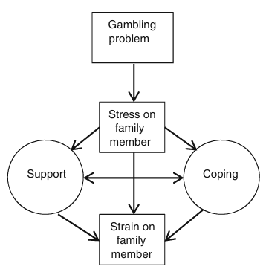
Theory
SSCSM
The Stress Strain Coping Support Model (Orford et al., 2010) provides a framework to understand these impacts
May provide a framework to understand the impacts of CSO interventions, with Kourgiantakis et al. (2018) suggesting there should be a bidirectional relationship.
Notes:
Reduced CSO strain (via improved support and coping) may allow them to provide increased support to the problem gambler, positively impacting recovery.

Slide 5
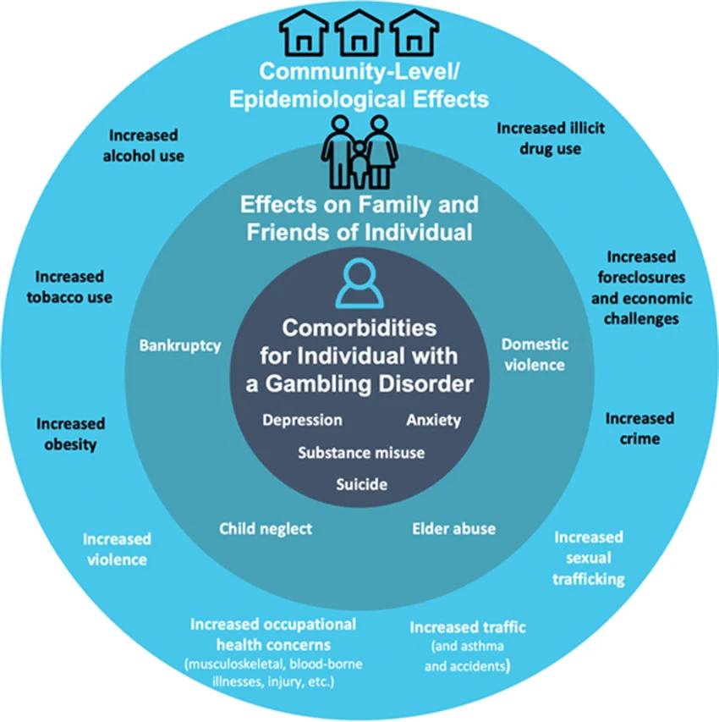
CSO Interventions
CSO interventions aim: to encourage problem gamblers to enter treatment; focused on CSOs needs; and joint interventions to treat gambling disorder (Copello et al., 2005).
Previous review found that CSO interventions led to reductions in the amount spent on gambling, frequency of gambling and the consequences of gambling (Kourgiantakis et al., 2013)
Notes:
May provide an alternative to individual treatment when gamblers are not engaged
May improve engagement
And retention
A number of modalities have been applied to problem gambling including; BCT, CCT, CRAFT, CBT and ICT-PG
- Discussion regarding limitations of kourgiantakis and reason a further review was needed
Also discussion re edgren and Vassallo

Slide 6
Aims
This review therefore aimed to assess:
1) To assess the effectiveness of CSO interventions on gambling related outcomes for the significant other who gambles (e.g. money spent on gambling).
2) To assess whether CSO interventions impact treatment entry, retention and engagement of the significant other who gambles.
Notes:
Discuss that specifically related to gambling outcomes- i.e. money spent/lost
Discuss reasons that a further review was needed- infancy of research, lack of focus on controls, lack of treatment modalities applied

Slide 7
Methods
PRISMA and SWIM guidelines followed (Campbell et al., 2021; Page et al., 2020)
Comprehensive searches undertaken
Joanna Briggs Institute checklists utilised to assess risk of bias
Direction of effect narrative synthesis was undertaken
Certainty in the direction of effect was assessed using the GRADE approach
Eligibility Criteria
Population | CSO and gambler
Intervention | CSO interventions
Comparison | Active or passive controls, pre to post comparisons
Outcomes | Gambling related outcomes: Money spent/lost on gambling Frequency of gambling Gambling Severity Measures Gambling Consequences
Study Design | RCT’s, quasi-experimental and cohort studies.
Notes:
Eligibility criteria; Interventions delivered to CSO and gambler, or CSO independently, report gambling related outcome (e.g. money spent, problem gambling severity), RCT’s, quasi-experimental and Cohort Studies included.
on APA PsycInfo, CINAHL, Embase, and MEDLINE and Cochrane Central Register of Controlled Trials.
Completed according to PRISMA and SWIM guidelines (Campbell et al., 2021; Page et al., 2020)
, in line with Cochrane guidance (McKenzie & Brennan, 2019)
(Barker et al., 2023; 2024;Moola et al., 2020).
Need to describe the direction of effect narrative synthesis

Slide 8
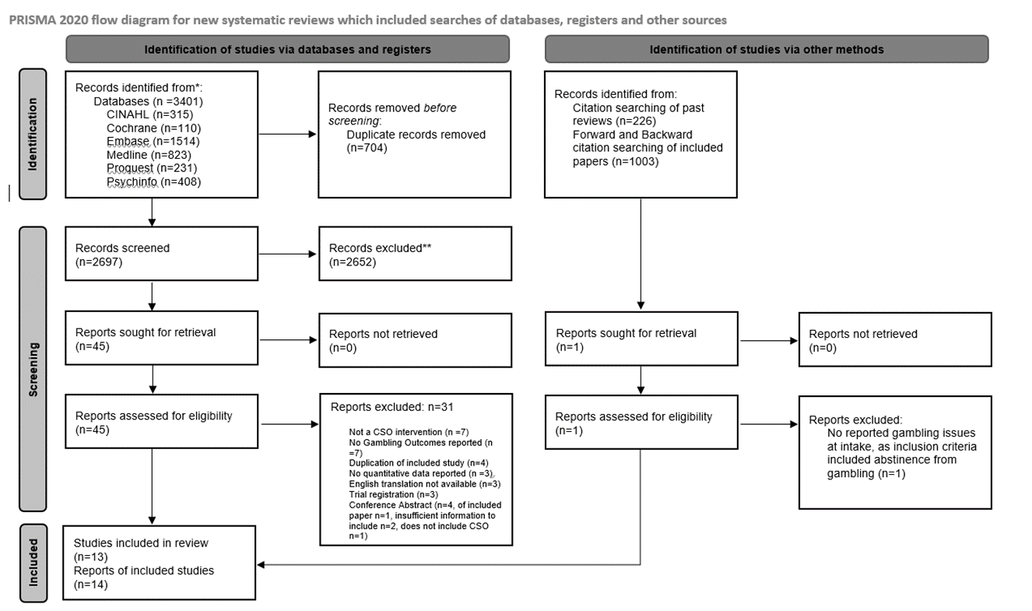
Results
Notes:
Provide brief summary of the results just-
13 studies were found, with 14 reports included

Slide 9
Study Characteristics
Studies were RCTs (n=10), cohort studies (n=2), a quasi-experimental study (n=1) and a secondary analysis (n=1)
Studies undertaken between 2002 and 2023 in Canada (n=8), Sweden (n=3), USA (n=2), and Spain (n=1)
RCT sample sizes varied from 23 to 272, with 975 participants in total.
Therapeutic modalities included: Congruence Couple Therapy (CCT) (n=4), CRAFT (n=3), CBT (n=3), Behavioural Couples Therapy (BCT) (n=2), Integrative Couples Therapy for Problem Gambling (ICT-PG) (n=1), and a coping skills intervention (n=1)
Control groups included passive (delayed treatment, waiting list) and active controls (e.g. CBT, counselling)
Delivery methods included face to face (n=9), online (n=3) and self-help interventions (n=2)

Slide 10
Bias Assessment
Within the RCTs, one study indicated low risk of bias, three indicated a moderate risk, and six indicated a high risk of bias.
Issues within allocation and selection and baseline differences in outcomes
Participant retention was a concern due to unreported reasons for drop-out and uneven, high levels of drop-out within studies
There was a lack of intention-to-treat analysis used and all studies appeared underpowered to detect small-to-medium effects
Notes:
Allocation-3 unclear allocation, 3 unclear allocation and baseline differences
Retention- no drop out reasons- 5 studies, high uneven level of drop out in 3. Relate to importance due to lots of drop out within studies
Power-and five studies did not acknowledge this limitation when interpreting results
Regarding statistical validity,

Slide 11
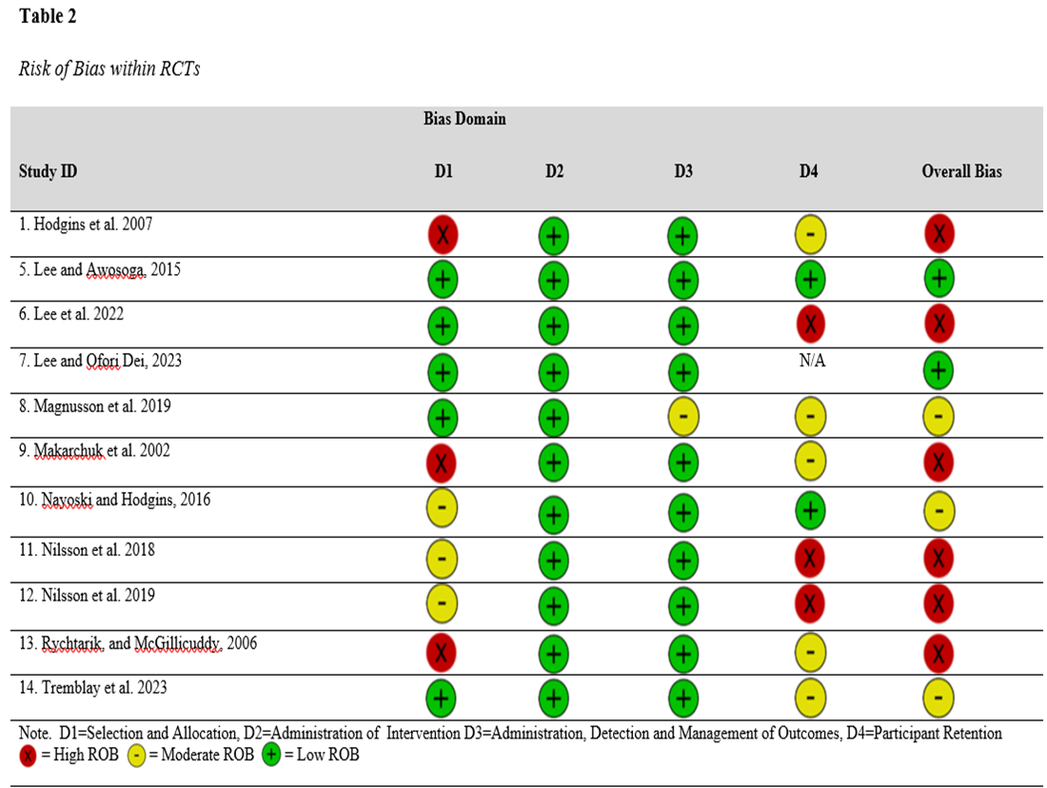
Risk of Bias Assessment

Slide 12
Results: Primary Outcomes
Money spent/lost Gambling: Control interventions were favoured, particularly if they were active controls (e.g. CBT).
Gambling Frequency: No overall pattern favouring CSO or control interventions.
Gambling related symptom severity: CSO interventions are favoured, including when compared to active CBT controls.
Gambling Consequences: One study reported gambling-related consequences for gamblers, favouring the CSO intervention over a wait-list control
Certainty in these results was low to very low across domains and was significantly effected by risk of bias, inconsistency and imprecision.
Notes:
Money spent/lost gambling- (3 favour control, 1 CSO intervention and one neither) passive controls mixed, active controls are CBT
There was very low certainty evidence that the direction of effect favoured control interventions, particularly when comparing to active controls
Frequency- (2 in favour, 1 control, 1 inconsistent) This inconsistency, combined with high risk of bias, led to very low certainty regarding the true direction of effect. Cohort studies findings were also mixed.
Cohort and quasi-experimental also favour CSO interventions.
Problem gambling severity- (4 CSO, 1 control), Discuss measures used to assess problem gambling severity.
Provide some hypothesis of why this may be the case- even if the impacts on behaviour are similar the increased focus on relationship and communication may lead to greater changes which reduce problem gambling behaviours (i.e. lying, arguments, criticism)

Slide 13
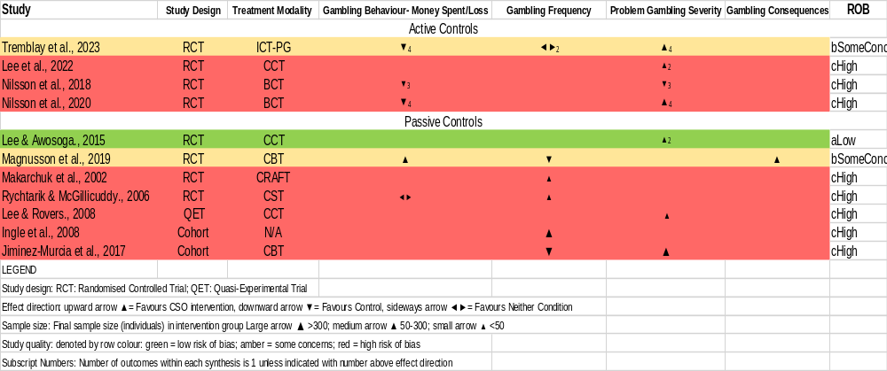
Direction of Effect Analysis
Notes:
Discuss what the format of this means

Slide 14
Results: Secondary Outcomes
Treatment Retention: RCTs favour control conditions. Within cohort studies CSO interventions were favoured.
Treatment Entry: No pattern indicating support for CSO interventions over control conditions, with inconsistent results found
Treatment Engagement: No pattern indicating that CSO interventions were favoured over controls, with inconsistent results found.
Notes:
Treatment Retention-
In RCT’s, four favour control condition, two favour CSO intervention. In contrast Contrast in results is of note, and worthy of further exploration.
Treatment entry- One study favoured the CSO intervention, two studies favoured control conditions, and one found no difference between conditions. Taken together. Point out that this is significantly different to drug/alcohol research
Treatment engagement- Mixed findings, with one favouring CSO interventions, one favouring control and one indicating mixed results. Therefore results remain unclear.

Slide 15
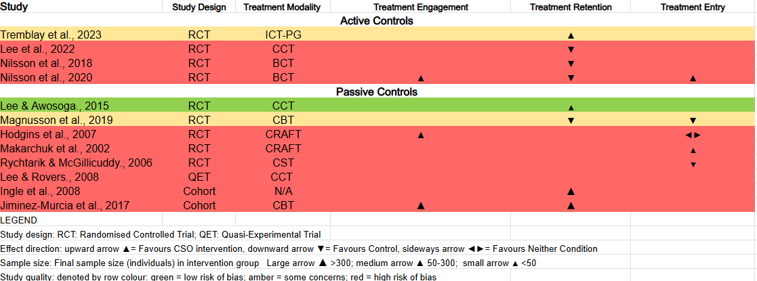
Direction of Effect Analysis

Slide 16
Conclusions and Limitations
Conclusions
Results indicate that CSO interventions are not better than controls for Gambling expenditure and frequency, which contrasts with drug and alcohol literature.
In contrast, CSO interventions appear to be favored for problem gambling severity.
Lack of clarity regarding what outcomes are important for CSO’s and individuals who gamble limits assessment of the relative importance of these contrasting results.
Limitations
Review was unable to undertake a meta-analysis due to lack of consistent outcome reporting, direction of effect synthesis provides minimal data regarding magnitude or significance of effect.
Notes:
Add reference for point one
Add potentially that relational nature of treatment favours this
Limitation-

Slide 17
Implications
Research implications
Further research should work towards an agreed definition of ‘positive treatment outcomes’ and updated reporting guidelines within Gambling treatment, with a focus on service user perspectives, including CSO’s.
Clinical implications
Where the focus of service provision is to reduce ‘problem gambling’ severity, the application of CSO interventions may improve treatment outcomes, which may be explained by the SSCSM.
These interventions have the further benefit of offering support to CSO’s and have been shown to reduce CSO mental distress (Edgren et al., 2023).
An increase in practise based evaluations, will help to assess the effectiveness of this alternative to individual treatment.
Notes:
Remeinder of what problem gambling severity is focused on (i.e. urges, thoughts, preoccupation)
This research should contribute to an updated reporting guideline.
Clinical Implications-
May be particularly helpful to offer these interventions where individual inputs have not worked previously and therefore indicating there may be something uniquely systemic about their difficulties.

Slide 18

Thank you
Any questions?
Contact Details:
Ruaridh.Gill@lanarkshire.scot.nhs.uk
lynda.russell@glasgow.ac.uk

Slide 19
References
Bijker, R., Booth, N., Merkouris, S. S., Dowling, N. A., & Rodda, S. N. (2022). Global prevalence of help-seeking for problem gambling: A systematic review and meta-analysis. Addiction, 117(12), 2972-2985. https://doi.org/10.1111/add.15952
Copello, A. G., Velleman, R. D., & Templeton, L. J. (2005). Family interventions in the treatment of alcohol and drug problems. Drug and Alcohol Review, 24(4), 369-385. https://doi.org/10.1080/09595230500302356
Edgren, R., Pörtfors, P., Raisamo, S., & Castrén, S. (2022). Treatment for the concerned significant others of gamblers: A systematic review. J Behav Addict, 11(1), 1-25. https://doi.org/10.1556/2006.2021.00088
Gabellini, E., Lucchini, F., & Gattoni, M. E. (2022). Prevalence of Problem Gambling: A Meta-analysis of Recent Empirical Research (2016-2022). Journal of Gambling Studies. https://doi.org/10.1007/s10899-022-10180-0
Guyatt, G. H., Oxman, A. D., Akl, E. A., Kunz, R., Vist, G., Brozek, J., & Schünemann, H. J. (2008). GRADE: an emerging consensus on rating quality of evidence and strength of recommendations. BMJ, 336(7650), 924-926. https://doi.org/10.1136/bmj.39489.470347.AD
Kourgiantakis, T., Saint-Jacques, M. C., & Tremblay, J. (2013). Problem Gambling and Families: A Systematic Review. Journal of Social Work Practice in the Addictions, 13(4), 353–372. https://doi.org/10.1080/1533256X.2013.838130
Kourgiantakis, T., Saint-Jacques, M.-C., & Tremblay, J. (2018). Facilitators and Barriers to Family Involvement in Problem Gambling Treatment. International Journal of Mental Health and Addiction, 16, 291-312. https://doi.org/10.1007/s11469-017-9742-2
Orford, J., Velleman, R., Copello, A., & Templeton, L. (2010). Family members affected by a close relative's addiction: The stress-strain-coping-support model. Drugs: Education, Prevention and Policy, 17(sup1), 36-43. https://doi.org/10.3109/09687637.2010.514801
Tulloch, C., Browne, M., Hing, N., Rockloff, M., & Hilbrecht, M. (2022). How gambling harms the wellbeing of family and others: a review. International Gambling Studies, 22(3), 522-540. https://doi.org/10.1080/14459795.2021.2002384

Slide 20


