Slide 1

Why is it so hard to share and ask for help?
Charlie Lowe
Family Matters
46-48 Devonport Road
Plymouth PL3 4DH
United Kingdom
Notes:
Good afternoon. Thank you AFINet for this opportunity.
The inspiration for this study came from running a family support service.
It’s that old paradox - family members really benefit from help
- laughter returns, lives are reclaimed, relationships with loved ones improve
so why was it so hard to persuade them to step through the door in the first place?
It’s a research question that echoes around many other papers at this conference.

Slide 2
Research Question
Why is it so hard to share and ask for help?
Exploratory study of family members’ experience
of telling others about their loved one’s
drug or alcohol problems,
and in separately seeking help for themselves
Funded by The Big Lottery, UK
Why is it so hard to share and ask for help?
Notes:
We wanted to better understand the journey family members take when they share, and seek help for themselves. In the time available we will only be discussing the sharing aspect.
We wanted information-rich qualitative material to illuminate the path they trod, and we are indebted to our 19 participants for providing such valuable and intimate data.

Slide 3
From the
15 year old son of a drug addicted mother
“I came back from Duke of Edinburgh awards to a dark house, no one in so I broke the back window.
No gas, no electric, usual mess … my mum was in a police cell. I lit a candle.
All I was worried about was
finishing my homework.”
20XX
Notes:
This example, from a then 15 year old, shows the environment that was to be such a big influence, on how he would share, later on.
I should explain the Duke of Edinburgh awards are a popular youth scheme promoting volunteering, skill development and outdoor expeditions.

Slide 4
Methodology
Purposive sampling of adult (≥ 18 years) population known to two support services in 2 local communities 30 miles apart in SW England
Semi-structured qualitative interview and attribute questionnaire Phase 1: 2 groups of 3
Phase 2: 12 individual interviews
NVivo software
Data saturation determined the sample size
Why is it so hard to share and ask for help?
Notes:
Methodology
Sampling was PUR+puh+sive (purposive), despite attempts to recruit more broadly, so all participants were known to one of two local support services.
We used a semi-structured interview format.
Once transcribed, interviews lasting about 75 minutes were added to NVivo.
Initial coding, led to category codes and after further analysis, themes were developed according to the principles of thematic analysis.

Slide 5
Findings overview
1. Participant and Loved One Attributes
SHARING | ASKING FOR HELP
2. Sharing experiences | Time taken
3. Time taken | Motivation
4. Circumstances | Journey
5. Barriers & Reaction Apprehension Model | Reasons
 | Benefits
 | Drawbacks
Why is it so hard to share and ask for help?
Notes:
Only the numbered sections in this table of findings will be covered.
In using quotations all names have been changed for confidentiality and
vocal emphasis mirrors that heard on audio recordings.

Slide 6
1. Participant Attributes
 | PARENTS N=12 | PARTNERS N=5 | ADULT CHILDREN N=2
Gender | 11 female 1 male | 4 female 1 male | 1 female 1 male
Average Age (Range) | 61.5y (50-70y) | 39y (22-46y) | 30y (19-41y)
In couple relationship | 8 | 5 | 0
Raising grandchildren | 2 | 0 | N/A
Own History of Drug or Alcohol problems | 0 | 1 1-3y in Recovery | 1 3y in Recovery
Why is it so hard to share and ask for help?
Notes:
Starting with Participant attributes, 3 main groups were immediately evident - Parents, Partners and the now Adult Children.
16 women and 3 men were interviewed. Ethnic diversity was limited as all described themselves as White British.
In 2 cases, grandparents were raising their grandchildren due to a daughter’s drug addiction.
2 participants were also in their own recovery from drug or alcohol dependence.

Slide 7
1. Loved One Attributes
 |  | PARENTS N=12 | PARTNERS N=5 | ADULT CHILDREN N=2
Relationship type |  | 5 daughters 7 sons | 1 female 4 male | 2 mothers 0 fathers
Average Age (Range) |  | 34.1y (20-43y) | 42.2y (37-52y) | 50y (40-60y)
Problems with Drugs Alcohol Both |  | D 10 A 1 B 1 | D 1 A 2 B 2 | D 2 A 0 B 0
Living together |  | 4 | 4 | 0
Considered to be Dual Diagnosis |  | 2 | 2 | 0
LO’s Recovery Status | Still using | 7 | 2 | 2
 | MH Section | 1 | 0 | 0
 | <1y clean/sober | 3 | 1 | 0
 | 1-3y clean/sober | 0 | 1 | 0
 | >5y clean/sober | 1 | 1 | 0
Why is it so hard to share and ask for help?
Notes:
Looking at the attributes of the loved one, we see that drug addiction was the commonest problem.
Most were still using, or drinking , but 7 were in recovery.
A few lived with their Parents. Partners all lived together except one couple who had just split. Both Adult Children had moved out of home.
Collectively they had over 200 years of experience living alongside a family member with addiction representing … a considerable resource of knowledge.

Slide 8
2. Sharing Experiences
POSITIVE 47% NEGATIVE 36%
MIXED 17%
Why is it so hard to share and ask for help?
Notes:
The first Finding relates to the sharing experience.
We asked about first times, who they told, why they shared, how it was done, what happened, how did the experience affect them.
There were 209 sharing episodes in total and focusing on their impact, here is a traffic light stack chart for each of the 19 participants where Dark blue is positive, Light blue negative and Green mixed. Only one was neutral.
On average 47% of sharings were positive, 36% negative and 17% mixed.
This finding struck us as significant.

Slide 9
2. Sharing experiences
When I told my elderly mother about her granddaughter’s drug problem, I was upset.
But she just said:
“Darling she’s still our Lisa. We must do whatever we can to make her realise, every day, that she’s very loved.”
Why is it so hard to share and ask for help?
Notes:
Here’s a very heartfelt positive example:
When I told my elderly mother about her granddaughter’s
drug problem, I was upset.
But she just said:
“Darling she’s still our Lisa. We must do whatever we can to make her realise, every day, that she’s very loved.”

Slide 10
2. Sharing experiences
I did share with a friend and it backfired because she went to my daughter’s employer and said:
“I think you’re very good taking on a heroin addict.”
So she lost her job which was very unkind and cruel.
This was a lifelong friend I thought I could trust.”
Why is it so hard to share and ask for help?
Notes:
And a negative one
I did share with a friend and it backfired because she went to my daughter’s employer and said:
“I think you’re very good taking on a heroin addict.”
So she lost her job which was very unkind and cruel.
This was a lifelong friend I thought I could trust.

Slide 11
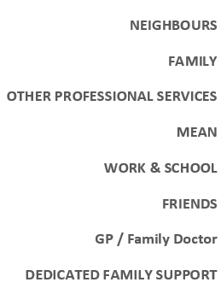
2. Sharing experiences (cont’d)
Why is it so hard to share and ask for help?
Notes:
Looking at who participants shared with, we established the following social categories.
Other Professional services covered Adult and Child mental health, Social Care and Drug & Alcohol services.
We wondered if any variations were evident between the groups?
This is what we found.
Not surprisingly over 80% of sharings at dedicated family support services, were positive, compared to 15% with the neighbours group - where the physical proximity brought its own particular issues.
The ranking was unexpected, and shows interesting trends, concerning who you are most likely to get, a positive response from.

Slide 12
3. Time taken to first sharing
 | PARENTS | ADULT PARTNERS | ADULT CHILDREN
EARLY <1y | 10 | 4 | 1
MID-RANGE 1-5y | 0 | 1 | 0
LATE >5y | 2 5 & 10y | 0 | 1 26y
Why is it so hard to share and ask for help?
Notes:
Next we looked at time to First sharing. Most shared quickly, especially parental couples, and usually within the first year.
For three, it took much longer. They all carried higher levels of internalised blame and the longer time, was consistent with their individual context.
One older divorced mother had complex emotions after discovering that her ex-husband had sexually abused their daughter who later took to drugs. Another’s spouse had a high profile job, and demanded absolute secrecy about their son’s addiction. The longest gap of 26 years, belonged to our 15 year old doing his homework by candlelight. He needed to establish his own recovery from alcoholism, before addressing the impact that his mother’s drug addiction, had upon him.

Slide 13
4. Circumstances of sharing
Two Themes: 1. Planned or Involuntary
        2. Presence of a CRISIS
 | PARENTS |  | ADULT PARTNERS |  | ADULT CHILDREN |  | TOTAL
CRISIS | Y | N | Y | N | Y | N
Planned | 5 | 14 | 0 | 8 | 0 | 2 | 29
Involuntary | 7 | 1 | 2 | 0 | 2 | 0 | 12
Why is it so hard to share and ask for help?
Notes:
Looking at the circumstances of sharing, 2 themes emerged.
Firstly whether sharing was planned or involuntary, and secondly whether a crisis triggered the sharing. As you can see most sharing was planned, but when involuntary, was usually associated with a crisis.
Involuntary examples are, the public exposure from a local newspaper front page with a loved one, on a list of recently convicted drug addicts, or when neighbours witnessed emergency visits by the Police or ambulances to deal with arrests or overdoses.
Children experienced less privacy, and their fear that sharing might lead to forced family break up, did happen.
Another common crisis was personal health breakdown, “cracking up” or being “sent home from work crying” often leading to sick leave.

Slide 14
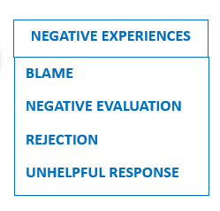
5. Barriers to sharing
BLAME
The moment you say …
“My husband’s an alcoholic.”
They say …
“Didn’t you know that when you first met him?”
“Why couldn’t you have just walked away?”
Why is it so hard to share and ask for help?
Notes:
Considering replies about perceived barriers to sharing, analysis revealed 4 major negative experience types that appeared relevant.
Firstly Blame –
The moment you say “My husband’s an alcoholic.”
They say “Didn’t you know that when you first met him?”
“Why couldn’t you have just walked away?”

Slide 15
5. Barriers to sharing
NEGATIVE EVALUATION
A head teacher approached her family doctor about her son.
The doctor said… “Chuck him out!”
I said “He’s bigger than me and
when he’s using drugs,
he can be physically aggressive.”
“Chuck him out!” he replied.
That was it. Just dreadful.
I remember creeping out of the room.
Why is it so hard to share and ask for help?
Notes:
And Negative evaluation –
A head teacher approached her family doctor about her son. The doctor said:
“Chuck him out!”
I said “He’s bigger than me and when using drugs he can be physically aggressive.”
“Chuck him out!” he replied.
That was it. Just dreadful.
I remember creeping out of the room.

Slide 16
5. Barriers to sharing
REJECTION
When telling his parents about his new partner’s addiction difficulties, they said to him …
“How can you do this to us?”
It’s was like I’m bringing some badness into the family.
Like I’ve socially excluded myself.
Why is it so hard to share and ask for help?
Notes:
Rejection
When telling his parents about a new partner’s addiction they said to him:
“How can you do this to us?”
It’s was like I’m bringing some badness into the family.
Like I’ve socially excluded myself.

Slide 17
5. Barriers to sharing
UNHELPFUL RESPONSE
People talking about their children and how wonderful they are,
and you just sit there
and say nothing.
Why is it so hard to share and ask for help?
Notes:
Finally the Unhelpful response
People talking about their children and how wonderful they are,
and you just sit there and say nothing.

Slide 18
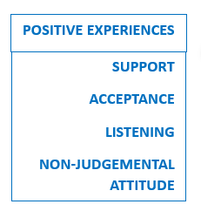
5. Barriers to sharing
Why is it so hard to share and ask for help?
Notes:
We noticed that the negative experiences sat in contrast to this
self-explanatory list of positive ones.
The Positive ones facilitated sharing and were associated with
relaxed and open communication typical of support group meetings or
being with a close and trusted confidant.
Negative experiences linked to descriptions of barriers.

Slide 19
5. Barriers to sharing
Specific behaviours adopted by family members:
SILENCE
SECRECY
PROTECTIVE-NESS
CANDID
-NESS
“You either get condemned or pity”
“I can’t be arsed to explain and
justify myself to others”
Why is it so hard to share and ask for help?
Notes:
We also noted these 4 behaviours that family members utilised as different communication options according to different contexts.
Firstly silence when strong feelings were evident:
‘You either get condemned or pity.’
‘I can’t be arsed to explain and justify myself to others.’

Slide 20
5. Barriers to sharing
Specific behaviours adopted by family members:
SILENCE
SECRECY
PROTECTIVE-NESS
CANDID
-NESS
‘I go around not lying but not telling the truth.’
“How is your daughter?”
‘Oh. She’s fine.’
Why is it so hard to share and ask for help?
Notes:
Then Secrecy
‘I go around not lying but not telling the truth.
“How is your daughter?”
‘Oh. She’s fine.’

Slide 21
5. Barriers to sharing
Specific behaviours adopted by family members:
SILENCE
SECRECY
PROTECTIVE-NESS
CANDID
-NESS
‘You actually tell a story,
but it’s not quite a whole story
because they might not be able to take it.
They would worry far too much.’
Why is it so hard to share and ask for help?
Notes:
Protectiveness
‘You actually tell a story,
but it’s not quite a whole story
because they might not be able to take it.
They would worry far too much.’

Slide 22
5. Barriers to sharing
Specific behaviours adopted by family members:
SILENCE
SECRECY
PROTECTIVE-NESS
CANDID
-NESS
I don’t sugar-coat it anymore, I’m not ashamed now. Yes my husband’s an alcoholic. Yes, he’s a drug addict.
It’s not my fault and I didn’t ask for it so don’t judge me along with everybody else”
Why is it so hard to share and ask for help?
Notes:
And finally Candidness
I don’t sugar-coat it anymore, I’m not ashamed now. Yes my husband’s an alcoholic, yes, he’s a drug addict. It’s not my fault and I didn’t ask for it so don’t judge me along with everybody else”

Slide 23
Reaction Apprehension Model
“I don’t know what they’re going to think.
It’s difficult to actually tell people.
You don’t know what their reaction is going to be.
Whether they’re going to avoid you.”
REACTION APPREHENSION
Why is it so hard to share and ask for help?
Notes:
When we considered these aspects together, one central feature seemed to connect them. This was the uncertainty of how people would react when you told them about your loved one’s drink or drug problem. As one mother explained:
I don’t know what they’re going to think… It’s difficult to actually tell people. You don’t know what their reaction is going to be. Whether they’re going to avoid you.’
We’ve called this Reaction Apprehension and created a model placing it at the centre.

Slide 24
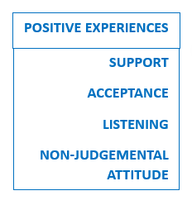
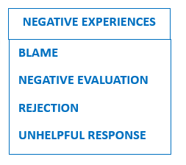
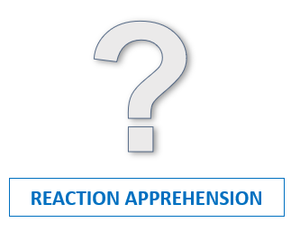
Reaction Apprehension Model
MIXED EXPERIENCES
BEHAVIOURAL PATTERNS
RELAXED & OPEN
SILENCE
SECRECY
PROTECTIVE-NESS
CANDID-
NESS
Why is it so hard to share and ask for help?
Notes:
Of course, any model is a simplified description, of a complex system.
No linear process is intended here, more a road map of the territory family members travel, with recursive elements, that influence each other, variably, over time and context.
Its purpose is to enhance our understanding of the bigger picture, to help the unaware to gain awareness more speedily, with the long-term aim of improving experiences and support systems.

Slide 25
Discussion
Why is it so hard to share about a loved one’s drug or alcohol problems?
Summary
Where does this take us?
Literature detour
Presentation ti
Notes:
Returning to our original research question :
Why is it so hard to share?
The study has provided a detailed data resource, a library of narratives to illustrate the sharing process. The role of Reaction Apprehension due to the confusingly unpredictable responses, has been highlighted, and negative responses associate with barriers and specific communication-limiting strategies or masks.
So where might this take us?
While the model links the parts together – and we heard some exceptionally positive responses, full of respect and hope, from hairdressers, work colleagues and many others, it is the negative ones which must be the focus for change. Over my lifetime, campaigns addressing the inequalities and taboos of race, gender and sexuality have succeeded in shifting the dial towards higher percentages of positive responses, thereby reducing, not eliminating, but reducing discrimination and increasing tolerance. How did this happen? I want to take you on a short detour now, into 3 past publications about stigma, which have stimulated my thinking into where this research might develop.

Slide 26
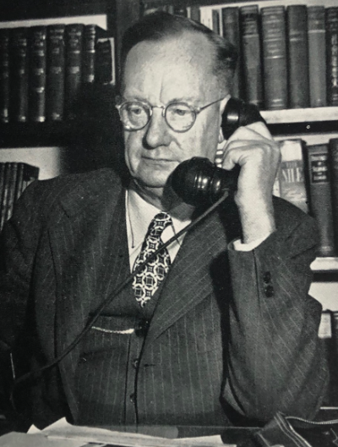


Discussion
EMORY BOGARTUS 1925 1963 NED JONES 1984
Notes:
Firstlty the Bogardus Social Distance Scale (SDS) which appeared 98 years ago in 1925, to measure group acceptability - with questions like – would you marry such a person? Would you let them into the country? etc.. . Rerun in 2005, it showed a continued improvement in tolerance to racial diversity in the USA.
Then in 1963 Goffman released his seminal book “Stigma - Notes on the Management of Spoiled Identity” coining the term ‘undesirable difference’. He proposed that we all instinctively stereotype others in society to enforce rules and normative expectations – privileging some, and projecting discredit on others.
He identified the common ground in how stigma consequences manifest themselves, whatever the issue.
Finally Ned Jones in his 1984 book ‘Social Stigma’ described 6 helpful dimensions that deconstruct our reactions to difference. For example the dimension ‘origin of the stigma’ – which is a particular sticking point for addiction, which struggles to dispel the prevalent assumption that it is a self-inflicted habit, and so unworthy of support.

Slide 27
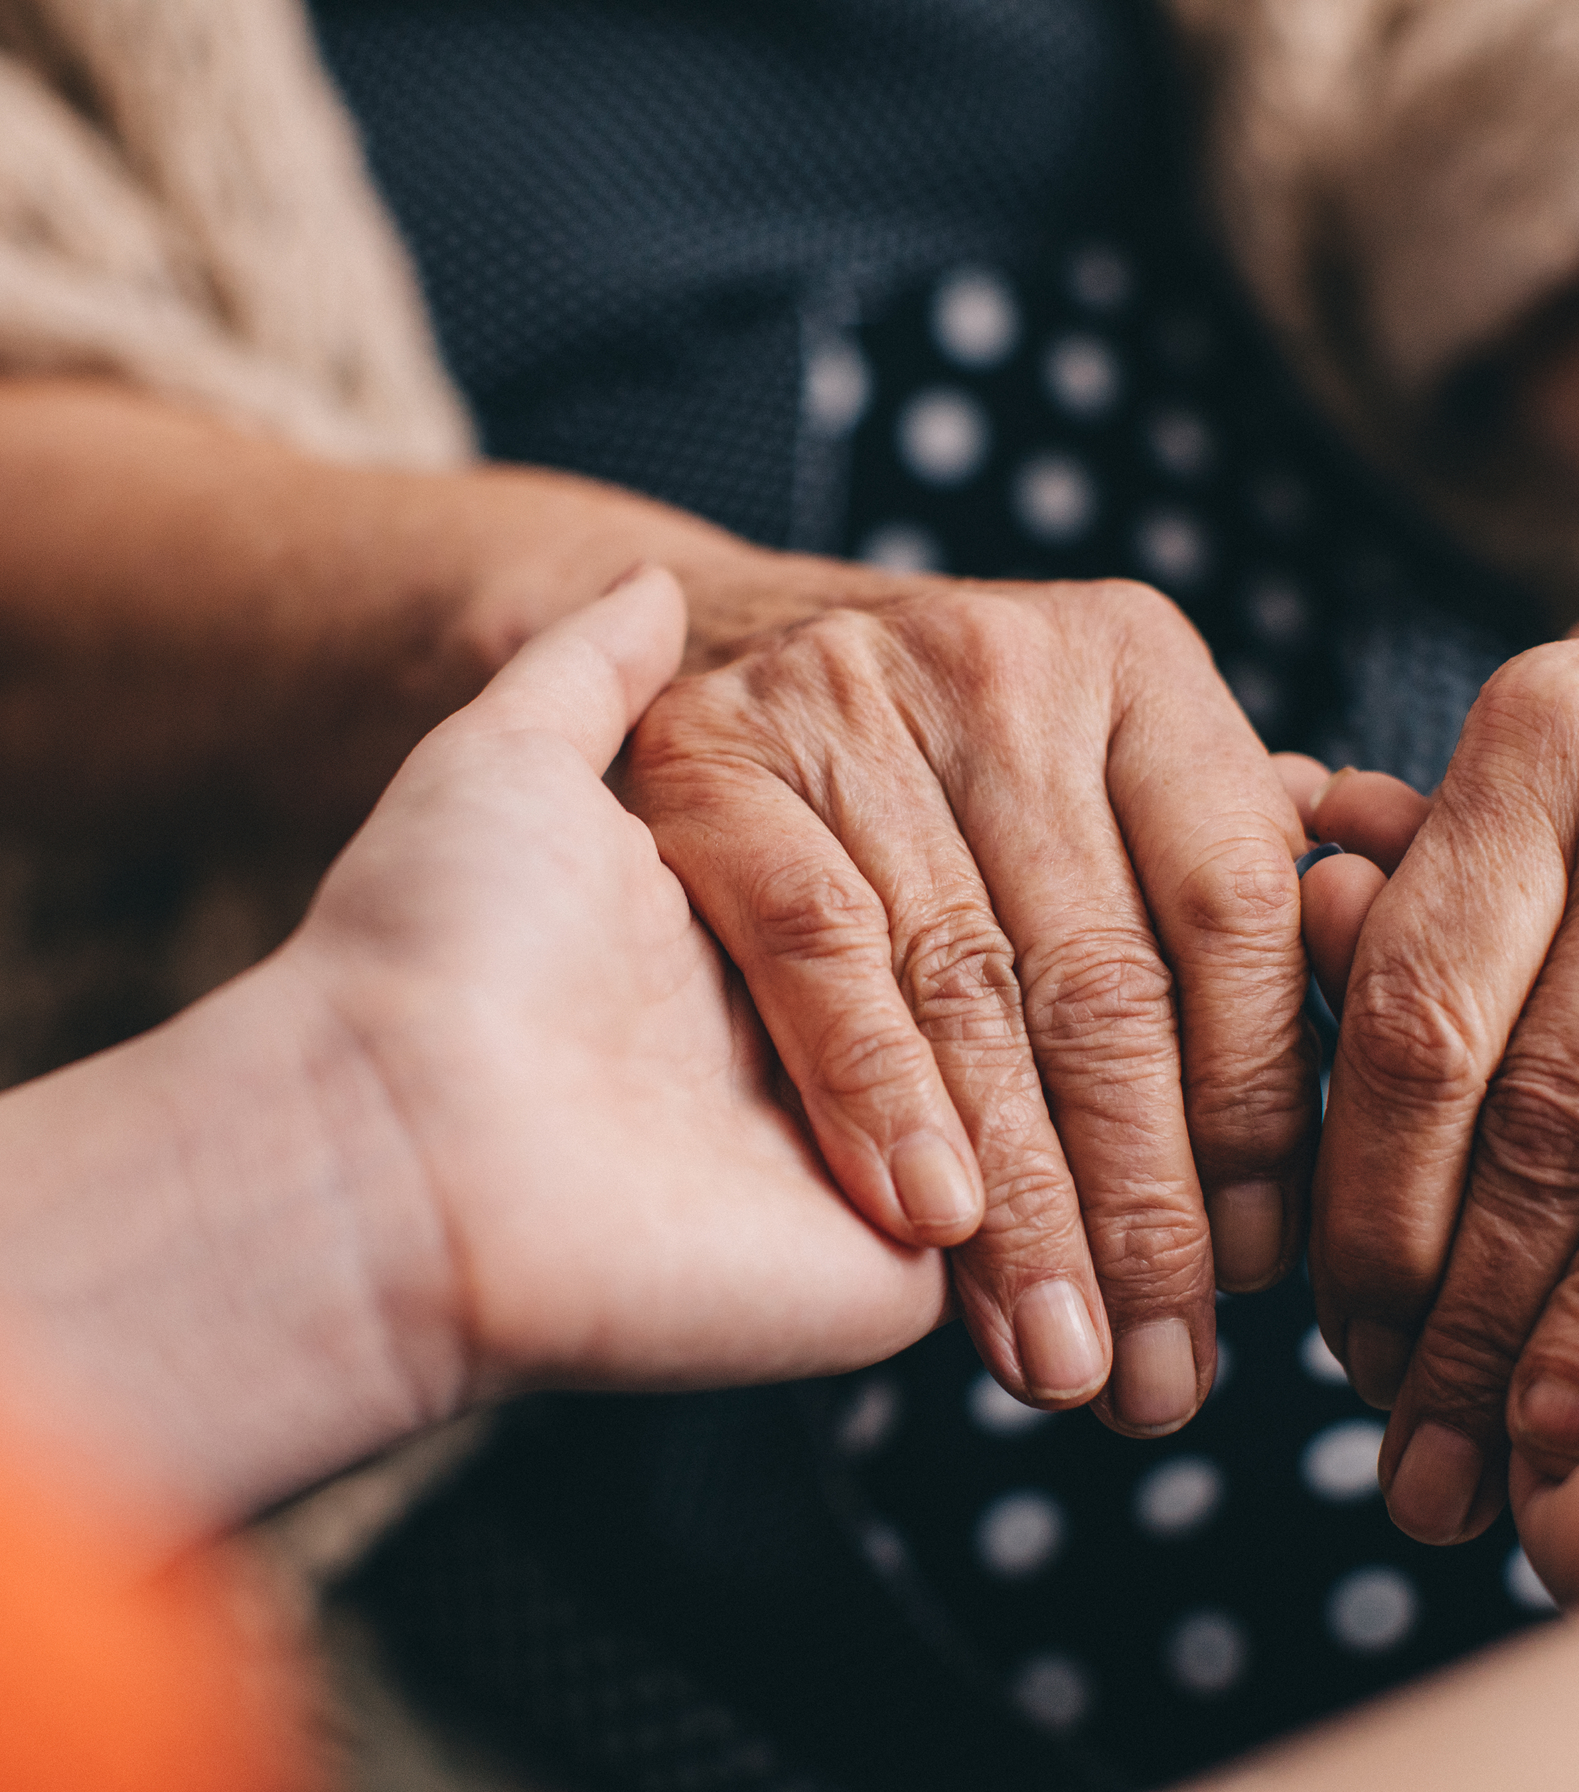
Conclusion
Dissemination of data set
Training resource targeting key professionals, policy makers, commissioners and family members
Stigma measurement and intervention tools
Presentation title
Notes:
So where does that take us?
Well, we are exploring further dissemination of the study findings through publication, workshop presentations and digital media.
However there is real potential to use the data to influence attitudes towards greater acceptability of family members, within training packages, targeting key professionals – practitioners and managers in drug & alcohol and mental health services, family doctors, also policy makers and commissioners, and of course families themselves. Use in the development of addiction-specific stigma measurement and intervention tools, could help create and sustain change over time.
In conclusion, despite its limitations in terms of generalisability, this small study I believe adds to the existing knowledge base, and importantly gives voice to family members.
In the modern world where many are trying to stand up to prejudice and rectify disadvantage, I hope this research can play a small part in our shared quest to reduce discrimination and make it easier for family members affected by a loved one’s addiction, to share with others, and ask for help.

Slide 28
Acknowledgements
The Big Lottery
Study participants
Judy Beckett Jim Orford Fiona Miller
Sue Tristram Heidi Lowe Lorna Templeton
Why is it so hard to share and ask for help?
Notes:
My thanks go to the following contributors in particular, Lorna Templeton.

Slide 29

Thank you for listening
Charlie Lowe
charlielowe@gmail.com
Further email correspondence is welcomed
Why is it so hard to share and ask for help?
Notes:
Thank you for listening.
I am happy to take questions.

