Slide 1
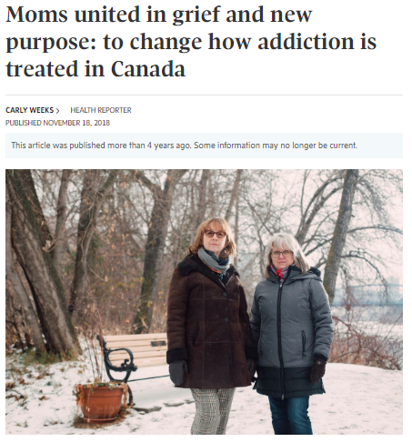
The use of media advocacy by families engaged in Canadian drug policy reform
Petra Schulz
Addiction and the Family International Network (AFINet) Conference, Rotterdam
June 15, 2023
moms Stop the Harm

Slide 2
Why we use media in advocacy
Stigma
Showing personal impact – reducing the stigma
Issues
Advocating for specific issues (naloxone, 911 Act)
Crisis
Drawing attention to the magnitude of the crisis
Policy
Advocating for broad drug policy change
Post Truth
Fighting “post-truth” attacks

Slide 3
Types of media
Newspapers
Radio
Television and streaming
Alternative media
Podcasts
Documentaries
Magazines
Blogs

Slide 4
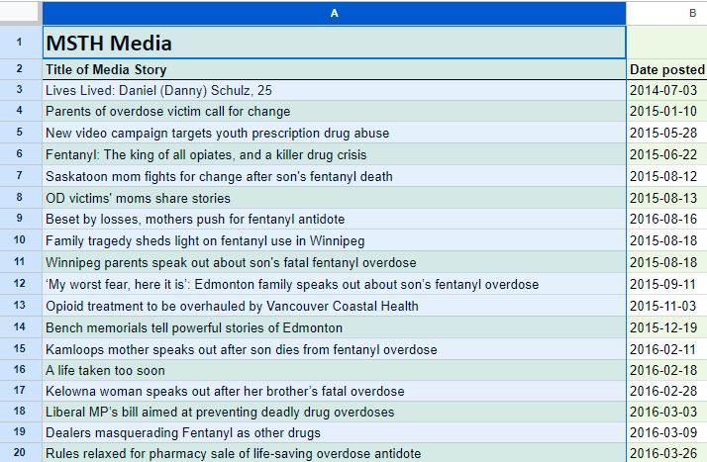
2014 to current incomplete listing of 969 media mentions including MSTH
Excluding media mentions no longer active online.
Only including those I was aware of or found on social media and via searches. https://docs.google.com/spreadsheets/d/16T4Rh83c-c7mSnXuRKmsqDwsd-W3vz4tOje3JjC4zG4/edit?usp=sharing

Slide 5
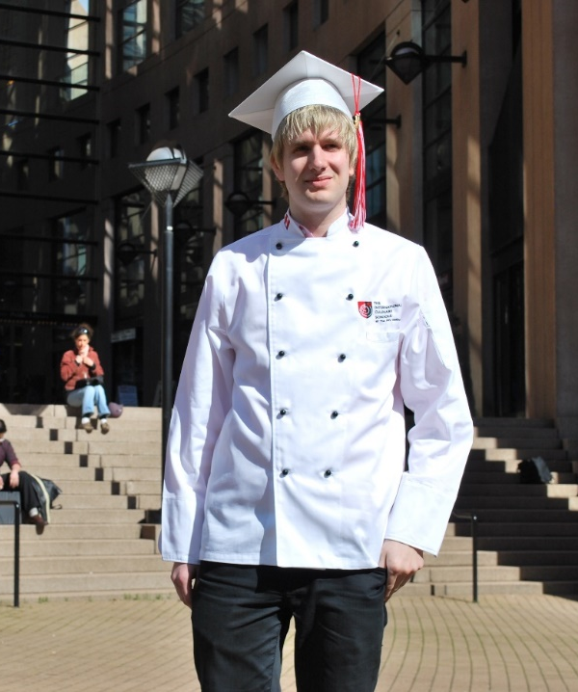
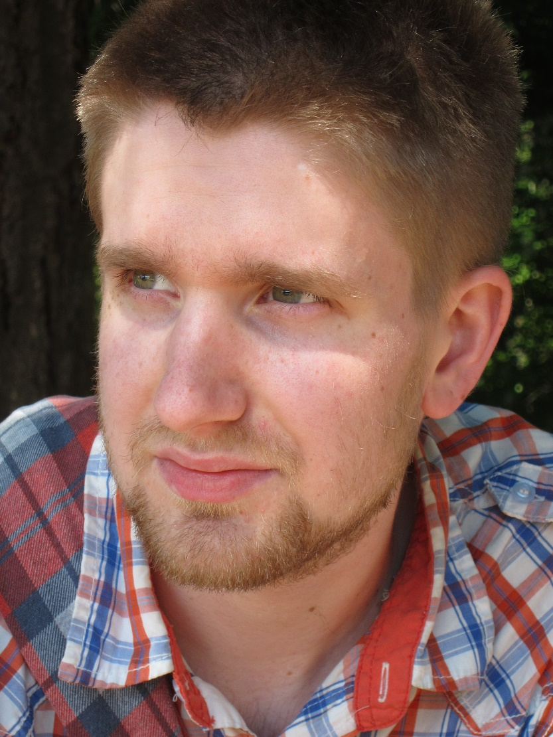
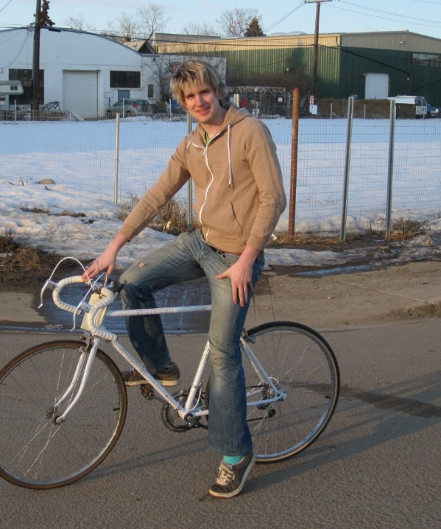
Danny Schulz
January 13, 1989 – April 30, 2014
Notes:
• Our youngest child Danny died from accidental drug poisoning in 2014. Danny was 25 years old.
• Danny was in recovery when one more pill, which he thought was a fake OxyContin, but was in fact Fentanyl, took his life. He was one of the early victims, before Fentanyl made the news, and before there were any health warnings. Those came several months after his death.
• After Danny died, we had many difficult decisions to make but we decided to be open about the cause of his death. We wanted to end the silence and the stigma. Friends and family, and his workplace were surprised. Substance use is often a hidden condition and Danny was a master at disguise.
• What worked for Danny was OAT with Methadone combined with CBT. Counselling we paid for privately since the only thing the public health system offered at the time was a list of NA groups, that would not have taken him on methadone.
• What did not work was that both he and we were keen to have him “drug-free” and he did not stay on the Methadone long enough to be stable. I have since learned that methadone and suboxone are not “just another drug” but vital medications that allow people to live in recovery and stay alive.
• For a while it seemed that we had the old Danny back, the kid we knew before he became dependent on drugs. The kid who wanted a cactus for his birthday when he was three, the teenager who had his first collector car before he even had his learner’s license and the young chef who put the final touches on my meals and always made sure my knives were sharp.
• On the outside, he looked like a successful young man, with a great job in one of Edmonton’s best restaurants and a cool downtown apartment.
• But inside he was still struggling. His drug use started as his way of dealing with his severe social anxiety. Still, there were other risk factors: A learning disability, being gay, and working in an environment where drug use is prevalent. Being impulsive and risk-seeking.
• Our experience and the experience of others point to the need to address underlying risk factors, such as mental health issues, trauma and ACE to intervene before the person turns to drugs.
• One of the most significant barriers to providing more effective support is stigma. Many people see drug use as a self-inflicted problem and drug poisoning death as a natural consequence. It is stigma that causes people to use and die alone and if we can stop stigma, we can save more lives.
Key points –
About Danny: age 3 he wanted a cactus for this birthday, at 8 gold panning equipment, he liked old cars, manual typewriters, listened to CBC on the radio and liked to read the paper edition of the Edmonton journal. Besides cooking he could sing. He was kind and compassionate. Always kept my knife sharp.
At risk: LD, MH, LGBTQ, job - Executive Function
No info on harm reduction – tough love message
Did not stay on Methadone long enough – only private access to counselling
Did not know about and I did not have Naloxone
Died home alone, in walking distance to Streetworks, like so many of his peers.
Greatest barrier is stigma that causes people to use and die at home.
Being open about the reason he died opened a floodgate of others in the same situation

Slide 6
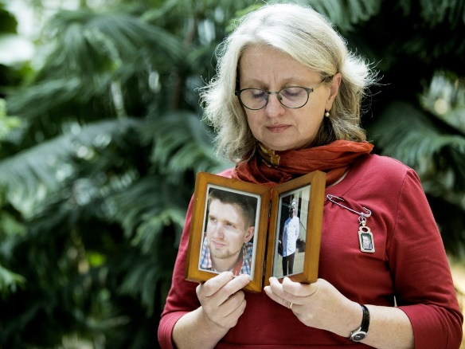
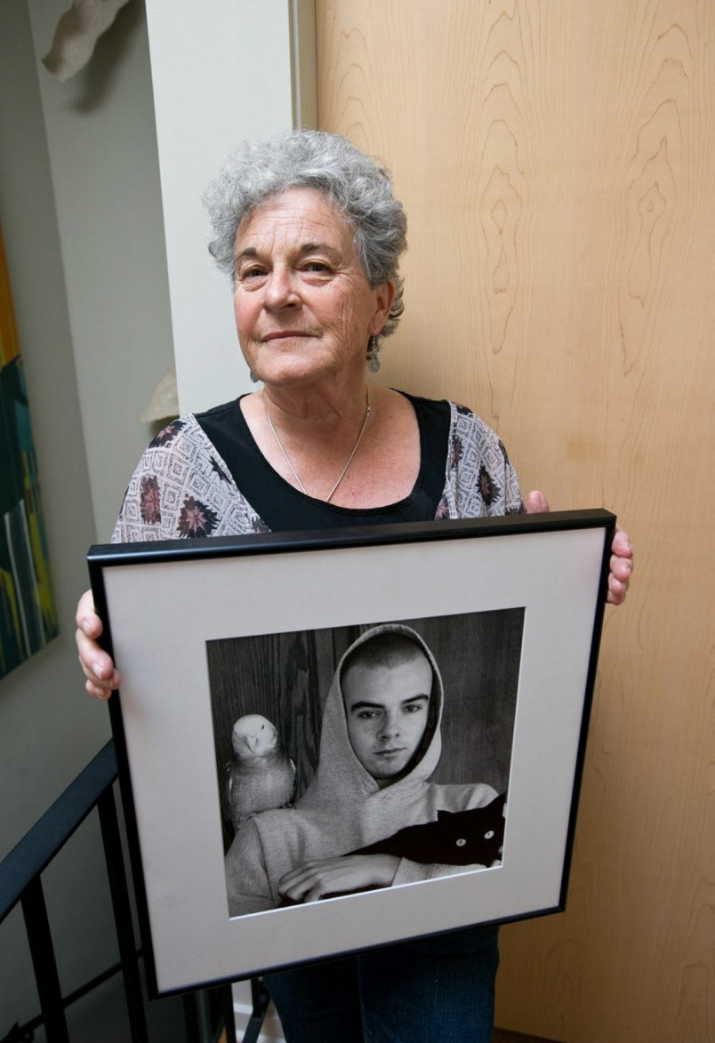
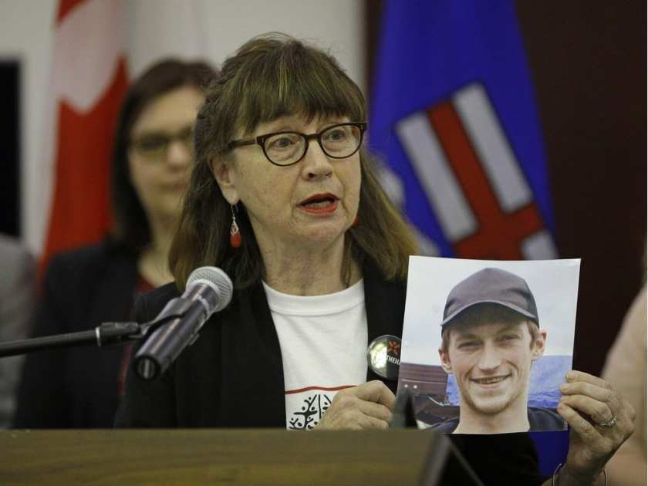
The Power of Parent Advocacy
Moms Stop the Harm (MSTH) is a network of Canadian families impacted by substance-use related harms and deaths.
3500 families Canada wide – sign up to BI
Mission: We advocate to end substance use related stigma, harms and death.
Provide peer support and welcome new families.
Notes:
The lack of health warnings (Letter to Dr. James Talbot), the rising number of death and our experience with the health system lead me to speak out and find like minded individuals.
Lorna Thomas, Leslie McBain and I founded MSTH in 2016 and today there are nearly 2000 Canadian families in our group, most in BC, AB and ON.
Review mission and support
.

Slide 7
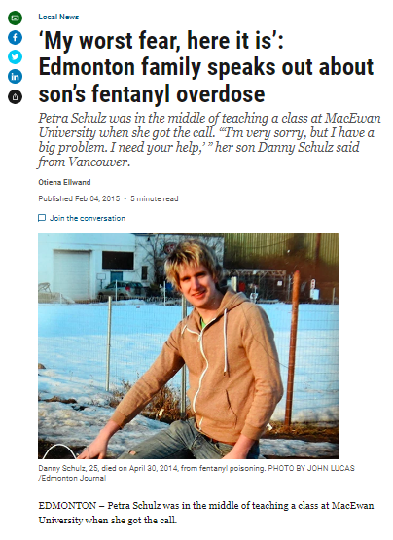
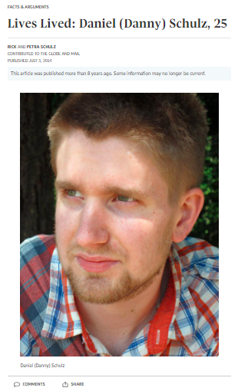
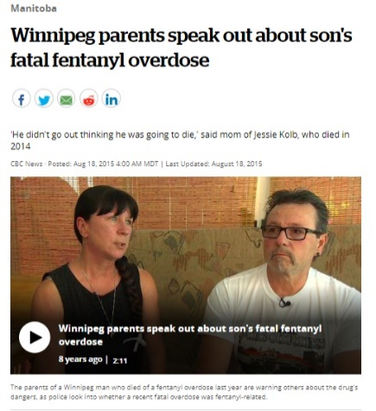
The beginning – drawing attention to an emerging crisis

Slide 8
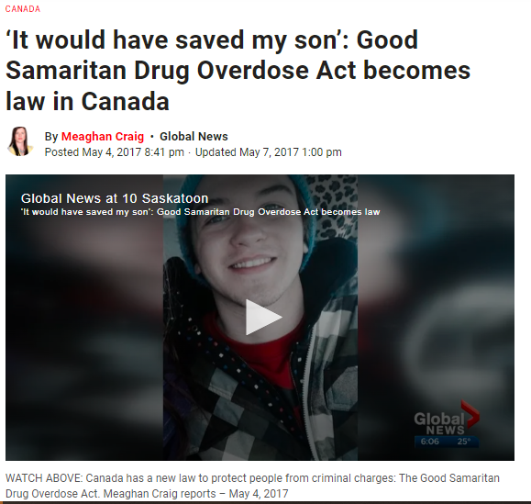
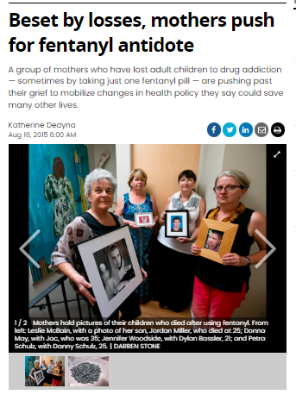
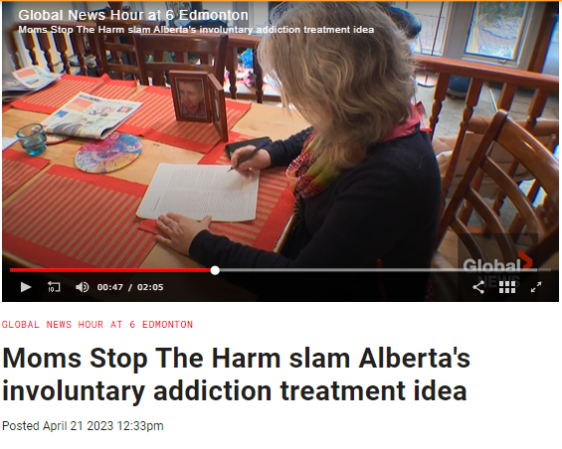
Advocating on specific issues
Scheduling of Naloxone/Narcan
911 Good Samaritan Law
Against Involuntary Care

Slide 9
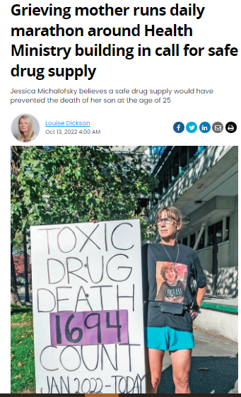
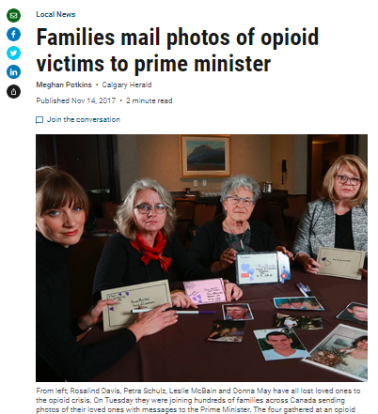
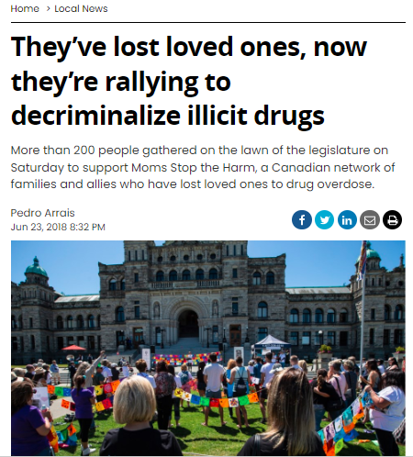
Advocating for specific Issues
Decriminalization and Safe Supply

Slide 10
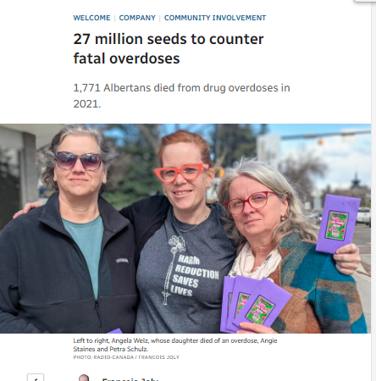
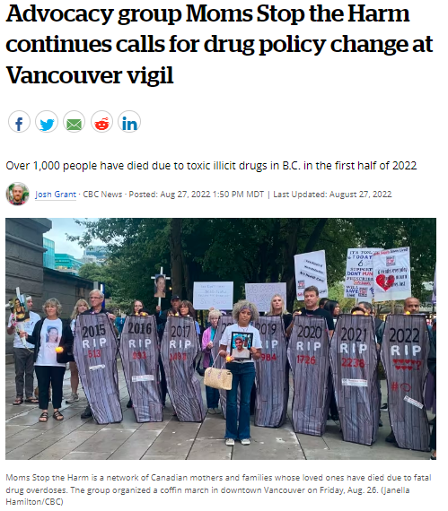
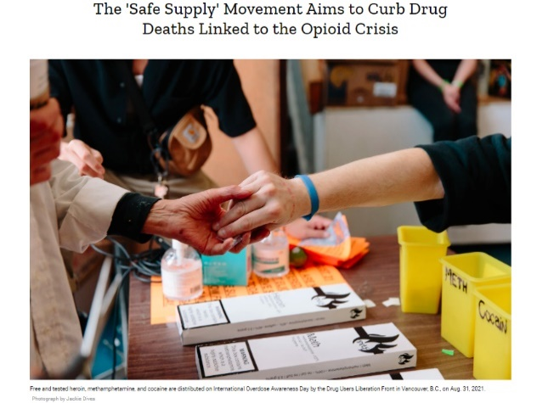
Creative ways to get media attention and move the policy discussion

Slide 11
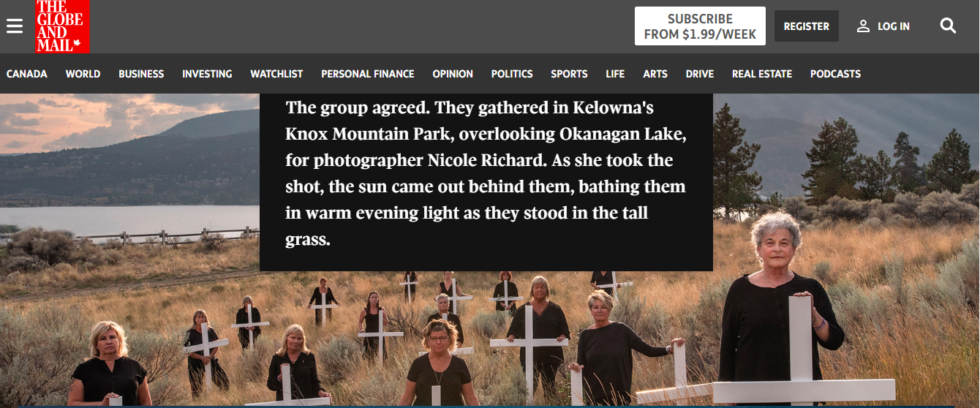

Slide 12
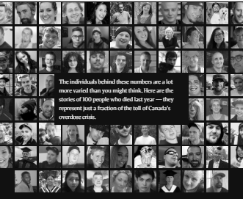
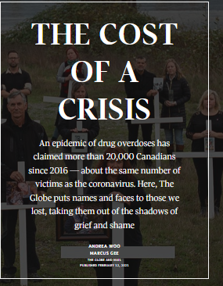
Working with media

Slide 13
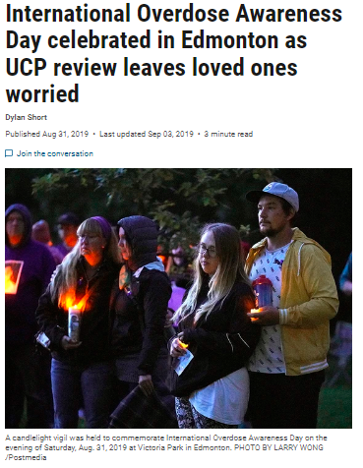
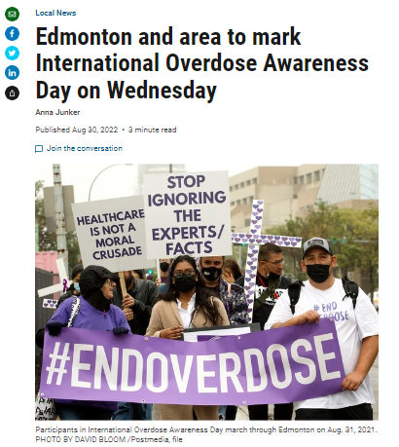
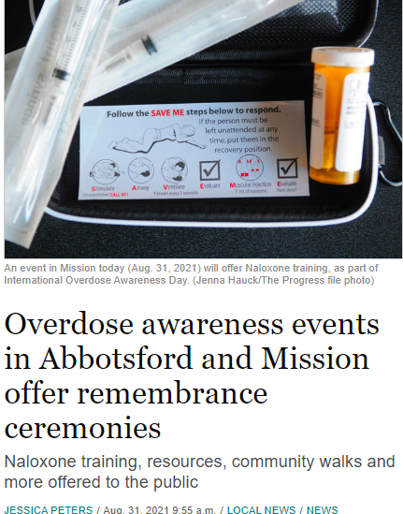
Getting media attention at key events - IOAD

Slide 14
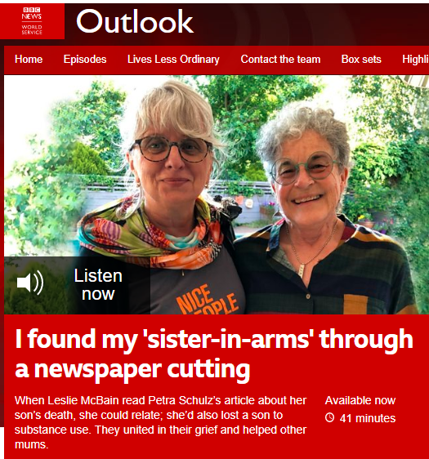
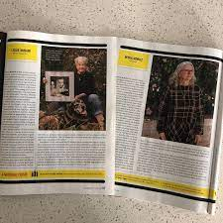
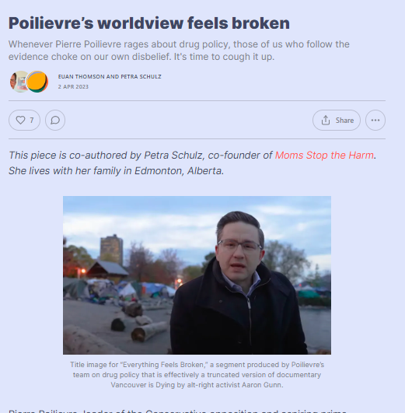
Finding new audiences
International (BBC), Women's magazine Chatelaine, Substack Blog page of Euan Thomson (MSTH allie)

Slide 15
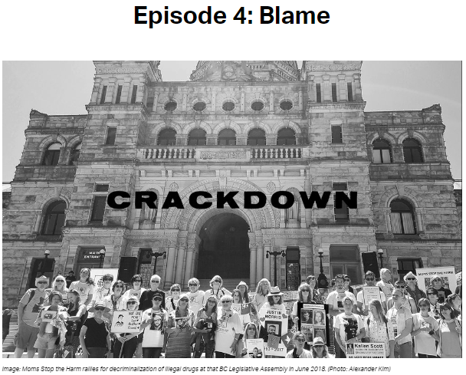
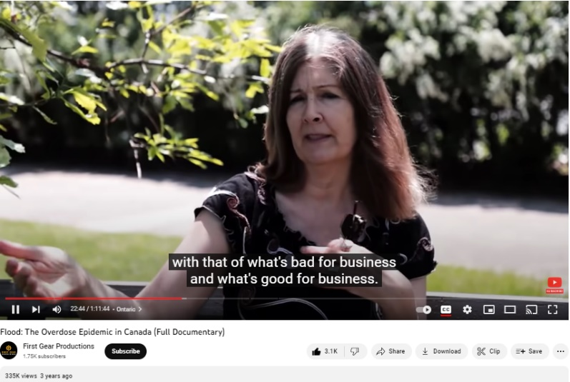
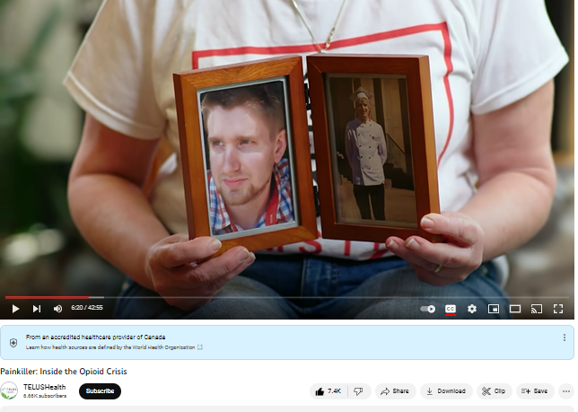
Documentaries & Podcasts
Flood: The Overdose Epidemic in Canada and
Painkiller: Inside the Opioid Crisis (Telus Health)
Crackdown Podcast Episode 4: Blame

Slide 16
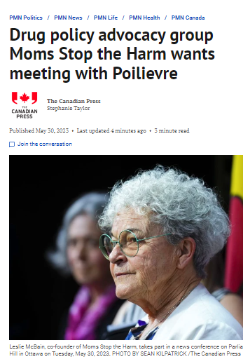
Post Truth attacks
“These so-called experts are typically pie in the sky theorists with no experience getting people off drugs, or they’re members of the misery industry, those paid activists and public health bureaucrats whose jobs depend on the crisis continuing,” he said.
Conservative party leader Pierre Poilievre
https://nationalpost.com/news/pierre-poilievre-slams-safer-supply-activists

Slide 17
Lessons Learned - Successes
Use our stories/images
The voice of families
Get policy makers attention
Mentor new advocates
Creative ideas/actions
Working with [media] allies

Slide 18
Lessons Learned - Challenges
Focus on emotion
Being click- bait
Keeping our story fresh
Diversity
Social Media
Post-truth messaging

Slide 19

Why we share our stories
We hope to open hearts and that opening hearts leads to opening minds.
To change drug policy.
To save lives!

Slide 20




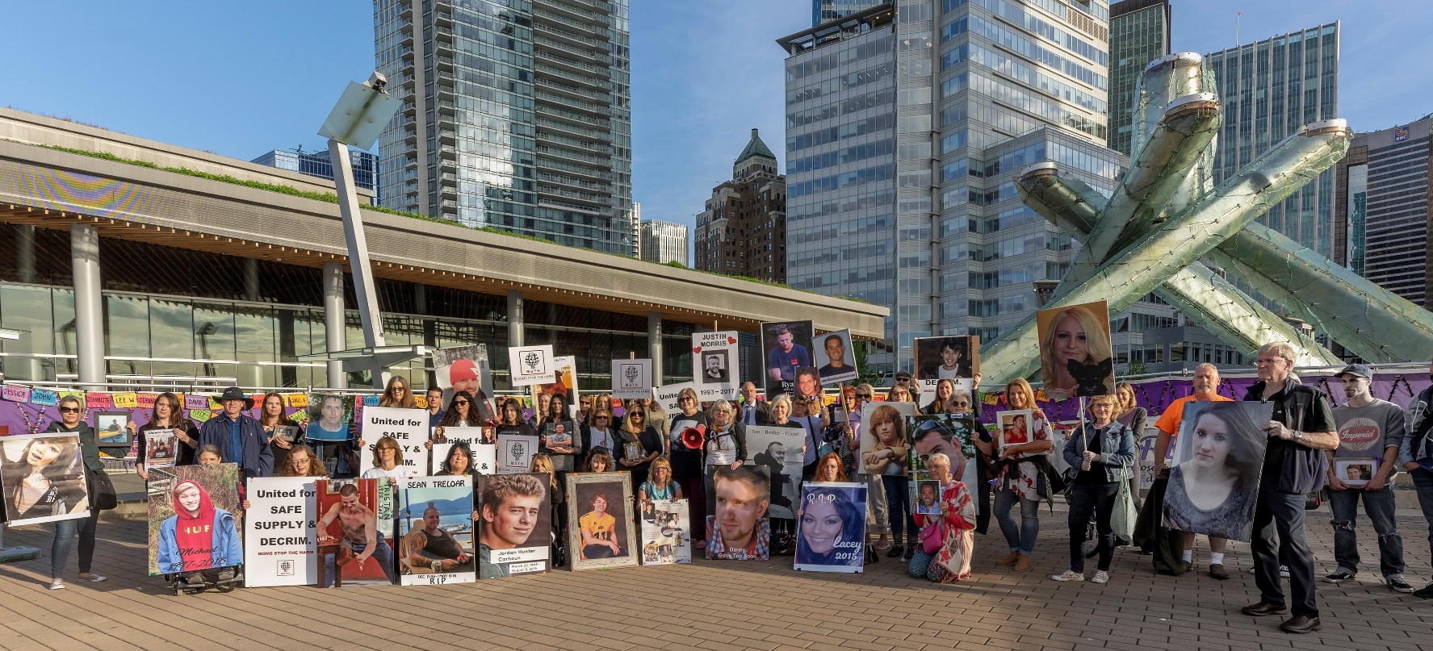
Thank you!
Websites
momstoptheharm.com holdinghopecanada.org healingheartscanada.org
Social Media
Facebook, Instagram, Twitter @momsstoptheharm
Contact
info@momsstoptheharm.com attention: Petra Schulz

