Slide 1

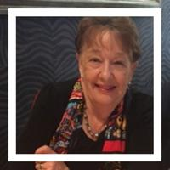

Delivering the 5-Step Method via
TELEHEALTH in New Zealand
Dr Pauline Stewart
B.Ed., M.Ed., PhD., M.Ed (Counselling)
Registered Counselling Psychologist and Educational Psychologist
Executive Officer / Founder
Family Drug Support AotearoA New Zealand

Slide 2
Overview
The reasons for choosing to deliver our service via Telehealth
How Family Drug Support (FDS) manages programmes via Telehealth
The advantages and disadvantages of delivery via Telehealth, and
Other factors to consider in this strategic direction FDS has taken

Slide 3
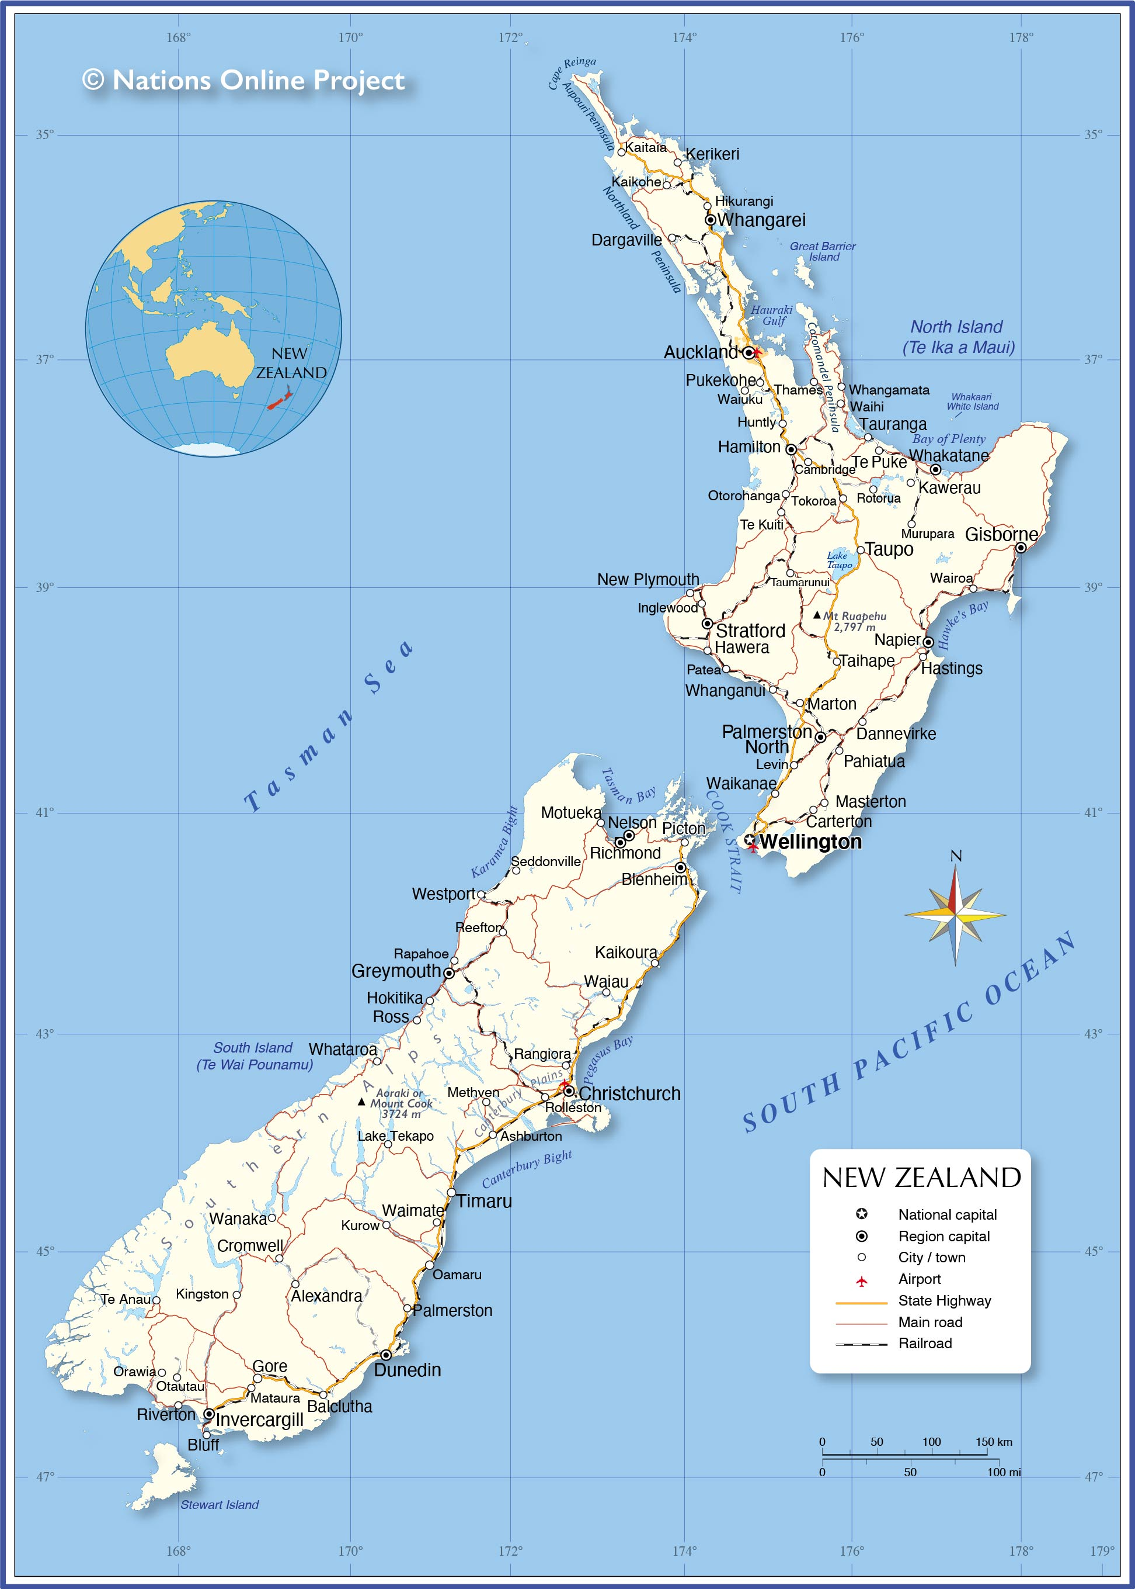
Map of
New Zealand

Slide 4
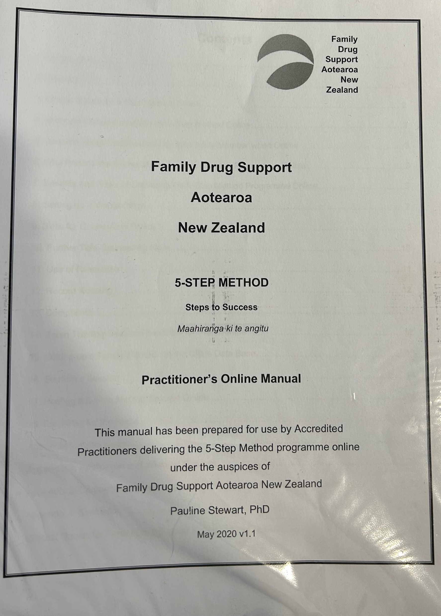
Practitioner’s
Online
Manual

Slide 5
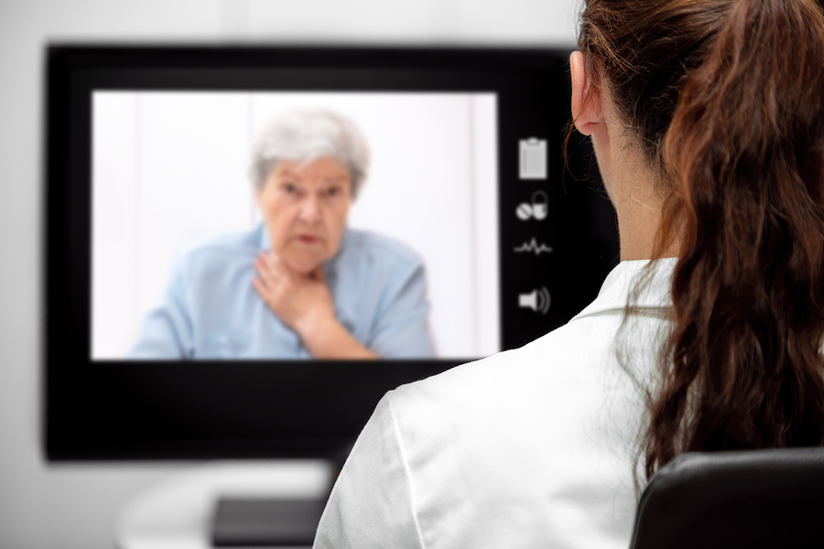

Why use Telehealth?
Support can be provided to Impacted Family Members (IFMs) outside ‘office hours’
Allay IFMs concerns about reputational protection
Support can continue for IFMs without disruption due to pandemic / illness / injury or physical disabilities
IFMs with small children are able to access the service
Wait times reduced - Accredited Practitioners able to work from home (not in main centres / have children)
Volunteer Accredited Practitioners can work via Telehealth outside normal work hours & expand AOD workforce
People in rural areas and small towns can access a service and gain support without travelling long distances
IFMs feel comfortable in familiar surroundings

Slide 6

The “But” Questions
Can a therapeutic alliance be developed using Telehealth?
Is internet access sufficiently available to allow people to access Telehealth?
Are Impacted Family Members confident enough in the use of devices?

Slide 7
Setting Up and Starting The 5-Step Method via Telehealth
Originally Zoom sessions set up and started through our central office
6 professional Zoom accounts for 28 Accredited Practitioners, and adding more
Two Zoom accounts are allocated to each of the 28 Accredited Practitioners
All booked sessions leave 15 minutes on each side of sessions, to allow for early starts and late finishes
Practitioner Management System currently being implemented

Slide 8
Further Use of Telehealth
Recording of sessions and accreditation process for those trained in the 5-Step and for the inter-rater process and training of Accredited Assessors
Professional development and supervision of Accredited Practitioners
Weekly group Zoom session where any Impacted Family Member can access help before or after other support from Family Drug Support
Training of Accredited Practitioners from all over New Zealand in the online delivery of the 5-Step both during and post training e.g., using new strategies, such as the new whiteboard on Zoom.
For the inter-rater process / discussions when training Accredited Assessors living all over NZ

Slide 9
Nga mihi nui. Thank you very much.
Dr Pauline Stewart
paulinestewart@fds.org.nz
www.fds.org.nz

