Slide 1


Qualitative exploration of the relationships between people who regularly use methamphetamine and their family and friends
Paige Webb
PhD candidate
p.webb@unsw.edu.au
Notes:
Good afternoon. My PhD explores family relationships when a member uses methamphetamine, from the perspectives of both people who use the drug and their family members. My presentation is a little bit different to the other presentations you will be hearing about during this conference, as I will be presenting the findings from some qualitative interviews I conducted with people who regularly use methamphetamine. I will be discussing how these findings can help family members to understand their loved ones’ perspectives and experiences better, and how they can inform family support to facilitate stronger family connections.

Slide 2

Notes:
I would like to begin by acknowledging the Traditional Custodians of the lands on which I live and work, and also to note that we are all joining in from many beautiful lands across the globe today. I am joining you from the lands of the Darug and GuriNgai peoples, in the Hornsby region north-west of Sydney, and would like to recognize their continuing connection to lands, waters, and communities, and that sovereignty of these lands was never ceded.

Slide 3
Acknowledgements
Research team:
Prof Rebecca McKetin
Dr Simon Clay
Prof Louisa Degenhardt
I would like to acknowledge all the participants who shared their lived experiences for this study
Advisory group:
Chloe Span
Chris Gough
Sarah Etter
Funded by Aus Government & NDARC
Notes:
I would also like to thank some groups of people who made this study possible. Most importantly, I would like to thank all of the participants involved in this study for trusting me with their stories. I would also like to thank the research team and advisory group that was formed for this study. This group included people who have lived or living experience of their own or a relative's substance use, or who provide drug and alcohol support to others.

Slide 4


Methamphetamine use in family relationships
Methamphetamine use associated with interpersonal behaviour changes (e.g., agitation, paranoia)
Having a loved one who uses methamphetamine can also be difficult for family members
People who use methamphetamine often experience family conflict and social isolation, reducing wellbeing
Understanding the perspectives of people who use methamphetamine can inform family support
Images: Flaticon.com
Notes:
**
Methamphetamine use is associated with certain interpersonal behaviours, including agitation and paranoia, that can influence family relationships. Research also shows that people who use methamphetamine often experience family conflict, which is associated with lower mental well-being and quality of life, and can experience a general sense of social isolation.
**
Having a loved one who uses methamphetamine can influence family dynamics, as they often become the focus of the family, and difficulties with communication are common. Family relationships may reduce in quality, leading to distress for the whole family. Stigma is also commonly experienced by the person using methamphetamine and their family members, compounding the issues they experience. Understanding how people who use methamphetamine perceive their family relationships can help develop a deeper understanding of the dynamics within these families and inform supports to facilitate connection and well-being throughout the whole family.

Slide 5
Aim
Explore the how people who use methamphetamine navigate their family relationships

Slide 6



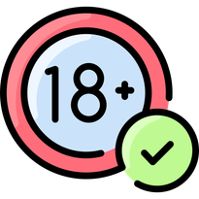






Interviews
Methods
Inclusion criteria
Qualitative interviews
70% phone
Weekly methamphetamine use over the last 6 months
30% Zoom
Recruitment
Thematic analysis
Braun & Clarke, 2006
Images: Flaticon.com
Notes:
This study involved qualitative interviews with 20 people who use methamphetamine at least weekly from across Australia. Participants were primarily recruited through an existing clinical trial for methamphetamine use disorder, as well as flyers placed in harm reduction services and word of mouth. Interviews were conducted through Zoom or over the phone and lasted an average of 45 minutes. Participants were reimbursed $50 for their time.

Slide 7








women 30%
gender diverse 10%
Findings
LGBTQI+ 45%
mean age
QLD 40%
VIC 25%
NSW 25%
WA 10%
employed 40%
cannabis 55%
alcohol 45%
‘party drugs’ 25%
heroin 10%
daily 35%
2-3/week 25%
weekly 40%
Images: Flaticon.com
Notes:
Most participants were male, straight and living in Queensland. All participants lived in a major city. All but 3 participants engaged in polydrug use, mostly cannabis or alcohol use, and about a third reported daily methamphetamine use. I will be showing some quotes on the next few slides, which I will also read out. All names listed on the slides are pseudonyms.

Slide 8

1 Why did participants use methamphetamine
“When I tried [methamphetamine], I liked it. I feel like it really helped me overcome, I guess, some of my social anxieties and insecurities. I found it made me more confident. And yeah, I just loved to take meth and go out dancing all night.”
- Aurora*, woman, aged 36
*All names are pseudonyms
Image: Flaticon.com
Notes:
Participants primarily described initially using methamphetamine because it helped them to socialize. It increased their confidence and helped them talk to and connect with others, particularly those who also used methamphetamine. They were able to make new connections based on acceptance and shared understanding, which was especially appreciated by those who experienced social anxiety or had few social connections before they began using, as it helped them to overcome the loneliness they felt.
Participant Aurora said: “When I tried [methamphetamine], I liked it. I feel like it really helped me overcome, I guess, some of my social anxieties and insecurities. I found it made me more confident. And yeah, I just loved to take meth and go out dancing all night.”

Slide 9

1 Why did participants use methamphetamine
“It definitely creates a unique relationship ... You can talk about the stigma that you're experiencing and the way that people [judge] you ... A lot of people can easily end up only wanting to hang out with other people that use [drugs] because you feel safe with them.”
- Violet, transgender women, aged 35
Image: Flaticon.com
Notes:
Some participants continued to feel connected in their methamphetamine-using social networks as their use continued. These peers were easy to relate to, and participants noted feeling able to be their full, genuine selves in these relationships. Many also described peer-based harm reduction services as valuable sources of validation, understanding, and important social connections, as well as settings for receiving education and support to reduce the harms associated with methamphetamine use. Social interactions within harm reduction and methamphetamine-using networks also allowed participants to share past experiences of stigma, helping them to overcome some of the distress these experiences caused. Overall, these relationships could provide important forms of care, emotional support, and understanding.
Violet said: “[Methamphetamine] definitely creates a unique relationship because [it’s a] thing that you share. You can talk about the stigma and stuff that you're experiencing and the way that people are judging you ... A lot of people can easily end up only wanting to hang out with other people that use the same drugs as them, because you feel safe with them.”

Slide 10

2 Seeking connections in family relationships
“My [parents] said they didn't want anything to do with me. And I just said, ‘Look, I don’t need to be judged … I’ve got enough people that are judging me; what I need from you is understanding.’”
- Remi, woman, aged 52
Image: Flaticon.com
Notes:
Many participants also mentioned a desire to discuss their methamphetamine use with their family members, in the hopes of being understood and accepted by them. However, many felt their families held different views on methamphetamine use than they did, and so they often felt judged, blamed, and criticized by their family members. They often felt their families misunderstood why they used methamphetamine, and felt dismissed when they tried to discuss their reasons for using with them. Overall, these interactions led participants to hide their ongoing use from their families or to distance themselves to avoid feeling judged by them, which resulted in disconnection in their family relationships.
Remi said: “My parents said that they didn't want to have anything to do with me. And I just said, ‘Look, I don’t need to be judged … I’ve got enough people that are judging me; what I need from you is understanding … [it’s up to you] if you want anything to do with me, but I don't need [you] in my life if you're going to judge me.’”

Slide 11

2 Seeking connections in family relationships
“My stepmother is actually pretty chill with [my drug use] now … But I think if I hadn't formed a closer relationship with her and put in the effort to do that, she'd probably still [think] that I needed abstinence to function in the world.”
- Billie, non-binary, aged 31
Image: Flaticon.com
Notes:
Overall, family members responded to the participants’ discussions about their methamphetamine use in a variety of ways. Some responded gently, offering support to participants when and if they needed it. Other participants mentioned feeling dismissed or recounted their family members urging them to get substance use treatment, even if this was not what they wanted for themselves. Although many participants experienced family conflict during these interactions, many were able to work through this conflict. If participants and family members both acknowledged their roles in the conflict, and learned to have more supportive and constructive conversations about methamphetamine use in the future, they were able to develop stronger relationships. Billie explains how their relationship with their stepmother is now a source of support after enduring a period of drug-related stigma.
“My stepmother is actually pretty chill with [my drug use] now … It allows her to see that using doesn't have to be a chaotic thing. It can be just a party on the weekend. You know, the rest of the week, I'm sitting in an office. But I think if I hadn't formed a closer relationship with her and put in the effort to do that, I think she'd probably still have the idea that I needed abstinence to function in the world.”

Slide 12

3 Family support when reducing use
“I don’t like the thought of [my family] having watched me destroy myself in a sense. That’s [one of] the main drivers of me giving up … I didn’t know what to do [to get help]. So I went to Mum ... and she helped me [find] services that I might be able to [go to].”
- Austin, man, aged 46
Image: Flaticon.com
Notes:
Some participants eventually wanted to reduce their methamphetamine use so they could refocus on their family relationships. Many wanted to relieve the distress their family members experienced or reduce their concerns about the participants’ well-being. Sometimes the decision to reduce their use was motivated by a desire to develop deeper connections with their families. Family support while working to reduce their methamphetamine use was highly valuable for participants. This included receiving practical support, such as helping them to research different drug support and treatment services, or moving back into their parents’ homes for a few months during periods of sobriety. Participants also highly valued receiving emotional and motivational support. Overall, being able to receive non-judgmental support from family members helped participants feel supported and connected to their families while they reduced their methamphetamine use.
Austin said: “I don’t like the thought of [my family] having watched me destroy myself, in a sense. That’s [one of] the main drivers of me giving up … [At one point] I didn’t know what to do [to get help]. So I went to Mum, and I asked her what she thought and [told her] how I was feeling. And she helped me with [finding] services that are available that I might be able to [go to].”

Slide 13




How can these findings help families?
Understanding why their loved one uses methamphetamine
Harm reduction services can foster social connection
Family support is valued, when their loved one is ready for it
Images: Flaticon.com
Notes:
So, how does this help family members?
*
Understanding that people often use methamphetamine as a way of seeking connection, understanding and acceptance can help family members understand why their loved one uses. Although they may sometimes use to cope with emotional distress, it can also be a positive experience for some people who use methamphetamine. This is particularly in the case of feeling understood and connected by other people who use methamphetamine. Importantly, it helps family members appreciate that some substance-using peer networks can provide important emotional support and may not necessarily be detrimental to their safety or well-being.
*
The ability to foster these connections during interactions with harm reduction services highlights the value of these services, beyond the more commonly thought-of functions of providing education and support to reduce substance-related harms. As such, family members could encourage their loved one to access harm reduction services, rather than insisting that they stop using and access drug treatment, if this is not what their loved one wants to do. This could allow their loved one to learn how to use in a safer way, as well as helping them to improve their overall social well-being.
*
Family support is also considered to be very important when individuals reach a point of wanting to reduce their methamphetamine use. This can help family members to understand that, although they may not be able to get their loved one to access treatment when the family member wants them to, letting their loved one know that they will be there for them, to support them emotionally and practically, when they are ready, can be helpful. The findings also suggest that it can be beneficial for family members to have non-judgmental, open conversations with their person about why they use methamphetamine. These discussions can foster understanding and acceptance in their relationship, leading to more connected family relationships overall.

Slide 14
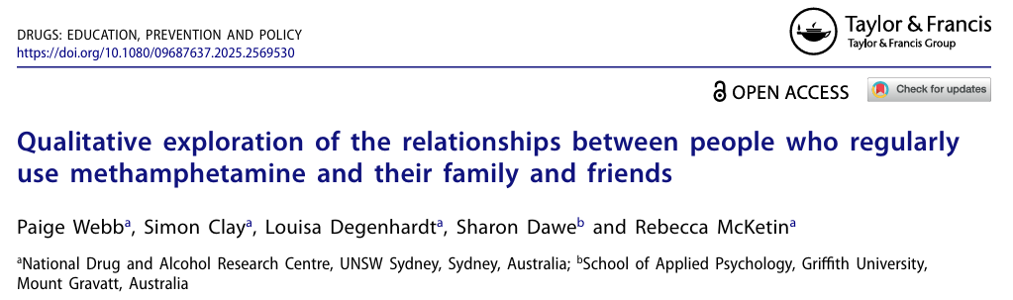
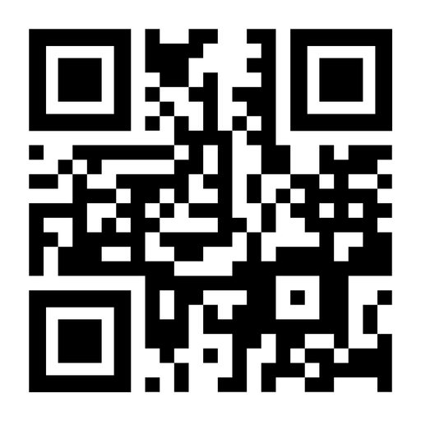
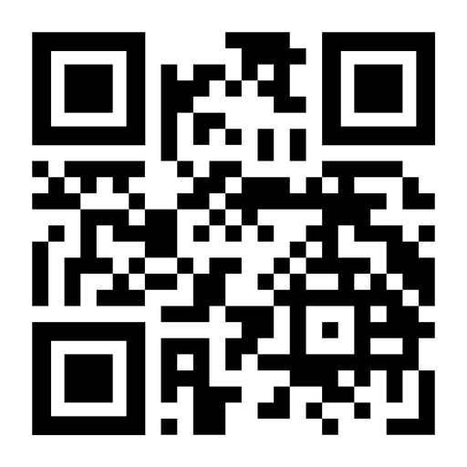
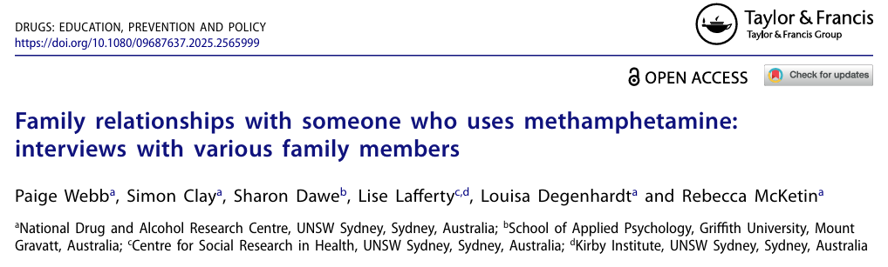
Thank You!
Paige Webb
p.webb@unsw.edu.au
Notes:
*
This study has been published in an open access journal, this QR code will take you to the article if you are interested in learning more about the study.
*
I have also conducted a set of interviews with family members of people who use methamphetamine, covering similar topics that I have discussed today, which has also been published at the link in this second QR code, for those who are interested.
Please also feel free to reach out if you would like to discuss either paper further.

