Slide 1




Methamphetamine
and the family:
Relationships and resilience processes
Paige Webb
NDARC, UNSW
p.webb@unsw.edu.au
Clare Rushton
University of Wollongong
cr566@uowmail.edu.au
Notes:
Paige: Hi everyone. Clare and I are both PhD students from Australia, I am from University of NSW and Clare is from University of Wollongong. We have both recently completed individual studies exploring methamphetamine use in a family context. We are presenting these in a joint presentation today given the overlap in topic areas. Throughout this presentation the purple colour will represent my study, while the green represents Clare's.

Slide 2
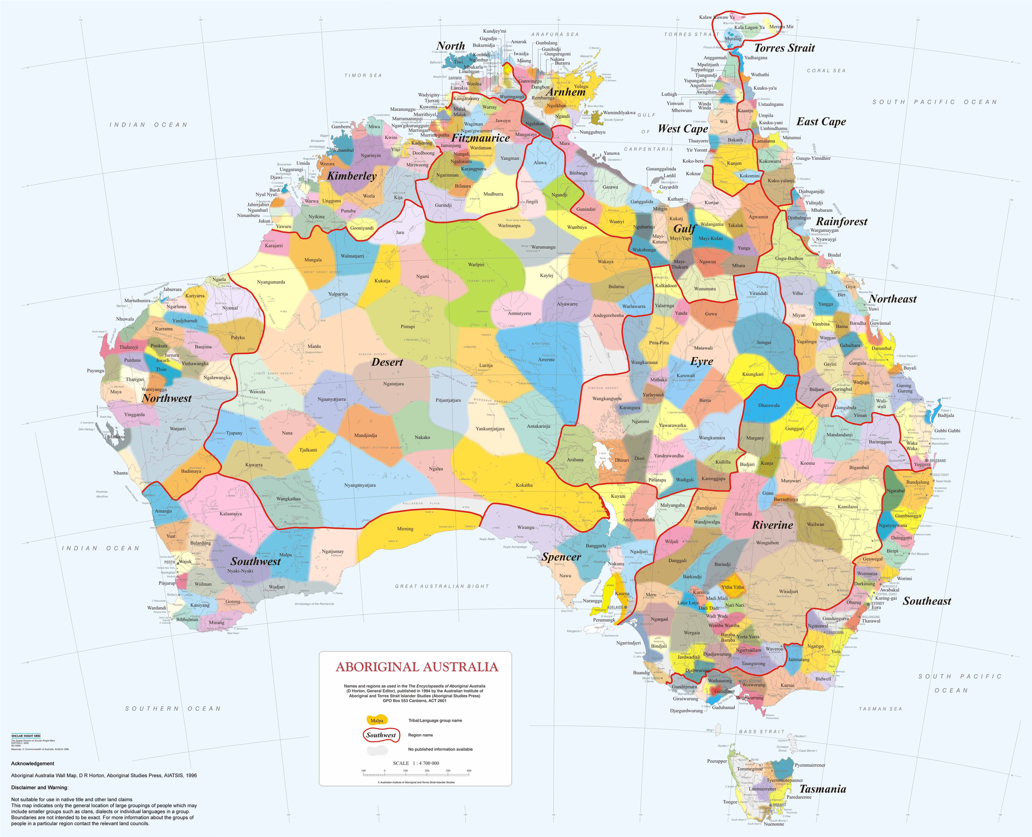
Acknowledgement of Country
This map attempts to represent the language, social or nation groups of Aboriginal Australia. It shows only the general locations of larger groupings of people which may include clans, dialects or individual languages in a group. It used published resources from the eighteenth century-1994 and is not intended to be exact, nor the boundaries fixed. It is not suitable for native title or other land claims. David R Horton (creator), © AIATSIS, 1996. No reproduction without permission. To purchase a print version visit: https://shop.aiatsis.gov.au/.
hhttps://aiatsis.gov.au/explore/map-indigenous-australia
Notes:
Clare: We acknowledge the traditional custodians of the lands on which we meet today. We pay our respects to Aboriginal Elders past and present, who are the knowledge holders and teachers. We acknowledge their continued spiritual and cultural connection to Country.
This is the Aboriginal language map developed by the Australian Institute of Aboriginal and Torres Strait Islander Studies: Australia's first people have lived on the continent for thousands of years. The map represents the many distinct cultural groups, each with different languages, laws, and customs. There are over 250+ languages with 600+ dialects (slightly different but distinct versions of the language).

Slide 3
Acknowledgement of Country
This map attempts to represent the language, social or nation groups of Aboriginal Australia. It shows only the general locations of larger groupings of people which may include clans, dialects or individual languages in a group. It used published resources from the eighteenth century-1994 and is not intended to be exact, nor the boundaries fixed. It is not suitable for native title or other land claims. David R Horton (creator), © AIATSIS, 1996. No reproduction without permission. To purchase a print version visit: https://shop.aiatsis.gov.au/.
hhttps://aiatsis.gov.au/explore/map-indigenous-australia
Notes:
We are both from the southeast region.
Clare: I am joining you from the traditional country of the Awabakal and Worimi peoples.
Paige: I am joining you from the traditional country of the Gadigal people

Slide 4


Acknowledgements
Lived experience
We acknowledge the individual and collective expertise of those with a living or lived experience of mental health, alcohol and other drug issues.
CF
Study A
Study B
Funding body
Funding body
  Aus Government, NDARC
Advisory Committee
  Chloe Span (Family Drug Support)
  Chris Gough (CAHMA)
  Sarah Etter (NADA)
Partnership with
Research Team
Research Team
  Clare Rushton (University of Wollongong)
  A/Prof Peter Kelly (University of Wollongong)
  Tamsin Thomas (University of Wollongong)
  Dr Briony Larance (University of Wollongong)
  Dr Alison Beck (University of Wollongong)
  Camilla Townsend (University of Wollongong)
  Paige Webb (NDARC, UNSW)
  Dr Simon Clay (NDARC, UNSW)
  Prof Louisa Degenhardt (NDARC, UNSW)
  A/Prof Rebecca McKetin (NDARC, UNSW)
  Prof Sharon Dawe (University of Queensland)
Notes:
Paige: Clare and I will be presenting on two independent studies with similar samples and methodologies. We would like to acknowledge a few groups of people who made these studies possible. Firstly and most importantly we would like to thank all of the participants for sharing and trusting us with their stories. We would also like to acknowledge the funding bodies, partners and research teams involved in these studies. My study also involved an advisory committee including service providers and people with lived and living experience.

Slide 5


Methamphetamine as a societal concern in Australia
  Families experience substantial burden
  Methamphetamine use significant issue in Australia
    Recent use* 1% 200 000 people
    Lifetime use 7.5% 1 million people
  Associated with specific interpersonal behaviours (agitation, paranoia)
  Majority of the family research focuses on the parent-child relationship
  In particular, currently limited understanding of families’ responses
*Recent = past 12 months. Source: AIHW, 2024
Notes:
Clare: Given the audience we are talking to today, we are all aware that families experience significant burden from having a family member who uses drugs. While methamphetamine is a global concern, it is a particular issue in Australia. Given the association between methamphetamine use and certain interpersonal behaviours, including agitation and paranoia, it is likely that the use of this particular drug has specific influences on family dynamics.
Past research has often focused on the parent-child relationship - that is, either exploring the impact of parental drug use on children, or the experience of being a parent of a young adult who uses drugs. Less is known about the experiences of other relationship groups.
There has also been a historical focus on the impact on families, with less understanding around families’ response and adaptations to the stress.

Slide 6
Study Aims
Study A
To explore the influence of methamphetamine use on the relationship between the person using and other family members and any subsequent influences on family members’ lives.
Study B
To identify adaptations in response to the stress and strain of supporting a loved one with methamphetamine use and explore the resilience-facilitating processes.
Notes:
Paige to say aim A
Clare to say aim B

Slide 7
Method
Study design: Qualitative
Inclusion criteria: Adults (18+ years), Australian resident, identified as the family of someone who uses methamphetamine
Analysis: Thematic analysis aided by Iterative Categorisation
CF
Study A
Study B
  Phone/Zoom interviews (M=55 minutes)
  June - August 2023
  N=19 participants
    9 parents; 5 siblings; 4 partners; 1 friend
    12 women; 7 men
  Primarily recruited through Family Drug Support
  Phone interviews (M=24 minutes)
  March - October 2021
  N=24 participants
    21 women; 3 men
    Involved in larger study assessing the feasibility of a support program for families.
  SSCS model guided inductive themes.
  Family Resilience Framework informed analysis.
Notes:
Paige: both of these studies involved qualitative interviews with Australian adults who identified as a family member of someone who uses methamphetamine. Both studies also utilised thematic analysis with iterative categorisation. My study, study A, was conducted through Zoom and phone mid last year. I recruited 19 participants from a variety of family roles. Majority of participants were parents, female and most were recruited through Family Drug Support, a national service providing support groups and phone support to families affected by AOD.
Clare STUDY B: This study used the baseline interview data from a larger study assessing the feasibility of a support program for families. Therefore all the families in this study had reached out for help - so that context needs to be kept in mind when interpreting the results. This is also the case for the majority of participants in Study A who were recruited through Family Drug Support.

Slide 8
Results - Study A
Aim
To explore the influence of methamphetamine use on the relationship between the person using and other family members and any subsequent influences on family members’ lives.
Notes:
Paige: I will be presenting the results of my study first.

Slide 9

Results - Study A
1. Perception of loved ones becoming ‘other’
“[I] noticed changes in Arthur* and Ethan*. They were a bit more aggressive; maybe the word would be hyperactive … just generally erratic in their behaviours and experiencing mood swings and general agitation”
- Poppy*, aged 33,
family friend of brothers Arthur and Ethan
Notes:
I will be sharing some quotes on the screen which you can read in your own time. All names included in my presentation are pseudonyms.
When discussing how they first became aware of the methamphetamine use, most family members described physical and behavioural changes in their person, such as mood swings or sudden weight loss. Family members were often only able to attribute these changes to methamphetamine use after confronting their person.

Slide 10
Results - Study A
1. Perception of loved ones becoming ‘other’
“It’s like [she was] another person. It’s like nobody’s home - you just stare into their eyes, and there’s nobody there. It’s just next level. You never expect to have a beautiful child, and then it to go [away]”
- Zara, aged 58, mother of Layla
Notes:
At this stage family members felt that they were no longer dealing with the 'real person'. They felt as though their person had become someone else who they couldn't related to or connect with anymore. This was reflected in the frustration participants often felt when interacting with their person, as participants often felt unsure how their person would behave at any given time.
Zara’s emotional quote here highlights the despair she is experiencing in her perception of losing her daughter to methamphetamine use.
A lot of family members were reluctant to accept that their person was using methamphetamine. This reaction from families is likely the first indication of stigma influencing family dynamics.

Slide 11

Results - Study A
2. Responding with grief and mourning
“[It's] really hard seeing what [methamphetamine use] has done to Grace, [like] psychosis [and] mental health situations. [Pretty] serious and scary stuff. And so sad, from somebody who had a lot of potential”
- Ava, aged 65, mother of Grace
Notes:
Family members experienced grief in a number of areas. They mourned the person their loved one used to be and the connection they previously shared, perceiving this connection to now be lost. Families felt helpless in watching their person going through difficult times and feeling unable to help. Witnessing acts of self-harm in particular were devastating for family members, and many participants expressed concern over their person passing away.
Families also mourned the potential future they had previously wished for their person – a future that family members felt was no longer possible. The perceived loss of this future was not only accounted for by the psychoactive effects of methamphetamine, but also on the social limitations that methamphetamine-related stigma would place on them throughout their lives.

Slide 12
Results - Study A
2. Responding with grief and mourning
“[In the beginning], it was all about, what can I do next, what can I say … should I do this? It was all about what I could do to help Charlie”
- Harper, aged 69, mother of Charlie
Notes:
Families usually went through an initial period of hyperfocus on the drug use and believed they could ‘fix’ the drug use by finding the right treatment. This period was associated with a range of emotions, including shock, disappointment, dread, and despair. Interactions with their person centred on imploring them to seek support and treatment for their substance use. Family members also frequently checked in with their person on how they were doing, which was often interpreted as nagging by the person using methamphetamine. Conversely, family members lamented the constant demands for money and the verbal abuse they often received if they refused. Overall, these types of interactions led to increased strain and tension in these relationships and families grieved the absence of loving and supportive conversations with their person.

Slide 13

Results - Study A
3. Influences on home and work environments
“[Our] household didn't function very well; it couldn't flow … We were all walking on eggshells … It's just awful …. Jordan [has] worn us [all] down because of [his drug­­­ use]”
- Charlotte, aged 51, mother of Jordan
Notes:
Family members felt that the influence of methamphetamine use on family dynamics was 'all consuming'. Family life was described as chaotic, with an atmosphere of uncertainty and concern. Unexpected absences of the person using methamphetamine were common, as were confrontations between them and other family members. This led some family members to feel uncomfortable and sometimes unsafe in the home.
Some participants saw their workplace as a welcome distraction from the chaos they experienced at home. Most participants experienced a reduction in their ability and motivation to work, however. Some were unable to focus, had poorer decision making skills, or had no desire to go to work. This meant many participants had to take time off work. Other participants had to miss work in order to take care of their person.

Slide 14
Results - Study A
3. Influences on home and work environments
“When Hugo [went to] rehab the first time … I was so proud ... [And then] when he relapsed … I just had this rage inside me … By the end of [multiple unsuccessful rehab attempts] I honestly just lost hope. Like the last time he went to rehab, I wasn’t proud anymore”
- Levi, aged 26, brother of Hugo
Notes:
As well as relief from work for some family members, other participants received a reprieve when their person entered residential rehabilitation. The initial episode of rehab was met with relief, joy, and pride. Families were optimistic about what this meant for the future of their person and the rest of the family. When their person eventually began using methamphetamine again, however, these feelings of elation quickly morphed into disappointment and distress. This cycle often repeated many times, and families eventually lost hope for this future. Levi here described his experiences of his brother entering and exiting rehabilitation as an emotional rollercoaster.

Slide 15

Results - Study A
4. Keeping everyone safe and happy
“I burst into tears, [and] I said, ‘I love you, but I can't have you [at home] anymore, I just can't do it … My whole life has gone down the toilet’ … That was a very hard thing to do … but looking back, it's the best thing I could have done”
- Florence, aged 61, mother of Patrick
Notes:
After experiencing these influences over family life for a period of time, participants began to establish boundaries around their interactions with the person using methamphetamine. These boundaries were an attempt to minimise the negative consequences I have just described, while still maintaining a relationship with their person. Limiting the provision of financial support and restricting their access to the family home were common. Despite knowing these boundaries were necessary and beneficial for all parties, it was not an easy process and had a significant emotional toll on family members.

Slide 16
Results - Study A
4. Keeping everyone safe and happy
“I've had to try not to choose one child over the other … [they] used to be super close growing up and I think that's part of the reason why [my daughter]’s so hurt - the fact that they were so close. And now she's lost the brother that she loved and adored”
- Millie, aged 54, mother of William
Notes:
Relationships between the person using methamphetamine and their siblings were particularly complicated. Siblings expressed concern, compassion and frustration in these relationships. They tended to resent their sibling for monopolising their parent's attention, and some felt that their sibling should ‘know better’ than to use methamphetamine. Sibling's emotions were also conflicted by the distress they witnessed their parents experiencing, with some siblings acting as a physical buffer during altercations within the family. This placed parents in the difficult position of feeling forced to intervene and mediate the relationship between siblings, while trying not to take sides. Parents expressed a desire for their children to have a closer relationship but also acknowledged the emotional turmoil siblings experienced.

Slide 17

Results - Study A
5. Social support and experiences of stigma
“I lost a lot of friends, [laughs] and my life went down the toilet. People just thought I was mad for keeping on trying [to support Patrick] … But my three close friends have stuck with me through it all. The rest sort-of just dropped away”
- Florence, aged 61, mother of Patrick
Notes:
Expectations and experiences of being judged, criticised, and blamed for their person’s substance use were prevalent across all interviews. Many family members had lost friendships after disclosing their person’s methamphetamine use, leading to a reluctance to reach out to others in the future. When they did discuss their person with friends and family they often receive unwarranted, unhelpful, and often harmful advice, generally along the lines that their person should ‘just stop using’ or that the participant should just ‘cut them off’. These experiences of stigma were especially felt by mothers, who were frequently blamed for their child’s drug use and sometimes even blamed themselves. Overall, many participants described feeling socially isolated in association with experiences of stigma. Family members who were able to receive support from others, such as Florence here, spoke about how beneficial these positive interactions were. This social support, as well as the professional support that most families received helped them to develop a greater resilience, a process which Clare will now explore in the context of her study.

Slide 18
Results - Study B
Aim
To identify adaptations in response to the stress and strain of supporting a loved one with methamphetamine use and explore the resilience-facilitating processes.
Notes:
Clare's results:
I'll now present the results of study B - looking at resilience processes in response to the stress of supporting their loved one's methamphetamine use.

Slide 19
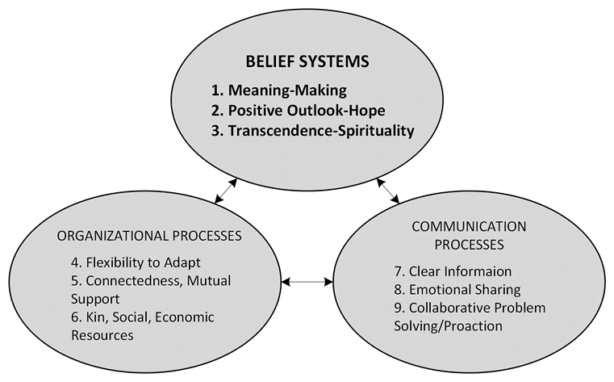
Family Resilience Framework
Figure 1. The family resilience framework. Walsh, 2016.
Notes:
Clare's results:
Before I go into the results of my study - the final analysis was informed by the family resilience framework.
This framework provides a conceptual overview of the key variables seen to facilitate healing and growth within families facing adversity. The framework identifies nine distinct processes involved in resilience development, grouped into three categories.
This framework has been used to better understand the processes that help families respond to challenges such as mental illness, disability, chronic disease, and bereavement - but it hasn't yet been used to look at the experience of families affected by methamphetamines.

Slide 20

Family Resilience Framework
Figure 1. The family resilience framework. Walsh, 2016.
Notes:
Clare's results:
This study specifically focused on the Belief Systems component of the framework: made up of meaning-making, positive outlook, and transcendence-spirituality.

Slide 21

Results - Study B
  Acceptance and resignation
“I just need to be able to cut myself off from this situation. And then try and get my, I guess, sense of wellbeing back. And I think I’m on the edge of it. I can’t use my son as an excuse to not be good to myself, because it’s the worst thing I can do, really.”
(Participant 5, female, parent)
Notes:
Almost all participants spoke about navigating acceptance in the process of making sense of their experience supporting a loved one who used methamphetamine. In particular, families' acknowledged the cyclic patterns of addictive behaviours and the recognition of their own limitations in influencing the outcomes of their loved one’s drug use. This presented at times as a resignation and hopelessness.
Family members who spoke about the effect of stress and strain on their wellbeing often demonstrated renewed empowerment to prioritise their own wellbeing. This is demonstrated in the following quote...

Slide 22

Results - Study B
2. Alternative perspectives to develop a compassionate view of addiction
“Their take on it is that it’s all trauma based. It’s not a choice. It’s not a disease. People use drugs so they can feel better because they’re struggling. I believe that theory…I’ve done some other reading and lots of self-help stuff. So I think I’ve come to a more compassionate place with it, which makes it probably a bit easier to deal with.”
(Participant 20, female, parent)
Notes:
Taking on different perspectives of addiction seemed to shape almost all participant’s perceptions of their loved ones, themselves, and their role in managing their loved one’s behaviour.
People spoke about hearing about different views of addiction through support-groups, friends, or professionals had supported a more compassionate understanding of drug use.
This is seen in the following comment by a mother who described the process of learning about a trauma-informed perspective and the positive impact of this on her wellbeing.

Slide 23

Results - Study B
3. Transcendence and finding purpose
“What helps me is like what I’m doing with you. I feel like I’m making a small contribution, I’m hopefully making things better down the track.”
(Participant 20, female, parent)
Notes:
The third theme is transcendence and finding purpose, this idea of connecting with higher values. Participants spoke about taking a step back from their role with their Person, and coming back to re-connect with their identity - which many had spoken about having lost in while supporting their loved one.

Slide 24

Results - Study B
4. Hope and a positive outlook
“But anyway, he tells me he went (to AA) last night, so I’ve just got to hope and pray that he’s telling the truth. When he rang me and said about it, I tried to be positive and said, oh, yes, did you really go, well, that’s wonderful. I don’t say prove it or anything like that. You’ve got to trust, I suppose.”
(Participant 3, female, parent)
Notes:
Lastly, holding onto hope and a positive outlook. This was spoken about as a way to balance the uncertainty and grief of supporting their loved one.

Slide 25

Conclusions and future directions
  Families experience stigma in many aspects of their lives.
  Stigma prevents families from seeking social and professional support.
  Supporting resilience-facilitating processes may improve outcomes.
  Increase awareness and availability of support services.
Notes:
Paige:
Experiences of stigma and discrimination underscored all of the findings of Study A. Families struggle to feel included within their social networks, as well as in society as a whole, and want the same for their person. Stigma prevents social and professional support seeking, a big issue considering social support is constantly identified as vitally important to these families. Need to consider families own needs for support, not just their role in supporting their person to reduce their drug use.
Clare: Adaptations in the belief systems of families affected by a loved one’s methamphetamine use may facilitate resilience.
Treatment design should consider methods that support resilience-facilitating processes, such as providing different conceptualisations of addiction to support acceptance, an integrated understanding, and reconnection with self-identity.

Slide 26
Paige Webb
NDARC, UNSW
p.webb@unsw.edu.au
Thank you
Clare Rushton
University of Wollongong
cr566@uowmail.edu.au
Notes:
Paige: Thank you for listening to our presentation. Feel free to reach out if you would like to discuss either of these studies after the conference today.

