Slide 1


From storybook to classroom: co-production and early piloting of a preventive intervention for children affected by parental substance use in UK primary schools
NIHR Three Schools Prevention Programme
Dr Nicola Aldridge
Research Associate, Newcastle University, Newcastle Upon Tyne, UK
On behalf of the wider Twinkle, Twinkle Arti Research Team
The views expressed are those of the author(s) and not necessarily those of the NIHR or the Department of Health & Social Care.
Notes:
Hi I’m Nicola Aldridge and I’m going to talk to you today on behalf of the wider twinkle twinkle arti team about a project called
From storybook to classroom: co-production and early piloting of a preventive intervention for children affected by parental substance use in UK primary schools
This project is funded by the National Institute for Health and Care Research (NIHR) Three Research Schools Prevention Research Programme

Slide 2

Background: Bringing Two Projects Together
  SAFEguarding children in Substance exposed fAmilies by supporting the non-using CaregivEr
  3 focus groups & 7 interviews with practitioners
  19 parents and 5 children
  2 co-production workshops
  Study exploring Parental substance use and Resilience in young people
  21 young people via online interviews
  44 practitioners via interviews/focus groups
  3 co-production workshops with 13 young people and 94 practitioners
SAFE SPACE
SPRing
Notes:
We have been talking to families who experience difficult situations and this is the work of two projects coming together: one looking at SAFEguarding children in Substance exposed fAmilies by supporting the non-using CaregivEr and the other exploring exploring Parental substance use and Resilience in young people.

Slide 3





What parents and carers told us…
I don’t know how to talk to my child about what is going on at home. I want to protect them from it
It’s hard to know when is the right time and how much to tell them.
I need support to start the conversation with my children
Notes:
In safe space non using caregivers were saying things like
I don’t know how to talk to my child about their parent’s substance use. I want to protect them from it.
It’s hard to know when is the right time and how much to tell them.
I need support to start the conversation with my children.

Slide 4
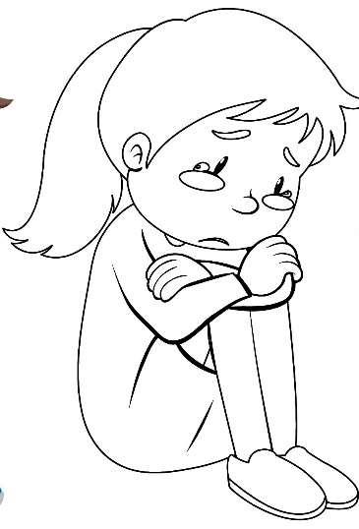
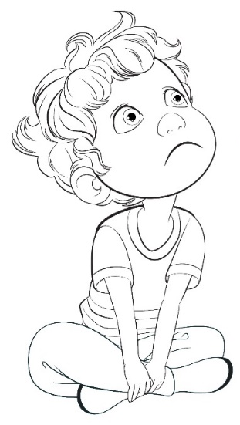

What young people told us…
It’s embarrassing because all your friends have got normal parents and you haven’t… It’s horrible, it really is
I gather all my soft toys in the bed, turn off the lights and tell them my worries
School did not have any red flags about me, because they just saw me as an achiever and just left me as that. I had a lot of stuff going on and they did not acknowledge that, to be honest. I was giving them [teachers] what they wanted. I was on my own. No teacher cared, because I was an achiever
As I got older I stopped
attending classes, started talking to teachers harshly and later started self-harming. I was showing how bad it was for me, and later, I started consuming alcohol and drugs at school
Notes:
And in the other study SPRing young people were talking about the effect on their mental health, feelings of loneliness and the stigma of asking for support. Saying things like…
“I gather all my soft toys in the bed, turn off the lights and tell them my worries”
“It’s embarrassing because all your friends have got normal parents and you haven’t… It’s horrible, it really is”
They also talked about the effect this had on their schooling and some talked about how what was going on was missed because there were no obvious red flags.
Saying things like…
“I stopped attending classes, started talking to teachers harshly and later started self-harming. I was showing how bad it was for me, and later, I started consuming alcohol and drugs at school”
School did not have any red flags about me, because they just saw me as an achiever and just left me as that. I had a lot of stuff going on and they did not acknowledge that, to be honest. I was giving them [teachers] what they wanted. I was on my own. No teacher cared, because I was an achiever.

Slide 5
The need for an open approach at school…
For so many children, there may be a lot of stuff going on that it’s just totally invisible to everybody. Just because they're not presenting with the problems doesn't mean the problems aren't there, so that's why anything that's universal, I
think, is beneficial (Social worker,
Children’s Social Care)
Having lessons in school would make a difference, so it is, kind of, spoken about, and it’s not just a subject that no-one speaks about, if that makes sense, because we had nothing like that at school
It was the most amazing thing the first time that I realised that I wasn’t the only one
Taking an open and universal approach within the school environment can help break down stigma and ensure more children are reached.
Notes:
There seemed to be a need for an open approach at school
Having an open approach within the school environment was thought of as a starting point to breaking down the public stigma and helping reach more children with the young people saying things like
Having lessons in school would make a difference, so it is, kind of, spoken about, and it’s not just a subject that no-one speaks about, if that makes sense, because we had nothing like that at school
It was the most amazing thing the first time that I realised that I wasn’t the only one
And health professionals commenting
For so many children, there may be a lot of stuff going on that it’s just totally invisible to everybody. Just because they're not presenting with the problems doesn't mean the problems aren't there, so that's why anything that's universal, I think, is beneficial

Slide 6

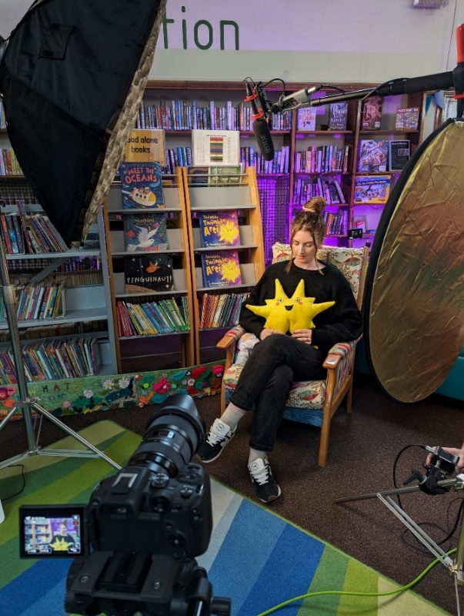
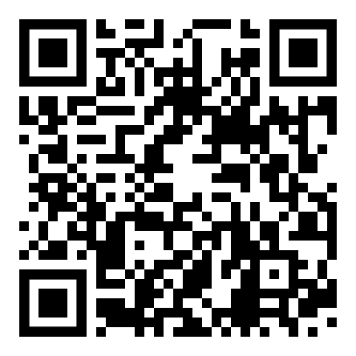
We co-produced the Twinkle, Twinkle Arti Story
Key messages are:
Children are not alone, and other children may have similar experiences
Children are not responsible for the needs and welfare of adult family members
Speaking to a trusted adult about their feelings can be a positive experience for children experiencing such issues
Scan QR code for Twinkle, Twinkle Arti Video
6
Notes:
So this brings us to where we are at now… in response to these findings Twinkle, Twinkle Arti was co-produced with families.
Twinkle, Twinkle Arti is a storybook and read-along video for 5–8-year-olds that can be read to all children and may be particularly useful for children affected by difficult family situations. The storybook was co-created with families and professionals and is designed to help all children understand and talk about family life in a safe and supported way. It focuses on the emotional and social challenges children may face and aims to mitigate the negative impact of family adversity and promote positive mental health.
The story focuses on the emotional and social challenges children may face, without explicitly mentioning difficult home situations. Difficult family situations are represented by a character named a ‘Yozzle’ which displays behaviours that represent the negative impact on some families. The book uses a character, Arti, who is a young star and goes through struggles that may feel familiar to children living in difficult situations – for example those experiencing disruption, worry or confusion.
Key messages are:
Children are not alone, and other children may have similar experiences.
Children are not responsible for the needs and welfare of adult family members.
Speaking to a trusted adult about their feelings can be a positive experience for children experiencing such issues.
This book does not directly mention adversity; instead, it includes a character causing disruption in the lives of the main characters. This approach respects children's different levels of understanding, and parents' wishes to protect them from sensitive topics.

Slide 7
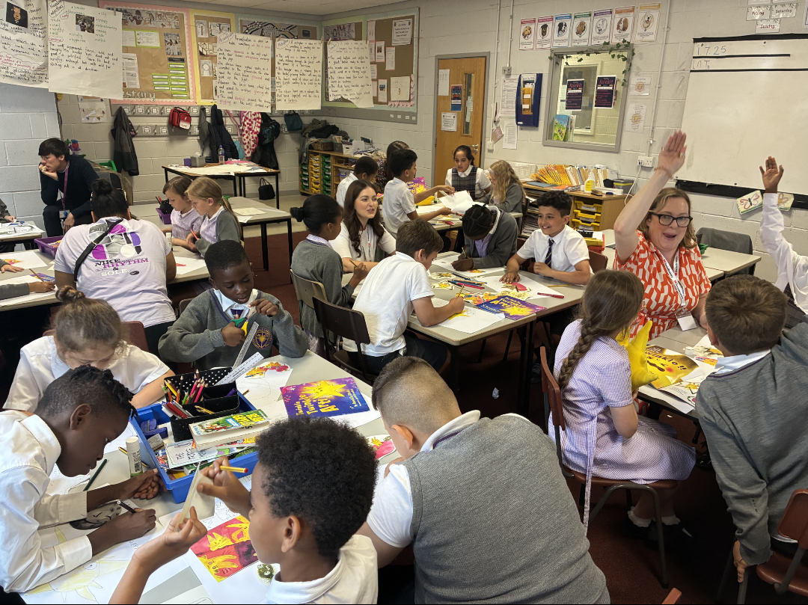

Co-producing a School Resource
Year 3 & 4 Children
Parents
Workshop & one to one discussion
N=3
School Staff
One to one discussion
Coram SCARF
N=5
3 class workshops
N= 69 (ages 7-9 years)
  Plan development from compiled feedback
Notes:
To support practitioners and teachers to share the story of Twinkle, Twinkle Arti and help encourage all children to recognise and talk about their feelings in a safe and open manner and to be able to identify trusted adults with whom they can speak accompanying resources were co-produced with primary-school aged children (N=69), parents (N=3), school staff (N=5) and Coram SCARF the leading charity provider of relationships, health, wellbeing, and drugs education to children across the UK.
All stakeholders held ‘power’ in the material development, through shared knowledge generation from 4 workshops (children and parents separately), individual discussion (school staff and parents) and plan development (children’s education charity).

Slide 8
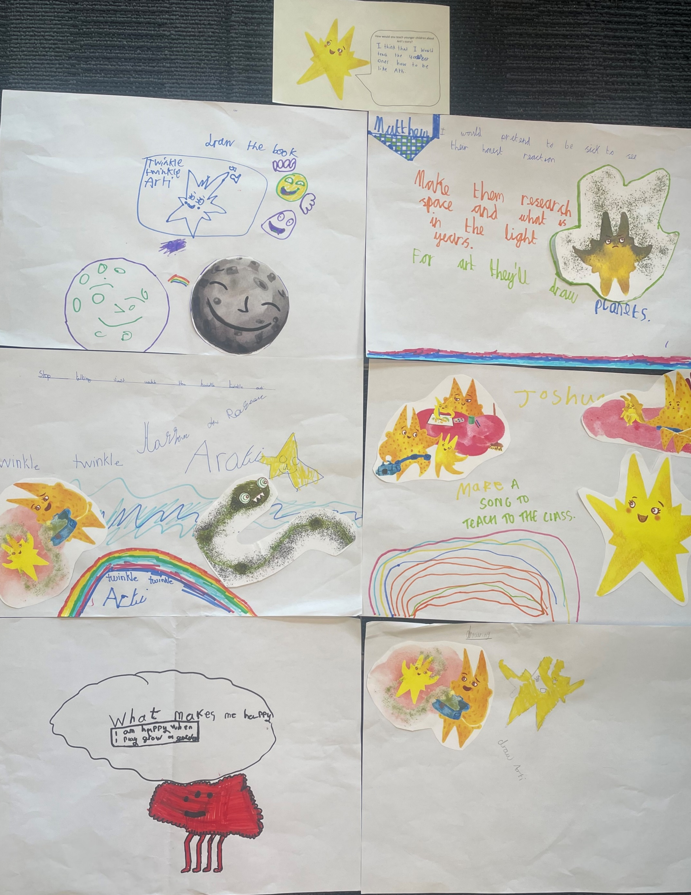
Preliminary Findings: Co-Production
Parents & School Staff
Positive emotional wellbeing messages that acknowledge stigma surrounding family adversity
Teachers
Children
Suggested fun & creative activities using art craft, music, puppets and physical activity
Intervention that fits into current practice with minimal staff burden & considers practical resource ideas
Coram SCARF
. Lesson plan for Years 1-3, addressing core aspects of national curriculum
Notes:
Parents and school staff acknowledged stigma surrounding family adversity and asked for lessons using positive emotional wellbeing messaging that enables children to interpret meaning depending on their family experiences. Teachers want an intervention to fit into their current practice, with minimal staff burden and provided practical resource ideas including: preferred activity duration and timeframe, effective activity types (e.g. role play, flash cards, circle discussion) and adaptations to consider additional needs. Children suggested fun and creative activities using art, craft, music, puppets and physical activity. These ideas were taken by Coram and developed into a lesson plan for Years 1-3, addressing core aspects of the statutory Relationship Sex Health Education national curriculum.

Slide 9
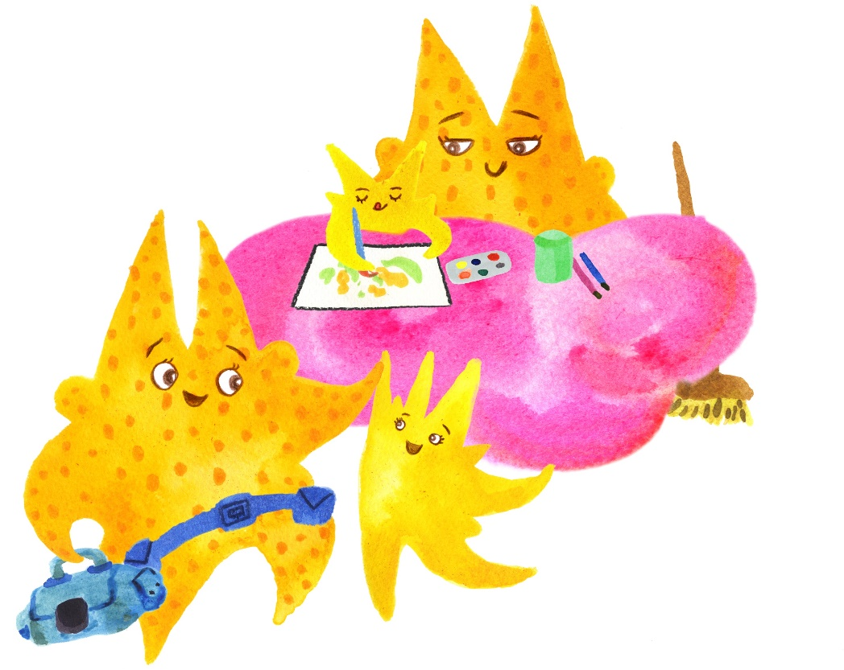
Lesson Plan
Learning Outcomes
Recognise and name emotions
Understand that it can be helpful to talk about feelings
Build empathy by listening to others
Use art and design to express emotions
Recognise the importance of positive mental health
Understand who their trusted adults are
Lesson plan and activities for Years 1-3 (aged 5-8), addressing core aspects of the statutory Relationship Sex Health Education curriculum
Produced by CORAM SCARF (leading charity provider of relationship, health, wellbeing and drugs education to children within the UK)
Notes:
The learning outcomes are:
Children will:
Recognise and name emotions
Understand that it can be helpful to talk about feelings
Build empathy by listening to others
Understand who their trusted adults are
Recognise the importance of positive mental health
Use art and design to express personal emotions

Slide 10
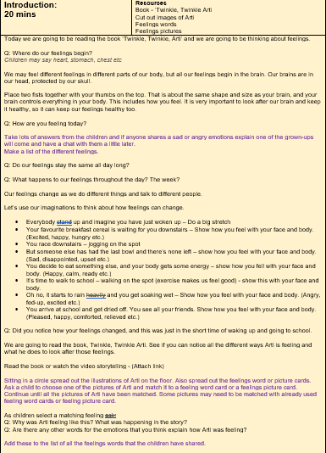
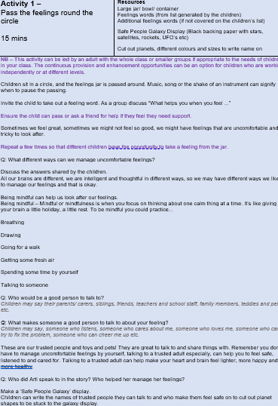


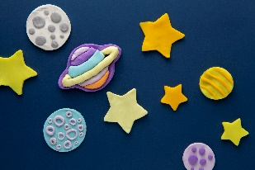

Lesson Plan Core Activities
Introductions (20 mins)
  Introduce book
  Discuss where feelings begin, where they come from and how feelings can change
  Read book
  Match pictures of Arti, feeling words and picture cards
Activity 1 (15 mins)
  Pass a feelings jar round the circle
  Make a safe person galaxy display
happy
happy
Notes:
The main teaching elements of the lesson plan are;
Introduction – this involves talking about feelings and explaining where they come and how feelings can change. The teacher then reads the book or the children watch the video before asking the children to sit in a circle and match pictures of arti to feeling images or words cards.
For Activity 1 – Pass the feelings round the circle
Children sit in a circle, and the feelings jar is passed around. Music, song or the shake of an instrument can signify when to pause the passing. Invite the child to take out a feeling word. As a group discuss “What helps you when you feel ...” What different ways can we manage uncomfortable feelings? Who would be a good person to talk to? What makes someone a good person to talk to about your feeling? Who did Arti speak to in the story? Who helped her manage her feelings?
Following this make a ‘Safe People Galaxy’ display.
Children can write the names of trusted people they can talk to and who make them feel safe on to cut out planet shapes to be stuck to the galaxy display.
avoiding actual names of people but instead writing their role, e.g. grandma, mum, aunt, friend, teacher etc.

Slide 11
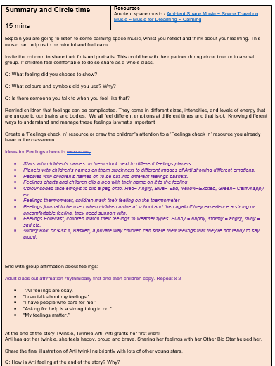
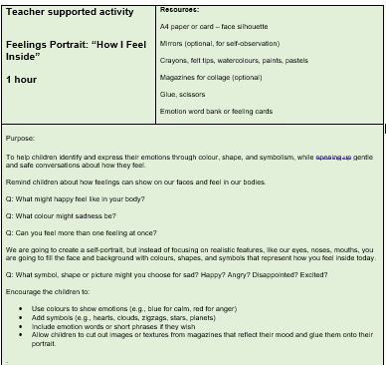
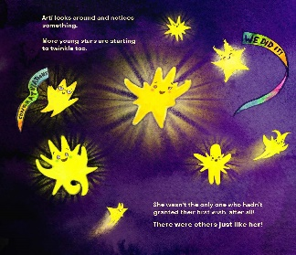
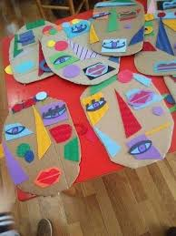

Lesson Plan Core Activities
Teacher supported activity – feelings portrait (1 hour)
  Create a self-portrait, but instead of focusing on realistic features, like eyes, noses, mouths, fill the face and background with colours, shapes, & symbols that represent how they feel inside today
Summary and circle time (15 mins)
  Listen to calming music & share learning
  Create a feelings check in resource
  End with group affirmation about feelings & share final illustration of Arti
“All feelings are okay.
“I can talk about my feelings.”
“I have people who care for me.”
“Asking for help is a strong thing to do.”
“My feelings matter.”
Notes:
Teacher supported activity – Feelings Portrait
Ask children to create a self-portrait, but instead of focusing on realistic features, like eyes, noses, mouths, fill the face and background with colours, shapes, & symbols that represent how they feel inside today
Summary and circle time
Explain you are going to listen to some calming space music, whilst you reflect and think about your learning.
Invite the children to share their finished portraits. This could be with their partner during circle time or in a small group. If children feel comfortable to do so share as a whole class.
Create a ‘Feelings check in’ resource (somm examples are included in the lesson plan) or draw the children's attention to a ‘Feelings check in’ resource you already have in the classroom.
End with group affirmation about feelings and share the final illustration of Arti twinkling brightly with lots of other young stars.
And there was some extra activities which the teachers could choose to extend the lessons or for children to engage with independently whilst teachers may be working with smaller focused groups.

Slide 12

Pilot
Attendance data: term pre, post & during intervention session (s)
N.E England
69 children, years 1-3*
No opt out
N(%) and alternative activity for opt out children
Pre SDQ/CHU9D
Read Story
Class activities
Child feedback session
Staff feedback interview
Post SDQ/CHU9D
S.W England
69/89 children, years 1-3*
20 opt out
S.E England
57 children, years 1-3*
*Aged 5-8 years
Notes:
School 1 -69 recruited
School 2 - 69 recruited
Piloted in three schools in different areas of England including areas with high parental substance use, financial hardship, and cultural diversity during spring/summer 2026. Teachers interviewed about their experiences of implementing the intervention and its perceived impact on children’s well-being. Children’s experiences explored within whole-class feedback sessions. Teacher reported Strengths and Difficulties Questionnaires completed pre-and post-intervention for every child to measure change. In one school a health related quality of health measure, the CHU-9D was completed pre and post too. Attendance data collected pre, post and during the intervention.

Slide 13
Preliminary Findings: Feasibility
Challenges | Strategies
Recruiting three schools for pilot | Approaching Coram SCARF associated schools first Linking into existing research active school networks Adopting a suitable timeframe that considers school’s other commitments
Intervention delivery | Obtain enthusiastic contact within the school and buy in from headteacher Provide detailed implementation plan and regular reminders from research team Explicit links to current curriculum
Pilot data collection | Provide detailed implementation plan and regular reminders from research team Offer alternative methods to collect feedback if requested
Data collection complete for two schools. Third school encountered internal issues unrelated to project which limited their capacity before summer break. Hoping to recommence data collection in the coming weeks
Notes:
Data collection complete for two schools. Third school encountered internal issues unrelated to project which limited their capacity before summer break. Hoping to recommence data collection in the coming weeks.
Key challenge with recruitment and intervention delivery was capacity or perceived capacity.
Strategies to aid recruitment
Approaching Coram SCARF associated schools first
Linking into existing research active school networks
Adopting a suitable timeframe that considers school’s other commitments
Strategies to aid implementation
Obtain enthusiastic contact within the school and buy in from headteacher
Provide detailed implementation plan and regular reminders from research team
Explicit links to current curriculum
Provide detailed implementation plan and regular reminders from research team
Offer alternative methods to collect feedback if requested

Slide 14
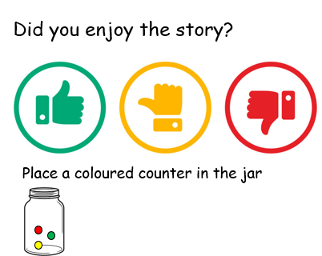
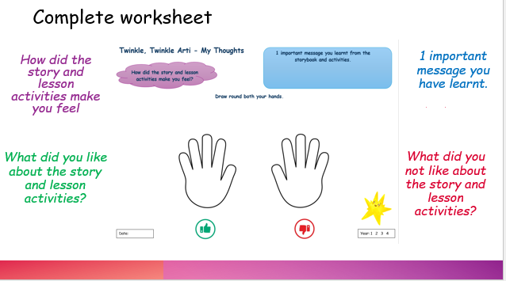
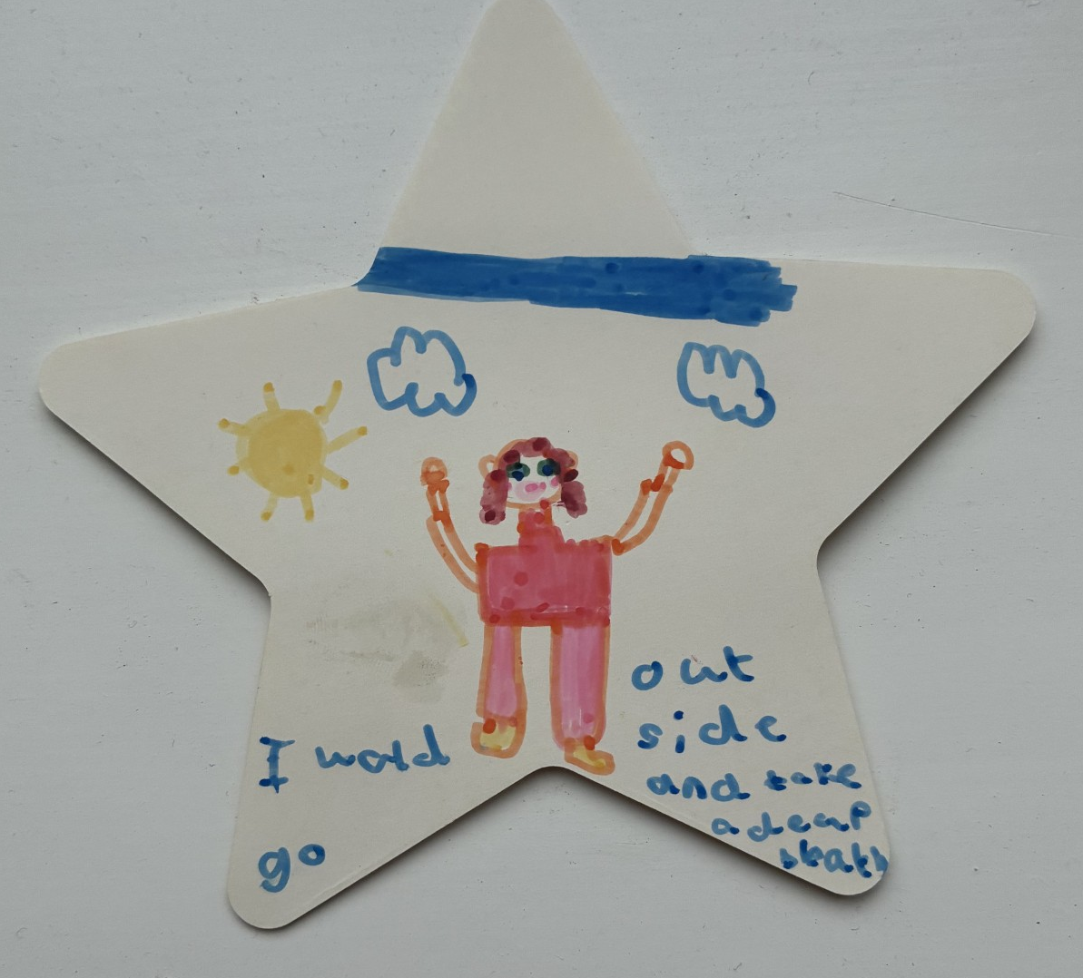
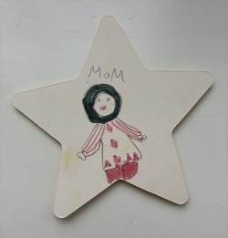
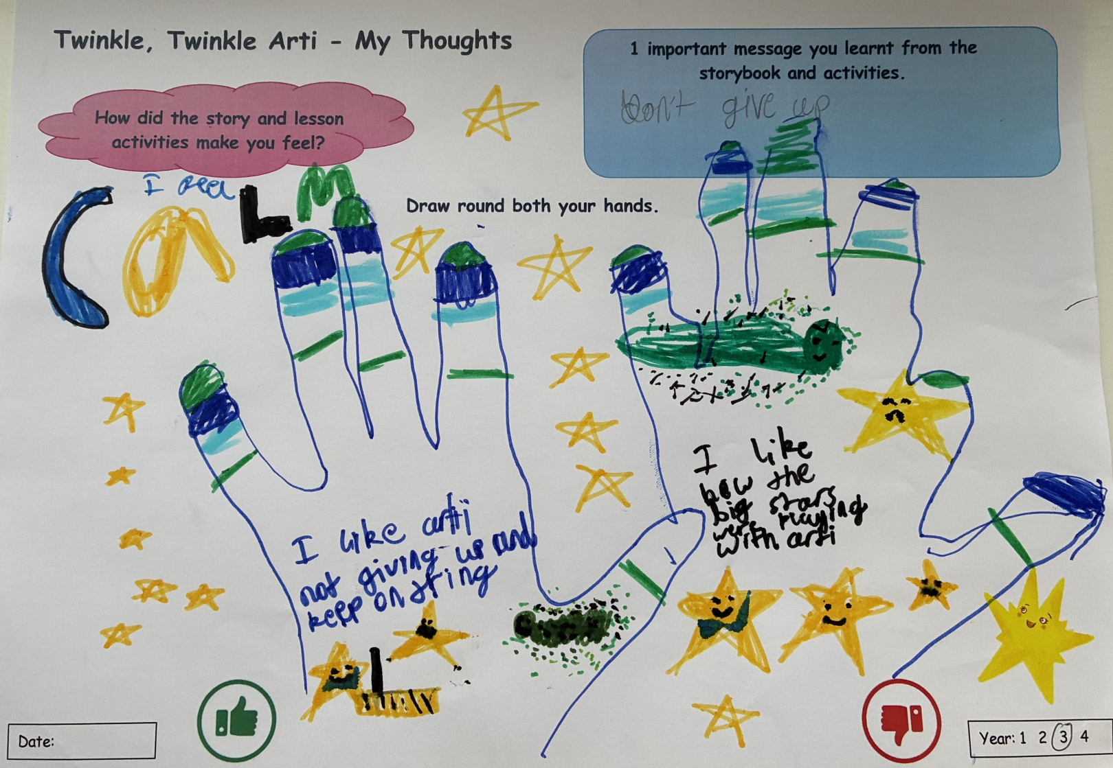
Preliminary Findings: Class Feedback
What would you do when you feel sad or worried?
Write or draw what you would do on a star.
48% 40% 12% | 55% 34% 11%
The children were able to identify the key messages of the story and enjoyed the core lesson activities
They reported learning to never give up, the importance of sharing your feelings & that you don’t have to protect everything if you’re young
They were able to identify a key person they would talk to or something they would do if they felt sad or worried
Notes:
As can be seen above, most enjoyed the story.
They disliked the Yozzle’s effect on other big star & making Arti sad &liked it when big star helped Arti and other big star, when the Yozzle left and when Arti got her Twinkle back.
The children were able to identify the key messages of the story, listing Arti talking to big star about feelings, when Arti is helped by big star and when Arti loses her shine and gets it back as key parts of the story. They reported learning to never give up, the importance of sharing your feelings and that you don’t have to protect everything if you’re young.
They enjoyed the core lesson activities in particular the art based activities and the feeling cards.
When asked to write or draw on a star what they would if they felt sad or worried, they were able to identify a key person they would talk to or something they would do. These included talking to a trusted family member, teacher or friend or engaging in an activity they found calming or fun.

Slide 15
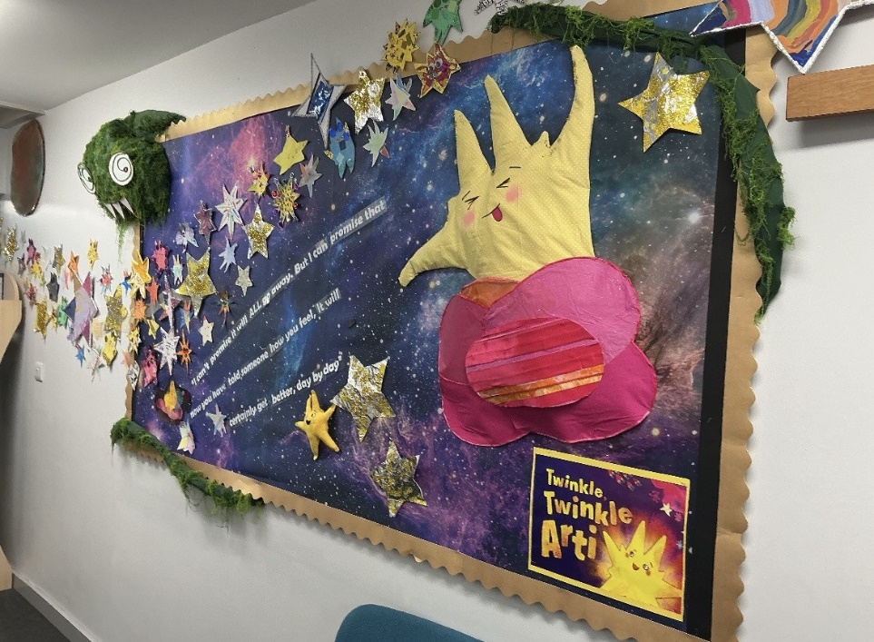
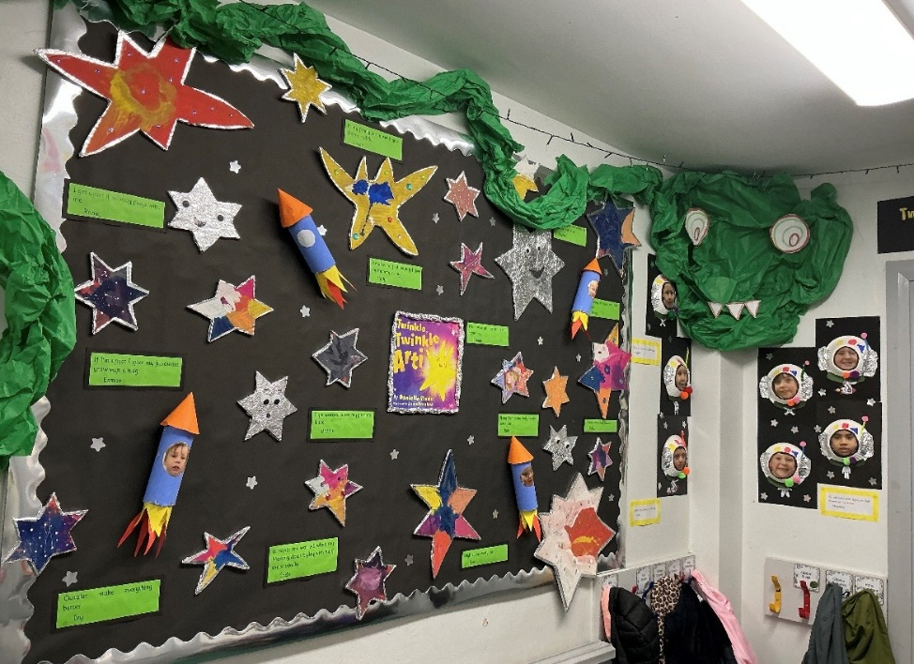
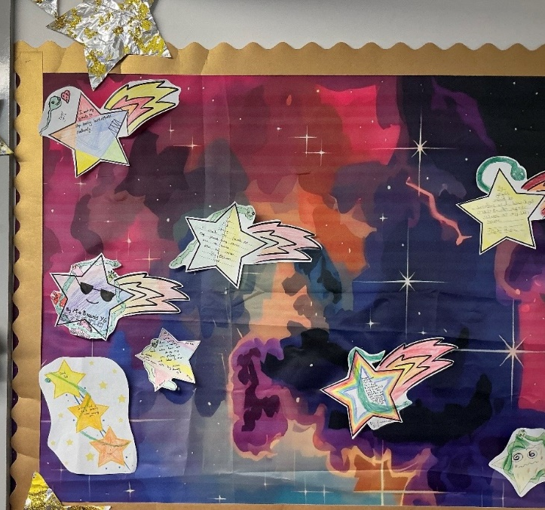
Preliminary Findings: Teacher Feedback
Story provided useful introduction which led seamlessly into discussion of emotions
Children really engaged with story and activities (inc. SEND) & were comfortable talking about emotions
Resource aligns with school’s values & teaching approach and this aided implementation
Activities completed across the whole school
Implementation aids to help embed resource
Give each child a book
Provide lesson plan and resources so ‘ready to go’
Link to PHSE
Consider existing relationships
Appropriate time of year
Notes:
Data still to be formally analysed and awaiting teacher feedback from second school but initial findings are very positive.
Story provided useful introduction which led seamlessly into discussion of emotions.
Children really engaged with story and activities (those children with SEND needs) and were comfortable talking about emotions.
Resource aligns with schools values and teaching approach and this aided implementation.
This school saw such value in the resource that they decided to read the book and complete some activities across the whole school.
The teachers reflected on their acceptability of the resource and highlighted implementation aids that could help embed the resource within other schools and primary education generally.
Give each child a book
Provide lesson plan and resources so ‘ready to go’
Link to PHSE
Consider existing relationships (e.g. links with Coram SCARF ensured resource linked further into current teaching)
Appropriate time of year (links well to teaching at start of school year)

Slide 16
Next Steps
Complete data collection in third school
Qualitative analysis of feedback data – process evaluation
Quantitative analysis of feasibility outcomes (in line with RE-AIM Implementation Framework)
Quantitative analysis of change in SDQ, CHU-9D or attendance post intervention compared to pre intervention
Further co production & dissemination
Notes:
Complete data collection in third school
Qualitative analysis of feedback data – process evaluation
Quantitative analysis of feasibility outcomes (in line with RE-AIM Implementation Framework)
Uptake rates of schools who participate in study
Frequency & proportion of parent opt-out
Frequency & proportion of class with SDQ & CHU9D complete pre & post intervention
Frequency & proportion of class that received storybook intervention & associated activities & complete activities
Retention rates
Quantitative analysis of change in SDQ, CHU-9D or attendance post intervention compared to pre intervention

Slide 17



Acknowledgments
Twinkle, Twinkle Arti Research Team
Dr Cassey Muir, Population Health Sciences Institute, Newcastle University, UK
Prof Ruth McGovern, Population Health Sciences Institute, Newcastle University, UK
Ms Deborah Smart, Population Health Sciences Institute, Newcastle University, UK
Ms Jenny Lorimer, Coram SCARF Life Education, UK
Ms Jan Forshaw, Coram SCARF Life Education, UK
Prof Eileen Kaner Population Health Sciences Institute, Newcastle University, UK
Prof Geraldine Macdonald, School for Policy Studies, Bristol University, UK
Dr Lee Clay, School for Policy Studies, Bristol University, UK
James Parsonage, Population Health Sciences, Bristol University UK
Ass. Prof Dinithi Wijedasa, School for Policy Studies, Bristol University, UK
This project is funded by the National Institute for Health and Care Research (NIHR) Three Research Schools Prevention Research Programme
Notes:
I would just like to acknowledge the Twinkle Twinkle Arti research team listed here and ofcourse the schools that have taken part.

Slide 18
Dr Nicola Aldridge
Population Health Sciences Institute
Newcastle University
Newcastle Upon Tyne, UK
Nicola.Aldridge@newcastle.ac.uk

