Slide 1




Parenting Skills Training Program Cap sur la famille:
What is the Impact on Families with Parents with an Addiction?
AFINet Conference,
Rotterdam, Netherlands, June 15th and 16th 2023
MYRIAM LAVENTURE, Ph. D.
University of Sherbrooke
Department of Community Health Sciences
Addiction Programs

Slide 2

Context
Since 2008, in Quebec, Parenting Skills Training Programs (PSTP) are developed and adapted for families, where at least one of the parents has an addiction.
In 2018, after a study aimed at gathering information, comments and opinions on these programs, the Cap sur la famille program a PSTP specifically aimed at parents with addictions and their children aged 6 to 12 years old was developed. ​
Over the past 5 years, the Cap sur la famille program has been implemented in several Addiction Treatment Centers in Quebec.

Slide 3



Parenting Skills Training Programs
PSYCHOEDUCATIVE APPROACH
COLLABORATIVE APPROACH
Implementing new strategies and behaviours
Focussing on the participants’ competence rather than their knowledge.​
Actively involved and supported by the facilitator
Approach based on an equal relationship between the facilitator and the participants.​
Goal : Restore and develop the adaptive capacities of people
Goal : Enhance the autonomy of family members
Notes:
The psychoeducative approach aims to​ restore and develop, in the here and now, the adaptive capacities of people, parents and children, by implementing new strategies and new behaviours.​ The psychoeducative approach considers the individual in their entirety, taking into account both their strengths and their limitations. Through these pedagogical methods, the facilitator seeks enhance the autonomy of family members.
In the collaborative approach, the facilitators work in collaboration with the participants, engaging with them using a problem-solving approach.
​In these learning approaches, the person being helped is actively involved in their learning process. As with the collaborative approach, in a psychoeducational approach, the role of the facilitator is not that of an expert, but rather of support.​

Slide 4

The program
Spouse
Families
Children aged 6 to 12
Parents with addiction to alcohol or drugs
Grand parent
Friend
Notes:
The Cap sur la famille program is for families of children between the ages of 6 and 12 in which one of the parents is addicted to alcohol or drugs.
Support people surrounding the family, such as a spouse, grandparent, or friend, are also welcome in the program in order to support the parent through this process.
To participate in the program, a parent must be addicted to alcohol or drugs or have been in the past year.
The parent must acknowledge their substance use problem and must show up to the meetings sober.
The goal of the program is to reduce the impact of parental addiction on family life.

Slide 5


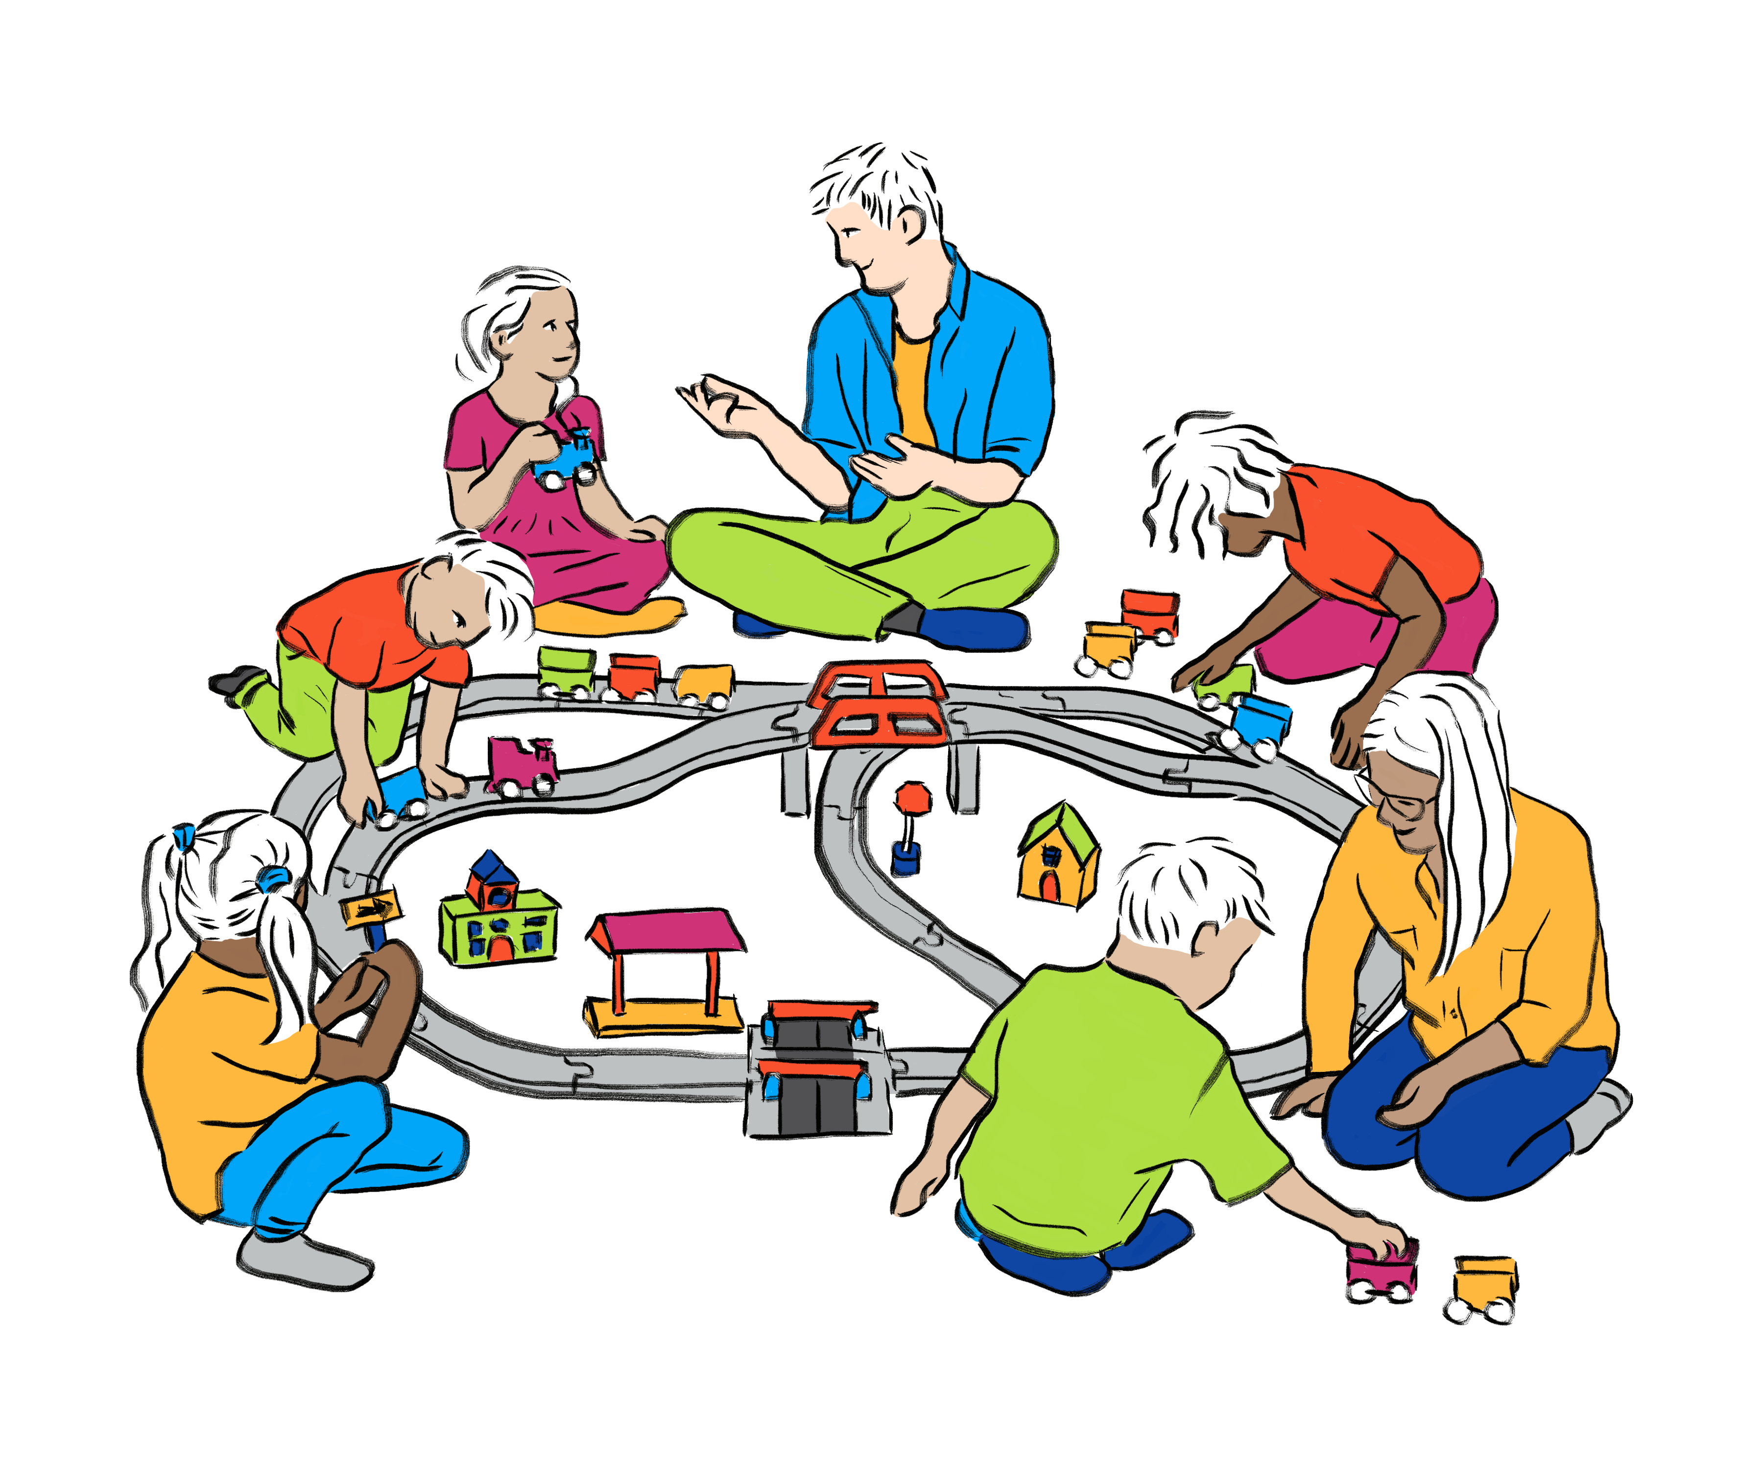

The program
5 to 8 families
Agenda
18 h : Parent group
Child group
19 h : Family group
Notes:
The Cap sur la famille program was developed to be offered to groups of 5 to 8 families.
Ideally, four facilitators lead the program.
Two facilitators would facilitate the group of parents and the two others would do the same with the group of children.
Prior training in a social field such as psychoeducation, social work or special education is recommended to facilitate this program.
As it can be difficult to free four facilitators from the same organization, it is suggested to establish partner relationships between different organizations specializing in addiction treatment as well as those providing services to youth. These partnerships will be beneficial to bring together complementary expertise.
A typical meeting includes:
A workshop hour where parents and children will work separately on complementary themes.
An hour of family workshop that will put those new skills into action.
A snack or lunch break with all families and facilitators can be added to allow facilitators to observe families and shape behaviours in a positive manner.

Slide 6
The program
Sequence and themes of the workshops
0
V
Pre-group meeting
VI
Addiction and the Family
I
Introduction
VII
Boundaries
II
VI
A Balanced Family Life
VIII
Communication Skills (part 1)
III
Children Aged 6 to 12
IX
Communication Skills (part 2)
III
Parental Discipline, Anger Management and Family Harmony
IV
Positive Childrearing Practices (part 1)
X
VII
IV
XI
V
Positive Childrearing Practices (part 2)
Celebration
Notes:
In its most effective 11-session format, the Cap sur la famille program has been developed to be offered to a group of families. However, if it is impossible for you to offer the program in its optimal format, here are some adaptations that can be made while respecting the evidence-based practices in terms of intervention with families.
First, the program can be offered in a shorter format over 7 sessions. If you choose this version, here are the workshops you will have to offer.
Although shorter, this version will allow you to discuss key themes, which are those at the base of the parenting pyramid. The general idea remains the same: by strengthening positive parenting practices, parents will improve the relationships in their family. This short version ensures that the family is exposed to 8 hours of treatment, which is the minimum of sessions necessary for the program to be effective to observe improvements in the family dynamic.

Slide 7


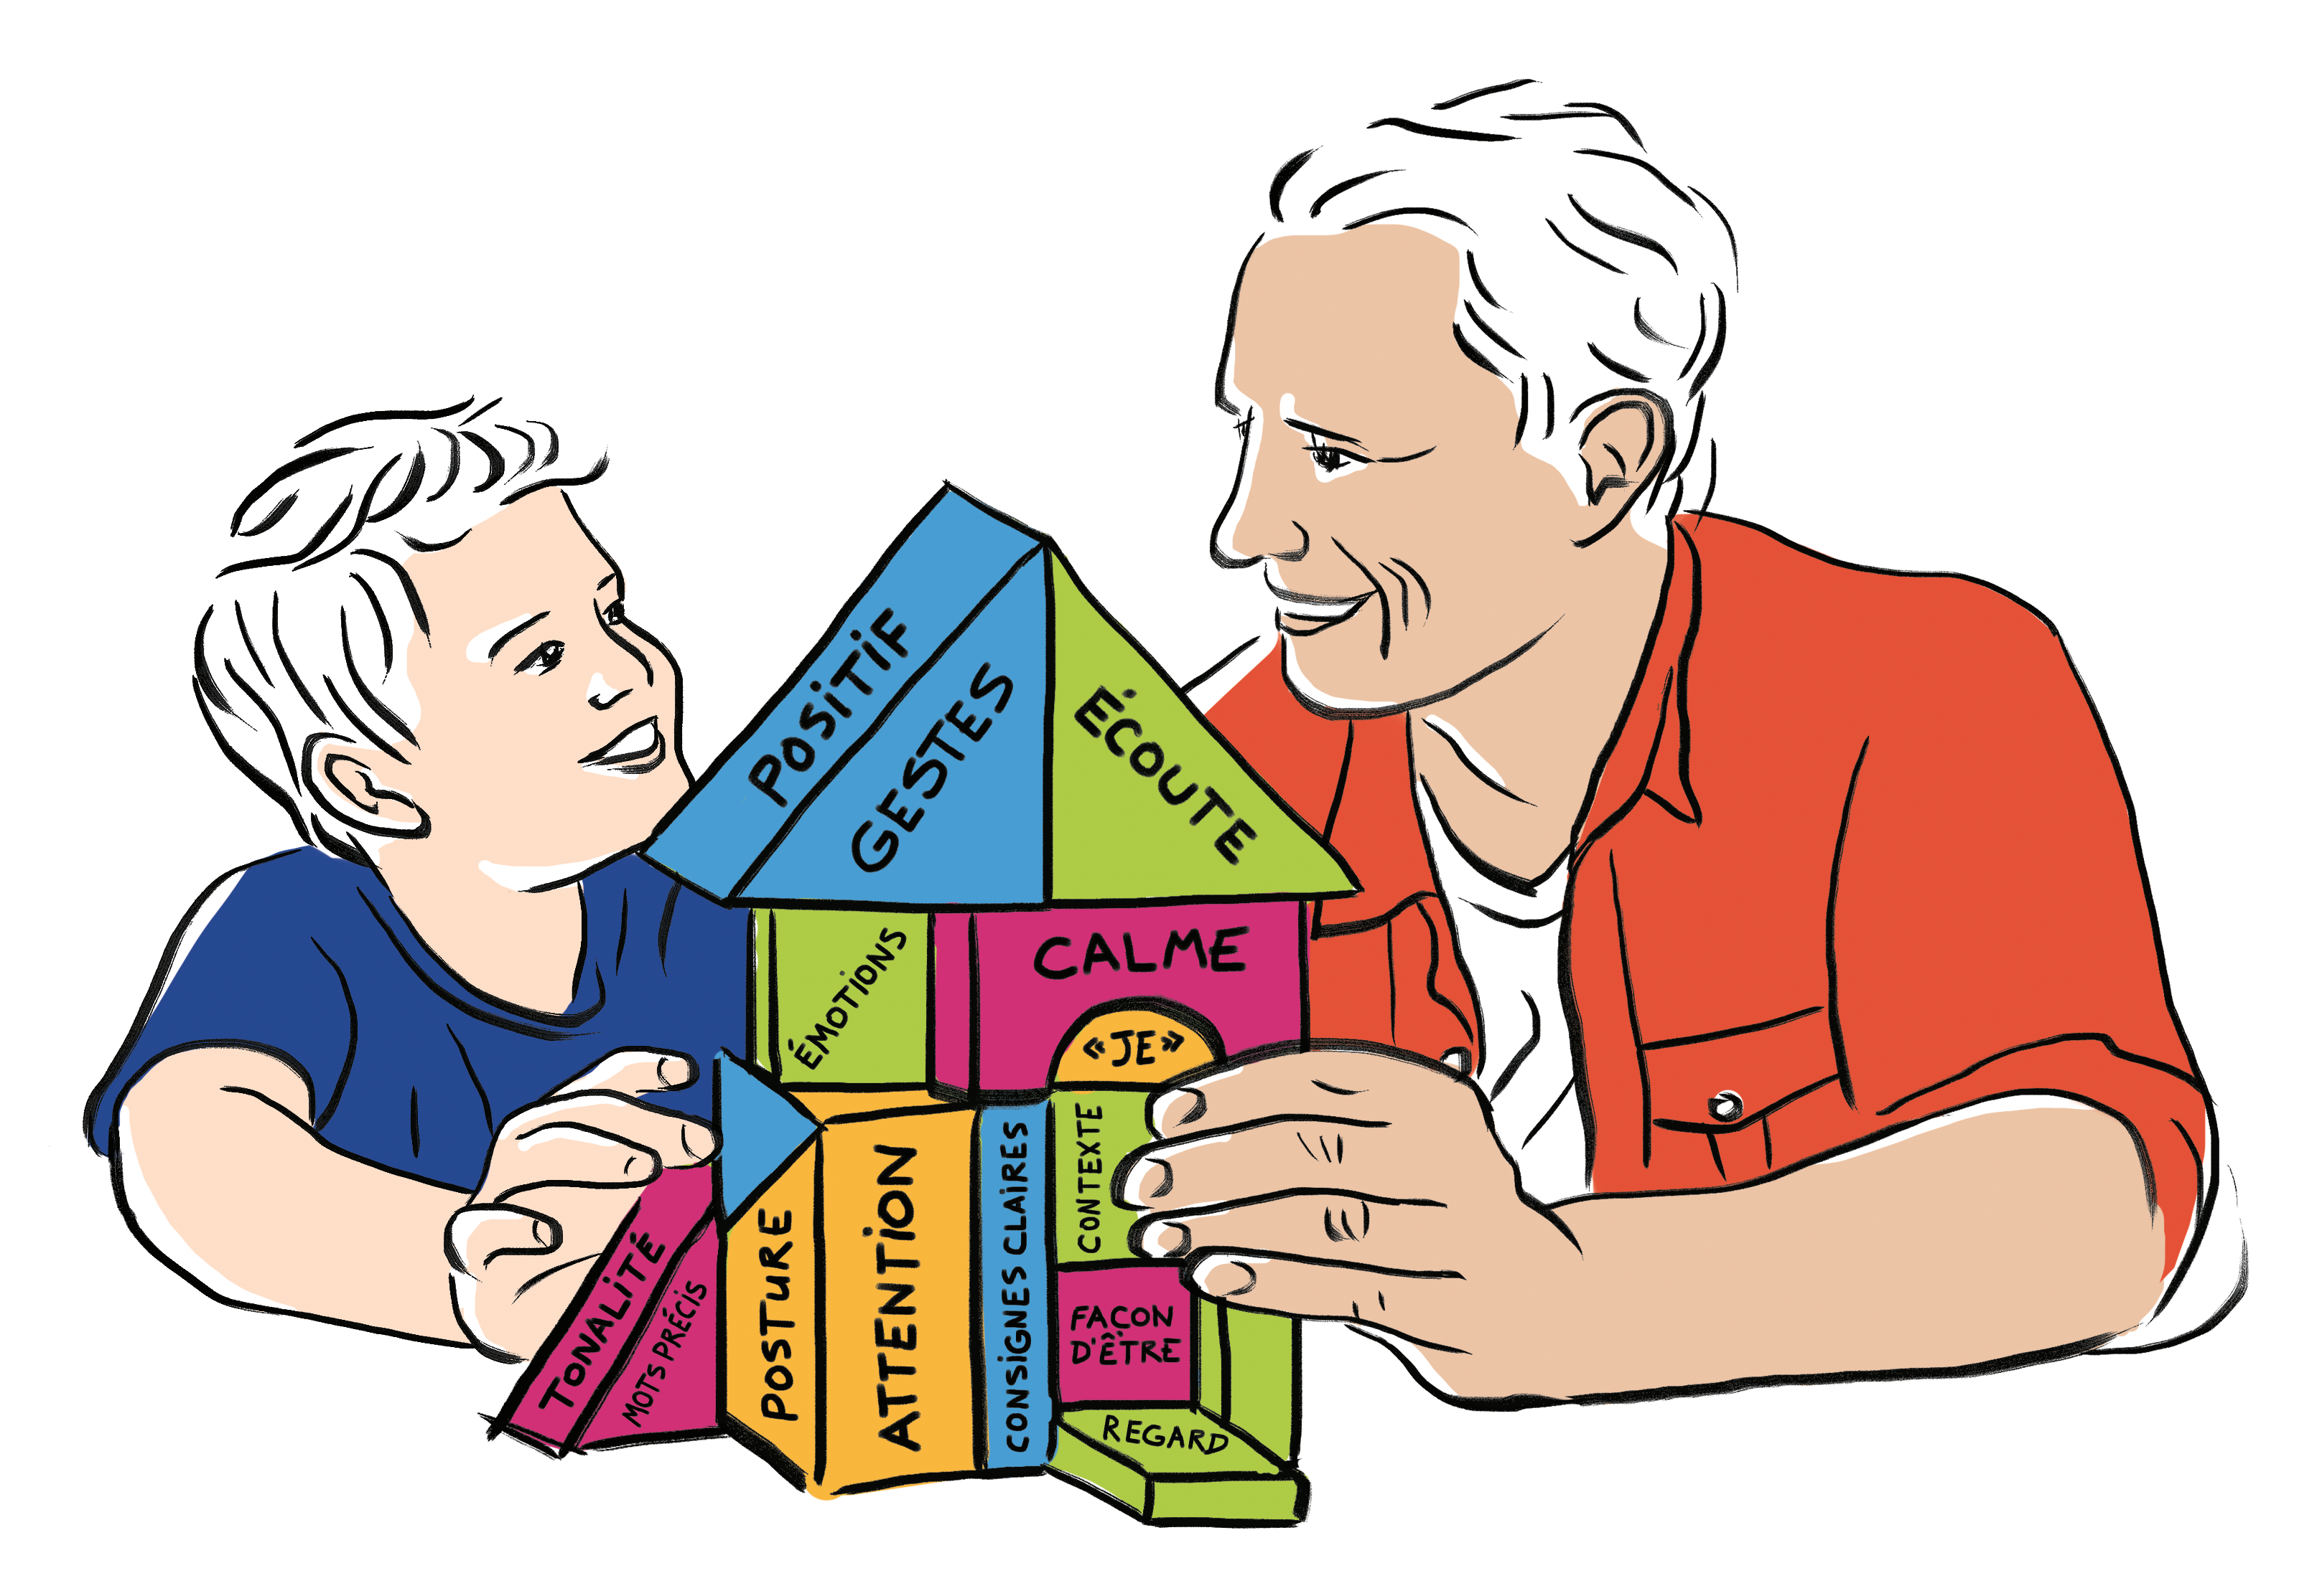

The program
Program Adaptations
Retrait
Family group
Individual family meeting
Parent group
Virtual meeting
Attention / Émotions / Écoute / Communication
Notes:
The treatment being in a group context offers many benefits for the parents. It allows parents to create a sense of belonging, to obtain social support and benefit from the experience of other parents.
If creating a larger group of 5-8 families is impossible, the program can be offered to smaller groups, or even one family at a time.
If the inclusion of children is impossible, for instance if you work in an inpatient addiction centre, it may be possible to only offer the segments aimed towards the parents.
Again, it is suggested to opt for a group intervention when possible, however if this is not possible, the parent segments may be offered on an individual basis.
If the families live on a vast territory and it is difficult to reach them, a virtual option for the parent segments is available.
Finally, the Cap sur la famille program is available in both official languages, that is French and English.

Slide 8



Objectives of the study
Notes:
A total of 87 parents (68 mothers and 19 fathers) participated inthe assessment.

Slide 9
Objectives
To draw a portrait of the families who participated in the Cap sur la famille program.
To measure the evolution of the families who have participated in the program.
9

Slide 10

Material and Method

Slide 11


Sample
N = 89 families
Women : 76.3% - 36.1 years (SD=5.8)
Men : 23.7% - 41.0 years (SD=5.2)
Family Types
Intact : 20.0%
Single Parent : 63.8%
Blended Family : 16.2%
Girls : 52.5% - 8.4 years (SD=2.0)
Boys : 47.5% - 8.8 years (SD=1.5)
On average, families attended 6.29 (SD=3.8) meetings.
11
Notes:
A total of 89 parents (68 mothers and 21 fathers) participated in the assessment.
To maintain the independence of the observations in the classification analysis, only one child per family was randomly selected.
On average, families attended 6.29 (SD=3.8) meetings.

Slide 12

Procedures
Study was approved by the University of Sherbrooke and Addiction treatment centers Ethics Committees
Written informed consent was obtained from all participants.
Online self-report questionnaires completed before and after de program by the parent.
Different measures:
      Sense of Self Efficacy: Self-Agency Measure (Dumka et al., 1996)
      Parental substance use: DÉBA-Alcool/Drogues (Tremblay et al., 2001)
      Parents’ anxiety, depression and irritability: Psychiatric Symptoms Index (Ilfeld,1976)
      Insufficient Supervision, Inconsistent Discipline and Family Dysfunction: Alabama Parenting Questionnaire (Frick, 1991)
      Warmth, Hostility, Neglect and Rejection: Perceived Parental Acceptance-Rejection Questionnaire (Rohner, 2005)
      Child Difficulties: Eyberg Child Behavior Inventory (Eyberg & Ross, 1978)
12

Slide 13
Analysis
First objective:
      A principal component analysis was carried out for the first objective. A hierarchical classification analysis method was performed.
Second objective
      A repeated measures ANOVAs were performed to compare the scores obtained for the different variables before and after the program.
13
Notes:
A principal component analysis is a dimensionality reduction method that is often used to reduce the dimensionality of large data sets, by transforming a large set of variables into a smaller one that still contains most of the information in the large set.

Slide 14

Results

Slide 15




Results
Four Family Profiles
Profile (46.1%)
Profile
(15.2%)
Profile (N=15.2%)
Profile
(N=23.5%)
With both important family functioning difficulties and parents’ psychological difficulties
With few familiy functioning and parents’ psychological difficulties
With important family functioning difficulties
With important parents’ psychological problems
15

Slide 16
Results
BEFORE and AFTER the program
Variables | M (SD) | Sums of square | df | Mean Square | F
Sense of self efficacy
T1 | 3,83 (0,6) | 2,81 | 1 | 2,813 | 24,44***
T2 | 4,21 (0,4)
Parents’ anxiety
T1 | 2,41 (0,06) | 0,74 | 1 | 0,74 | 4,10*
T2 | 2,22 (0,8)
Parents’ depression
T1 | 2,13 (0,7) | 0,59 | 1 | 0,59 | 1,54
T2 | 1,96 (0,7)
Parents’ irritability
T1 | 1,99 (0,6) | 0,61 | 1 | 0,61 | 1,74
T2 | 1,82 (0,6)
Positives practices
T1 | 4,20 (0,5) | 0,06 | 1 | 0,06 | 0,52
T2 | 4,18 (0,5)
Insufficient supervision
T1 | 1,28 (0,3) | 0,09 | 1 | 0,09 | 2,61
T2 | 1,21 (0,2)
Inconsistent discipline
T1 | 2,56 (0,8) | 4,08 | 1 | 4,08 | 23,17***
T2 | 2,10 (0,6)
p < 0,05 * p < 0,01 ** p < 0,001***
16

Slide 17
Results
BEFORE and AFTER the program
Variables | M (SD) | Sums of square | df | Mean Square | F
Family dysfunction
T1 | 2,40 (0,2) | 8,28 | 1 | 8,28 | 50,88***
T2 | 1,72 (0,5)
Warmth
T1 | 3,73 (0,4) | 0,13 | 1 | 0,13 | 2,26
T2 | 3,81 (0,3)
Hostility
T1 | 1,55 (0,4) | 0,61 | 1 | 0,61 | 7,82**
T2 | 1,37 (0,4)
Neglect
T1 | 1,58 (0,5) | 0,53 | 1 | 0,53 | 6,90**
T2 | 1,42 (0,4)
Rejection
T1 | 1,21 (0,4) | 0,12 | 1 | 0,12 | 1,30
T2 | 1,13 (0,2)
Child difficulties
T1 | 98,68 (27,6) | 831,14 | 1 | 831,14 | 3,11
T2 | 91,97 (27,7)
p < 0,05 * p < 0,01 ** p < 0,001***
17

Slide 18



Testimonials
“… Cap sur la famille program is more than a program. It has given us quality family time. I especially liked being able to involve my children. To do something together to make things better. It has been a turning point for me.”
“ The program helped me get back to the basics; the importance of emotions, of precise instructions to bring back family harmony. It also helped me to establish a routine and spend time with my child. a new way of seeing how to do things as a family.”
18

Slide 19

Conclusion

Slide 20
Conclusion
Different profiles of families participated in the Cap sur la famille program.
It is easy to understand why the families who present important difficulties agree to participate in the Cap sur la famille program.
Why families reporting fewer difficulties did it?
  The presence of guilt,
  The wish to be a better parent for their children,
  The recognition of difficulties, although they are lesser,
  The presence of a strong therapeutic alliance with the professional who proposed to participate in the program.

Slide 21
Conclusion
Following the program, parents have …
  A better sense of self-efficacy,
  Fewer symptoms of anxiety,
  More constant discipline,
  Better family functioning,
  Less hostile and neglectful behaviors towards their children.
Maybe bringing together families with different difficulties can allow mutual support, families not presenting all the difficulties at the same level.
The main challenges are recruiting and retaining the families who need it the most.

Slide 22


Free Training Program capsurlafamille.espaceweb.usherbrooke.ca

Slide 23





Description
  Cap sur la famille training program
Online (French and English)
14 hours
Short videos
Explanatory videos
Supplementary reading
Quizzes
Reference guides
Notes:
This training program is available in both French and English, is entirely accessible online enabling you to train yourself following your own rhythm.
The total length is approximately 14h and includes the screen training time, the supplementary readings, as well as the time dedicated to the integration of the content.
We will offer different interactive tools such as [short videos, explanatory videos, supplementary reading, quizzes and reference guides. All of these tools will enable you to make the Cap sur la famille's program your own.

Slide 24
Description
  Cap sur la famille training program
Parenting in the context of addiction
1
The program
2
Clinical assessment
3
Methods to lead a group
4
Notes:
The training program is divided into 4 modules;
The first module pertains to parenting in an addiction context: its impact and the intervention needs;
The second module pertains to the program Cap sur la famille: its approaches and the possible adaptations;
The third module pertains to clinical assessment;
And the fourth module explains the different methods used to lead a group through the program.

Slide 25

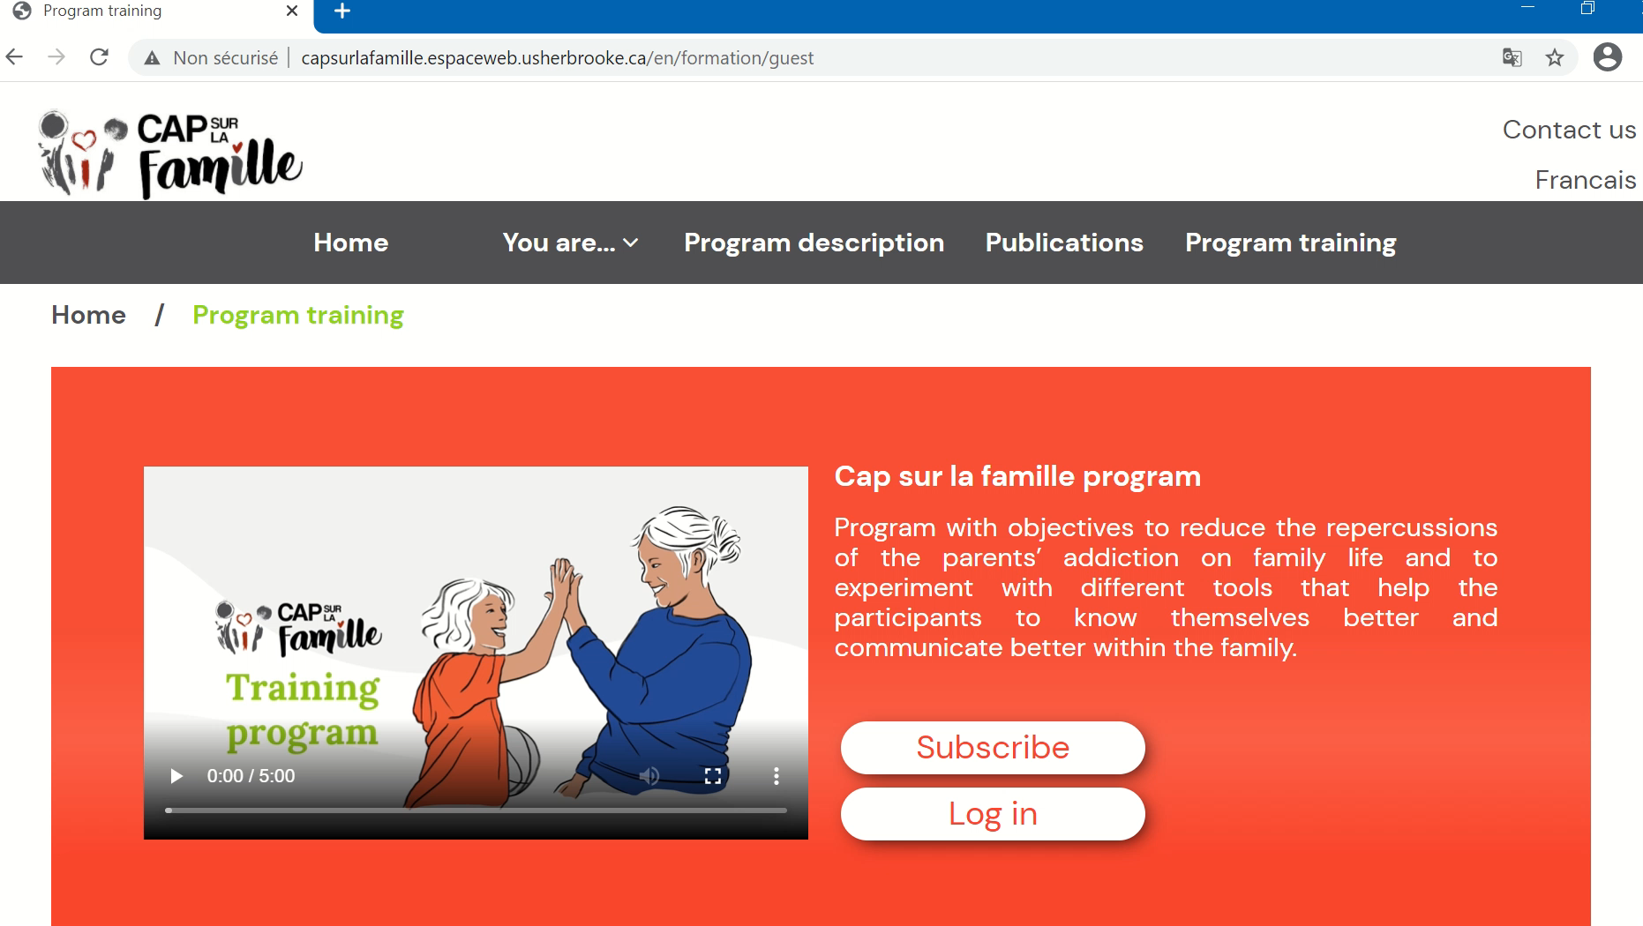
Description
  Cap sur la famille training program
Notes:
To get free access to the content of the training program, sign up by following the link situated below this short video.
Enrollment will be accepted within five days, after which you will be able to start your training.

Slide 26
Thank you!

Slide 27

AN INITIATIVE OF
With the precious collaboration of
MINISTRY OF HEALTH AND SOCIAL SERVICES
HEALTH
CANADA
With the support of the Department of University Education and Research
SPECIAL MENTION :
"The views expressed herein do not necessarily reflect those of Health Canada, the Department of
Health and Social Services or CIUSSS du Centre-Sud de l’Île-de-Montréal. »

