Slide 1
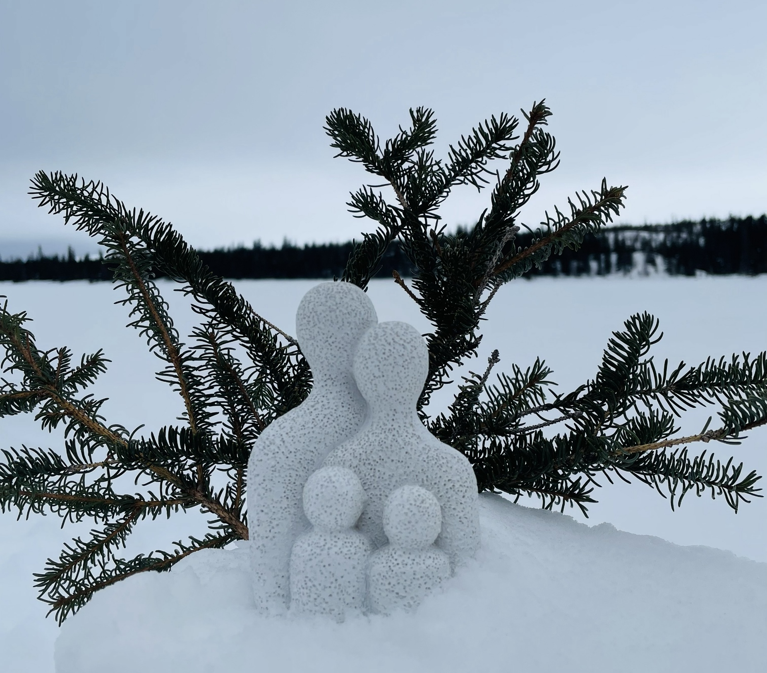
“I Needed a Father”: Well-being, Challenges, and Needs of Matimekush-Lac John Innu Youth Close to Someone Returning to the Community After Addiction Treatment
Presentation by
Garneau, Lahaye, Bellefleur et al.
2026 AFINeT
on-line conference
Photo by: Research participant
Notes:
This presentation shares findings from a community-based participatory research project exploring the experiences of Matimekush-Lac John Innu youth who are affected by the addiction and the return of a closed-one after addiction therapy.

Slide 2
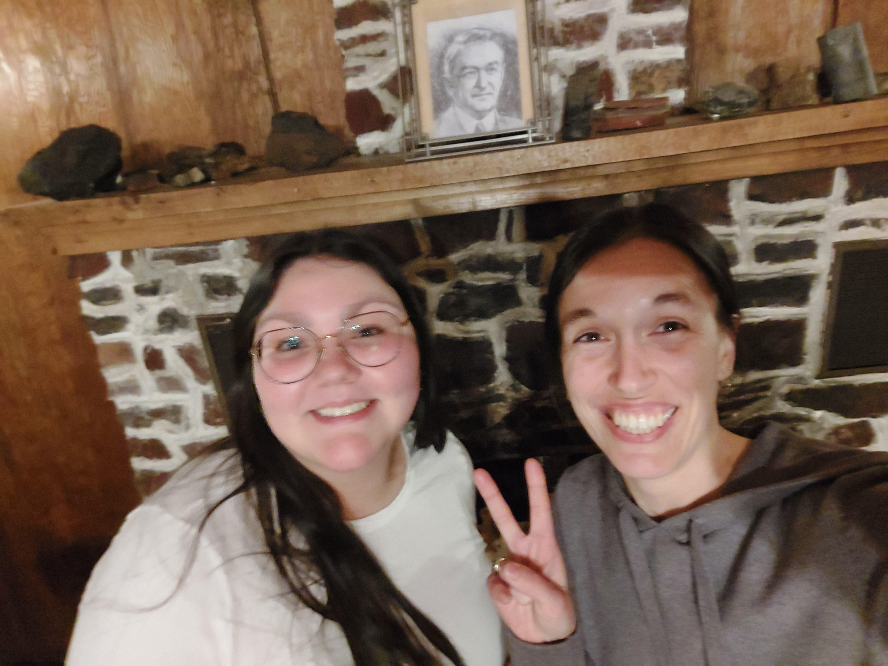


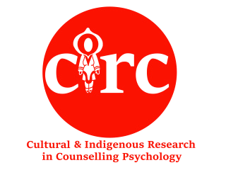
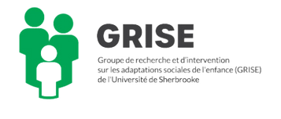


Team
Principal investigator:
  Mathilde Garneau
    Professeure-chercheuse en psychoéducation
    Université de Sherbrooke
Principal research assistant:
  Marie-Pier Bellefleur
    BA en psychologie (McGill)
    Première Nation Innue de Pessamit
    Research assistant (qualitative analysis):
    Bianca Lahaye
    Étudiante à la maitrise en psychoeducation
    Université de Sherbrooke
    Partner:
    Équipe des services sociaux de la Nation Innu Matimekush-Lac John
    Co-investigators:
    Dennis Wendt, McGill University
    Morgan Kahentonni Phillips, McGill University
    Chantal Plourde, Université du Québec à Trois-Rivières
    Anne-Marie Tougas, Université de Sherbrooke

Slide 3
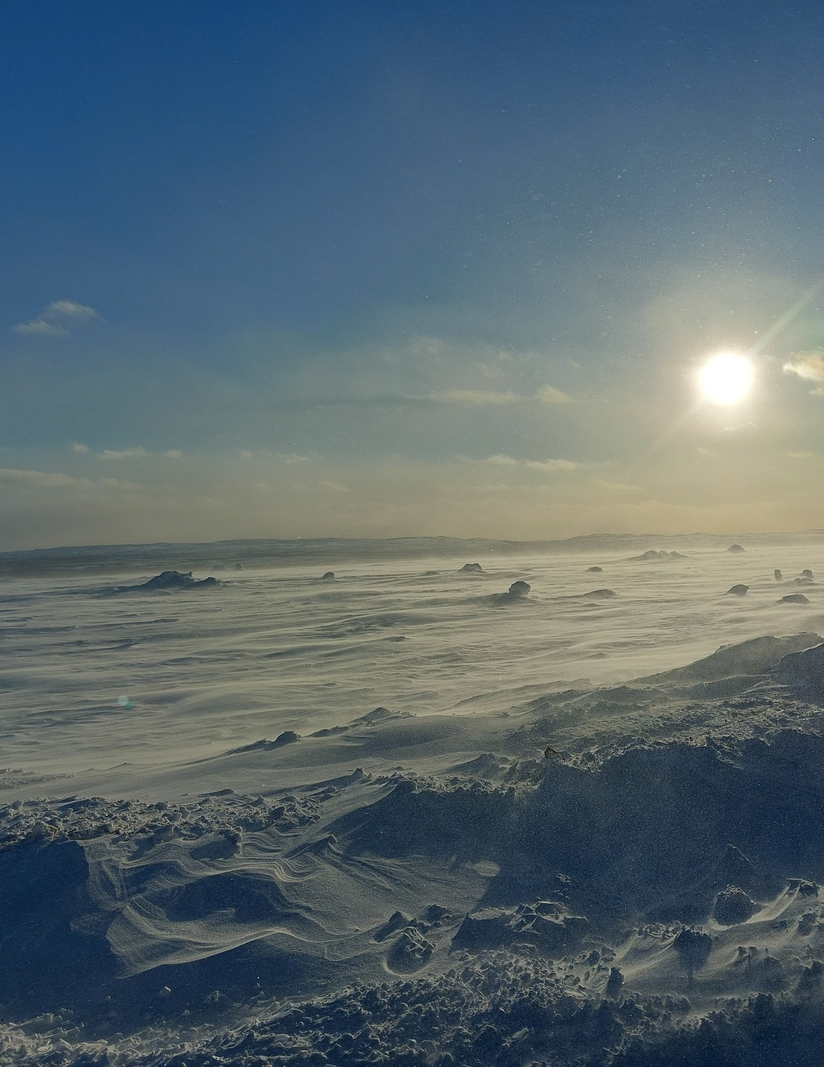
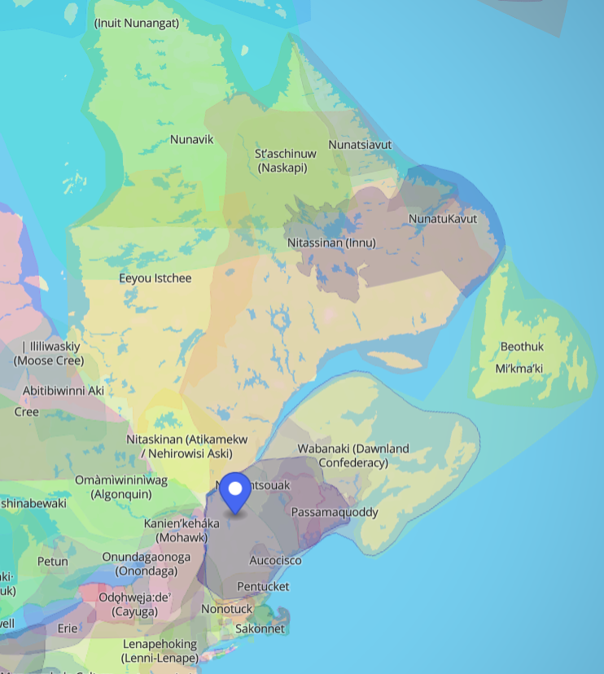
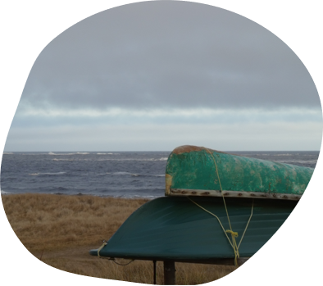
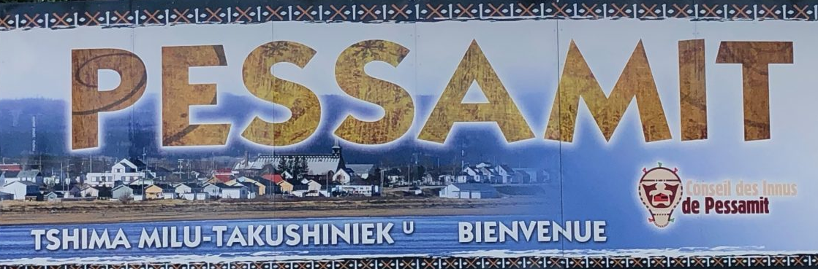
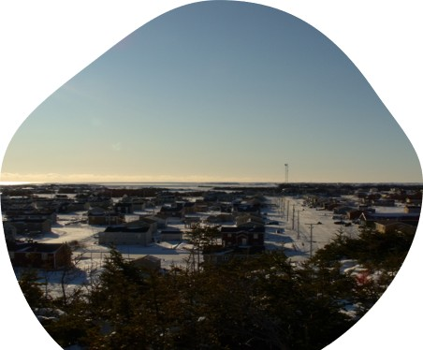

Land Acknowledgement and the Innu People
Notes:
Nitassinan : From Lac Saint-Jean (Pekuakami) to Labrador
10 855 Innu living on one out of the 9 Innu Quebec communities in 2016
Diversity in terms of socio-economic, educational, and geographical contexts
35% are 0-19-years-old
Culture : Language (Innu-aimun), connexion to the land, hunting Caribou, The laughing People
Matimekush : 550 km North to Sept-Îles
Current fights with mines exploitation to preserve Caribou (Atik)

Slide 4
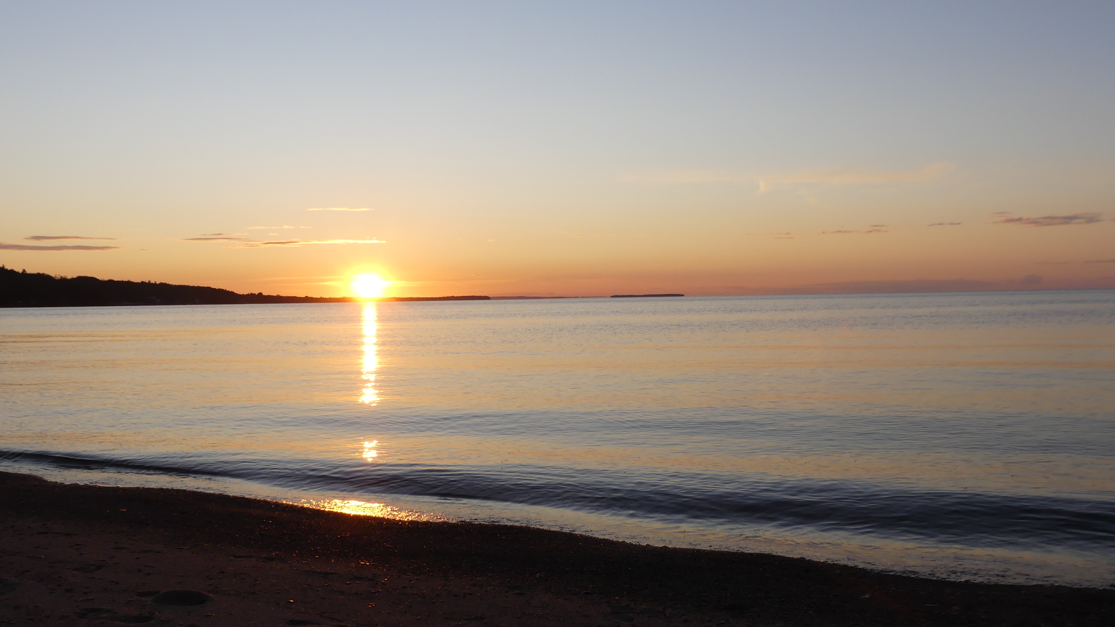
Notes:
Since InIt is also important to position myself
Lac-St-Jean. Ma famille. Mère de Chambord, père de Roberval. Sportif les deux. Famille maternelle plus artistique, musique, et orientation politique souverainiste. Famille paternelle, plein air, chasse et pêche, contact avec la nature. orientation politique libérale. Appris à voir les deux côtés de la médaille.
Ajouté photo du Goéland.

Slide 5
Background of the study
Support from peers, family, and the community plays a vital role in the healing process for Indigenous people returning to their communities after treatment for substance use disorders (SUDs).
People in these individuals’ social circles, including young people, are also affected by their loved ones’ struggles and their healing process.
Indigenous people living in remote communities experience unique challenges, like limited access to care, that need to be considered.
Notes:
As a consequence of colonization and historical trauma, problematic alcohol and drug use is a community health issue in many Indigenous communities in Canada, Australia, New Zealand and the United States (CANZUS)².
Having access to culturally appropriate care is necessary for recovery.
Recovery from addiction is a long road, and one that does not systematically end with the end of a treatment².
Several authors recognize the need for continuation, support and follow-up care. One of the things that we know is that…
… And the needs of these family members affected by addiction remain under documented.

Slide 6
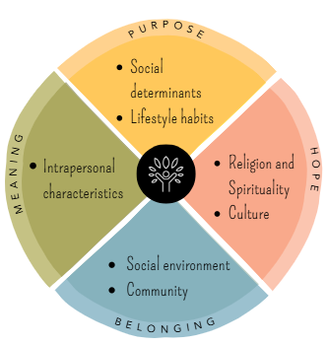
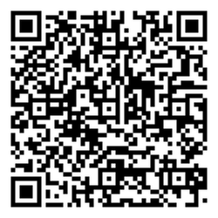
Model freely adapted from the Indigenous Wellness Framework (Thunderbird Partnership Foundation, 2020)
Results from a literature review
“Four Dimensions Supporting the Well-being of Indigenous People Following Addiction Therapy“
(Lahaye, Garneau, et al., 2024; 2025)
Further information on this review
bit.ly/413bkS7
2026-09-15
Innu youth affected by addiction in Matimekush-Lac John
6
Notes:
Identifying factors related to post-treatment recovery could enable
the development of follow-up care interventions targeted to
Indigenous Peoples needs and perspectives.
Indigenous wellness :
Balance between the Mental, Emotional, Spiritual and Physical, reinforced by a sense of meaning, belonging, hope, and a sense of purpose in daily lives. Wellness translates into harmony between mind, heart, soul and body⁴.
Psychosocial wellbeing may include factors that can be predictors or consequences of substance use, such as, quality of family relationships, youth cultural engagement, mental health, community sense of belonging, and participation in work or community activities.

Slide 7
Objectives of the partnership
To support Matimekush-Lac John Social Services team in the development of
better addiction follow-up care. Current project is a first step.
To identify the needs of Matimekush-Lac John individuals with addictions and their families in terms of well-being and recovery following addiction therapy.
1) To define well-being and recovery in the context of addiction according to
Matimekush-Lac John people;
2) To identify the facilitators and barriers to addiction recovery encountered by community members following treatment.
Notes:
Still, the specific contexts of Matimekush-Lac John (remote community, service delivery and healthcare access Innu culture) and their a need to understand the specific needs of its community members and literature review left unanswered questions :
What are the needs of the loved ones (family, friends) of a person returning from addiction treatment?
This presentation will highlight the voices of five Innu youth (ages 14-21) who are family members of someone who has undergone treatment for SUD (e.g., a parent), regarding the factors contributing to their well-being since their loved one’s return, the challenges they have faced, and the needs they identify to better support youth in similar situations within their community, particularly children.

Slide 8
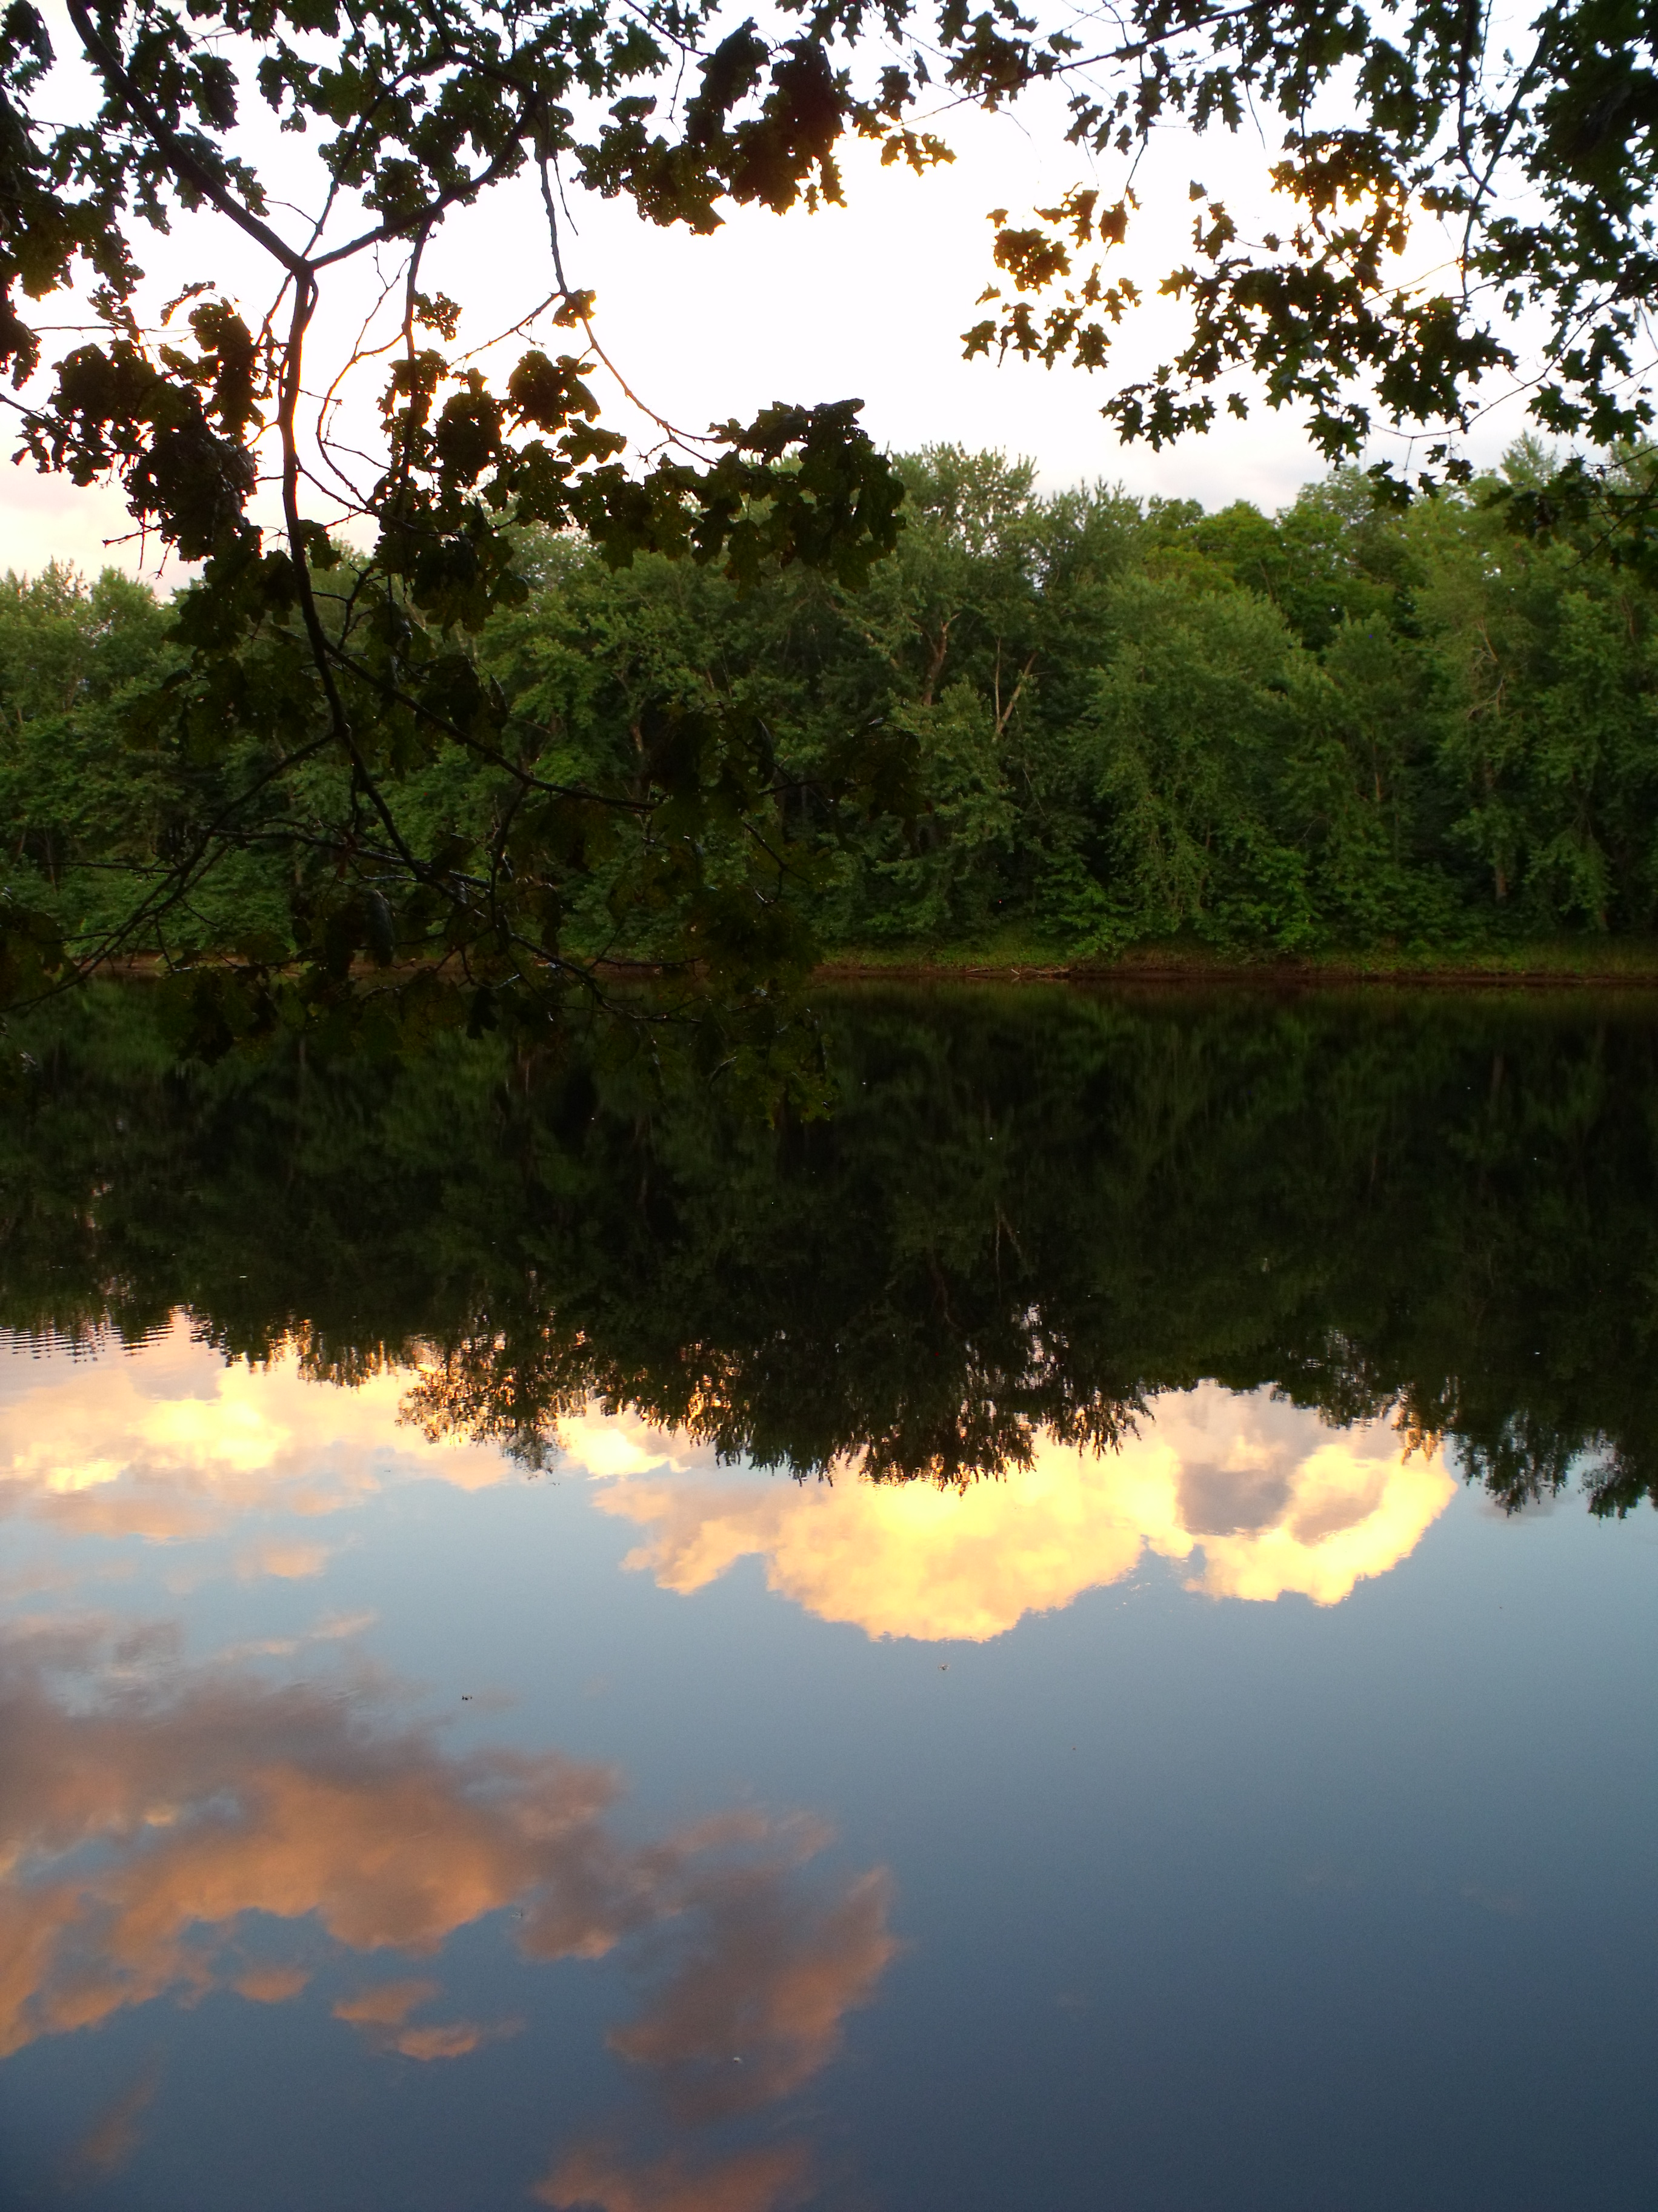
Two-eyed seeing
2026-09-15
Innu youth affected by addiction in Matimekush-Lac John
8
Notes:
Approche à double perspective

Slide 9
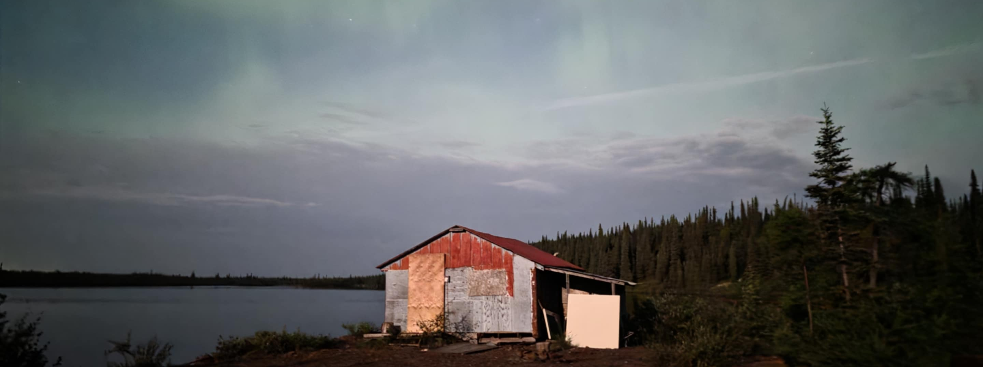
Research methodology
Photo by: Research participant
“My Friend, the Tree”: Sources of Strength Among Innu People Returning to Their Community After Addiction Therapy

Slide 10
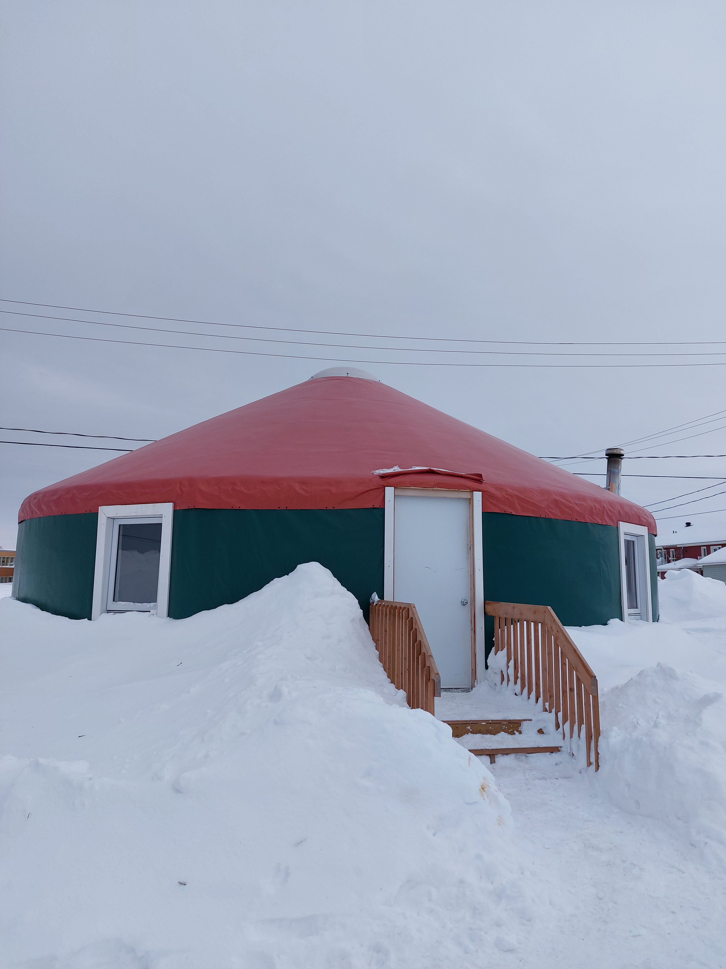
CBPR and Photo-VOICE project
Data collection :
Photo-VOICE activity and sharing cercle
Analyses validation:
Sharing cercle with participants & individual or group meetings with advisory committee members
Knowledge mobilization:
Community gathering and photo-exhibition
Notes:
Grounded in a community-based participatory research approach and the Two-Eyed Seeing framework, the youth were met in group as part of a photovoice activity, where they shared their experiences in a sharing circle, accompanied by a cultural facilitator from the community.
To identify factors that have the potential to support wellbeing and recovery among community members affected by addiction, groups of Innu participants shared their post-therapy experiences through photo-VOICE and talking circles. Participants could express themselves in French or Innu-aimun, supported by the second author – an Innu woman – who fostered cultural safety and trust between participants and the research team.

Slide 11
Photo-VOICE & Sharing Circles : With who?
Four groups of ≈6 persons affected by addictions at different levels
People aged 18+ who are struggling or who struggled with problematic substance use and who have recently experienced therapy in an addiction center (3 men, 3 women)
Nurse, NAADAP and other health and social workers (3 social services team members + 2 health services team members)
Respected people in the community (e.g. Elder, Council members, community services workers) who have experienced addiction and therapy in the past (6 women)
Family members (aged 14-21) of people who have experienced
therapy in an addiction center (5 [7] youth)

Slide 12
Photo-VOICE & Sharing Circles : With who?
Four groups of ≈6 persons affected by addictions at different levels
People aged 18+ who are struggling or who struggled with problematic substance use and who have recently experienced therapy in an addiction center (3 men, 3 women)
Nurse, NAADAP and other health and social workers (3 social services team members + 2 health services team members)
Respected people in the community (e.g. Elder, Council members, community services workers) who have experienced addiction and therapy in the past (6 women)
Family members (aged 14-21) of people who have experienced
therapy in an addiction center (5 [7] youth)

Slide 13
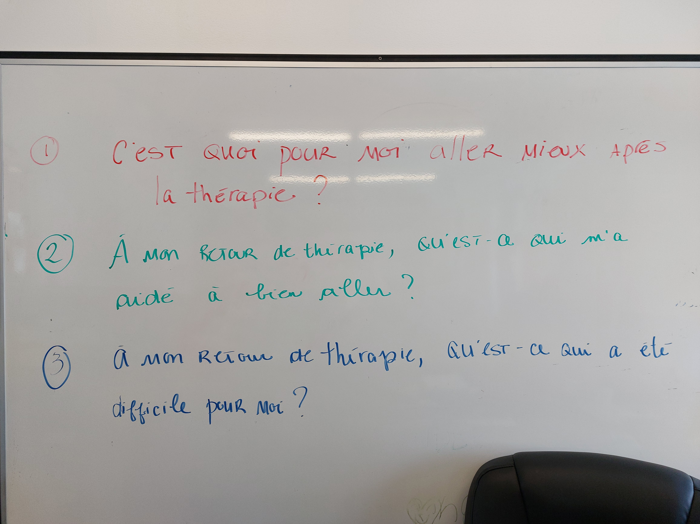
2026-06-04
13

Slide 14
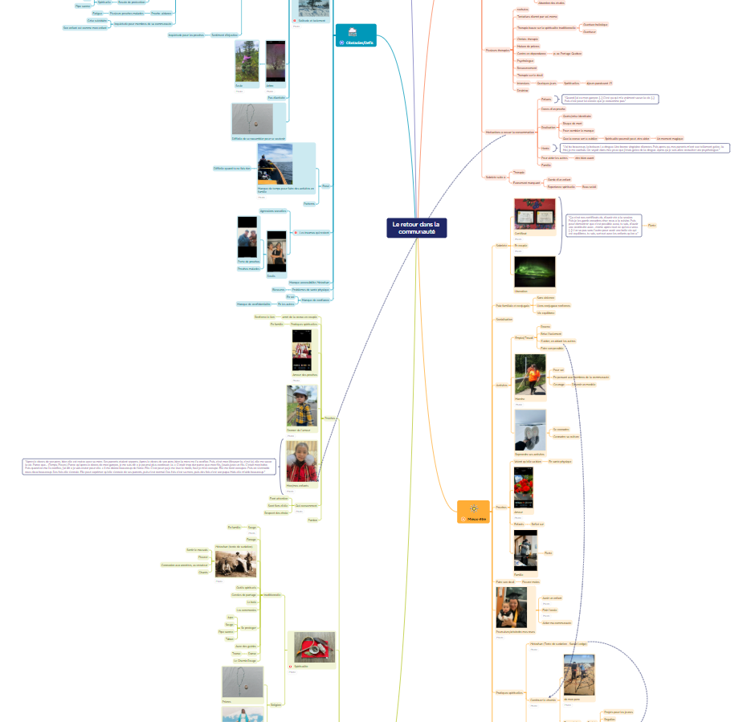
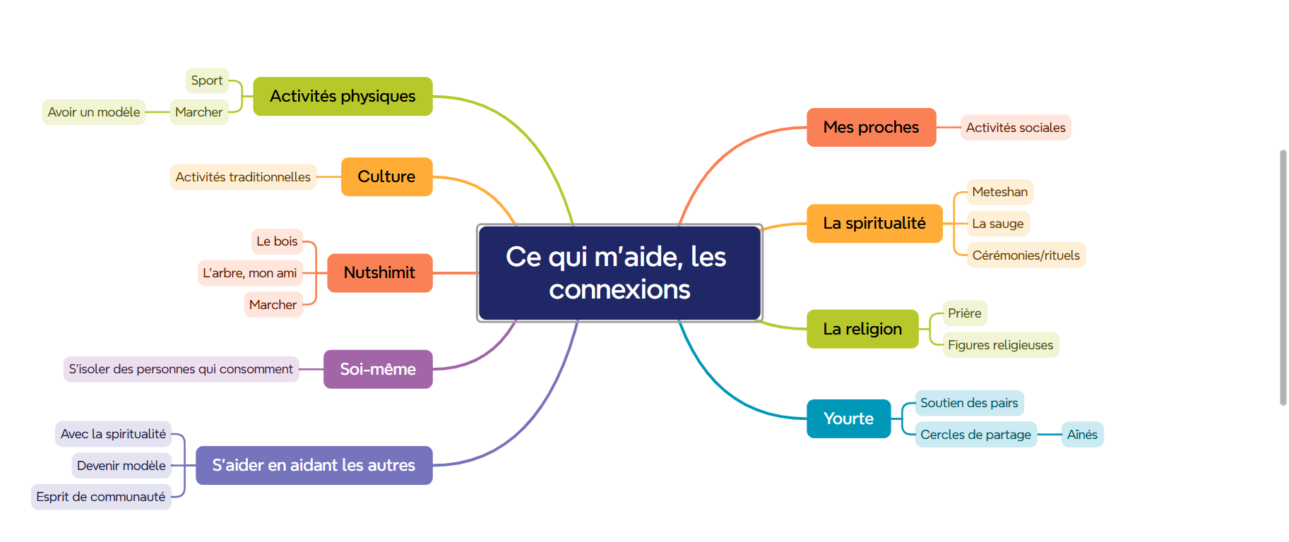

Thematic analysis

Slide 15
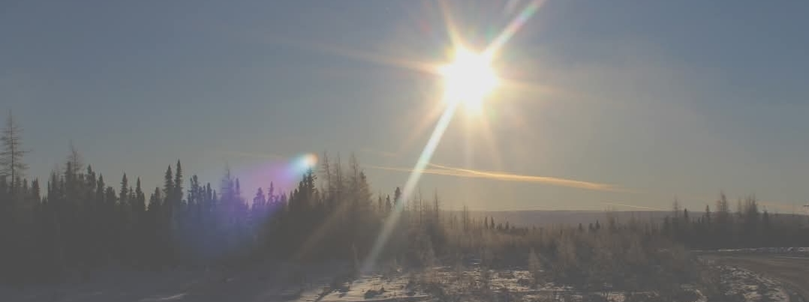
Well-being, Challenges, and Needs of Innu Youth Close to Someone Returning to the Community After Addiction Treatment
Photo by: Research participant
Results from a CBPR and photo-voice project
Notes:
The results will be illustrated with photographs taken by the youth. Thematic analysis identified cultural “Innu-aitun” learning, sports, family activities, and spirituality, all rooted in the relationship to the land, Nutshimit, as key factors supporting their well-being, while past and ongoing wounds were identified as persistent challenges.

Slide 16
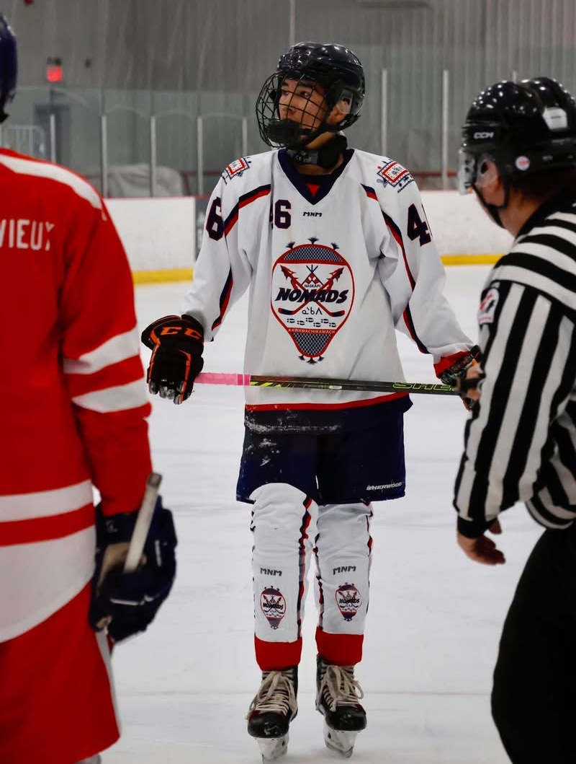
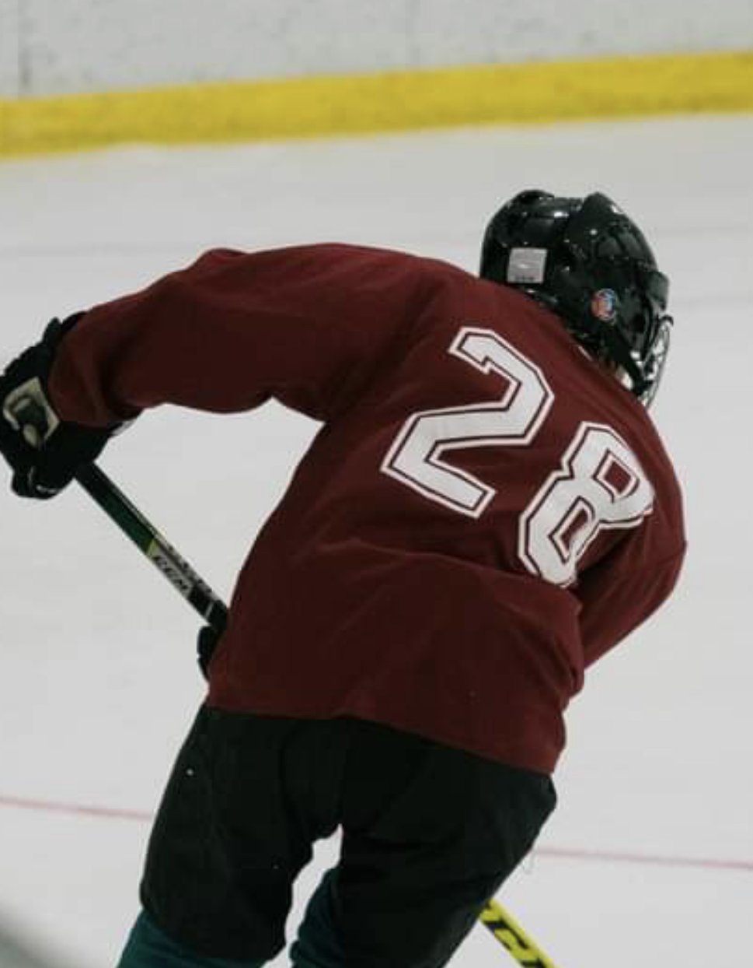
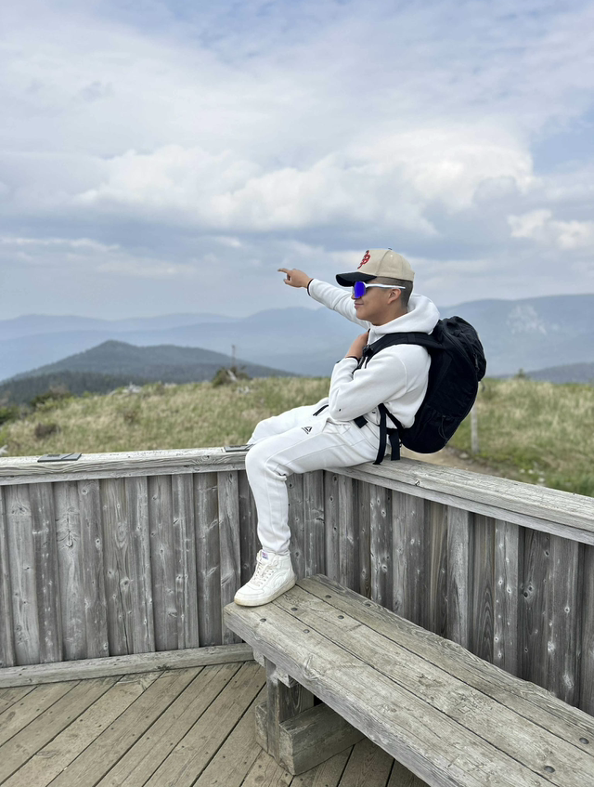
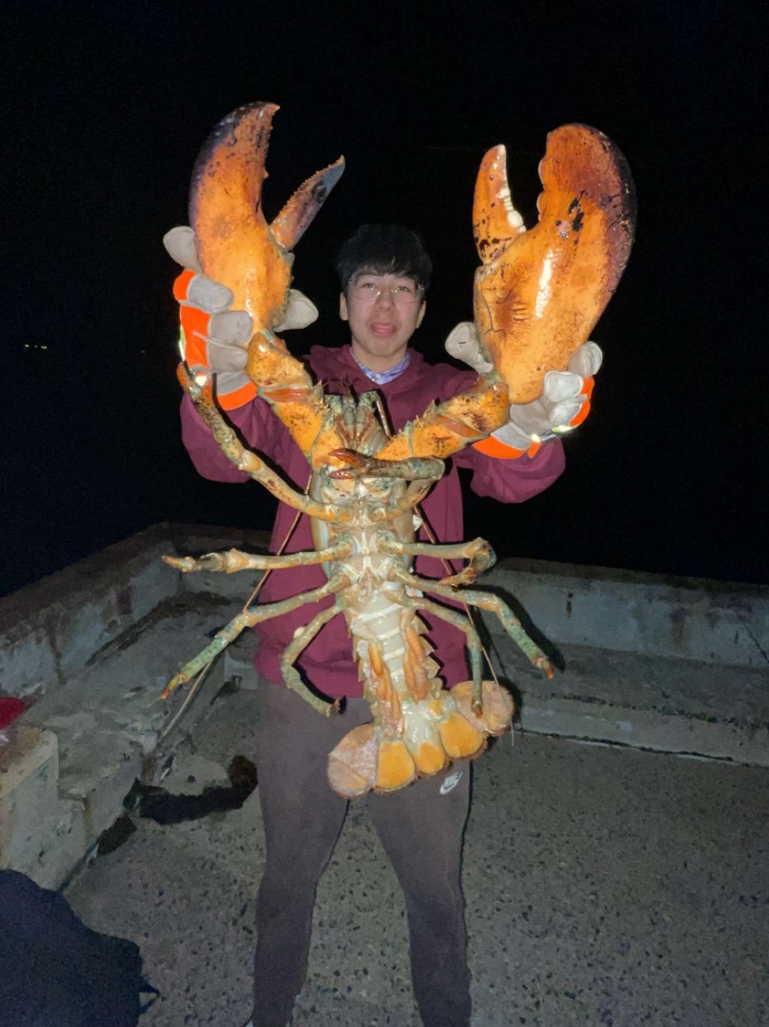
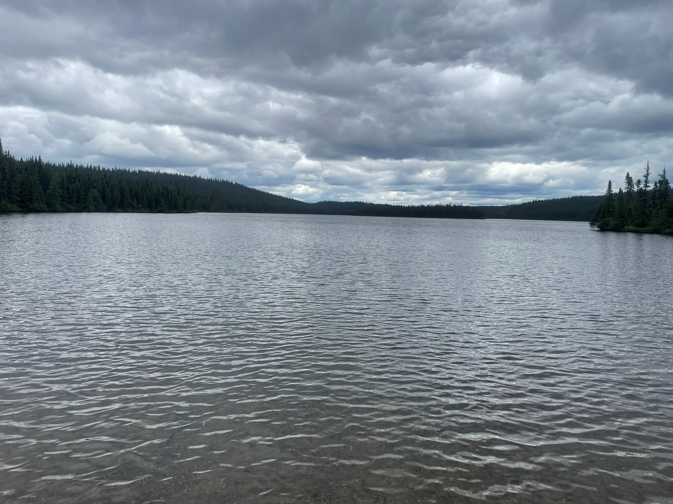
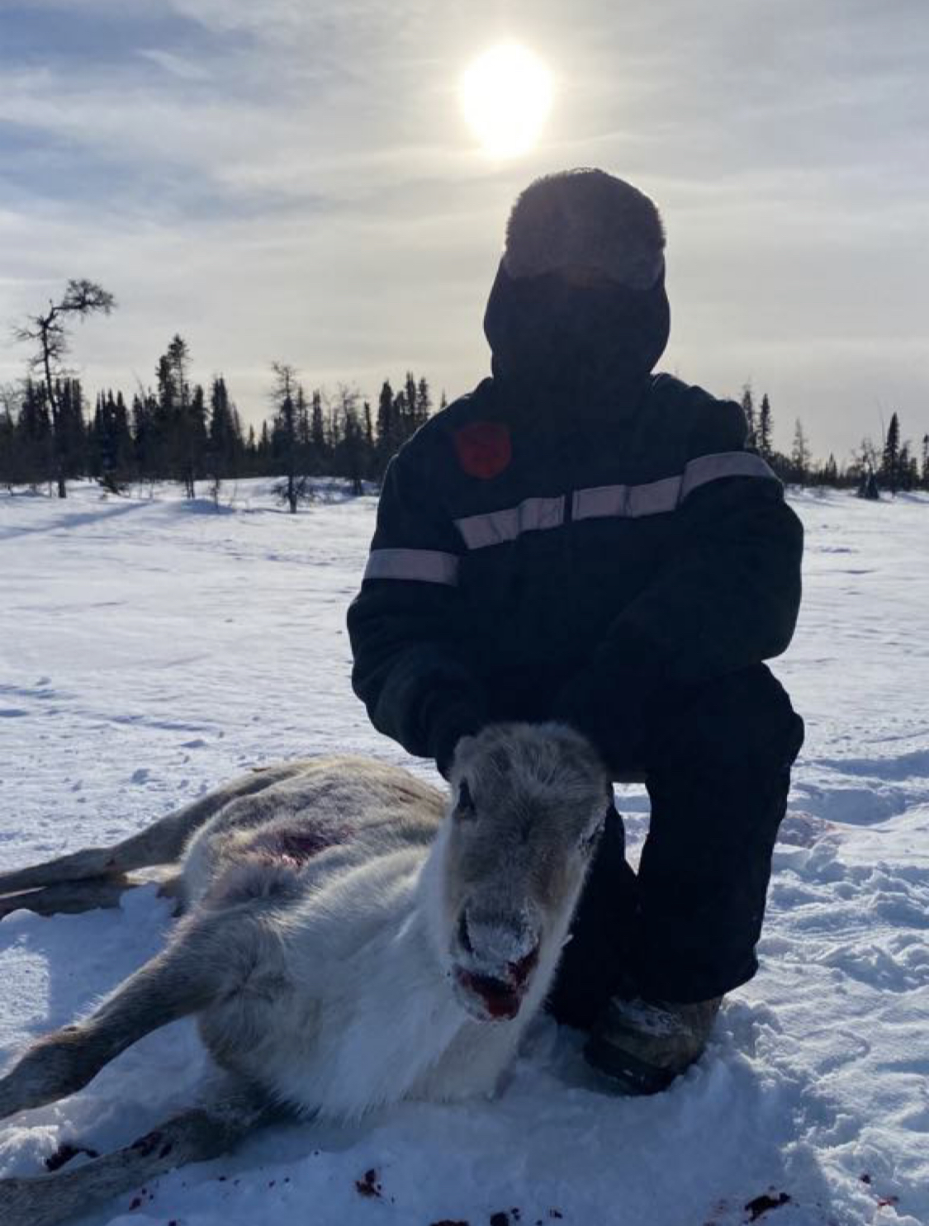
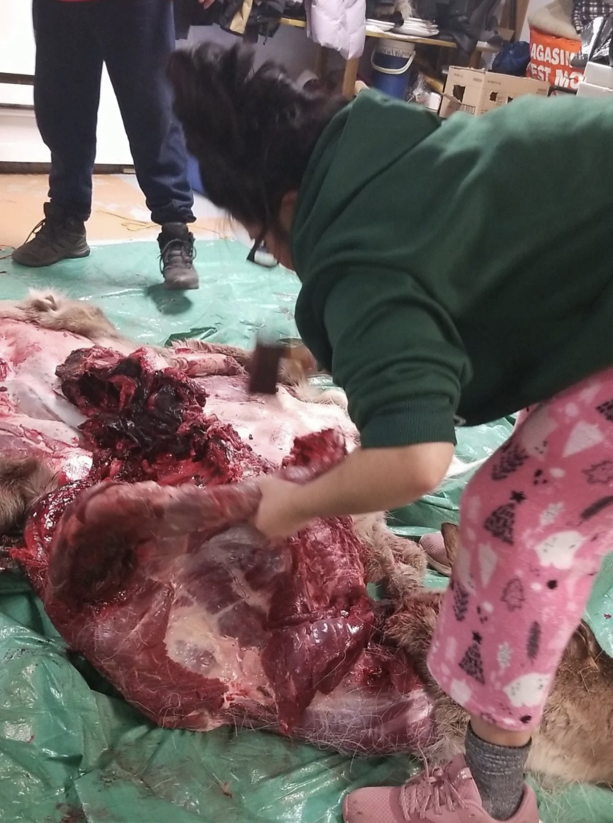
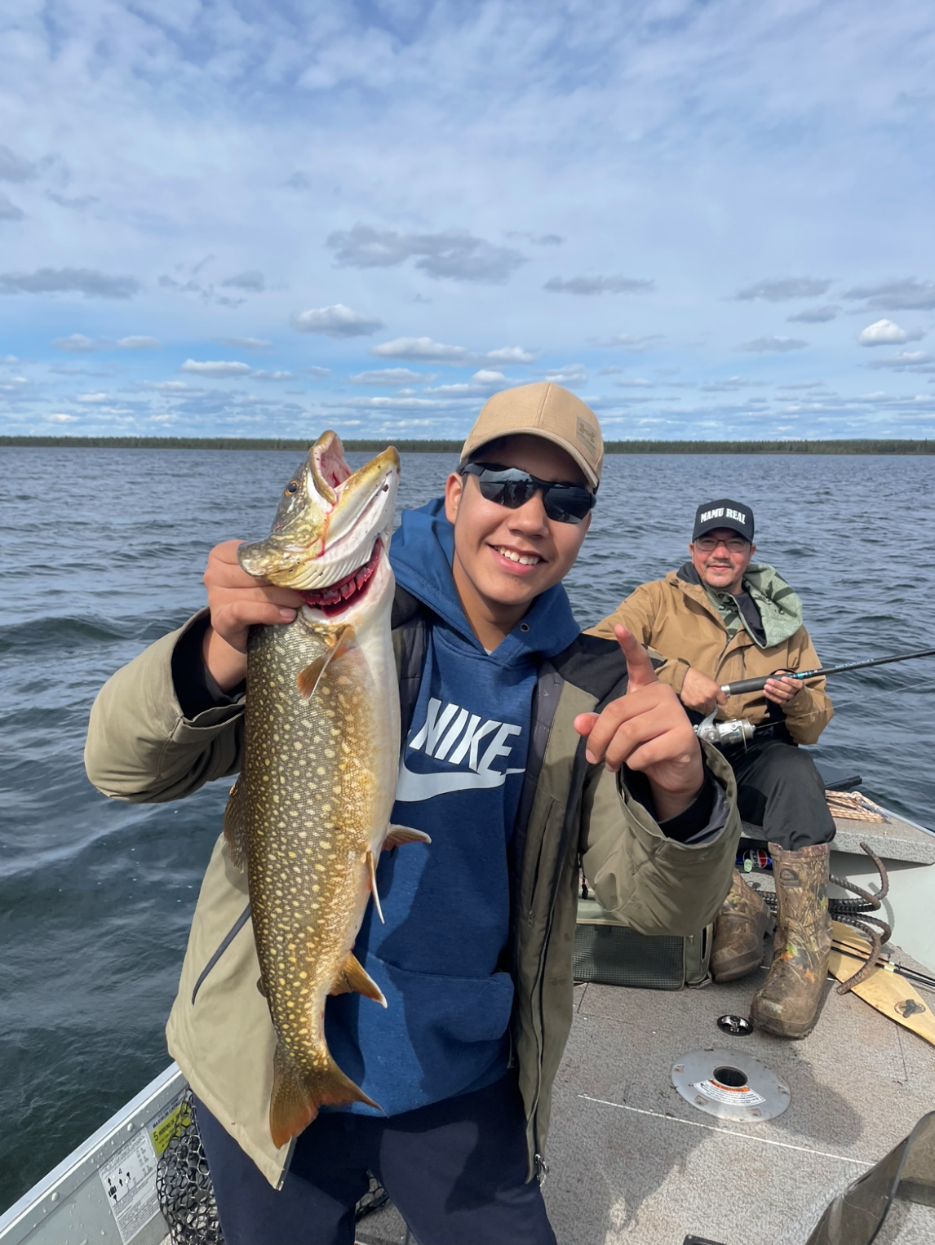
PURPOSE
  Cultural activities
  Sports
Comittement to a sport
Fishing
Walking in the
woods
  Communication
  Learnings
  Faith
  Innu Identity
  Nutshimit
MEANING
HOPE
Nutshimit
Learning Innu-aitun
(Innu culture)
  Family relationships
BELONGING
Family activities
Notes:
The results will be illustrated with photographs taken by the youth. Thematic analysis identified cultural “Innu-aitun” learning, sports, family activities, and spirituality, all rooted in the relationship to the land, Nutshimit, as key factors supporting their well-being, while past and ongoing wounds were identified as persistent challenges.

Slide 17
Spiritual wellness
Faith, Innu identity, including the importance of language (Innu aimun), and connection to the land (Nutshimit) foster hope.
PURPOSE
  Cultural activities
  Sports
  Communication
  Learnings
  Faith
  Innu Identity
  Nutshimit
MEANING
HOPE
  Family relationships
Nutshimit
« Ekuet anite uitshikuian iat e taian. Nana nutau ka tshitshipatat. Nana mani e akushian. Nana mani e mishtakushian, mak minuat e mishta nekatenitaman. Ekuet anite itutaian mani, au bord de la mer. Apu tshekuan petakuat. Le calme. » (youth, 14-years-old)
BELONGING
Notes:
« Ça m’aide d’être là-bas. Quand mon père est parti. Quand je suis malade, que je ne vais vraiment pas bien. Quand je suis triste. C’est là que je vais, au bord de la mer. On n’entend rien. Le calme. » (jeune, 14 ans)

Slide 18
PURPOSE
  Cultural activities
  Sports
Comittement to a sport
Fishing
Walking in the
woods
  Communication
  Learnings
  Faith
  Innu Identity
  Nutshimit
MEANING
HOPE
Nutshimit
Learning Innu-aitun
(Innu culture)
  Family relationships
BELONGING
Family activities

Slide 19
PURPOSE
Emotional wellness
Quality time spent with their parent after they return from therapy, along with the sense of family peace that emerges from it, fosters well-being by strengthening the attachment bond and providing a model of resilience.
  Cultural activities
  Sports
  Communication
  Learnings
  Faith
  Innu Identity
  Nutshimit
MEANING
HOPE
  Family relationships
BELONGING
Family activities
Notes:
J’aime la culture innue. Quand mon père est parti en thérapie, on n'en faisait pas beaucoup [innu-aitun] déjà avant qu’il parte, mais depuis qu’il est revenu on a fait plein de choses. On part dans le bois, on aime ça.
J’étais bien quand mon père est revenu. C’était la première fois qu’on partait [dans le bois] depuis sa thérapie. On part. Moi et mon père. On aime ça. On se promène. C’est ça, on fait plusieurs activités maintenant. On part des fois. Mon oncle, là. Quand on part, on jase. J’aime vraiment ça entendre mon père raconter ses histoires. On part. Il parle de ce que les innus faisaient dans le temps. Je vois la culture. Je connais la culture.

Slide 20
PURPOSE
  Cultural activities
  Sports
Comittement to a sport
Fishing
Walking in the
woods
  Communication
  Learnings
  Faith
  Innu Identity
  Nutshimit
MEANING
HOPE
Nutshimit
Learning Innu-aitun
(Innu culture)
  Family relationships
BELONGING
Family activities

Slide 21
Mental wellness
Various forms of communication, such as listening, self-expression, and music, as well as learning Innu culture, give meaning to everyday life when a loved one is gone to and when they returns home following therapy.
PURPOSE
  Cultural activities
  Sports
  Communication
  Learnings
  Faith
  Innu Identity
  Nutshimit
MEANING
HOPE
  Family relationships
BELONGING
Learning Innu-aitun (Innu culture)

Slide 22
PURPOSE
  Cultural activities
  Sports
Comittement to a sport
Fishing
Walking in the
woods
  Communication
  Learnings
  Faith
  Innu Identity
  Nutshimit
MEANING
HOPE
Nutshimit
Learning Innu-aitun
(Innu culture)
  Family relationships
BELONGING
Family activities

Slide 23
PURPOSE
  Cultural activities
  Sports
  Communication
  Learning
  Faith
  Innu Identity
  Nutshimit
Comittement to a sport
MEANING
HOPE
Walking in the woods
Physical wellness
Participating in cultural activities (fishing and hunting) and sports activities (hockey, volleyball, and walking) provides a sense of purpose in daily life.
  Family Relationship
BELONGING

Slide 24
Past and ongoing challenges
Grief
Feelings of loneliness
Trauma
A young woman affected by the substance use of a related-one explains the burden of their injuries and how walking has helped them cope: « Mitshetu pua ne tshekuan ninatshishketi kie nin tshekuan e auassiuian. Eku, euh, ekuan ekue kutshipanitaian ne la marche. Ka pimutaian, kuet un outil ne kie nin anite utat tshekuan e takunaman. Kuet anite ut, ut e inniuian kie nin. [...] Ne pua nitamatshuti miam e mishta-kushikuat les premiers jours. Eku ute katshi pessish taian, miam ne mishta-natshitishian. »
Notes:
Même lorsque la consommation ne représente plus un problème, il reste plusieurs défis, dont les traumas, des deuils, qui ne sont pas guéris, ou de nouveaux qui peuvent survenir. Une jeune-membre de l’entourage explique le poids de ses blessures, mais aussi comment la marche l’a aidée : [En innu-aimun] « J’ai rencontré plusieurs embûches moi aussi dans ma jeunesse. Donc j’ai essayé la marche. En marchant, j’ai utilisé ce que je traînais comme outil pour avancer. C’est grâce à tout ça que je suis en vie en ce moment. […] Je me sentais comme si c’était vraiment lourd pendant les premiers jours. Mais en arrivant près d’ici, c’est comme si c’était plus léger. »
“I also faced many obstacles in my youth. So I started walking. As I walked, I used what I had been carrying as tools to move forward. It’s because of all that that I’m still alive today. [...] During the first few days, it felt really heavy. But as I got closer to here, it was as if the burden had become lighter.”

Slide 25
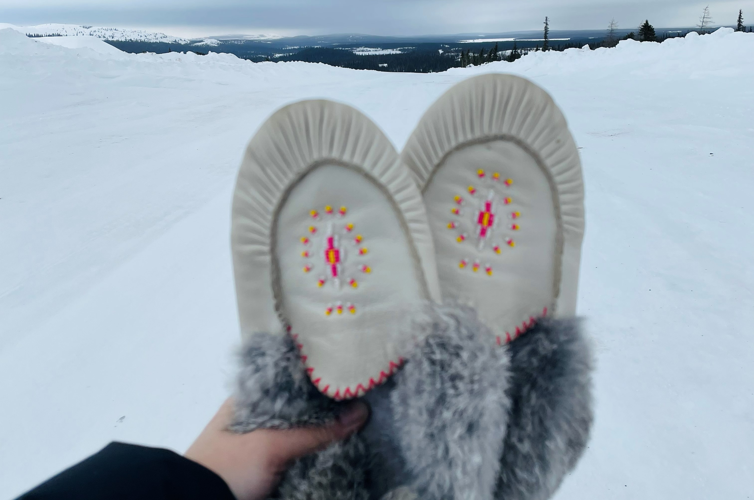
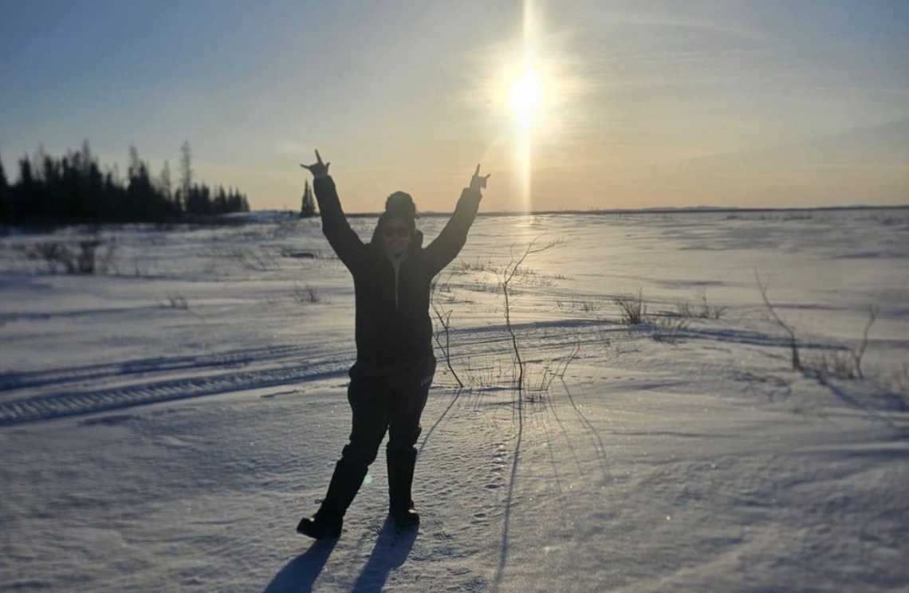
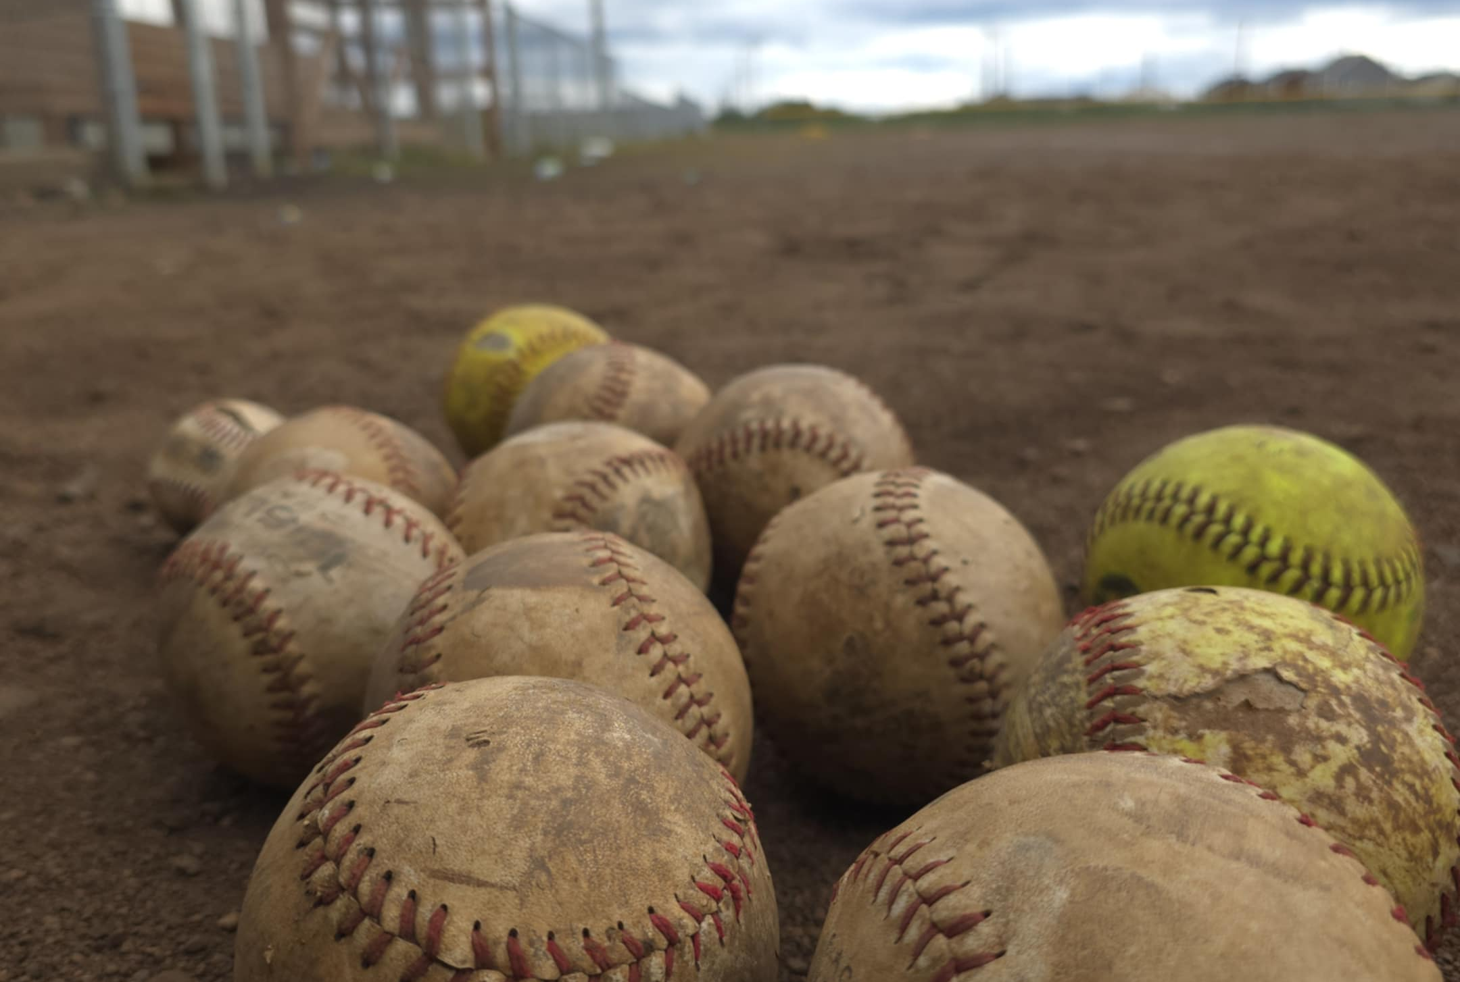
Identified needs and recommendations
Youth asked for: increased engagement from the community to support youth who wants to learn Innu-itun, to facilitate transportation and access to Nutshimit, and to offer a diversity of activities that help cope in difficult times and achieve their dreams.
Social and addictions services in the community should include family members, especially children, in the treatment plan and should offer support to these persons affected by addiction of a related-one.
Photos by: Research participant
Notes:
Finally, the interpretation of the results, combined with the reflections of the youth and the cultural facilitator themselves, will help highlight the needs of Indigenous youth who are close to someone in recovery and concrete avenues for community-based action.
Le rôle du parent en tant que personne ressource pour transmettre la culture semble déterminant dans le mieux-être, tout comme le territoire (Nutshimit) qui semble présent à travers les quatre aspects du mieux-être.
Ces facteurs semblent renforcer les sentiments de fierté, de confiance en soi et de courage.
The challenges of recovery from addiction are evident in the Innu Nation of Matimekush-Lac John. Like other remote communities, members must leave their territory for addiction therapy, and recovery continues upon return. Findings advance knowledge on the needs of Indigenous individuals from remote communities and can inform aftercare approaches.
-continuum : préparation + suivi ajusté (peut être informel) : l’importance de se tenir occupé
ex. supporting initiatives and activities communi to Nutshimit
Supporting community connections

Slide 26
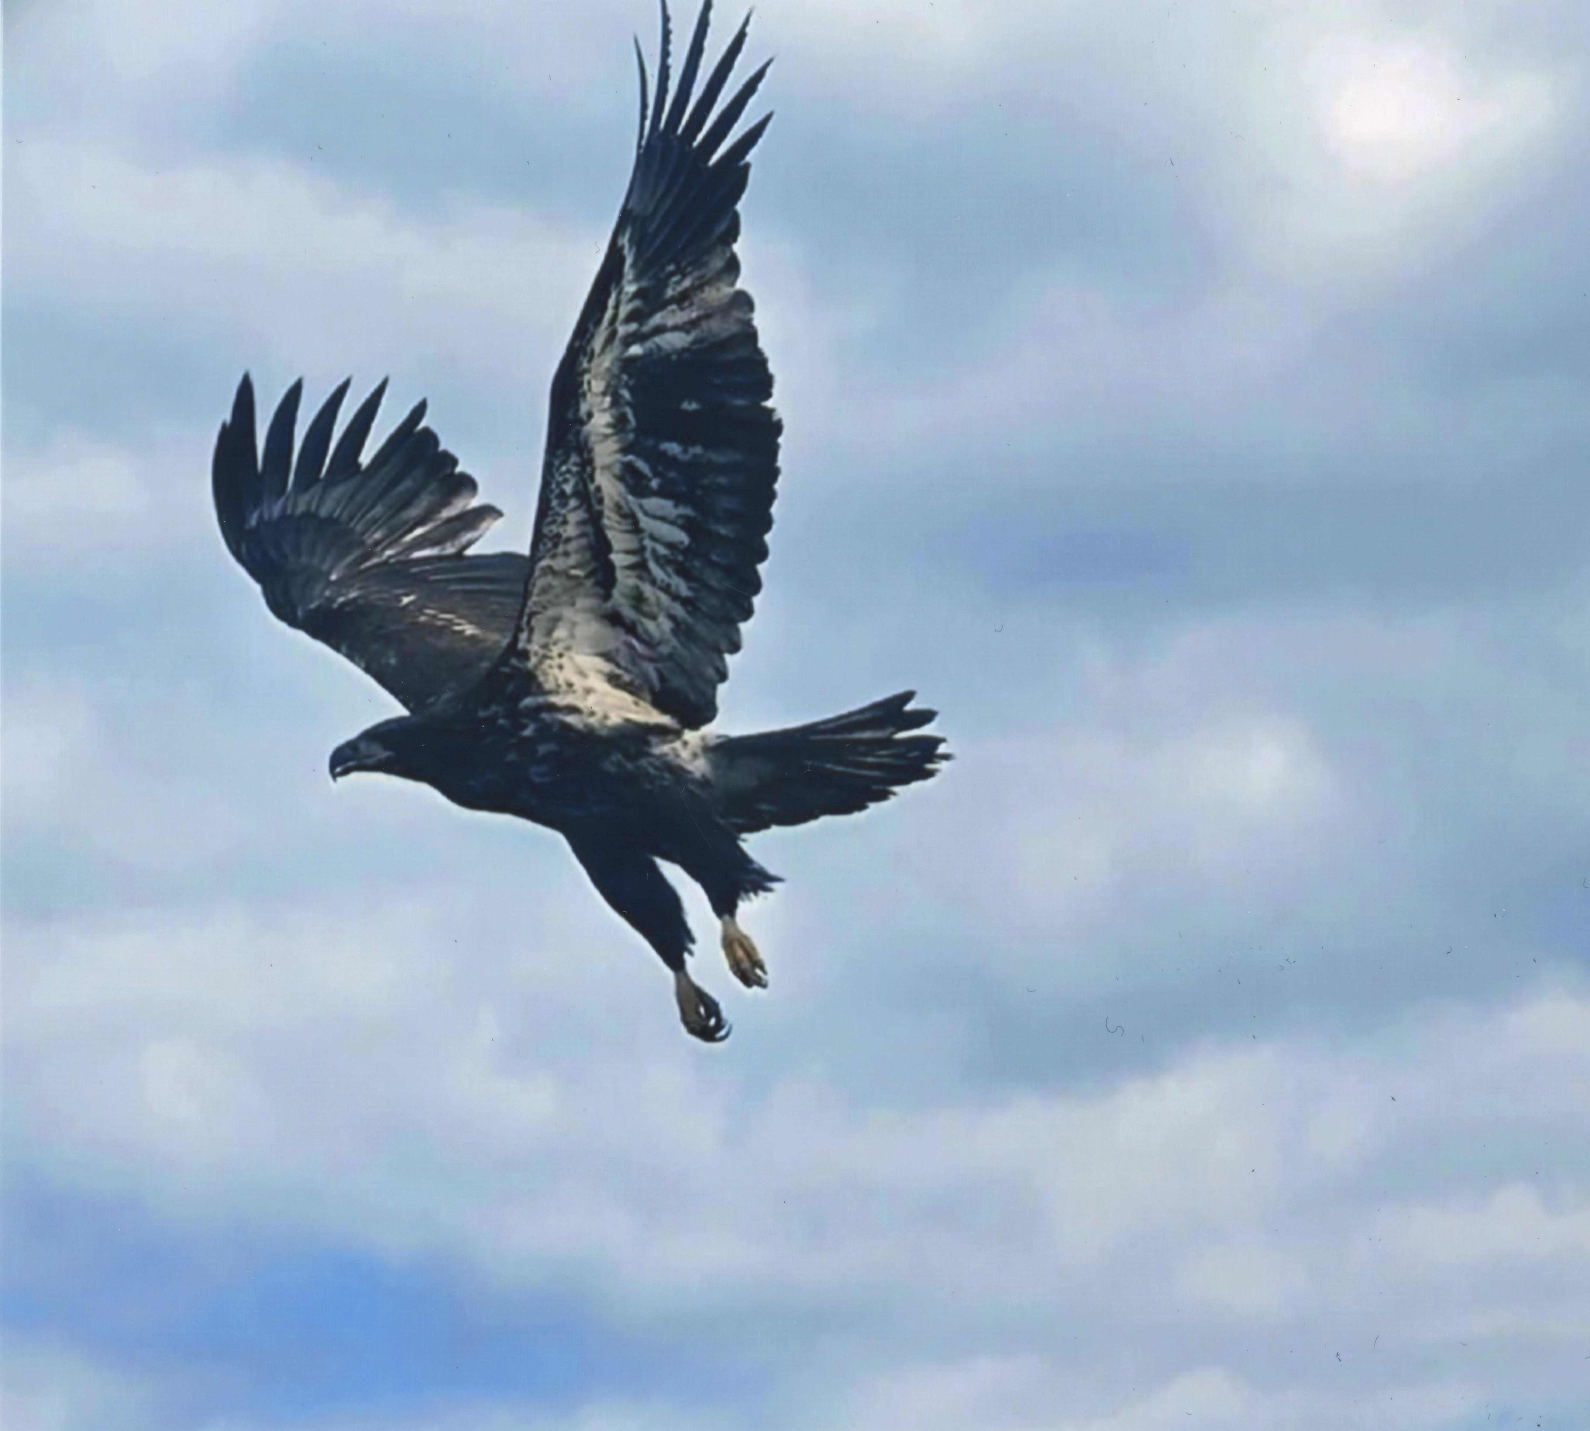
Limitations and future research
Limitations:
  Exploratory research
  Small sample size
  Language barrier
Future research
  Development and evaluation of family support systems within a continuum of culturally safe care for Indigenous people affected by addiction and living in remote areas.
Photo by: Research participant
Notes:
Considérant l’importance du territoire et des savoirs innus pour le mieux-être, comment ces derniers pourraient-ils être mobilisés pour soutenir la relation parent-enfant dans les familles affectées par la dépendance

Slide 27
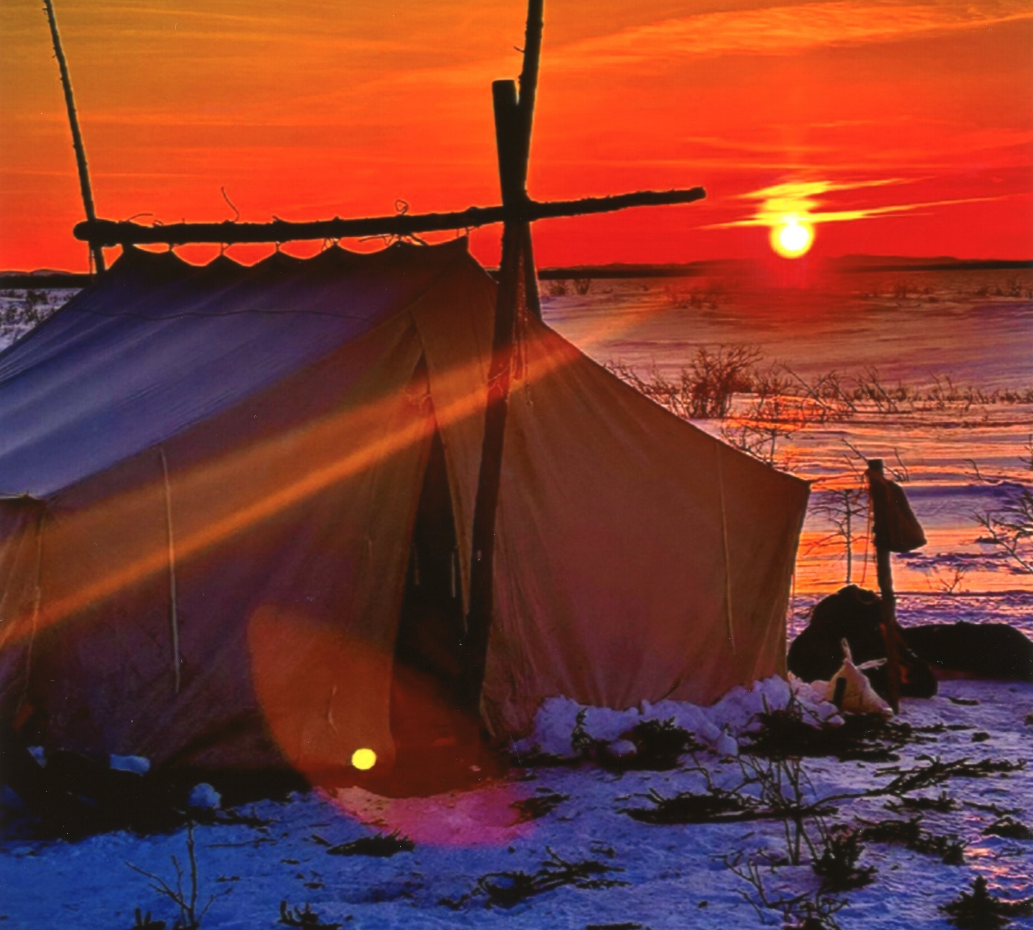
Tshinashkumitinau!
Contact information,
for references and more:
Mathilde.Garneau@usherbrooke.ca
https://www.usherbrooke.ca/recherche/fr/specialistes/details/mathilde.garneau
To cite this presentation: Garneau, M., Lahaye, B., Bellefleur, M.-P., Wendt, D.C., Phillips, M.K., Tougas, A.-M., Plourde, C., & L’équipe des services sociaux de la Nation Innu Matimekush-Lac John (2026, sept. 15).
“I Needed a Father”: Well-being, Challenges, and Needs of Matimekush-Lac John Innu Youth Close to Someone Returning to the Community After Addiction Treatment. 2026 AFINeT on-line conference.
Photo by: Research participant
Notes:
I hope you enjoyed this presentation, and, please, feel free to share your ideas on this project.

