Slide 1
Synthesizing the global research on family caregiving for people who use drugs in rural settings: What we know and next steps
Holly Mathias, MA
School of Public Health
University of Alberta
AFINet International Conference
June 15, 2023

Slide 2
Acknowledgements
The University of Alberta respectfully acknowledges that we are situated on Treaty 6 territory, traditional lands of First Nations and Métis people
I acknowledge the nearly 35,000 Canadians and many more around the world who have died from a toxic drug supply, and the families and communities who grieve their passing.

Slide 3
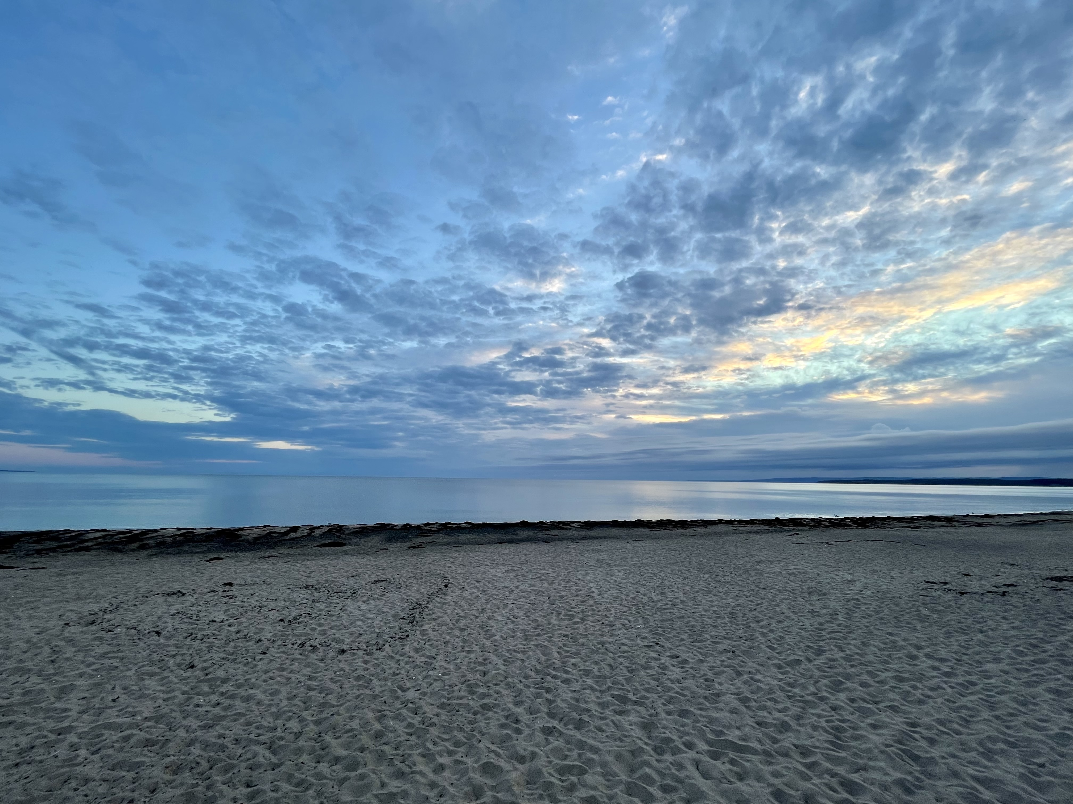
Positionality
PhD Public Health student
Ally of people who use drugs and their families
Raised in rural Canada
Young caregiver

Slide 4
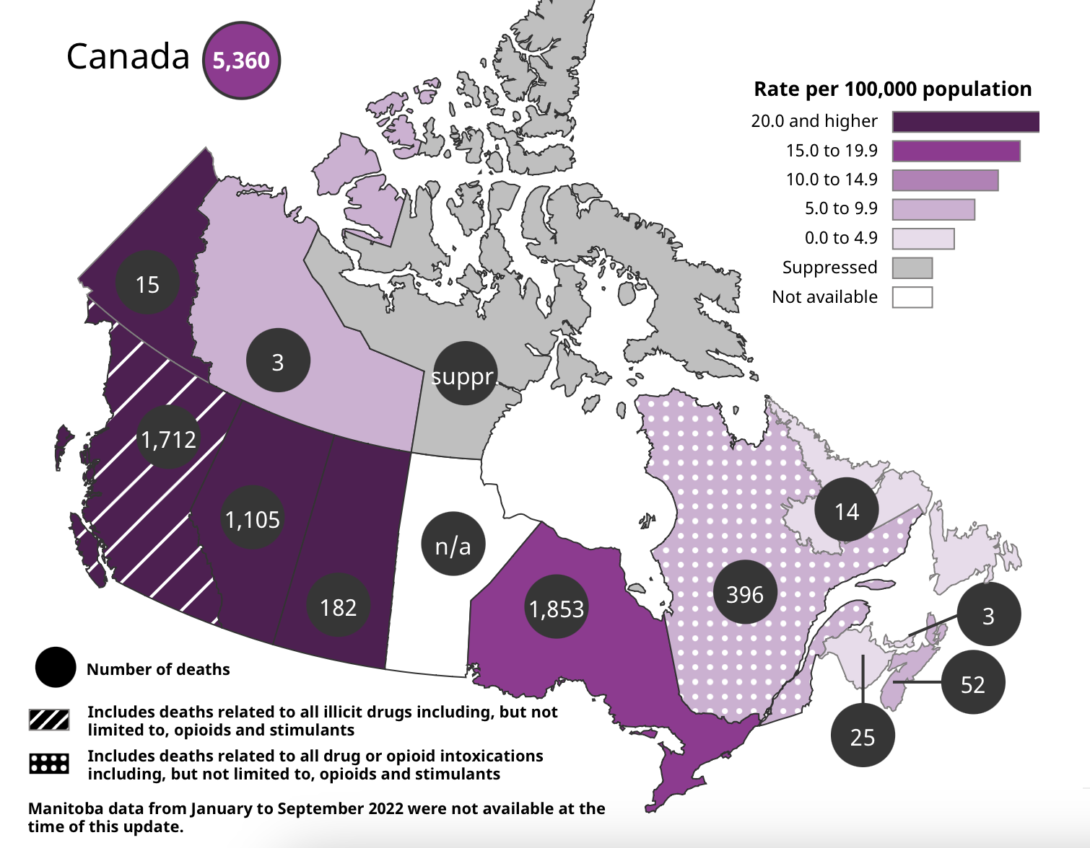
The Drug Poisoning Crisis in Canada
Nearly 35,000 apparent drug-related deaths in Canada since 2016
Linked to toxic drug supply and harmful drug policies
Additional social and health harms linked to substance use

Slide 5
Access to Services
Access to a range of supports and services may reduce harms
Some access challenges in rural areas
Availability
Stigma/discrimination
Criminalization/risk of arrest
Informal supports may fill ‘access gaps’ to formal supports and services

Slide 7
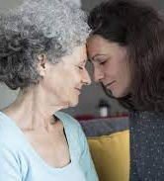
Role of Family Caregivers
Provide 80% of informal unpaid care in Canada
25% of Canadians will be a family caregiver in their lifetime
Most knowledge on family caregiving is linked to aging
Not much known about family caregiving for people who use drugs (especially in rural places)
Focus on peer support and youth substance use
Photo Source: Vanier Institute

Slide 8
Key Questions
1. Who provides family caregiving for people who use drugs in rural places?
2. What activities comprise family caregiving for people who use drugs in rural places?
3. What are the impacts of family caregiving for people who use drugs in rural places?

Slide 9
Design
Narrative literature review (Sept 2021-January 2023)
Scholarly databases searched, relevant journals hand searched, references scanned
Inclusion Criteria | Exclusion Criteria
Peer-reviewed manuscripts in English (2016-2023) Focus on unpaid family caregiving for adult people who use drugs in rural places | Articles that focused on: - Paid caregiving - Caregiving for youth who use drugs - Solely alcohol and cannabis use

Slide 10
Findings
Total of 3 articles (6 excluded)
Some thoughts
From United States and India
Centres on middle-class families and impacts of caregiving

Slide 11
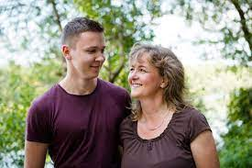
1. Caregiving is Gendered
Most family members providing care are:
Mothers
‘Intensive mothering’ values
Wives
Cultural responsibility
Fear of stigma/lack of privacy

Slide 12
2. Caregiving in the Context of Crime
Some activities are similar to caregiving for other health issues:
Supporting access to health and social services
Transportation, co-pay for treatment
Supporting general well-being
Basic necessities (food, housing), emotional support
Framed within the context of criminalization and subsequent stigma.
Sole caregiver for children when parents are incarcerated or in treatment
Photo Source: The DePaulia

Slide 13
3. Caregiving Can Be Challenging
Impact on Self | Impact on Others
Poor mental health Poor physical health Financial stress | Isolation/stigmatization from community
Photo Source: Verity
Very few caregiving supports available for caregivers of people who use drugs

Slide 14
Summary
Family caregivers are important supports for people who use drugs
Their work is tied to the criminalization of drugs.
Very few supports for family caregivers of people who use drugs
Need to better understand diverse experiences
Other family members (e.g., fathers, siblings, extended family members)
Black, Indigenous and People of Colour (BIPOC)
Rural and remote settings

Slide 15
Future Research Directions
Informs doctoral research on family caregiving experiences in rural Alberta, Manitoba, and Saskatchewan
Developed with several community partners, including members of Moms Stop the Harm, Manitoba Harm Reduction Network, Alberta Alliance Who Educate and Advocate Responsibly
Aim of bringing visibility to rural substance use, outlining requisite supports for people who use drugs and their families in rural places, and inform advocacy efforts.

Slide 16
Thank You!
Special thanks to doctoral research team members, including supervisor Dr. Elaine Hyshka
Funding provided by University of Alberta and Vanier Canada Graduate Scholarship (SSHRC)
For questions and more information: hmathias@ualberta.ca

Slide 17
Questions?
hmathias@ualberta.ca

