Slide 1
Drug addiction in African families, exploring risk and vulnerability factors: A qualitative study of six cases
Dr. Marileine KEMME KEMME
MD | Addiction Certified Pratitioner | Drug Harm Reduction Expert
Center for life – Yaounde | Cameroon
Didier DEMASSOSSO
Clinical Psychologist | Green Ribbon Health & Community Development Association

Slide 2
Outline
Introduction
Problem
Methodology
Results
Conclusion

Slide 3
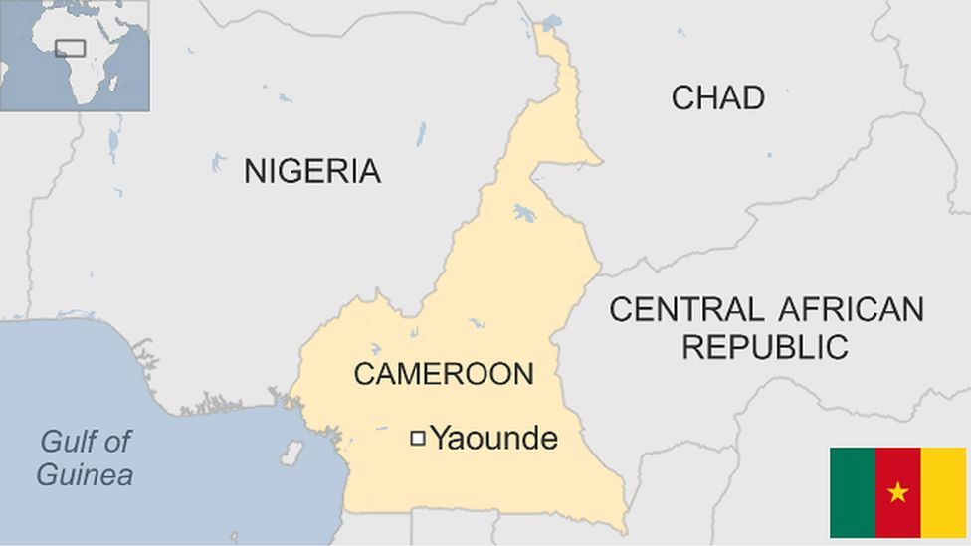
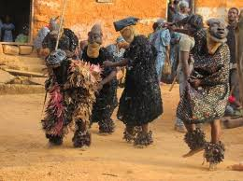

Slide 4
Center for Life – Addiction Care Center
ADDICTOLOGY UNIT After a comprehensive & holistic patient evaluation Medical support Individual and group therapy for patients. PASSADDICT – Therapy Emotional support groups for parents | ADDICTIVE BEHAVIOR PREVENTION UNIT Promotion of mental health and healthy behaviors Investigations into the emergence of new PAS and behaviors under the influence of narcotics. Development and Implementation of an addiction prevention plan. Partnership CBO/Public/Private/Administrative and religious authorities. | RESEARCH AND TRAINING UNIT Data collection and processing Participation in ongoing training. Drawing up annual work and operating plans.

Slide 5
Introduction
Drug addiction is becoming a public health problem even in African countries, affecting individuals, families and communities.
In this study, our main objective was to improve the overall management of patients with drug addictions, by involving their families.
We will present six clinical cases of patients followed at the Addiction Care Center in Yaounde|Cameroon.

Slide 6
Problem
Our aim is to highlight the causal link in the one hand, between vulnerability factors such as an overly rigorous or overly permissive upbringing, and on other hand, risk factors in family such as a violent environment, absence of a parent, hardship, trauma and the incidence of drug abuse with a disturbance of the parental relationship fostering a lack of self-esteem and a need for recognition and belonging.
How do vulnerability and risk factors lead to drug addiction and what role do families play in maintaining the abnormal and pathological behavior?

Slide 7
Methodology
This is a qualitative, phenomenological study involving the presentation of six clinical cases, for which we used thematic interview guides.

Slide 8
Results
We carried out a thematic analysis of the interview guides, which reveals that individual vulnerability and environmental risk factors weaken a person's mental health and expose him or her to drug abuse.
The involvement of parents in the treatment process, through a family approach and group therapy for parents, has enabled us to improve relations between parents and children, with a positive impact on their mental health, and has strengthened their motivation to stop using drugs.

Slide 9
Results

Slide 10
Conclusion
Changes in nature, structure and dynamics of African families could be a workable hypothesis to explain both vulnerability and risk factors in the development of addictive behaviors.
The bio-psycho-social model is the standard of care in addictology. By emphasizing the psychological and social dimensions, we observe better patient adherence and great progress in their overall care process.

