Slide 1



Where Do We Go From Here? Reflections On Possibilities Following The Launching Of A Psychoeducation Toolkit For Families Affected By Addiction In Prince Albert, Saskatchewan, Canada
Dr. Geoffrey Maina, Associate Professor, University Of Saskatchewan, Canada
Notes:
Hello from Canada. I am Geoffrey Maina, Associate Professor, College of Nursing, University of Saskatchewan. My presentation today is more of a reflection on the outcome of the work we completed in developing a psychoeducational tool for families affected by addiction in Prince Albert,. Saskatchewan.

Slide 2
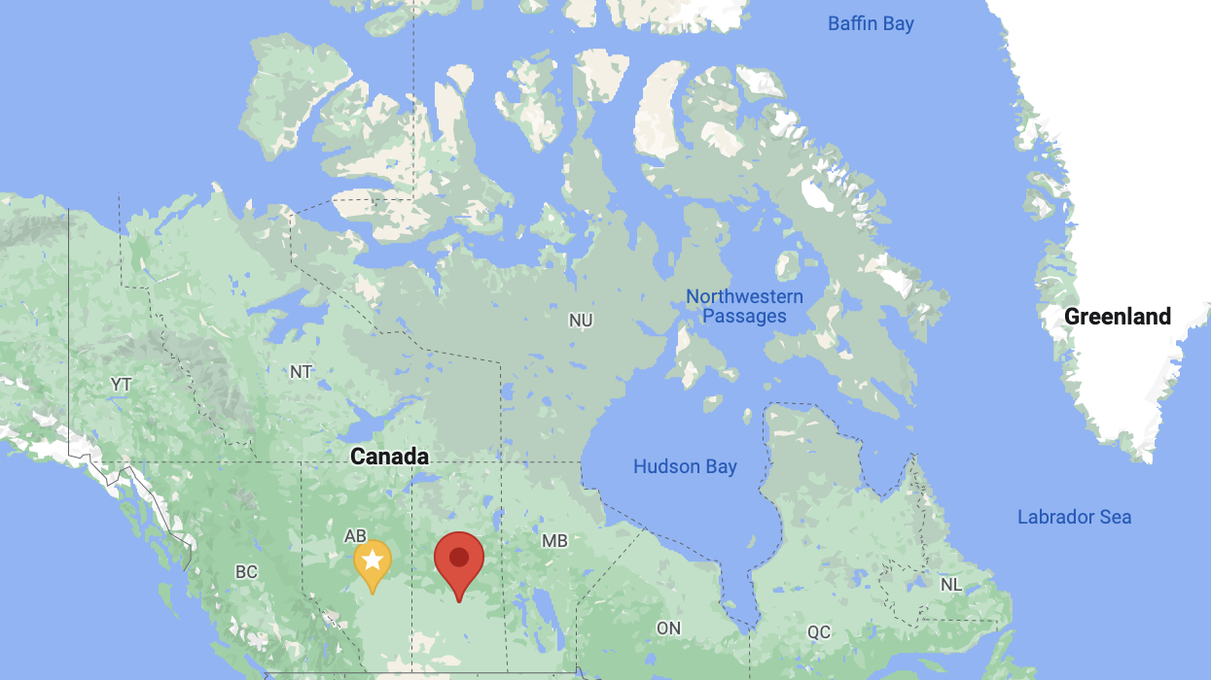

Prince Albert, Saskatchewan
Notes:
Prince Albert is in Central Saskatchewan and the the third biggest city in Saskatchewan, with a population of 40,000 or so people. Saskatchewan is a mid-west province in Canada with a population of 1.1 million people. Prince Albert is referred as the gateway to the north as it serves communities of more than 90,000 people.

Slide 3


The local statistics
The alcohol use per capita is about 1.5 times the national average and almost double the provincial average
73.8% of youth consume alcohol compared to the 62.2% national average
Binge drinking is 20% higher than the national average ( PPA alcohol strategy, 2016)
9.2% of emergency room visits and 18.2% of hospital admission are due to addiction-related ailments
Between Jan. 2015-June and 2016, 23 patients spent a combined 668 days in acute care and only a small percentage completed the treatment
Between 2010-2012, PAPAS arrested close to 6000 people for public intoxication costing $2.5m.
Notes:
I moved to Prince Albert in July 2016, to assume a position as assistant professor with the USASK. I was drawn to the local statistics on substance sue in the prince albert region and as you can see, they are not flattering. Our statistics ranging from per capita use to youth alcohol use is higher than the provincial and national average.
As a result, a lot of resources are used to manage the fall out associated with substance use including health care and policing costs.

Slide 4
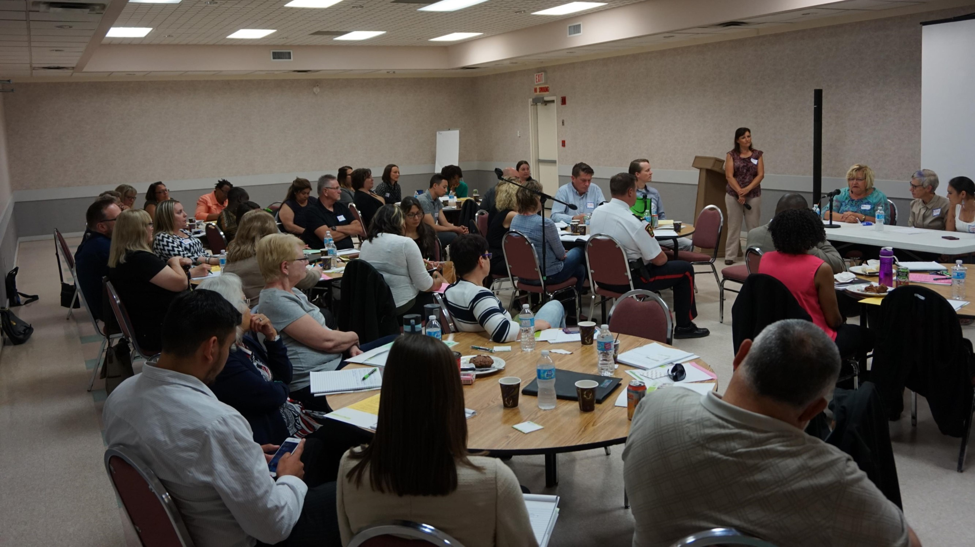
Knowledge translation event
Notes:
As a community-based researcher, I wondered where to start given the state of substance use in the city. I led a team in applying for a seed grant to organize a knowledge exchange event whose title was the Prince Albert we want. Of the many suggestions and recommendations that were made, it was apparent that families affected by addiction did not have the same level of support compared to people with substance use disorder. This focus was narrow and specific enough to start with.

Slide 5

The research: Exploring the needs for and developing interventions for families affected by
Notes:
So, we put together a team to apply for a research funding whose aim was to understand the needs for families affected by addiction and thereafter develop interventions that would address this need.

Slide 6
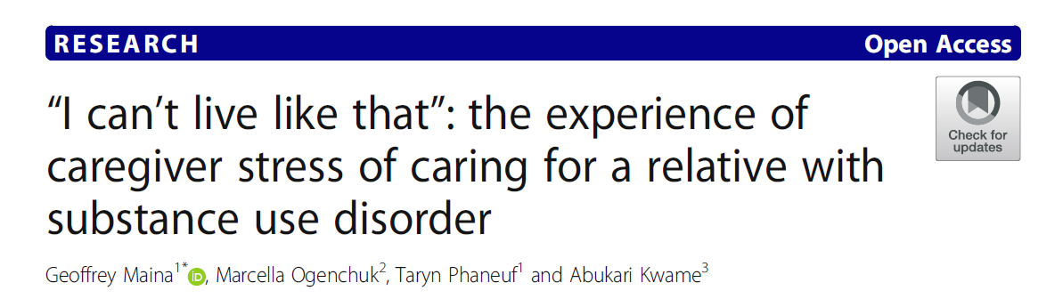
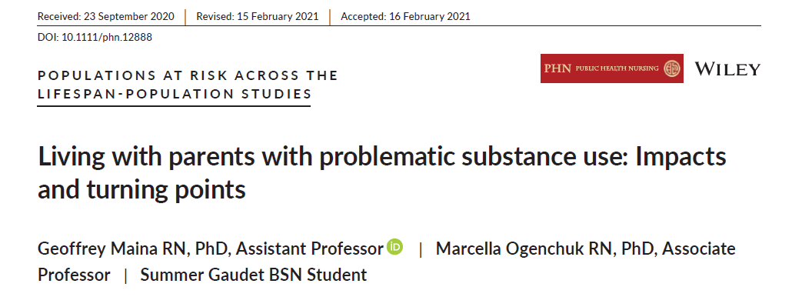
Main issues that arose from the project
Notes:
As expected, the caring for families affected by addiction had a significant Physical, Emotional, Psychological, Social and financial consequences.
Families were oblivious of the need to prioritize self care to mitigate against these consequences.

Slide 7
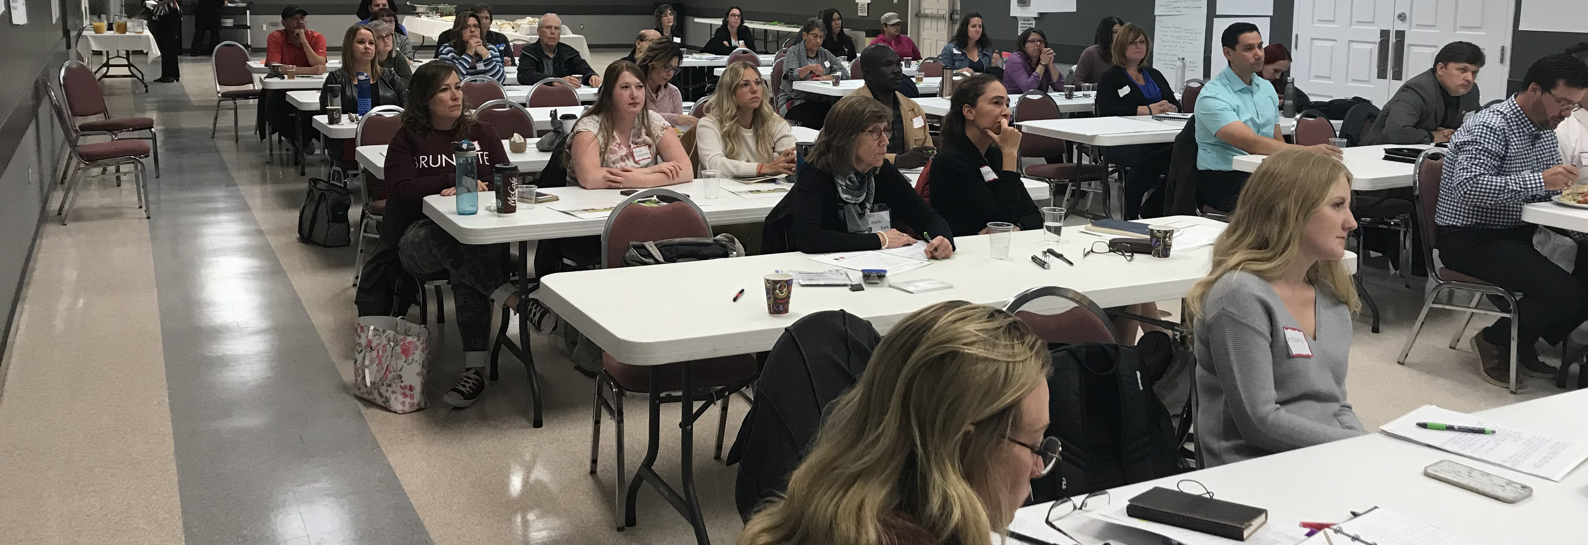
Sharing the findings with the community
Notes:
In September 2019, we returned to the community to share the results of the study. Among the many things the community suggested for intervention, they were clear that the voices of the participants be included.
We had to change the plans to develop psychoeducation toolkit due to the restrictions that COVID 19 brought.

Slide 8
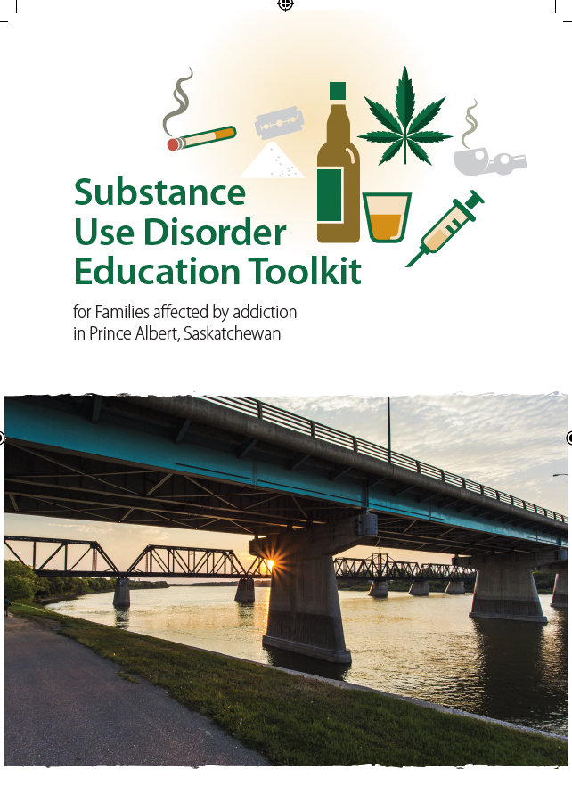
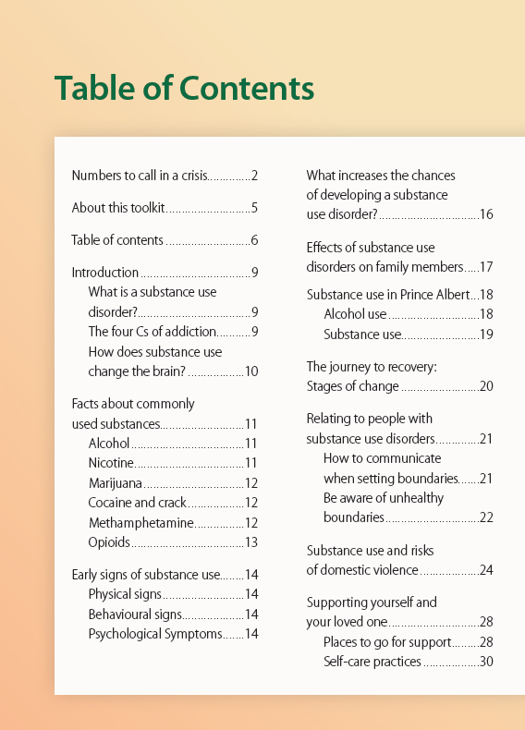
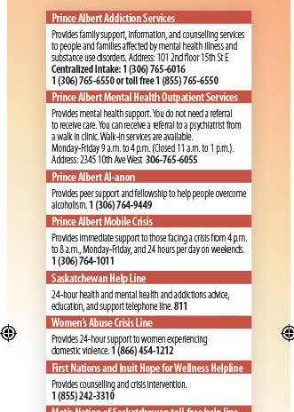
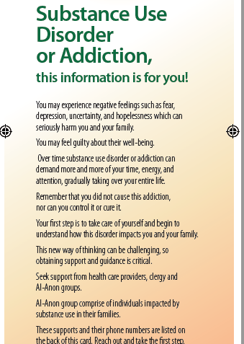
Resource development
Notes:
The working group that comprised of researchers, people with lived experiences, health care providers and community members settled on an education toolkit- 52 pages with information that families affected with addiction would need. The aim of the toolkit was to increase self awareness and empower families to take agency in their own self care.
The two images on the right are bookmarks that summarizes main information for families. They are to be distributed in the city in doctors’ office etc.

Slide 9
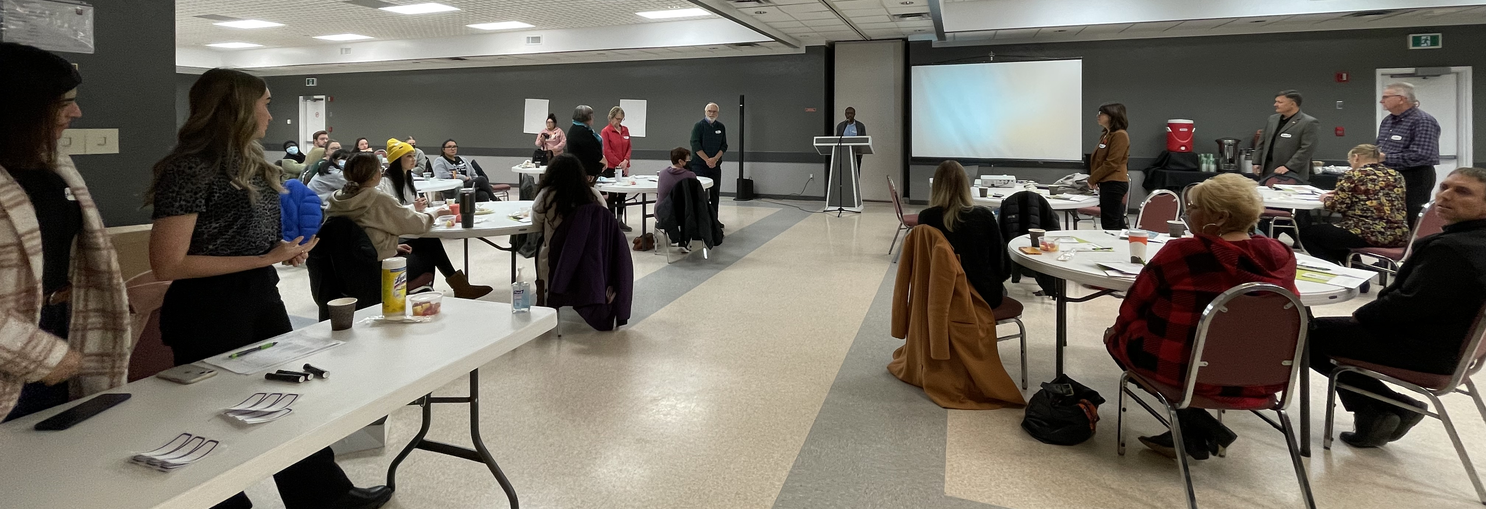
Launching of the resource
Notes:
In November 2022, we brought the community together once again to formally launch the documents. The documents were well received and each attendees was given two booklets and 10 bookmarks to carry. In the next couple of slides, I will talk about what has happened since this event.

Slide 10
Opportunities that arose from this project
The toolkit is now housed at the Prince Alert Alcohol Strategy Website- https://paalcoholstrategy.Ca/wp-content/uploads/2022/11/substance-use-disorder-education-toolkit.Pdf
Requested to join the board of director of Community Alcohol Strategy Steering Committee
Invitation to join Affected Family International Network
Used my reflection on my experiences as a basis for the book chapter on the impact of addiction on the quality of life
Notes:
Community Alcohol Strategy Steering Committee (CASSC) whose goal is to create healthy communities by changing unhealthy attitudes and behaviors around alcohol use and encouraging healthier communities agreed to host the toolkit.

Slide 11
Future plans
Plan to collaborate with local agencies to convert the document to podcasts
Collaborate with local radio networks to syndicate messaging on the effects of addiction on families.
Additional grant writing to build capacity for AFM self-care through peer support programs
Notes:
When I though that I was done with this project, more possibilities seem to arise. These include- creating awareness to families affected by addiction about how addiction in the family impact them.
This we hope to achieve through podcasts drawn from the content I the toolkit. We also hope to work with the radio stations to share the message about how addiction is a family illness.
To achieve these objectives, we will seek additional fundings from diverse local, provincial and national agencies.

Slide 12
What have we learned from the project
We are all affected by addiction in one way or another
Substance use stigma is still alive and well
The needs of families affected by addiction are not fully acknowledged
Support for families affected by addiction is desperately required
Community based research takes a lot of patience, but is very rewarding
Relationship building with important stakeholders.
Notes:
Conducting this project has been a delight as it has allowed us to deepen relationship with local partners and learn from them.

Slide 13
questions
geoffrey.maina@usask.ca

