Slide 1




Cooperation is key!
Results of the EU-funded project
“Make the difference”
„Together for child protection in families with addiction issues“
Rebekka Kleinat (LWL), Germany &
Sonja Basemans (Tactus), Netherlands

Slide 2
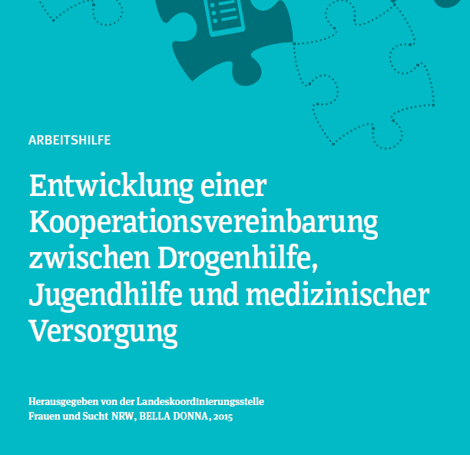
Bella Donna, 2015
“Dealing with the life situation of children growing up in families with addiction issues is a challenge for professionals across all fields, disciplines and institutions.”
Notes:
Why focus on cooperation?
This will be a guide for the joint development of an individual cooperation agreement, no one fits all

Slide 3
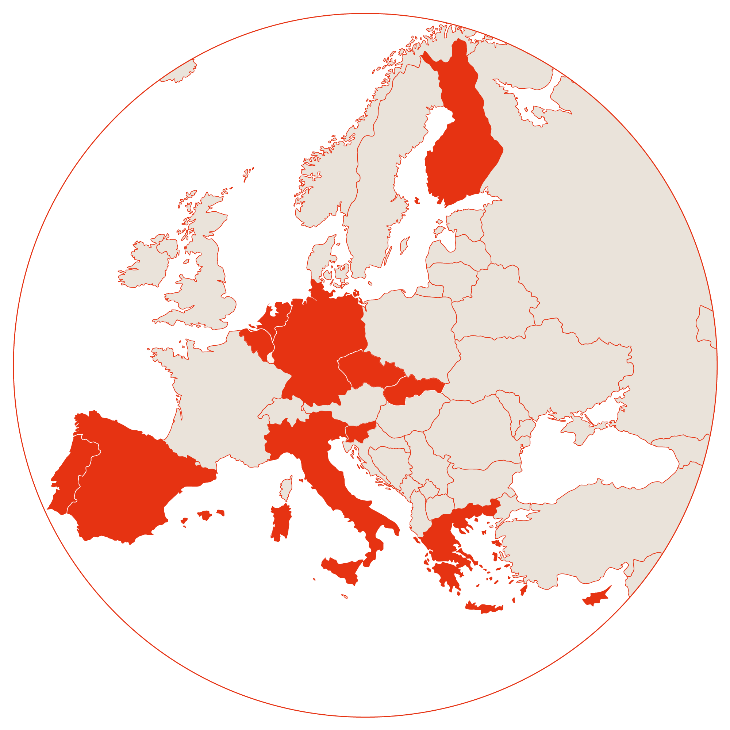



Project consortium
13 beneficiaries in 12 EU countries:
Belgium, Cyprus, Czechia, Finland, Germany, Greece, Italy, Spain/Catalonia, Portugal, Slovenia, Slovakia
& the Netherlands
Local partners in each country with responsibility for child protection (e.g. youth welfare, social services, … (letter of intent)
Coordinator: LWL (Germany)
Notes:
Euro net logo and website

Slide 4
Main objective
Specific objectives
Improve cooperation & structures
Identify affected children earlier!
Develop & implement a guide for joint development of a cooperation agreement!
Qualify professionals
Increase security of action in both help systems!
Offer suitable help
Offer suitable help to the children & families
Strengthen children's protective factors!
Test mentoring approach
Preventing a possible risk to the well-being of children from families with addiction problems through binding cooperation between youth and addiction services.

Slide 5
Methods
Structures & cooperation
Qualifying professionals
Mentoring
Development of 12 individual cooperation agreements in 12 countries along a guide
Guide towards a binding individual cooperation agreement
Implementing the agreements
Participation in 6 joint international workshops
Monthly online work meetings
Monitoring: Quarterly status reports
Questionnaires (t0-t4) (not yet completed)
Joint training for 42 professionals from addiction and youth welfare services
Curriculum for training & knowledge transfer
Partially further trainings in countries
Following the example of "Balu und Du” (German approach)
Testing the mentoring approach for children from families with addiction problems
Lessons learned on mentoring for children from families with addiction problems
Notes:
Questionnaires for process evaluation and assessment of satisfaction with the project

Slide 6
(Preliminary) results: MTD in numbers
42
Professionals educated on issues concerning the target group
6
joint international workshops (digital and on site)…
48
Professionals from 12 different countries and different help systems…
10
Cooperation agreements developed and signed (goal is 12)
→ Curriculum
…with professionals from both help systems
…agreed on joint key messages
→ Guide towards a cooperation agreement

Slide 7
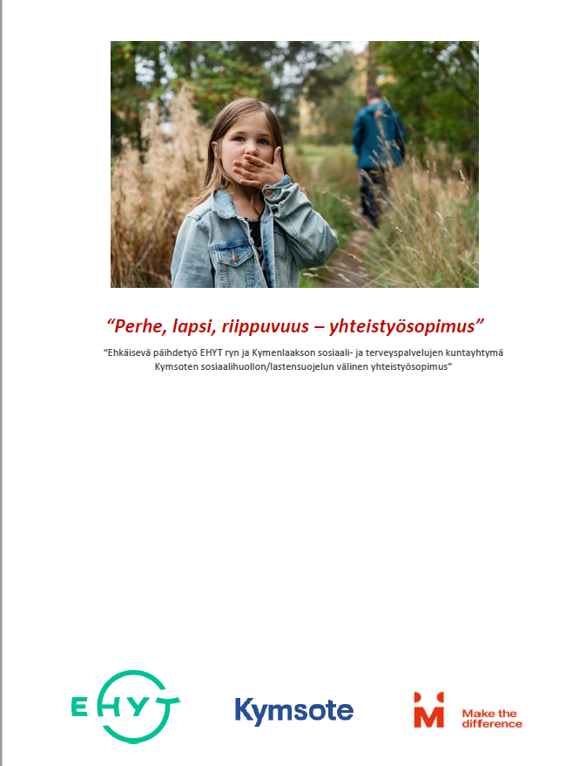
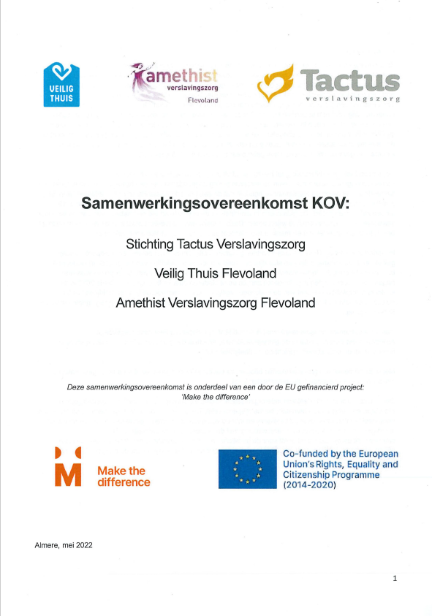
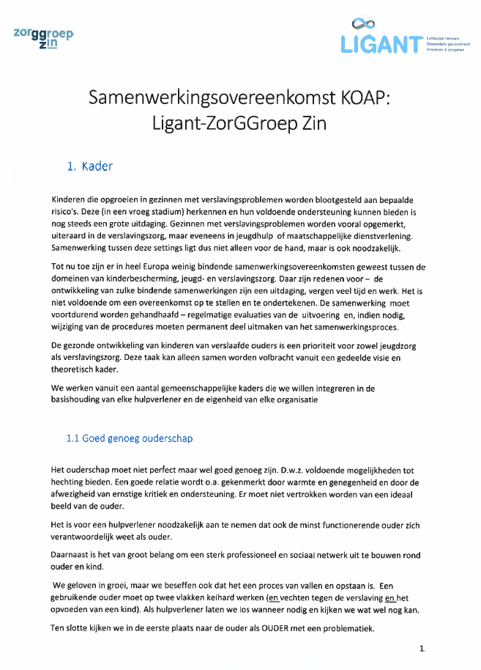
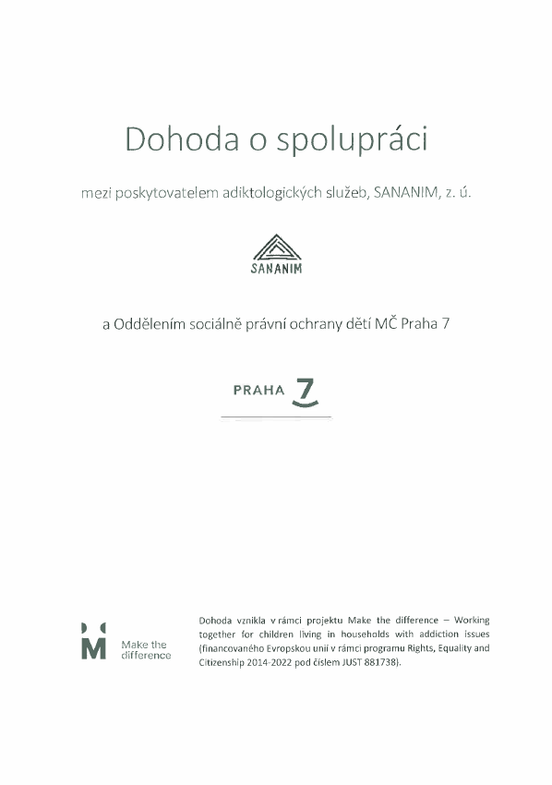






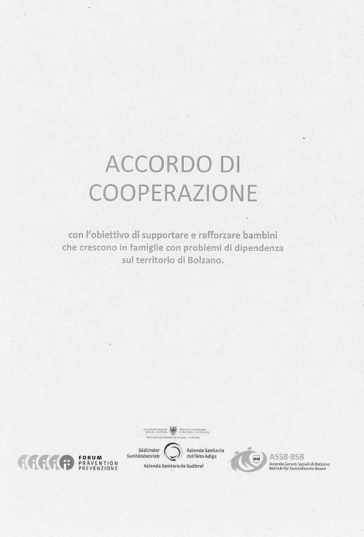
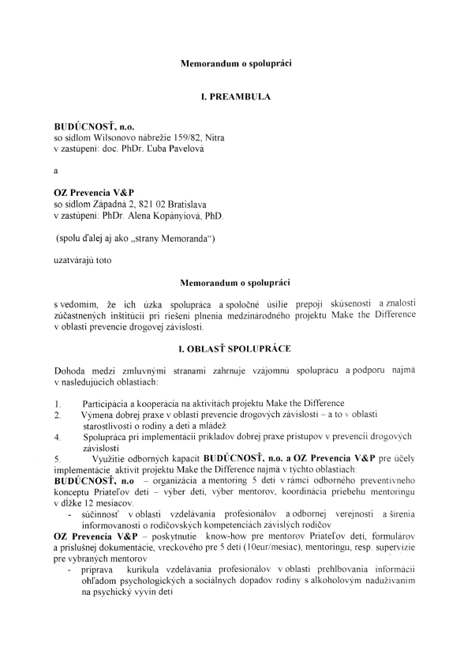

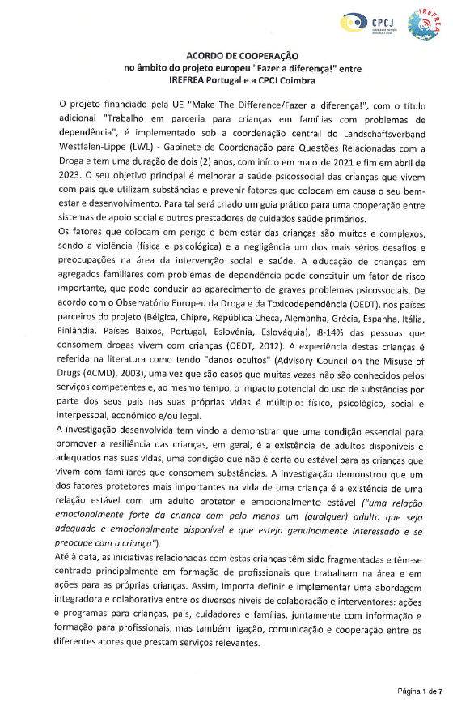
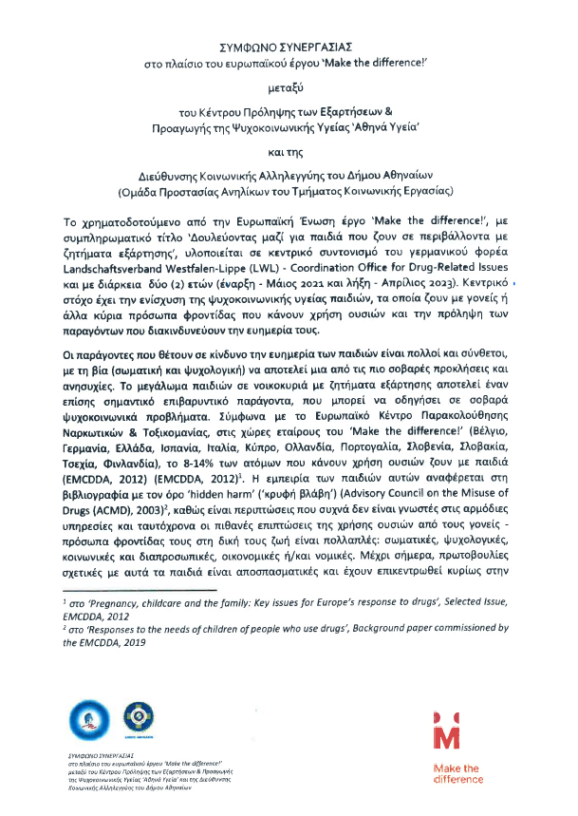
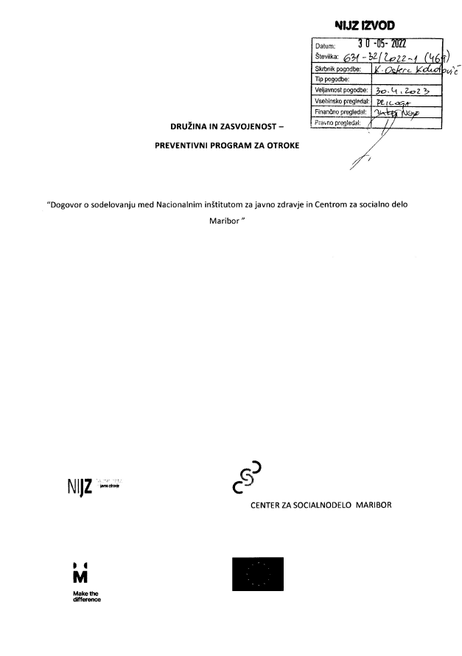




Cooperation agreements
Notes:
Cyprus and catalonia missing

Slide 8
Key messages
The safety of the child is always the priority.
Professionals should address parenting skills (also in addiction care). When is a parent “good enough”?
Addiction and parenting need to be addressed at the same time!
Cooperation of the help systems is essential to gain a comprehensive perspective on the family situation.
Notes:
48 professionals worked on these messages in a joint workshop an agreed on these 4.

Slide 9
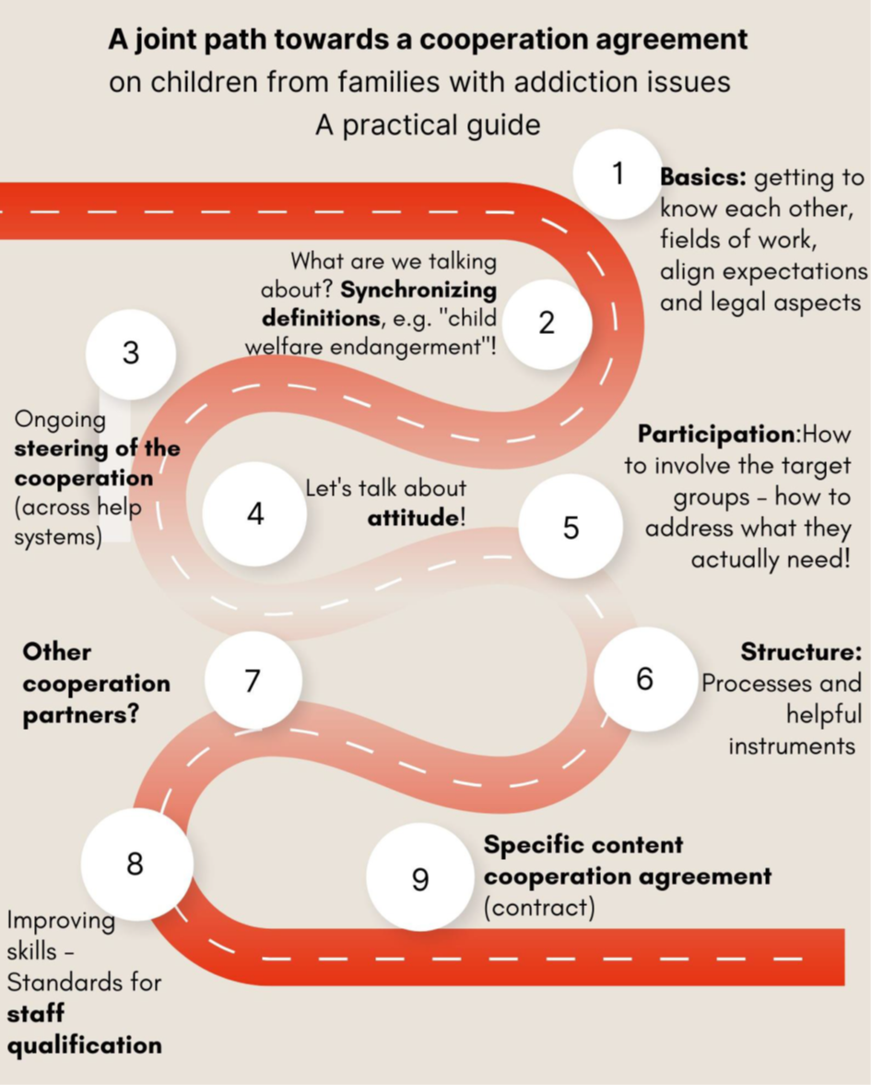
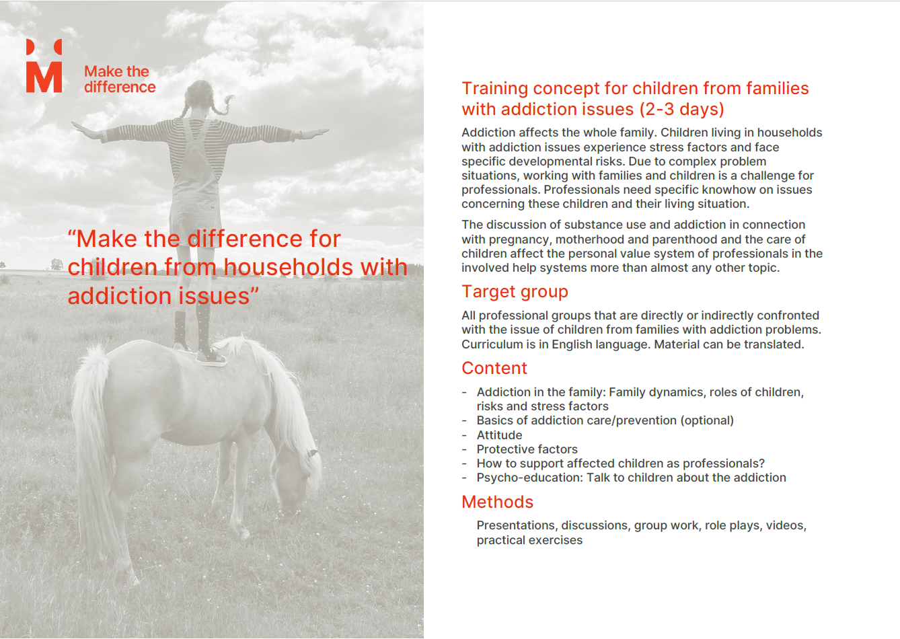

MTD products
Guide for the joint development of a cooperation agreement (September 2023)
Curriculum for professionals from different help systems (available on website)
Necessary conditions for success for a mentoring approach for children living in families with addiction issues (September 2023)
Balu und Du logo

Slide 10
Attempt at a conclusion:
Which parts of the MTD project offer the greatest benefit for the target group?
MTD will can have a sustainable effect, if these aspects will be continued:
Improvement of early identification and support structures through cooperation and introduction of defined processes (flow-charts).
Comprehensive approach: Families are addressed from different perspectives.
Increased awareness for children's and families' needs.
Professionals are qualified, increased security of action.
Parenting is being addressed by addiction care more often!
Embed processes, checklists and guidelines in the structures of the organization.
Re-evaluate the cooperation, adjust goals and align expectations.
Qualify professionals & train new employees
Formal & informal cooperation, regular meetings – know each other!
Raise awareness for these children („Talk about it!“).
„See the problem and act accordingly!“
Notes:
In the end, each beneficiary is responsible for building on the work done in MTD. Some have better conditions than others

Slide 11
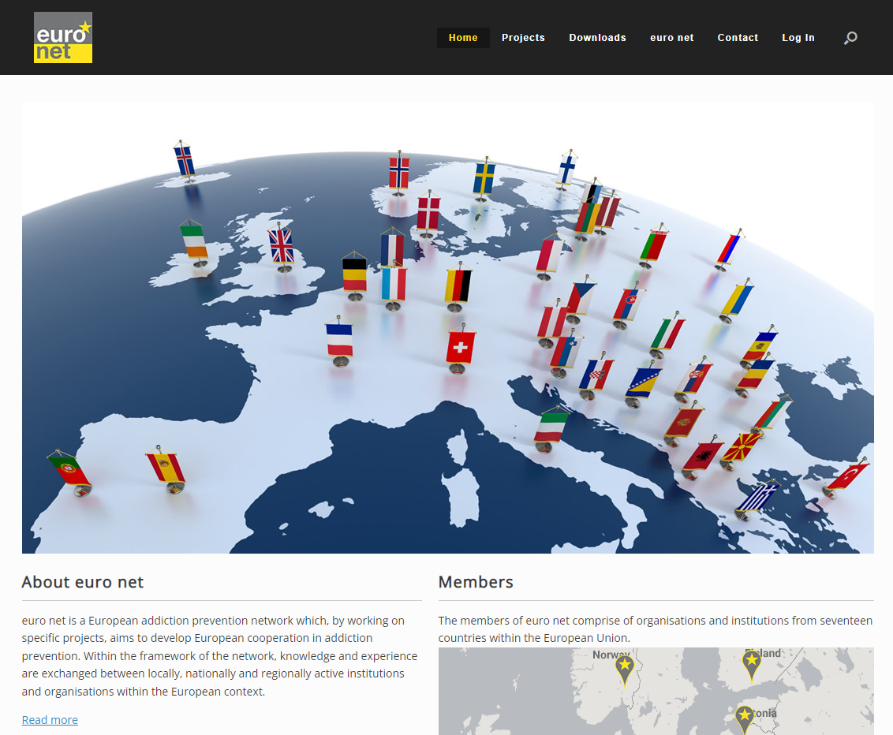
Invitation: MTD final conference
18 September 2023
Time 10:00 - 11:15 (CEST)
Online via Zoom
Register here: https://forms.gle/uKbvcMxRQPa78jXR8
Information and downloads:
https://www.euronetprev.org/projects/makethedifference/ -
4th Annual AFINet Conference, Rotterdam, NL, 16 June 2023
Notes:
We want to share two things…

Slide 12
Natalia T., Athina Ygia, Greece
“It has been worth it to make time to meet professionals from other services and find ways to work together for the benefit of our clients.
While creating a common ground to work on, we have educated and challenged one another & we are building the ‘village’ that will contribute to raising happy and resilient children.

Slide 13
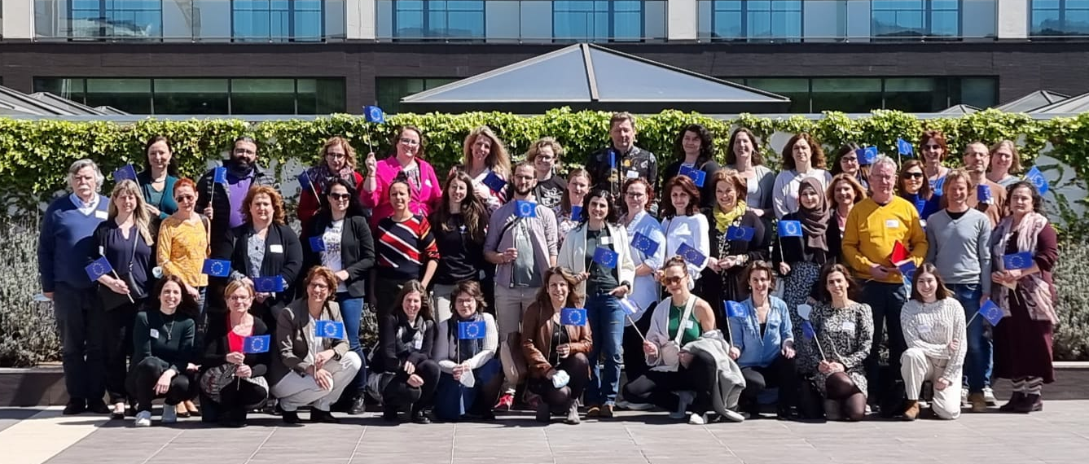
Why a European project?
Common challenges
  Child protection in families with addiction issues
  Cooperation with other help systems
  Addressing parenthood in the work with adult clients
Benefits
  Learning from each other
  (Guided) exchange
  "Thinking outside the box”
  Sharing good practices (e.g. Kindreflex¹ process)
  Not "reinventing the wheel”
  Jointly developing new approaches
¹www.kindreflex.be

