Slide 1


Lived experience performances of Three Side of the Coin to educate professionals about gambling harm
AFINet Online Conference 19th - 20th September 2024
Presented by Judy Avisar
Notes:
Fiona – share slides at 1:35pm
Revisit research questions

Slide 2

Setting the Scene
Aussies are the world’s biggest losers - losing more per capita through gambling than any other country in the world! $25 billion a year!
Three Sides of the Coin (3SOC) project empowers people with lived experience to perform their stories to educate about gambling harm.​
Intention of 3SOC is to change attitudes:
Increase understanding of gambling harm, and confidence to talk about it
Humanize the people behind the addiction, increase empathy, reduce the stigma and shame…so more people will speak up and seek help
Put gambling on professional’s radar
Include gambling as a screening question in client assessment
Disrupt the normalization of gambling in Australia
Frame gambling as a Public Health issue
Notes:
Fiona – share slides at 1:35pm
Revisit research questions

Slide 3

Deakin University Research Study
Lived Experience Performance to Reduce Stigma, Enhance Understanding of Gambling Harm and Change Attitudes and Behaviours of Professionals and Community Members | Journal of Gambling Studies (springer.com)
Do Three Sides of the Coin lived experience performances:
Increase audience understanding of gambling harm?
Increase audience empathy to those impacted by gambling harm?
Lead to positive changes in attitudes and behaviours of professionals in the short and longer term?
How does performing arts impact these outcomes?
Notes:
Fiona – share slides at 1:35pm
Revisit research questions

Slide 4
Research Methodology
Mixed Methods
Audience Post-performance survey (n=301)
    64 Community members
    224 staff working in allied sectors
    7 staff from gambling-help sector
Audience 3-12 month Follow-up survey (n=116)
    26 Community members
    66 staff from allied sectors
    17 staff from gambling-help sector
Notes:
Fiona
Mixed methods – quantitative and qualitative survey data
Focus today on the impact for audience members who are working in intersecting professions, excluding gamblers-help
Pre-COVID

Slide 5
Research findings
Three Sides of the Coin (3SOC) successfully
Increased professionals’ understanding of gambling harm
Increased empathy and respect towards those affected by gambling
Created positive and sustained changes in attitudes and behaviour
3SOC storytellers’ use of artistic methods to share their personal stories in a powerful, emotive way elicits personal critical reflection amongst audience members

Slide 6

As a result of participating, professionals reported…
Post Performance
3-12 month follow up
*excluding gambling-help professionals
Notes:
As a result of attending 3SOC PD, audience members reported increased …. This continued for at least 3-12 months after the PD

Slide 7
Qualitative themes
Understanding
  Complexity and scale of gambling harm in Australia
  Impacts of gambling to and beyond an individual
  Shame and stigma
Work practices
  how to effectively engage with someone harmed by gambling, including how to ask an individual about gambling
  Being alert to the presence of gambling issues
  How to work in a respectful and empathetic manner
Notes:
Fiona
Understanding
Complexity and scale of gambling harm in Australia
Impacts of gambling to and beyond an individual
Shame and stigma
Work practices
how to effectively engage with someone harmed by gambling, including how to ask an individual about gambling
Being alert to the presence of gambling issues
How to work in a respectful and empathetic manner

Slide 8
Professionals’ reflections
Understanding “how it affects the well-being of the partner and children”
“I came away with a new sense of empathy for both the person experiencing gambling issues and their family.”
“definitely changes my attitude and called me to reflect on my own biases”
“I will be more conscious of asking people/clients about their gambling behaviour, I’ll be more aware of the shame and stigma surrounding the behaviour”
“Made a sharper connection between gambling – shame – suicidality”
“If I notice issues with money, I’ll be much more likely to ask if gambling is a problem for the person I’m talking to”
“Since the performance, the impact of gambling has been more humanised”
Notes:
“An increased understanding
about how frightening feeling
compelled to gamble would
feel”

Slide 9
Tracking professionals’ responses over time
Post-performance
3-12 months later
“I have probably held some negative beliefs…I have definitely changed these beliefs”
“More empathy towards people with gambling issues”
“I ask more often about gambling, both to the client and about family members and their thoughts around this”
“Being more open to ask about gambling.”
“I have included this issue in mentoring sessions that I've provided to junior staff, and … service planning and delivery”
“More open to understanding/being sensitively curious to open a conversation”
Notes:
intention to behaviour

Slide 10
Artistic methods
Use of performance arts continued to provoke sustained impact, reflection and empathy.
Post performance
  98.6% - performance by people with lived experience was a powerful way of connecting to the issue
Follow up survey
  98.4% - the use of theatre was an effective way to present the material
  98.4% - performance by people who have experienced gambling harm was a powerful way of connecting to the issue
Agreed or Strongly Agreed
Agreed or Strongly Agreed
Notes:
Proportion who agreed or strongly agreed

Slide 11
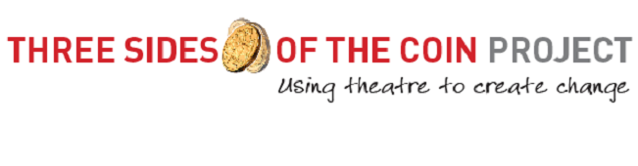
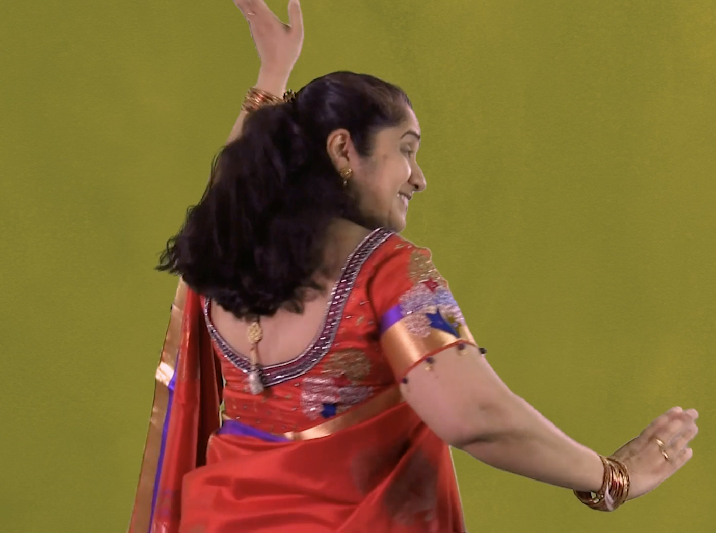
Chandana’s Story
Notes:
Proportion who agreed or strongly agreed

Slide 12


Thank you
Questions?
Judy Avisar
Coordinator, Three Sides of the Coin
E: javisar@sharc.org.au
W: sharc.org.au | threesidesofthecoin.org.au
Family Drug and Gambling Help Helpline: 1300 660 068
Self Help Addiction Resource Centre Inc.
Notes:
Hand over to Vic to lead the Q&A at 1:45pm (with Judy, Anna and Catherine)

