Slide 1
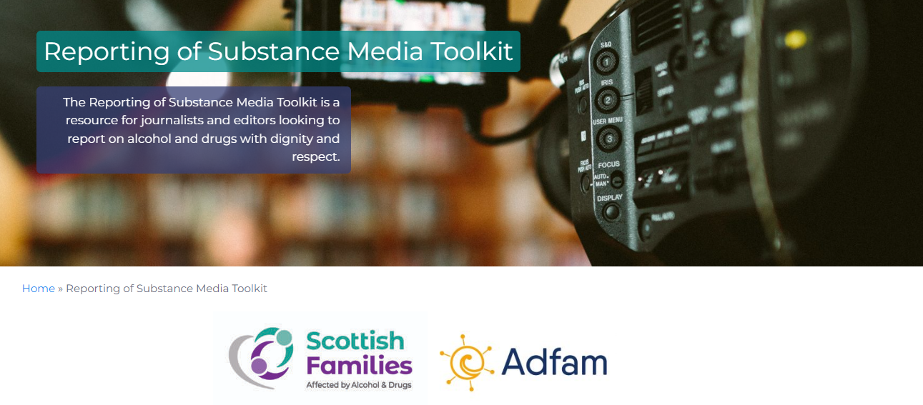


Reporting of Substance
A media toolkit for reporting on alcohol and drugs with dignity and respect
Justina Murray, CEO
Scottish Families Affected by Alcohol and Drugs
@ceosfad
@ScotFamADrugs

Slide 2
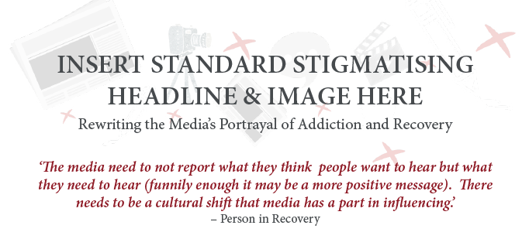
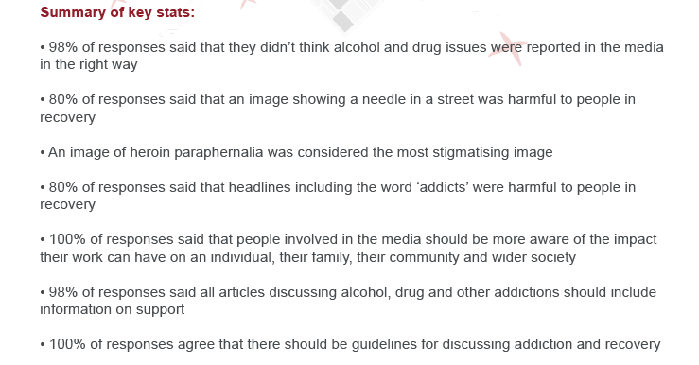

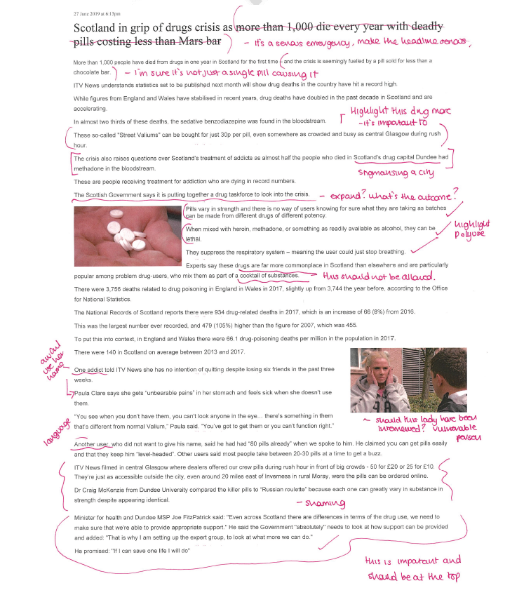
Where this all started – Rewriting the Media (2020)
@ceosfad
@ScotFamADrugs

Slide 3
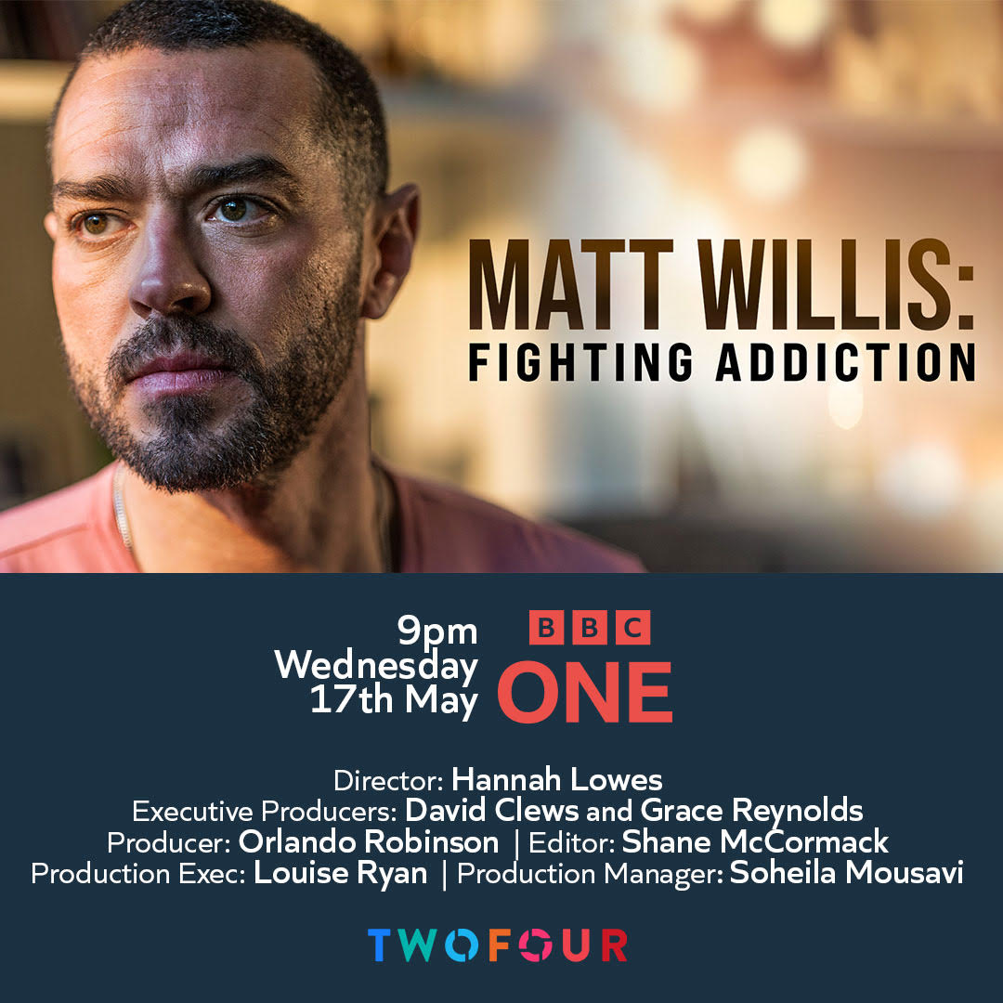
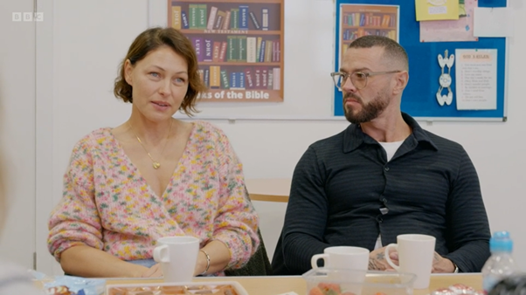
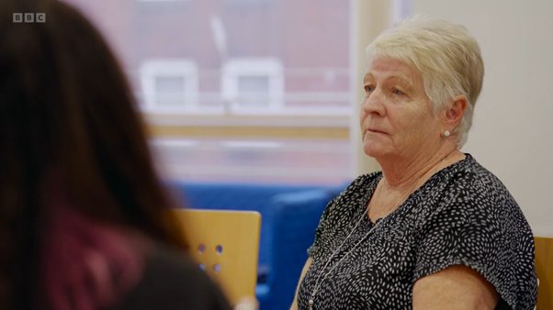

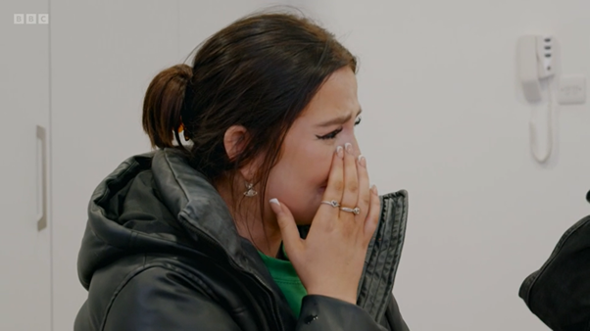
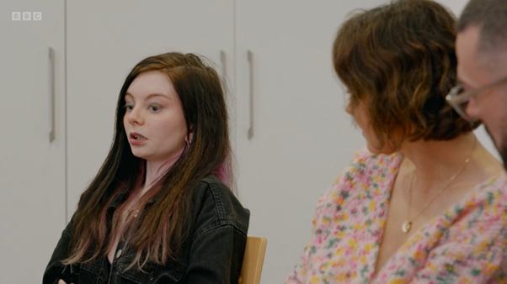
Family experiences of media engagement
NEGATIVE experiences include: ‘Journalist with an agenda’ ‘Political scoring’ Reworded stories Change in narrative Long days filming Final article is shorter than expected Breaking news taking over Non-approved language | POSITIVE experiences include: Feel heard Can see their story in a newspaper Get copy approval Share their photos Get positive feedback from others Feel empowered Not afraid to hide behind anonymity Don’t feel stigmatised Proud
@ceosfad
@ScotFamADrugs
Fighting Addiction images © TwoFour Productions

Slide 4

The importance of co-production
with family members and journalists
‘For far too long there has been confusion and upset over the way stories of alcohol and drug use are reported. This toolkit will at last act as a one-stop-shop for print and broadcast media wanting to provide information, accurate and most importantly – sensitive content on one of the most prevalent problems for society today.’
Camilla Tominey, Associate Editor, The Daily Telegraph
@ceosfad
@ScotFamADrugs

Slide 5
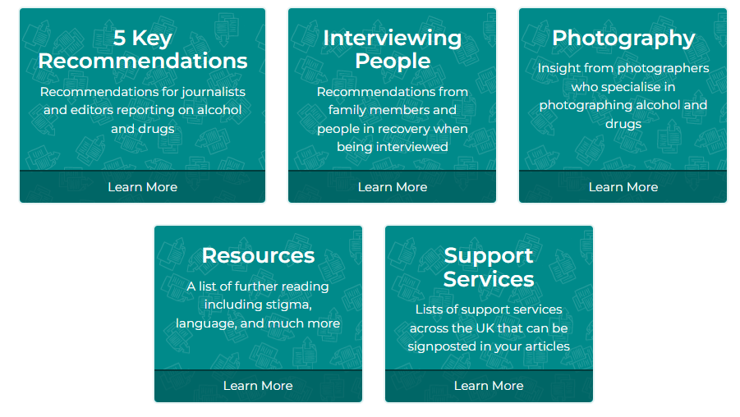




Reporting of Substance – The Toolkit
@ceosfad
@ScotFamADrugs

Slide 6
Recommendation (1): IMAGERY
Imagery
Images of alcohol and drugs should only be used where appropriate in articles.
Images of people in vulnerable conditions – including whilst drunk or unconscious – are stigmatising. These images should always be avoided.
Articles about alcohol harm should not contain images which make drinking seem glamorous, sociable, or appealing.
Drug paraphernalia should only be used where the context is informative.
Images should tell the human side of the story in a positive and responsible way. Photos of interview subjects, support services, and/or the community featured in the report should be used instead.
@ceosfad
@ScotFamADrugs

Slide 7
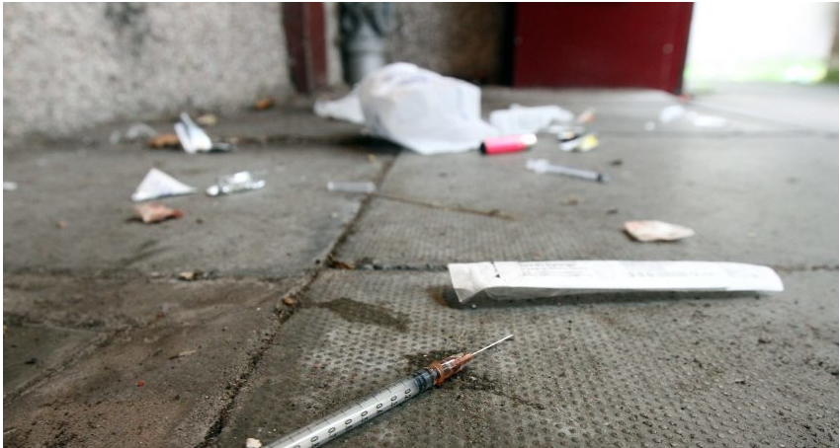

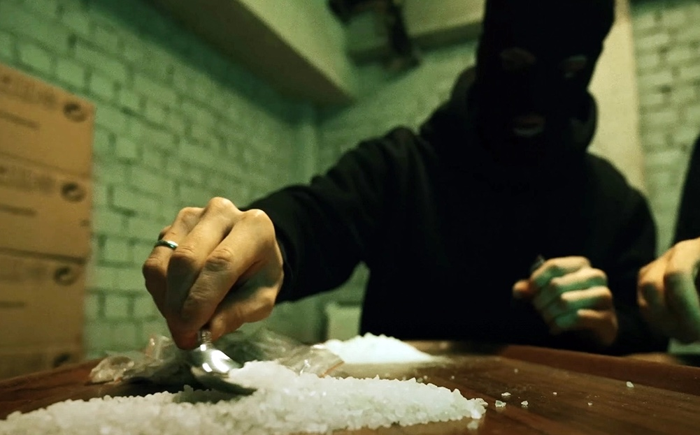


Slide 8
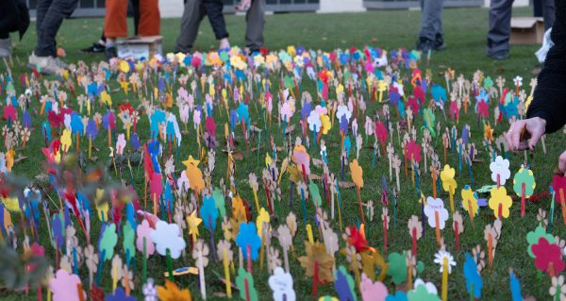
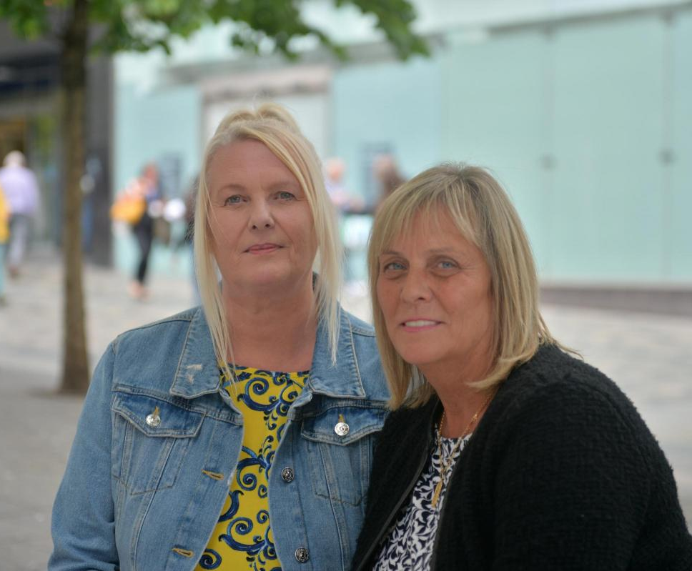
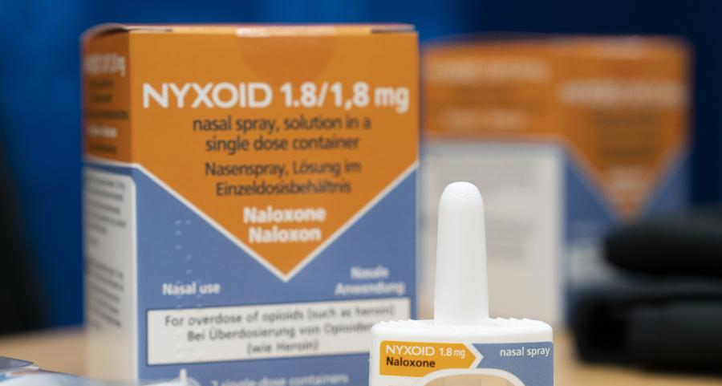
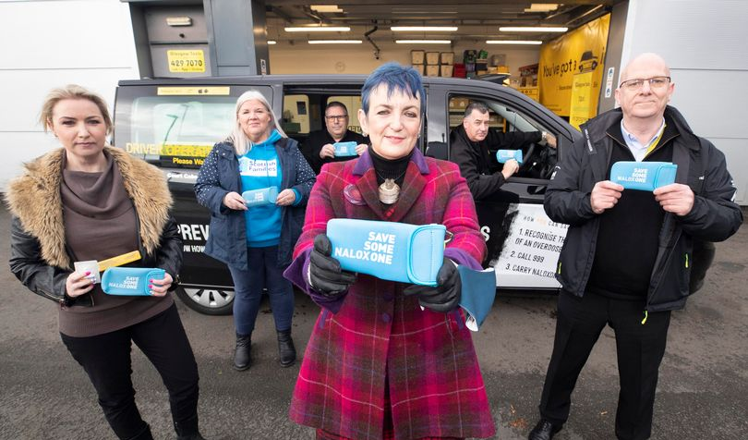
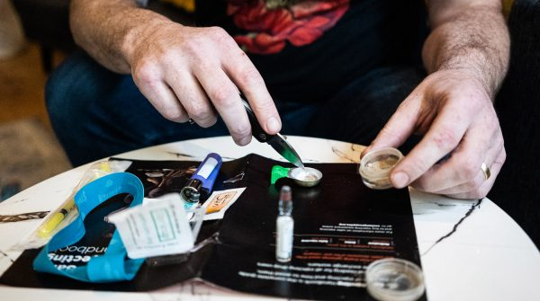

Slide 9

Recommendation (2): LANGUAGE
Language
Stigmatising language such as ‘user’, ‘addict’ and ‘alcoholic’ should be kept to a minimum.
Journalists and editors should use language appropriately, referencing interview subjects as parents, professionals and so forth.
Interview subjects should be asked how they would prefer to be described.
Examples of best practice include saying ‘substance use’ instead of ‘substance abuse’. Words like ‘druggie’ or ‘junkie’ should always be avoided.
https://www.sdf.org.uk/wp-content/uploads/2020/10/Moving-Beyond-People-First-Language.pdf
@ceosfad
@ScotFamADrugs

Slide 10
Recommendation (3): CASE STUDIES
Case Studies
There are many people who are happy to share their stories in a bid to help others to find support. Some people may prefer to share their experiences anonymously and this should be respected by the journalist.
Journalists and editors should spend time getting to know people and learning more about their experiences. Interview subjects deserve to be treated as humans.
A person’s story might be ignored because it is not ‘interesting enough’, but all stories are worth telling if they can help others into recovery.
Interview subjects should be offered copy approval of their own quotes and contributions.
@ceosfad
@ScotFamADrugs

Slide 11
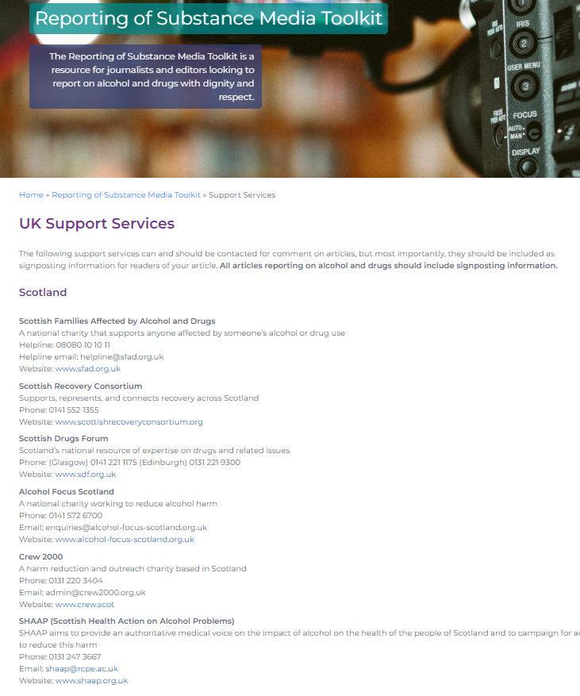
Recommendation (4): SUPPORT INFORMATION
Support Information
Support information should always be included in any article that is reporting on alcohol and/or drugs.
This is already standard practice for media stories covering issues such as mental health, suicide, abuse, domestic abuse
The Toolkit includes a list of useful sources of information and support from across the UK – journalists can use these to signpost readers/viewers to support.
@ceosfad
@ScotFamADrugs

Slide 12
Recommendation 5: Education and Stigma
Education and Stigma
Lived experience stories will not only be more compelling for readers but will actually help others. By including honest accounts of alcohol/drug use and recovery you can promote the message that people can and do recover.
People usually remember a story more vividly if it reflects the human experience, helping readers to relate and empathise more with those involved.
There are many support groups and recovery communities that are happy and willing to speak to journalists. We recommend that journalists and editors reach out to groups and communities to learn more about their work.
@ceosfad
@ScotFamADrugs

Slide 13
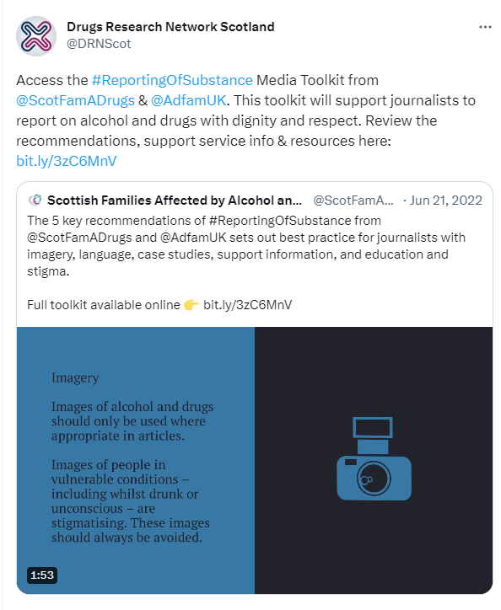
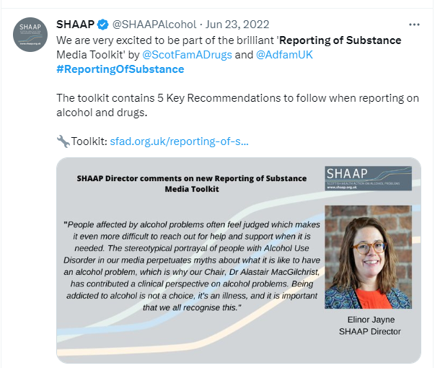
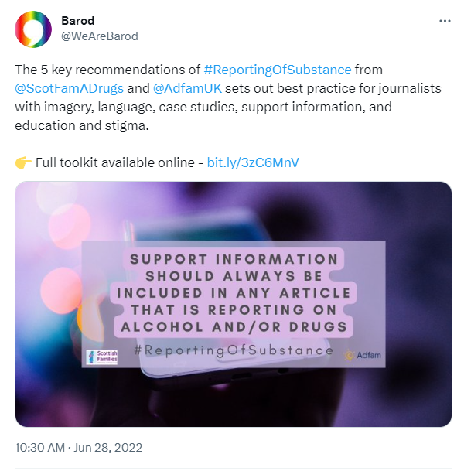
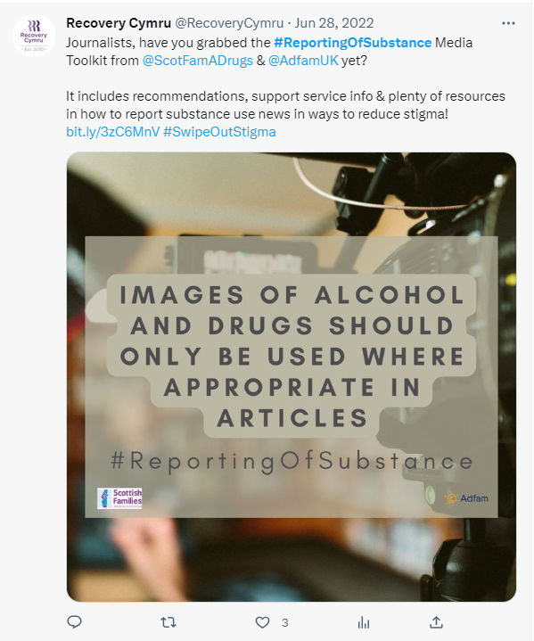
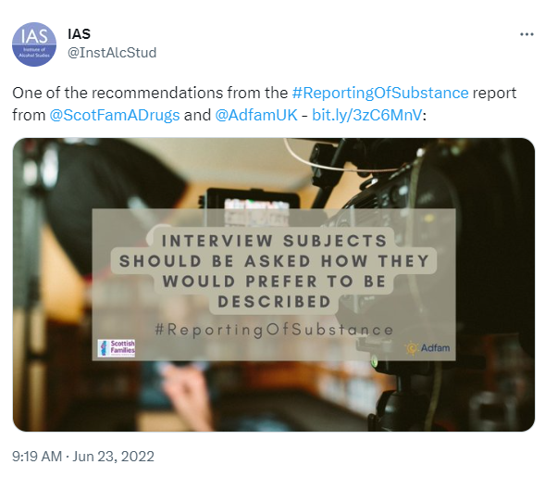
Reporting of Substance – The Response
Shared with 211 journalists directly and 50 media outlets at launch including BBC News, STV News, The National, The Herald, The Telegraph, The Guardian, etc.
Our media enquiries now often include references to the Toolkit (e.g. ‘I have read your toolkit and want to make sure I am responding correctly.’)
1,592 page views and 322 shares from the Scottish Families website directly
10,235 impressions and 640 engagements on social media in the launch month June 2022
Widely shared and supported by our partners – thank you!
@ceosfad
@ScotFamADrugs

Slide 14
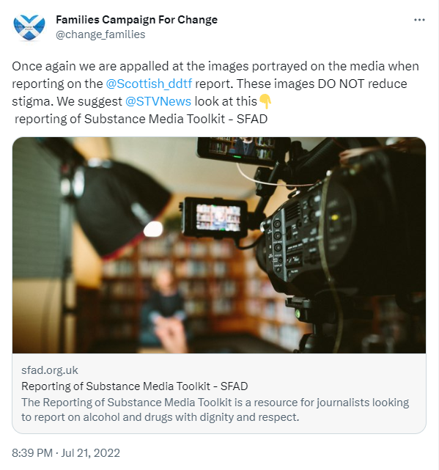
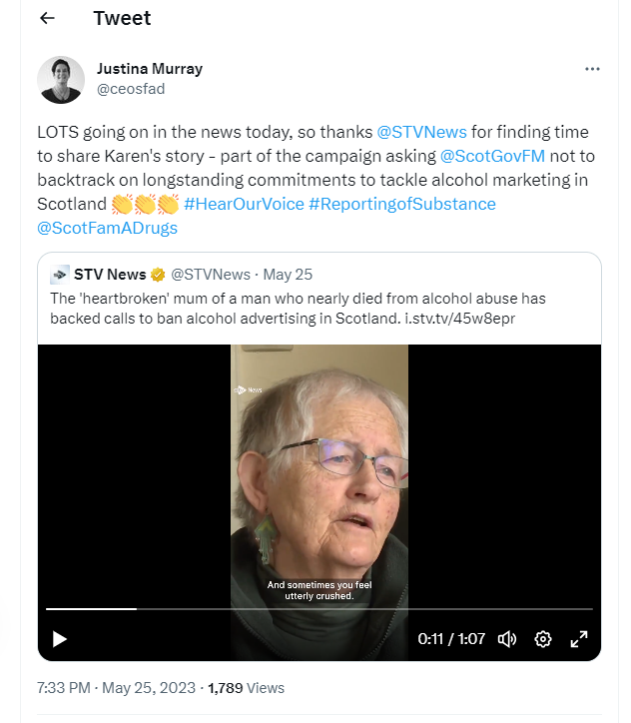
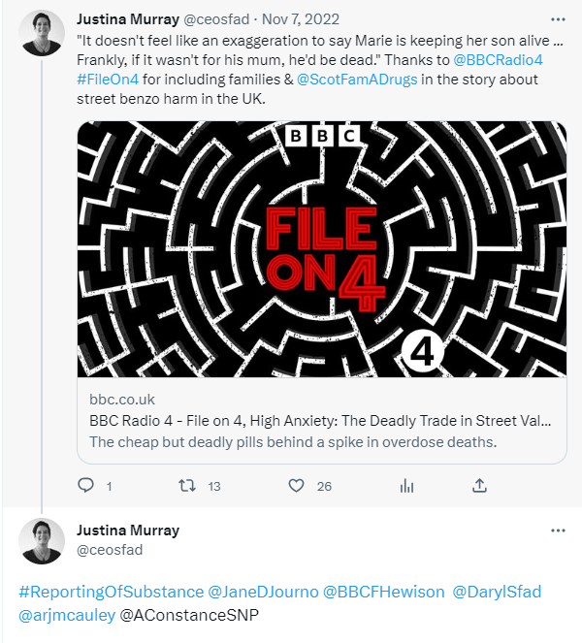
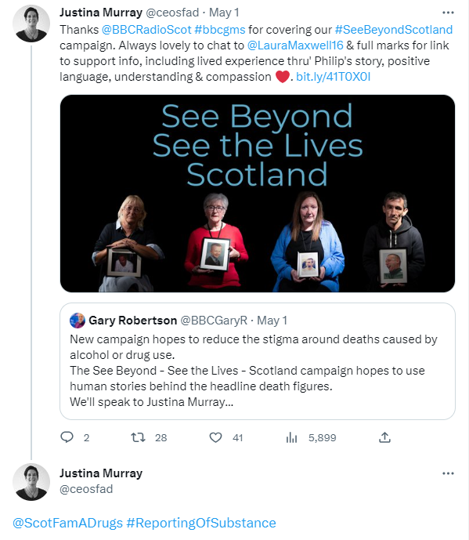
How you can use Reporting of Substance
Check out the Toolkit (link on next slide) and share with your networks and media contacts
Share good examples of reporting using the hashtag #ReportingOfSubstance
You can also name check the journalist to thank them for upholding the guidelines
Feel free to tag us too @ScotFamADrugs!
You can also call out breaches of the guidelines in the same way.
@ceosfad
@ScotFamADrugs

Slide 15
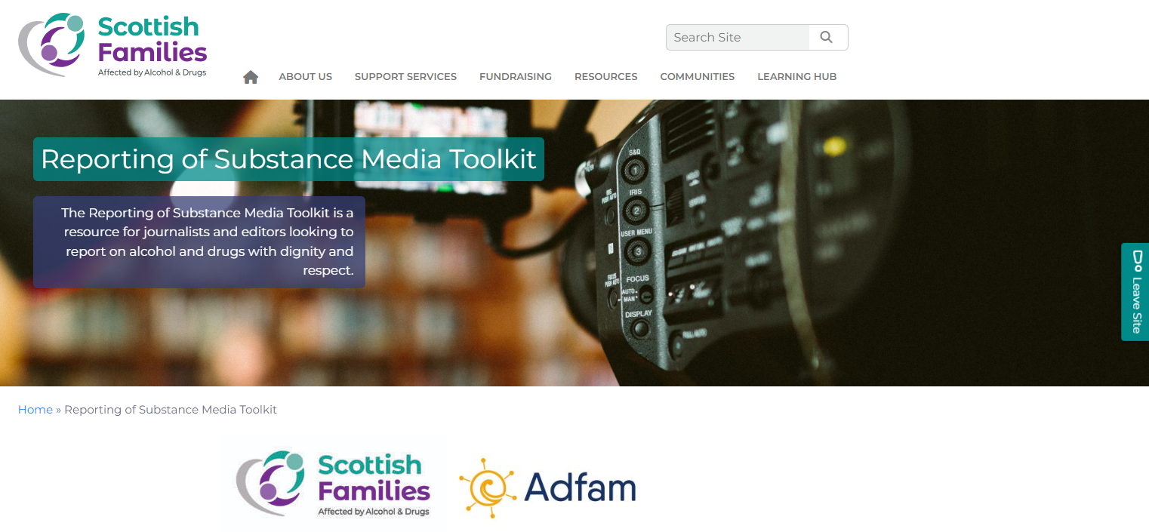
Where to find out more
www.sfad.org.uk/reporting-of-substance-media-toolkit
Thank you and keep in touch!
ceo@sfad.org.uk
www.sfad.org.uk
@ceosfad
@ScotFamADrugs

