Slide 1

5-Step
Method within Secondary Care Mental Health Services
Dr Isaac Akande
Consultant Clinical Psychologist
Co-Occurring Mental Health and Addictions Rehabilitation Team
(COMHART)
With special thanks to Niah Gill, Ria Viswanathan, Erya Wu, Jan Larkin and all 5SM facilitators within SLaM

Slide 2
Background
Over a third of people with a severe and enduring mental health problem have a problematic relationship with alcohol and/or substances (NHS England, 2025).
In the UK, the policy direction has been such that the needs of this cohort has been primarily met within mental health services (Public Health England, 2017). This input however is often focused on the needs of patients, with less attention paid to their social network.
This is despite the evidence to suggest, in addition to wellbeing benefits for the family member themselves (Sin et al., 2016), when family intervention is received, the patient relative has better outcomes, including less hospital admissions and relapses (Pharoah et al., 2010).
Notes:
Co-occurring mental health and substance use delivery framework - GOV.UK
Better care for people with co-occurring mental health, and alcohol and drug use conditions
Effectiveness of psychoeducational interventions for family carers of people with psychosis: A systematic review and meta-analysis – ScienceDirect
Family intervention for schizophrenia - Pharoah, F - 2010 | Cochrane Library

Slide 3
Affected family members (AFMs) – family and close friends of those with substance use difficulties – experience higher levels of psychological distress and a poorer quality of life (Di Sarno et al., 2021).
A similar pattern exists for carers of people with a psychosis-spectrum diagnosis (Onwumere et al., 2016; Sin et al., 2021).
A response to this gap in support is the 5-Step Method (5SM), developed through the Addiction and the Family International Network (AFINet) and grounded in Orford and colleagues' Stress-Strain-Information-Coping-Support (SSICS) model.
Notes:
Understanding the needs of carers of people with psychosis in primary care – PMC
Mental health and caregiving experiences of family carers supporting people with psychosis | Epidemiology and Psychiatric Sciences | Cambridge Core

Slide 4
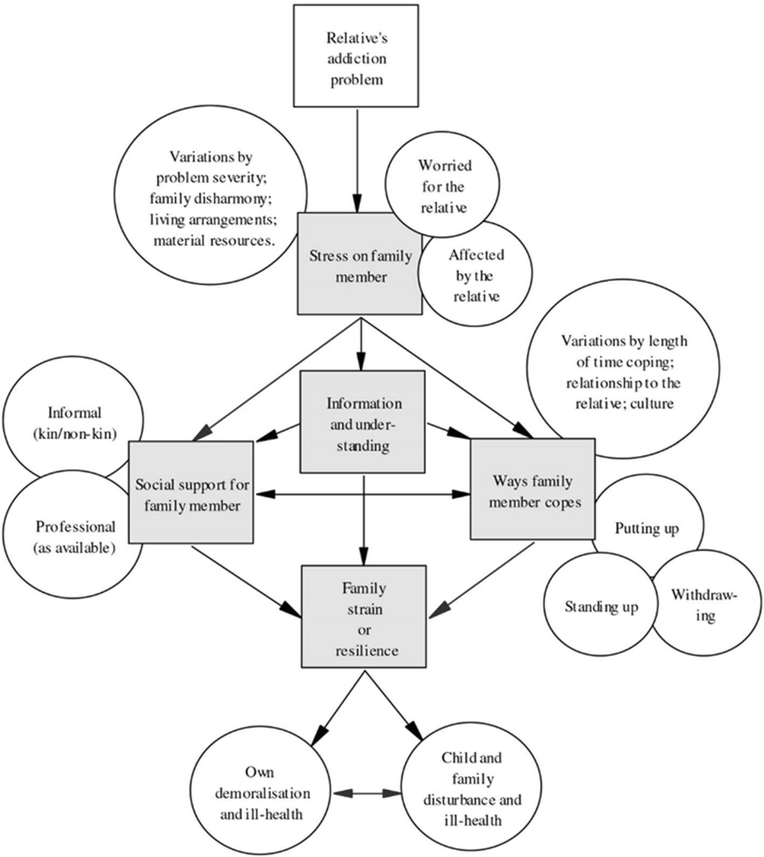
Step 1
Step 2
Identify relevant and targeted information
Step 3
Explore ways of coping and responding
Step 4
Explore and enhance support and communication
Review previous steps and explore further needs
Family member story – listen, reassure and explore concerns
Step 5
(Orford et al., 2013, cited in van Namen et al., 2022)
Notes:
The stress of a relative's substance misuse produces strain in the form of physical or psychological distress, which is moderated by the AFM's access to information, their coping response, and the quality of social support available to them. The 5SM operationalises these steps into a flexible intervention deliverable in one-to-one, group, or self-help formats, requiring no clinical background and is usable regardless of whether their relative is engaged in treatment.

Slide 5
Local project
As part of a pilot project in 2025, 11 practitioners within one adult mental health directorate of the South London and Maudsley NHS Foundation Trust (SLaM) completed training in 5SM. Within a six-month period, 6 of these practitioners had delivered 5SM to 1 or more AFMs.
Since this training cohort, other clinicians in other directorates have been trained and some have since delivered the 5SM in practice.
There is an ongoing project looking at outcomes using the Family Member Questionnaire (FMQ), however this presentation will focus on a project concerning 5SM practitioner experiences, including those who have and haven’t yet delivered the intervention in practice.
Semi-structured interviews were conducted with 12 trained clinicians, half of which had not yet delivered the intervention. This was analysed using reflexive thematic analysis, with 5 emergent themes.
Notes:
The training consisted of multiple components, including pre-reading, online webinar and an in-person skills practice session.

Slide 6
Conceptual Thematic Map
The 5SM in different hands
Built for one population,
not another
Seen through
a Western lens
IMPLEMENTING &
SUSTAINING 5SM PRACTICE
Conjuring AFMs
into the room
Building conditions
for the model to last
Notes:
The themes collectively illustrate how implementation and sustainability of 5SM are shaped by practitioner experiences, AFM population fit, and cultural applicability. Engagement of affected family members (AFMs) emerged as a key implementation challenge, while long-term sustainability depended on organisational capacity and embedding of the model within routine practice.

Slide 7
Theme 1: The 5SM in Different Hands
The training was experienced positively, but its effects proved short-lived within months in cases where there was a gap before delivering the 5SM. This was minimised by access to regular supervision and coaching input.
Clinicians also engaged with the same 5-step structure differently, some valuing it as a helpful scaffolding, whereas others experienced its brevity as constraining deeper therapeutic work.
They also described how the model broadened their thinking, for example, to the experiences of AFMs and ways the framework (e.g., coping responses) could apply outside of substance use.

Slide 8
Theme 2: Built for One Population, Not Another
Clinicians reported that the model, designed for substance use alone, repeatedly met a caseload it was not built for.
  They were required to attend to substance use and varied psychiatric symptoms together, rather than treating the former in isolation.
  This was particularly felt at Step 2 (Information).
  Clinicians described being left to draw on supervision and preparation well beyond what the 5SM provides.
Attendance patterns, particularly for 5SM groups, also posed the same issues around how best to adapt the model within the different service contexts.

Slide 9
Theme 3: Seen Through a Western Lens
Clinicians' experience of interpreter-mediated delivery diverged, some finding it facilitated good rapport, others feeling AFMs engaged less fully than an English-speaking client would, even with the support of a skilled interpreter.
Clinicians drew attention to the model's cultural positioning despite its cross-cultural research grounding and named gaps in their own cultural understanding that further training had not closed.
  AFM feedback that the coping responses appeared to be drawn from a Western framework was also cited.

Slide 10
Theme 4: Conjuring AFMs into the Room
AFMs frequently declined support, yet substantial need surfaced beneath this refusal e.g.,
  calls to tell them about 5SM “bec[a]me almost like its own sort of therapy session, because these individuals have not had anyone to speak to them for a really long time”.
Organisational factors compounded this unmet need, such as the absence of a dedicated carer section in patient records and 9am-5pm operational hours.
This was compensated by practitioners, often at personal cost, in an organisational context where the needs of patients were often prioritised over AFMs.

Slide 11
Theme 5: Building Conditions for the Model to Last
Caseload and time pressure were prominent across the sample, with half not delivering the 5SM, reflective of workforce factors, such as staff changes and dependency on a small cohort of clinicians, more than scepticism about the model itself.
Clinicians absorbed more of this fragility personally than expected, particularly through independent awareness-raising, outreach and at times, working outside of core operational business hours.
The absence of a training pipeline within the organisation was highlighted as a barrier to growing the practice.

Slide 12
Next steps
Raising awareness of 5SM use at the most senior levels.
Training more 5SM facilitators, but with the caution that coaching, protected time and other organisational levers are needed.
  As part of this, attention is being paid to developing more trained facilitators into accredited practitioners.
Building on FMQ data collection.
Learning new ways of adapting the 5SM to mental health service contexts.
  e.g., building on unpublished local work that included both practitioner and carer perspectives (Viswanathan et al., 2025), interviewing AFMs about their experiences of 5SM interventions.
Notes:
The findings show that 5SM has reached mental health clinicians through training, but it is not sufficient on its own to build the organisational structures necessary to sustain the practice.

