Slide 1


Child Protection Responses to Alcohol-Related Domestic Violence in Lithuania: Assessing
Children's Safety and Support Needs
Ilona Tamutienė
Vytautas Magnus University
Lithuania
The 7th annual AFINet conference (Online)
September 15-16, 2026

Slide 2

Acknowledgment
• Alcohol industry actor review: Nothing to declare.
• This presentation is based on research funded by the Research Council of Lithuania (PROVICA, S-MIP-25-88).

Slide 3

Problem and theoretical approach
Parental alcohol misuse is linked to:
domestic violence,
child maltreatment,
cumulative child harm.(Leung et al., 2025; Mendonca & Patel, 2025; Chmiel & Kurpas, 2025; Nehring;Hokins et al, 2024)
Street-Level Bureaucracy Perspective
Frontline professionals work within:
legal regulations,
organizational procedures,
assessment templates,
documentation systems.
Assessment tools are not neutral.
They structure professional discretion, institutional responses, and practical policy outcomes. (Lipsky, 2010; Vikander, Strand, 2025; Evans & Hupe, 2020; Barfoed, 2019)
Assessment systems may render cumulative alcohol-related harm institutionally invisible by focusing on:
isolated incidents,
immediate intoxication,
and functional parenting.

Slide 4
Research Aim and Method
Research object
Assessment tools and procedural forms and practices used by child protection specialists (CPSs).
Methods
Document analysis
Risk assessment forms and practical guidelines used by child protection specialists.
Semi-structured interviews
Interviews with 14 child protection specialists responsible for assessing children’s situations and safety (January–March 2026).
Data analysis
Directed content analysis (Hsieh & Shannon, 2005) applied to both documents and interview data.
Research focus
Do current frameworks structurally recognize harmful alcohol use, domestic violence, recurrence, cumulative harm to children?
Aim
To examine how alcohol-related domestic violence involving children is framed through everyday assessment tools and practices

Slide 5
POLICE response to DV report in Lithuania
Close the case
Initiate a pre-trial investigation
Evaluate DV risk only
Child safety screening
If one or both parents are intoxicated:
treated as immediate danger to the child safety
CPS notified immediately
DV risk evaluation
Using a structured assessment tool
Emergency protection order initiated (15-day duration)
Detailed child situation assessment transferred to CPS
Information on adult victims transferred to the Specialized Complex Assistance Centre for support services
Alcohol intoxication assessed using a breathalyzer or through referral to healthcare
Regulations do not define intoxication thresholds

Slide 6
Child Protection response to police notifiactions about alcohol related DV cases
Emergency response:
child safety ensured within 1 hour
child situation assessed within 3 days
Child situation assessment (during 15 days)
referral for service needs assessment
child protection intervention/measures
Temporary placement commonly used when one or both parents are intoxicated.
Parental intoxication accounted for 66% of cases requiring a safe environment for the child in 2024.
After 3 days, or sooner, the child may be returned once the parents are not-intoxicated, as this is considered a “change in circumstances.”
Repeated temporary placements have no defined threshold for escalation.
Decisions largely depend on CPS specialist discretion

Slide 7
Child Situation Assessment:
Risk and Protective Factors Balance Framework
Through the assessments of the child situation assessment, street-level bureaucrats become gatekeepers to the services.
They also determine when and what protective measures are needed to ensure the child’s safety.

Slide 9

Risk Factors Related to the Child’s Social Environment
Parents experiencing difficulties in meeting the child’s needs, but recognizing the situation and being open to support
Violence or other violations of the child’s rights by persons other than the child’s legal representatives
Risk Factors Related to Child Functioning
Current assessment indicators include:
Persistent school absence
Running away from home
Aggressive or harmful behaviour
Child’s alcohol/substance use or signs of addiction

Slide 10
Risk Factors Related to Parents / Legal Representatives
Repeatedly avoids contact with education professionals or mandatory child health check-ups.
Does not seek to help the child or is unable to manage situations that pose a threat to the child.
Alcohol intoxication, harmful substance use or addiction.
Leaves the child without appropriate supervision or care.
Health problems limit the ability to care for the child and require assistance.
Negative relationship with the child.
Insufficient knowledge and parenting skills to adequately meet the child’s developmental needs.
Ongoing divorce or separation
Other possible violations of the child’s rights and interests.
One of the child’s parents is a minor.

Slide 11
The CPS must assess whether the identified risk factors are outweighed by protective factors
:
Risk and protective factors must be assessed separately for each parent
Protective factors:
Parent recognizes the situation and takes action to change it.
Risk factors concern only one parent, while the other parent is considered able to ensure the child’s safety.
Identified risks are not directly related to parental actions or omissions.
Other factors may reduce the impact of identified risks.
“Functional child” and one “functional” parent may lead to the child no longer being treated as at risk.
One “functional” parent may neutralize identified risks
Case closure may follow despite ongoing alcohol-related DV dynamics

Slide 12
What Is Missing from the Risk Assessment Framework?
Recurrence and escalation
Repeated police notifications
Domestic violence protection orders
Repeated DV incidents
Escalation over time
Alcohol-related risk over time
Cyclical harmful alcohol use
Relapse
Links between alcohol and repeated violence
Chronic unpredictability in the child’s life
Cumulative harm to the child
Repeated exposure to violence
Fear and emotional insecurity
Accumulating traumatic experiences
The child’s longitudinal risk trajectory
With broad professional discretion, their recognition depends largely on whether the individual specialist identifies and substantiates them.

Slide 13
CPS voices:
Protective factors transform the risk, even though the police have identified it and issued a domestic violence protection order against the person posing the risk.
Researcher: Well, what are the protective factors that could outweigh the risk posed by one person heavily drinking in the family?
CPS: A non-intoxicated mother or a non-intoxicated father.[CPS 3]
,,If the mother is capable and able to look after her child and ensure the child’s safety, then the case can be closed.”[CPS 5]

Slide 14
Repeated exposure to alcohol-related harm may becomes normalized:
“Children in those drinking families get used to it by adolescence. For them, the police and child protection services are nothing new anymore.” [CPS 4]
Verbal conflicts are frequently perceived as lower-risk situations:
,,Most often these were just verbal conflicts.”[CPS 2];
,,But in many cases, there isn’t even a hint of violence against a child .”[CPS 5]
“Well, I think we’re heading in that direction [recognition of cumulatative harm], but as for the tools, the specific tools needed for that...”[CPS 8]

Slide 15
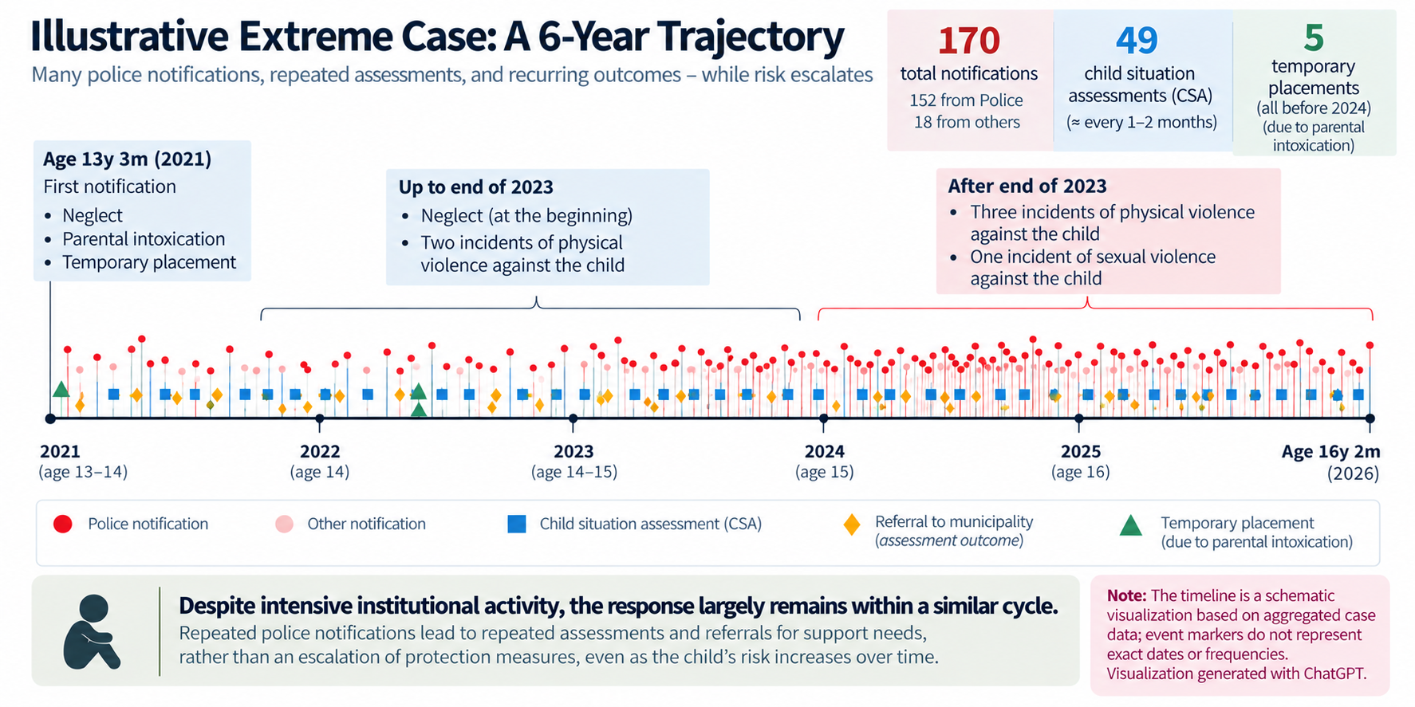

Slide 16
Conclusions
Alcohol intoxication is treated as an acute emergency rather than a chronic child safety risk
Harm caused by parental alcohol use and domestic violence itself remains insufficiently recognized and assessed.
Institutional logic may redefine chronic alcohol-related violence as “non-harmful” when minimum family functionality is preserved.
Absence of recurrence thresholds creates conditions for cumulative harm to remain invisible

Slide 17
Recomentations
Practice and assessment
Assessment tools should help CPSs recognize and substantiate cumulative risk, so that repeated incidents are assessed as part of the child’s longitudinal risk trajectory – not only through the “here and now” balance of risk and protective factors.
2. Future research
Future research should focus on institutional responses to cumulative harm, tools that support professionals in identifying and substantiating such harm, and the effectiveness of services in mitigating its impact on children.

Slide 18

Thank you for your attention.
Questions and discussion are welcome
ilona.tamutiene@vdu.lt

