Slide 1
Online Community Reinforcement and Family Training for concerned significant others in rural Australia:
A qualitative study
Heidi Gray, Nicole Snowdon, Nicola Ivory, Matt Thomas and Julaine Allan
Notes:
Hi everyone, my name is Heidi and I’m currently a PhD candidate at the Rural Health Research Institute at Charles Sturt University in Australia. I am going to be sharing with you the results from a qualitative study exploring participants experiences of Community Reinforcement and Family Training

Slide 2

Outline
Background information
Our project
Interview results
Notes:
In this session I’ll go through some background information about support for rural Australians and Community Reinforcement and Family Training, I’ll then share how our project was run, and then the results from interviews which were conducted with participants from the project

Slide 3

Terminology
CSO (Concerned Significant Other) = family member or friend seeking help
IP (Identified person) = the person experiencing substance use problems
Notes:
Before we begin, some terminology to get started

Slide 4

Concerned significant others
01
Substance use can greatly impact CSOs physical and mental health 11
Families with someone using substances tend to have higher rates of mental health distress 3, 4
02
Providing support to CSOs benefits their wellbeing AND reduce IP use of substances and increase willingness to enter treatment1, 5, 6
03
04
Few substance use services provide support to CSOs 2
Rural Australians face additional barriers to accessing substance use support, with most services located in major cities 2
05
Notes:
So what are some key points about substance use in Australia?
An individual’s use of substances can greatly impact CSOs physical and mental health, financial circumstances, and marital and family relationships.
Providing support to CSOs benefits their own wellbeing but also reduce Identified persons use of substances and increase their willingness to enter a treatment program
Few substance use services provide support to CSOs. In 2022, only 8.1% of Australians receiving treatment or support for substance use were family or friends.
Rural Australians face additional barriers, the first of these being Lack of services throughout rural Australia. The geographical distance between these limited services can mean significantly large travel distances, which is also compounded by the Lack of private or public transport in rural Australia. Finally, living in a small community can reduce anonymity and confidentiality

Slide 5
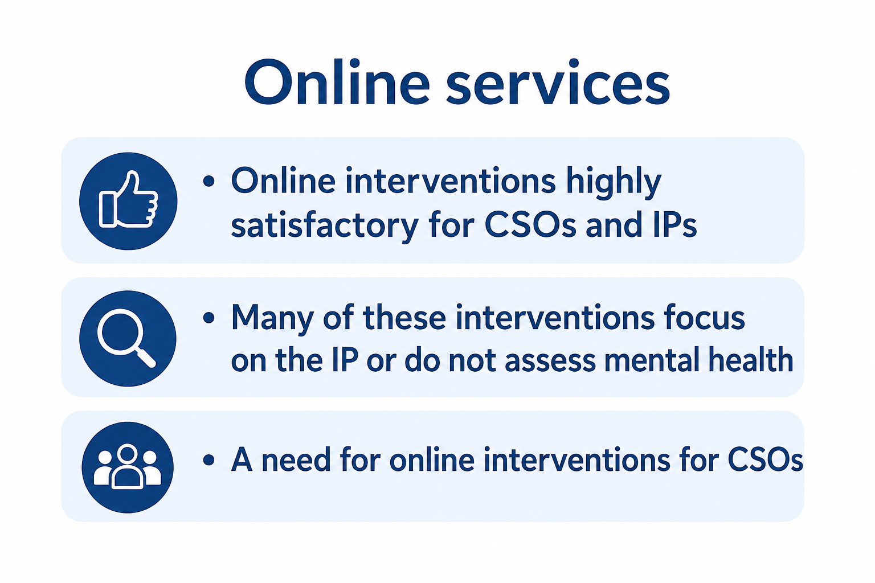
Notes:
However, Online services may help improve healthcare access for rural Australians. Online interventions for substance use have been shown to be highly satisfactory for both CSOs and individuals using substances. However, many of these interventions focus on the IP or do not specifically assess the mental health outcomes of the CSO Despite the growing evidence supporting online interventions, there remains a need for online interventions specifically designed to support CSOs and address their unique concerns.

Slide 6

Community Reinforcement and Family Training
CRAFT
Notes:
One intervention designed to support family and friends of someone with a substance use problem is Community Reinforcement and Family Training or CRAFT.

Slide 7

CRAFT
01
Grounded in Cognitive Behavioural Therapy and Motivational Interviewing 10
Teaches safe removal of positive reinforcement for problematic substance-using behaviours while increasing positive reinforcement for non-using behaviours 10
02
03
Aims: to increase CSO social and emotional wellbeing 13 and encourage the IP to enter AOD treatment 12
04
Studies show CRAFT improves CSO wellbeing ₁₃ and is associated with increased IP engagement with AOD services ₁₂
05
Could an online/telehealth version of CRAFT support rural Australian CSOs?
Notes:
1) Utilises techniques from Cognitive Behavioural Therapy (CBT) and Motivational Interviewing (MI)
2) Teaches Safe removal of positive reinforcement for problematic substance use behaviours while Increasing positive reinforcement for non-using behaviours
3) Aims to increase the family members’ own social and emotional well-being and Positively encourages their relative to use health and substance treatment services.
4) Several studies across America and Europe have demonstrated cross-cultural effectiveness
5) So could an online version of CRAFT support rural Australian CSOs? And that leads us into the research questions for this project

Slide 8
Research questions
Is Community Reinforcement and Family Training an effective support service for concerned significant others of people using substances?
What are the experiences of CSOs in accessing Community Reinforcement and Family Training?
Notes:
We had two research questions for this project. The first research question “Is Community Reinforcement and Family Training an effective support service for concerned significant others of people using substances?” used a randomized controlled trial to measure the changes in psychological wellbeing and coping style of the concerned significant other due to their accessing online CRAFT. The second question “What are the experiences of CSOs in accessing Community Reinforcement and Family Training?” is what I am focusing on today.

Slide 9

Sample Population
Study participants were self-selected people with a relative or friend who has a substance problem.
Inclusion:
Family member/s of someone with substance dependence and a mental illness
Speaks English
Over 18 years of age
Is able and willing to attend FEP sessions
Is able to provide informed consent
Having at least one contact/day on four days over the past month (in-person or electronic) with the Identified Person (IP)
Access to a computer with internet or mobile phone with video conferencing capabilities
Living in regional Australia (MMM2-MMM7)
Exclusion:
Domestic and family violence from the person with substance dependence to the family
member
Current participation in other family support/therapy programs
Notes:
Study participants in our RCT were self-selected people who perceived their relative or friend to have a substance problem.
Here is the inclusion/exclusion criteria. Have a read over
Participants needed to live in rural Australia
Participants couldn’t be involved if there was a history of domestic violence with the person using substances , due to CRAFT encouraging changing of behaviours and the impact that can have on DV
After participants completed the RCT, I then contacted participants via email or SMS to invite them to take part in an interview exploring their experiences of caring for someone using substances and their engagement with the CRAFT intervention. I used purposive sampling to ensure a diverse range of perspectives, including participants from both the intervention and waitlist groups, program completers and non-completers, and those who received CRAFT from different practitioners. In total, 55 individuals were invited to participate; 26 participants completed interviews, four did not attend, and the remainder either declined participation or did not respond. Interviews were scheduled at participants’ convenience via Zoom.

Slide 10
CRAFT session outline
Session # | Session summary
1 | Introductions, program overview, participants share their story, completion of happiness scale, and goal-setting exercise
2 | Review participants performance on practice task set in the first session, introduce and practice positive communication, plan first milestone conversation
3 | Review first milestone conversation, conduct functional analysis of the IPs substance use, and plan second milestone conversation
4 | Review second milestone conversation, complete functional analysis of the IPs healthy behaviours, discuss time out from positive reinforcement, and plan practice task for the week
5 | Review planned activity from previous session, introduce and practice the problem-solving procedure, discuss how to allow for the natural consequences of substance use, and plan third milestone conversation
6 | Review third milestone conversation, discuss encouraging IP into substance treatment, and conduct program review
Notes:
The intervention offered participants six 60-min sessions delivered over a 6 week period. Due to time, I won’t go over the sessions however you can see that Practitioners followed a specific program, which was called the Family Empowerment Program Brief Facilitator Guide. This was adapted from the original CRAFT materials and created by Prof Julaine Allan, who is an accredited CRAFT therapist, supervisor, and trainer.

Slide 11
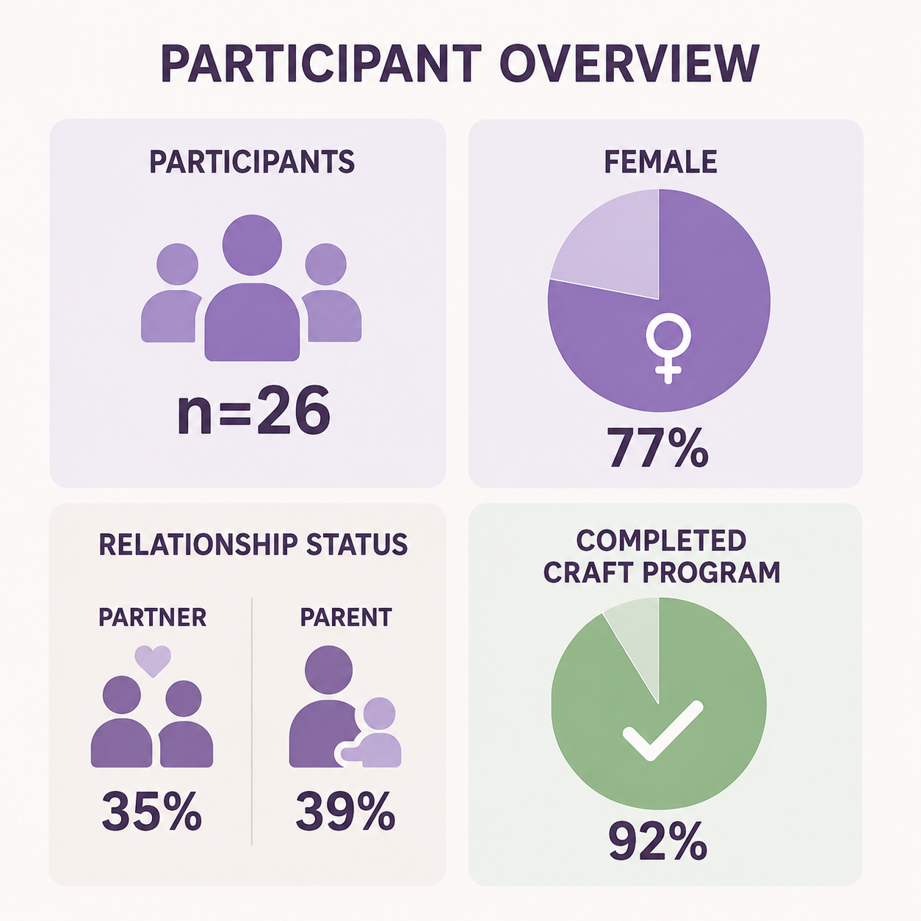
Participants
Notes:
Interview participants
Most participants identified as female, White/Caucasian and were the parents or partners of the person using substances, with ages ranging from 25 to 67 years . 92% of this group had completed the CRAFT program

Slide 12
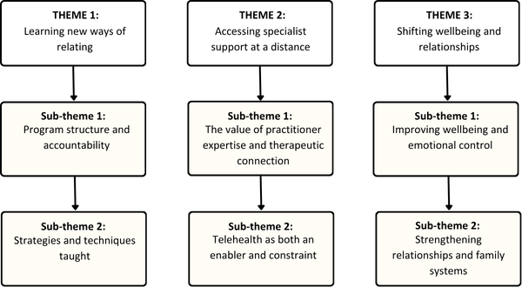
Notes:
From these interviews, three themes of how change occurs through online CRAFT were identified:
Learning new ways of relating: Highlighted how participants valued the structured, but flexible format, homework tasks and practical techniques. The practical techniques considered particularly important included communication strategies, role plays, boundary setting, positive reinforcement, and strategies related to mental health and self‑care
Accessing specialist support at a distance: Participants emphasised the importance of CRAFT being delivered by trained professionals. participants also noted that accessibility shaped both their ability to participate and the extent to which the program’s strategies were usable in their daily lives. Many participants described telehealth as a central factor enabling them to access the program,
Shifting wellbeing and relationships: encompassed the changes experienced by CSOs from participating in the CRAFT program. Across interviews, most participants reported noticeable improvements in their emotional wellbeing, including reduced anxiety, feeling less triggered by the IP’s substance use, and greater ability to regulate their emotions and reactions. Participants commonly described positive shifts in the quality of their interactions with their loved one. Many reported that conversations became calmer, more constructive, and more open. several CSOs noticed positive changes in the IP’s behaviour. These included adjustments to rules around substance use, reductions in use, more receptive responses during conversations about substance use,. Participants also saw improvements in the IP’s physical or mental health.

Slide 13
Community Reinforcement and Family Training (CRAFT) in rural Australia: A qualitative study
“They were really good techniques for negotiating…I just learnt some techniques around framing it” (P6)
“Having someone that's outside of your circle to even talk to and know that you can tell them everything and not be judged.” (P22)
“The drinking has really reduced… he went out and got a day job” (P26)
“We understand it more now, what he’s going through.” (P10)
Notes:
Here are some quotes that show what some of the participants felt after being involved in the CRAFT program
Read quotes:
The first quote looks at the strategies taught in the program: They were really good techniques for negotiating…I just learnt some techniques around framing it
The second quote shows the importance of professional support: Having someone that's outside of your circle to even talk to and know that you can tell them everything and not be judged
The third quote shows the changes the CSOs went through in understanding their loved one: We understand it more now, what he’s going through
And the fourth quote demonstrates the changes in the identified person: The drinking has really reduced… he went out and got a day job
Our findings from this project highlighted the value of practitioner‑led CRAFT that emphasises core therapeutic components while allowing flexibility to support rural CSOs in translating skills into everyday practice.
These findings extend the limited qualitative evidence on CRAFT and highlight the potential of practitioner-led telehealth interventions to address gaps in family-focused substance use support in rural communities.

Slide 14
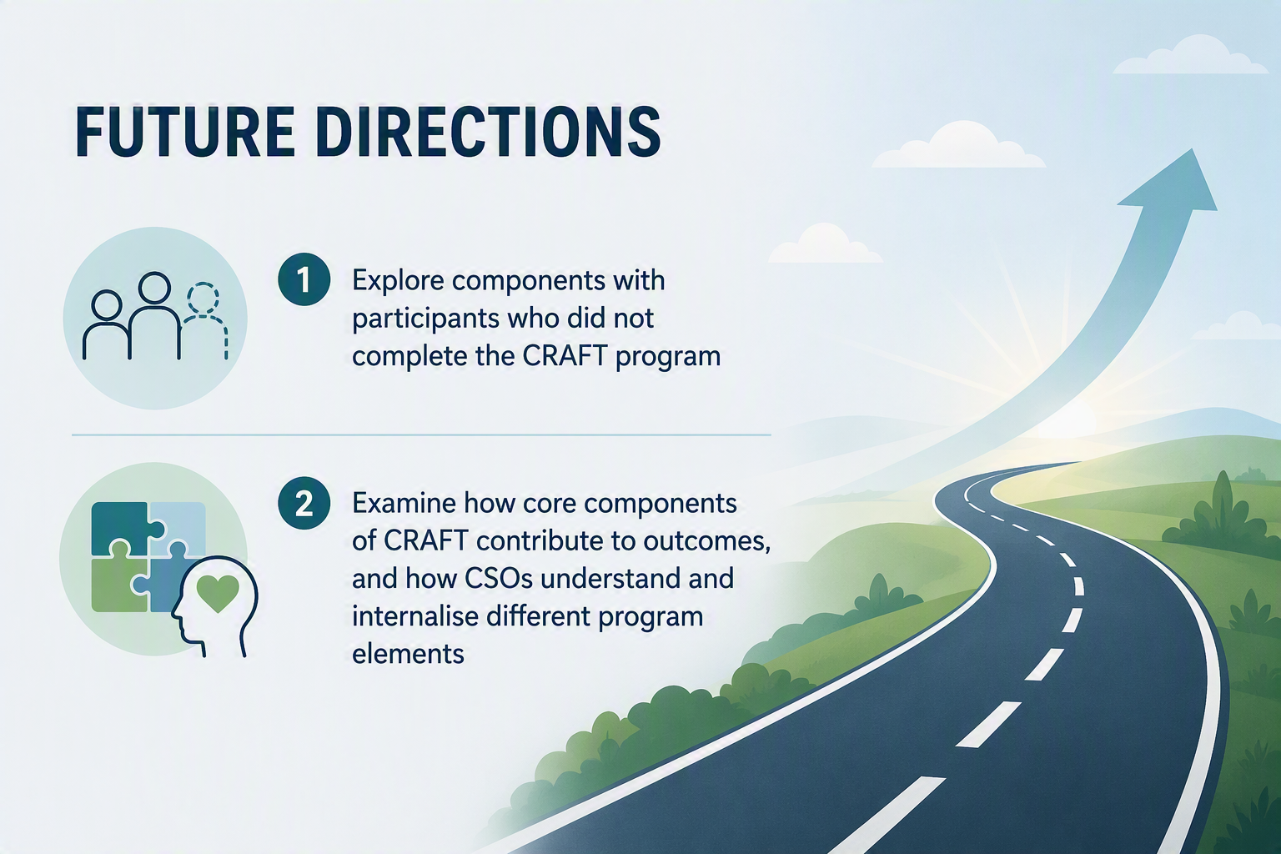
Notes:
So where could our research go next?
While efforts were made to include a broad range of participants, including both those who completed the program and those who did not complete it, very few of the latter agreed to participate in an interview. As a result, their perspectives are underrepresented, limiting our ability to understand whether specific aspects of the CRAFT program contributed to disengagement or could be improved to support sustained participation.
Future research could also examine how core components of CRAFT contribute to outcomes, and how CSOs understand and internalise different program elements, including whether some mechanisms of change operate implicitly rather than being consciously recognised by participants.

Slide 15
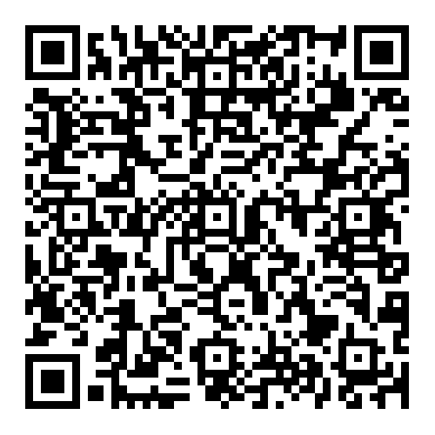
Questions?
@: hegray@csu.edu.au
Listen to our podcast or read more here
Notes:
Thankyou for listening, if you have any questions about the CRAFT project, you are welcome to contact me. This qr code takes you to our website that has more information. It also has a podcast we created last year in which 10 different people including some concerned significant others from the project, some of the practitioners, 2 other researchers and myself share about caring for someone who struggles with substance use and how CRAFT helped.

Slide 16
References
Ariss, T., & Fairbairn, C. E. (2020). The Effect of Significant Other Involvement in Treatment for Substance Use Disorders: A Meta-Analysis. Journal of consulting and clinical psychology, 88(6), 526-540. https://doi.org/10.1037/ccp0000495
Australian Institute of Health and Welfare. (2023). Alcohol and other drug treatment services in Australia annual report. https://www.aihw.gov.au/reports/alcohol-other-drug-treatment-services/alcohol-other-drug-treatment-services-australia/contents/treatment-types
Gandhi, R., Suthar, M., Pal, S., & Rathod, A. (2017). Anxiety and depression in spouses of males diagnosed with alcohol dependence: a comparative study. Archives of psychiatry and psychotherapy, 19(4), 51-56. https://doi.org/10.12740/APP/79459
Gohil, J., Patel, M., & Samani, M. (2016). Quality of Life and Psychiatric Morbidity in Caregiver of Alcohol Dependence Patients. IOSR Journal of Dental and Medical Sciences, 15, 98-101. https://doi.org/10.9790/0853-15080198101
Higgins, S. T., Budney, A. J., Bickel, W. K., & Badger, G. J. (1994). Participation of Significant Others in Outpatient Behavioral Treatment Predicts Greater Cocaine Abstinence. The American journal of drug and alcohol abuse, 20(1), 47-56. https://doi.org/10.3109/00952999409084056
Kelly, S. M., O'Grady, K. E., Schwartz, R. P., Peterson, J. A., Wilson, M. E., & Brown, B. S. (2010). The relationship of social support to treatment entry and engagement: the Community Assessment Inventory. Subst Abus, 31(1), 43-52. https://doi.org/10.1080/08897070903442640
Lawrinson, P., Copeland, J., & Indig, D. (2006). Regional differences in injecting practices and other substance use-related behaviour among entrants into opioid maintenance pharmacotherapy treatment in New South Wales, Australia. Drug and Alcohol Dependence, 82(supp 1), S95-S102. https://doi.org/10.1016/S0376-8716(06)80015-3
McCann, T. V., & Lubman, D. I. (2018). Help-seeking barriers and facilitators for affected family members of a relative with alcohol and other drug misuse: A qualitative study. Journal of Substance Abuse Treatment, 93, 7-14. https://doi.org/10.1016/j.jsat.2018.07.005
Meyers, R. J., & Godley, M. D. (2001). Developing the community reinforcement approach. In Robert J. Meyers & William R. Miller (Eds.), A community reinforcement approach to addiction treatment (pp. 1-7). Cambridge University Press.
Meyers, R. J., Miller, W. R., Hill, D. E., & Tonigan, J. S. (1998). Community reinforcement and family training (CRAFT): engaging unmotivated drug users in treatment. Journal of substance abuse, 10(3), 291-308. https://doi.org/https://doi.org/10.1016/S0899-3289(99)00003-6
Orford, J., Natera, G., Copello, A., Atkinson, C., Mora, J., Velleman, R., Crundall, I., Tiburcio, M., Templeton, L., & Walley, G. (2005). Coping with Alcohol and Drug Problems: The Experiences of Family Members in Three Contrasting Cultures (1 ed.). Routledge. https://doi.org/10.4324/9780203759608
Roozen, H. G., De Waart, R., & Van Der Kroft, P. (2010). Community reinforcement and family training: an effective option to engage treatment-resistant substance-abusing individuals in treatment. Addiction (Abingdon, England), 105(10), 1729-1738. https://doi.org/10.1111/j.1360-0443.2010.03016.x
Smith, J. E., & Meyers, R. J. (2004). Motivating substance abusers to enter treatment: Working with family members. The Guilford Press. https://books.google.com.au/books?hl=en&lr=&id=qR_8jr5-kt4C&oi=fnd&pg=PA1&ots=KOTXXojleV&sig=pKV-c7YnpgVYPjjPSX4kW8Oh2ls&redir_esc=y#v=onepage&q&f=false
Thorn H, Olley R. Barriers and facilitators to accessing medical services in rural and remote Australia: A systematic review. Asia Pacific journal of health management. 2023;18(1):20-9.

