Slide 1

Experiences and perspectives of American
Indian affected family members impacted by a relative’s substance use
Fiona Grubin, MSPH, PhD Candidate, Indigenous & Rural Health Program, Montana State University
Co-authors: Paula FireMoon¹, Courage Crawford², Olivia Johnson¹, Jessica Alden¹, Ashley Solheim-Azure¹, & Monica C. Skewes³
¹ Fort Peck Community College ² Spotted Bull Recovery Resource Center ³ Department of Psychology, Montana State University

Slide 2
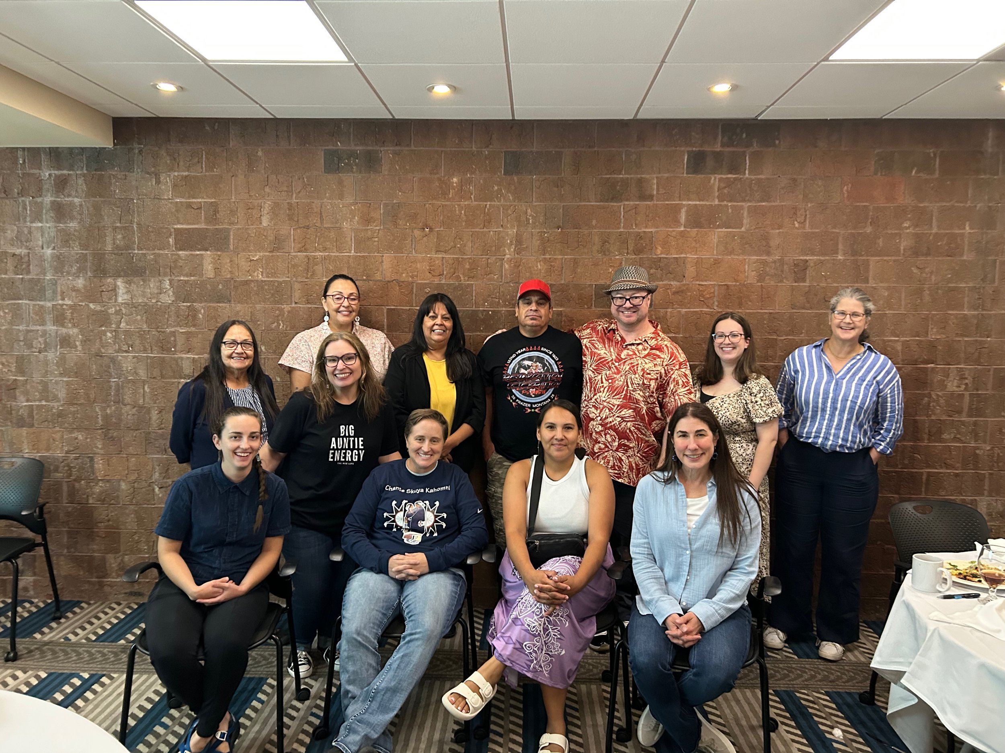
The researchers
Collaborative, community-based participatory research (CBPR) team
Established 2014
PI: Dr. Monica Skewes
Focus on substance use

Slide 3

The community
Rural, frontier community in the Northern Plains & prairie
American Indian reservation

Slide 4
The data
In-depth interviews collected 2015-2016
Generated as a first step in CBPR partnership
  Goal: Explore and understand community experiences and perspectives related to substance use, build relationships
25 participants
  Tribal members
  13 men, 12 women
  Mean age = 51.68 years; range 28-79
  Selected purposively for ability to speak about substance use
Original study & this secondary analysis approved by Tribes’ Institutional Review Board

Slide 5
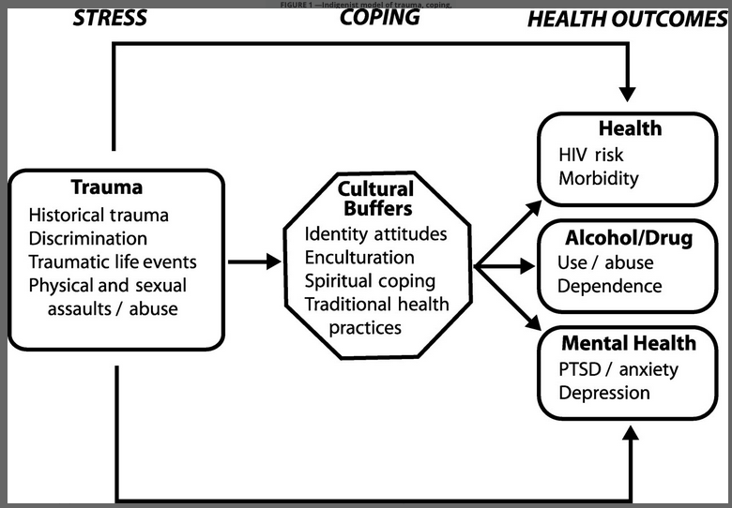
The analysis
Research question: What are the experiences and perspectives of American Indian affected family members who are impacted by the substance use of a loved one?
Reflexive thematic analysis
  Constructivist research paradigm
  Experiential orientation
  Primarily inductive coding, mix of semantic & latent codes
  Informed by 6+ years of engaging in CBPR with American Indian Nations across U.S., understanding role of colonization and historical trauma
  Community advisory board (CAB) meeting
Walters & Simoni (2002)

Slide 6
The results
Three themes describing AFMs’ affective experience
Substance use tears families apart
Pervasive, compounding experiences of pain and loss
“It’s like living with his dark cloud over me”
One theme describing the need for AFM support
“What about us?”
CAB emphasized:
Importance of understanding link between trauma + substance use
Centrality and importance of family
Context of colonization & historical trauma, especially boarding school

Slide 7
Theme: Substance use tears families apart
“Most of my cousins and their children, it’s affecting their lives because the alcohol, they drink so much. … I think it just builds up down into the next generation.” (P17)
Shifts household structure, roles, responsibilities
Children removed from homes are torn from family
Changes family relationships, creates discord and hurt
Moves across generations
“It impacts and affects the whole family. If there’s one, everyone’s hurt. Because we’re all the same blood. We’re all inter-related. We’re all related.” (P8)
“My aunt … she raised 5 of her grandchildren, her daughter’s kids. Her daughter went into drugs, so she left these 5 young boys with my aunt. My aunt raised them and all graduated from high school.” (P14)
“Alcohol causes family break ups, divorcing, causes people stabbing each other, shooting each other, beating each other up.” (P18)

Slide 8
Theme: Substance use tears families apart
Healing from substance use helps restore family bonds
“The definition of wealth in our capitalist society is when your assets outweigh your liabilities. Then coming back to the reservation, my assets are my family. And I have many number of family members, and that’s my value set, is my relationship to my family, how I can participate in my family to give what I can to help improve their lives. That’s what makes me whole. That’s what makes me well. That’s what makes me healthy. … I undermine that by utilizing substances.” (P13)

Slide 9
Theme: Pervasive, compounding experiences of pain and loss
“Understanding how many funerals and deaths that we have here. Whether it’s sickness through diabetes, whether it’s through drugs or alcohol, whether it’s through … you know, whatever. That’s the mentality that we live with.” (P8)
Impacts of a family member’s substance use are added to a collective web of historical and intergenerational trauma
Actual loss
Ambiguous loss
“Sometimes I used to tell my brother, ‘You’re not my brother when you’re drunk, you know? When you’re sober, you’re my brother.’ I’d say that to him, ‘I got my brother back,’ whenever he’d sober up.” (P7)
“Three of my siblings passed away from excessive use of alcohol.” (P3)

Slide 10
Theme: “It’s like living with his dark cloud over me”
“Then when I hear like the ambulance, it’s like, ‘Oh man. I wonder where he’s at.’ ‘Oh good. I didn’t get a call.’ Yeah. So it’s like living with that like a dark cloud, his dark cloud over me waiting, you know. It’s like wow, I just hope he’s OK.” (P8)
Constant worry and concern affects every aspect of AFMs’ lives
Concern for relative
Fear of theft
Feelings of frustration, hopelessness
“If a person in your family is a drug addict or alcoholic, it seems like everything then becomes centered around them. You’re walking on eggshells, you’re trying to deal with that. It takes a lot of your time, so I just think it really stricken the family because you’re kind of helpless in a way too. You can’t really help them unless they help themselves. … And their problem also becomes your problem.” (P4)
“My mother is a victim of everybody stealing from her. … And I think they come around like when I’m not there, like maybe at work, but we have to keep the bedroom doors locked. But still, you can see indications on the door where they’ve broken in the doors. So I keep my valuables at work.” (P1)

Slide 11
Theme: “What about us?”
“I was sitting in this Meth Summit [community event] a couple weeks ago and there was a mother in that situation that you were asking about, we were so focused on the addicts, desperate almost, trying to get help for them, but the mother spoke out and she said, ‘What about us? We're tired, how are you going to help us?’” (P8)
AFMs need support, too
AFM support must be culturally relevant
Family is very important, and AFMs who are supported could play a greater role in their relative’s recovery and whole family healing
“In our culture, the families are really close. We have an extended family that’s very close. Your first cousins are like your brother and sister, and when you come back from treatment, or you’re trying to get better, it’s those family members that can also bring you down. … So in Indian culture, we’re so close with our families.” (P3)
“I think if people heard other people's stories they wouldn't feel so alone. Like they're the only ones dealing with that problem. Like that could help out a lot if they had that here. Families going to help support the person who is dealing with the problem so then they know what steps to take I guess... towards building a good strong home.” (P23)

Slide 12
Discussion
Results connect to previous work with Indigenous AFMs in Australia (Orford et al., 2001)
Worry as a core element of AFM experience
Family discord & violence
Large number of AFMs
Results connect to previous work with non-Indigenous AFMs
Family discord
Disruptions to daily life/caregiving responsibilities
Worry, concern, grief, hopelessness
Results highlight how AI AFM’s experiences are connected to a larger web of intergenerational trauma
Where substance use comes from and how it tears through generations of families
Results emphasize importance and power of family
AFMs need support, too
AFMs can play a role in their relative’s recovery + whole family healing

Slide 13

Future directions
More research is needed:
  To understand how AI AFMs are impacted in other domains of health (e.g., physical, spiritual)
  To understand how to provide culturally relevant support for AI AFMs

Slide 14

Thank you!
Contact: fiona.grubin@montana.edu

