Slide 1
Parental substance use: dynamics, parenting and associations with child educational outcomes
Dr Emily Lowthian for AFINet

Slide 2
INTRODUCTION
Research on parental substance use and children’s educational outcomes
Parental substance use dynamics
Associations with child educational outcomes
Exploring pathways through parental substance use and child educational outcomes

Slide 3
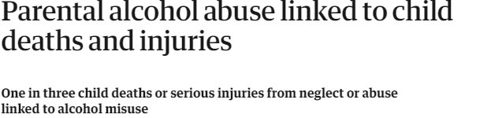
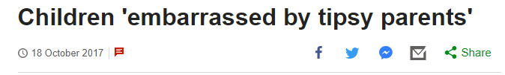
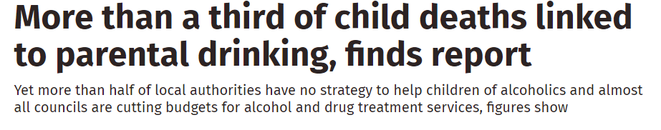
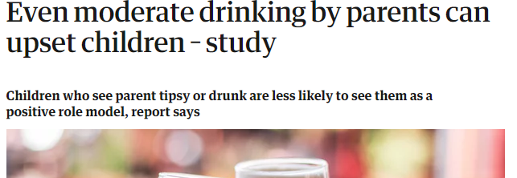
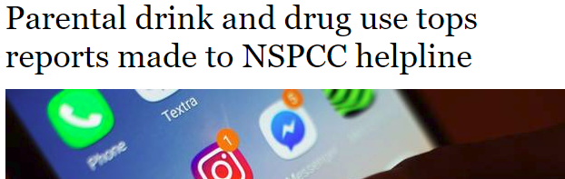
INTRODUCTION

Slide 4
REVIEW
Numerous papers showing impact on children from their parents or caregivers substance use
Notably Park and Schepp (2015), Velleman and Templeton (2016), and McGovern et al (2018)
Papers focused on areas where volume and quality of research was high
  Internalising and externalising symptoms
  Injury
  Substance use

Slide 5
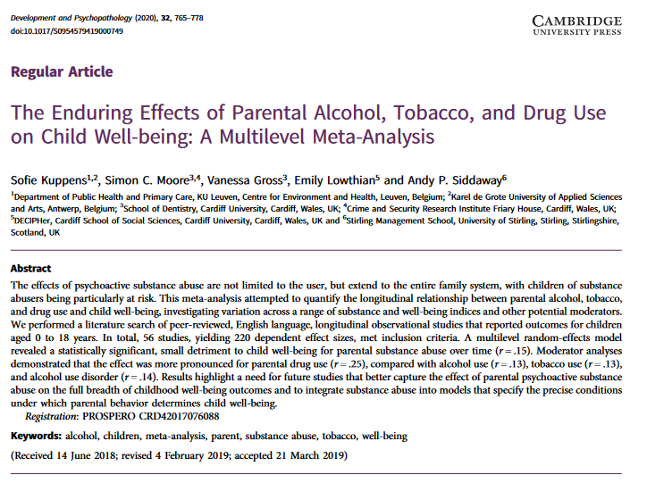
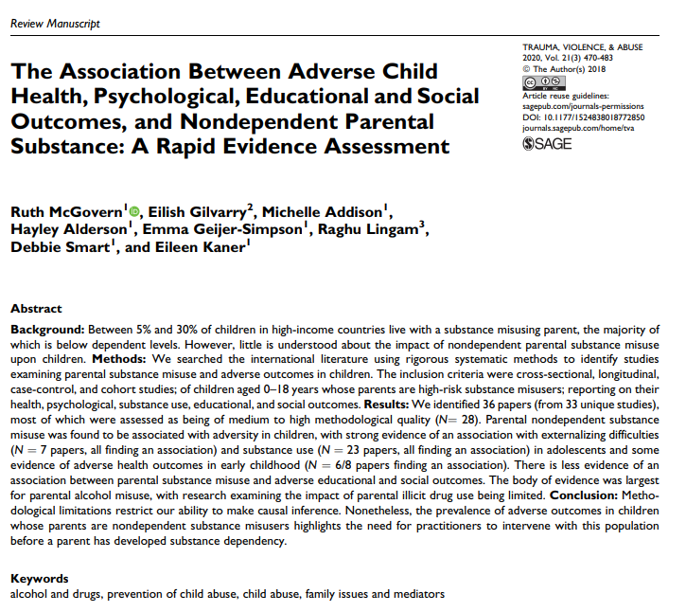
REVIEW
Reviews were often finding a low number of studies on educational outcomes
Note papers
  Kuppens et al. (2020)
  McGovern et al. (2021)

Slide 6
What research is out there?

Slide 7
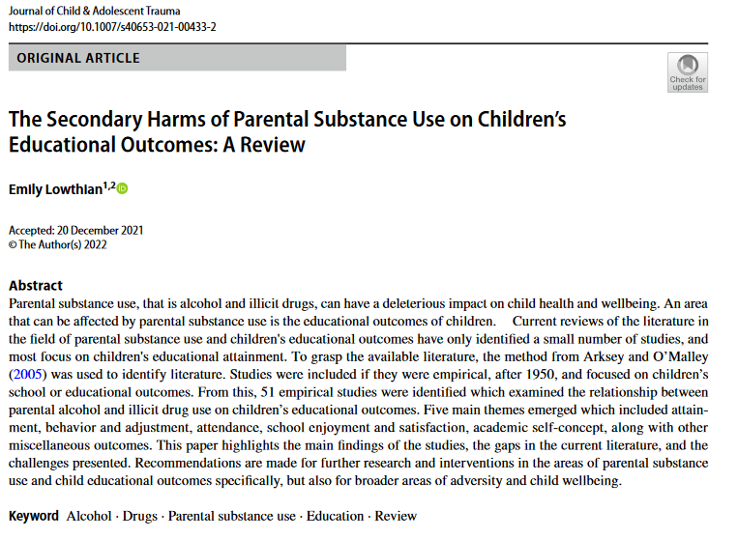
REVIEW

Slide 8
REVIEW
METHODS
Aimed to map and synthesise current literature
Identify gaps in the field
Summarise overall activity
Following Arksey and O’Malley (2005) guidance on scoping reviews
PROCEDURE
Literature from 1950 – 2018 was searched via Google Scholar
Key studies identified
Citations and references tracked – alerts used
Included recommendations
Charted data
Focused on educational or school outcomes only

Slide 9
51 studies
Excluding 8 reviews found

Slide 10
MAP OF STUDIES
Finland, Denmark, Sweden
Canada
Wales, Ireland
Russia
Slovenia
US
Spain
Greece
India
Brazil
Australia
NZ

Slide 11
THEMES
Attainment
Behaviour/Adjustment
School attendance
Academic self-concept
School satisfaction
Miscellaneous

Slide 12
THEMES
Attainment
Negative association found for most studies, including longitudinal. Economic distress partial mediator.
Behaviour
More likely to have conduct problems, exclusions, and suspensions. But other studies argued that the school provides routine.
Attendance
At greater risk for lower attendance, even in longitudinal studies. Maltreatment exacerbated absence.

Slide 13
THEMES
Academic self-concept
Children of parents who use substances less likely to rate themselves ‘above average’, ‘excellent’ or ‘good’.
School satisfaction
Most studies showed evidence for no differences in school satisfaction and enjoyment.
Miscellaneous
Lower homework competition, higher attendance of ‘special’ classes, more referrals to school psychologist. Schools are often aware of situations at home.

Slide 14
KEY GAPS
DRUG USE
Few studies considered parental drug use, most studies focused on alcohol, or poly-use
MEASUREMENT
Studies highly varied in their measurement of alcohol, e.g. dependent, problem etc. Hard to compare estimates
CONFOUNDERS
Some studies, often older, did not adequately adjust for confounders in research when testing relationships
MECHANISMS
Single study found exploring parent-child relationship as a mediator between substance use, personality and educational outcomes

Slide 15
So, how will I contribute to the knowledge gaps in this area?

Slide 16
ROADMAP
Crafting a theory by applying the socioecological model by Bronfenbrenner
Identifying the key parenting and family environment factors which are mechanisms
What data sources will provide useful measurements for this research?
1
3
5
2
4
6
How can I understand both alcohol and drug use by parents?
Considering the school, individual and socio-economic contexts
Need more than one source to actively contrast estimates to assess validity and replicability

Slide 17
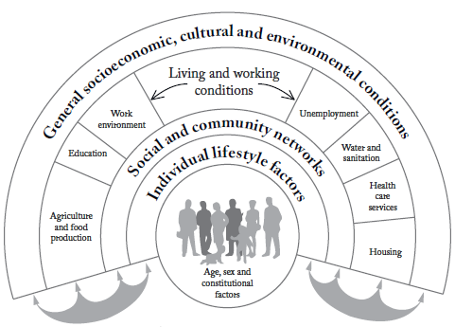
THEORY
1
Dahlgren and Whitehead (1993)

Slide 18


METHODS
Secondary analysis of two leading longitudinal cohort studies
The Avon Longitudinal Study of Parents and Children (ALSPAC), n=15,000
The Millennium Cohort Study (MCS) n=19,000
Cross-cohort analysis

Slide 19
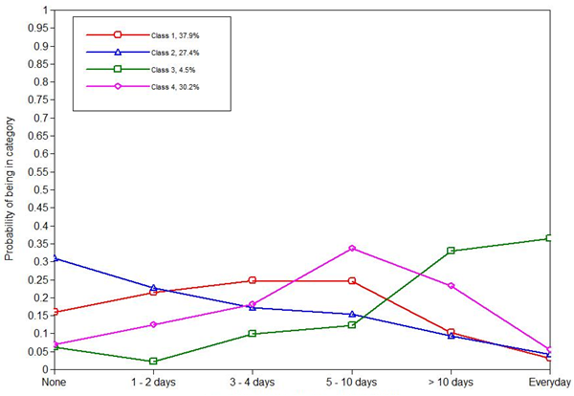
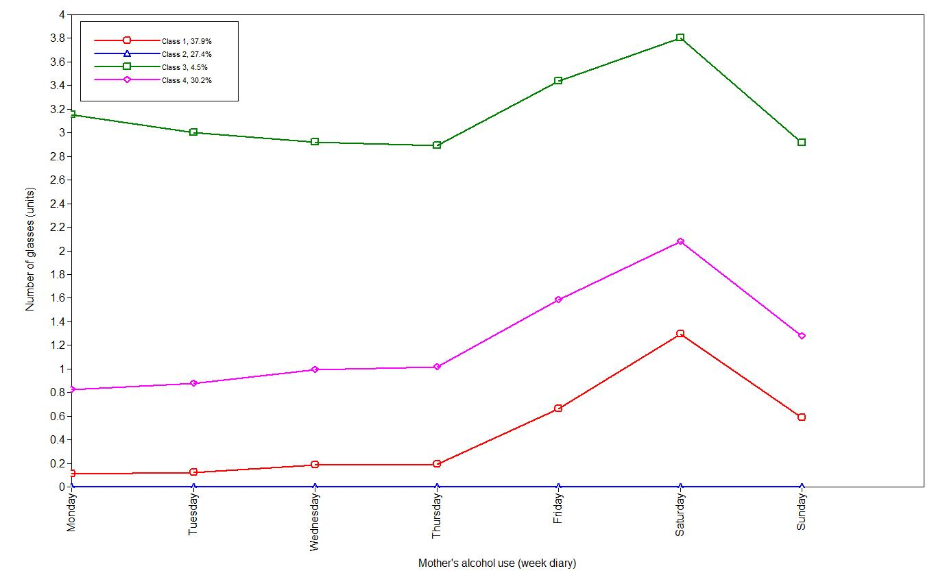
DYNAMICS IN SUBSTANCE USE
ALSPAC
2
Latent class analysis of parental substance use – mothers and their partners alcohol use, and mothers drug use – child aged 3.
Four qualitatively different groups emerged through using quantitative methods
  Very low users
  Low users
  Moderate users
  Heavy users*

Slide 20
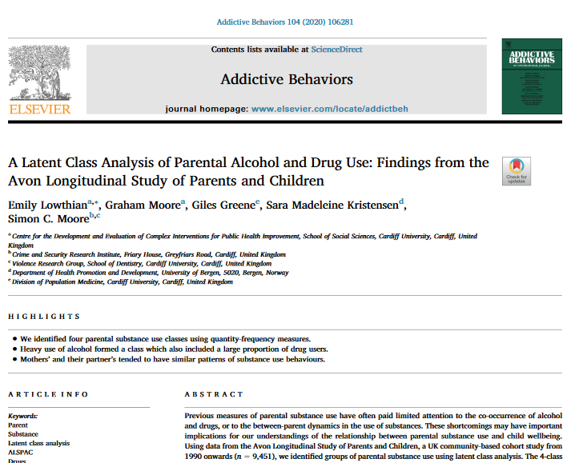
PAPER

Slide 21
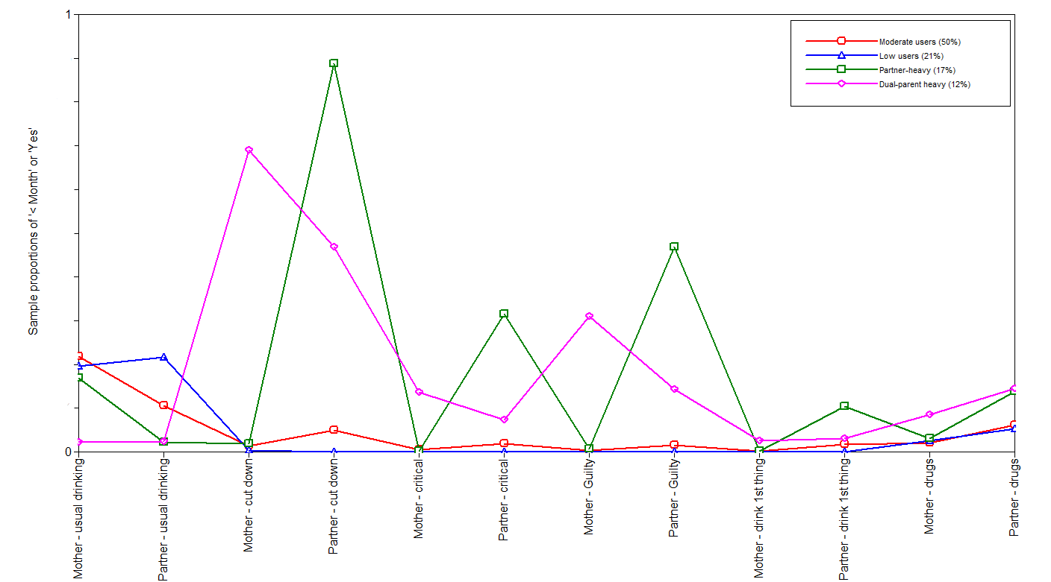
DYNAMICS IN SUBSTANCE USE
MCS
2
Latent class analysis of parental substance use, including mothers and partners alcohol and drug use when the child was aged 3
Four qualitatively different groups emerged through using quantitative methods
  Low users
  Moderate users
  Partner-heavy users*
  Dual-heavy users*

Slide 22
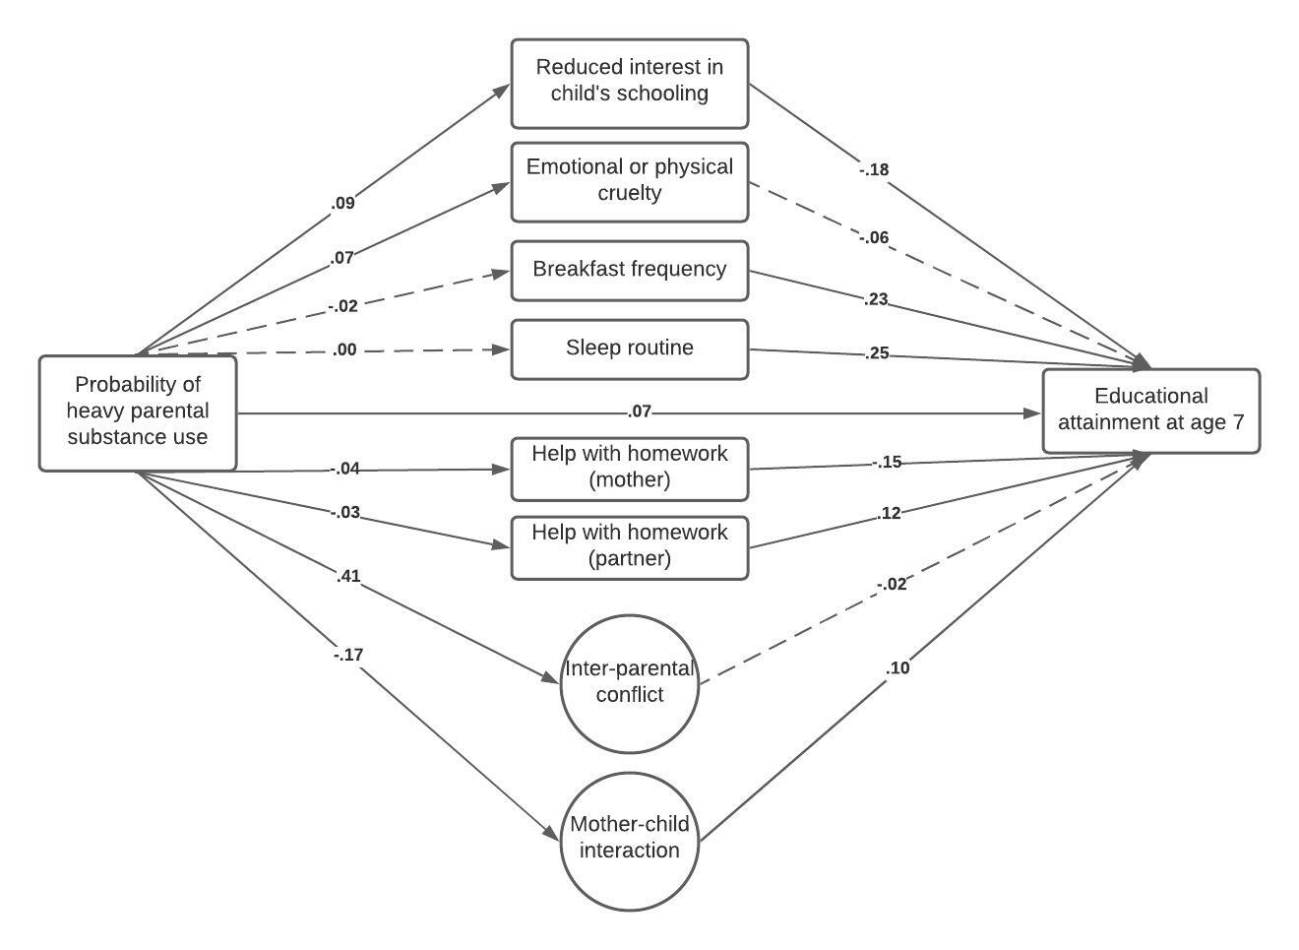
PARENTING AND THE FAMILY ENVIRONMENT
ALSPAC
3

Slide 23
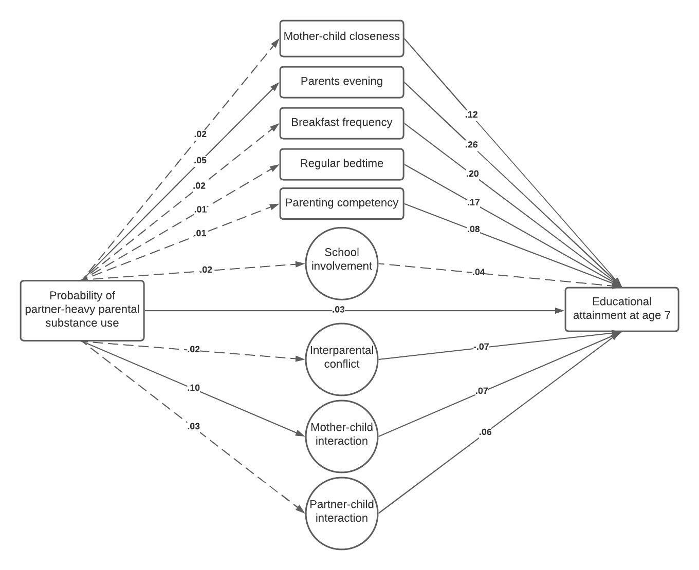
PARENTING AND THE FAMILY ENVIRONMENT
MCS
3

Slide 24
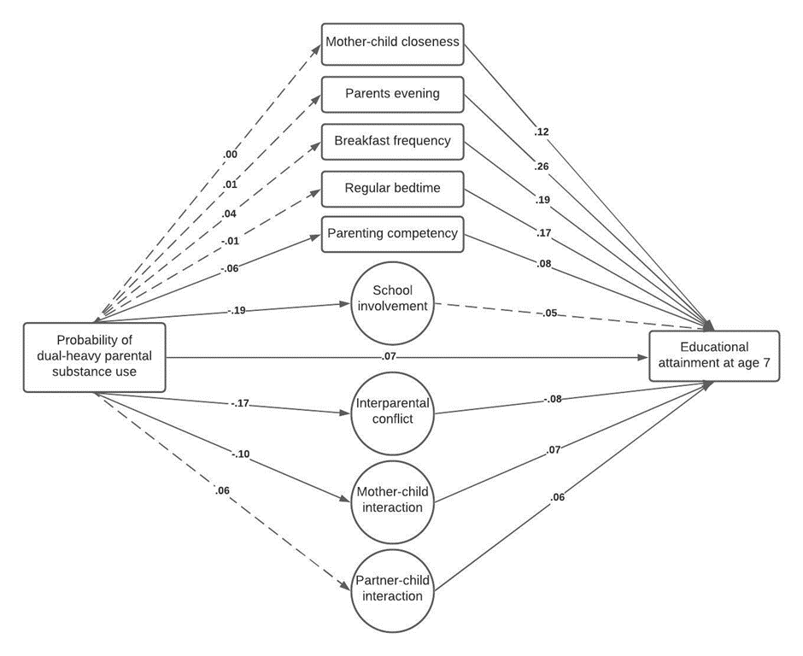
PARENTING AND THE FAMILY ENVIRONMENT
MCS
3

Slide 25


SOCIOECONOMIC CONTEXTS
When interpreting the findings, it appeared that parental substance use increased educational outcomes – this needed further investigation
We found the latent class analyses were confounded heavily by social class
We split by parental education and found most associations in the path models were among families with fewer qualifications – despite using less substances.
4

Slide 26

CROSS-COHORT RESEARCH
5
6
Excellent harmonisation of measures across the two datasets
Different political contexts when data was collected
Both datasets had very similar findings in terms of latent class analysis, indirect effects
Both datasets found socioeconomic differences

Slide 27
SUMMARY
DYNAMICS
Parents often mirror one anothers behaviours, with male partners being more likely to drink alcohol more, or be the stand-alone substance user
EDUCATION
When adjusted for confounders, we did not find associations with educational outcomes. But in the mediation models there was heavy socioeconomic confounding
MECHANISMS
Parenting and the family environment seemed to be under strain when families were in a heavy substance using group. This was also confounded by socioeconomic status

Slide 28
These are important findings for further research, intervention development and policy-making

Slide 29
GOING FORWARD
More use of data sources, e.g. substance use treatment records
Greater longitudinal research in this area
Consideration of mechanisms using qualitative data collection methods

Slide 30
DIOLCH!
Dr Emily Lowthian
A note: I have been well supported throughout my research, and this webinar is partially due to many people who helped me along the way developing and challenging my ideas
@LowthianEmily
e.m.lowthian@swansea.ac.uk

Slide 31
CREDITS
Special thanks to all the people who made and released these awesome resources for free:
Presentation template by SlidesCarnival
Photographs by Unsplash

