Slide 1
The dynamics of stress experiences of students with relatives with addiction problems: a longitudinal qualitative study
AFINet
Dorine van Namen
September 19, 2024

Slide 2
PhD research: the team
Promoters: Prof. Gera Nagelhout
Prof. Hein de Vries
Maastricht University
Co-promoters: Prof. AnneLoes van Staa
Prof. Sander Hilberink Rotterdam University of Applied Sciences
Research Center Innovations in Care

Slide 3
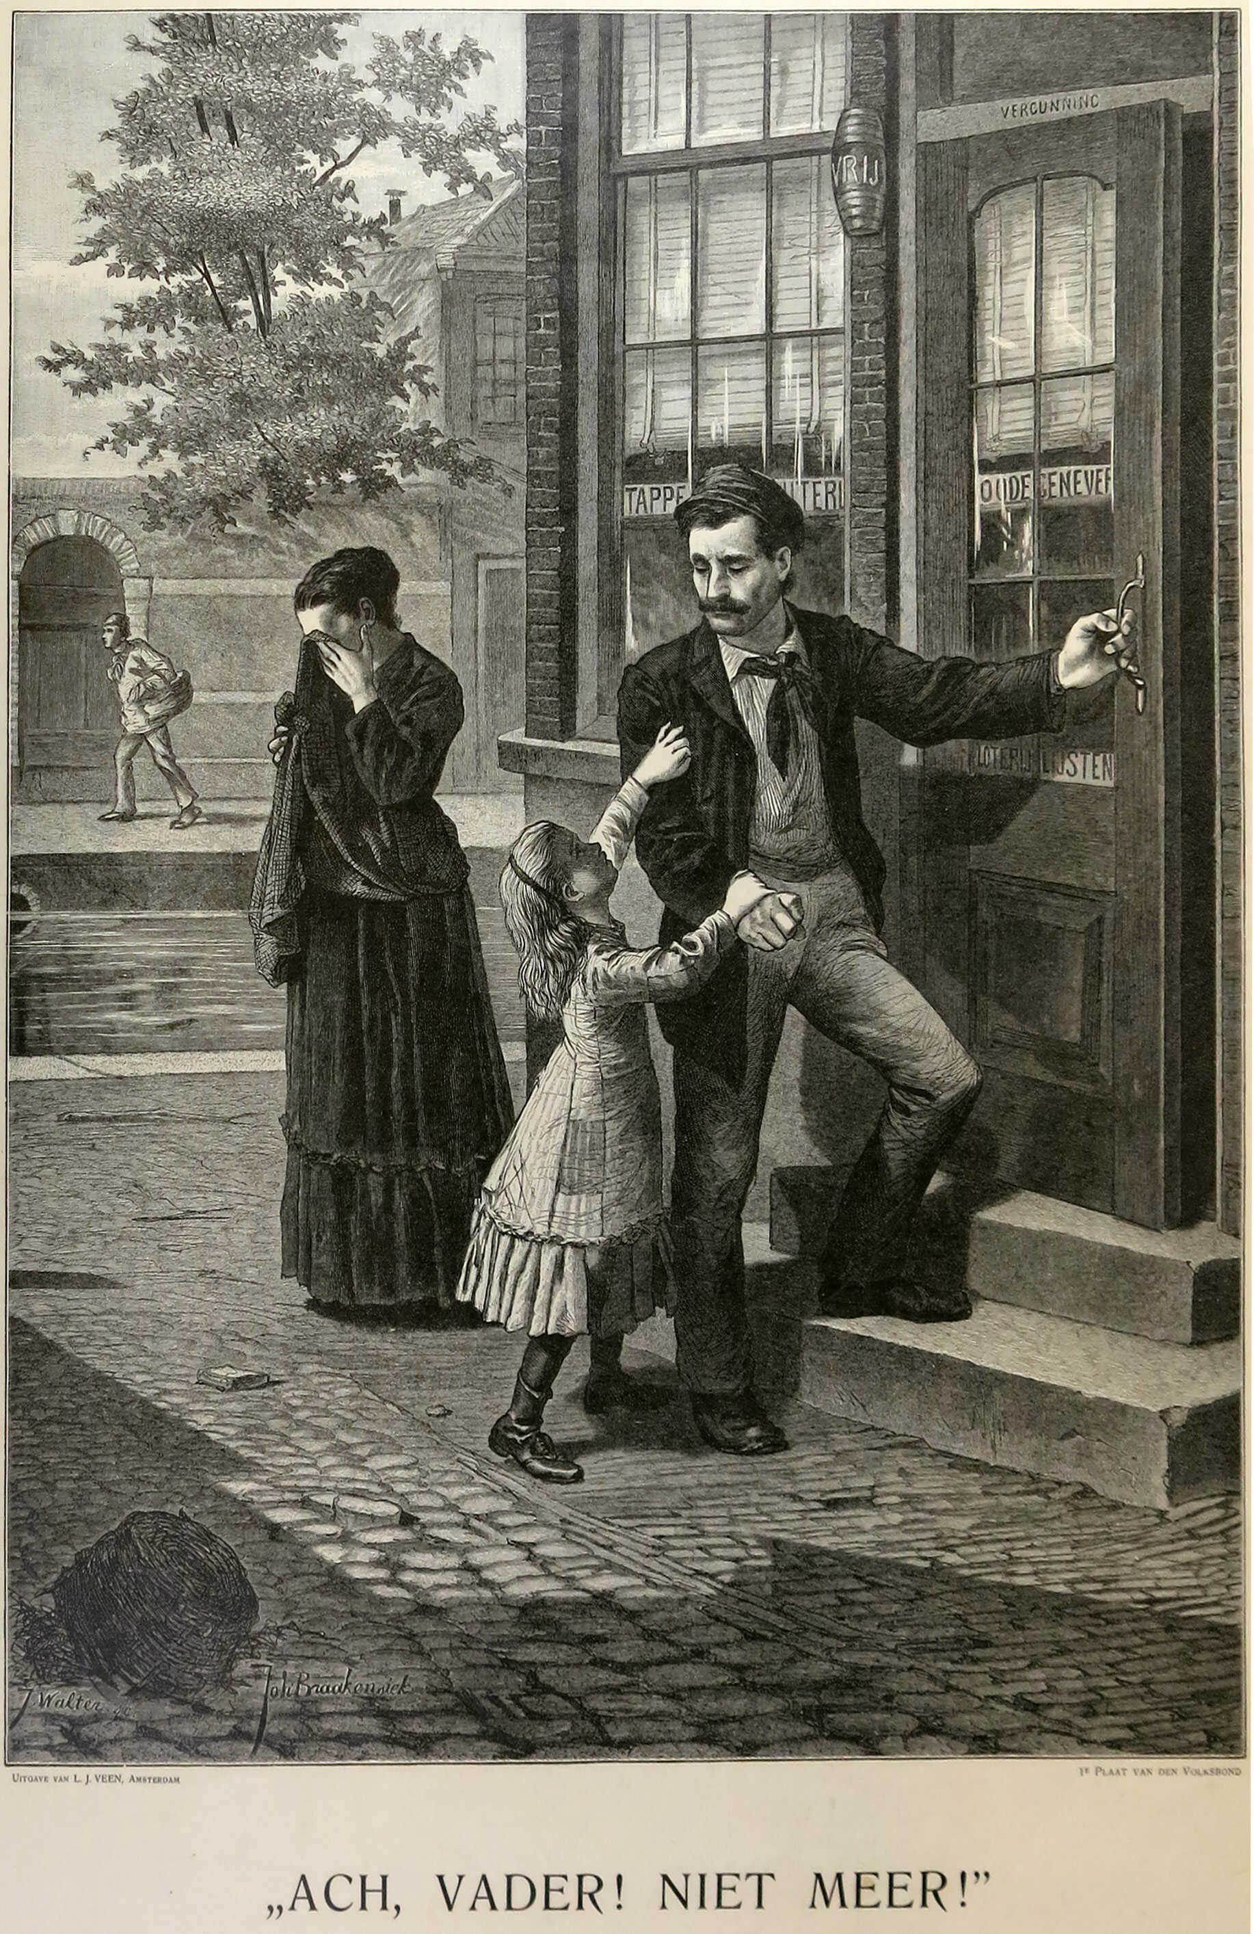
Research questions
Research questions:
How does the stress of young adult AFMs evolve over the research period of three years?
What causes stress to increase or decrease?

Slide 4

Why?
Chronic stress is risk factor for the onset and progression of physical and emotional problems
Accelerated aging
Negative impact on study success
O’Connor DB et al, 2021; Dai S et al, 2020; Yegorov YE et al, 2020; Schraml K, et al, 2012

Slide 5
Method
Longitudinal Qualitative Research: Interviews (3 years): 30 students. 93% participated in at least two interviews, and 80% participated three or four times.
Stress graphs (24) stable (n=3), increase (n=5), decrease (n=10), erratic highs and lows (n=6)
January 2020- December 2024

Slide 6
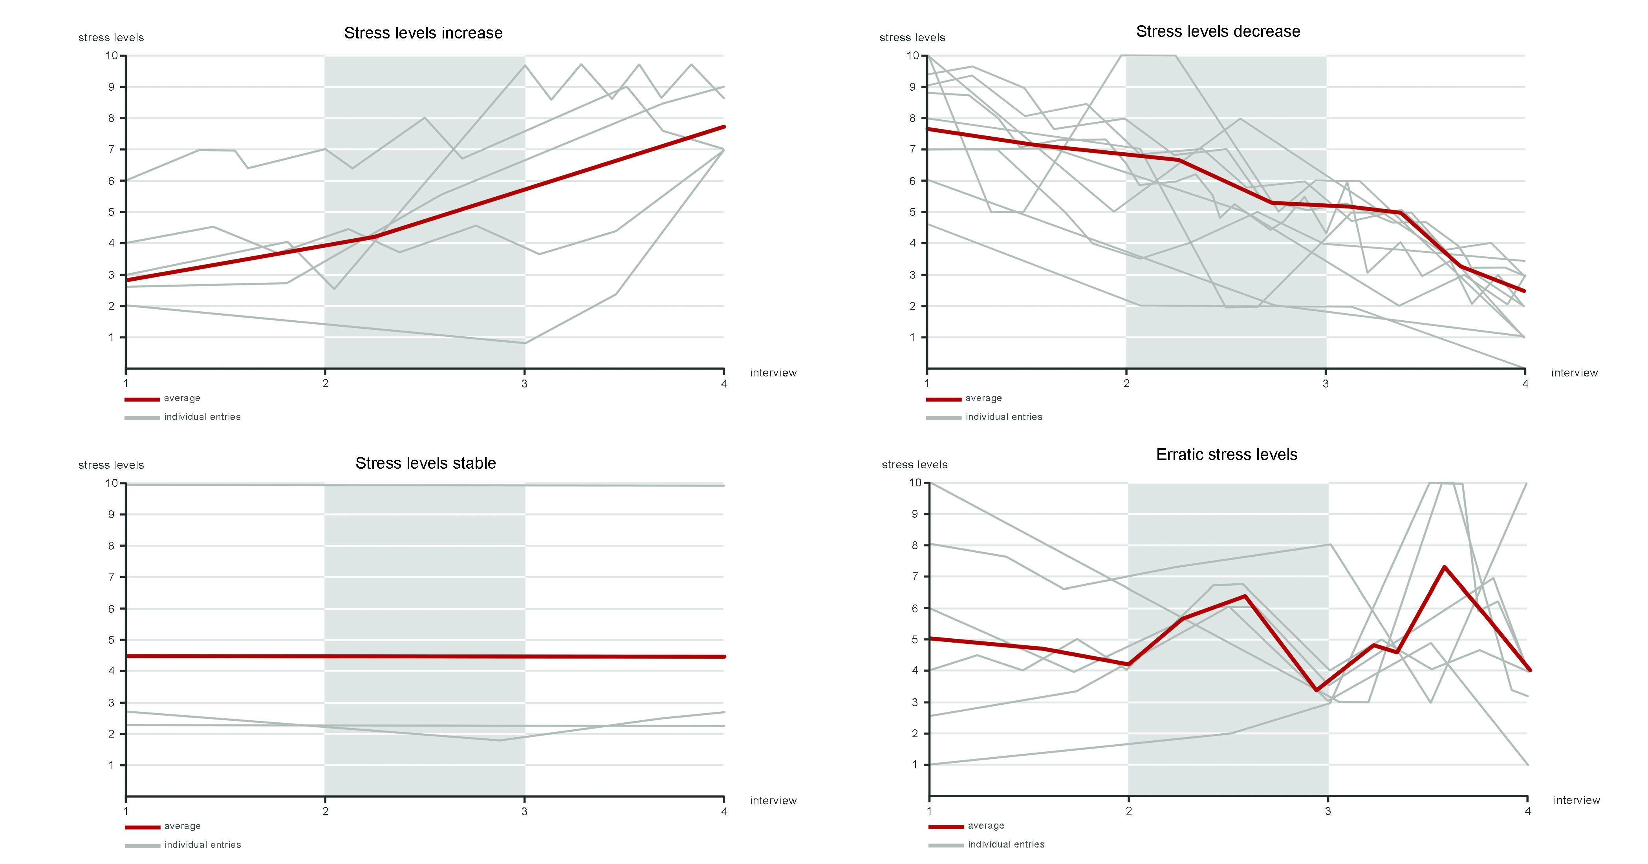
Stress graphs

Slide 7
24 participants
14 women and 10 men
Mean age at baseline 22.5 years
Participants had 95 relatives with addiction problems (4)
In nuclear families: 12 fathers, 10 mothers, 1 stepmother, 3 stepfathers, 11 siblings, and 4 partners (1.7)
Alcohol and poly-users
Mental health problems (n=21), physical health problems (n=17), and sleeping problems (n=19)
One-third diagnosed with Post Traumatic Stress Disorder (PTSD)

Slide 8

Reasons for changes in stress
Stress going up:
aggression,
incidents or accidents
performance and work pressure
informal care duties
Coping: standing up
Stress going up or down:
treatment, recovery, relapse
intimate relationships
Stress going down:
Good quality support (informal or professional)
Coping: Withdrawing

Slide 9

Aggression
“History repeats itself. Now it's my sister. She has children and she now uses drugs all day. Same poor coping strategy as my parents. She abuses her oldest boy, physically and verbally. She tells him she wants to kill herself. It just keeps going on.”
(P10, woman, 26 years)

Slide 10

Incidents and accidents
“My father was stone drunk. While we were driving, he pulled the handbrake.”
(P6, woman, 25 years)

Slide 11

Performance pressure
“That pressure, the responsibility, the stress, it was way too much... One day I just quit without having a new job. That fear that I couldn’t do it, that I am not good enough keeps coming back.”
(P13, woman, 24 years)

Slide 12

Informal care + …
"I now have to do all kinds of things for my sister [one of several relatives with addiction problems]. But I'm in the process of graduating now and I don't have time for it. I get all stressed when she reschedules appointments on short notice. Then I also must reschedule my appointments. She doesn’t ask her friends to help her, but she has no problem asking me. When I have a lot on my plate, it feels extra stressful to help the people around me."
(P24, man, 25 years)

Slide 13

Treatment, recovery and relapse
“The first year [of our study] my stress was the highest, then my brother was full-on in addiction. When he went to the clinic, my stress went down, and when he relapsed, it went straight up again. Now, he is clean again and I have very little stress regarding his addictions.”
(P25, male, 24 years)

Slide 14

Romantic relations, stress up
“A relationship is super stressful for me. In my first relationship, I saw my girlfriend as a mother figure. I wanted her to be the mother I did not have [because of neglect and abuse due to addiction problems]. I started to behave as a child right away. I became submissive and made myself small. That led to all kinds of problems and a lot of stress because she didn't like that, and I didn’t know how to behave differently. I find it very difficult to be with someone and be close to them.”
(P9, male, 26 years)

Slide 15
Romantic relations, stress down
“I think because I got rid of all the nagging, I feel better. From arguing every day and thinking every day: am I good enough? All that lying, always being on my guard, I don't have all that now. I feel much more relaxed.”
(P5, woman, 26 years)

Slide 16
Conclusions and final remarks
Participants’ stress related to their relatives' addiction problems was highly dynamic.
Stress experiences were long-lasting and could be triggered even in participants whose relatives had died or with whom contact had been broken off.
We found no one-to-one relationship between patterns and reasons for stress to increase/decrease.
Considering the importance of chronic stress: Identifying reasons for stress increasing or decreasing might help AFMs and healthcare and educational professionals who want to support AFMs manage their stress.

Slide 17
Dorine van Namen, d.m.van.namen@hr.nl

