Slide 1
Boxing for Children of Parents with Mental Illness and/or Addiction
Findings from a Dutch Mixed-Methods Pilot Study
Dorine van Namen, PhD
Willemijn Langkamp, MSc

Slide 2
The Team
Willemijn Langkamp¹
Dorine van Namen²
Tina Bellemans³
Daphne Heemskerk¹
Jasmijn Holla¹
¹ Inholland University of Applied Sciences
² Rotterdam University of Applied Sciences
³ Windesheim University of Applied Sciences

Slide 3
Background
Only one dedicated COPMI intervention in the Netherlands
Limited reach;
Overly therapeutic¹;
Sense of injustice;
Fear of emotions.
1. van Namen, D. M., Hilberink, S. R., de Vries, H., Nagelhout, G. E., & van Staa, A. (2024). 'Please, see me'; Informal and professional support of students with relatives with addiction problems: a three-year longitudinal qualitative study. BMC Public Health, 24(1), 3092.

Slide 4
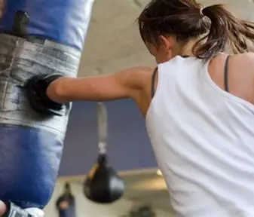
Why Boxing?
Evidence² suggests boxing can promote:
Resilience
Emotional regulation
Protection from victimization
Focus and self-discipline
Social connectedness
Self-confidence
Stress reduction
Physical wellbeing
Can boxing provide a feasible and meaningful support environment for COPMI youth?
2. Langkamp, W., Namen, D. M. v., Bellemans, T., Heemskerk, D., & Holla, J. (2026). Boksen voor de mentale gezondheid van KOPP/KOV-jongeren. Tijdschrift voor Gezondheidswetenschappen

Slide 5
Intervention Development
Co-created Intervention
Developed together with:
Boxing coaches
Experts by experience
Researchers
Community and healthcare partners
Training
One-day mandatory training:
Understanding COPMI youth
Trauma-sensitive coaching
Stress responses
Strengths-based approaches
Referral pathways

Slide 6
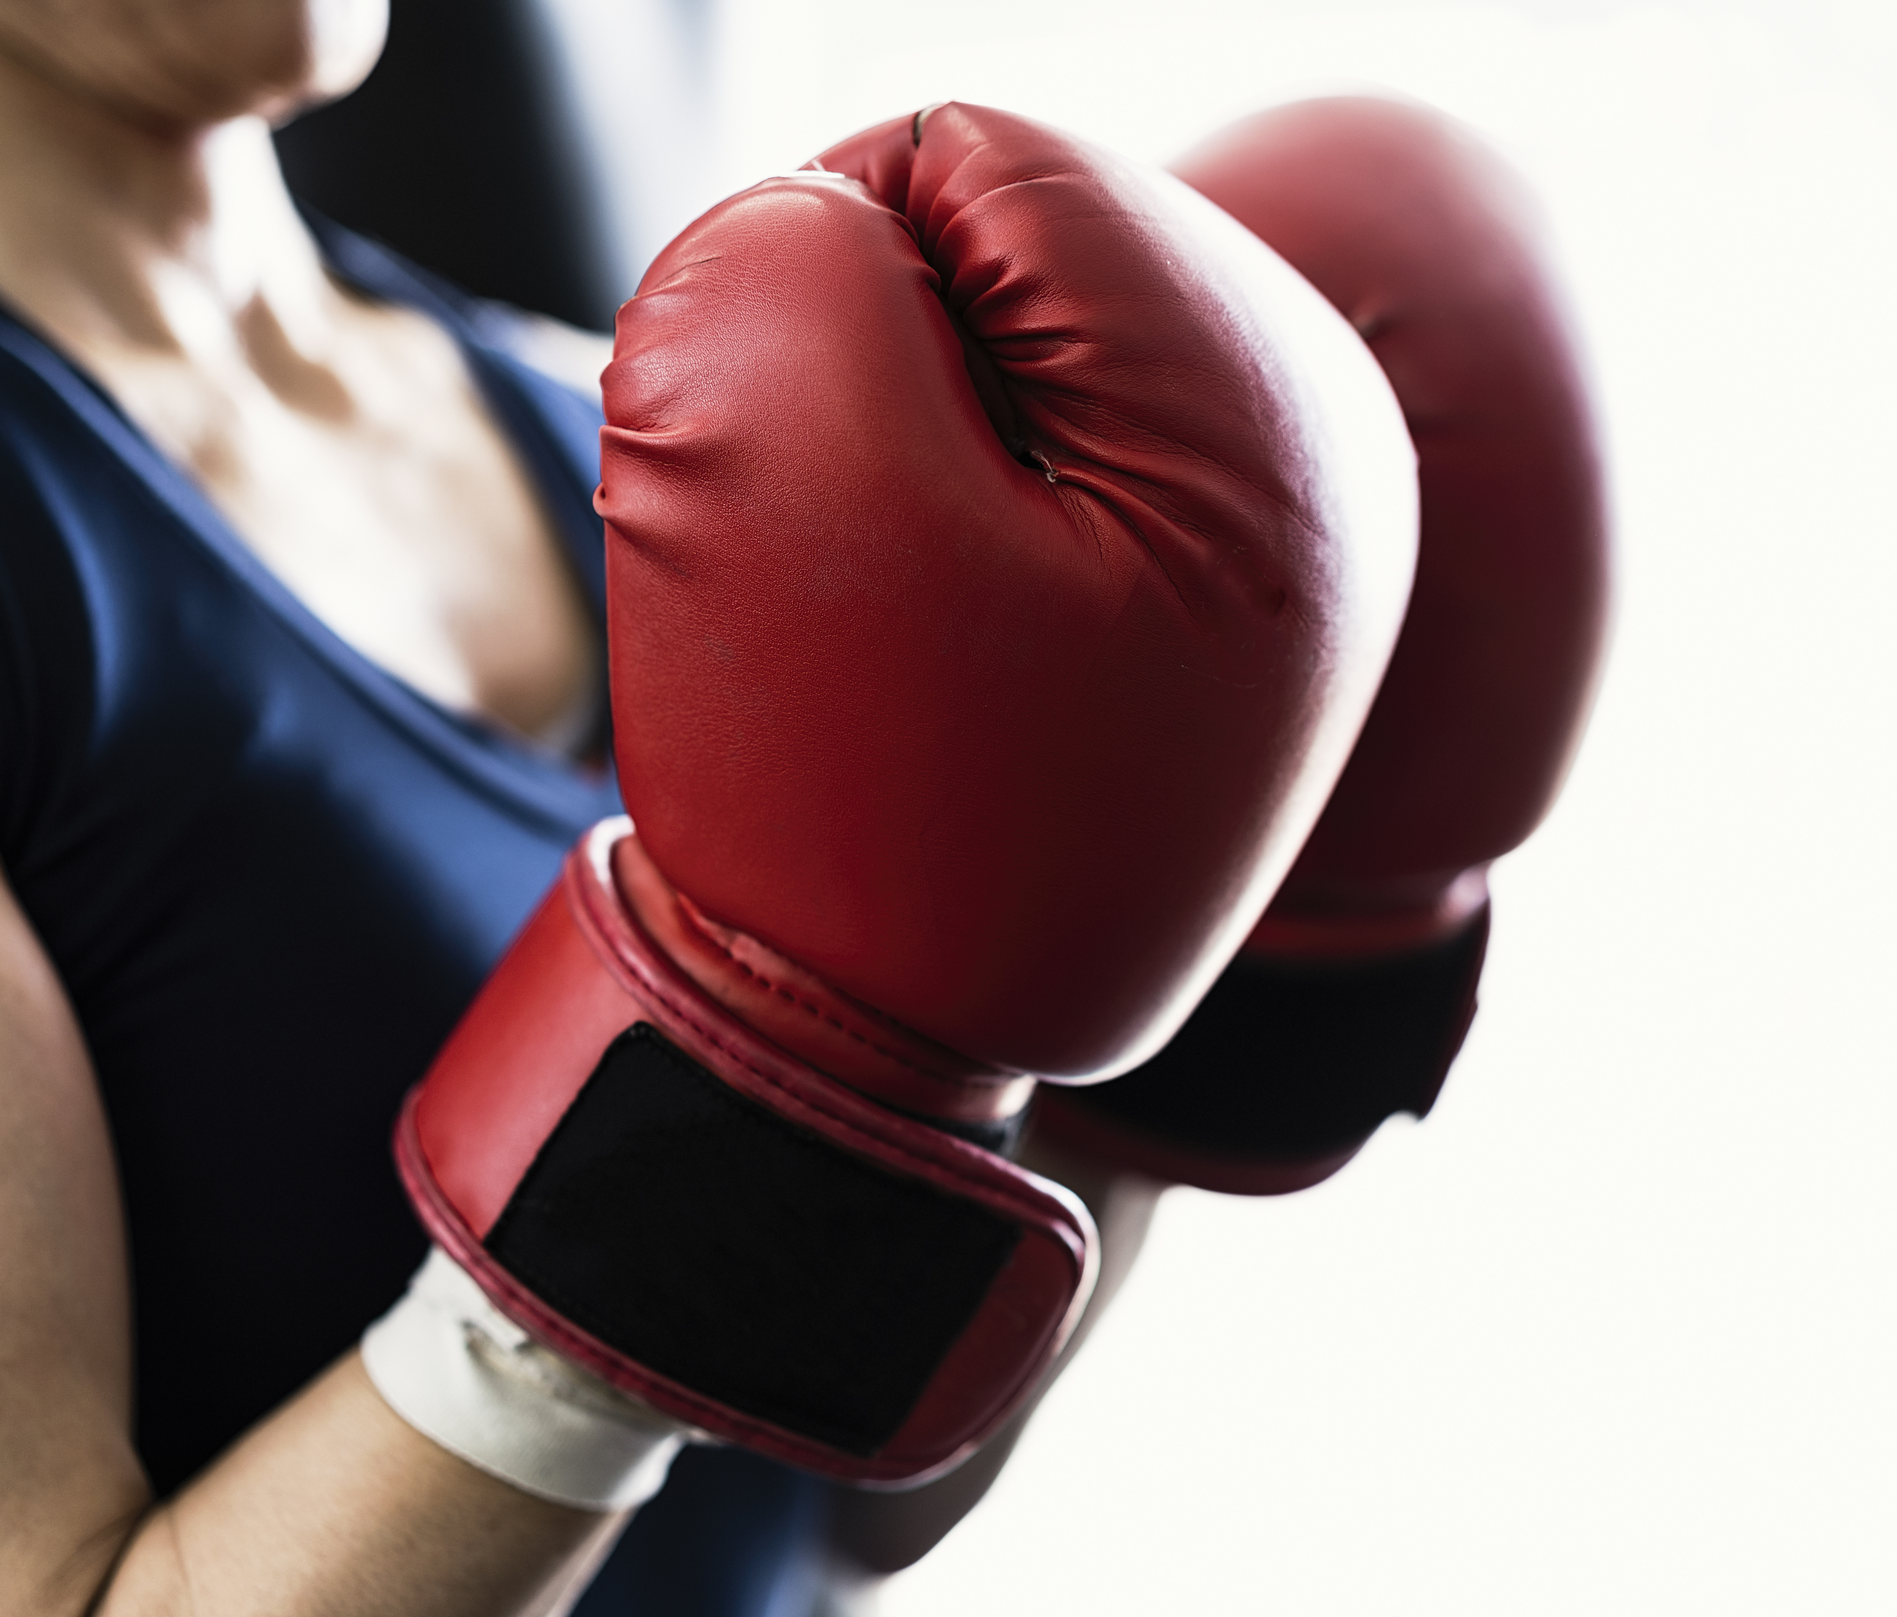
The Boxing Program
Five Core Themes
Enjoyment & Play
Social Functioning & Boundaries
Personal Growth
Self-Esteem & Self-Efficacy
Physical Activity & Relaxation
Duration: 12 weeks

Slide 7
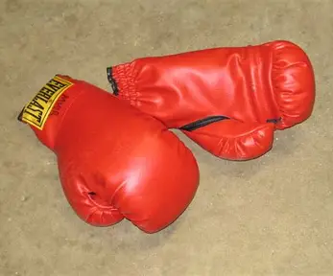
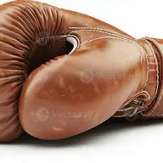
Data Collection
Quantitative
Qualitative
Body satisfaction
Mental health
Stress
Resilience
Self-efficacy
Interviews
Observations
Evaluation meetings
Stakeholder discussions

Slide 8
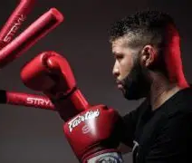
Findings (quantitative)
26 participants in 3 cities (Age 16-30 years; 22 female, 4 male)
Body awareness and satisfaction
⬆ Significant improvement
Mental Health
⬆ Positive improvement trend
No statistically significant changes
Perceived stress
Resilience
Self-efficacy

Slide 9
Findings (qualitative)
Focus on themselves
Joy
Social connection
Self-confidence
Emotional regulation
"At first I was very quiet, but over time I became more social and assertive." (female, age 22)
"Boxing makes me feel more confident; it's a feeling I can take home with me." (female, age 25)
"The program helped me move out of my head and into my body." (female, age 20)

Slide 10
What worked, what was challenging?
Success factors
Challenges
Non-clinical setting
Relationship with boxing coach
Enjoyable activities
Relaxation
Positive group atmosphere/social connections
Flexible delivery
Recruitment
Cross-sector collaboration
Funding
Long-term provision

Slide 11

Discussion & Implications
Boxing appears to offer meaningful benefits for COPMI
Sports and community-based interventions may complement traditional support services for COPMI youth.
Larger controlled studies are needed to establish effectiveness and long-term impact.

Slide 12
Thank you!
Contact:
Willemijn Langkamp, willemijn.langkamp@inholland.nl
Dorine van Namen, d.m.van.namen@hr.nl

