Slide 1
Psychosocial wellbeing of family members reached by NGOs in the field of addictions
Addiction & the Family International Network (AFINet):
1st International Conference,
Friday 9th November 2018, Newcastle upon Tyne, UK
Dr. Tuuli Pitkänen, Senior researcher
A-Clinic Foundation, Helsinki, Finland

Slide 2
The Finnish legislation takes into account the family members and close others
Act on Welfare for Substance Abusers No. 41/1986 7 § Service needs
Services have to be provided for people with substance use problems, and to his/her family members and close others. Help, support and services need to be provided according to the needs of the person and the close others.
Child Welfare Act No. 417/2007 Section 10 – Taking children into consideration in services for adults
The need for care and support for a child must be investigated and adequate care and support safeguarded when the child’s parent, custodian or other person responsible for the care and upbringing of the child 1) is being provided with substance abuse and mental health services or other social and health care services during which the person’s capacity to give their fullest attention to the child’s care and upbringing is deemed to have deteriorated; 2) is in pre-trial detention; or 3) is serving a prison service. (88/2010). https://www.finlex.fi/en/laki/kaannokset/2007/en20070417_20131292.pdf
See also the paper in Session 5 by Minna Ilva (Finland) How much does your drinking affect close others? Session 5: Saturday at 15.30-17.00

Slide 3
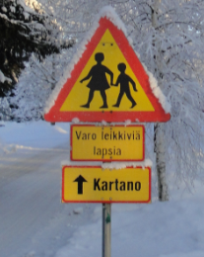
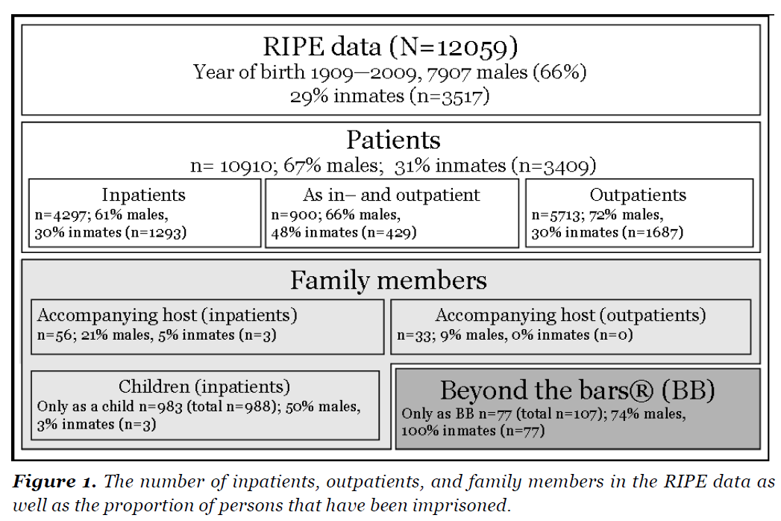
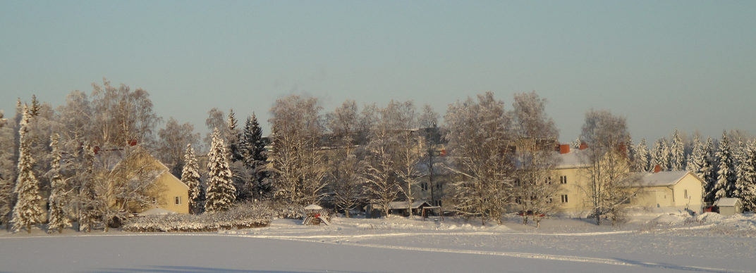
We had services for family members
We aimed to build a welfare state
Services were provided for parents, spouses and children.
Outpatient councelling
Inpatient services for the whole family: for example, Järvenpää Addiction Hospital https://www.paihdesairaala.fi/eng
The hospital had a school and a kindergarden; councelling programs for spouses History shortly
Our research sample includes 5197 patients, 56 spouses and 988 children. Hence, the electronic treatment records were not available before 1997. https://keskuststo.a-klinikka.fi/tietopuu/follow_up

Slide 4
Current situation??
Breaking down the welfare state
Raise of individualism
Worry about expences
Public services for family members are difficult to get
→ Health care:
The role of adult family members - to support the person with SUDs
Medicalization and stigmatization of family members? treated with medication when mental health problems emerge
Family members not getting treatment for themselves in time
→ NGOs are left alone
NGOs provide versatile services
NGOs do a good job, however, this is not enough

Slide 5
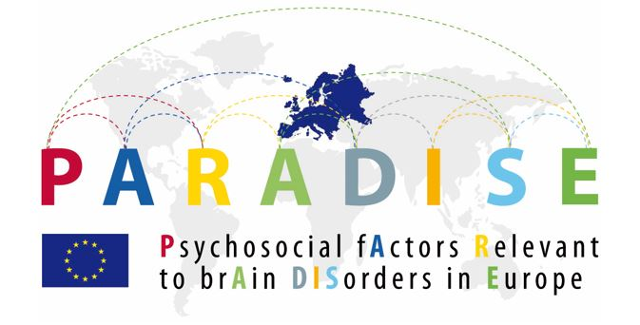
Measuring the burden of psychosocial difficulties
A research based questionnaire
24 questions – practical to use in clinical practise and in research
Evaluates the range and severity of psychosocial difficulties affecting daily life
Created in international collaboration (8 countries) by experts of nine neurological or psychiatric disorders
A general measure that can be used in different contexts
Linked to International Classification of Functioning, Disability and Health (ICF) by World Health Organization (WHO)
Information and the questionnaire in English: www.a-klinikka.fi/paradise24fin
Recent publications
Pitkänen, T., Levola, J., de la Fuente, J. & Cabello, M. (2018). Identifying psychosocial difficulties of inpatients with substance use disorders: evaluation of the usefulness of the PARADISE24 for clinical practise. Disability and Rehabilitation. Published online 5.9.2018.
de la Fuente, J., Cabello, M., Levola, J., Caballero FF., Ayuso-Mateos, JL. & Pitkänen, T (2018). Validity of the PARADISE24 questionnaire in people with substance use disorders: A measure to assess psychosocial difficulties. Drug and Alcohol Dependence 187:66-71.

Slide 6
Psychosocial difficulties (PARADISE24fin) mean: 24 questions
0 = no difficulties; 4 = extreme difficulties/cannot do
Mirka Vainikka and Mira Reponen
https://irtihuumeista.fi/

Slide 7
Psychosocial difficulties (PARADISE24fin) mean: 24 questions
0 = no difficulties; 4 = extreme difficulties/cannot do

Slide 9
Conclusions
Family members experience psychosocial difficulties, especially emotional difficulties, pain and problems with sleep
We know that family members need help and support for their own wellbeing
We need to work to increase awareness of this need among politicians, service producers and the family members themselves
We hope that we will find funding to translate the 5-step method in Finnish and to arrange the first 5-step training.
Meanwhile, we do what we can. Several NGOs are doing a very good job.
My current project aims to increase awareness of the difficulties and problems that people experience in their daily life, and to find ways to overcome and prevent suffering.
We help different kinds of NGOs to collect data about functioning, wellbeing and feedback, and to use the collected data for developing the activities.

Slide 10
Thank you! The following slides include additional background material
Photo by Tuuli: Järvenpää Addiction Hospital

Slide 11
Non-Governamental Organizations (NGO) in Finland
Long history of voluntary work around substance use issues
More than 100 organizations that work on SUD prevention
A big number of non-profit NGOs that provide service for problems caused by SUD for the users and their family
A big number of organizations and peer groups arrange activities
Funding from different sources, the most important source is through Ministry of Social Affairs and Health based on the revenues of Finnish gaming company (Veikkaus).
- Funding is given on the bases of applications.
- Follow-up of the use of the funding and the results of the work.

Slide 12
A-Clinic Foundation
the largest Finnish NGO in the addiction field.
versatile professional services for adults, adolescents and families. Services are used annually by 30 000 clients.
e-services reach over 300 000 monthly users.
involved in national and international activities in the fields of prevention, information, development, training and research.
the research group: Dr. Jouni Tourunen, Dr. Tuuli Pitkänen and doctoral student Teemu Kaskela
www.a-klinikka.fi/in-english www.a-klinikka.fi/reseach

Slide 13
MIPA 2015 - 2018
A research programme of ten Finnish NGOs in the field of substance use and mental health
Three main themes:
Organizational structures and leadership
The people that are reached by these organizations: wellbeing and service needs
Peer help
NGOs have good knowledge and direct contact to the field. The research questions raise from the need to know.

Slide 14
Three groups
What are the differences between people that come to the NGOs due to
own problems with substance use and/or mental health
the problems of a family member, and
those who took part because of other reasons (like to help, meet people, voluntary work etc.)

Slide 15
Three groups of people at the NGOs

Slide 16
Differences between the three groups: own problems, family, other
1) Evaluating 13 areas of life. Life-situation. 13 questions to evaluate different areas of life. Scale 4=very bad situation; 10= excellent
2) Subjective experience of change. Life-situation, same 13 questions now - when starting at the treatment. Retrospective. Calculated from two variables, possible variation from -6 to 6.

Slide 17
Life-situation; group means; scale: 4=very bad situation; 10=excellent

Slide 18
Experienced change after coming to the NGO Current situtation – starting situation using the scale from 4 bad to 10 excellent

Slide 19
Conclusions
NGOs in the field of addictions and mental health reach and serve people that have own problems or problems in the family
Three different kinds of groups according to the reason for taking part: own problems, family memeber, other reason
Family members suffered mostly from emotional stress, pain and difficulties with sleep
People experience positive changes in several areas of their life when they take part to the activities and services provided by the NGOs
Family members reported that they had received help from NGOs to their daily life, family relations, emotional wellbeing and quality of life

Slide 20
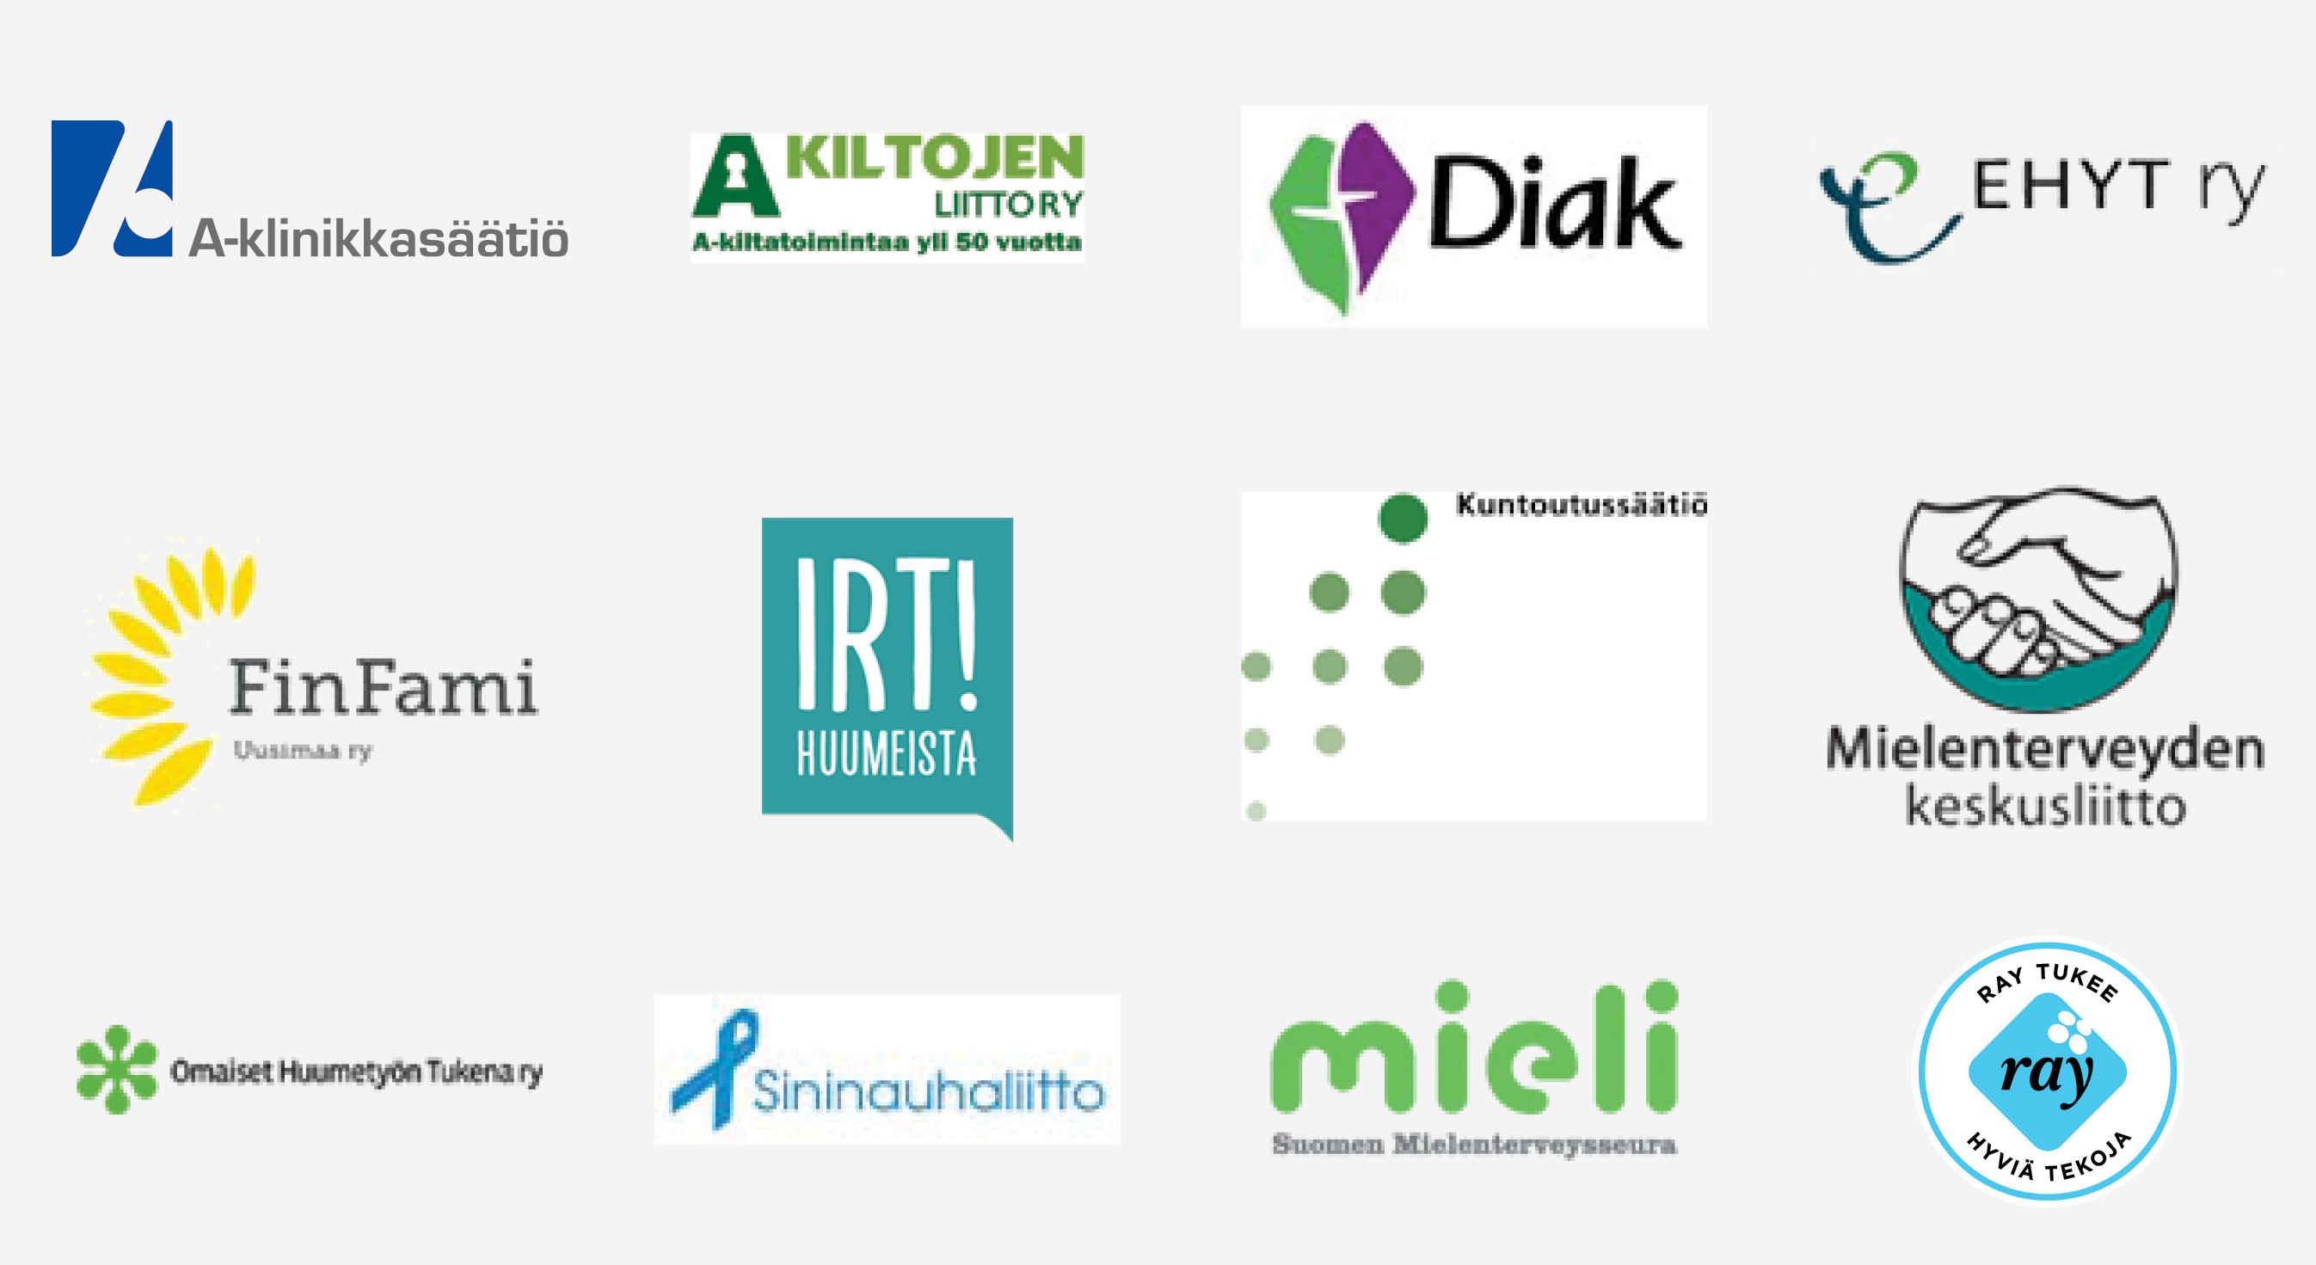
Thank you!

