Slide 1

Community Reinforcement and Family Training (CRAFT):
Real World outcomes in Germany
Dr. Gallus Bischof
University Lübeck
Dpt. of Psychiatry and Psychotherapy
Research group S:TEP
(Substance abuse: Therapy, Epidemiology and Prevention)

Slide 2
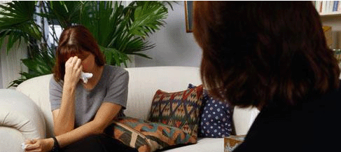
Background
In Germany, an estimated number of approx. 10 Million individuals are AFMs, i.e. affected by an addiction of a family member (Bischof et al., 2023)
AFMs show significantly elevated levels of depression and ill-health
Cost free support for AFMs is available in addiction counselling centres (n>1400) at no cost (financed by public agencies)
While counsellors need to have qualifications for counseling individuals with addictive disorders, only a minority has received training for working with AFMs

Slide 3

Utilization of addiction counselling in AFMs in Germany
7,3 % of all clients
>1% of AFMs in general population
Dauber et al. (2018), Jahresbericht der Deutschen Suchthilfestatistik, IFT München.
.

Slide 4
Availability of Interventions for AFMs in Germany (EVIFA 2020)
N=352 Addiction Counselors working with AFMs
Notes:
Was gibt es – wie gut ist es?

Slide 5
Implementation in an Addiction Counselling Centre (aggregated data only)
(Köster-Sommer & Pöltl-Knüppel, 2017)

Slide 6
Implementing CRAFT in an addiction counselling centre II
Counseling centre in Darmstadt started in January 2021 to offer CRAFT
Ongoing project, Data available from January 2021 – April 2024
N=75 AFMs received an intake interview, N=55 participated in the program
Sociodemographic and addiction-related variables, coping behavior and well-being of AFMs were assessed at:
  Intake interview
  Start of treatment
  End of treatment
  6-months follow-up

Slide 7
Sociodemographic variables
Variable | Participants (n=55) | Non-Participants (n=20)
Female (%) | 78,2 | 86,7*
Relationship status
Partner | 36,3 | 15,0
Parents | 54,5 | 45,0
Other | 9,1 | 40,0
Type of Addiction**
Alcohol | 74,1 | 72,2
Drugs | 44,4 | 38,9
Prescription drugs | 13,0 | 0
Gambling | 11,1 | 0
*n=7 (due to missing data); ** multiple entries possible

Slide 8
Outcomes wellbeing AFMs

Slide 9
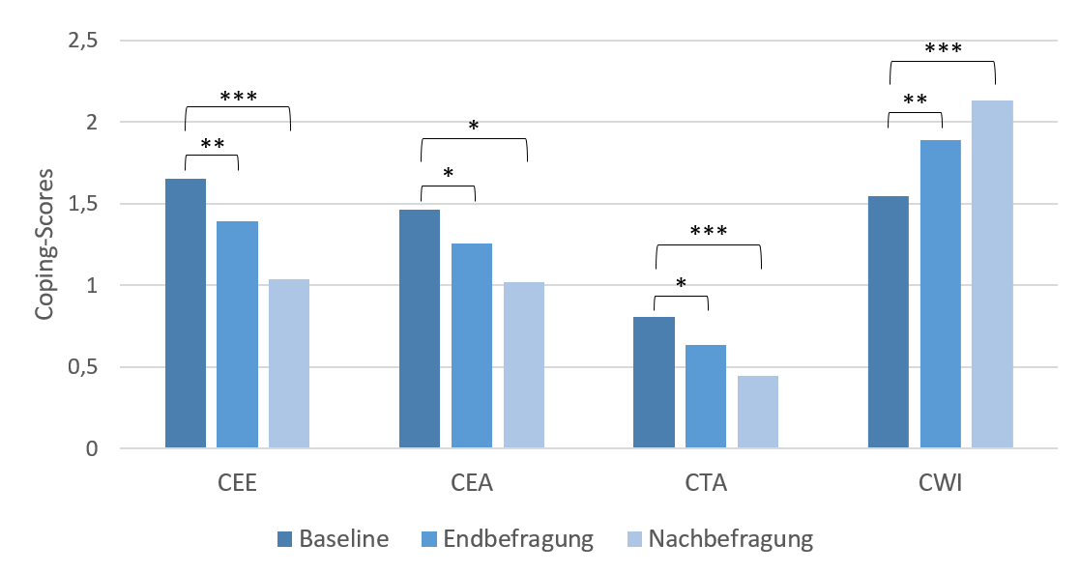
Coping-mechanisms of AFMs
CEE: Engaged-
Emotional
CEA: Engaged-
Active
CTA: Tolerant-
Inactive
CWI: withdrawal
Posttreatment
3-month-f-u

Slide 10
Treatment Utilization of relatives
Incidence treatment entry of previously untreated Relatives: 16%

Slide 11
Summary
Implementing structured programs like CRAFT increases reach and treatment adherence
A substantial number of AFMs reached is attached to addicted relatives that already are in treatment
CRAFT provides positive effects in these AFMS regarding wellbeing and increase of withdrawal coping
Comparative studies in real world setting using unselected samples are needed
Notes:
Was gibt es – wie gut ist es?

