Slide 1
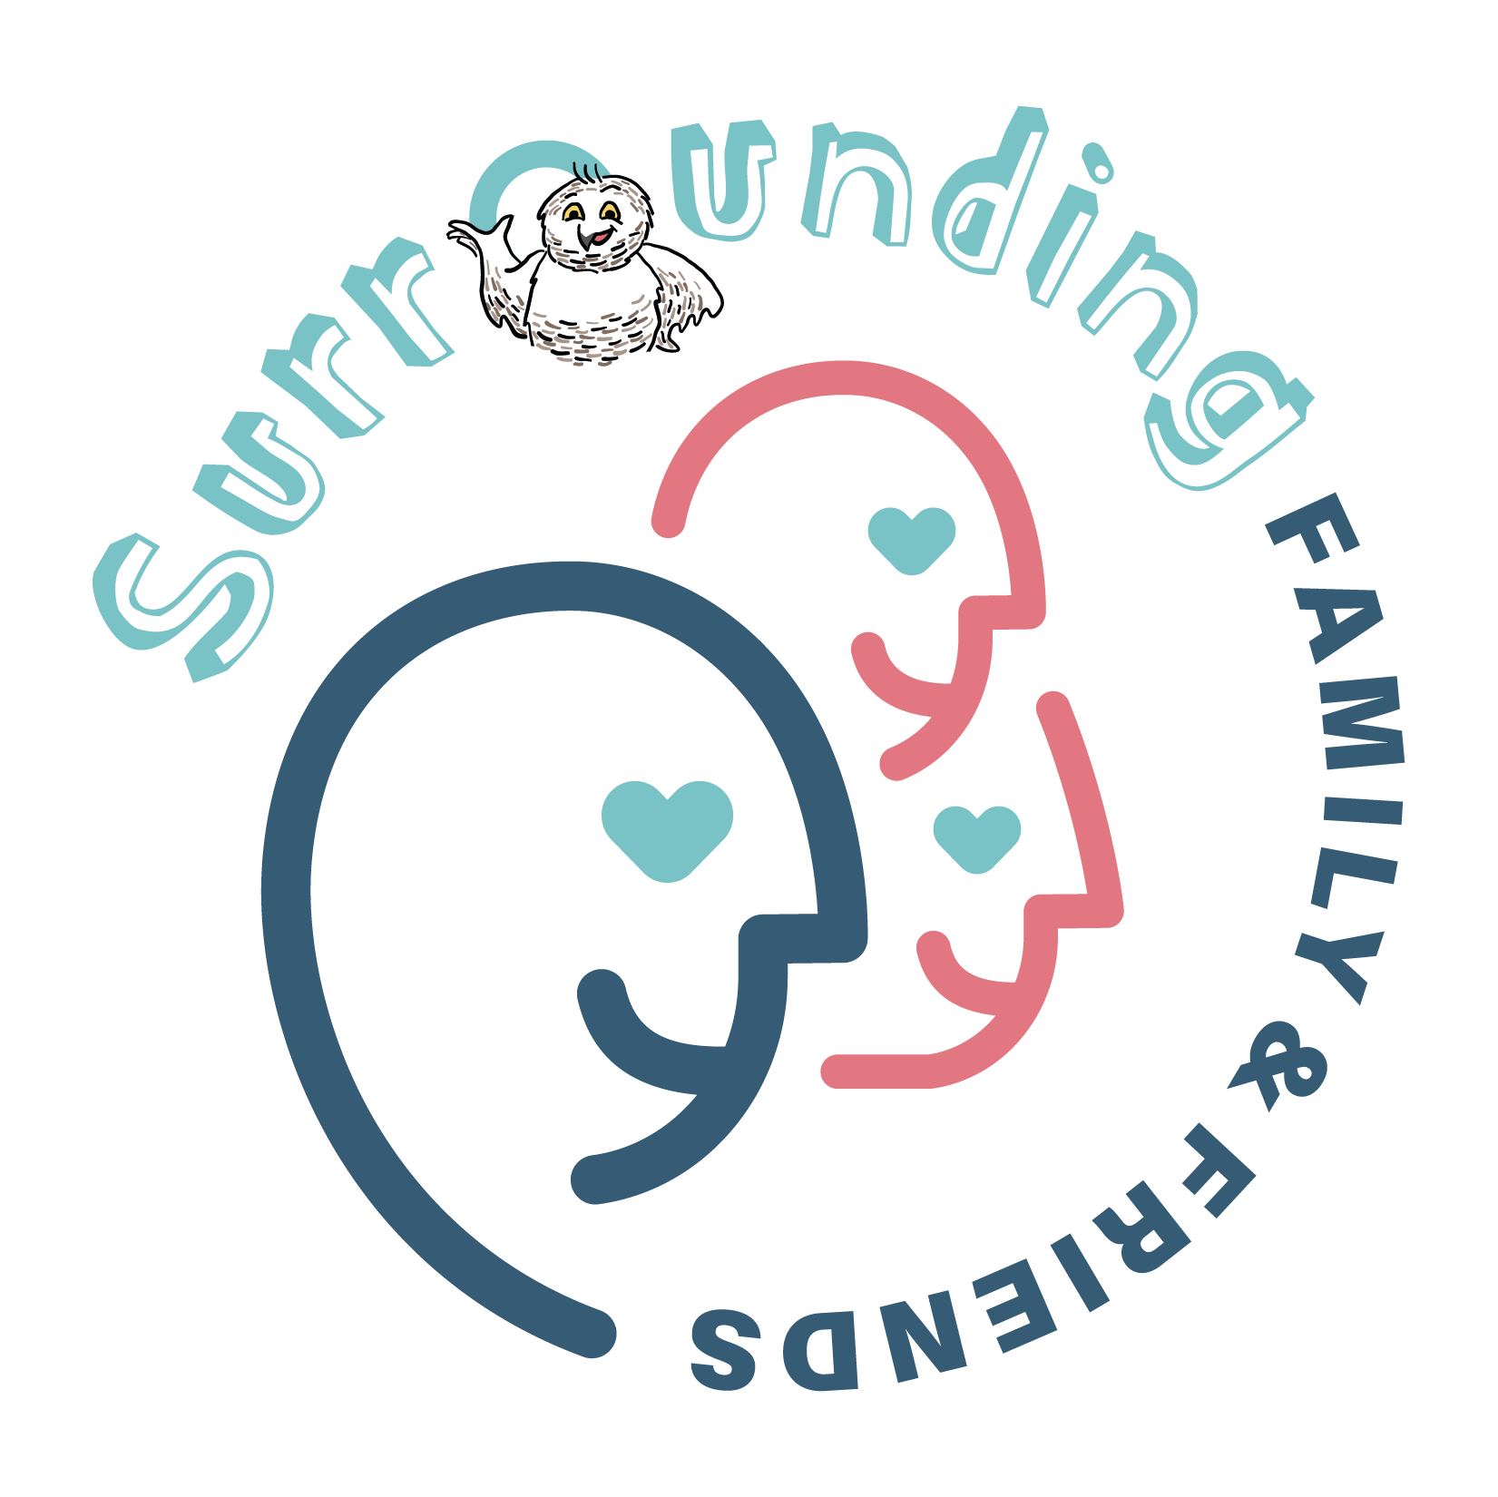
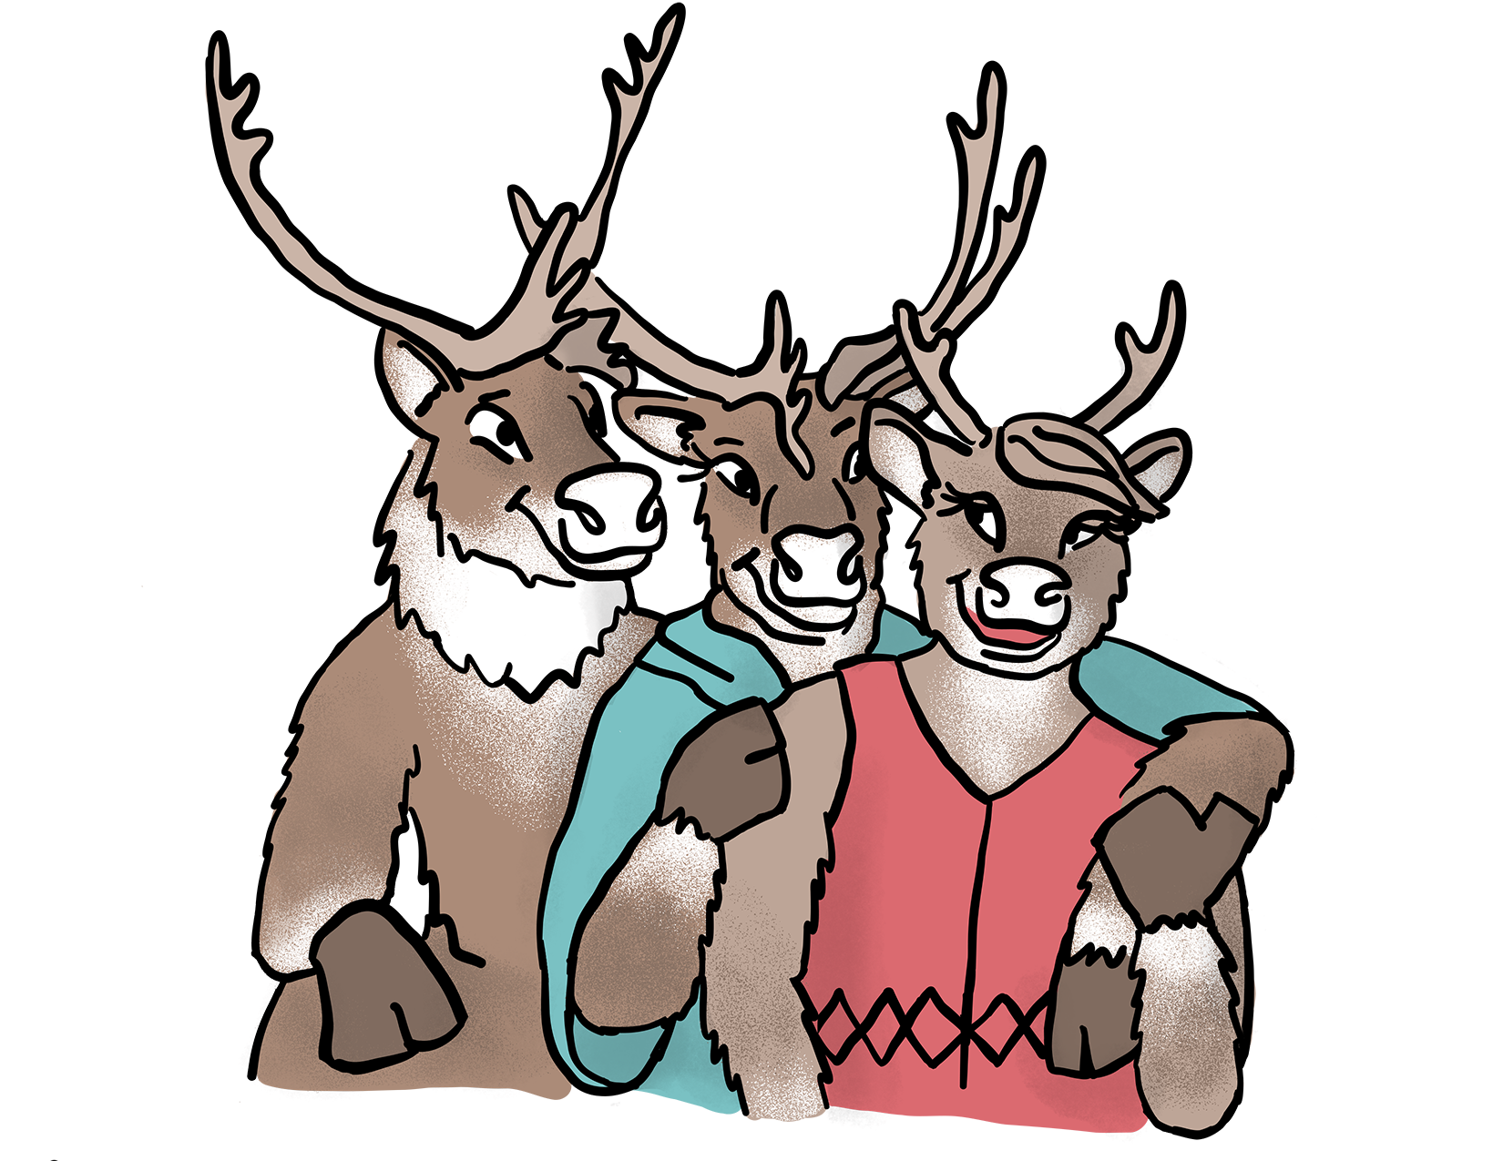
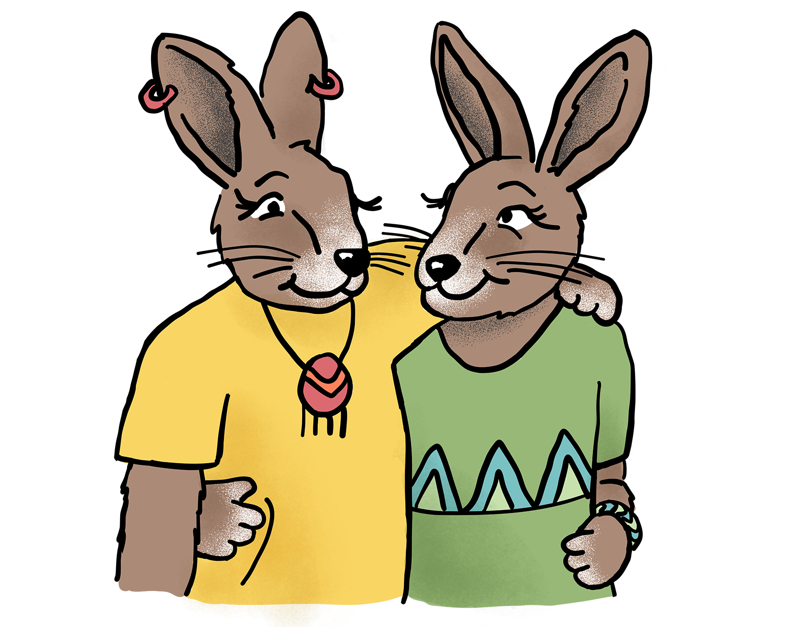
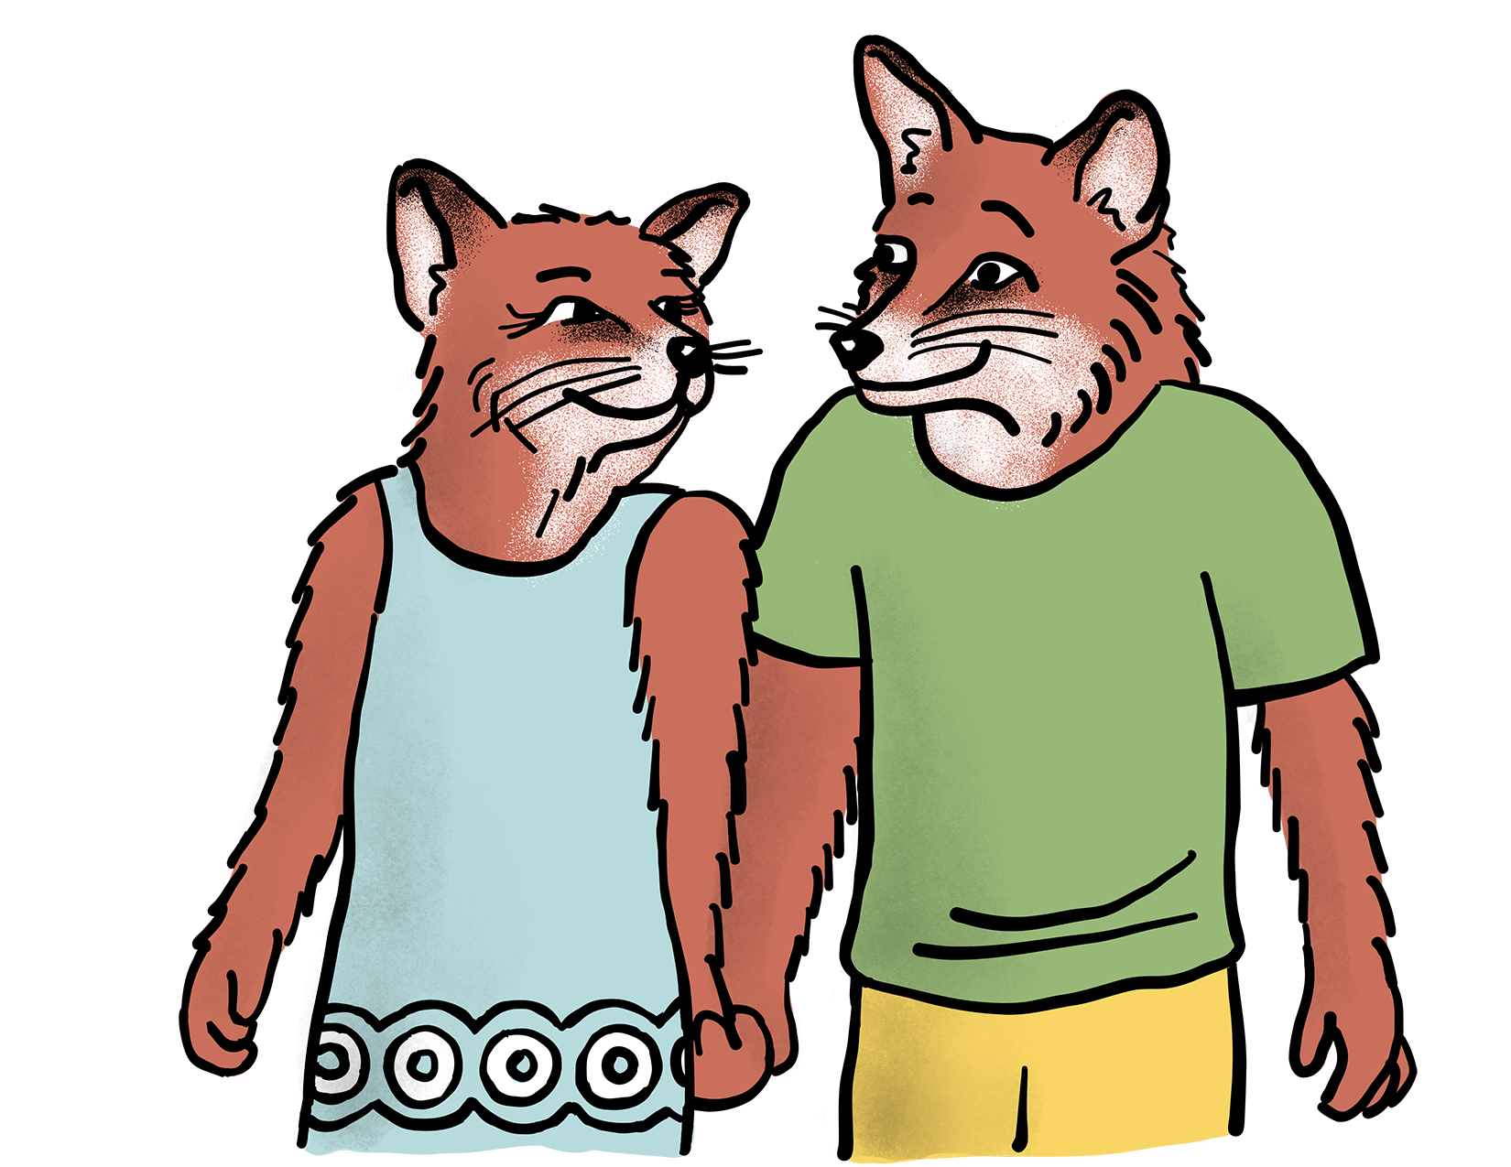
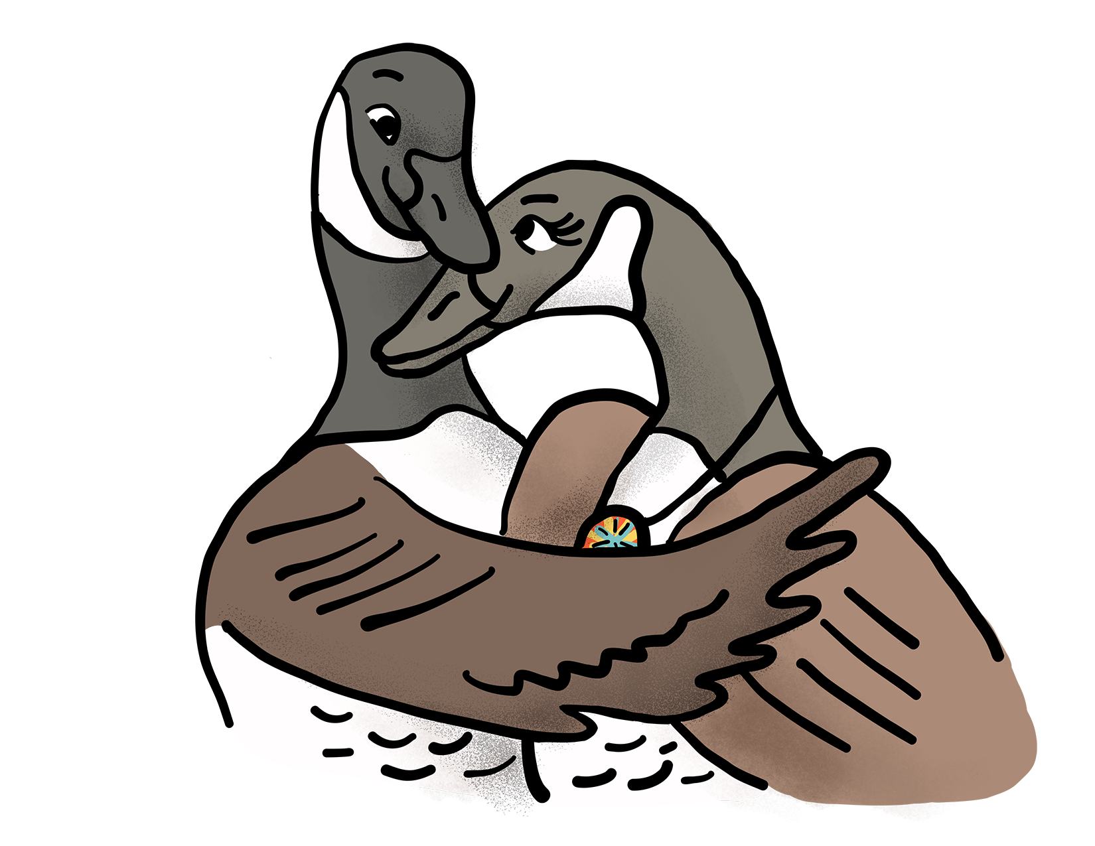
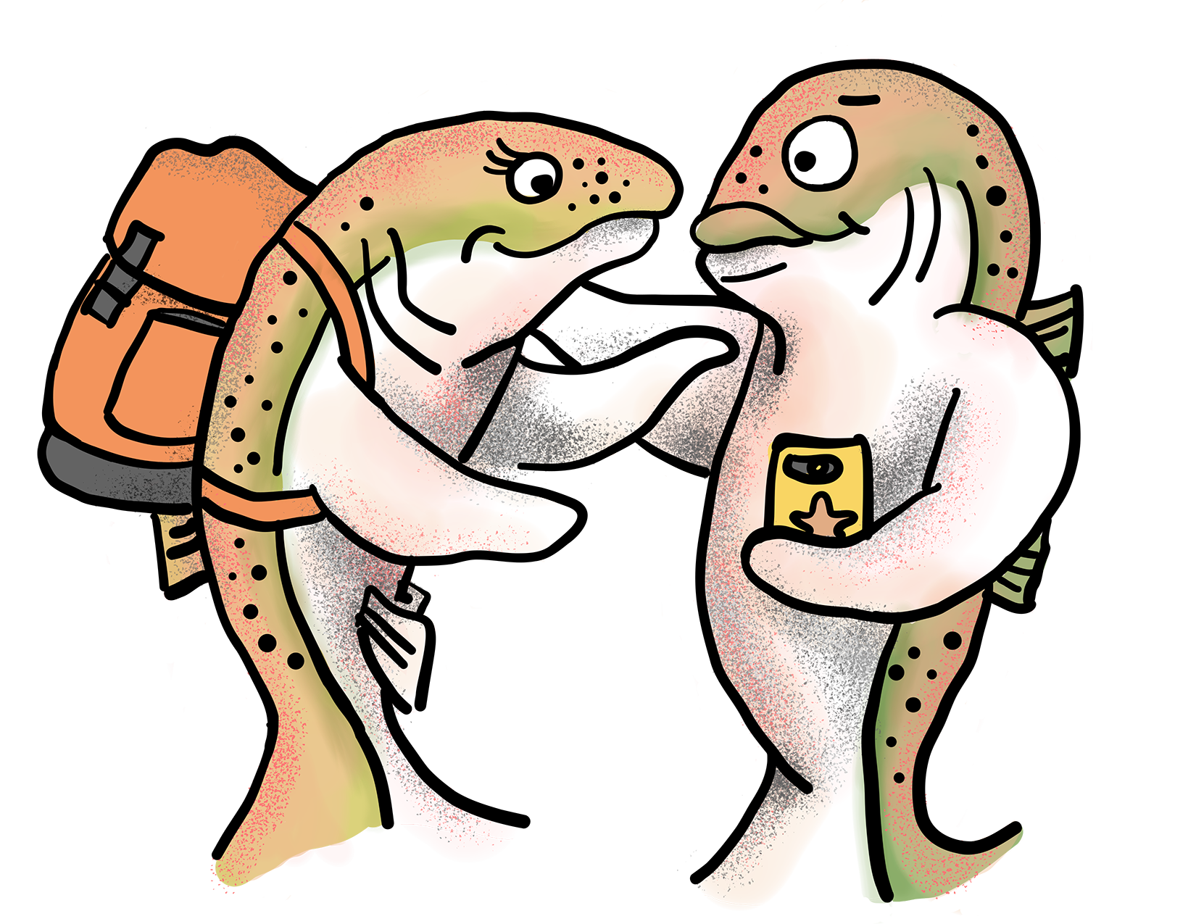
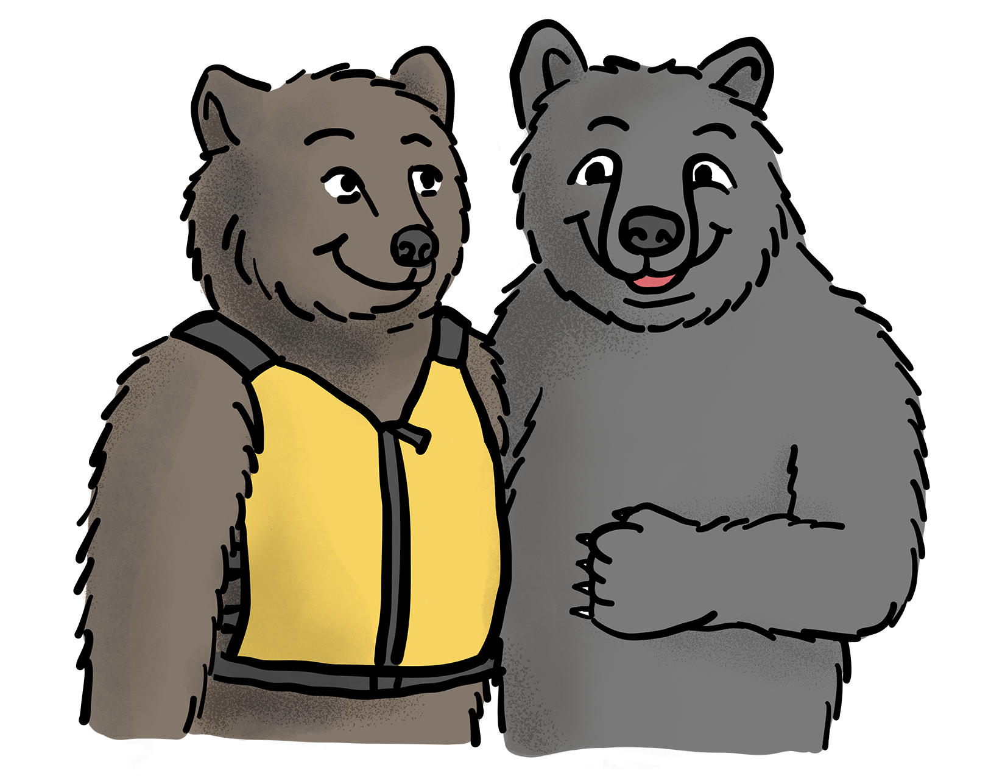
“Surrounding Family and Friends”: A collaborative research process with Indigenous people in Quebec
Chantal Plourde, Ph. D.
Université du Québec à Trois-Rivières, Canada
Autour de l’entourage

Slide 2
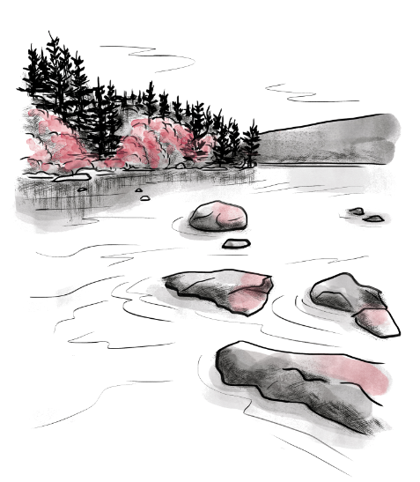
TERRITORIAL RECOGNITION
We would like to begin by acknowledging that the lands where this research project took place, are the traditional and unceded territory of many Indigenous Nations in Quebec.
Even today, First Nations and Inuit members face major inequalities in health and social services. It has been clearly established that the persistent prejudices, unavailability, and cultural inadequacy of the health care offered to First Nations and Inuit of Quebec are the causes.

Slide 3
Consequences for Indigenous Affected Family Members
In a context of multiple traumas, social isolation and stigmatization
Anxiety, guilt, disappointment and frustration
Fear of losing their loved one to overdose or criminal activity
Fear for their own safety and the safety of other family members
(Gendera et al., 2022; Orford et al., 2005, 2010, 2017; Tanner et al., 2022; Whiteside et al., 2018)

Slide 4
Context
Additional pressure : a problem that affects the whole community :
If they put their own needs first, AFM expect to be blamed for thinking of themselves.
As the results of historical, social and systemic factors:
Few specialized services are available in the communities
Indigenous are left on their own
(Gendera et al., 2022; Orford et al., 2005, 2010, 2017; Tanner et al., 2022; Whiteside et al., 2018)

Slide 5
Method
Research Objective:
Develop a better understanding of the support needs, services required, and barriers to treatment among Indigenous AFM.
Collaborative and Participatory Research Approach:
In order to gain in-depth access to their values, beliefs and experiences, we opted for a method that leaves plenty of room for them to express themselves.
Implies a sustainable engagement in which participants are considered as partners that have real decision-making power (MacKinnon, 2018).
*This project has been approved by two Research Ethics Boards

Slide 6
Method
Advisory committee:
14 addiction intervention stakeholders from 10 different Indigenous communities
The First Nations of Quebec and Labrador Health and Social Services Commission
Nunavik Regional Board of Health and Social Services.

Slide 7
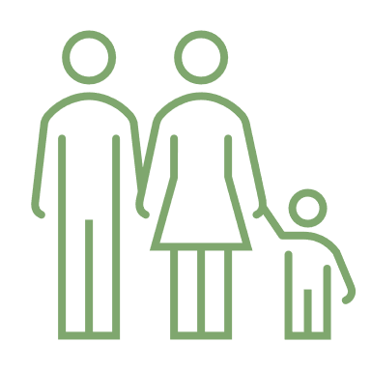
Data Collection and Sample
Interviews (French or English) in person, by telephone, or by video conference (between July 2021 and January 2022) conducted by the project coordinator (non-indigenous) and 3 Indigenous research assistants
The sample gathered 21 Indigenous AFM aged between 21 and 75 (M = 44.9; SD = 15.66), 18 women and 3 men.
All participants had more than one loved one with a problematic use:
10 partners
9 parents
4 children
8 extended family members

Slide 8
Analysis
N’Vivo 12
Continuous thematization method (Braun and Clarke, 2006) :
Familiarization with the data through reading and rereading the interviews.
Initial encoding of interesting characteristics.
Assignment of theme names to the groupings of codes.
Refinement of the themes through rereading the excerpts selected for each theme and relating them to the data set.
Refinement of the themes to reduce the number while retaining meaning.
Production of the analysis report.

Slide 9
Results : Four Main Categories of Need
To understand, help, and hope
To receive help in recognizing their own difficulties
To be supported humanely by a significant person
To have culturally adapted, diverse, and accessible services

Slide 10
To Understand, Help, and Hope
Understanding their loved one
Having the tools they need to help him or her
Learning to communicate better
Hoping that their loved one will get better

Slide 11
To Understand, Help, and Hope
“Ok, I think if alcoholism were explained to me, like, in depth, you know, what happens to a person when they become addicted to alcohol or to any other substance. And then, try to make my poor little brain understand all that and the implications, and the complications of alcoholism and what it does to the person, and what it does to the family”.
Rita, 74 years old, spouse’s experience

Slide 12
To Understand, Help, and Hope
“ When I asked for help, I just was asking help in the ways that I could better navigate the relationship. Like, being with somebody who has a substance abuse problem, I wanted to be able to uh, you know, help them in the best way that I could. And I still do um. ”
Catherine, 28 years old, spouse’s experience

Slide 13
To Receive Help in Recognizing Their Own Difficulties
Starting to work on themselves
Reflecting on their own use
Learning to communicate better
Venting and expressing their emotions
Learning to set boundaries

Slide 14
To Have Help in Recognizing Their Own Difficulties
“ Well, it's like I'd come to the end of what I needed, there was something I couldn't... I wasn't ready to go out there, you know, I wasn't ready to talk. The shame that was in me, the guilt, all that, I dragged it out for a long time. And I felt that I needed another resource that could help me, and that's when I started contacting psychologists. ”
Jacques, 58 years old, child's experience

Slide 15
To Be Supported Humanely by a Significant Person
Availability
Authenticity
Discretion
Non-judgment
Empathy
Competency

Slide 16
To Be Supported Humanely by a Significant Person
“ I would’ve liked to say all the things that I didn’t say [laughs]. In confidence in somebody who wouldn’t have judged me, or someone…that you could’ve spoke with someone who wouldn’t judge you and would kind of, like, understand more, yeah. ”
Julie, 38 years old, spouse’s experience

Slide 17
To Have Culturally Adapted, Diverse, and Accessible Services
Culture-centered approaches
Support groups
Working as a family
Working as a couple
Safe spaces for children
Making services accessible

Slide 18
To Have Culturally Adapted, Diverse and Accessible Services
“ The thing I wish I'd had longer ago there, to help me too. It would be more the...what...my culture. Because you know, the...I think that everyone who's injured here, we're looking for our identity, our cultural identity. ”
Mélanie, 46 years old, child, parent and spouse’s experience
“ Should it be structured like an individual therapy sort of way, uh group therapy, land-based activities? How […]? A combination of all. ”
Lucie, 61 years old, extended family members’ experience

Slide 19
Discussion
Participants would like to know more about addiction, how to better communicate with their loved one, and how to set boundaries.
They wished they had access to culturally appropriate services.
They also wished that someone had reached out to them to help.
Factors that promote recovery for AFM are : healthy lifestyle, education, training and support, adaptability of families, adoption of new behaviours and good communication (Rushton & al., 2023)

Slide 20
The Tool Developed
Consistent with the literature and what was mentioned by participants, we developed 6 short infographic cards to support intervention with Indigenous AFM.

Slide 21
Cards Content

Slide 22
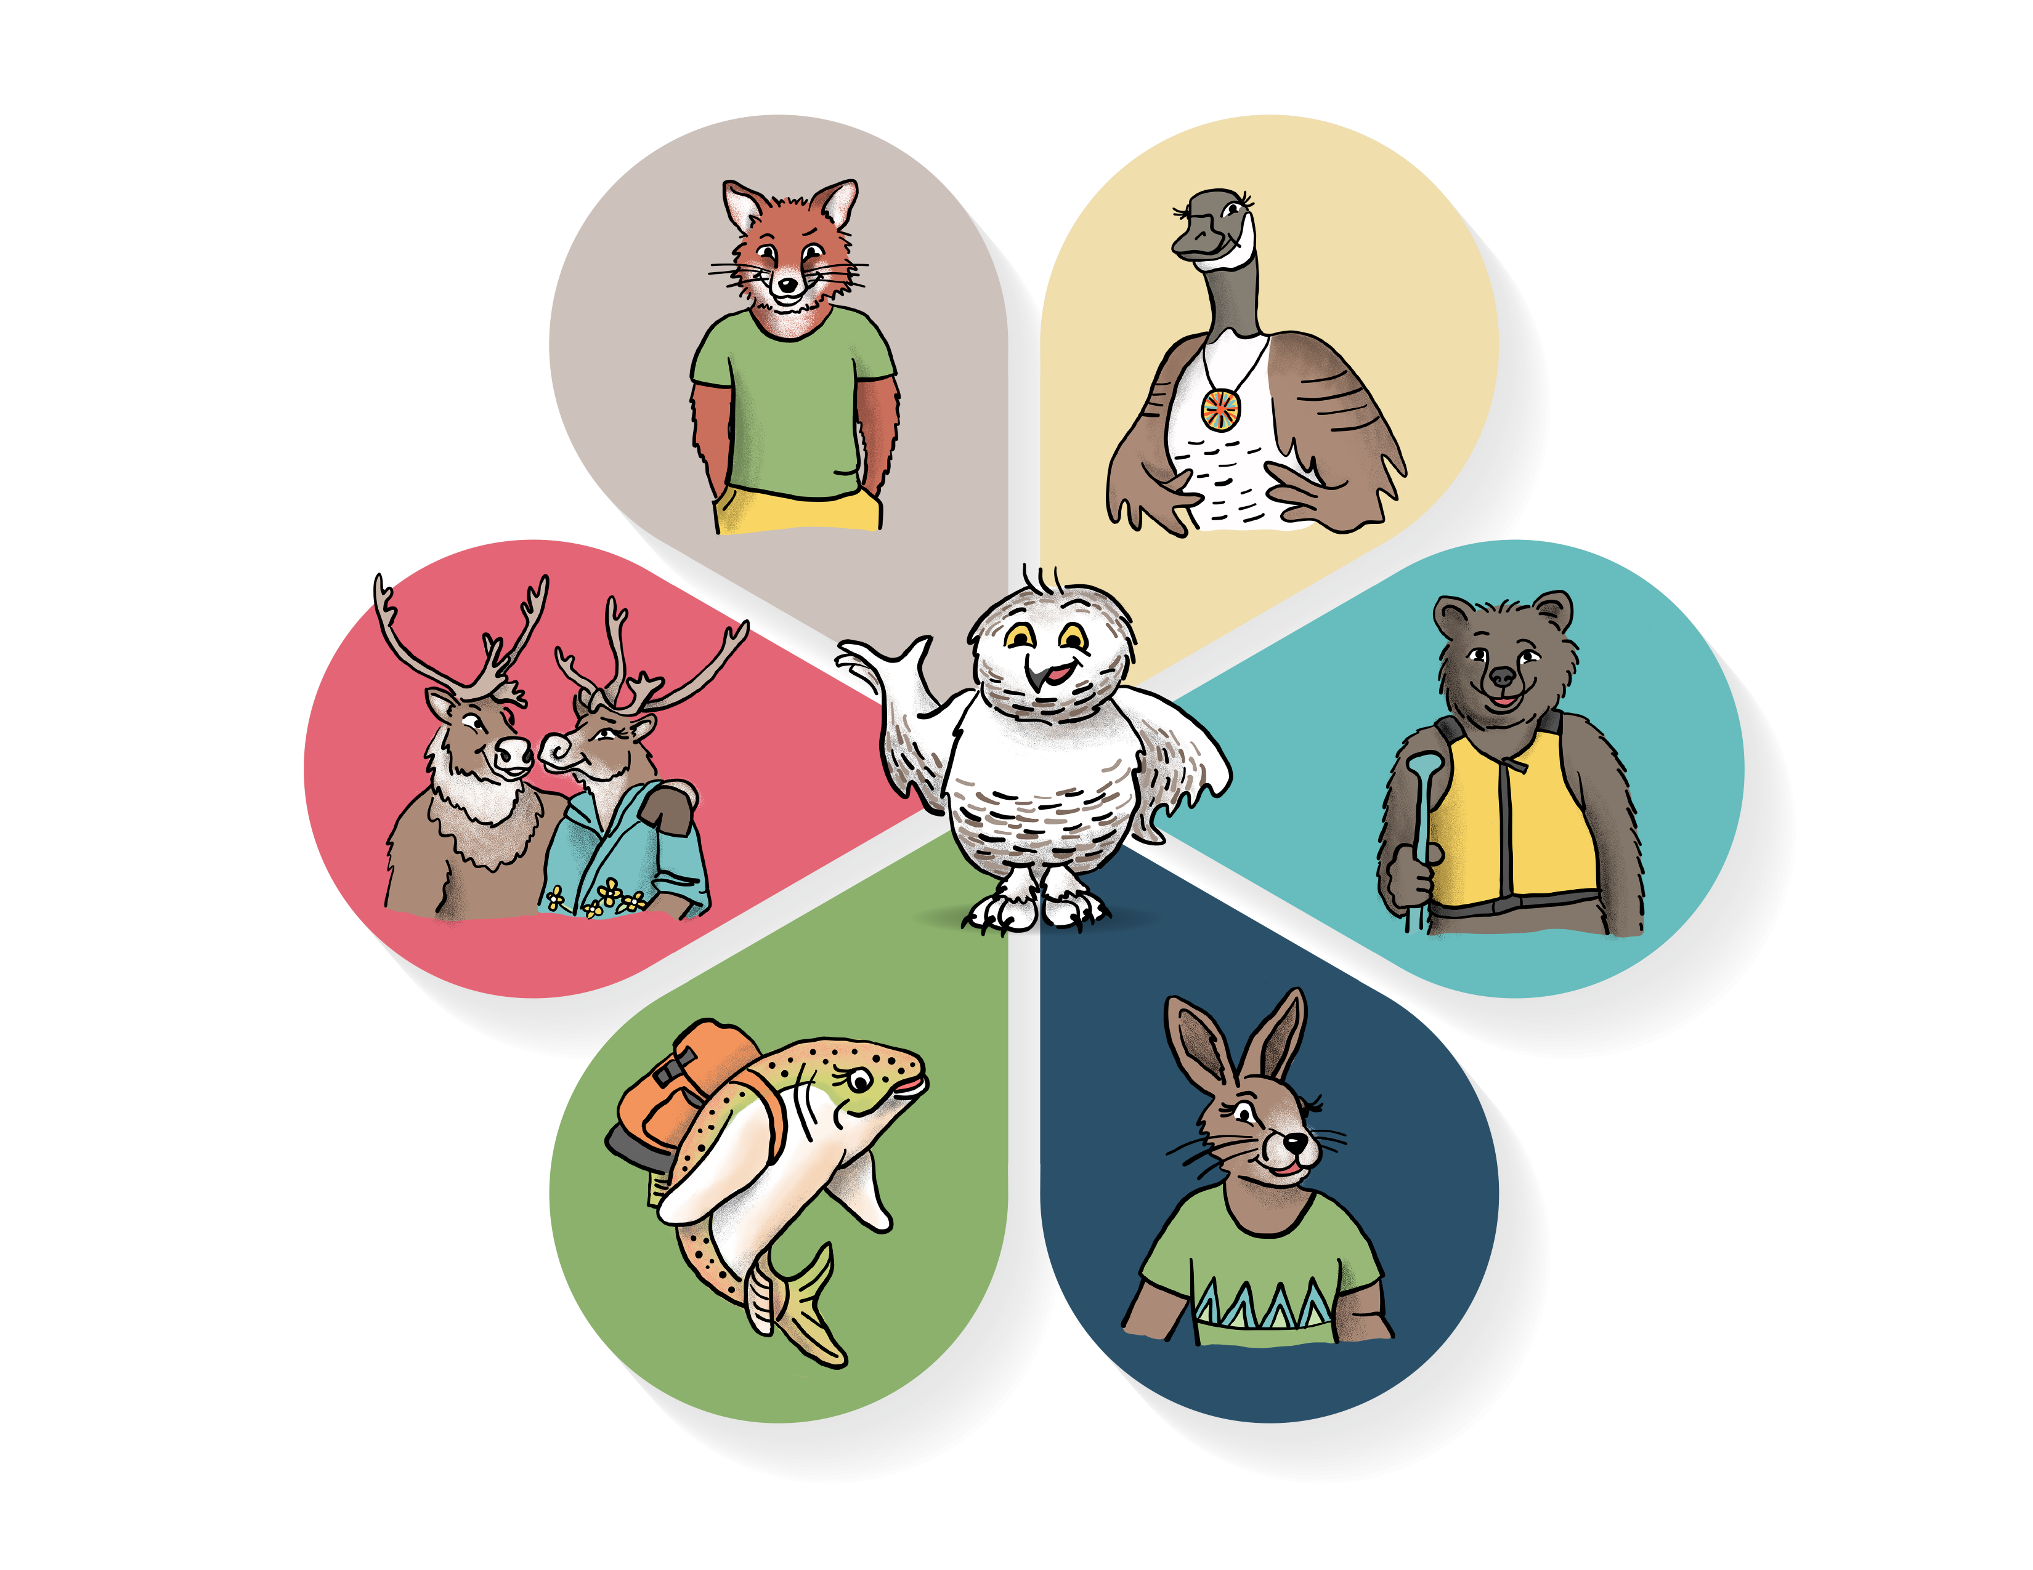
Topics Addressed
Motivation
Addiction
Lapses and Relapses
Self-care
Communication
My Behaviours

Slide 23
Creation and Validation Process
Experts
Addiction
Motivation
Self-care
Communication
My behaviours
Lapses and relapses
AFM (6) | 6 | 6 | 4 | 4 | 3 | 3
First Nations and Inuit students (4) | 4 | 4 | 4 | 4 | 4 | 4
Friendship center (14) | 10 | 10 | 6 | 6 | 5 | 5
Care providers (6) | 6 | 6 | 4 | 3 | 3 | 2
FNQLHSSC and NRBHSS (3) | 3 | 3 | 3 | 2 | 2 | 2

Slide 24
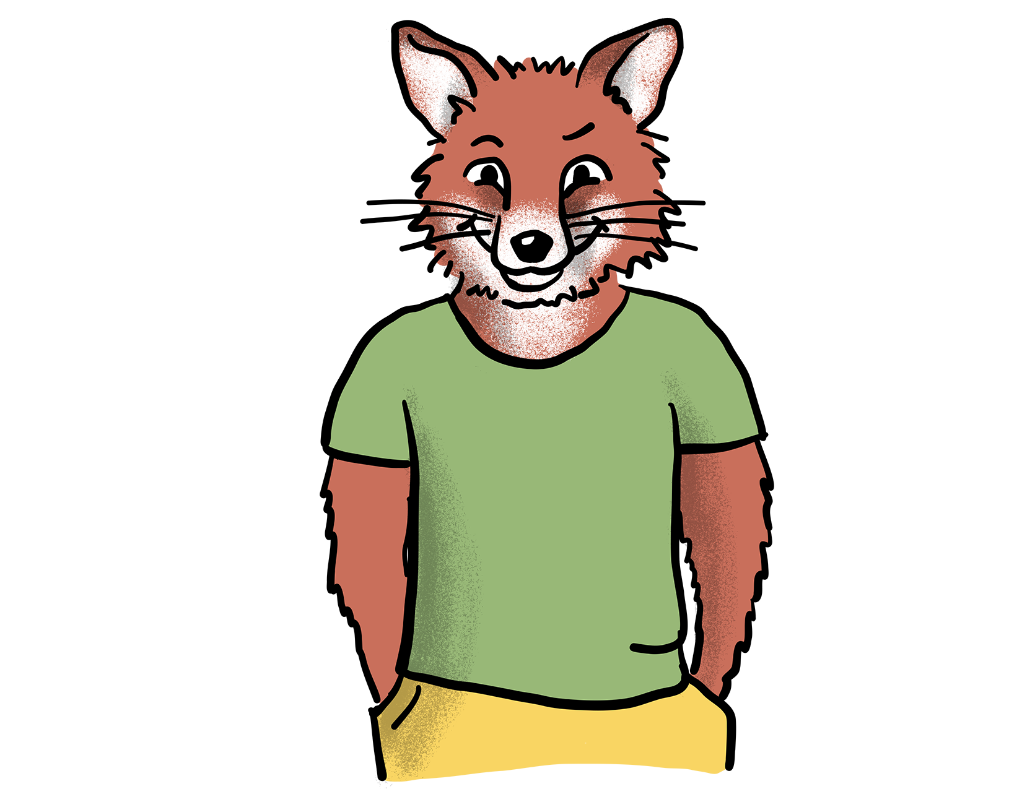
How to Use the Cards?
With AFM
Individual, family, couples or groups.
Allows to initiate the discussion and to inform.
To be handed out so that people can look at them at home and access the resources.
With the loved one
Discuss how their situation may affect those around them.
Encourage them to give the cards to their family and friends.
With other members of the community
Share on social media, in the newspaper, on the radio, or during thematic weeks.
Leave printed copies in strategic areas (e.g., waiting room).

Slide 25
Conclusion
Next step : Evaluate the tool
Implementation in more communities and organizations
Indigenous and non-indigenous

Slide 26
Where to Get the Tool?
Printable and audio versions of the cards are available in the section “Entourage” of the RISQ website: www.risqtoxico.ca
Questions/information: Chantal.Plourde@uqtr.ca

Slide 27
References
Braun, V. & Clarke, V. (2006). Using thematic analysis in psychology. Qualitative Research in Psychology, 3(2), 77‑101. https://doi.org/10.1191/1478088706qp063oa
Gendera, S., Treloar, C., Reilly, R., Conigrave, K. M., Butt, J., Roe, Y. & Ward, J. (2022). « Even though you hate everything that’s going on, you know they are safer at home »: The role of Aboriginal and Torres Strait Islander families in methamphetamine use harm reduction and their own support needs. Drug and alcohol review, 41(6), 1428‑1439. https://doi.org/10.1111/dar.13481
MacKinnon, S. (dir.). (2018). Practising Community-Based Participatory Research: Stories of Engagement, Empowerment, and Mobilization. Purich Books.
Orford, J. (2017). How does the common core to the harm experienced by affected family members vary by relationship, social and cultural factors? Drugs: Education, Prevention & Policy, 24(1), 9‑16. https://doi.org/10.1080/09687637.2016.1189876
Orford, J., Natera, G., Copello, A., Atkinson, C., Mora, J., Velleman, R., Crundall, I., Tiburcio, M., Templeton, L. & Walley, G. (2005). Coping with Alcohol and Drug Problems: The Experiences of Family Members in Three Contrasting Cultures. Routledge. https://doi.org/10.4324/9780203759608

Slide 28
References
Orford, J., Velleman, R., Copello, A., Templeton, L. & Ibanga, A. (2010). The experiences of affected family members: A summary of two decades of qualitative research. Drugs: Education, Prevention and Policy, 17(sup1), 44‑62. https://doi.org/10.3109/09687637.2010.514192
Orford, J., Velleman, R., Natera, G., Templeton, L. & Copello, A. (2013). Addiction in the family is a major but neglected contributor to the global burden of adult ill-health. Social Science & Medicine, 78, 70‑77. https://doi.org/10.1016/j.socscimed.2012.11.036
Rushton, C., Kelly, P. J., Raftery, D., Beck, A. & Larance, B. (2023). The effectiveness of psychosocial interventions for family members impacted by another’s substance use: A systematic review and meta-analysis. Drug and Alcohol Review, 42(4), 960‑977. https://doi.org/10.1111/dar.13607
Tanner, B., George, N., Brubacher, L. J., Morton Ninomiya, M. E., Peach, L., Bernards, S., Linklater, R., George, J. & Wells, S. (2022). Navigating Paths to Wellness: A Strengths-Based Photovoice Study Conducted with One First Nation in Southern Ontario, Canada. International journal of environmental research and public health, 19(17). https://doi.org/10.3390/ijerph191710979
Whiteside, M., MacLean, S., Callinan, S., Marshall, P., Nolan, S. & Tsey, K. (2018). Acceptability of an Aboriginal Wellbeing Intervention for Supporters of People Using Methamphetamines. Australian Social Work, 71(3), 358‑366. https://doi.org/10.1080/0312407X.2018.1473455

Slide 29
An Initiative by:
With the Financial Contribution of:
Special mention: "The views expressed here do not necessarily reflect those of Health Canada, the Ministère de la Santé et des Services sociaux or the CIUSSS du Centre-Sud de l'île-de-Montréal."

