Slide 1






A Mixed Methods Study of Online Peer-led Support for Family Members of People Living with Addiction
Robert Campbell, Programme Manager Family Drug & Gambling Help, SHARC
4th International AFINet Conference
Rotterdam, 15th and 16th June 2023
Annette Peart, Freya Horn, Jasmin Grigg, Victoria Manning, Robert Campbell, DanLubman

Slide 2


Acknowledgement of Country
Acknowledgment of Lived and Living Experience
I begin today by acknowledging the Bunnerong People of the East Kulin Nation on which SHARC stands and pay my respect to all Aboriginal and Torres Strait Islander peoples, and to their Elders past, present, and emerging.
SHARC acknowledges the individual and collective expertise of those with a lived or living experience of alcohol and other drug, mental health, and/or gambling harm. We envision a world where all people affected by the impact of addiction can proudly and openly seek help, help each other, and demonstrate the living proof that recovery is possible.
Notes:
Family members/friends affected by addiction can face challenges, including
Drug and alcohol misinformation
Public stigma and internalized stigma
Isolation
Difficulties coping
Unstable family relationships
Financial challenges
However, the health and well-being of family members/friends are often overlooked
There are limited services that support family members/friends, and limited research on support programs
Copello AG, Velleman RDB, Templeton LJ. 2005. Family interventions in the treatment of alcohol and drug problems. Drug Alcohol Rev. 24:369-385.
McCann TV, Lubman DI. 2018a. Stigma experience of families supporting an adult member with substance misuse. Int J Ment Health Nurs. 27:693-701.
McCann TV, Polacsek M, Lubman DI. 2019. Experiences of family members supporting a relative with substance use problems: A qualitative study. Scand J Caring Sci. 33:902-11.

Slide 3


Family Drug and Gambling Help (FDGH)
Founded in 2000 from grass roots response of families impacted by addiction
There are 54 staff made up of 9 paid staff and 45 volunteers
The service is made up of the following programs:
  Telephone Helpline
  InFocus – family education
  BreakThrough – family education, adapted to online
  Support Groups
  Muslim Youth, Adult and Family Program
  Three Sides of the Coin – enacted stories of gambling recovery
  Informed by the Stress Strain Coping Support Model and 5-step approach
Family Drug and Gambling Help (FDGH)

Slide 4
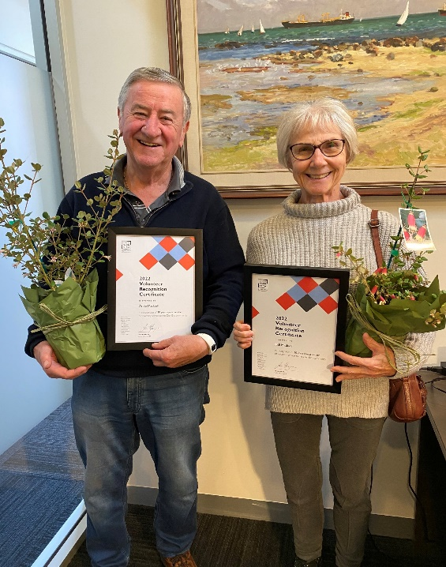
Recognising our Volunteers
Multiple awards have been received in recognition of the outstanding work done by our volunteers in FDGH
Family Drug and Gambling Help (FDGH)

Slide 5
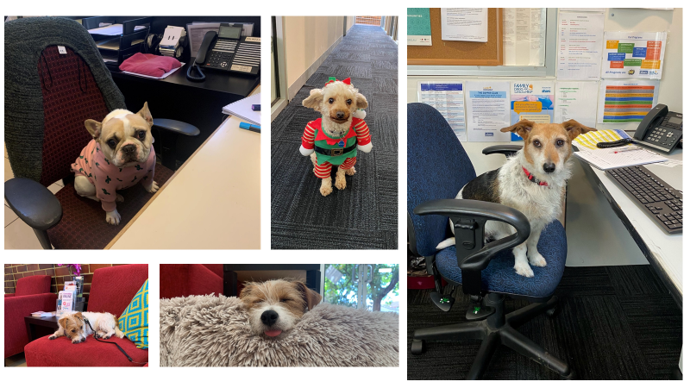
Telephone Helpline – some of the canine volunteers on SHARC dog days!
Family Drug and Gambling Help (FDGH)

Slide 6
  Family members/friends affected by addiction can face challenges, including: guilt, worry, stigma, estrangement, financial issues ……
  The health and well-being of family members/friends are often overlooked
  There are limited services that support family members/friends, and limited research on support programs
Family and Friends Affected by Addiction

Slide 7

Group psychoeducation and skills-building program for family and friends affected by addiction
Established 2015, delivered to over 7,000 Victorians, with approximately 50 sessions annually
Available online, with weekly hour-long sessions
https://www.breakthroughforfamilies.com/
Notes:
Group psychoeducation and skills-building program for family and friends affected by addiction
BreakThrough provides:
Information about addiction
Practical strategies, e.g., how to talk about substance use and boundaries, manage and respond to challenging behaviours, and care for oneself
A safe and confidential space, that is peer-based with trained facilitators
Established 2015, delivered to over 5,000 Victorians, with approximately 50 sessions annually
Available online, with fortnightly hour-long sessions
Joint program run by Turning Point and the Self Help Addiction Resource Centre (SHARC)
Website for BreakThrough is listed on the slide or google BreakThrough for families.

Slide 8

BreakThrough Online Support Group
Project Aim
  The aim was to understand how, and to what extent, the online peer-led support group impacted affected family members’ confidence in their coping abilities (self-efficacy), social support, and general wellbeing.
Notes:
We knew from BreakThrough internal feedback and from qualitative interviews with BT participants, that the BT program was highly valued by attendees.
Desire for more opportunity to connect with other families
Online setting is convenient, accessible, and non-threatening for Breakthrough attendees
So this research involved piloting an online support group, that built on the BreakThrough program.
The aim was to understand how, and to what extent, the online peer-led support group impacted affected family members’ confidence in their coping abilities (self-efficacy), social support, and general wellbeing.

Slide 9
Designed and trialed an online peer support group, connected to BreakThrough program
Support Group
Fortnightly, hour-long group meetings, after BreakThrough, led by BreakThrough facilitators
  Meetings comprised of participants reflecting and sharing on topics discussed in the Breakthrough sessions in a safe space.
  They were encouraged to use learned strategies with positive reinforcement.
  Meetings held 18 times between September 2021 and March 2022

Slide 10
2. Interviews: Qualitative semi-structured interviews
  Two part, mixed-methods design
Methods
Data Collection
1. Surveys: Pre and post online survey data
Notes:
Two part, mixed-methods design:
1. Surveys: Pre and post online survey data.
Participants completed pre-group survey when registering for the program. Participants invited to completed a secondary survey three-months after registration.
2. Interviews: Qualitative semi-structured interviews.
Invited to be interviewed about program in secondary survey

Slide 11
55 attended 1 or more meeting (average attendance 3 meetings, range 1-18)
N = 23 (completed pre and post surveys and 1 or more sessions)
96% women, average age 54 years, median 52 years (range 20 to 75)
65% parents, 22% partner/ex-partner, 13% child, friend, or other relative
Average 5 years as an affected family member
Common substances were methamphetamine, alcohol, and polysubstance
Survey Participants
Notes:
Two part, mixed-methods design:
1. Surveys: Pre and post online survey data.
Participants completed pre-group survey when registering for the program. Participants invited to completed a secondary survey three-months after registration.
2. Interviews: Qualitative semi-structured interviews.
Invited to be interviewed about program in secondary survey

Slide 12
Improvement in general self-efficacy (confidence to manage and cope with life challenges)
b = 2.63, 95% CI 0.82, 4.44, p = .004
Non-significant improvements in well-being index and social connectedness
Survey Results
Notes:
We had three main outcomes: General self-efficacy (confidence to manage and cope with life challenges), Well-being index (well-being measure based on seven key life indices), social connectedness scale (connection and isolation feelings).
Compared pre and post intervention scores by fitting liner mixed models with fixed effect for time and random intercept

Slide 13
All women, average age 57 years (range 40-66)
10 (91%) parents, 1 was partner/ex-partner
Average 9 years as an affected family member (range 1-18 years)
Methamphetamine, alcohol, and polysubstance
11 Interviews

Slide 14
1. Connecting with others who share the same world
2. It’s the facilitators that make the group
3. Accessing support when in crisis
3 Interview
Themes
Notes:
Conducted 11 semi-structured interviews. Developed three themes

Slide 15

Importance of connecting with others who share their experiences
Benefits of emotional support, normalisation, and practical advice
“I found it just helps you get your eyes off yourself […] people just gave good advice, just heard different ways that different people handled things.” – Erica, 56 years old, mother of son
“You wouldn’t really understand it unless you'd been through it [...] People are supportive, but if they haven't lived through it, it's different.” - Joy, 66 years old, mother of son
Participant names are replaced with pseudonyms
Theme 1 - Connecting with others who share the same world
Notes:
Opportunity to Connecting with others who share the same world
Isolation, supporting relative a different world, outsiders couldn’t understand
Benefits of emotional support, normalisation within realm of addiction, and practical lived-experience advice

Slide 16
Facilitators needed to be effective group managers
Facilitators needed complex skills, training, and professionalism to create a safe and supportive group
‘There will be some people who want to dominate. There will be shy people. [The facilitators] were really on track with, maybe checking people, but being nice, saying, ‘thank you, and let's hear from someone else’. – Emilia, 66 years old, mother of daughter
Theme 2 –
It’s the facilitators that make the group
Notes:
Facilitators role in creating a safe and supportive group environment
Facilitators needed to be effective group managers
Ensure equal opportunities to share
Manage different personalities, particularly distressed, talkative, or dominant attendees
Maintain non-judgemental and hopeful group tone
Facilitators needed complex skills, training, and professionalism
Without skilled and trained facilitators, support groups can be negative

Slide 17
Participants described accessing support when new challenges arose
Need for services to be easy and convenient to access
“Normally, I just go along, and try not to kind of think about it too much, but then something will happen […] that will start me off again, and then I will seek help”. - Mary, 64 years old, mother of daughter
“When you're doing something new, like - total strangers, it's difficult […] I found the Zoom was really good, because you could just sit and listen, if you feel a bit teary” - Joy, 66 years old, mother of son
Theme 3 –
Accessing support when in crisis
Notes:
Really about how family members access support services
Pattern of accessing support when new challenges arose
Need for services to be easy and convenient to access, to fit with other life demands and easy when stressed/emotionally drained.
Participants felt that online supports were generally convenient, nonthreatening, and easier than face-to-face supports, particularly during a crisis period.

Slide 18
SMS reminders prior to the sessions were a great resource used for all registered participants
Topics presented at Breakthrough prior to Online Support Group were relevant to the group.
The sessions provided opportunities for participants to have a voice for challenging situations that they have been dealing with, often for a large number of years.
Open questions from facilitators enabled effective reflections in the group.
Effective time was allocated to all participants to share.
Call-backs were offered and taken up by participants post-session.
Terrific feedback was received.
Experience of the Group
Notes:
Really about how family members access support services
Pattern of accessing support when new challenges arose
Need for services to be easy and convenient to access, to fit with other life demands and easy when stressed/emotionally drained.
Participants felt that online supports were generally convenient, nonthreatening, and easier than face-to-face supports, particularly during a crisis period.

Slide 19
Suggests online support group may increase confidence to manage challenges
Suggests connecting with other family members, skilled facilitators, and accessibility are core components
Quote from participant:
“Thanks so much Glenn, I really loved last night’s support group and found it powerful and emotional, but most of all I connected with everyone in it. Thanks so much for facilitating such a great group.”
Summary
Notes:
Most participants were mothers in midlife. We don’t know much about non-represented groups, e.g., male family members, and other (non-mother) family members, and AFMs in other age groups. -> what their needs are, how we can support them

Slide 20
Thank you to the team:
Annette Peart and Freya Horn
BreakThrough and Online Support Group Facilitators, Anna Guthrie, Nicola Scarlett, and Glenn Hunter
All participants
Contact – Robert Campbell rcampbell@sharc.org.au
https://www.breakthroughforfamilies.com/ https://www.turningpoint.org.au/
https://www.sharc.org.au/
Thank You!
Resources
Questions?
Notes:
Participants felt that online supports were generally convenient, nonthreatening, and easier than face-to-face supports, particularly during a crisis period.

Slide 21

Community Reinforcement and Family Training for parents of young adults with hazardous substance use: a randomized controlled trial
Ola Siljeholm, licensed psychologist, PhD-student
Department of Clinical Neuroscience, Centre for Psychiatry Research, Karolinska Institutet

Slide 22

background
Substance use peak between 18-29
Elevated risks in the present and future
Treatment gap
Parents matter
Notes:
I’m actually going to start by mentioning the aims of this doctoral project for the sake of clarity. The overall aim is to investigate new ways of supporting concerned significant others of persons with a problematic use of alcohol or other substances or CSOs as they will be referred to from now on. A more specific aim is to investigate if these support programs for CSOs, beside helping the CSOs themselves, can actually change the impact of alcohol and substance use on children and young adults. And already now I want to say that these support programs have a common foundation in a program called Community Reinmforcement Approach and Family Training, CRAFT which I will tell you more about in a short while.

Slide 23
background
Parents as concerned significant others (CSOs) particularly strained
Stigma by association
Often excluded from treatment
In need of support
Notes:
I’m actually going to start by mentioning the aims of this doctoral project for the sake of clarity. The overall aim is to investigate new ways of supporting concerned significant others of persons with a problematic use of alcohol or other substances or CSOs as they will be referred to from now on. A more specific aim is to investigate if these support programs for CSOs, beside helping the CSOs themselves, can actually change the impact of alcohol and substance use on children and young adults. And already now I want to say that these support programs have a common foundation in a program called Community Reinmforcement Approach and Family Training, CRAFT which I will tell you more about in a short while.

Slide 24
Community reinforcement and family training (CRAFT)
Three main aims:
Increase quality of life for CSOs
Decrease the relative’s alcohol-/drug consumption
Promote treatment seeking behavior in the relative
Notes:
One interesting approach for supporting CSOs that has emerged over the last twenty years is this program, called….

Slide 25



CRAFT – basic components
Functional analyses
Communication skills
Reinforcement of healthy behaviors
Notes:
One interesting approach for supporting CSOs that has emerged over the last twenty years is this program, called….

Slide 26
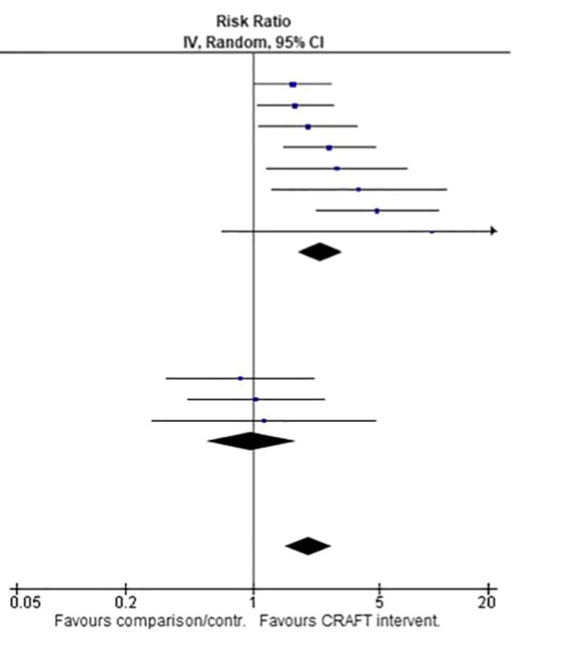
CRAFT – evidence
Meta-analysis (Archer, 2020):
72% - 100% female
Treatment seeking 12,5% - 86%
”In-house treatment” appear significant
Other systematic reviews:
CRAFT increase CSOs quality of life – so does active controls
Not previously evaluated (RCT) for parent – young adult relationship

Slide 27
Aim
Investigate if CRAFT for parents is more effective than
counselling in engaging treatment refusing substance
using young adults in treatment.

Slide 28

Method
Design: Randomized controlled superiority trial
Participants: 113 parents (or similar relationship) of a treatment refusing young adult (age: 18-24) with hazardous substance use
Interventions: CRAFT vs counselling in two outpatient clinics, subsequently via Zoom
Primary outcome measure: Young adult’s treatment entry at 24 weeks after inclusion
Secondary outcomes (selection): Young adult alcohol- and substance use, parental depression, anxiety and stress, parental self-efficacy and relational happiness
Funding: Public Health Agency of Sweden, Stockholm County Council (ALF project)

Slide 29
Method
Interventions:
CRAFT
  8 individual sessions, 1/week
  Each session different themes
  Home assignments each week
Counselling:
5 individual sessions
  Each session different themes
  No home assignments or exercises aimed at behavioral change
1 group session, facts about drugs

Slide 30
Results – study flowchart
Notes:
Hur går det för oss? Jo i slutet av våren då vi hade följt upp drygt 100 deltagare så fick vi indikationer på att det gick bra för deltagarna i båda grupperna. Vi bestämde oss då för att göra en interimsanalys och såg att det mer eller mindre var dött lopp mellan de två armarna. Båda programmen ledde alltså till att nästan hälften av de unga vuxna inledde någon form av behandlingskontakt under de sex månader som vi följde dem. Vi beslutade oss därför att avsluta studien i förväg för att inte i onödan utsätta fler deltagare för det omak det ändå innebär att vara med i en studie och för att snabbare kunna få ut dessa stödprogram i den ordinarie verksamheten.

Slide 31
Results – participant characteristics

Slide 32
Results – young adult characteristics

Slide 33
Preliminary results – treatment seeking
32% of young adults entered treatment
No between groups difference
Higher treatment engagement in young adults previously in treatment
Harder to engage young adults 18-21 years
Notes:
Hur går det för oss? Jo i slutet av våren då vi hade följt upp drygt 100 deltagare så fick vi indikationer på att det gick bra för deltagarna i båda grupperna. Vi bestämde oss då för att göra en interimsanalys och såg att det mer eller mindre var dött lopp mellan de två armarna. Båda programmen ledde alltså till att nästan hälften av de unga vuxna inledde någon form av behandlingskontakt under de sex månader som vi följde dem. Vi beslutade oss därför att avsluta studien i förväg för att inte i onödan utsätta fler deltagare för det omak det ändå innebär att vara med i en studie och för att snabbare kunna få ut dessa stödprogram i den ordinarie verksamheten.

Slide 34
Preliminary results – Substance use
Reduction substance use, groups combined (effect size: Cohen’s d = 0.516)
Reduction alcohol use, groups combined (Cohen’s d = 0.361)
Notes:
Hur går det för oss? Jo i slutet av våren då vi hade följt upp drygt 100 deltagare så fick vi indikationer på att det gick bra för deltagarna i båda grupperna. Vi bestämde oss då för att göra en interimsanalys och såg att det mer eller mindre var dött lopp mellan de två armarna. Båda programmen ledde alltså till att nästan hälften av de unga vuxna inledde någon form av behandlingskontakt under de sex månader som vi följde dem. Vi beslutade oss därför att avsluta studien i förväg för att inte i onödan utsätta fler deltagare för det omak det ändå innebär att vara med i en studie och för att snabbare kunna få ut dessa stödprogram i den ordinarie verksamheten.

Slide 35

Preliminary results - selection
No change in parental depression, anxiety or stress (low baseline values)
Within-group changes:
Increased parental self-efficacy
Improved relationship happiness
Notes:
Hur går det för oss? Jo i slutet av våren då vi hade följt upp drygt 100 deltagare så fick vi indikationer på att det gick bra för deltagarna i båda grupperna. Vi bestämde oss då för att göra en interimsanalys och såg att det mer eller mindre var dött lopp mellan de två armarna. Båda programmen ledde alltså till att nästan hälften av de unga vuxna inledde någon form av behandlingskontakt under de sex månader som vi följde dem. Vi beslutade oss därför att avsluta studien i förväg för att inte i onödan utsätta fler deltagare för det omak det ändå innebär att vara med i en studie och för att snabbare kunna få ut dessa stödprogram i den ordinarie verksamheten.

Slide 36

Discussion
CRAFT treatment seeking as expected - counselling unexpectedly high
  High CSO motivation?
  Unknown components promoting treatment entry?
”In-house treatment” important as a bridge?
Notes:
Hur går det för oss? Jo i slutet av våren då vi hade följt upp drygt 100 deltagare så fick vi indikationer på att det gick bra för deltagarna i båda grupperna. Vi bestämde oss då för att göra en interimsanalys och såg att det mer eller mindre var dött lopp mellan de två armarna. Båda programmen ledde alltså till att nästan hälften av de unga vuxna inledde någon form av behandlingskontakt under de sex månader som vi följde dem. Vi beslutade oss därför att avsluta studien i förväg för att inte i onödan utsätta fler deltagare för det omak det ändå innebär att vara med i en studie och för att snabbare kunna få ut dessa stödprogram i den ordinarie verksamheten.

Slide 37

Strengths and limitations
+ Interventions delivered in an existing treatment setting – high ecological validity
+ High therapist adherence to protocol
+ 90% of participants completed interventions
- Difficult for parents to assess substance use
- Active control – no certain intervention effects
Notes:
Hur går det för oss? Jo i slutet av våren då vi hade följt upp drygt 100 deltagare så fick vi indikationer på att det gick bra för deltagarna i båda grupperna. Vi bestämde oss då för att göra en interimsanalys och såg att det mer eller mindre var dött lopp mellan de två armarna. Båda programmen ledde alltså till att nästan hälften av de unga vuxna inledde någon form av behandlingskontakt under de sex månader som vi följde dem. Vi beslutade oss därför att avsluta studien i förväg för att inte i onödan utsätta fler deltagare för det omak det ändå innebär att vara med i en studie och för att snabbare kunna få ut dessa stödprogram i den ordinarie verksamheten.

Slide 38

Preliminary conclusions
CRAFT and the manualized counselling program efficacious in:
Increasing treatment-seeking among young adults with hazardous substance use
Decreasing young adult use of alcohol and illicit substances
Provides argument in favor of offering manualized support programs for parents within the health care system
Notes:
Broadening the perspectives on CSOs mean that
within the social services and health care system in Sweden

Slide 39

queries looking ahead
What were the parents experiences of CRAFT (and counselling)?
How come both programs worked equally well?
How to implement manualized support for parents in health care?
Notes:
Broadening the perspectives on CSOs mean that
within the social services and health care system in Sweden

Slide 40
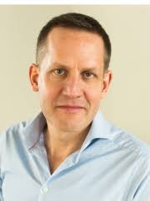
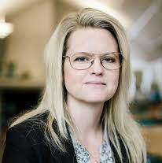
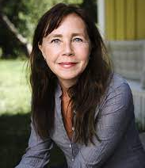
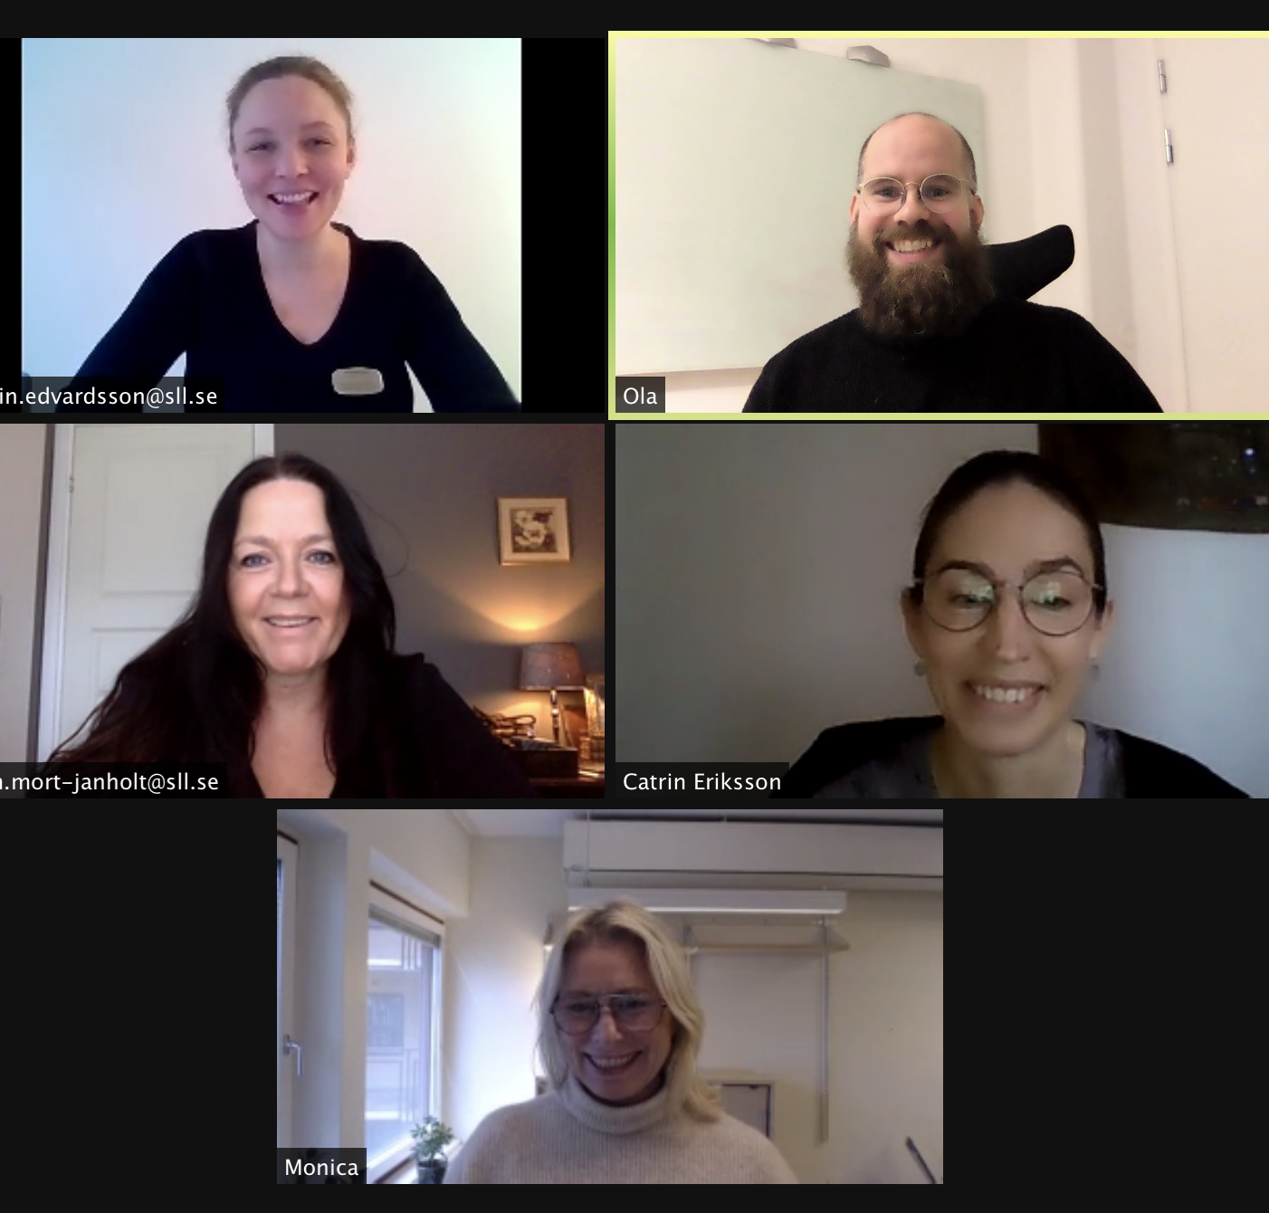
Acknowledgements
Anders Hammarberg, associate professor, Karolinska Institutet
Veronica Ekström, associate professor, Marie Cederschiöld University
Malin Bergström, associate professor, Karolinska Institutet
Study coordinators and therapists
Notes:
Ingen människa är som bekant en ö, och jag vill rikta ett stort tack till följande personer som bidragit på olika vis i det här projektet.

Slide 41

Questions

Slide 42

Thank you for listening
Ola.siljeholm@ki.se
Notes:
And since no man is an island I want to acknowledge a few people. First of all my excellent supervisors with Anders in the lead and Malin and Veronica as co.supervisors. I’m really happy to have you onboard and can always turn to you for support.
Magnus Johansson definately needs praise as the brains behind study I, co writer of the program and internet genious
Sofia Vänelid for all the help with taking care of participants in the program
Philip Lindner, for your statistical knowledge and other contributions
I’m very lucky to be surrounded with so many great people, thank you
And finally of course my wife Hanna and children Frank and Elis, the sun around which my world revolves

Slide 43
References
Archer, M., Harwood, H., Stevelink, S., Rafferty, L., & Greenberg, N. (2020). Community reinforcement and family training and rates of treatment entry: a systematic review. Addiction, 115(6), 1024-1037. doi:10.1111/add.14901
Bischof, G., Iwen, J., Freyer-Adam, J., & Rumpf, H. J. (2016). Efficacy of the Community Reinforcement and Family Training for concerned significant others of treatment-refusing individuals with alcohol dependence: A randomized controlled trial. Drug Alcohol Depend, 163, 179-185. doi:10.1016/j.drugalcdep.2016.04.015
Cleverley, K., Grenville, M., & Henderson, J. (2018). Youths Perceived Parental Influence on Substance Use Changes and Motivation to Seek Treatment. The Journal of Behavioral Health Services & Research, 45(4), 640-650. doi:10.1007/s11414-018-9590-2
Copello, A., Templeton, L., Orford, J., & Velleman, R. (2010). The 5-Step Method: Evidence of gains for affected family members. Drugs: Education, Prevention and Policy, 17(sup1), 100-112. doi:10.3109/09687637.2010.514234
Corrigan, P. W., Watson, A. C., & Miller, F. E. (2006). Blame, shame, and contamination: the impact of mental illness and drug dependence stigma on family members. J Fam Psychol, 20(2), 239-246. doi:10.1037/0893-3200.20.2.239
Earnshaw, V. A., Bogart, L. M., Menino, D. D., Kelly, J. F., Chaudoir, S. R., Reed, N. M., & Levy, S. (2018). Disclosure, Stigma, and Social Support Among Young People Receiving Treatment for Substance Use Disorders and Their Caregivers: a Qualitative Analysis. International Journal of Mental Health and Addiction, 17(6), 1535-1549. doi:10.1007/s11469-018-9930-8
Grant, B. F., Goldstein, R. B., Saha, T. D., Chou, S. P., Jung, J., Zhang, H., . . . Hasin, D. S. (2015). Epidemiology of DSM-5 Alcohol Use Disorder: Results From the National Epidemiologic Survey on Alcohol and Related Conditions III. JAMA Psychiatry, 72(8), 757. doi:10.1001/jamapsychiatry.2015.0584
Notes:
I’m actually going to start by mentioning the aims of this doctoral project for the sake of clarity. The overall aim is to investigate new ways of supporting concerned significant others of persons with a problematic use of alcohol or other substances or CSOs as they will be referred to from now on. A more specific aim is to investigate if these support programs for CSOs, beside helping the CSOs themselves, can actually change the impact of alcohol and substance use on children and young adults. And already now I want to say that these support programs have a common foundation in a program called Community Reinmforcement Approach and Family Training, CRAFT which I will tell you more about in a short while.

Slide 44
References
Grant, B. F., Saha, T. D., Ruan, W. J., Goldstein, R. B., Chou, S. P., Jung, J., . . . Hasin, D. S. (2016). Epidemiology of DSM-5 Drug Use Disorder: Results From the National Epidemiologic Survey on Alcohol and Related Conditions-III. JAMA Psychiatry, 73(1), 39. doi:10.1001/jamapsychiatry.2015.2132
Gulliver, A., Griffiths, K. M., & Christensen, H. (2010). Perceived barriers and facilitators to mental health help-seeking in young people: a systematic review. BMC Psychiatry, 10(1), 113. doi:10.1186/1471-244x-10-113
Hodgins, S., Larm, P., Molero-Samuleson, Y., Tengstrom, A., & Larsson, A. (2009). Multiple adverse outcomes over 30 years following adolescent substance misuse treatment. Acta Psychiatr Scand, 119(6), 484-493. doi:10.1111/j.1600-0447.2008.01327.x
Kirby, K. C., Versek, B., Kerwin, M. E., Meyers, K., Benishek, L. A., Bresani, E., . . . Meyers, R. J. (2015). Developing Community Reinforcement and Family Training (CRAFT) for Parents of Treatment-Resistant Adolescents. Journal of Child & Adolescent Substance Abuse, 24(3), 155-165. doi:10.1080/1067828x.2013.777379
Meyers, R. J., Miller, W. R., Hill, D. E., & Tonigan, J. S. (1998). Community reinforcement and family training (CRAFT): engaging unmotivated drug users in treatment. J Subst Abuse, 10(3), 291-308. Retrieved from http://dx.doi.org/
Miller, W., Meyers, R.M., & Tonigan, S.J. (1999). Engaging the unmotivated in treatment for alcohol problems- A comparison of three intervention strategies. Journalof consulting and clinical psychology, 67(5), 688-697.
O’Farrell, T. J., & Clements, K. (2012). Review of Outcome Research on Marital and Family Therapy in Treatment for Alcoholism. Journal of Marital and Family Therapy, 38(1), 122-144. doi:10.1111/j.1752-0606.2011.00242.x
Notes:
I’m actually going to start by mentioning the aims of this doctoral project for the sake of clarity. The overall aim is to investigate new ways of supporting concerned significant others of persons with a problematic use of alcohol or other substances or CSOs as they will be referred to from now on. A more specific aim is to investigate if these support programs for CSOs, beside helping the CSOs themselves, can actually change the impact of alcohol and substance use on children and young adults. And already now I want to say that these support programs have a common foundation in a program called Community Reinmforcement Approach and Family Training, CRAFT which I will tell you more about in a short while.

Slide 45
References
Orford, J., Velleman, R., Copello, A., Templeton, L., & Ibanga, A. (2010). The experiences of affected family members: A summary of two decades of qualitative research. Drugs: Education, Prevention and Policy, 17(sup1), 44-62. doi:10.3109/09687637.2010.514192
Ozechowski, T. J., & Waldron, H. B. (2010). Assertive Outreach Strategies for Narrowing the Adolescent Substance Abuse Treatment Gap: Implications for Research, Practice, and Policy. The Journal of Behavioral Health Services & Research, 37(1), 40-63. doi:10.1007/s11414-008-9136-0
Richert, T., Johnson, B., & Svensson, B. (2018). Being a Parent to an Adult Child With Drug Problems: Negative Impacts on Life Situation, Health, and Emotions. Journal of Family Issues, 39(8), 2311-2335. doi:10.1177/0192513x17748695
Roozen, H. G., de Waart, R., & van der Kroft, P. (2010). Community reinforcement and family training: an effective option to engage treatment-resistant substance-abusing individuals in treatment. Addiction, 105(10), 1729-1738. doi:10.1111/j.1360-0443.2010.03016.x
SAHMSA. (2020). Substance Abuse and Mental Health Services Administration. (2020). Key substance use and mental health indicators
in the United States: Results from the 2019 National Survey on Drug Use and Health (HHS Publication No.
PEP20-07-01-001, NSDUH Series H-55). Rockville, MD: Center for Behavioral Health Statistics and Quality,
Substance Abuse and Mental Health Services Administration. Retrieved from https://www.samhsa.gov/data/.
Waldron, H. B., & Turner, C. W. (2008). Evidence-based psychosocial treatments for adolescent substance abuse. J Clin Child Adolesc Psychol, 37(1), 238-261. doi:10.1080/15374410701820133
Notes:
I’m actually going to start by mentioning the aims of this doctoral project for the sake of clarity. The overall aim is to investigate new ways of supporting concerned significant others of persons with a problematic use of alcohol or other substances or CSOs as they will be referred to from now on. A more specific aim is to investigate if these support programs for CSOs, beside helping the CSOs themselves, can actually change the impact of alcohol and substance use on children and young adults. And already now I want to say that these support programs have a common foundation in a program called Community Reinmforcement Approach and Family Training, CRAFT which I will tell you more about in a short while.

Slide 46







How to reach the wide number of AFMs with Evidence-Based Information and Motivational Intervention in the Low Income Country, Brazil?
4th Annual Conference University of Rotterdam
Cassandra Borges Bortolon
Clinic Psychologist, Specialist, MSc, Health Science PhD,
AFINet Trustee
AFINet June 2023

Slide 47
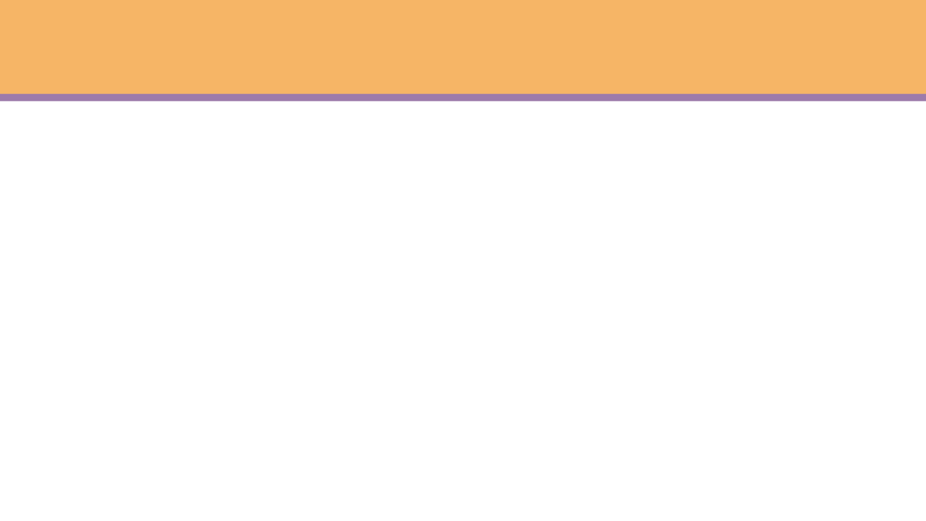
Outline
Global burden on family health
AcurarTECH (intervention)
Main characteristics in our database
Flora's intervention script
Case report
Summary

Slide 48
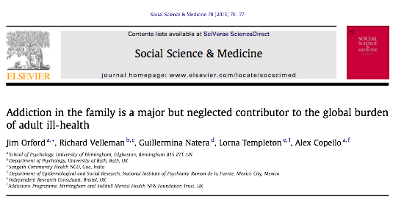

Introduction
Global burden in AFMs health
Prevalence in Brazil
AFMs around 30 million
Information deficits
30.000.000

Slide 49
Introduction
Minimizing the information deficit
Increasing specialized care
Support program for AFMs

Slide 50
What is the AcurarTECH?
AcurarTECH
It is a startup that focuses on reaching the wide prevalence of AFMs in a Low Income Country, Brazil.
AIM
To provide an environment that connects qualified professionals to help for AFMs.
AcurarTECH was supported by funding centers of research and entrepreneurship in Brazil.
However, there is no funding at the moment.

Slide 51
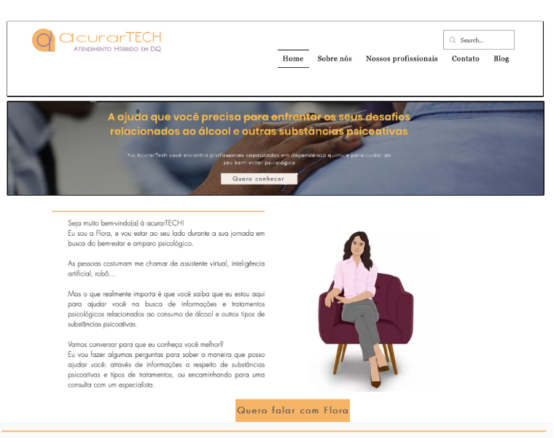
Website
Dependência Química | Acurartech
WhatsApp: +55 51 98310-2726

Slide 52
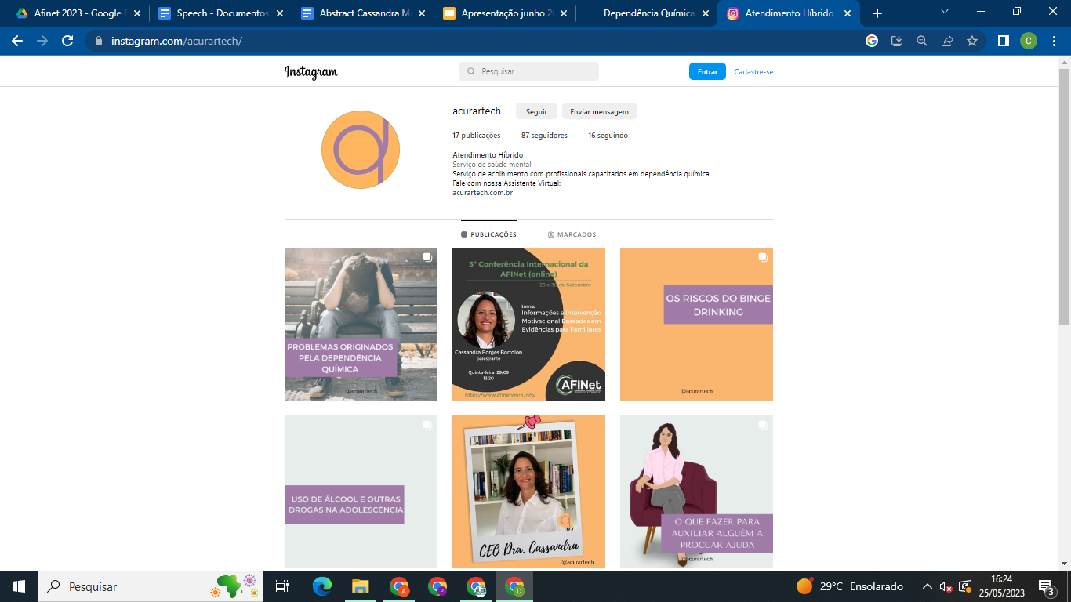
Instagram
Atendimento Híbrido (@acurartech) on Instagram

Slide 53

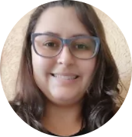
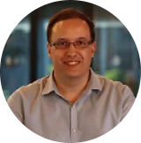
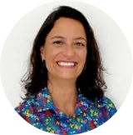
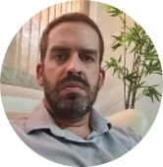
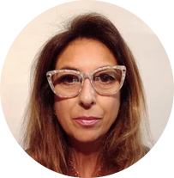
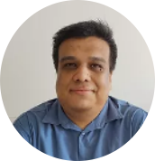
Our Team of Psychologist

Slide 54
How does Acurartech work?
Our intervention is made in 2 ways:
1- For free, using a virtual assistant, Flora.
1.1- Provide orientation and information.
2- Charging a reduced fee using human counsellors.
2.1- Psychology counseling.

Slide 55

Our Intervention - Way 1
1 Proving orientation - Flora
Information regarding to drug abuse and how the family can deal with its misuse.
Therefore, Flora utilizes our database to
provide initial counseling to AFMs.

Slide 56
Database Evidence - Based Information
Clear and direct questions and answers
Development of the Chatbot
Flora's Script
We are here
Advance to Deep learning
Advance to Deep learning

Slide 57
Our Intervention - Way 2
2- Hybrid model
2.1- Psychology counseling by Motivational Intervention for Families (MIF)
After the contact of AFMs with Flora and if AFMs are interested, the next step is MIF conducted by a psychologist, for a reduced fee of ⅓ of the standard counseling fee.
Our psychologists have trained the Protocol MIF.

Slide 58
Our Approach
Motivational Intervention for Families was based on:**** (MIF)
Stages of change;
Motivational Interview,
Telemedicine.
It consists of 9 structured sessions.
MIF in order to minimize the impacts of living with a loved one that misuses substances.
**** Bortolon et al., 2017.

Slide 59
Main characteristics of the AFMs
Relationship of AFM to people with addiction/alcohol problems: Mothers, wives and siblings.
Gender: Female.
Age: > 41 years old.
Marital status: Married.
Educational level: > 8 years.
Income: <5 times the minimum wage.
Request of AFMs: Asking for help and Information about alcohol and other drugs.

Slide 60
Flora's Interaction Script
Flora introduces itself.
It explains what AcurarTech is and how it can help.
It asks some questions in order to get to know a little bit more about AFMs.
Flora provides information.
After providing this information it asks if it had made sense.
Flora checks.
Flora follows according to their need.
Flora highlights.
Therefore, information and specialized care is important.

Slide 61
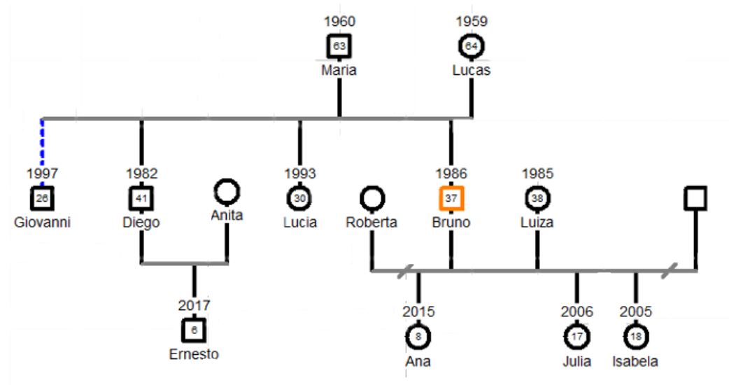
Case Report - Cruz Family Genogram

Slide 62
Case Report - Initial Information
- The family suspect that Bruno was gambling, but not using cocaine.
- Bruno told his family about his problems and ask for help seeking treatment.
-The intervention followed the first 6 sessions with the participation of the parents and the siblings.
- After, Bruno and his partner joined the sessions.

Slide 63
Case Report – The main matters discussed and worked
Initial Stage
Family conflicts.
Communication.
Relapses.
Intermedium Stage:
To encompass the father-son relationship and the family company bonds.
Psychoeducation.
"Final” Stage:
Change of work: Bruno left the family company.
There were attempts to schedule a "closing" session with all the members of the family.
However, it did not happen, but has not yet been discarded for the mother.
Maria remains sending positive updates to psychologist.

Slide 64
Case Report – Benefits of the intervention
Maria feels better.
She sees that Bruno is happier and more at ease.
Lucas accepted and respected Bruno's decision, stepping down from the company. Bruno and Lucas' conflicts have decreased.
Bruno quit use of cocaine, but remained using alcohol with his wife in order to keep a monitored and controlled use.
The whole family is calmer and with more knowledge about the issue.
The family has to maintain a continuous support to the son.

Slide 65
How to reach a bigger number of AFMs?
The advancement of the WhatsApp interaction with Flora into AI.
Increase of the dissemination of the MIF.
Get more funding to develop the AI tool.
Have more partners.
Our team will write a paper.

Slide 66
Summary
AcurarTECH has worked for some AFMs.
The engagement of AFMs is very important to help other families.
When AFMs get attention and intervention with focus on themselves, the outcome to the whole family will be good.
Increase the accessibility of AcurarTECH through Artificial Intelligence may reach a bigger number of Brazilian AFMs.

Slide 67

References
BORTOLON, C.B. et al. (2016) Family Functioning and Health Issues Associated with Codependency in Families of Drug Users. Ciência & Saúde Coletiva (Online), 21, p.101 – 107.
BORTOLON, C.B. et al. (2017) Six-Month Outcomes of a Randomized, Motivational Tele-intervention for Change in the Codependent Behaviour of Family Members of Drug Users. Substance Use and Misuse, 52 (2), p. 164-174, 2017.
CARR, C. J.A, et al. (2008). Individual and system influences on waiting time for substance abuse treatment. Journal of Substance Abuse Treatment. 34. 192-201.
COPELLO, A. et al. (2010). The impact of addiction on the family: Estimates of prevalence and costs. Drug: education, prevention and policy. December; 17 (S1): 63-74.
HORTA. A. et al. (2016). Vivência e estratégias de enfrentamento de familiares de dependentes. Rev. Bras. Enfermagem. nov-dez, 69 (6):1024-30.
ORFORD, J. et al. (2017a). The burden experienced by Brazilian family members affected by their relatives’ alcohol or drug misuse. Drug: Education, prevention and policy. 24(1):9-16.
ORFORD, J. (2017b). How does the common core to the harm experienced by affected family members vary by relationship, social and cultural factors? Drugs: Education, Prevention and Policy. 24(1):9-16.
ORFORD, J. et al. (2013). Addiction in the family is a major but neglected contributor to the global burden of adult ill-health. Social Science & Medicine 78. pg 70-78.
SAKIYAMA, H.M.T. et al. (2015). Family members affected by a relative’s substance misuse looking for social support: Who are they? Drug and alcohol Dependence, 147, p. 276-279.
UNODC. United Nations Office on Drugs and Crime. (2019). World Drug Report. Retrieved 2022, September 20.

Slide 68
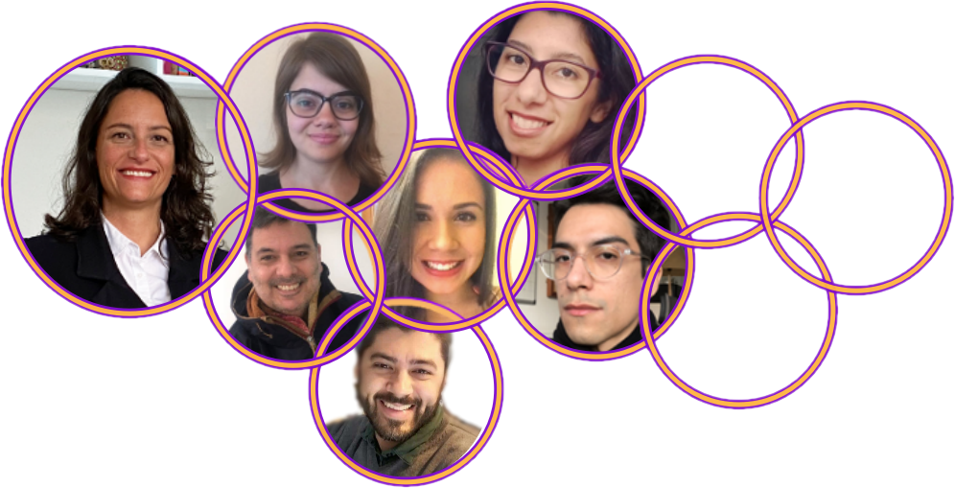
Our Team
Cassandra Borges Bortolon ª
Fernando Frederic ^{b}
Juliana Ribeiro da Rosa ^{c}
Daniel Carneiro ^{d}
Caroline Moresco de Moura ^{e}
Vitoria Mendonça Dias ^{f}
Robson Inácio ^{g}
Founder Acurartech, Department of Psychiatry, Federal University São Paulo, Brazil.ª
Co-founder and Commercial Manager of Acurartech.^{b}
Innovation Management Consulting, Administration Department, Federal University of Rio Grande do Sul.^{c}
Acurartech Intern. Psychology student. Federal University of Rio Grande do Sul.^{d,e}
Clinic Psychologist, Specialist Cognitive Behavior Therapy^{f}
Technology Professional.^{g}

Slide 69

Thank you very much
Thank you very much
Contact:
cassandra@acurarte.com.br
+55 51 981394719
Av. Osvaldo Aranha 440-404
Porto Alegre, Rio Grande do Sul
ZipCode 90.035-190 - Brasil

