Slide 1

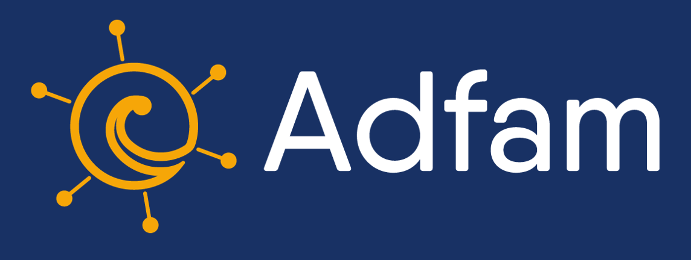



A co-produced prioritisation of intervention ideas for young people whose parents use substances
Cassey Muir
Doctoral Researcher & Research Assistant
Newcastle University, Fuse
@cassey_muir
cassey.muir@newcastle.ac.uk

Slide 2


Background
UK Prevalence – 4% or 478,000 children and young people lived with a parent who used alcohol or drugs in 2019–2020 (Children’s Commissioner’s Office, 2020)
Child-centred Interventions – Limited and low quality effectiveness (McGovern et al., 2021 & Barrett et al., 2023)
Qualitative studies – Limited evidence on how to support children and young people from their point of view (Muir et al., 2022)

Slide 3
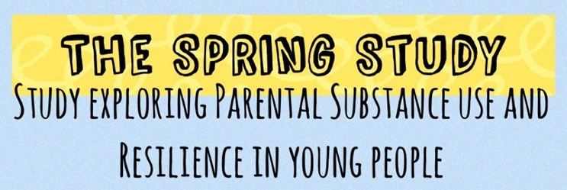
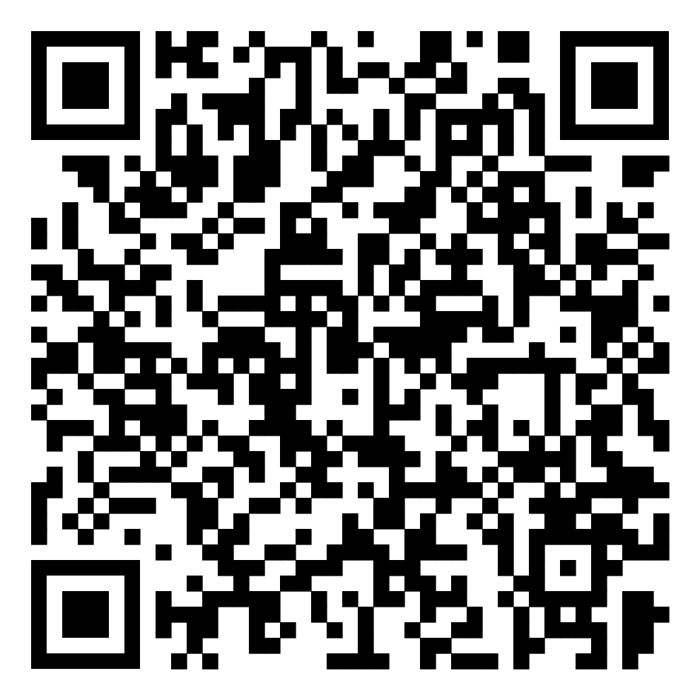
An overview of my PhD
Qualitative Systematic Review: Experiences
700+ Children & Young People (20 countries)
Scan QR code for SPRing’s latest publication!
2. Interviews and Focus Groups: Support needs
21 Young People & 44 Practitioners (England)
3. Co-production Workshops: Prioritisation
13 Young People & 94 Practitioners (England)

Slide 4
Aim
To identify, prioritise, and select, intervention ideas that support young people whose parents use substances
To understand the underlying principles of acceptable and prioritised interventions

Slide 5


Methods
Young Person Research Group
Experts by Experience
Practice Advisors
Selected top 3 ideas
Identified 20 intervention ideas
Prioritised ideas: consultations & workshops with 13 young people and 94 practitioners
Remote interviews and focus groups

Slide 6
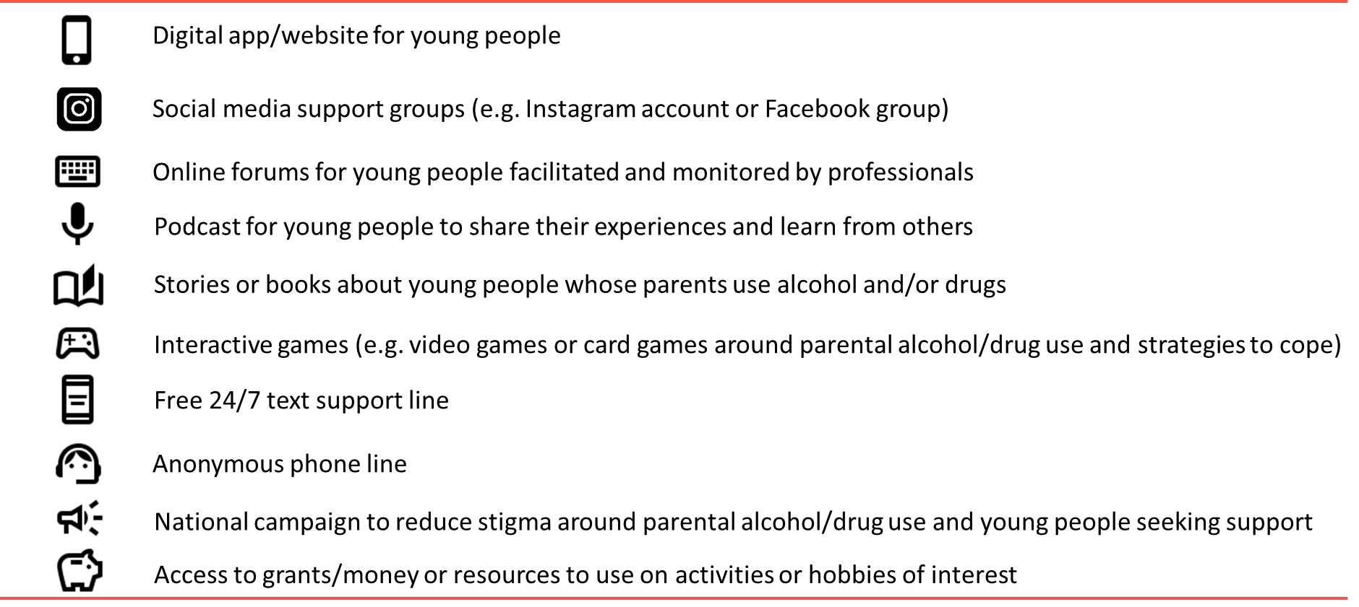
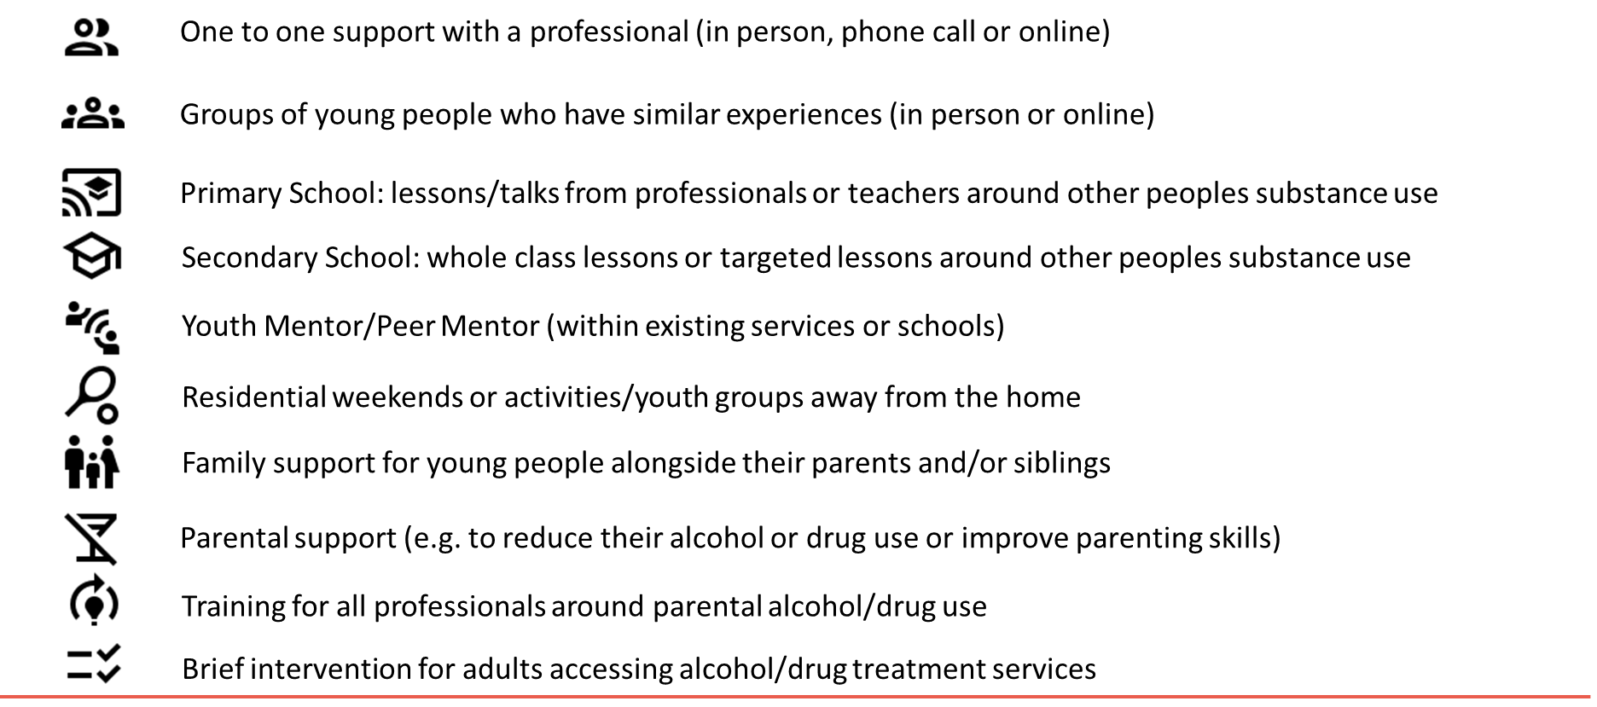
Twenty intervention ideas
Remote interviews and focus groups

Slide 7
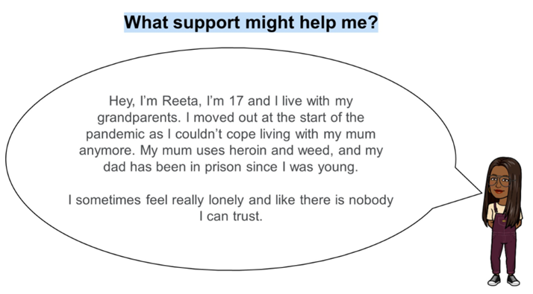
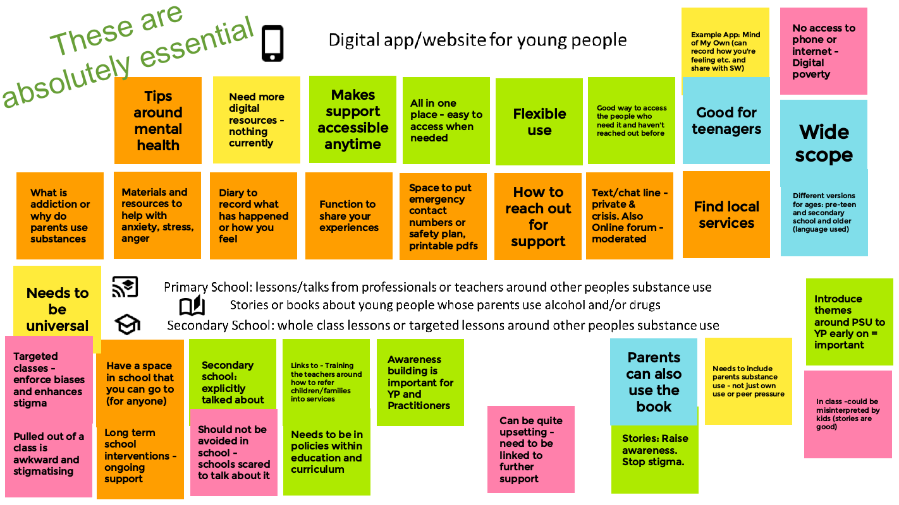
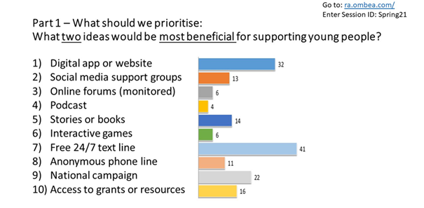
Consultations and workshops
Personas
Google Jamboard
OMBEA Response

Slide 8

And the top priorities are…
…drum roll please…

Slide 9



Digital app or website
Information on substance use, how to access in-person support, social and emotional support/resources, human support (texting)
Allowing for flexibility, personalisation, and agency to address feelings of limited choice
But issues with equity
I think it’s best to start online because then people don’t feel as intimidated because you don’t have to see the person to talk to them and maybe if they’re comfortable with it, then move to face to face after.
Alfie (16) Mum’s Alcohol Use
As children get older, a resource with the internet would be good, they would want somewhere where they can go and learn themselves and make decisions.
Social worker

Slide 10

Training for practitioners
Information on parental substance use, how to respond and approach the topic with young people, where to refer on to
Raising understanding and awareness
Addressing feelings of being misunderstood and subsequent stigma or discrimination
There does need to be some resource put in there to improve for instance the social work training, to include it to improve GP training, to include it at schools training, all those professionals that come into contact with young people to be aware of what might be going on.
Manager of Voluntary Organisation

Slide 11

Age-appropriate school resources
Storybooks or animations that depict common emotional and social experiences/impacts (primary & secondary school)
Universal and non-stigmatising
Creating connections amongst young people to address feelings of loneliness and isolation
It could have a bigger impact to a kid outside of just that classroom or that lesson or that school time because somebody might be there and they’ll hear it, and they’ll think it resonates but they don’t want to do anything about it [at the time] but then it might just stick five years later.
Naomi (24) Mum’s Alcohol Use

Slide 12

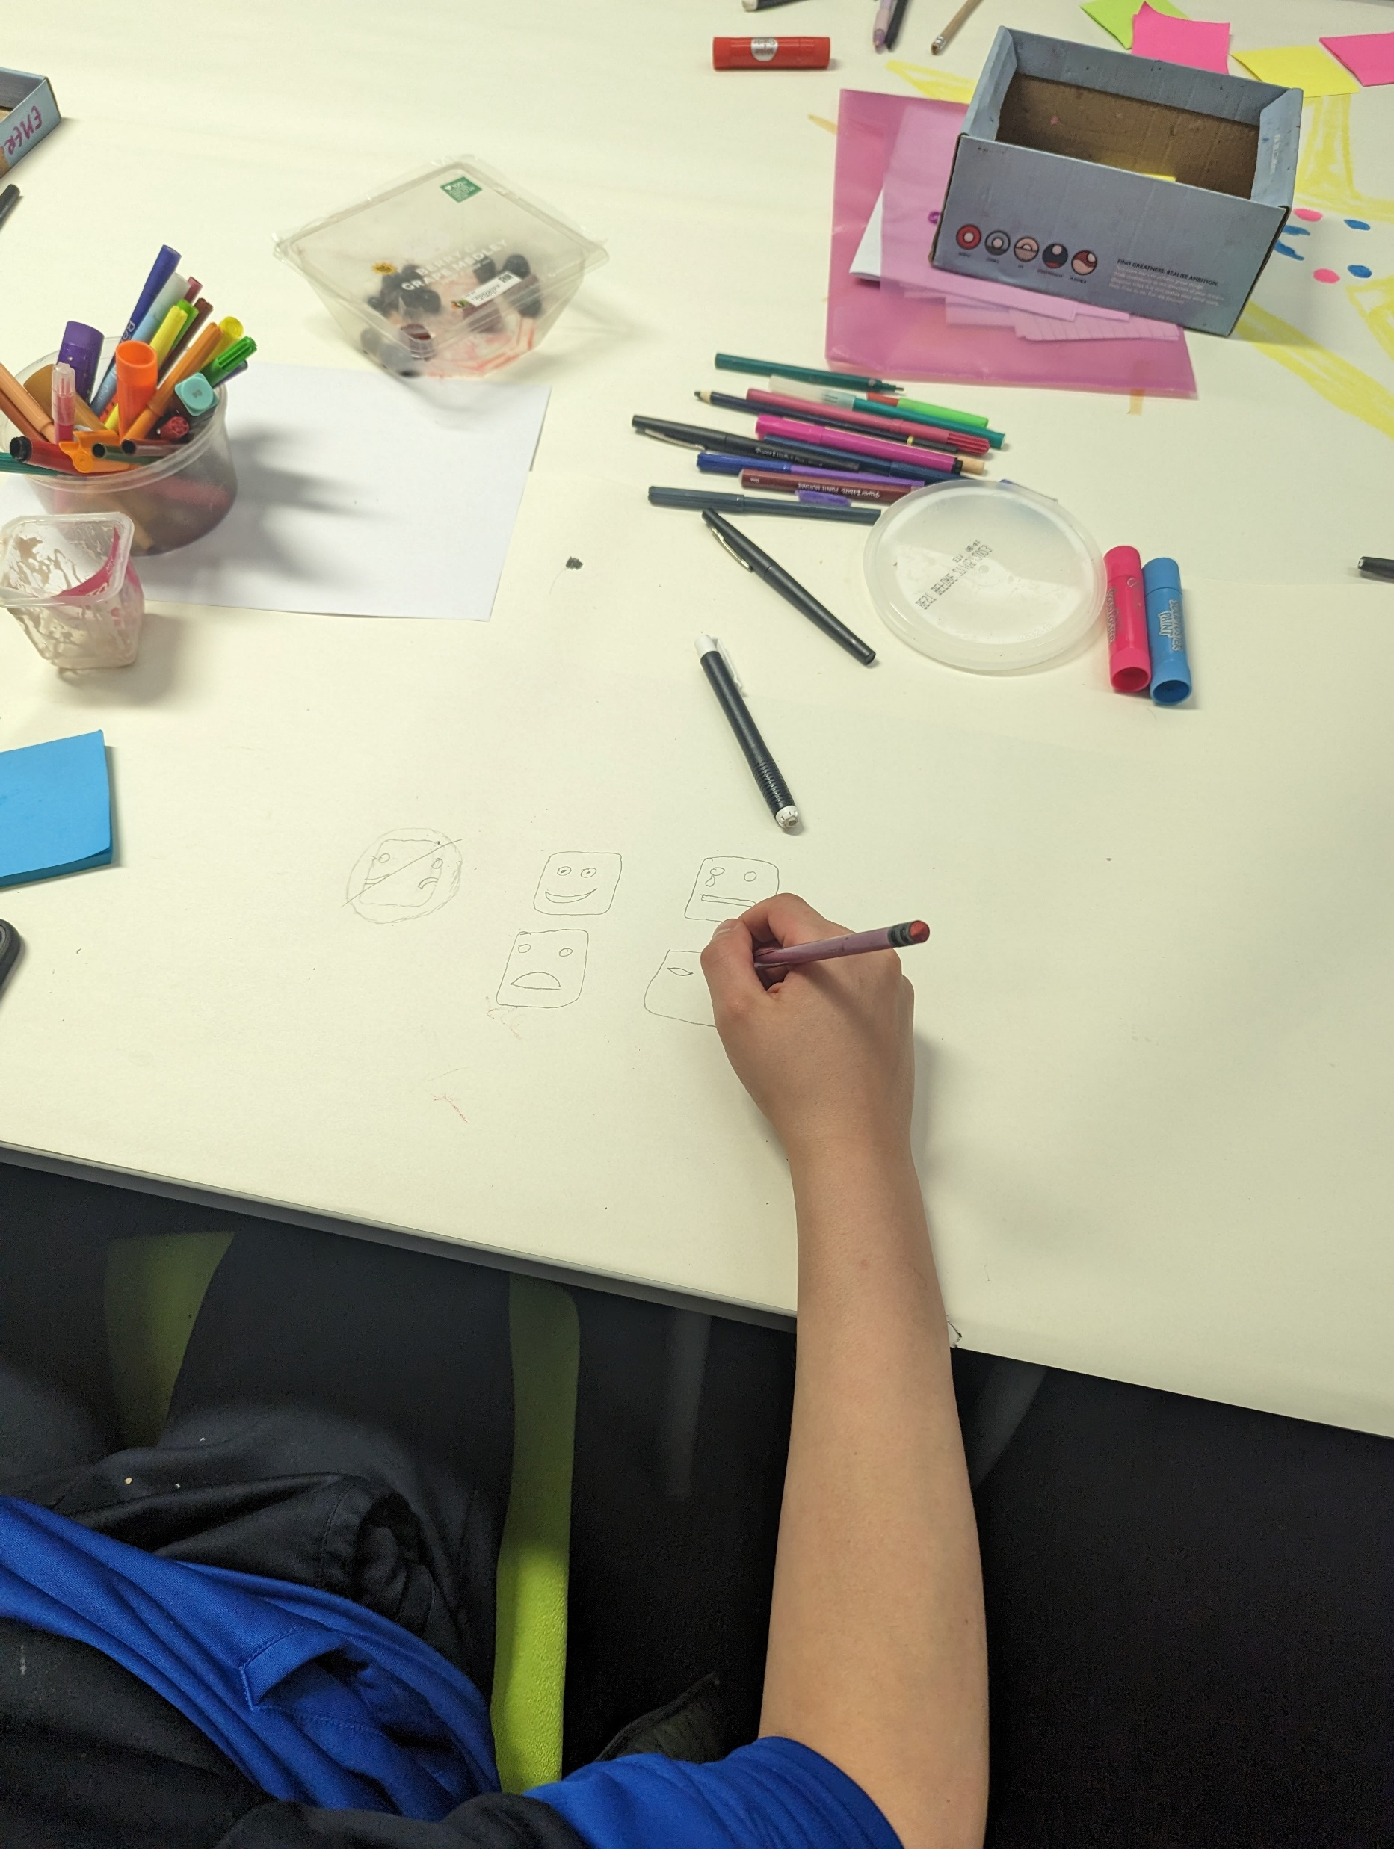
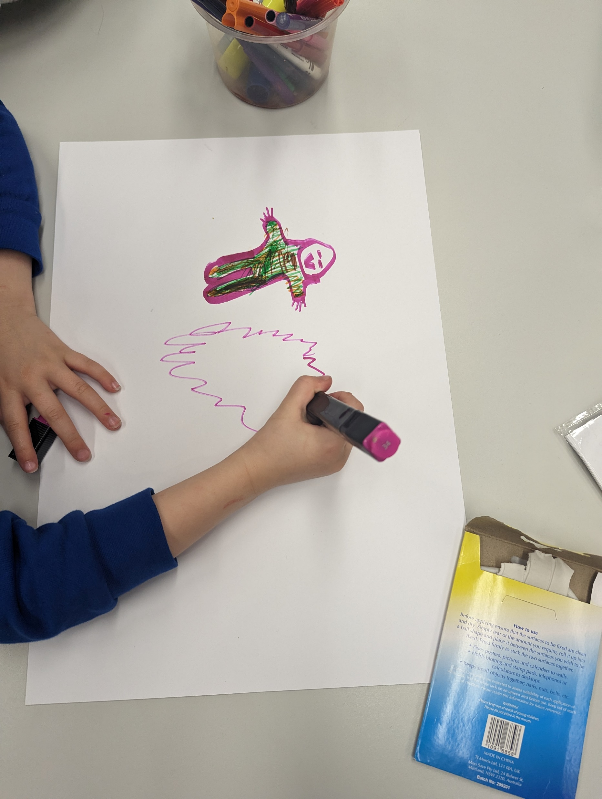
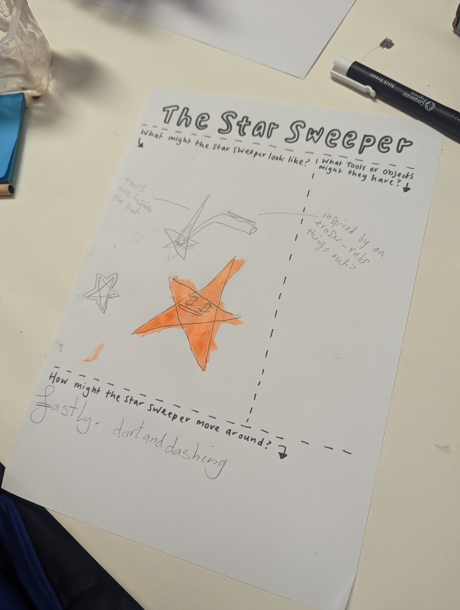
We are co-producing a children’s storybook
Families and children <11 years old
Author, illustrator & primary school practitioners
Young person with lived experience on research team
See Dr Ruth McGovern’s presentation for more information

Slide 13


Conclusions
Acceptable interventions were: resources within schools, digital applications, as well as building resilient and non-stigmatising systems around young people, including training for practitioners.
Further co-production is required to design and develop the prioritised intervention ideas, with later piloting and evaluation.
The inclusion of multiple stakeholders in the decision-making and priority-setting process allows for potentially meaningful, trustworthy, and relevant findings with more chance of future intervention success.
Based on a UK population – are there similar priorities for young people and practitioners in other countries?
Slide 13 of 14

Slide 14
Thank you for listening cassey.muir@newcastle.ac.uk
Acknowledgements
  Funders: National Institute for Health and Care Research, School for Public Health Research (NIHR SPHR)
  Supervisors: Dr Ruth McGovern & Professor Eileen Kaner (Newcastle University), Dr Judi Kidger (University of Bristol)
  Public Advisor and Supervisor: Viv Evans OBE (Adfam)
  Young Person Research Group
  Young people and practitioners involved in the research
References
  Children’s Commissioner’s Office. (2020). Childhood Vulnerability in England. Retrieved from https://www.childrenscommissioner.gov.uk/chldrn/
  McGovern, R. et al. (2021). Psychosocial Interventions to Improve Psychological, Social and Physical Wellbeing in Family Members Affected by an Adult Relative’s Substance Use: A Systematic Search and Review of the Evidence. International Journal of Environmental Research and Public Health, 18(4), 1793. DOI: https://doi.org/10.3390/ijerph18041793
  Barrett, S., Muir, C. et al. (2023). Interventions to reduce parental substance use, domestic violence and mental health problems, and their impacts upon children’s wellbeing: A systematic review of reviews and evidence mapping. Trauma, Violence & Abuse. https://doi.org/10.1177/15248380231153867
  Muir, C. et al. (2022) A systematic review of qualitative studies exploring lived experiences, perceived impact, and coping strategies of children and young people whose parents use substances. Trauma, Violence & Abuse.
  DOI: https://doi.org/10.1177/15248380221134297

