Slide 1
Support for parents of teenagers with problematic internet use – a qualitative analysis of the pilot programme SWITch
URSULA GISELA BUCHNER, Birgit Gerl, Pawel Sleczka & Markus Hess
Notes:
Umfang: 15 Minuten + 5 Minuten Fragen → 10-12 Folien
Ggfs. Backup 5 Minuten

Slide 2
Support for parents of teenagers with problematic internet use – a qualitative analysis of the pilot programme SWITch
A qualitative study of the programme SWITch for parents of teenagers with problematic internet use
Ursula Gisela Buchner, Birgit Gerl, Pawel Sleczka & Markus Hess
Research objective
To identify the burden and needs of parents of teenagers with problematic internet use (PIU) and to analyse whether a specialised 8-session webinar (SWITch) is helpful for affected parents.
Methodology
Guided interviews were conducted with the participating parents (n=7) before the start of SWITch. During the last webinar a focus group discussion was held. Furthermore, two interviews with experts specialised in PIU were conducted. The data were transcribed and analysed by means of qualitative content analysis.
Theory
Due to pandemic restrictions, screen time of children and teenagers has increased further in the last years (Thomasius, 2021). In 2021, about 9 % of all affected family members in German Addiction Care Centres sought help due to PIU and about 47 % of all people looking for help for their own PIU still lived with their parents (IFT, 2023). Parents whose teenagers show PIU report chronic stress as well as psychological and physical symptoms, e.g. sleep problems, rumination, concentration problems, and lower self-efficacy (Buchner et al., in preparation) and thus require psychological counselling. SWITch was conceptualised based on a systemic approach focusing on parental presence (Heim & von Schlippe, 2017) as well as on current knowledge of stress-prevention and behavioural interventions for parents.
Summary of results and conclusions
Results show that parents are unsettled, feel helpless with their previous coping strategies and perceive high levels of conflict in their families. They seek behavioural advice and guidance, information about addiction and support services as well as an exchange of experiences with other affected parents. Deficits were identified in the areas of communication and parental presence. A programme like SWITch provides low-threshold cost-effective information and support and encourages parents to strengthen their parental presence.
Notes:
Insgesamt 30 Minuten – 20+10

Slide 3

Conflict of Interests
There was no funding for this study.
Many thanks to Katerina Vickers and Siegfried Gift at Condrobs for the opportunity to run the programme and for recruiting participants
and to Birgit Gerl for collecting the data.

Slide 4
Adolescents Online Usage
In Germany, nearly all adolescents (96 %) aged 12-19 own a smartphone, about two-thirds own a laptop or computer (JIM 2022)
Due to pandemic restrictions, screen time of children and teenagers has increased further in the last years (Thomasius 2021)
In 2022, adolescents had 204 minutes per
day online use in their free time (JIM 2022)
Greater addictive tendencies towards
social media (beyond screen time) are
associated with decreased well-being/
increased depressive tendencies
(Montag & Elhai, 2023)
(JIM 2022)
Notes:
240 min = 4 Stunden

Slide 5


Problematic Internet Use
In 2021, about 9 % of all affected family members in German Addiction Care Centres sought help due to Problematic Internet Use (PIU) (IFT 2023)
About 47 % of all people looking for help for their own PIU in German Addiction Care Centres still lived with their parents (IFT, 2023)
Both adolescents and their parents show high distress and are in need for help (Brandhorst et al., 2023)
Parents with a teenager with an addiction are discouraged, exhausted, overwhelmed, and feel like they have tried everything and that nothing will work anymore (Bonnaire et al., 2019)
→ Parents reporting problems with their children’s internet use need
help to cope with the situation

Slide 6
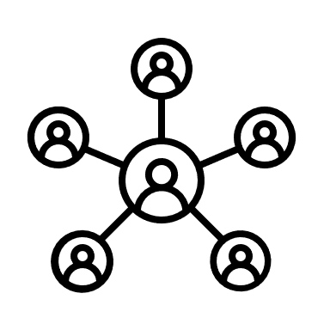
Risk factors for Problematic Internet Use
Poor parent-child communication (Boniel-Nissim & Sasson, 2018)
Poor family functioning (Costa et al., 2019)
Interparent conflict (Gao et al., 2018)
Parenting style:
  authoritarian (Yaffe & Seroussi, 2019)
  controlling (Shek et al., 2019)
  dismissive or punitive (Kim et al., 2016)
  overinvolved (Li et al., 2020)
  overprotective (Siomos et al., 2012)
→ Family focused interventions might be helpful to reduce risk factors and to change family patterns
Notes:
Family therapy originally sought to articulate theory and practice in order to change dysfunctional transactional family patterns that connect to the development of problem behaviors (Liddle, 2010)

Slide 7

Supporting parents
Barriers to treatment:
  Shame, embarrassment, stigma, denial and guilt (Magnusson et al., 2019; Hing et al., 2013)
  Opening hours, distance to facilities (Kourgiantakis et al., 2018)
  Lack of knowledge about possible support (Kourgiantakis et al., 2018)
AFMs favour low intensity interventions like self-help, telephone or online support (Hing et al., 2013)
→ Web-based interventions provide low-threshold access, are convenient and
can be used during lockdown
→ An online programme might be helpful for parents

Slide 8
SWITch – Systemic Webinar for Parents of Teenagers with PIU
Introduction
Media literacy
Parenthood III: Critical stages
Basic knowledge of addiction & media
Parenting skills I: Parenthood
Parenting skills II: Presence
Communication & Conflict Management
Conclusion
Systemic and family therapy
→ Systemic approach focusing on parental presence (Omer & von Schlippe, 2017)
Support for AFMs
→ Stress-Strain-Information-Coping-Support model
Adapted from an earlier on-site version (Buchner & Sleczka, 2019)
→ 8 Video sessions + platform with all slides, handouts and worksheets from the sessions as well as with further information

Slide 9

Methods
easyContact JugendSuchtBeratung (Youths Addiction Counselling) spread information about the programme in their network
Interested parents contacted easyContact and were screened for eligibility
(child or children in their teens with problematic internet use; commitment to participate in the study and all sessions)
Data collection:
  In-depths guided interviews (online) with all participants (n = 7) before SWITch (mean 83:46 min., range 65:14-98:01 min.)
  Focus group discussion (online) with all participants (n = 6) at the end of SWITch (last session)
Notes:
Participants: An SSCS orientiert
Practitioniers: Leitfaden

Slide 10
Participants’ Characteristics
Number | Parent | Family Member in SWITch | Relationship status | Age | Number of children | Age of affected child | Son or daughter | Duration Interview | Comment
1 | Mother | No | Married | 51 | 3 | 16 | Son | 83:22
2 | Father | Parent 3 | Separated | 54 | 2 | 15 | Son | 87:44
3 | Mother | Parent 2 | Separated | 45 | 2 | 15 | Son | 83:48
4 | Father | Parent 5 | Married | 71 | 1 | 16 | Son | 89:52
5 | Mother | Parent 4 | Married | 56 | 1 | 16 | Son | 98:01
6 | Father | Parent 7 | Separated during participation | 47 | 2 | 13 | Son | 78:21
7 | Mother | Parent 6 | Separated during participation | 45 | 2 | 13 | Son | 65:14 | Cancellation of participation after session 3

Slide 11


Results: Needs and stressors reported by parents
Needs for support:
Exchange with other parents
Professional Support
Informationen
Access to help
Discussing coping strategies
Uncertainties about appropriate media use
Reflection on parenting style
Supporting parental skills
Support in assessment of severity
Developing understanding for the child /
the situation
Stressors:
Couple Conflicts
Escalation/physical confrontation
Shame
Admitting helplessness
Frustration about the current situation
Distribution of tasks/roles in the family

Slide 12


Results: Coping strategies and parents‘ wishes
Coping strategies:
Doing chores for the child
Enforcing rules
Parents‘ wishes for dealing with the situation:
Set of tips and tools
Getting into contact
Avoiding conflicts
Setting limits

Slide 13
Results: Changes reported by parents in Session 8
So, I think what impressed me the most, what I took away here, was that my children also have a life of their own. I can't just burst into the room and say: "I want you to do this now because I’m thinking that you have to do it now", but I ask carefully: "Do you have time to talk to me right now?” … I have to get a feeling for what the other person's need is right now. … It is not "You are the child and I decide," but: "You are someone whose needs I take seriously”. (Parent 1)
So with this bursting into the room, I figuratively saw myself like that. And as (…) also said: You have to remember that they are grown. He said yesterday: “Maybe you could knock." I forgot. I have to accept his age. (Parent 3)
And then I notice that I get into such a negative mood. (...) I have to see that I get out of it. To distance myself from this mood, but to have a clear attitude and then also show understanding. ... But it's been going quite well lately that we've agreed on something. And that is perhaps also one of the possibilities or strategies that I would like to continue. And he has grown older. I notice now that he has also made an incredible boost. (Parent 3)
And I didn't want to sink back into the circle and so I thought, "Stop! Parents are allowed to set the rules." And then I told him: ... And then I went out of the room and patted myself on the back in my mind: "Yes, well done." And at the same time, I could have cried. And then it took about ten minutes and then he cleaned up. (Parent 5)

Slide 14
Results: Changes reported by parents in Session 8
I am always a bit skeptical at the beginning, especially with workshops or seminars, and whether it really triggers and effects something. And in fact, it has been more relaxed since we started and the atmosphere in the house is much better. I have also received feedback from my partner. There was always a cycle with the yelling and then everything was focused on the computer. And now we have made new agreements in the family. (Parent 3)
I think we have opened up more, too, to his computer game. Or at least, we accepted it. I think he rebelled all the time because we were not prepared to let him play this game. And that's why he always played secretly and then played more and more. I think we really have to loosen up a bit now. … I think he realizes that he doesn't have to work against it all the time now. (Parent 3)
If he (...) thinks you talk to him at eye level, then he feels taken seriously. Then you can get a bit closer to him by saying, which is what I'm trying to do now: "What do you actually do?” (Parent 2)
But, of course, I have now also understood that there is no one way that applies to everyone, but everyone has to find their own individual way. And then there is not just one particular advice. Everyone has to find what suits them. (Parent 1)

Slide 15
Conclusion
Parents express numerous needs and stressors and few coping strategies
They wish for easy-to-use solutions according to the motto "one size fits all“ and for exchange with other parents and professionals
Parents report changes at the end of SWITch
  In their own behaviour and attitude: Taking their children seriously, giving them space/autonomy
  In their children's behaviour: more cooperative behaviour and interaction
Virtual Group Setting is easy to realize and offers low threshold access
On-Site programmes can be adapted
Parents report positive changes at the end of SWITch

Slide 16
Literaturverzeichnis
Boniel-Nissim M, Sasson H. Bullying victimization and poor relationships with parents as risk factors of problematic internet use in adolescence. Comput HumBehav. 2018;88:176–83. https://doi.org/10.1016/j.chb.2018.05.041.
Bonnaire C, Liddle HA, Har A, Nielsen P, Phan O. Why and how to include parents in the treatment of adolescents presenting Internet gaming disorder? J Behav Addict. 2019;8(2):201–12. https://doi.org/10.1556/2006.8.2019.27.
Brandhorst I, Petersen K, Hanke S, Batra A, Barth GM, Renner T. Belastungen in Familien von Jugendlichen mit problematischer Internetnutzung. Suchttherapie. 2022; 23(S 01): 16-17. https://doi.org/10.1055/s-0042-1755983
Buchner UG, Koytek A, Wodarz N. Help on the Internet for Family Members of Disordered Gamblers – Usage and Results of the E-Mental Health Programme EfA. Suchttherapie. 2017; 18(4):184-195. Doi: 10.1055/s-0043-119332
Buchner UG, Sleczka P. Modellprojekt Pausetaste. 2019
Costa RM, Patrao I, Machado M. Problematic Internet use and feelings of loneliness. Int J Psychiatry Clin Pract. 2019;23(2): 160–2. https://doi.org/10.1080/13651501.2018.1539180.
Gao T, Meng X, Qin Z, Zhang H, Gao J, Kong Y, et al. Association between parental marital conflict and Internet addiction: a moderated mediation analysis. J Affect Disord. 2018;240: 27–32. https://doi.org/10.1016/j.jad.2018.07.005.
Hing N, Tiyce M, Holdsworth L, Nuske E. All in the Family: Help-Seeking by Significant Others of Problem Gamblers. Int J Ment Health Addiction. 2013;11(3):396–408. Doi: 10.1007/s11469-012-9423-0
IFT Institut für Therapieforschung, Forschungsgruppe Therapie und Versorgung (2023, 27. Februar). Deutsche Suchthilfestatistik 2021. Alle Bundesländer. Tabellenband für ambulante Einrichtungen (Typ 1). Bezugsgruppe: Zugänge/Beender. https://suchthilfestatistik-datendownload.de/Daten/download.html.
JIM. Jugend, Information, Medien. Basisuntersuchung zum Medienumgang 12- bis 19-Jähriger in Deutschland; 2022. https://www.mpfs.de/fileadmin/files/Studien/JIM/2022/JIM_2022_Web_final.pdf
Kim JE, Epstein NB, Moon UJ. Self-efficacy and perceived parental support/affection as mediators of stressor risk factors for adolescent Internet addiction in South Korea. Family and Family Therapy. 2016;24(4):483–504.
Kourgiantakis T, Saint-Jacques M-C, Tremblay J. Facilitators and Barriers to Family Involvement in Problem Gambling Treatment. Int J Ment Health Addiction. 2018;16(2):291–312. Doi: 10.1007/s11469-017-9742-2
Li Y, Wang Y, Ren Z, Gao M, Liu Q, Qiu C, et al. The influence of environmental pressure on internet use disorder in adolescents: the potential mediating role of cognitive function. Addict Behav. 2020;101:105976. https://doi.org/10.1016/j.addbeh.2019.04.034
Magnusson K, Nilsson A, Andersson G, Hellner C, Carlbring P. Internet-delivered cognitive-behavioral therapy for significant others of treatment-refusing problem gamblers: A randomized wait-list controlled trial. Journal of Consulting and Clinical Psychology. 2019;87(9):802–14. Doi: 10.1037/ccp0000425
Montag C, Elhai JD. On Social Media Design, (Online-)Time Well-spent and Addictive Behaviors in the Age of Surveillance Capitalism. Curr Addict Rep (2023). https://doi.org/10.1007/s40429-023-00494-3
Nielson P, Favez N, Rigter H. Parental and family factors associated with problematic gaming and problematic internet use in adolescents: a systematic literature review. Curr Addict Rep. 2020;7: 365-386. https://doi.org/10.1007/s40429-020-00320-0
Omer, H. & von Schlippe, A. (2017). Autorität ohne Gewalt. Coaching für Eltern von Kindern mit Verhaltensproblemen. »Elterliche Präsenz« als systemisches Konzept. Göttingen: Vandenhoeck & Ruprecht.
Rodda SN, Lubman DI, Dowling NA, McCann TV. Reasons for using web-based counselling among family and friends impacted by problem gambling. Asian J of Gambling Issues and Public Health. 2013;3(1). Doi: 10.1186/2195-3007-3-12
Siomos K, Floros G, Fisoun V, Evaggelia D, Farkonas N, Sergentani E, et al. Evolution of Internet addiction in Greek adolescent students over a two-year period: the impact of parental bonding. Eur Child Adolesc Psychiatry. 2012;21(4):211–9. https://doi.org/10.1007/s00787-012-0254-0.
Shek DTL, Zhu X, Dou D. Influence of family processes on Internet addiction among late adolescents in Hong Kong. Front Psychiatry. 2019;10:113. https://doi.org/10.3389/fpsyt.2019.00113.
Thomasius, R. (2021). Mediensucht während der Corona-Pandemie. Ergebnisse der Längsschnittstudie von 2019 bis 2021 zu Gaming und Social Media. DAK Gesundheit.
Yaffe Y, Seroussi D-E. Problematic Internet use in Israeli-Arab adolescent males: do parenting styles matter? Cyberpsychology. 2019;13(4). https://doi.org/10.5817/cp2019-4-5.

Slide 17
Overview Session 1-3
Session | Content | Exercises | Aim
1. Introduction | Welcome, schedule Introduction/getting to know each other Mood diary Wishes & expectations Contents & procedure Reflection on media use Conclusion/flash feedback | Mood diary Worksheet Media Use Target | Orientation Relationship, motivation Current condition and stress Inclusion, commitment Providing information, inclusion Reflection Introspection, self-awareness
2. Basic knowledge of addiction & media | Check-in, Mood diary Debriefing Basic knowledge of addiction & media Coping strategies Homework Conclusion/flash feedback | Slides/Handout Worksheet Coping Target | Orientation, current condition and stress Clarifying open questions Providing information Reflection & exchange Consolidation Introspection, self-awareness
3. Parenting skills I: Parenthood | Check-in, Mood diary Debriefing: Coping Roles in Balance Conclusion/flash feedback | Slides/Handout/ Worksheet Roles Target | Orientation, current condition and stress Clarifying open questions Providing information, reflection & exchange Introspection, self-awareness

Slide 18
Overview Session 4-6
Session | Content | Exercises | Aim
4. Media literacy | Check-in, Mood diary Debriefing Media literacy Conclusion/flash feedback | Worksheet Own Media Use Target | Orientation, current condition and stress Clarifying open questions Providing information, reflection & exchange Introspection, self-awareness
5. Parenting skills II: Presence | Check-in, Mood diary Debriefing Parental Presence Parenting style Homework Conclusion/flash feedback | Slides/Handout, Worksheet Presence Slides/Handout, Work-sheet Family atmosphere Target | Orientation, current condition and stress Clarifying open questions Providing information, reflection & exchange Providing information, reflection & exchange Consolidation & reflection Introspection, self-awareness
6. Communication & Conflict Management | Check-in, Mood diary Debriefing Communication & conflict management Conclusion/flash feedback | Slides/Handout, Work-sheet Communication Target | Orientation, current condition and stress Clarifying open questions Providing information, reflection & exchange Introspection, self-awareness

Slide 19
Overview Session 7-8
Session | Content | Exercises | Aim
7. Parenthood III: Critical stages | Check-in, Mood diary Debriefing Brain development during adolescence Developing identity & roles Conclusion/flash feedback | Slides/Handout Slides/Handout Target | Orientation, current condition and stress Clarifying open questions Providing information, reflection & exchange Providing information, reflection & exchange Introspection, self-awareness
8. Conclusion | Check-in, Mood diary Debriefing Review Mood diary Self-efficacy Contingency plan Looking back and looking forward Conclusion/flash feedback | Slides/Handout Worksheet What if… Target | Orientation, current condition and stress Clarifying open questions Providing information, reflection & exchange Providing information, reflection & exchange Reflection & exchange Introspection & reflection Introspection, self-awareness

Slide 20
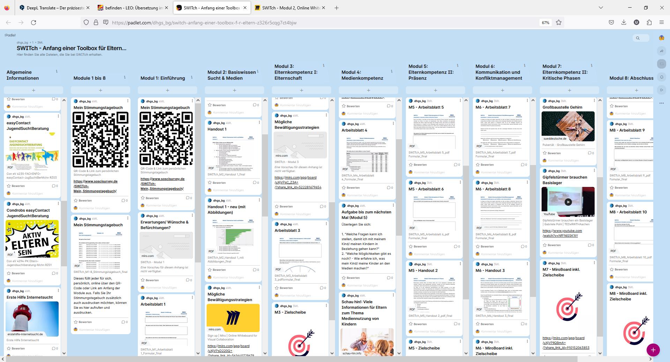
x
xn
(x
Notes:
https://padlet.com/dhgs_bg/switch-anfang-einer-toolbox-f-r-eltern-z326r5cqg7ct4bjw/slideshow

Slide 21
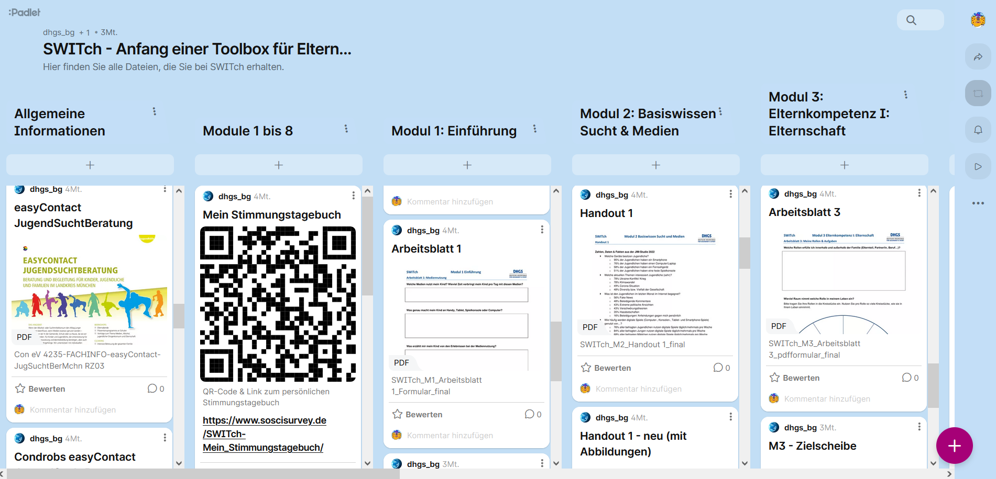
x
xn
(x

Slide 22
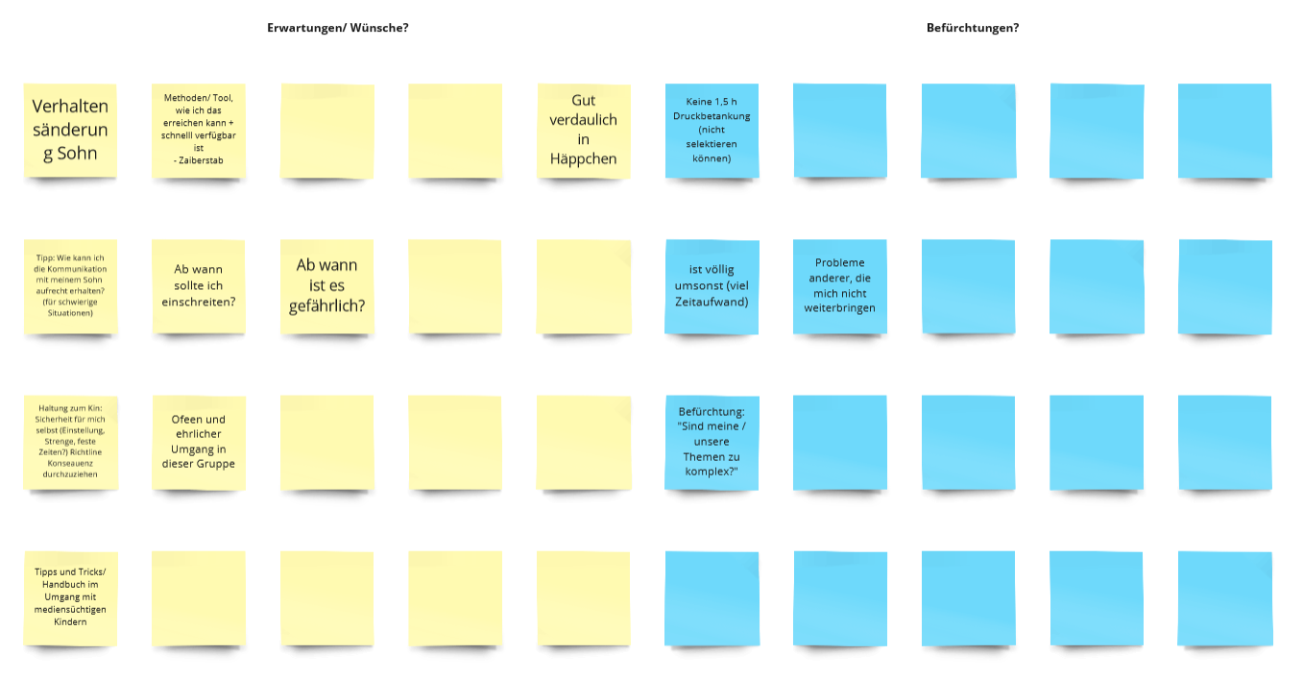
Session 1: Parents expectations and fears

Slide 23
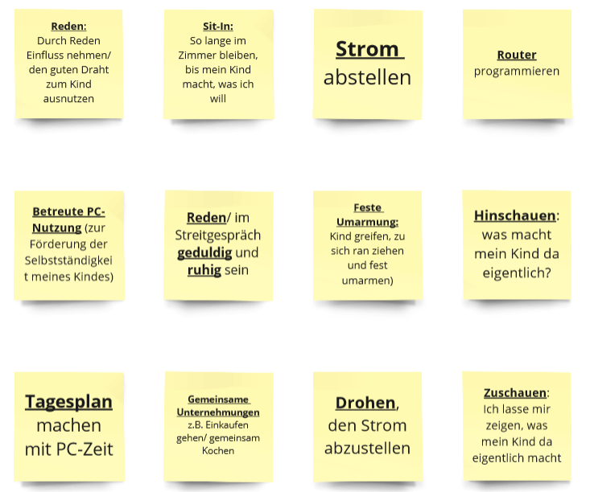
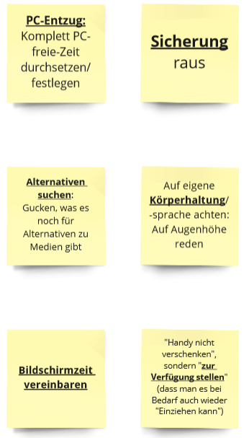
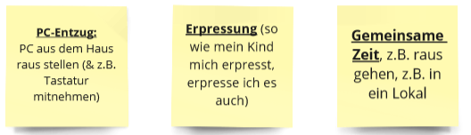
Session 2: Parents‘ Collected Coping Strategies

Slide 24
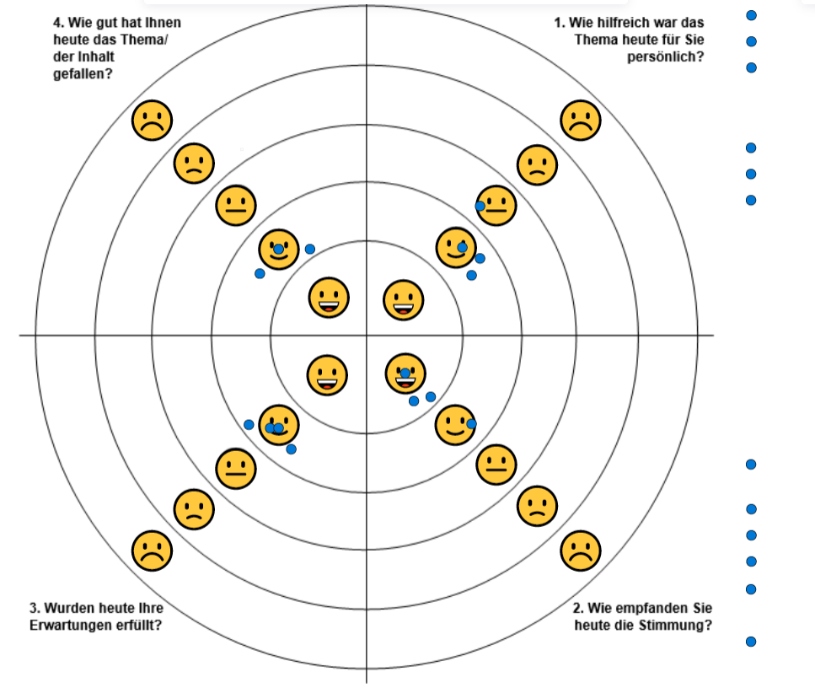
Session 2: Target
How well did you like the topic today?
How helpful was the topic for you personally today?
Were your expectations met today?
How did you feel about the atmosphere today?

Slide 25

Results: Practitioners insight into needs and wants
Low threshold access to help is necessary
More support services for parents and families, also for leisure time, is necessary
Parents often want simple and functioning solutions
Parents deal with uncertainty: Problem or disorder? Good or bad media use?
Often, children have comorbid illnesses, e.g. ADHD, and are under medication or have pre-treatments

Slide 26


Results: Practitioners insight into family situations
Stress on parents:
  Fear for the children's future
  Lack of understanding of technology/internet
  Boundaries are set to late
  Escalation and physical abuse by the children
Domestic situation:
  Parents are role models, also regarding their media use
  Parents overstep boundaries
  Partnership problems of parents
  Unequal distribution of tasks regarding control
  Too little family time and too little time for parents as individuals
Coping strategies used: Too many rules at the same time

Slide 27


Results: Practitioners insight into possible solutions
Aims:
  Change in family climate
  Relationship work
  Less control, more trust
  Consistent rules
  Development of new coping strategies
Contents of interventions
  Platform for exchange between parents
  Information transfer
  Exercises on communication
  Accompaniment in difficult situations

