Slide 1
Parents of individuals with an addiction –
Results of the BEPAS study
Anja Bischof, Hans-Jürgen Rumpf, Gallus Bischof
University of Lübeck, Dpt. of Psychiatry and Psychotherapy, Research group S:TEP
AFINet Conference 15-17 June 2023

Slide 2

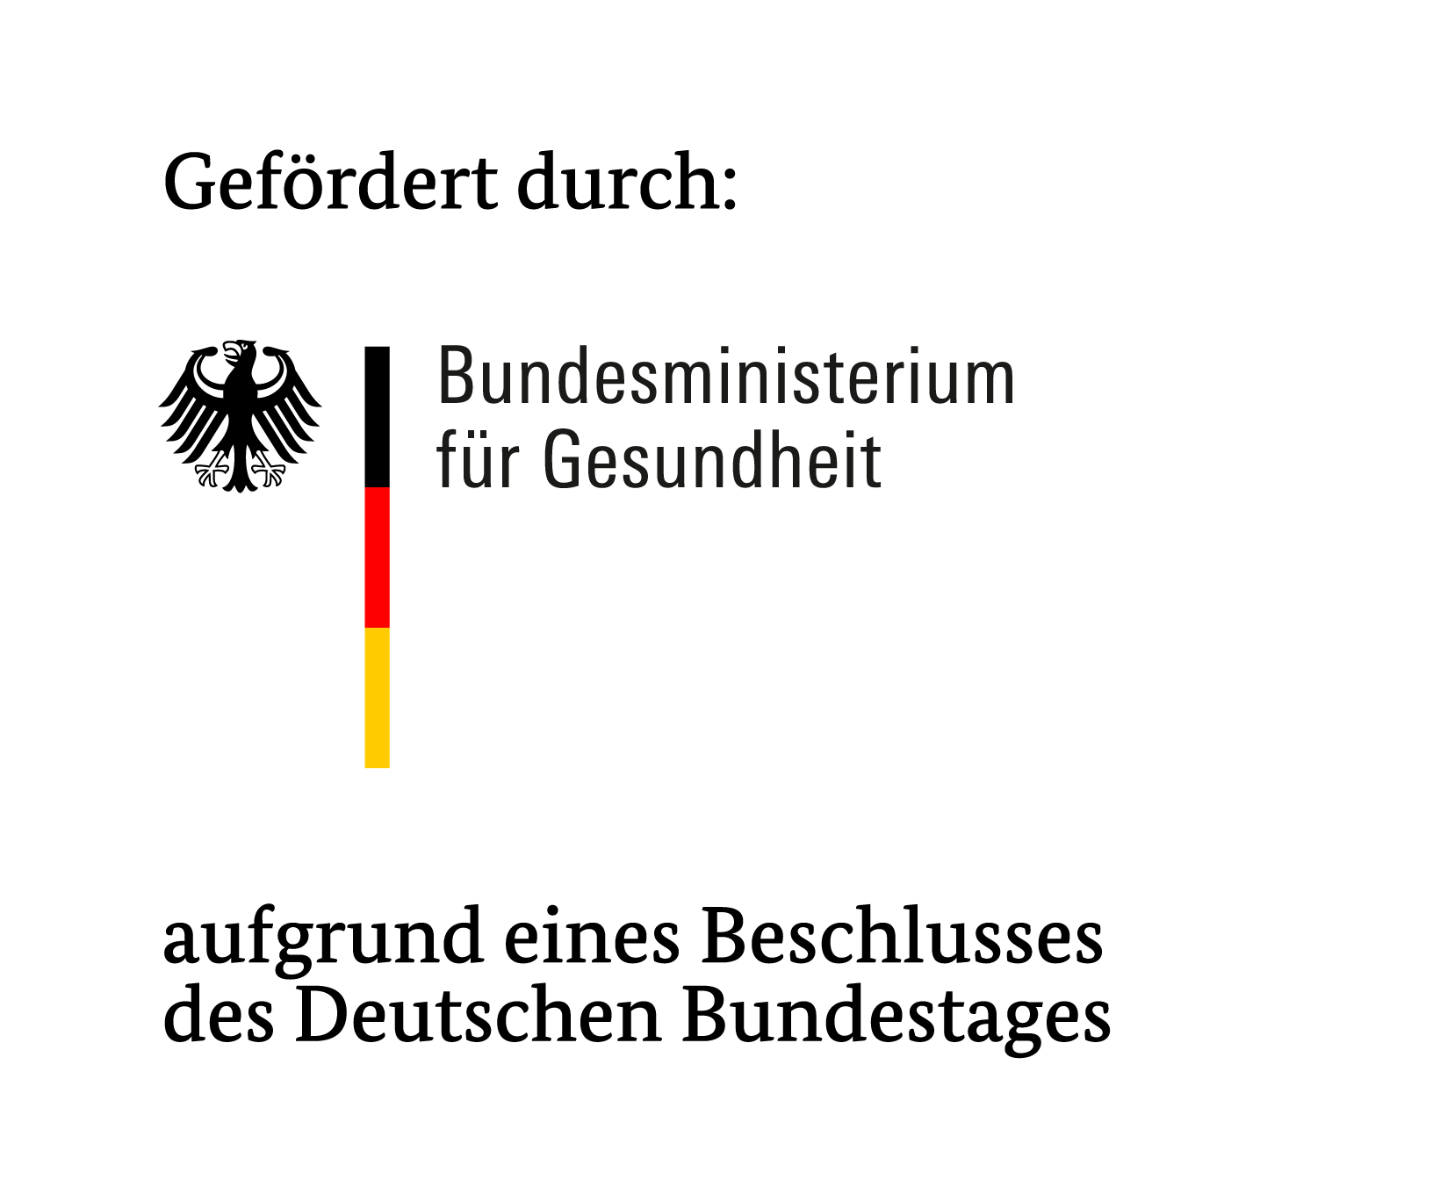
COI - Disclosure
Personal (all authors):
No financial support for resarch, talks, counseling or other activities by any industry or other third parties with ecomonic interests.
The study was funded by:
The German Ministry of Health (BMG), Grant No. ZMVI5-2514DSM208
The Ministry had no role in the conduct, analysis,
interpretation, reporting, or presentation.

Slide 3
Background
Negative impact of addiction on well-being and health of family members demonstrated in various studies
  Increased strain and stress
  Increased medical costs
Majority of studies: Mainly focus on female partners of individuals with an addiction
Burden and Coping strategies of family members affected by addiction (FMAs) vary depending on gender (Orford et al. 2005)
  Females experience more violence
  Males have other coping strategies than females

Slide 4
Parents
Proportion of parents among FMAs in a German nationwide sample: 10.3% (Bischof et al. 2022)
Research mostly on mothers
Role attributions in the parenting unit (father financial provider, mother main care-giver)
Bias in research concerning family bonding and responsibilities (Smith & Estefan 2014)
Communication problems between mothers and fathers → additional family stress

Slide 5

Research question
Are there gender-related differences between mothers and fathers of individuals with an addiction in terms of strain, resources, barriers to treatment and needs?

Slide 6
BEPAS – Burden, Expectancies, Perspectives of Addicted individuals‘ Significant others study: a multimodal approach
Mixed-method study over 24 months
Study focus:
  Stress and strain factors & resources of FMAs
  Need for support and barriers to treatment
Aims
  Derivation of an integrative model for a conceptual understanding of strain and resources
  Stimulus for the improvement of the health care situation for FMAs in Germany

Slide 7
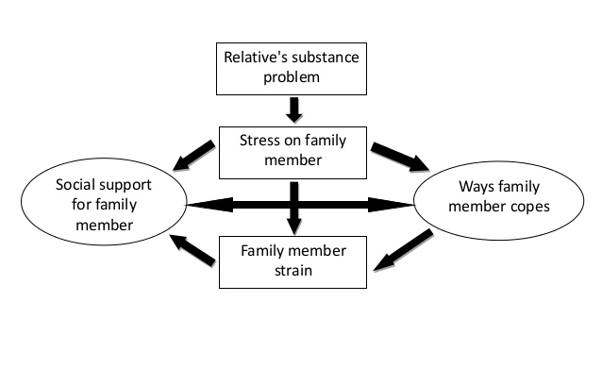
„Stress-Strain-Coping-Support-Model“ (Orford et al. 2005)
Based on the SSCSM

Slide 8
BEPAS Study design
Recruitment (N=100):
  Self-help groups for FMAs (theoretical sampling approach)
  Pro-active screening in general practices and general hospitals
Inclusion criteria:
  Age 18 years
  Regular contact to the index patient (IP)
  Addiction of the IP within past 12 months
Parents: 22 mothers, 9 fathers
Face-to-face qualitative semi-structured interviews
Recording and summary within 24 hours
Analysis based on Grounded Theory
Assessment of quantitative questionnaires after the interviews

Slide 9
Manual-based qualitative interview
Addiction problems
Form, quantity, pattern
Development, abstinence, relapses, treatment utilization IP
Strain
Familial, social, financial, psychological, somatic, guilt, shame
Coping strategies
Attitudes, behavioral patterns
Resources
Family, partners, friends, work, colleagues
Leisure time, nature, religion
Needs and barriers to treatment
Treatment utilization, access to the treatment system
Barriers to treatment
Appropriate/unsuitable strategies, changes in strategies

Slide 10
RESULTS
Demographics
 | Mothers | Fathers
Mean age | 53.6 (43-65) | 55.1 (50-61)
Living in partnership | 68% | 100%
Living with IP | 40.9% | 22.2%
Daily contact with IP | 45.5% | 33.3%

Slide 11
Addiction form
Cannabis | Alcohol | Illegal drugs | Gambling disorder | Prescription drugs | Total
25 (80.6%) | 9 (29.0%) | 9 (29.0%) | 3 (9.7%) | 6 (19.4%) | 31
54.8% of the IPs had probIems with more than one substance or behaviour

Slide 12
Strain
Both:
Impairment of family and professional life
Unreliability and unpredictability of IP
Communication problems
Stress
Mothers more often: | Fathers more often:
Feelings of guilt | Somatic strain
Concern for the IP‘s health | Burdened by IP‘s aggressive behaviour:
Conflicts of loyalty | Insults
Helplessness | Threats
Pressure to keep the addiction a secret | Vandalism
Fear, sadness, depressive moods

Slide 13
Confirmation of psychological burden in the quantitative questionnaires:
Short Questionnaire for Family Members – Affected by Addiction (SQFM-AA; Buchner, Koytek, Fischer, Wodarz, & Wolstein, 2016)
Subscale psychological strain: sig. difference between mothers (M=7.5, SD=1.6) and fathers (M=5.9, SD=1.6) with a higher strain in mothers (U=46.0, z=-2.373, p=.018)
Patient Health Questionnaire (PHQ-8; Spitzer, Kroenke, & Williams, 1999)
Depression: sig. difference between mothers (M=8.3, SD=5.1) and fathers (M=4.2, SD=3.0, U=47.5, z=-2.253, p=.024)
None of the fathers, but eight mothers scored >9 in PHQ-8 (= moderate depression)
General health status:
Mothers assessed theirs sig. poorer (M=3.1, SD=0.8) than fathers (M=2.2, SD=0.8; U=49.0, z=-2.489, p=.013)

Slide 14
Coping strategies
Mothers more often: | Fathers more often:
Found it difficult to distance themselves | Distanced themselves from the addiction problem
Took on more responsibility | Took less responsibility
Sacrificed themselves | Less rule-setting
Concealed problems | Found it easier to implement the agreements consistently
Changed their coping over time
Developed self-care strategies at a later stage

Slide 15
Resources
Mothers more often: | Fathers more often:
Family as significant resource | Doing exercies
Rarely felt supported by their partners: | Saw their partners as „backup“
wished for more support | Work environment
wished for handling the addiction as a couple
Had sought professional help

Slide 16
Needs and barriers
Both:
Were equally dissatisfied with the undifferentiated, partly stigmatising portrayal of addiction in the media
Criticism on the lack of presence/visibility and networking of the addiction help system
Criticism of the lack of accessibility of support facilities
Criticism of the difficult access or long waiting times for further (therapeutic) support services for their IPs
Need for more information and counselling at schools
Need for more awareness in the public and in the media

Slide 17
Needs and barriers
Mothers more often: | Fathers more often:
Fear of stigmatisation | Lack of admission of their own helplessness
Need for concrete information on how to deal with the addiction
Need for more instructions for acute emergencies and problematic situations

Slide 18
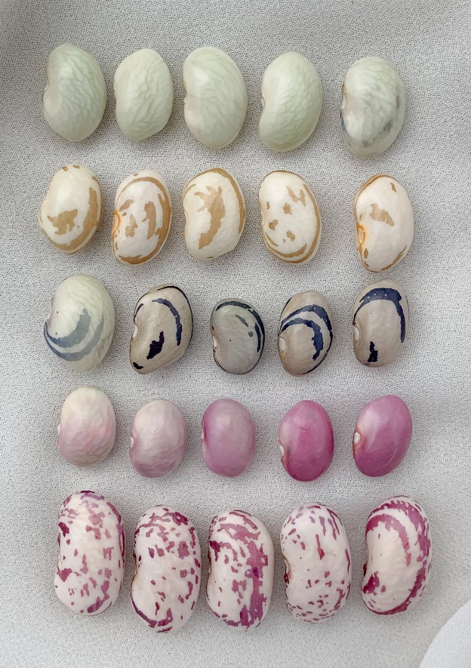
Conclusions
Same same but different

Slide 19
Conclusions
Complex psychosocial stress situation of parents of children with an addiction
Similar severity in strain in mothers and fathers
Differences in stress factors, adverse consequences, and coping
Reason for neglect of mothers‘ own needs may lie in gender role expectancies (mother as primary care-giver, closer bonding)
Gender role expectancies may result in self-stigmatisation (guilt, shame)
  Fear of being held responsible
  Higher stress and strain
  Coping strategies that are ineffective and lead to higher stress
  Barriers to treatment

Slide 20
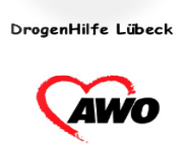




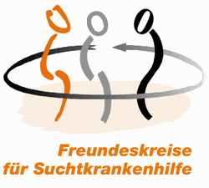








Cooperation partners

Slide 21

Thank you for listening!
Questions, critique, suggestions: anja.bischof@uksh.de

