Slide 1

Something new
for your toolbox
By the Iceberg team
L’Arco e La Ricerca
PROGETTO
ICEBERG
Alessandra Bassi
September 15, 2026
AFINet Conference
Fondazione La Ricerca, Cooperativa sociale L’Arco

Slide 2
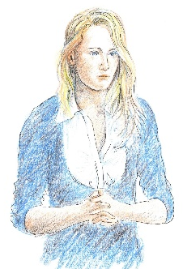
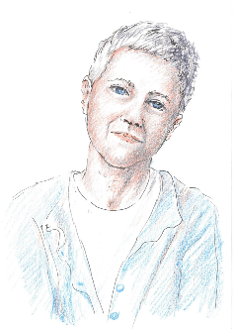
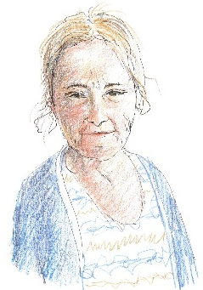
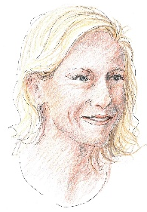
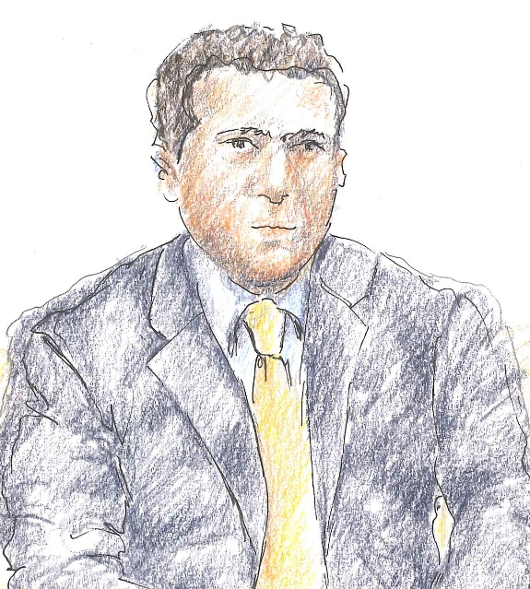
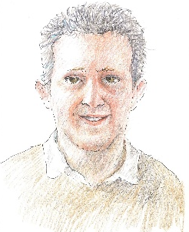
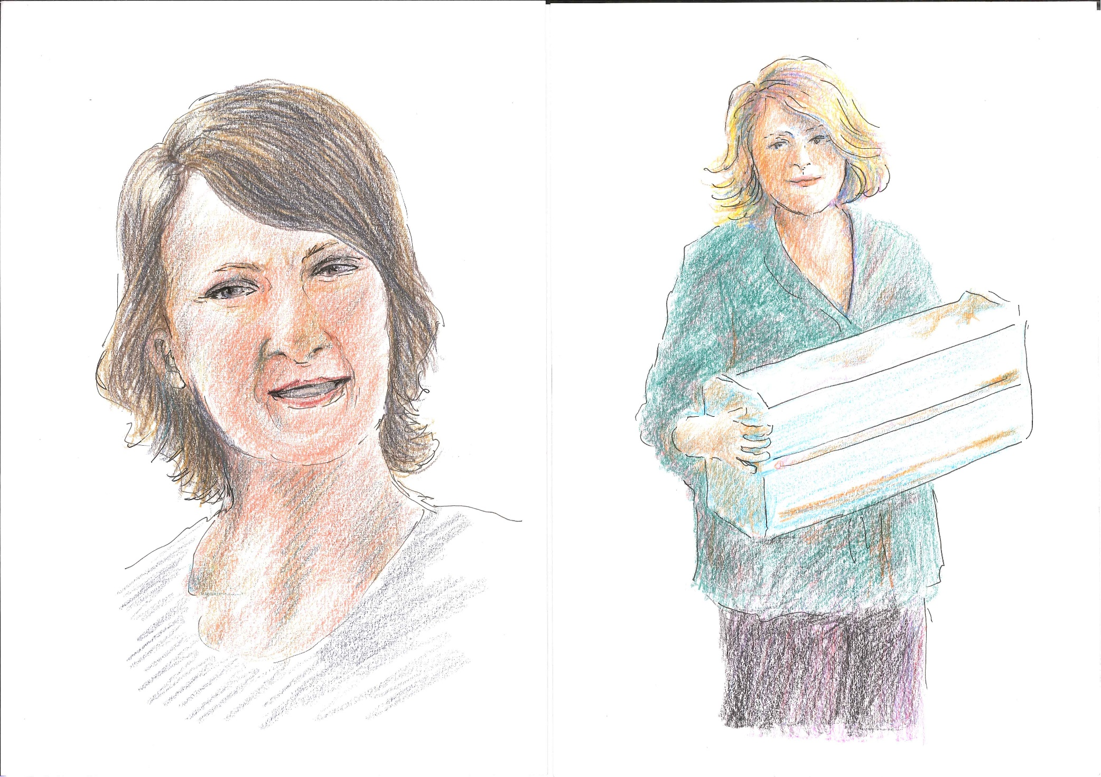
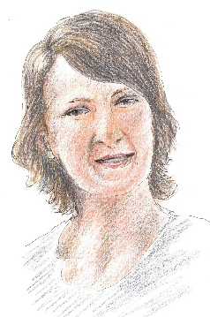
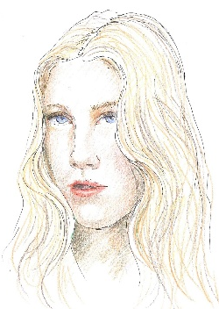
The context

Slide 3
Let’s talk about some new tools …
… devised by the Iceberg team to raise awareness amongst social and health professionals, people and communities about the family members of problem gamblers. We work alongside them as part of the Iceberg project (L’Arco cooperative, Fondazione La Ricerca, and SerDP from Piacenza, Italy).
After writing Chapter 14 of *FAMILIES AFFECTED BY ADDICTION*, we have been continuing to reflect on tools, organise them and try out new ones.

Slide 4
Why new tools?
Encouraging people and communities to listen to and see a voiceless group, which remains largely invisible, has always been a challenge.
Gambling is a topic that arouses curiosity: both the general public and professionals want to understand it better.
The stories of family members are a subject that strikes a chord and stirs strong emotions: they face serious problems, suffering, and physical and mental illnesses. But interest wanes quickly. What people think – and sometimes say – is ‘thank goodness my family isn’t like that’.

Slide 5
Explaining family members' problems is easy…
… but tends to elicit in those who listen feelings of helplessness
Everyone believes that, in order to improve the situation of family members, problem gamblers need to undergo treatment. Yet only 3 per cent of problem gamblers actually do so: this leads to feelings of frustration and mistrust amongst professionals and the community.
Explaining family members' problems is easy… but often leads people to avoid the topic.

Slide 6
Then we designed tools that could …
… engage people so that they can put themselves in the shoes of family members. Raising awareness within groups is extremely helpful because groups create resonance and mirroring effects..
To inspire constructive and positive attitudes in people. To help them understand that family members need support and help, which a community can provide.
We have organised the use of these tools into a flexible checklist: it contains everything we can use.

Slide 7
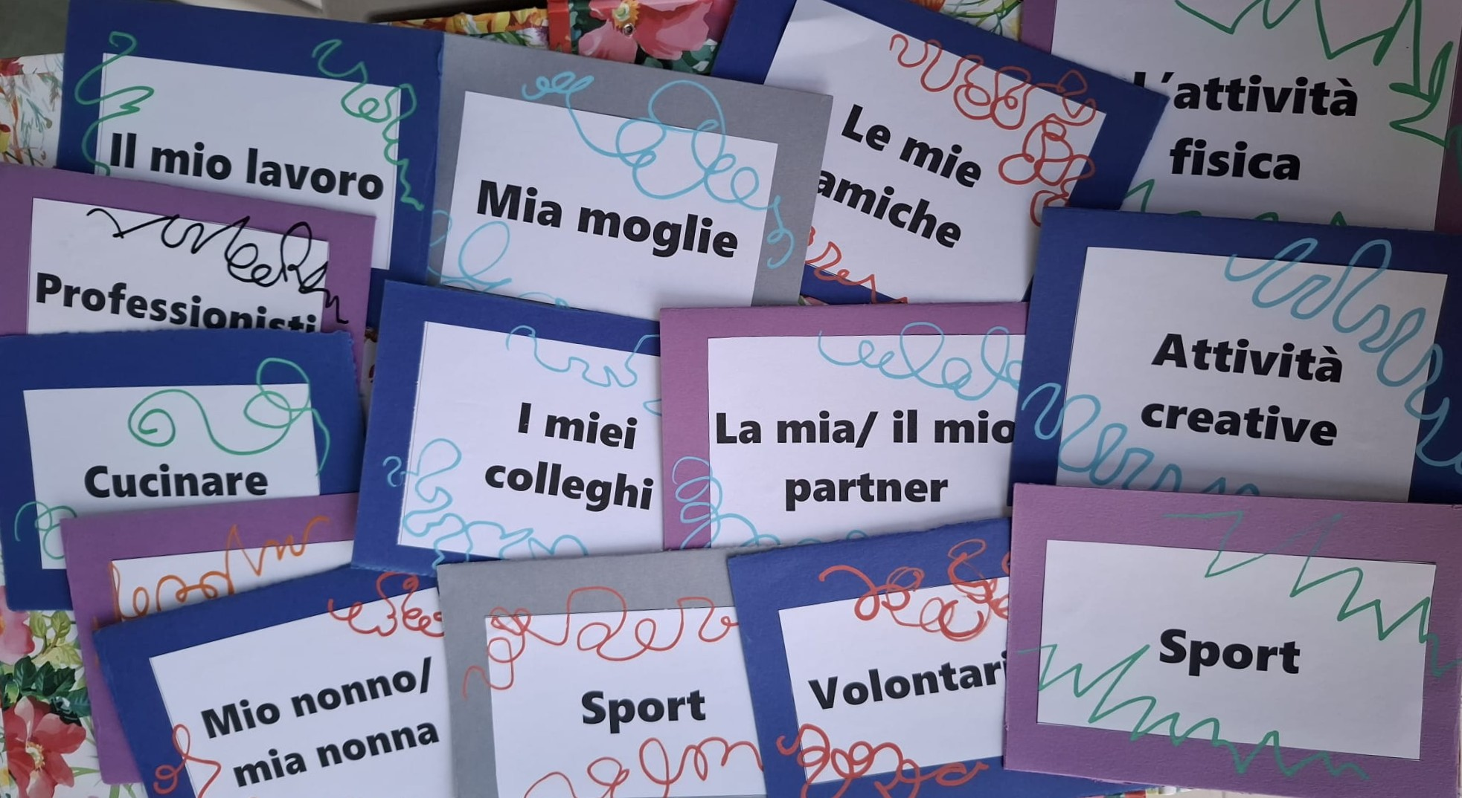
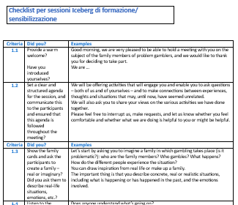

Output
The checklist
The FM cards
The network and its cards
The podcast
Julia
Mum
+
Sister and Brother-in law (Emma & Steve)
-/+
Running club
+
Listening to music & gardening
+
GP, Dr Barnes
+/-
Manager at work, John
+
Friend, Liz
+/-

Slide 8
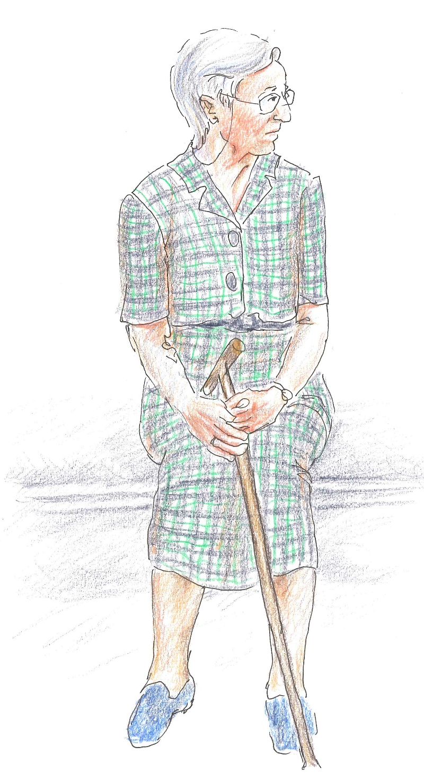
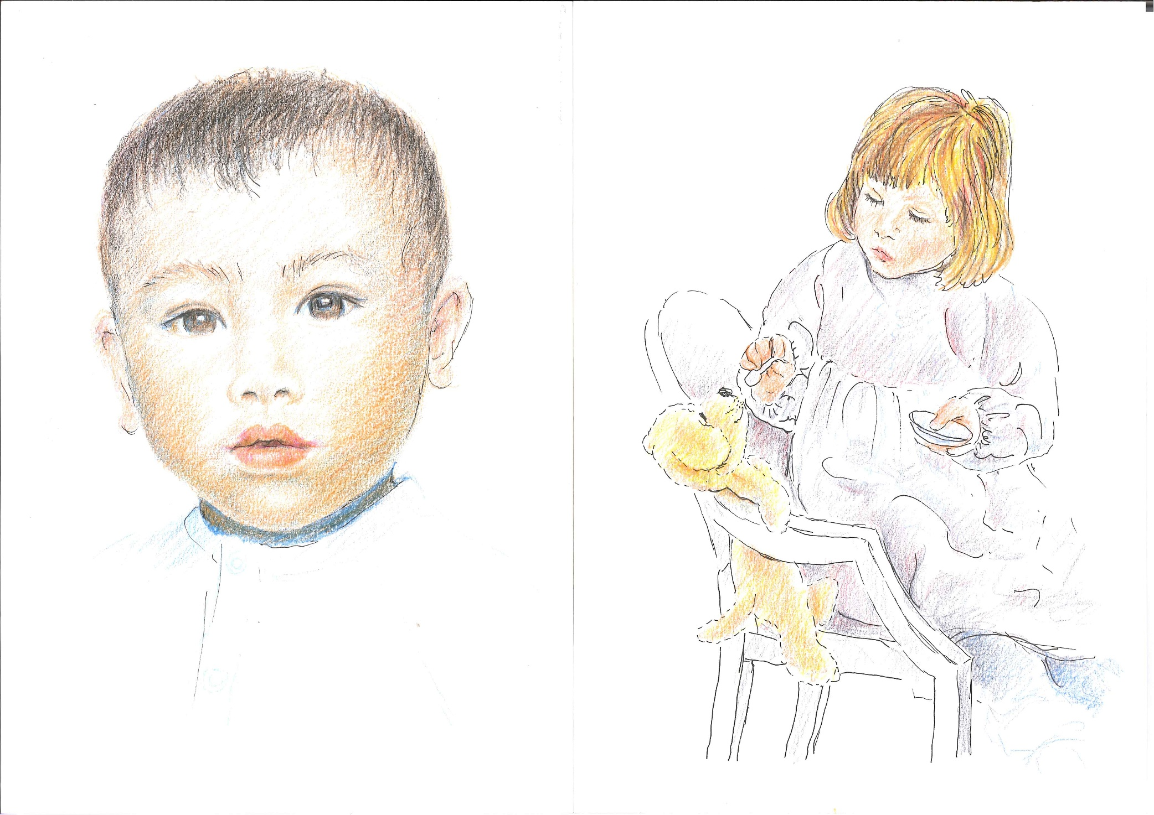
Our Checklist…
… is inspired by the one we use in the 5-Step Method, but is designed to support the process of awareness-raising and training sessions.
We use it to prepare awareness-raising sessions, to decide who does what, to assess how the sessions went.
Here we present parts of the first and of the second meeting
Notes:
When we are asked to deliver an awareness-raising session, the team responsible for that target audience assesses the characteristics of the group for whom the session is intended and the participants’ likely expectations: whether it is a group of social and educational workers, a voluntary organisation, a team of colleagues, and so on.
Our team then uses this checklist to decide what to cover during the session, or what to propose for the first session – if two sessions are planned, as we hope – and how to structure the second session.

Slide 9
Checklist 1.1 & 1.2
Criteria | Did you? | Examples
1.1 | Provide a warm welcome? Introduced yourselves? | Good morning, we are very pleased to hold a meeting with you about family members of problem gamblers, and we would like to thank you for being here. We are …
1.2 | Set a clear and structured agenda for the session, communicate this to the participants and ensured that this agenda is followed throughout the meeting? | We will offer activities that will engage you, allow you to ask questions and make connections between experiences, thoughts and situations that may, until now, have seemed unrelated. We will also ask you to share your views on the activities we have done together. Please feel free to interrupt us, make requests, and let us know whether you feel comfortable and whether what we are doing is helpful to you or might be helpful.

Slide 10
Checklist 1.3
Criteria | Did you? | Examples
1.3 | Show the family cards and ask the participants to create a family – real or imaginary? Did you ask them to describe real-life situations, emotions, etc.? | Let’s start by asking you to imagine a family in which gambling takes place (is it problematic?): who are the family members? Who gambles? What happens? How do the different people experience the situation? You can draw inspiration from real life or make up a family. The important thing is that you describe concrete, real or realistic situations, including what is happening or has happened in the past, and the emotions involved.

Slide 11
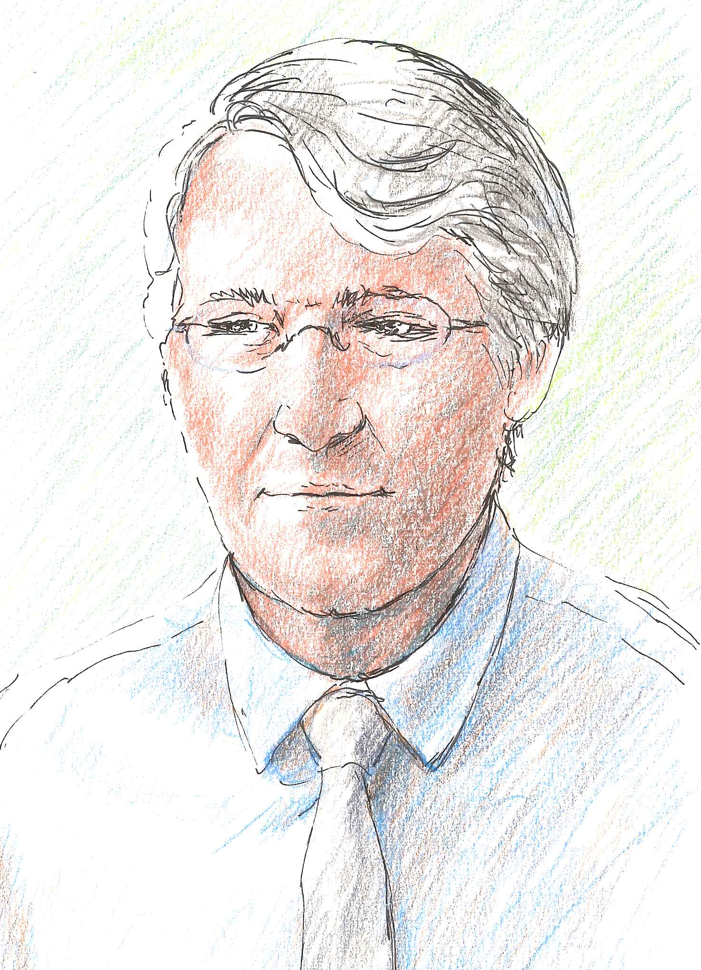
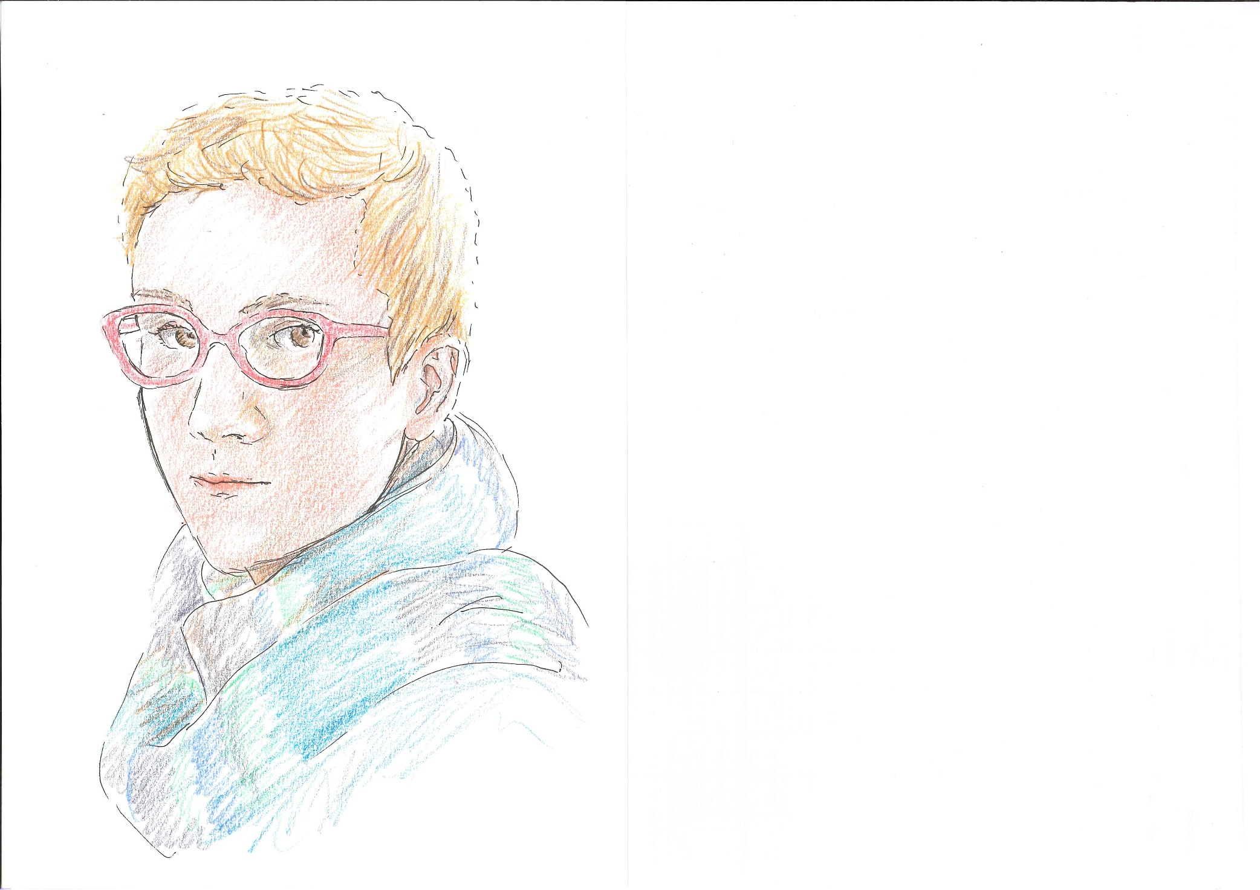
Family Members’ Cards
We created a pack of cards entirely dedicated to family members: we took into account the statistics relating to the resident population in Italy; we designed and had the cards printed, making the packs available to the entire Iceberg project team.
The 35 cards can therefore represent people of various ages, genders, backgrounds (in Italy, 15 per cent of residents are migrants) and possible roles within the family…
If there are more than 8 participants at the meeting, we ask that they form small groups to discuss how to create families. If there are a great many people, we can use two packs.
 | Age range | %
 | 0 to 14 | 12,7
 | 15 to 24 | 9,87
 | 25 to 34 | 10,56
 | 35 to 44 | 12,1
 | 45 to 64 | 30,97
 | 65 and more | 24,04
Notes:
In Italy, 12.7 per cent of the population consists of children under the age of 14, 10 per cent of young people aged between 15 and 24, 11 per cent are young adults aged between 25 and 34, 12 per cent are adults aged between 35 and 44, 31 per cent are adults aged between 45 and 65, and 24 per cent are older people aged over 65. Fifteen per cent of the population are migrants

Slide 12
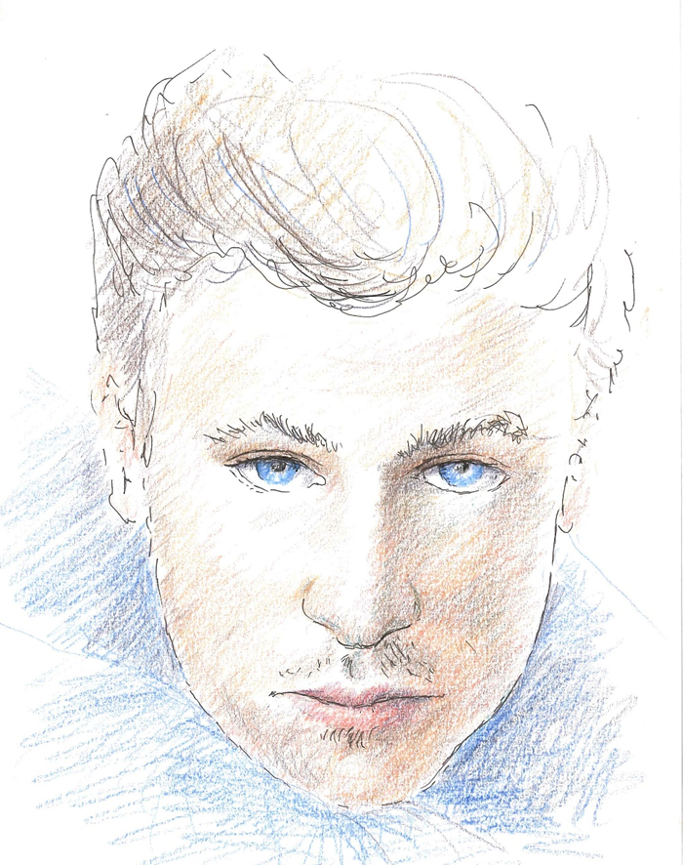


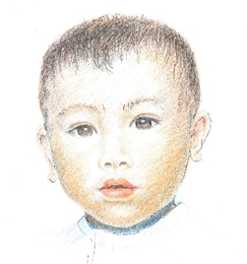
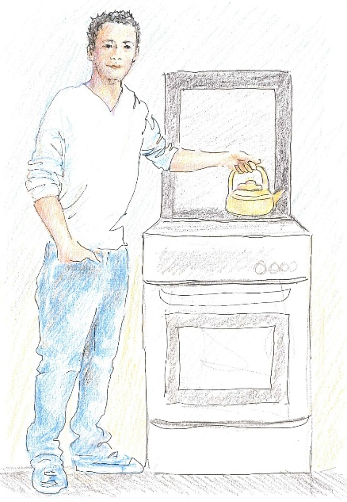

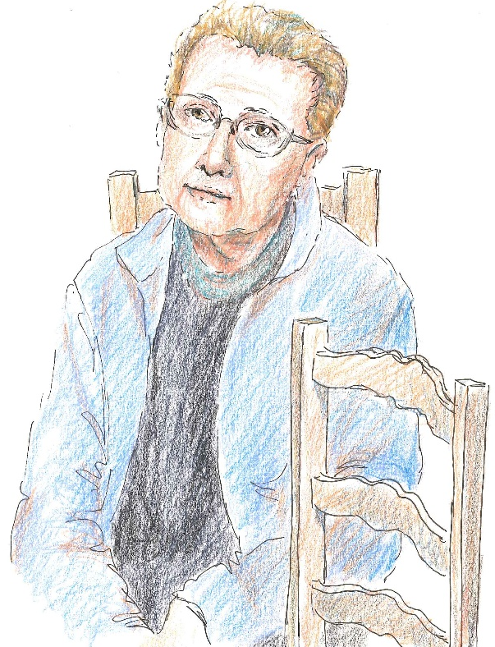
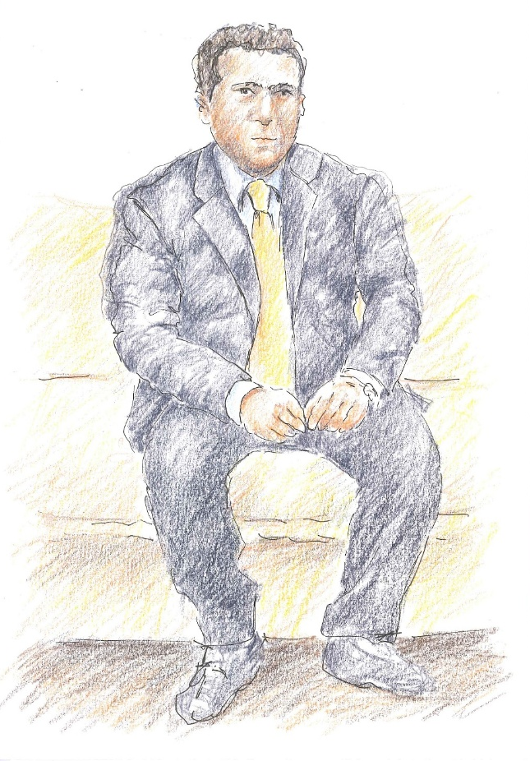
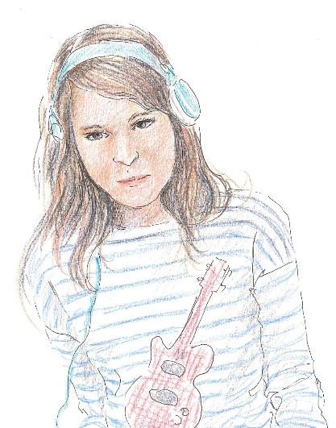
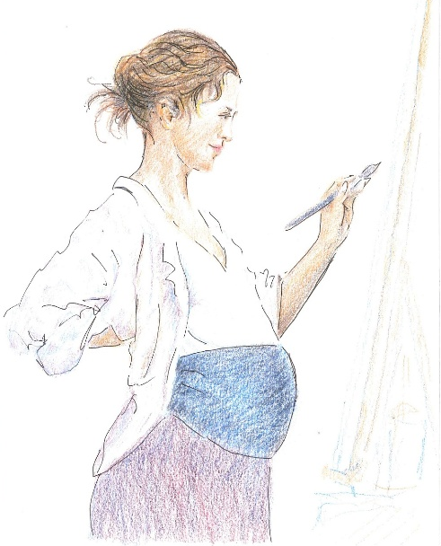

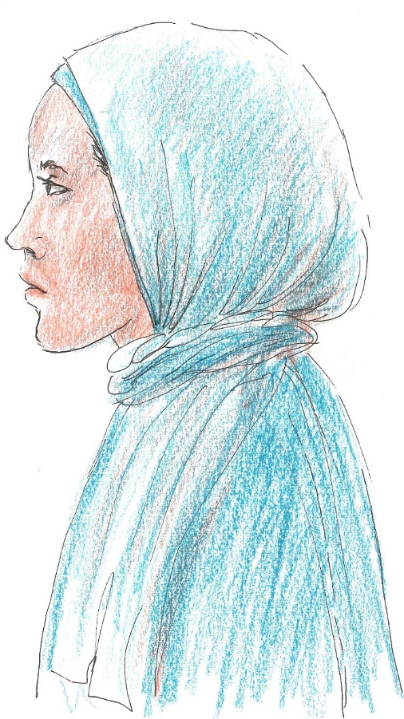


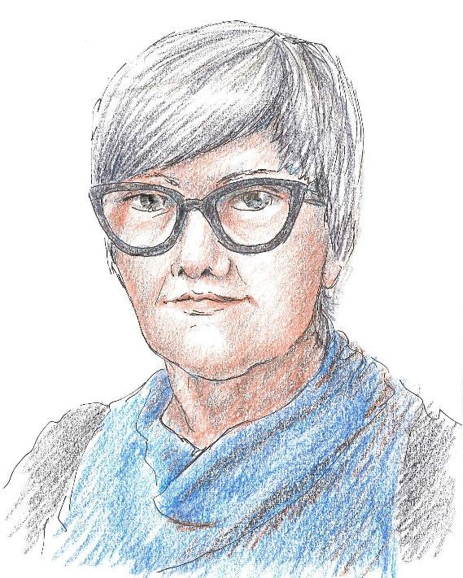
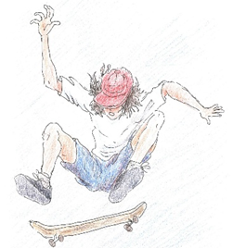

Slide 13
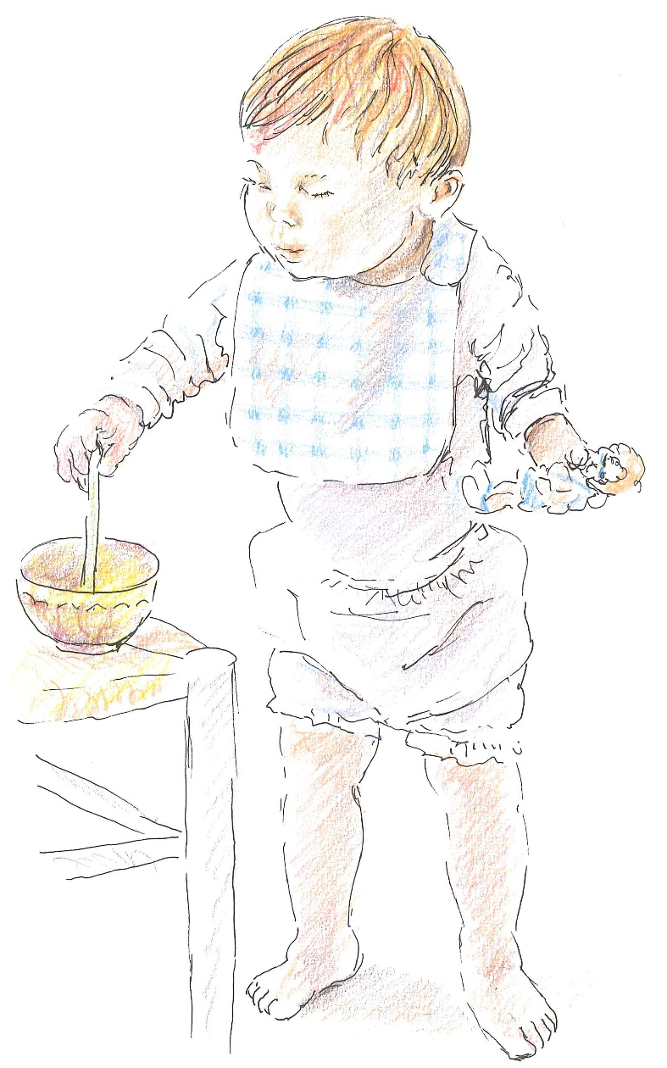
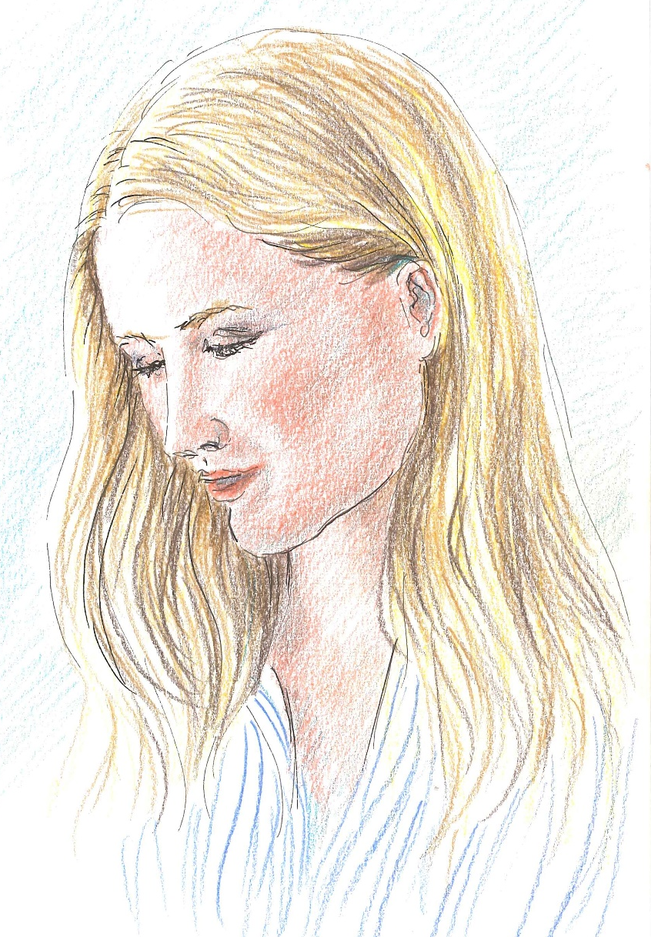
Checklist 1.4
Criteria | Did you? | Examples
1.4 | Listen to the families’ descriptions and ask for any other details? | Does anyone understand what’s going on? Is there anything particularly worrying? Are people reacting to what’s happening? In this family, are there some who know something and others who know nothing? How long has this situation been going on? What problems are there? How serious are they? Is anyone trying to tackle them? And how is that going?

Slide 14
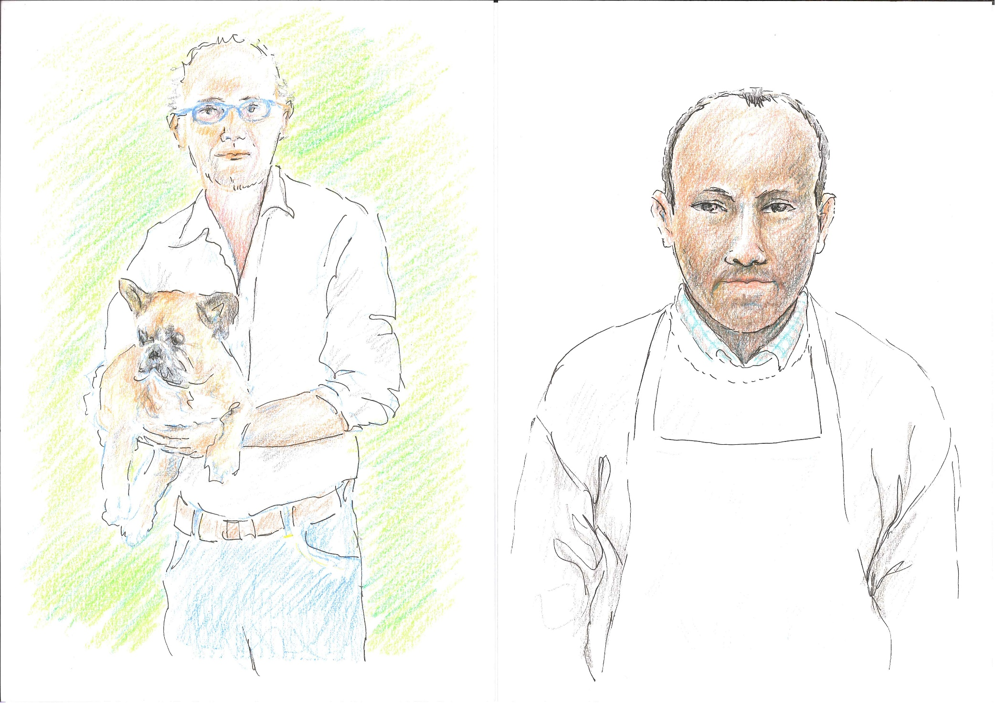
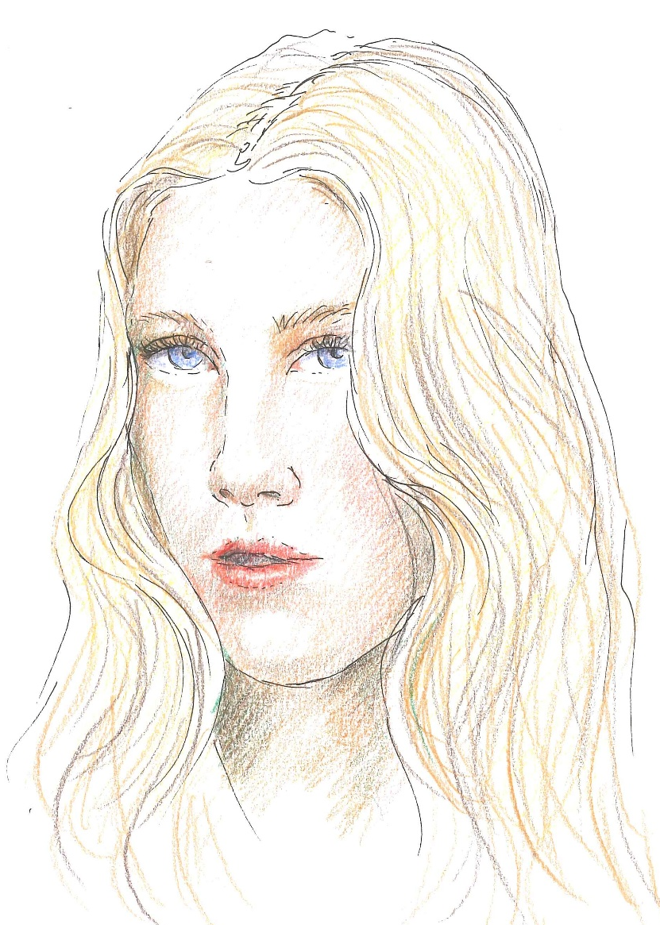
Using cards, people build stories
They are free to invent situations or draw on real families. They are not forced to talk about themselves, but they can– whether through similarities or differences.
Our questions bring out the participants’ skills and help them realise that they know far more than they think they do. People emerge feeling empowered: they know a great deal about family members and are able to understand them.
Many topics that we used to introduce ourselves are now raised by the participants, and all we have to do, is to reflect them back in a simple way.

Slide 15
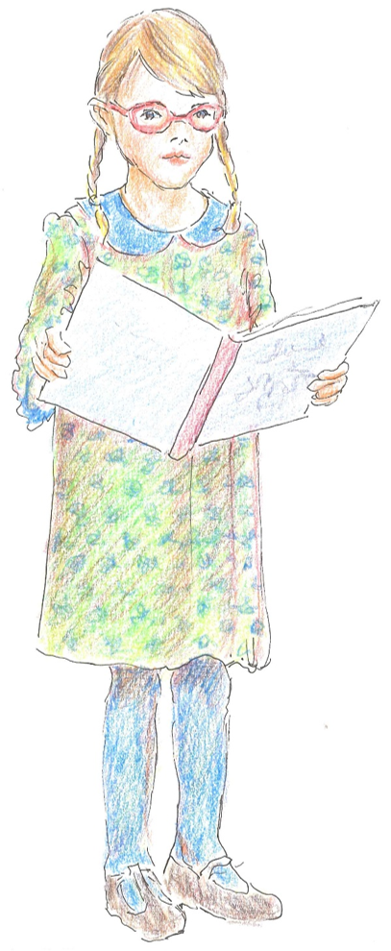
Checklist 1.5
Criteria | Did you? | Examples
1.5 | Introduce the Stress-Strain-Information -Coping-Support Model? | Hearing your descriptions of these families and their stories, we see that you said everything we would have told you about families of problem gamblers. You have very clear and accurate ideas, and you are very competent (or: the ideas you have are not consistent with our experiences: where did your views come from?).

Slide 16
Checklist 1.5, again
Criteria | Did you? | Examples
1.5 | Introduce the Stress-Strain-Information -Coping-Support Model? | What we can tell you is that your experiences are precisely those we find in the SSICS model. A group of researchers asked family members of people with an addiction about their circumstances: great suffering, arising from constant and significant stress going on for months or years, to which family members naturally react with strain. Strain can be psychological and physical symptoms: depression, anxiety, headaches, heart or gastrointestinal problems, fatigue, sleep disturbances, aches and pains all over the body. Research were carried out worldwide and led to the SSICS (Stress Strain Information Coping Support) model. Most important: what helped family members suffering so much from stress and strain was an improvement in three areas. Some information (etc.), more awareness of their ways of coping, and a good support network.

Slide 17
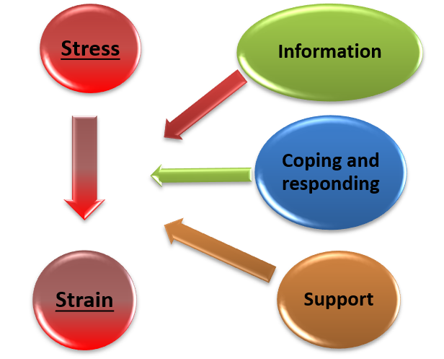
The Stress Strain Information Coping Support Model
We present the SSICS model because it is the one that can help people understand the complexity of situations.

Slide 18
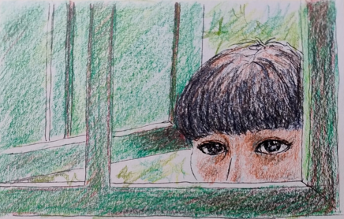
The second meeting
Julia
Mum
+
Sister and Brother-in law (Emma & Steve)
-/+
Running club
+
Listening to music & gardening
+
GP, Dr Barnes
+/-
Manager at work, John
+
Friend, Liz
+/-
In the second session, we help people understand how they can support any family members they may meet. In the first session, they feel that they can understand them; in the second, they learn how to be there for them and how to become part of their support network.
The main tool here is the network. .
The network, as presented in step 4, is central in supporting family members; therefore, we encourage participants to build their own network and to understand what is helpful and what does not, in fact, provide support to them.

Slide 19
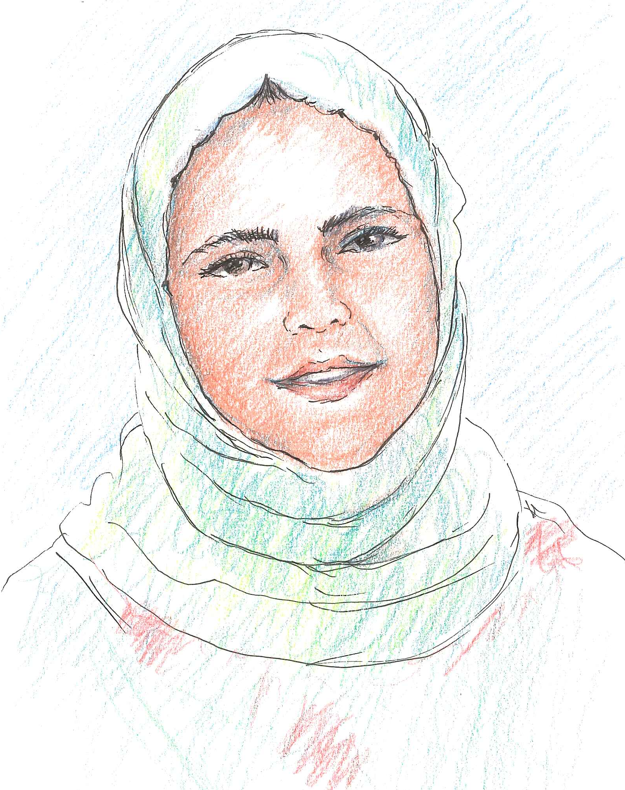
Checklist 2.1
Criteria | Did you? | Examples
2.1 | Explained that the vast majority of problem gamblers and their family members do not seek help? | Family members are suffering but do not ask for help, just as gamblers themselves do not, given their natural ambivalence. Suggesting that they seek specialist help may lead to refusal on the part of the gamblers and can cause great distress to family members. What can be done instead? Help is available for family members: we can offer both orientation interviews and the 5-Step method, which is based on the model we discussed earlier.
Notes:
Notes Using the cards helps people and practitioners see the similarities between themselves and FM families; presenting the model then enables people and practitioners to understand the differences between themselves and families facing difficulties. Indeed, many people comment by drawing comparisons between situations involving addiction and those caused by disability, Alzheimer’s and other degenerative diseases.

Slide 20
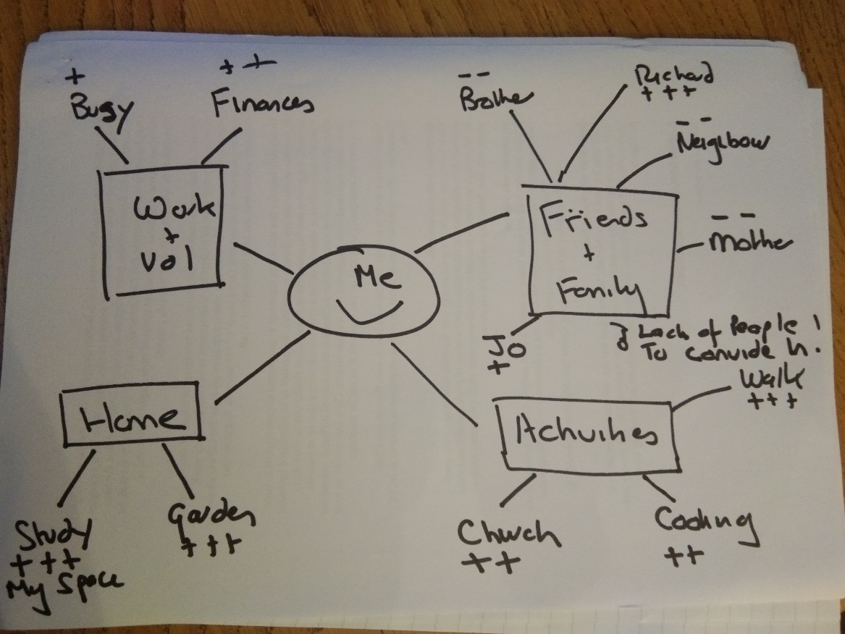
Checklist 2.2
Criteria | Did you? | Examples
2.2 | Did you ask the participants to build their own network? Did you suggest using the network cards and the 8 dimensions of wellness? | To better understand how we can support our family members, let’s start by thinking about who and what supports us. When you think about your support network, who would you include in it? You’ll find some suggestions in these cards: people like husbands, wives, parents, sons, daughters, relatives of all kinds, friends, and colleagues. Also think about the activities you do that make you feel good or even help you feel better when you’re going through a difficult time: sport, political or cultural interests, nature, walks, dancing, etc. Does anyone or anything come to mind that is partly helpful and partly not?

Slide 21
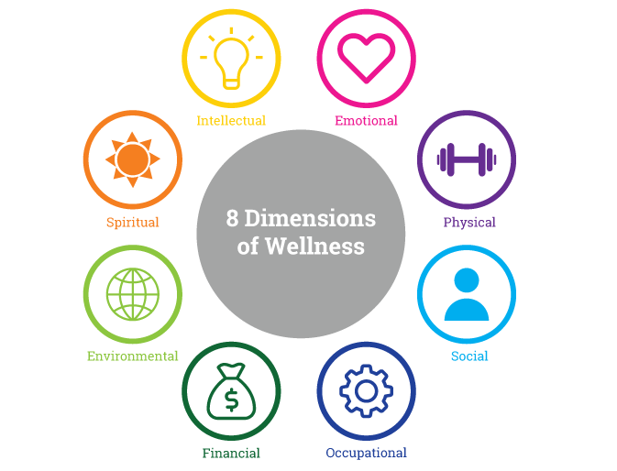

Slide 22
My friends | My sister
My husband | My dog
My wife | My cat
My daughter | My colleagues
My niece | My partner
My son | My brother
Take a walk | Cooking
Travel | Read
Volunteering | Associationism
My church | Exercise
Hike | Sport
The book club | Get involved in politics
My parents | My aunt
My sister in law | My brother in law
My uncle | My nephew
My grandchildren | Creative activities
Health Practitioners | Social Workers

Slide 24
Another tool: the podcast «Playing to Lose»
It is a tool designed to raise awareness amongst the general public, and we found it to be very powerful in training and awareness-raising contexts as well. We also recommend that family members who are following the 5-Step Method listen to it—
The Iceberg podcast consists of four episodes, in which a journalist interviews Iceberg team practitioners and SerDP, other members of the community and, above all, many family members and some problem gamblers.
We decided to use some excerpts from the interviews with family members during the second awareness-raising session to tie in with the themes of the first session, immersing participants in the real-life experiences of families, and suggesting a three-step approach: 1., we listen to the family members, 2. then move on to consider our own support network (and what is helpful or not), and 3. finally return to the family members to imagine what might be helpful to them.

Slide 25
Something metacognitive

Slide 26
Using engaging tools …
 | people |  | meetings |  |  | numb of persons |  |  |  | meetings |  | meetings
 | Professionals |  | numb of | persons | persons | CARDS | NET | PODCAST |  | num | PEOPLE | PROFES | num | num
2026 | Fiorenzuola Pubblica Assist |  | 2 | 15 | 15 | 15 | 15 | 15 |  | 2 | 15
2025 | Modena Counseling Day |  | 1 | 15 | 15 | 15 |  |  |  |  |  | 15 | 1 | 1
 | Mara Monica Ponente |  | 1 | 35 | 35 | 35 |  |  |  | 1 | 35
 | ANZIANI comune PC |  | 2 | 8 | 8 | 8 | 8 |  |  | 2 | 8
 | Centro per le FAMIGLIE PC |  | 3 | 15 | 15 | 15 | 15 |  |  |  |  | 15 | 3 | 3
 | IPPOGRIFO |  | 2 | 6 | 6 | 6 | 6 |  |  |  |  | 6 | 2 | 2
 | SOC workers Fiorenzuola |  | 1 | 7 | 7 | 7 |  |  |  |  |  | 7 | 1 | 1
 | SOC workers PC ANZIANI |  | 2 | 16 | 16 | 16 |  |  |  |  |  | 16 | 2 | 2
 | SOC workers ADULTI FRAG PC |  | 1 | 7 | 7 | 7 |  |  |  |  |  | 7 | 1 | 1
 | 2 classes of high school |  | 2 | 30 | 30 | 30 |  |  |  | 2 | 30
 | SerDP colleagues |  | 1 | 12 | 12 | 12 |  |  |  |  |  | 12 | 1 | 1
 | Maurizio at nurses training |  | 1 | 45 | 45 | 45 |  |  |  |  |  | 45 | 1 | 1
 |  |  | 19 | 211 | 211 | 211 | 44 | 15 |  | 7 | 88 | 123 | 11 | 11

Slide 27
Using visual and engaging tools…
Between 2025 and early 2026, we used the new tools in a total of 18 sessions: nearly 200 people (including professionals, residents and students) used the family member cards; more than 40 professionals and residents used the network; and 15 listened to part of the podcast before working on the network.
The podcast was recommended as further listening on many occasions, and at one awareness-raising session it was used as an ice-breaker, leading to a great deal of emotional engagement.

Slide 28
A SWOT analysis of the new tools
Strengths
Weaknesses
Focus on family members rather than on gambling, and on relationships rather than on problem. People feel competent
Engagement
Network tool arose from questions posed by participants
Podcast has great potential
Shared methodology for the team
Staff skills to engage with different groups
Engagement
Still no way of tracking participants’ feedback

Slide 29
A SWOT analysis of the new tools
Opportunities
Risks (threats)
Flexibility allows for adaptation to different contexts
Activities by the groups involved
Focus on potential rather than problems
People become aware of their own resources
Awareness of the Iceberg project and the opportunities it offers
Practitioners or people unwilling to get involved (resistance to change)
It’s a project rather than a permanent service, with periods of inactivity
Uncertainty regarding funding
Staff turnover

Slide 30
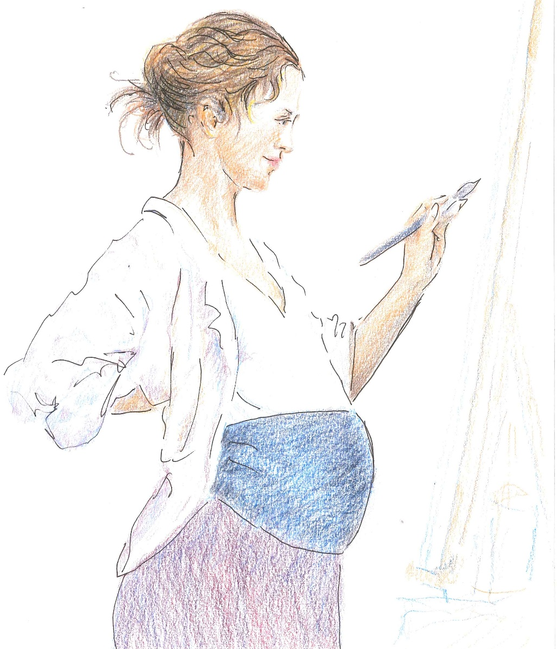
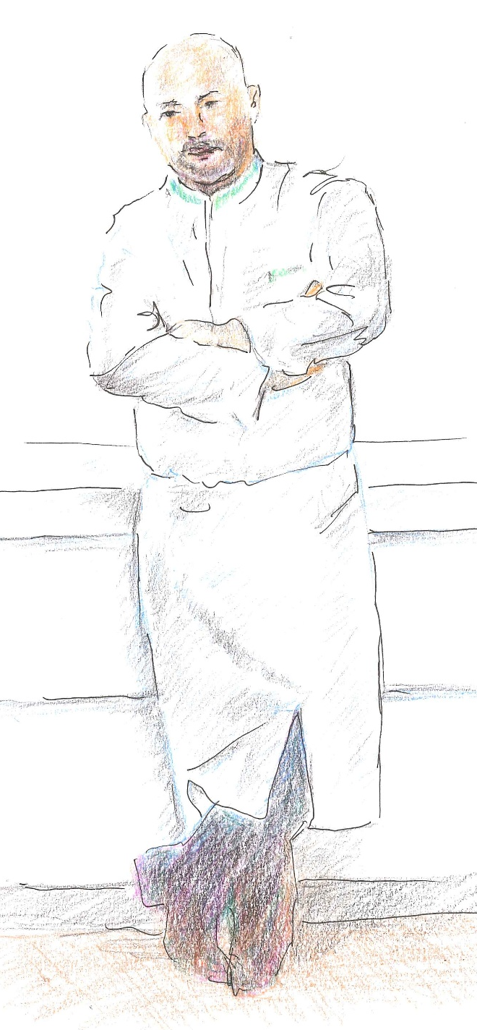

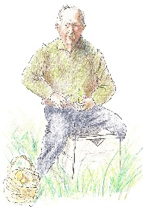
Thank you very much for your attention

