Slide 1
Me & My Family
– a family intervention
Ann Lyrberg
PhD Student, University of Gävle
Administrator, coordinator, project manager, FoU Välfärd Region Gävleborg.
Kari Jess
PhD in social work. Senior lecturer, Dalarna University

Slide 2

Me & my family - a family intervention and cross-sectional approach
A development project in 2013-2014 named "Coordinated Support for Children and Parents in Families with Substance Abuse" by the Swedish National Board of Health and Welfare
Children's health and development are negatively affected by parents’ abuse.
The intervention implies cooperation between case managers working with alcohol abuse and child protection.
Family-oriented and involves children
It focuses on improving the children’s situation and is an example of preventive work.
Me & My Family
Family-oriented outpatient programme
8 session
Communicate the SUP/abuse
Child participation
Improved health and family relationships, increased motivation to change alcohol and drug use

Slide 3

The aim and overall objectives of the intervention
Me & my family aim to involve children and parents and to communicate in a factual, de-dramatised, non-judgmental way about the SUP/addiction and the problems in the family.
The intervention focuses on child participation: Listening to children and taking their views and experiences seriously

Slide 4
Target group
The programme is aimed at families where one or both parents or the parent's partner have substance use problems.
Exclusion criteria:
Families with a chaotic social situation
Ongoing domestic violence
In cases of escalated abuse and where children need protection.
When a parent has an active psychotic disorder
There is no requirement for time in sobriety, but the parent must be sober at the sessions.

Slide 5


Guiding principles
All family constellations are OK.
Parents want their children to have a good upbringing.
No one chooses to develop substance use problems/addiction
Everyone in the child's household matters
There is no perfect family
There is always hope. We can make a difference today and in the future.

Slide 6
5 themes in 8 sessions
Two information sessions before start
Session 1: Addiction development
Session 2: Addiction development
Session 3: The family as a system
Session 4: How are children and parenting affected by SUP/abuse?
Session 5: Communication: “The importance of clear communication.”
Session 6: Dealing with emotions and how to improve family relationships
Session 7: Safety plan
Session 8: Summarising and closing
Two follow-up meetings: 6 weeks and 3 months after completion

Slide 7
How the sessions work
The Bear cards: “How do you feel today?”"
Highlights and lowlights since last session
The theme of the day.
  Short lecture
  Discussion
Exercise, e.g. drawing a picture:
  How I feel when mum/dad drinks
Homework assignment (e.g. an activity that reinforces sober behaviour and contributes to good social interaction)
The Bear cards: ”With which feeling do you leave the session?”

Slide 8
Theoretical framework
- childhood sociological perspective
The program is based on assumptions that:
Children are capable of meaning-making and competent in constructing their lives,
Children's agency affects not only children's own lives but also their environment, society, social relationships and cultures,
Children as actors and agents are developed through participation,
Child participation is a social right by Article 12 of the Convention on the Rights of the Child,
Participation promotes children's health - it becomes more comprehensible, meaningful, and manageable and increases the sense of coherence.

Slide 9
Results from two studies
An outcome study
An interview study with children

Slide 10
The outcome study
The aim of the outcome study:
To evaluate the outcomes of the knowledge- and motivation-enhancing programme Me & my family, focusing on child well-being and family climate, parental alcohol and drug use, and self-rated parental mental health.
  Addressing the limitations of previous research, this study includes children’s self-ratings.

Slide 11
Study design
The study was initially designed as a randomised controlled trial (RCT) in which participating families were randomly assigned to start with the intervention immediately or to a three-month waiting list. The families not included in our study or randomised to the waiting list received treatment as usual within the social services.
During the first year, the study design was revised. Instead, we decided to measure the outcome by comparing family members with their own baseline measures on completing the intervention and at three, six, and 12 months post-intervention.

Slide 12
Questionnaires used in the outcome study
Questionnaire | When | To whom
Family Climate Questionnaire (pick minimum 15 of 85 adjectives) | Pre intervention and three, six, and 12 months post intervention | Children and parents
Strengths and Difficulties Questionnaire (SDQ) (25 items) | Pre intervention and three, six, and 12 months post intervention | Children; parents of children under 11 years old
Hospital Anxiety and Depression Scale (HADS) (14 items) | Pre intervention and three, six, and 12 months post intervention | Parents
Alcohol Use Disorders Identification Test (AUDIT) (10 items) | Pre intervention and three, six, and 12 months post intervention | Parents
Drug Use Disorders Identification Test (DUDIT) (10 items) | Pre intervention and three, six, and 12 months post intervention | Parents
Motivation VAS scale, 1–10 | Pre intervention and three, six, and 12 months post intervention | Parents

Slide 13
Statistical analysis
All analyses were conducted with IBM’s Statistical Package for the Social Sciences (SPSS), version 27.
Descriptive statistics were used to describe the sample.
Attrition analyses were assessed using independent-sample t-tests and chi-squared tests. Linear mixed models were used to investigate changes in symptom ratings, family climate, and use of alcohol and drugs before (T1), on completing (T2), and three months after (T3) the intervention.
All reported results were considered significant at the 5% level (bold letters in the tables and figures)

Slide 14
Participants characteristics
 | Participated n = 41 children; n = 48 parents | Drop-outs n = 18 children; n = 19 parents | Statistics
Gender, children (females) | 55.3% | 50.0% | χ² = 0.14; p = 0.712
Gender, parents (females) | 52.1% | 47.4% | χ² = 0.12; p = 0.728
Age child, mean (SD) parent, mean (SD) | 11.15 (3.84) 41.38 (9.08) | 11.22 (3.32) 40.89 (7.08) | t = 0.73; p = 0.942 t = 0.21; p = 0.837
School participation, child | 100% | 90% | χ² = 3.08; p = 0.079
Occupation (work, student, parental leave), parent | 61.5% | 66.7% | χ² = 0.10; p = 0.748
Previous treatment for substance use problems | 62.4% | 65.5% | χ² = 0.09; p = 0.760

Slide 15
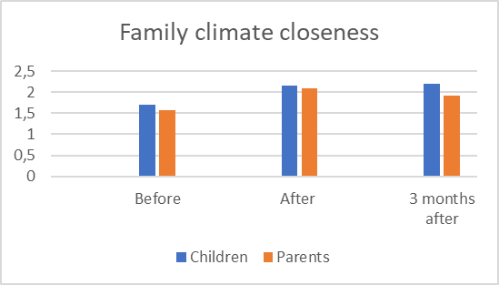
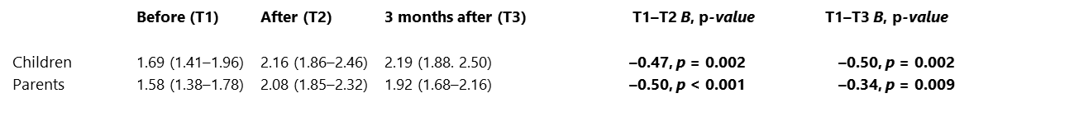
Outcomes family climate (Bold letters indicate significant outcomes)
Closeness

Slide 16
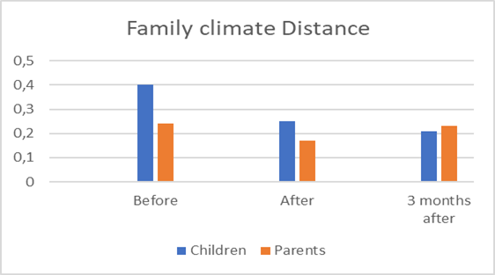
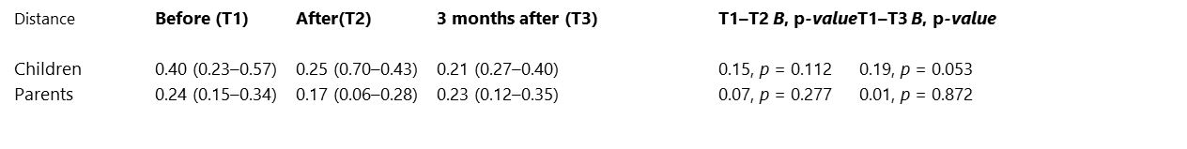
Outcomes family climate (Bold letters indicate significant outcomes)
Distance

Slide 17
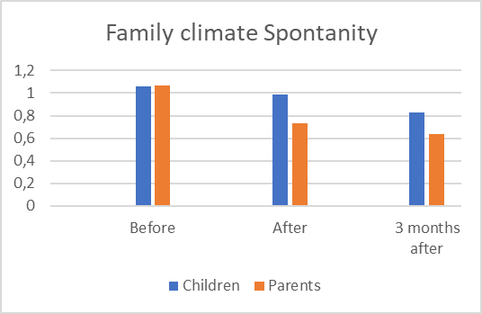
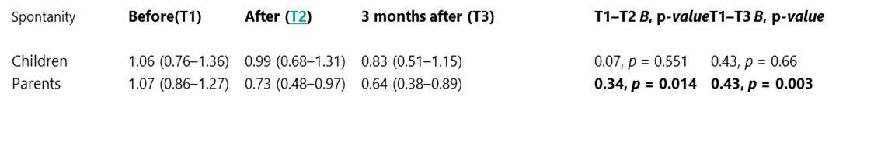
Outcomes family climate (Bold letters indicate significant outcomes)
Spontaneity

Slide 18
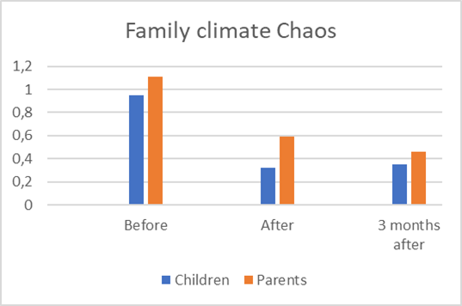
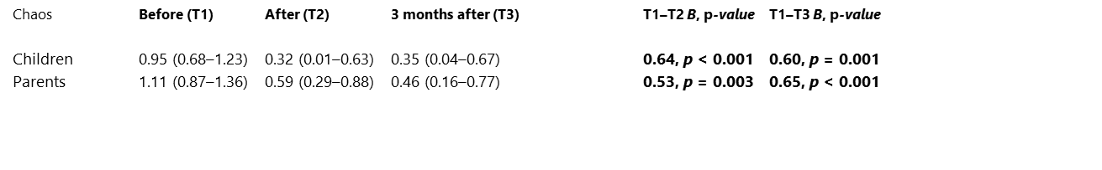
Outcomes family climate (Bold letters indicate significant outcomes)
Chaos

Slide 19
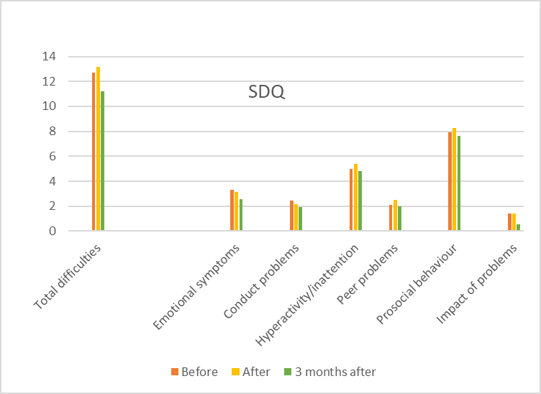
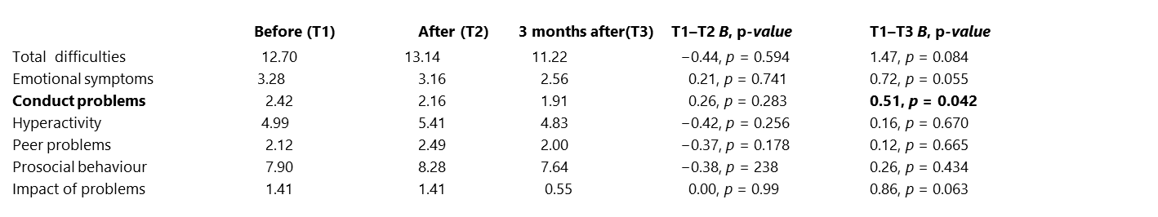
Strenghts and difficulties SDQ Children
(Bold letters indicate significant outcomes)

Slide 20
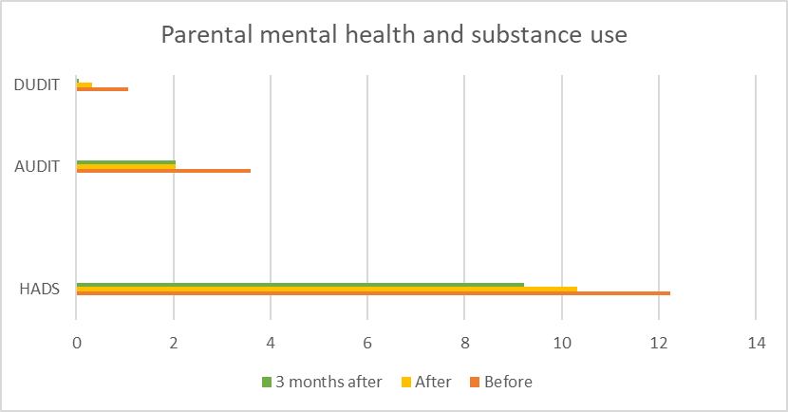
HADS, AUDIT, DUDIT Parents (Bold letters indicate significant outcomes)
Before After 3 months after P-value T1-T2 P-value T1-T3
HADS 12.23 10.31 9.23 1.92, p = 0.026 3.00, p = 0.002
AUDIT 3.59 2.05 2.05 1.54, p = 0.001 1.54, p = 0.001
DUDIT 1.07 0.32 0.06 0.75, p = 0.73 1.01, p = 0.017
*= fetstil är signifikanta resultat

Slide 21
Outcomes summary (significant outcomes)
Both the children and their parents self-reported more closeness and less chaos in the family post-intervention
Self-reported reductions in child conduct problems
Self-reported reductions in parental symptoms of anxiety and depression
Parents reported less substance use after the treatment.

Slide 22

Interview study
Aim
To investigate children’s experiences of the intervention
Me and my Family
What significance has the intervention had for the children?
What do the children find helpful?

Slide 23
Method
Qualitative
Semi-structured interviews
17 Children aged 7-20, 11 girls and 6 boys
Completed the program 2019-2021
The results are coded and analysed thematically in Nvivo, applying a salutogenic perspective.

Slide 24
Results
Three main themes:
Learn to know family members
Expressed feelings of relief
Helpful incentives

Slide 25

”Scary talk”
How will the parent react? What to say?

Slide 26

Process “learn to know family members”
Speak up – the Childs story
Listening
to parents and siblings
stories
Being heard and confirmed

Slide 27
Process “Feelings of relief”
Decreased feelings of
loneliness
Increased feelings of
security and calm
Relieved of responsibility and guild

Slide 28
Helpful incentives
Open communication
A safe room
Knowledge
Case manager support
Exercises and play

Slide 29
Discussion
Outcomes in the reported quantitative study mirror the results from the interview study with children in the following ways:
The outcome study:
Both the children and their parents self-reported more closeness and less chaos in the family post-intervention
The interview study:
The children learned to know family members and expressed feelings of relief
The outcome study:
Self-reported reductions in child conduct problems
The interview study:
Tabus are broken, and children feel relief from negative feelings

Slide 30
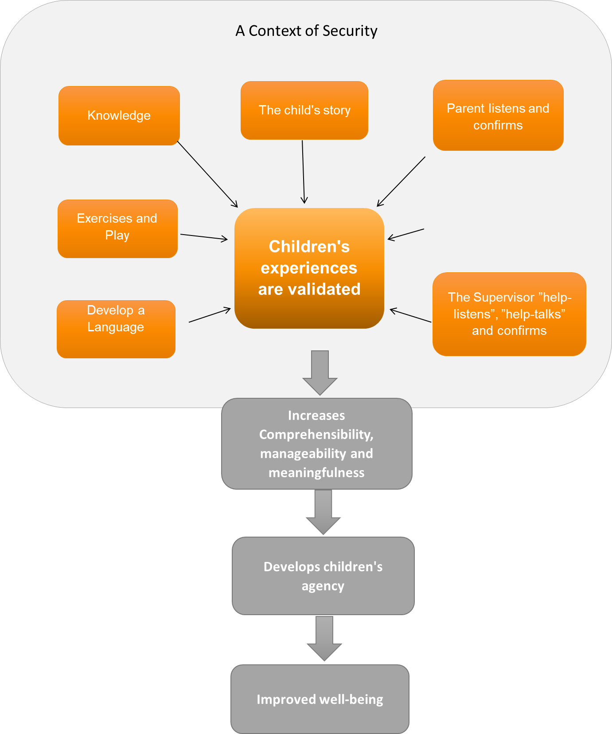
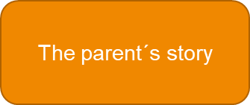
Contributed to stronger bonds between children and their parents and siblings
Break the taboo

Slide 31
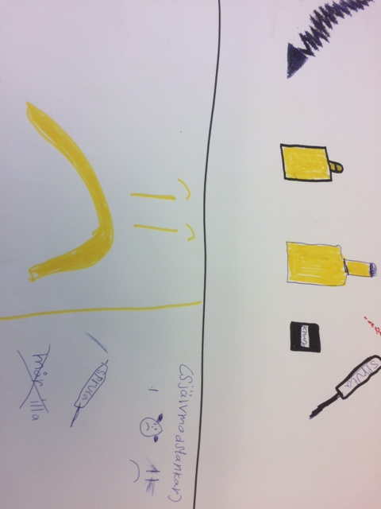

Questions?

Slide 32
Published articles
Jess, K., Lyrberg, A., Isaksson, J. & Nehlin, C. (2023). Me & my family: A programme for children and parents in families with parental substance use problems - an outcome study. Nordic Social Work Research. https://doi.org/10.1080/2156857X.2023.2192223
Lyrberg, A., Jess, K., & Forinder, U. (2024). Barns upplevelser av en intervention i familjer där vuxna har ett problematiskt bruk av alkohol och droger. Nordic Studies on Alcohol and Drugs.
https://doi.org/10.1177/14550725231219845

Slide 33
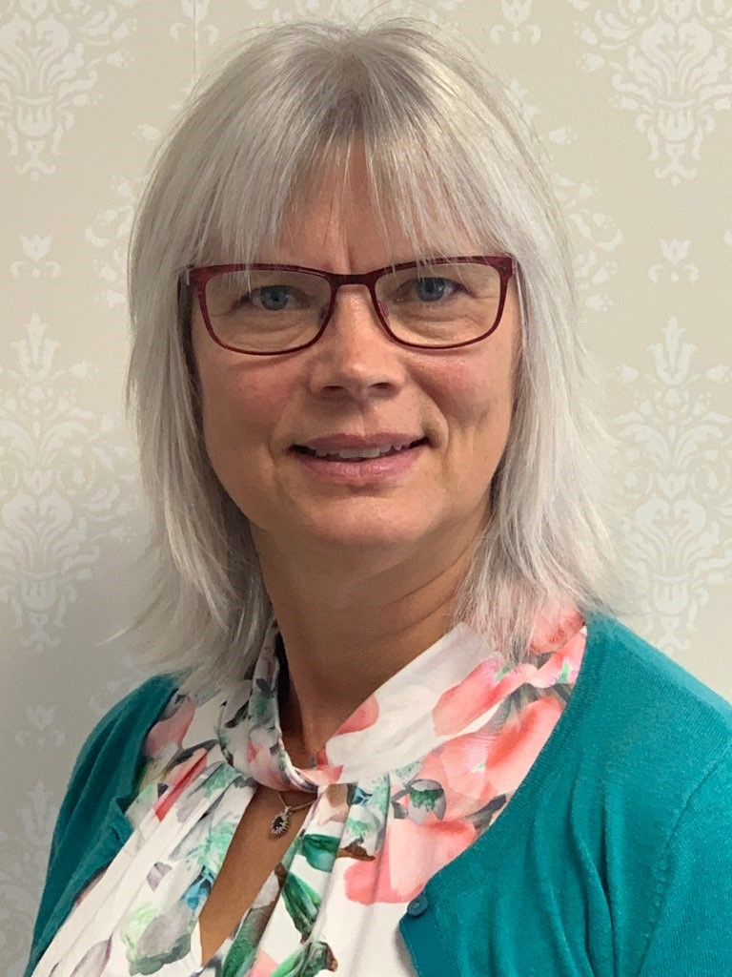

Thanks!
Ann Lyrberg
ann.lyrberg@regiongavleborg.se
ann.lyrberg@hig.se
Phone:
+4626531520
+46725232631
Kari Jess
kje@du.se
Phone:
+4623778513
+46760507320

