Slide 1





An Australian case study of an online group education and support program
BreakThrough: Families Understanding Addiction
Annette Peart, Monash University and Turning Point
Robert Campbell, Self Help Addiction Resource Centre
Notes:
RC

Slide 2

Acknowledgement of Country
Acknowledgment of Lived and Living Experience
We begin by acknowledging the Traditional Owners of the land on which we work and live, and pay respect to Elders past, present, and emerging. For Rob, this is the land of the Bunnerong People of the East Kulin Nation. For Annette, this is the land of the Wurundjeri People of the Kulin Nation.
We acknowledge the individual and collective expertise of those with a lived or living experience of alcohol and other drug, mental health, and/or gambling harm. We envision a world where all people affected by the impact of addiction can proudly and openly seek help, help each other, and demonstrate the living proof that recovery is possible.
Notes:
RC

Slide 3


Setting the scene at SHARC and Family Drug & Gambling Help
BreakThrough Program and Online Support Group
Research Project
Research Themes
Summary
Overview
Notes:
RC

Slide 4
Based in Melbourne, SHARC supports over 9000 individuals and families annually and our programs and services operate locally, across Victoria, and increasingly, Australia wide.
Peer support and lived experience are central to our work.
We provide telephone and online support, education programs, counselling, peer support groups, residential recovery, consumer representation and workforce training.
Self Help Addiction Resource Centre
Notes:
RC

Slide 5
Founded in 2000 from grass roots response of families impacted by addiction providing peer support
54 staff made up of 9 paid staff and 45 volunteers with lived and living experience of the impact of addiction
Programs offered:
  24/7 Telephone Helpline staffed by trained volunteers
  InFocus – family education
  BreakThrough – family education, adapted to online
  Support groups
  Muslim Youth, Adult and Family Program
  Three Sides of the Coin – enacted stories of gambling recovery
Informed by the Stress Strain Coping Information
Support Model and 5-step approach
Family Drug and Gambling Help
Notes:
RC

Slide 6
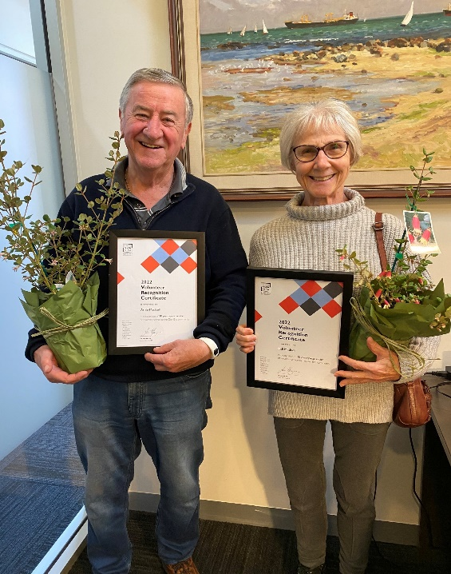
Multiple awards have been received in recognition of the outstanding work done by our volunteers in FDGH
Recognising our volunteers
Notes:
RC

Slide 7
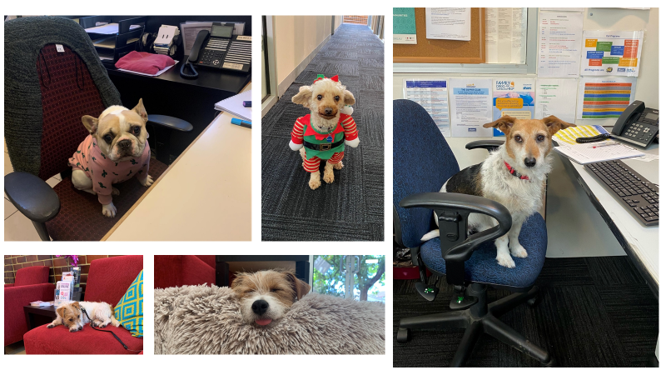

Some of the canine volunteers on SHARC dog days!
Telephone helpline
Notes:
RC

Slide 8
  Family members and friends affected by addiction can face challenges, including: guilt, worry, stigma, estrangement, financial issues …
  The health and well-being of family members and friends are often overlooked
  There are limited services that support family members and friends, and limited research on support programs
Family and friends affected by addiction
Notes:
RC

Slide 9

Group psychoeducation and skills-building program for family and friends affected by addiction
Established 2015, delivered to over 7,000 Victorians, with approximately 50 sessions annually
Available online, with weekly hour-long sessions
https://www.breakthroughforfamilies.com/
Notes:
RC
Group psychoeducation and skills-building program for family and friends affected by addiction
BreakThrough provides:
Information about addiction
Practical strategies, e.g., how to talk about substance use and boundaries, manage and respond to challenging behaviours, and care for oneself
A safe and confidential space, that is peer-based with trained facilitators
Established 2015, delivered to over 5,000 Victorians, with approximately 50 sessions annually
Available online, with fortnightly hour-long sessions
Joint program run by Turning Point and the Self Help Addiction Resource Centre (SHARC)
Website for BreakThrough is listed on the slide or google BreakThrough for families.

Slide 10

BreakThrough Online Support Group
Project Aim
  The aim was to understand how, and to what extent, the online peer-led support group impacted affected family members’ confidence in their coping abilities (self-efficacy), social support, and general wellbeing.
Notes:
AP
We knew from BreakThrough internal feedback and from qualitative interviews with BT participants, that the BT program was highly valued by attendees.
Desire for more opportunity to connect with other families
Online setting is convenient, accessible, and non-threatening for Breakthrough attendees
So this research involved piloting an online support group, that built on the BreakThrough program.
The aim was to understand how, and to what extent, the online peer-led support group impacted affected family members’ confidence in their coping abilities (self-efficacy), social support, and general wellbeing.

Slide 11
Designed and trialled an online peer support group, connected to BreakThrough program
Support Group
Fortnightly, hour-long group meetings, after BreakThrough, led by BreakThrough facilitators
  Meetings comprised of participants reflecting and sharing on topics discussed in the Breakthrough sessions in a safe space.
  They were encouraged to use learned strategies with positive reinforcement.
  Meetings held 18 times between September 2021 and March 2022
Notes:
AP

Slide 12
Mixed-methods quantitative and qualitative design, comprising a quantitative within-subjects analysis of pre- and post-intervention data and qualitative semi-structured interviews.
Data were collected between September 2021 and May 2022.
Methods
Notes:
AP
Two part, mixed-methods design:
1. Surveys: Pre and post online survey data.
Participants completed pre-group survey when registering for the program. Participants invited to completed a secondary survey three-months after registration.
2. Interviews: Qualitative semi-structured interviews.
Invited to be interviewed about program in secondary survey

Slide 13
Participants recruited from BreakThrough.
Baseline online survey.
Three months after first online support group session, exit online survey.
Invited to express interest in completing a telephone interview to explore experiences of the online support group sessions.
Recruitment
Notes:
AP
Participants recruited from BreakThrough. At the end of BreakThrough session, attendees informed of the online support group and project.
After completing online registration form and providing written informed consent, participants received Zoom link details and request to complete baseline online survey.
Three months after first online support group session, invited via email to complete exit online survey.
Invited to express their interest in completing a telephone interview to explore their experiences of the online support group sessions in more depth

Slide 14
Three measures baseline and exit: General Self-Efficacy Scale, beliefs in ability to cope with new or difficult situations; Personal Well-being Index, satisfaction with various life domains; Social Connectedness Scale, “belongingness”.
Three measures at exit: Client Satisfaction Questionnaire; Group Sessions Rating Scale; Perceived Personal Benefits Scale.
Qualitative interviews in relation to experience of the online support group, including content, facilitators, online delivery, and impact on their situation.
Data collection
Notes:
AP
We had three main outcomes: General self-efficacy (confidence to manage and cope with life challenges), Well-being (well-being measure based on seven key life indices), social connectedness (connection and isolation feelings).
Demographic information, relationship to relative, length of time providing support collected at baseline.
Three measures baseline and exit: General Self-Efficacy Scale, beliefs in ability to cope with new or difficult situations; Personal Well-being Index, satisfaction with various life domains; Social Connectedness Scale, “belongingness”.
Three feedback measures at exit: Client Satisfaction Questionnaire; Group Sessions Rating Scale; Perceived Personal Benefits Scale.
Qualitative interviews March - May 2022. Questions in relation to experience of the online support group, including content, facilitators, online delivery, and impact on their situation.
Compared pre and post intervention scores by fitting liner mixed models with fixed effect for time and random intercept

Slide 15
Demographic data and quantitative feedback outcomes: descriptive.
Baseline characteristics of completed cases and non-completed cases compared using independent samples t-test and Pearson’s χ2 analyses.
Repeated measures of outcome variables (general self-efficacy, well-being, social connectedness) analysed by fitting simple linear mixed models.
A p-value of < 0.05 (two-sided) used as the level of significance. Analyses completed in R (4.2.0;) and Stata.
Interviews were analysed following conventional content analysis.
Data analysis
Notes:
AP
Participants who attended at least one group and had at least one pair of baseline and exit outcomes recorded (i.e. self-efficacy, well-being, and/or social connectedness) had “complete” data and included in the analyses

Slide 16
Survey participants
Notes:
AP
Of the 78 participants who expressed interest in the online peer-led support group, 54 completed the baseline survey and 31 attended one or more of the support group sessions.
Of the 31 attendees, 23 completed the exit survey, were considered completed participants, and were included in the analyses.
Completed participants attended a median of three sessions (IQR = 4.25, total range 1–18).

Slide 17
significant improvement in mean general self-efficacy from baseline to exit (b = 2.63, 95% CI 0.82, 4.44, p = 0.004).
No significant changes for well-being or social connectedness over time (p > 0.05).
General self-efficacy, well-being, social connectedness
Notes:
AP

Slide 18
Majority reported experience “satisfactory” or “very satisfactory” (client satisfaction n = 22, 95.65%; group sessions n = 21, 91.30%).
95.65% agreed one or more benefits from attending, improvements in:
91.30% (n = 21) feelings of connection to others;
86.96% (20) ability to apply coping strategies;
82.61% (19) ability to work through emotions;
65.23% (15) frequency of enjoyable activities.
Program satisfaction and perceived benefits
Notes:
AP
The majority of participants who completed the exit survey reported their satisfaction and experience of the online peer-led support group as “satisfactory” or “very satisfactory”. The majority of participants agreed they had experienced one or more benefits from attending sessions. At program exit, improved feelings of connection to others in similar situations; improved ability to apply strategies; improved knowledge of coping strategies; improved ability to work through emotions; improved substance use knowledge; improved ability to maintain participation in enjoyable activities; and improved frequency of enjoyable activities.

Slide 19
Average age was 57.3 years (40–66) and all female.
Most common primary drug of concern was methamphetamine/ice (n = 5; 45.45%), then alcohol (n = 3; 27.27%), and poly-substances (n = 3; 27.27%).
10 AFMs of adult or adolescent child; 1 AFM of partner or ex-partner) had supported their relatives for mean of 8.8 years (1–18 years).
Interviews (n=11)
Notes:
AP
11 participants were interviewed.
Mean duration of 26.2 min (17.5–39.2 min).
Average age was 57.3 years (40–66) and all female.
6 lived in metropolitan areas and 5 in regional areas.
Most common primary drug of concern was methamphetamine/ice (n = 5; 45.45%), then alcohol (n = 3; 27.27%), and poly-substances (n = 3; 27.27%).
Participants (10 affected family members of adult or adolescent child; 1 affected family member of a partner or ex-partner) had supported their relatives for mean of 8.8 years (1–18 years).

Slide 20
Connecting with others who share the same world. Sub-theme: learning and contextualizing
It’s the facilitators that make the group
Accessing support when in crisis. Sub-themes: Needing help in crisis; Ensuring support is accessible
Interview themes
Notes:
AP
The first major theme related to participants’ emphasis on connecting with others who share their experience and “world”, through the support group. Under this theme we identified a subtheme, “Learning and contextualizing”. Through connecting with others, participants described being able to learn new strategies and skills to cope, as well as contextualizing and normalizing their experiences within a broader realm of addiction lived experiences.
The second major theme related to the role of the facilitators in creating a safe, rewarding, and supportive group environment. Participants emphasized that the sensitivity, professionalism, knowledge, and skills of the facilitators were central to the effectiveness of the group.
The third theme summarized participants’ descriptions of being able to access support provided by the group when they need it. This theme is divided into two subthemes: (i) Needing help in crisis and (ii) Ensuring support is accessible.

Slide 21
Theme 1: Connecting with others who share the same world
You wouldn’t really understand it unless you’d been through it [...] People are supportive, but if they haven’t lived through it, it’s different.
Joy, 66 y, mother of son, attended 3 sessions
It’s very hard for anyone to know what it’s actually like when you’re actually there, when I was actually there with [my son] seeing him using and just all the changes.
Erica, 56, mother of son, 6 sessions
Notes:
AP
In theme 1, participants described feeling alone in their experience as an affected family member, and found it difficult to gain emotional support from non-affected others. Misinformation, perceived stigma, and their low knowledge of addiction all contributed to participants’ isolation and their sense that non-affected others could not understand their experience.
Read quotes.

Slide 22
Theme 2:
It’s the facilitators that make the group
[The facilitators] used that thing that, we’re not to tell people what to do, you’ve got to be accepting of others’ situations. We can share information but we shouldn’t force information.
Emilia, 66, mother of daughter, 18 sessions
The facilitators were great and they always worked hard at including everyone and giving everyone the opportunity to speak […] it’s the facilitators that worked hard at making it work.
Marjorie, 60-70, mother of son, 10 sessions
Notes:
AP
Participants emphasized that the sensitivity, professionalism, knowledge, and skills of the facilitators were central to the effectiveness of the group. Skilled facilitators were needed to effectively manage the tone of the group and prevent potential distress.
Read quotes

Slide 23
Theme 3: Accessing support when in crisis
… normally, I just go along, and try not to kind of think about it too much, but then something will happen […] that will start me off again, and then I will seek help.
Mary, 64, mother of daughter, 2 sessions
You can just use your laptop, you can just use your phone, you can just kind of go move places, turn your camera [off or on].
Erica, 56, mother of son, 6 sessions
Notes:
AP
Participants described a pattern of seeking support during periods of heightened stress or crisis, and then stepping away from support when the crisis eased. Participants described barriers to accessing care and the ways the online setting made the group more accessible. Balancing everyday demands while caring for their relative often left limited time for seeking support for themselves.
Read quotes

Slide 24
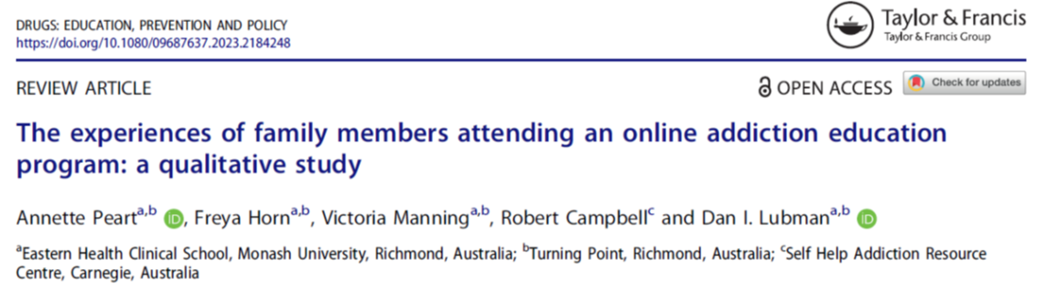
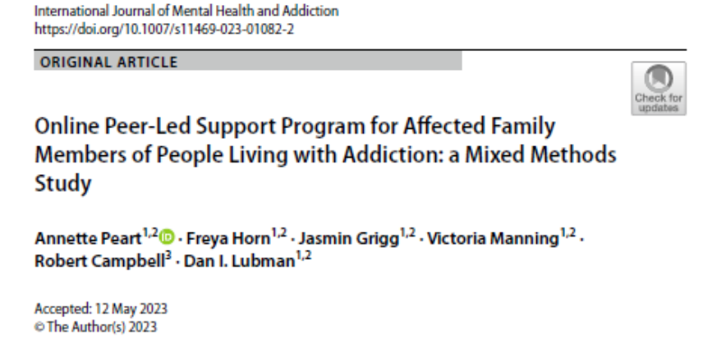
https://www.tandfonline.com/doi/full/10.1080/09687637.2023.2184248
https://link.springer.com/article/10.1007/s11469-023-01082-2
Notes:
AP
Here is a link to the papers we published for this project.

Slide 25
SMS reminders prior to the sessions were a great resource used for all registered participants
Topics presented at Breakthrough prior to Online Support Group were relevant to the group.
The sessions provided opportunities for participants to have a voice for challenging situations that they have been dealing with, often for a large number of years.
Open questions from facilitators enabled effective reflections in the group.
Effective time was allocated to all participants to share.
Call-backs were offered and taken up by participants post-session.
Terrific feedback was received.
Experience of the Group
Notes:
RC
Really about how family members access support services
Pattern of accessing support when new challenges arose
Need for services to be easy and convenient to access, to fit with other life demands and easy when stressed/emotionally drained.
Participants felt that online supports were generally convenient, nonthreatening, and easier than face-to-face supports, particularly during a crisis period.

Slide 26
Suggests online support group may increase confidence to manage challenges
Suggests connecting with other family members, skilled facilitators, and accessibility are core components
Quote from participant:
“Thanks so much Glenn, I really loved last night’s support group and found it powerful and emotional, but most of all I connected with everyone in it. Thanks so much for facilitating such a great group.”
Summary
Notes:
RC
Most participants were mothers in midlife. We don’t know much about non-represented groups, e.g., male family members, and other (non-mother) family members, and AFMs in other age groups. -> what their needs are, how we can support them

Slide 27
Thank you to the team:
Freya Horn
BreakThrough and Online Support Group Facilitators, Anna Guthrie, Nicola Scarlett, and Glenn Hunter
All participants
Contact – Annette Peart annette.peart@monash.edu
Robert Campbell rcampbell@sharc.org.au
https://www.breakthroughforfamilies.com/ https://www.turningpoint.org.au/
https://www.sharc.org.au/
Thank You!
Resources
Questions?
Notes:
RC
Participants felt that online supports were generally convenient, nonthreatening, and easier than face-to-face supports, particularly during a crisis period.

