Slide 1

CRAFT + Parent Training, delivered on-line: a Randomized
Controlled
Trial
Anders Hammarberg & Ola Siljeholm
Karolinska Institutet, Department of Clinical
Neuroscience, Centre for Psychiatry Research
Stockholm Centre for Dependency Disorders

Slide 2

Outline for presentation
Background
The SPARE-program
RCT
Qualitative study
Conclusions
Discussion
Notes:
So, outline for my presentation is as follows. We start with an overview of the project, a short background and aims. Then I will go in to some detail on the different studies and current status, say something about significance of the project and then open up for discussion.

Slide 3
Background

Slide 4

Background
Children exposed to parental alcohol-/substance use have increased risks of alcohol use disorder (AUD) and substance use disorder (SUD), early deaths, depression and anxiety (Hjern, 2014; Velleman & Templeton, 2007; Mellentin et al., 2016; Park & Schepp, 2015)
Only 2% of 380 000 Swedish affected children take part in support interventions (Elgán, 2015; Wannberg, 2014 ;Ramstedt, 2019).
Internet interventions reaches people not prone to seek other treatment (White, 2010).
Guided internet delivered CBT effective in improving e.g. anxiety and depression (Carlbring et al, 2018, Andersson et al 2019) and reducing alcohol consumption (Johansson et al, 2020)

Slide 5
Background
Parental training programs improve child behavioral- and emotional problems by increasing positive parental behaviors and reducing parental stress, (Barlow et al, 2012; Park & Schepp, 2015 ; Stattin et al, 2015)
Online self-directed parent training programs effective in reducing problematic child behaviors (Florean et al, 2020)
Parent training combined with treatment for substance use show promising results in substance reduction and positive parenting (Neger & Prinz, 2015)

Slide 6
Affected children in Sweden
Parents with severe alcohol use disorder
75 000
Exposed to parental drinking: 20%
Negatively affected: 15%
Affected very negatively: 10%
Parents with severe alcohol use disorder (AUD): 3,5%
(Ramstedt, 2019)
Affected very negatively
215 000
Exposed to parental
problematic drinking
140 000
No apparent exposure
1 720 000

Slide 7
Limitations previous research
Limited knowledge about co-parenting with someone suffering from alcohol problems
Mainly parents with heavy use
Few interventions aiming to improve factors mitigating effect of parental alcohol problems
No study targeting CSOs with combined treatment approach identified

Slide 8
CRAFT - Community Reinforcement Approach And Family Training
A treatment program for CSOs of persons suffering from problematic substance use (Meyers et al., 1997)
Based on cognitive behavioral theory (CBT) and motivational interviewing (MI)
Three main goals:
  to improve CSO quality of life
  to support the relative’s sober and healthy activities, thereby hopefully decreasing the substance use
  to increase the relative’s motivation to seek help
Notes:
One interesting approach for supporting CSOs that has emerged over the last twenty years is this program, called….

Slide 9

CRAFT - Community Reinforcement Approach And Family Training
Recent systematic review of 10 studies with CSOs to relatives with alcohol- or substance use: treatment entry rates of 40-86% (Archer et al, 2020)
CRAFT as well as active control conditions increase CSOs quality of life and reduce substance use in the relative (Roozen et al, 2010; O’Farrell et al, 2012; Archer et al, 2020)

Slide 10
All Children in Focus - ACF
Universal prevention program for parents of children 3-11 y/o
Based on CBT
  Positive reinforcement
  Communication skills
  Prevent and handle conflict
  Rules and boundries
Positive effects:
  Parent rated child well-being
  Parental self-efficacy
  Cost-effective
  (Ulfsdotter et al, 2014; Ulfsdotter et al, 2015)

Slide 11
RCT - Aim
Investigate if the internet-delivered self-administered program SPARE was more effective than an active control group (psychoeducational material ) in improving the psychological
health of children affected by parental alcohol use.
Notes:
So in order to investigate a dual approach we created an internet delivered self-help program that we called Skydda barnen, or protect the children.

Slide 12
RCT - Method
Design: Randomized controlled superiority trial comparing SPARE to an active control group (information)
Participants: Parents sharing a child (age: 3-11) with a partner with problematic Alcohol Use
Funding: Public Health Agency of Sweden, The Research Council of the Swedish Alcohol Retailing Monopoly (SRA)

Slide 13
RCT - Method
Inclusion criteria:
CSO: ≥ 18 y/o, Audit-C score <4/5 (women/men). No regular use of illicit drugs, no severe mental health problems. Not currently participating in support program for CSOs. Not under current threat of violence from co-parent.
Co-parent with alcohol problems: Audit-C score ≥ 4/5 (women/men) and/or ≥2 ICD-criteria for alcohol dependence. No regular use of illicit drugs.
Child: 3-11y/o, living ≥ 4 days/month with drinking parent, scoring above population mean on subscale/total score on parent rated Strengths and Difficulties Questionnaire (SDQ).

Slide 14
RCT - Method
Outcomes (selection)
Primary outcome measure: Changes in child’s psychological health at 3 months after inclusion, measured by Strengths and Difficulties Questionnaire (SDQ), parent rated
Secondary outcomes (selection): Depression, anxiety and stress in the CSO, co-parent’s alcohol consumption, parental self-efficacy

Slide 15

Supportive PArenting and
REinforcement (SPARE)
Self-delivered, anonymous participants
Four modules with core components from CRAFT and Parent training
  Take care of yourself (CRAFT)
  How to handle the co-parent (CRAFT)
  Parental training (ACF)
Assignment at the end of each module
Minimum time in program 4 weeks, maximum time 12 weeks
Chat forum available at all time

Slide 16
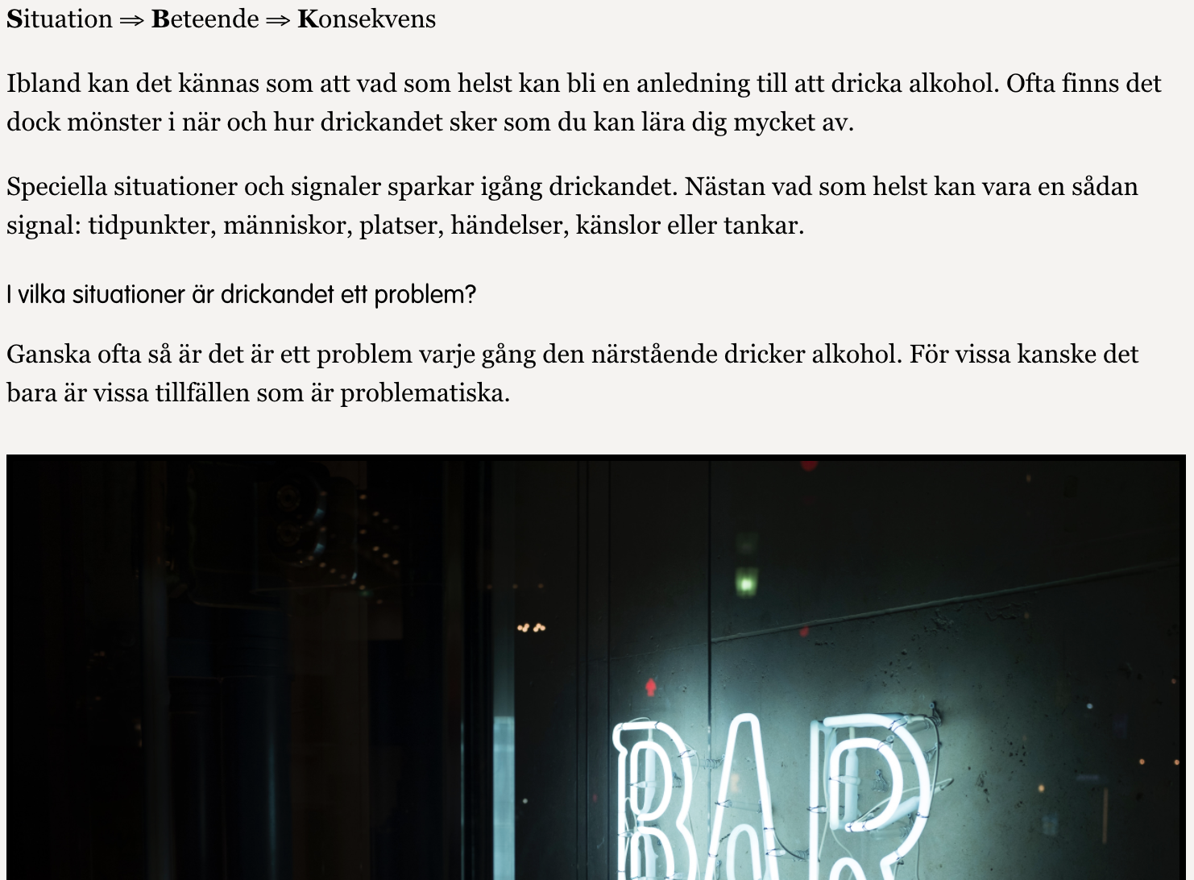
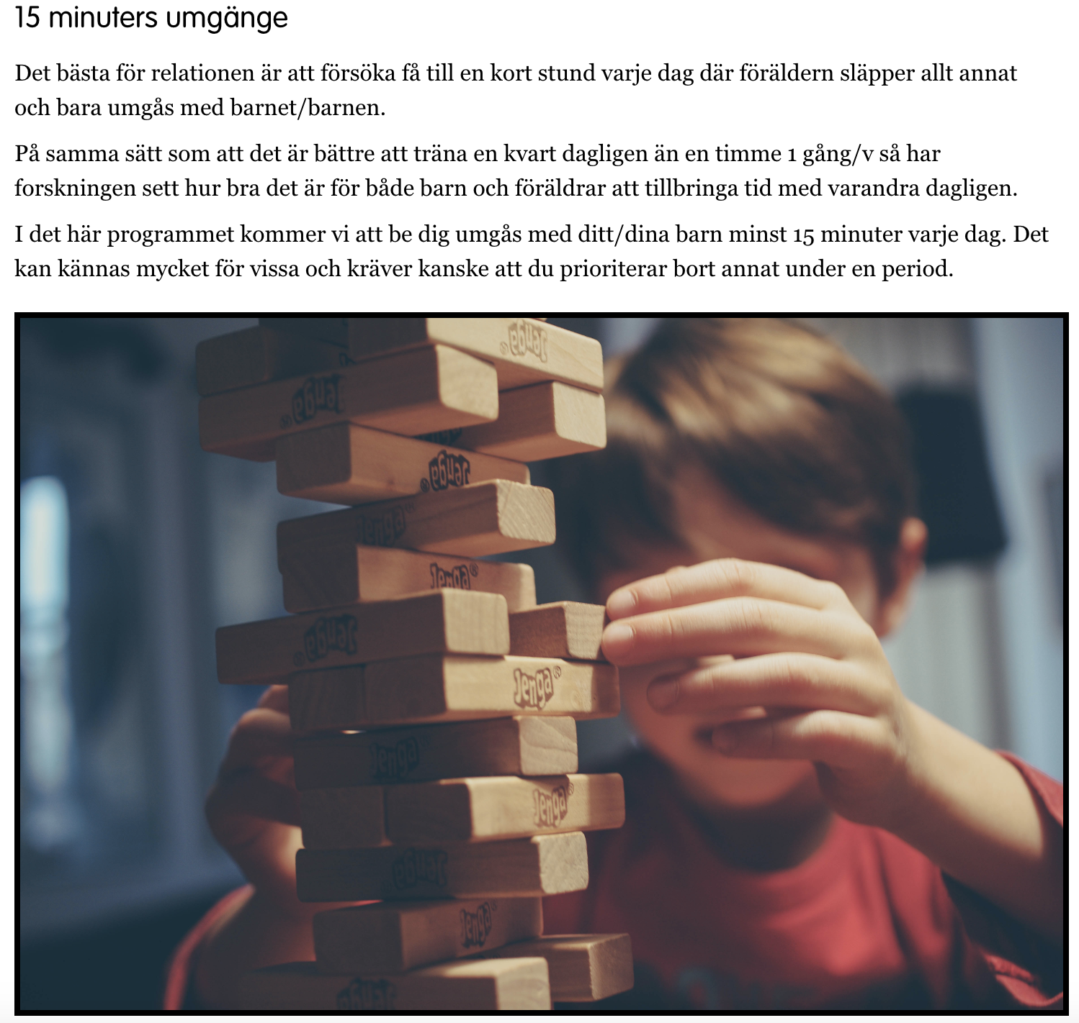
SPARE
Functional analysis
Positive reinforcement
Communication skills
Practice conversation on treatment seeking
Increase time spent with the child
Increase frequency of positive activities for CSO alone and for children

Slide 17
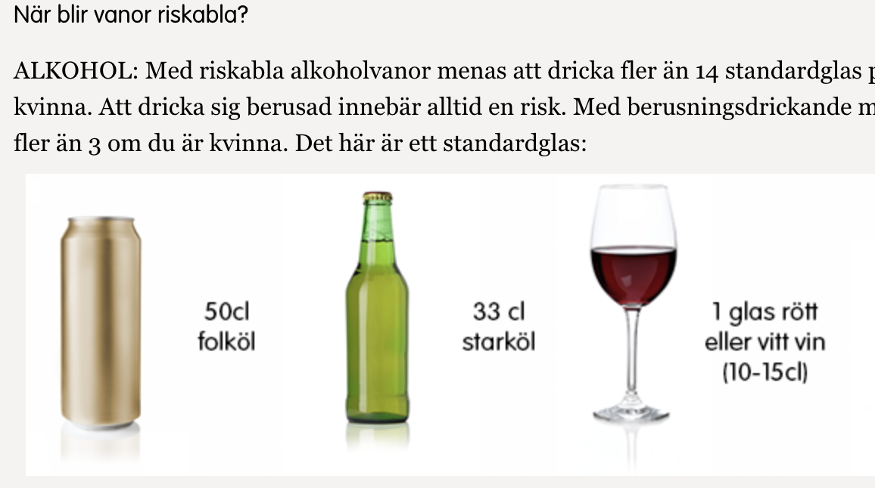
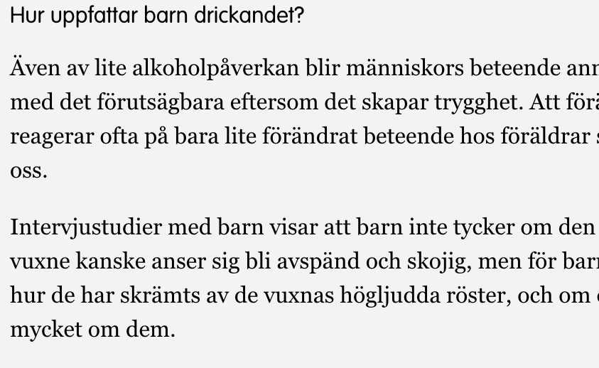
Active control condition: psychoeducational material
Four modules distributed weekly
No exercises aimed at promoting behavioral change
Chat forum available at all time
Topics:
Information about being a CSO to an individual with alcohol problems
Information about AUD and dependence
Information about taking care of yourself and your family
Finding help

Slide 18
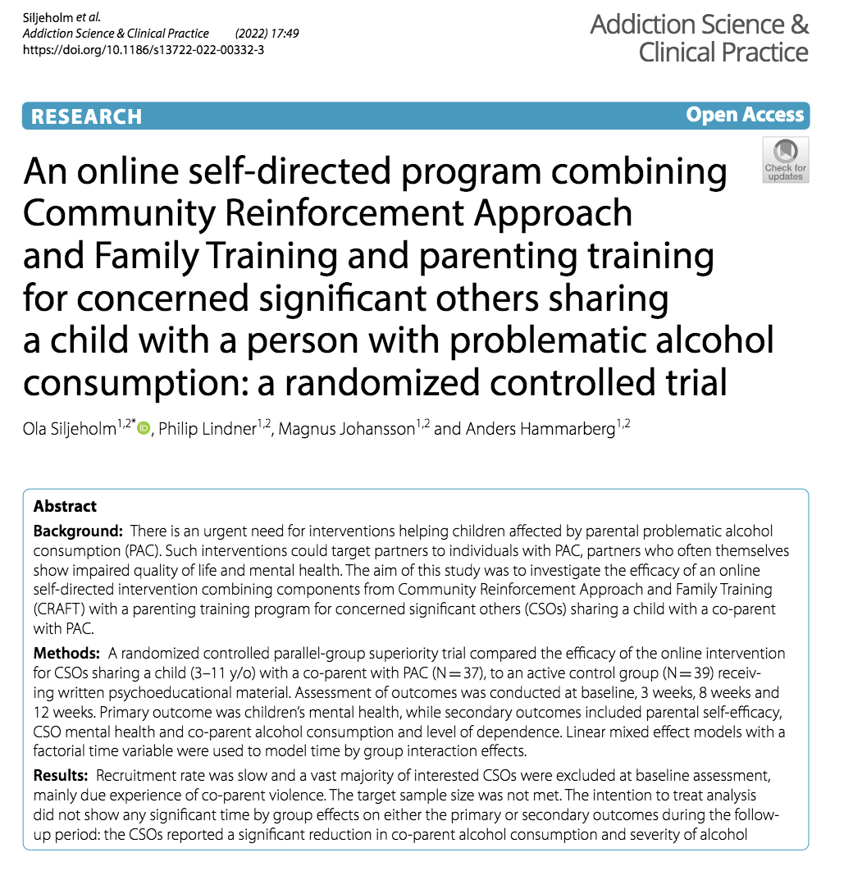

Slide 19
RCT - Results

Slide 20
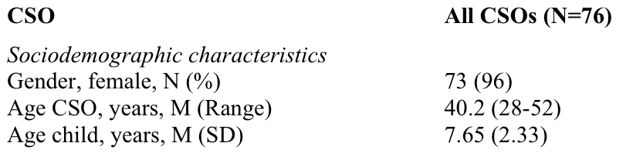
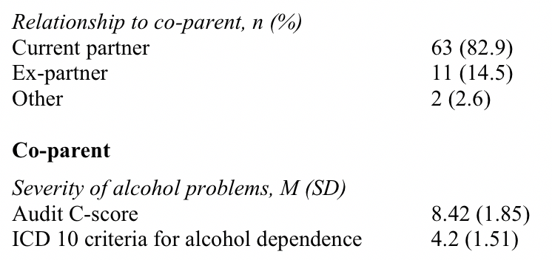
RCT - Results

Slide 21
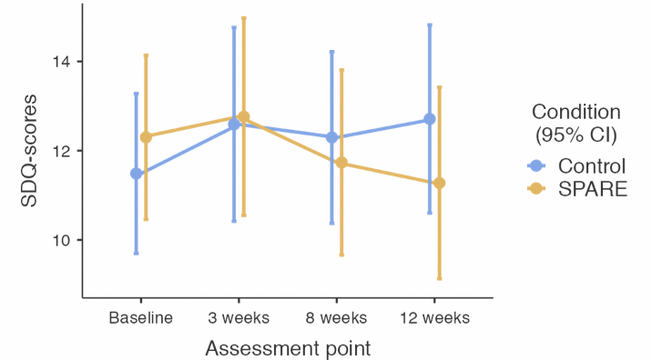
RCT - Results
Primary outcome: Children's’ mental health (SDQ)
  No differences between conditions
  No significant change over time (baseline-3 months)

Slide 22
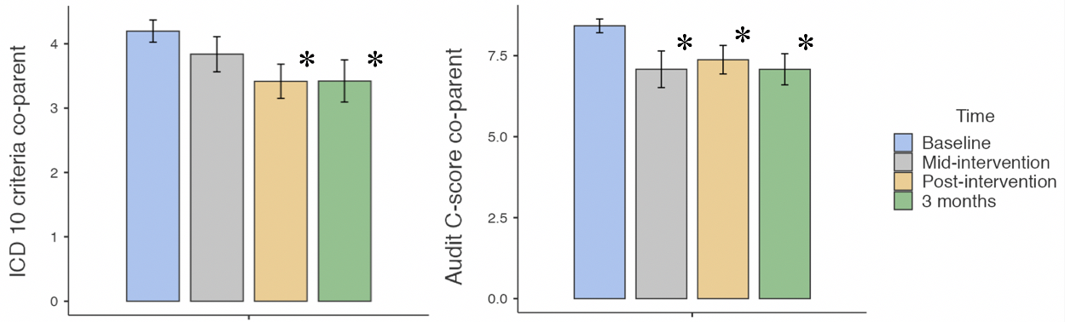
RCT - Results
Improvements in both conditions:
  Co-parents’ alcohol consumption (AUDIT-C)
  Severity of dependence (ICD-10 criteria)
  Self-efficacy in handling co-parent alcohol consumption

Slide 23

RCT - Conclusions
Children’s mental health assessed by parents at almost clinical levels, i.e. children are affected
No between-group effects of the SPARE-program
Difficult population to recruit – limited statistical power
Surprising amount of CSOs under threat of
co-parent violence
  Future studies may choose to focus on CSOs
  in more severely affected contexts.

Slide 24
Qualitative study

Slide 25
Qualitative study - Aim
To describe the experience of participating in internet-delivered support for co-parents of persons with problematic consumption of alcohol
Specific aims
to study reasons for seeking support as described by the parents
study how the parents perceived the effect that the program had on themselves, the children, and the drinking co-parent

Slide 26

Qualitative study - Method
13 females who completed ≥ 2 modules of SPARE
Semi-structured interviews
Qualitative content analysis (Hsieh & Shannon, 2005)

Slide 27
Qualitative study - Results
Content area | Reasons for seeking support | Perceived effects of the program
Categories and sub-categories | Coping with co-parent drinking Escalation of drinking and alcohol-related consequences Wanting new coping strategies in relation to the co-parent Emotional validation and support Worrying about the children Perceptions of available support for SOs | Change in my own behavior Interaction with the children Taking care of myself Coping with the co-parent Acknowledgement and relief Missing in the program

Slide 28
Qualitative study - Results
Emotional validation and support for myself
Yes, I noticed feeling bad, I understood that I needed help in some way as well, and that I would, perhaps, I don’t know, but I needed help to feel a little better, since I didn’t have anyone to talk to […]. (8)

Slide 29
Qualitative study - Results
Perception of available support
I live in a small town, I kind of felt like I didn’t want to contact anyone, because it becomes so obvious, it’s always people you know, working in the same field. So, I thought, well maybe there is something on the internet, so I started to Google and found this. […] An anonymous tool like this was very valuable.

Slide 30
Qualitative study - Results
Acknowledgement and relief
Because you get called crazy a lot when living with such a person, a lot of things become normalized. So, when you asked these questions, it was a kind of acknowledgement that I’ve been living with a man with a disease.

Slide 31
Qualitative study - Results
Interaction with the children
The children get a little, you know, I wouldn’t say “forgotten,” but you focus so much on other things with thoughts and everything. And there were really good exercises and thoughts, like this thing that you are supposed to take ten minutes with them and things like that. […] I think it was really good.

Slide 32
Qualitative study - Results
Coping with the co-parent
Like, “What a nice weekend we’ve had” instead of, like, “How nice that you didn’t get hammered today.” You know what I mean, really tried to talk to him in another way and I hope that has had a positive effect on him.

Slide 33
Qualitative study - Conclusions
The parents belonged to a group new to the research litterature
Boring, absent and sometimes neglectful fathers are strenuous to mothers and children
Mothers unsure if they were "eligible” for support
Wanted strategies to deal with the co-parent's drinking
Helpful with validation/confirmation
Increased focus on the children = better
relationship
Anonymity and availability important

Slide 34
Conclusions of total project
Target population hard to reach
  Do not yet identify children as harmed by co-parent drinking
Anonymity important
  Potentially more accurate measures of risk for violence
Providing structured support leads to decreased drinking in co-parent
Dedicated parent-child time recommended for similar interventions
Program completers felt empowered and acknowledged - lead to behavior change
SPARE-program can be offered as a first step for help-seeking parents
Notes:
Broadening the perspectives on CSOs mean that
within the social services and health care system in Sweden

Slide 35

Acknowledgements
Veronica Ekström – Associate professor
Malin Bergström – Associate professor
Magnus Johansson, PhD
Sofia Vänelid, study coordinator
Philip Lindner, Associate professor
Colleagues at Mottagningen för Alkohol och hälsa,
Riddargatan 1
Notes:
And since no man is an island I want to acknowledge a few people. First of all my excellent supervisors with Anders in the lead and Malin and Veronica as co.supervisors. I’m really happy to have you onboard and can always turn to you for support.
Magnus Johansson definately needs praise as the brains behind study I, co writer of the program and internet genious
Sofia Vänelid for all the help with taking care of participants in the program
Philip Lindner, for your statistical knowledge and other contributions
I’m very lucky to be surrounded with so many great people, thank you
And finally of course my wife Hanna and children Frank and Elis, the sun around which my world revolves

