Slide 1
Maternal Alcohol Dependence Symptoms & Maternal Insensitivity to Children’s Distress: Nuanced Pathways & Associations Underlying Early Childhood Adjustment
Dr. Debrielle T. Jacques
Assistant Professor
University of Washington

Slide 2

Children of Parents with Substance Use Disorders
Heightened risk for psychological and adjustment problems (Kuppens et al., 2020; Velleman & Templeton, 2007)
Child INTERNALIZING Problems
Child Externalizing Problems
Parent substance dependence
Caregiving
Caregiving Responses to Child Distress

Slide 3
Talk/ Study Roadmap
Study 1 → parsing nuance in parenting & infant outcomes
Study 2 → parsing nuance in child emotion regulation

Slide 4
Background
Internalizing problems among children of mothers with alcohol dependence symptoms is underexplored
However:
  Internalizing problems are prevalent (Bitsko et al., 2018; Côté et al., 2009; Whalen et al., 2017)
  Parental substance dependence is also prevalent (Lipari & Van Horn, 2017)
Little to no differentiation between types of internalizing problems

Slide 5


Different Forms of Internalizing

Slide 6
Parental Emotion Socialization
How parents help children understand, experience, express, and regulate emotions (Eisenberg et al., 1998; Malatesta-Magai, 1991).
Supportive socialization practices → healthy emotional functioning
Unsupportive socialization practices → harmful to child development (Eisenberg et al., 1998; Jacques et al. 2021; Shaffer et al., 2012).

Slide 7
Emotion Socialization & Psychopathology
Recent work has incorporated psychopathology into studies of emotion socialization (e.g. Godleski et al., 2020)
Insensitive caregiving behaviors → increased risk for child psychopathology
  Maternal insensitivity → higher levels of child depressive symptoms (Hastings et al., 2014; Sanders et al., 2015)
Parent psychopathology → insensitive responses (Jacques et al., 2021; Shaffer et al., 2012)
Few studies focused on mothers with alcohol dependence symptoms

Slide 8
Emotion Socialization & Maternal Alcohol Dependence
Mothers with alcohol dependence histories uniquely at risk for insensitive socialization behaviors
  Decreased neural processing of emotional cues (Kim et al., 2017; Rutherford et al., 2020)
  Report more unsupportive/insensitive socialization behaviors (Godleski et al., 2020; Hussong et al., 2020)
Despite prior work:
  Little is known about how alcohol-dependent mothers respond to their own child’s emotional distress

Slide 9


Parsing Maternal Insensitivity

Slide 10
Maternal Intrusiveness
Caregiving behaviors aimed around controlling the child’s behavior
  Overprotection, overstimulation, etc. (Biringen, 2000)
In emotional contexts, may manifest as:
  Excessive regulation of child’s emotions (Steinberg et al., 1989)
Adversely affects child development (Egeland et al., 1993; Eisenberg et al., 2015; Perry et al., 2018)
  Linked with child anxiety (van der Bruggen et al., 2008)
Few studies have explicitly examined maternal intrusiveness to child distress

Slide 11
Maternal Disengagement
Maternal behaviors that serve to reject or dismiss the child or minimize the nature and degree of the mother’s involvement with her child (Sturge-Apple et al., 2012)
Undermine parent-child emotional bond (Rohner & Rohner, 1980)
Maternal disengagement negatively affects child development (Rohner & Rohner, 1980):
  Withdrawn
  Emotion dysregulation
Disengagement to distress particularly harmful (Leerkes; 2021; Leerkes et al., 2012)

Slide 12
Study 1
Associations between maternal alcohol dependence, maternal insensitivity to child distress, and child internalizing problems remain unclear
No study has examined whether or how different types of insensitivity differentially predict child internalizing problems
This study examined specificity in these associations
Hypotheses:
  Maternal alcohol dependence symptoms
  child internalizing problems
  Insensitivity to child distress

Slide 13
Participants

Slide 14
Participants
201 toddlers (M_{age} = 26 months) & their mothers (M_{age} = 26.32 years)
Median family income = $18,300 per year
30% of mothers had not completed high school
Majority ethnic minority sample:
  56% Black/African American
  23% White
  11% Latinx/Hispanic
  7% Multiracial
  3% “Other”

Slide 15
Study 1 Methods

Slide 16
Procedures
Data collected across three waves, each spaced one year apart
Dyad visited the laboratory
  Mothers completed questionnaires
  Experimenters observed and rated children’s behavior
  Dyads completed the Strange Situation (SS; Ainsworth & Wittig, 1969)
    Child Distress
    Maternal insensitivity

Slide 17

So What did Study 1 Reveal?

Slide 18
Study 1
Child Affective Problems

Slide 19
Study 1: Child Affective Problems
↑Maternal Alcohol Dependence

Slide 20
Study 1: Child Affective Problems
↑Maternal Alcohol Dependence
↑ Maternal Disengagement

Slide 21
Study 1: Child Affective Problems
↑Maternal Alcohol Dependence
↑ Maternal Disengagement
↑ Child Affective Problems

Slide 22
Study 1: Child Affective Problems
Maternal Alcohol Dependence
Maternal Intrusiveness
Child Affective Problems
X
X

Slide 23
Study 1
Child Anxiety Problems

Slide 24
Study 1: Child Anxiety Problems
↑Maternal Alcohol Dependence
↑ Maternal Disengagement

Slide 25
Study 1: Child Anxiety Problems
↑Maternal Alcohol Dependence
↑ Maternal Disengagement
Child AnxietyProblems
X

Slide 26
Study 1: Child Anxiety Problems
Maternal Alcohol Dependence
Maternal Intrusiveness
X

Slide 27
Study 1: Child Anxiety Problems
↑ Maternal Intrusiveness
↑Maternal Alcohol Dependence
↑ Maternal Disengagement
X Maternal Intrusiveness
X Child Anxiety Problems
↑ Child Anxiety Problems

Slide 28
Study 1 Discussion
Mothers with histories of alcohol dependence may be more likely to be emotional disengaged than intrusive
Distinct types of insensitivity predict different child internalizing problems:
  Disengagement → affective problems
  Intrusiveness → anxiety problems

Slide 29



But why?
Why were maternal alcohol dependence symptoms associated with disengagement but not intrusiveness?

Slide 30


Parsing Child Outcomes

Slide 31



Study 2

Slide 32
Emotion Regulation & Reactivity
Close link between emotion regulation & reactivity (Gross, 2015)
  Reactivity: intensity, duration, & threshold of emotional expresses and responses to stimuli
  Regulation: processes used to monitor, modify, and control emotions
“Effective” emotion regulation → increased adjustment & well-being (Eisenberg et al., 2010; Rothbart & Bates, 2006)
Emotion regulation
Emotion regulation

Slide 33
Emotion Regulation & Reactivity in Childhood
Independent emotion regulation = challenging
  Caregiver-driven
  Reactivity initially high
  Infants use reactive-based (“unsophisticated”) strategies to regulate themselves
We get better over time!
  Strategies = more sophisticated, intentional, involving higher-order cognition
  Regulation (and emotions!) become more flexible and contextually informed

Slide 34


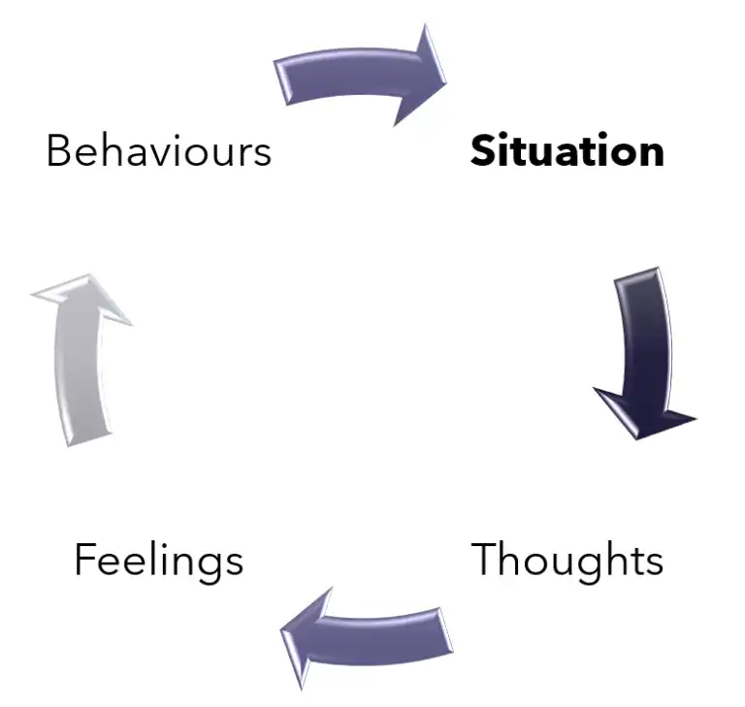
Implications of Regulation Strategies in Childhood
Two dominant regulatory strategies: expressive (emotional) suppression & cognitive reframing (reappraisal) (Gross, 1998; 2015)
Expressive Suppression
Inhibiting outward emotional expressions
Cognitive Reframing (Reappraisal)
Changing your interpretation of emotional events to modify its impact

Slide 35
Parent & Family Influences on Child Emotion Regulation
Families & parent-child interactions = primary context impacting infant’s emotional development
  Example: emotion socialization
Parental addiction undermines parent emotion socialization & parental responses to children’s emotions
But…how are children of mothers with alcohol dependence regulating their emotions?

Slide 36

But what about family context?
Parent behaviors → child emotion reactivity
Focus on (and findings related to) emotional undercontrol, hyper-reactivity
Less work (or findings on) emotion OVERcontrol

Slide 37
Study 2 Aims
How does maternal alcohol dependence impact children’s emotional reactivity?
Does maternal responsiveness to children’s emotional distress play a crucial role in this association?
Can findings reveal something meaningful about the context of maternal addiction/substance dependence?

Slide 38
Participants
201 toddlers (M_{age} = 26 months) & their mothers (M_{age} = 26.32 years)
Median family income = $18,300 per year
30% of mothers had not completed high school
Majority ethnic minority sample:
  56% Black/African American
  23% White
  11% Latinx/Hispanic
  7% Multiracial
  3% “Other”

Slide 39
Study 2 Procedures
Data collected across three waves, each spaced one year apart
Dyad visited the laboratory
  Mothers completed questionnaires
  Experimenters observed and rated:
    Children’s emotional reactivity (across contexts) & distress
    Mothers’ sensitivity to children’s emotional distress (during distress task)

Slide 40
What did Study 2 Reveal?
↑Maternal Alcohol Dependence
↑ Maternal Insensitivity
↓ Child Reactivity

Slide 41


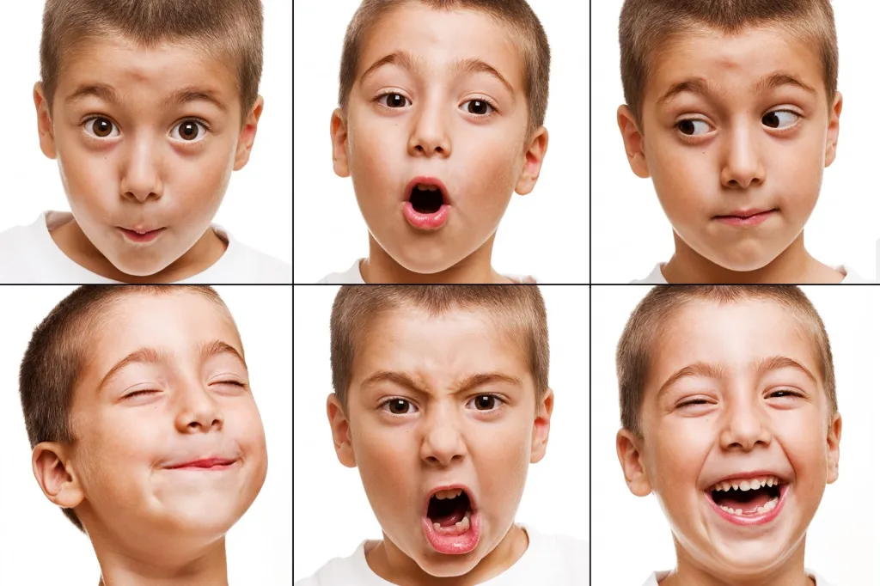
Takeaways

Slide 42







Acknowledgements
Melissa L. Sturge-Apple, Ph.D. Patrick T. Davies, Ph.D. Dante Cicchetti, Ph.D.
My collaborators, and funders: NIH & University of Rochester, University of Minnesota, & University of Washington
Former research staff (Jennifer Cristakos, Erin Dacey, & Kiran Sundaram)
All or our amazing families!

Slide 43
Thank you!

Slide 44

Questions
Questions?

Slide 45
Paper 1: SEM of Child Affective Problems

Slide 46
Δ W1-W2 Maternal Disengage.ΔΔ
W1 Family Income
-.177 (.004)*
W1 Maternal Psychopathology
. 160 (.160)*
.180 (.037)*
Δ W2-W3 Child Affective Problems
W1 Mat. Alcohol Dependence Symp.
Maternal Age
Avg. W1 Child Distress
Δ W1-W2 Maternal Intrusive.Δ
Model Fit:
RMSEA = .04
CFI = .90
W1 Child Affective Problems
Child Gender
Structural equation model examining associations between maternal alcohol dependence, psychological and socio-demographic variates, and longitudinal change in maternal disengagement, intrusiveness, and child affective problems. W1 = Wave 1; W2 = Wave 2; W3 = Wave 3. Mat. = maternal. * p < .05.

Slide 47
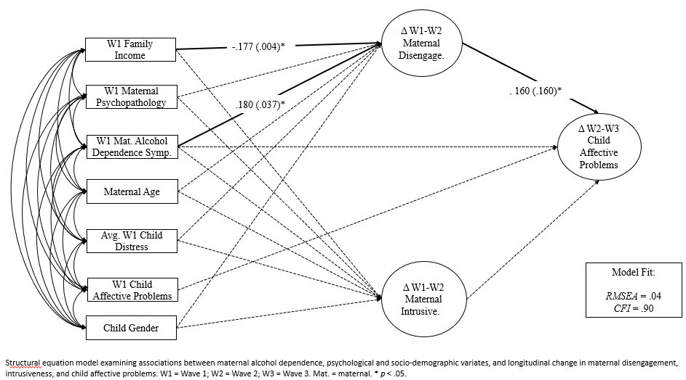

Slide 48
Paper 1: SEM of Child Anxiety Problems

Slide 49
Δ W1-W2 Maternal Disengage.ΔΔ
W1 Family Income
-.176 (.004)*
W1 Maternal Psychopathology
.174 (.037)*
Δ W2-W3 Child Anxiety Problems
W1 Mat. Alcohol Dependence Symp.
Maternal Age
Avg. W1 Child Distress
. 145 (.111)*
Δ W1-W2 Maternal Intrusive.Δ
Model Fit:
RMSEA = .034
CFI = .94
W1 Child Anxiety Problems
Child Gender
Structural equation model examining associations between maternal alcohol dependence symptoms, psychological and socio-demographic variates, and longitudinal change in maternal disengagement, intrusiveness, and child affective problems. W1 = Wave 1; W2 = Wave 2; W3 = Wave 3. Mat. = maternal. Symp. = symptoms; Disengage. = disengagement. Intrusive = intrusiveness. * p < .05.

Slide 50
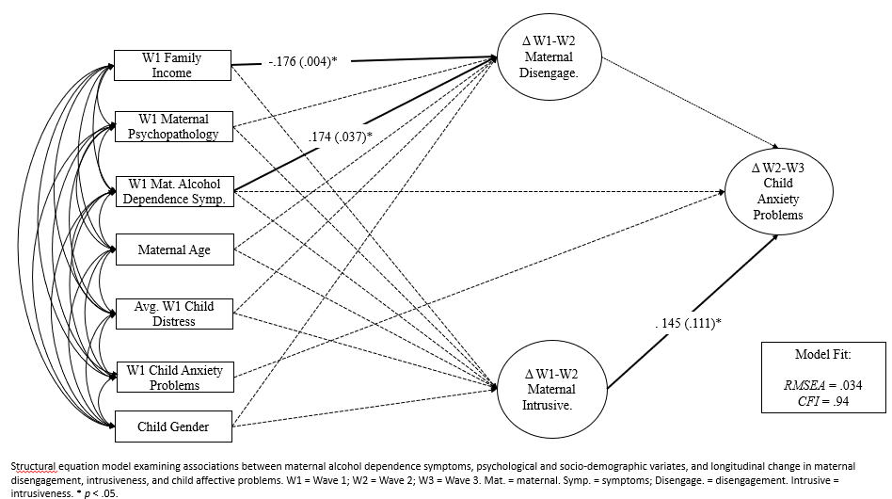

Slide 51
Paper 2: SEM Model

Slide 52
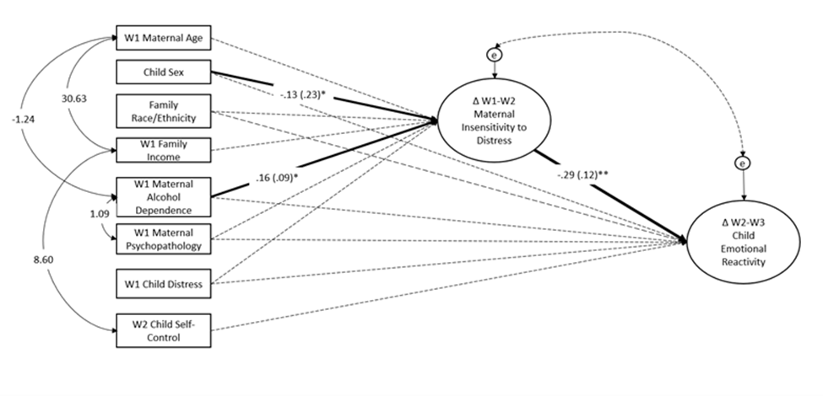
Structural equation model examining longitudinal associations between socio-demographic variables, maternal psychopathology symptoms, maternal alcohol dependence symptoms, change in maternal insensitivity to children’s distress, and change in children’s emotional reactivity. Dashed lines indicate non-significant pathways. W1 = Wave 1; W2= Wave 2; W3 = Wave 3. * p < .05.

