Slide 1




The Family and Friend Support Program
Co-design process, pilot study, and future directions

Slide 2

Acknowledgement of Country
We would like to acknowledge and pay respects to Aboriginal and Torres Strait Islander peoples, the traditional owners of the land.
As we share our own knowledge, teaching, learning and research practices, we also pay respect to the knowledge embedded forever within the Aboriginal Custodianship of Country.
Notes:
I am coming to you from Australia on the unceded lands of the Gadigal people of the Eora Nations and pay my respects to our First Nations, the Aboriginal and Torres Strait Islander peoples, the traditional owners of the land and pay respect to Elders past and present.

Slide 3



Background
“The first priority must be supporting families, workers and communities to better respond to people affected by crystal methamphetamine (ice)”
There is a need for evidence-based well-being interventions that are co-developed and accessible
Notes:
The Final Report of the National Ice Taskforce was established in 2015 by the Australian Government to provide advice on the impacts of ice in Australia stated that “The first priority must be supporting families, workers and communities to better respond to people affected by ice.” In parallel it was recognized that there were limited evidence-based interventions for affected family members and friends, and even fewer interventions that have been evaluated for real-world effectiveness.

Slide 4
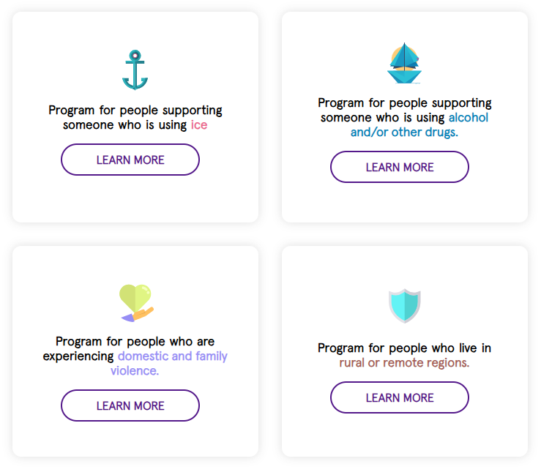

Family & Friends Support Program
Notes:
This led to the development of our program. The Family and Friend Support Program or FFSP is an evidence-based, online resilience and wellbeing program designed with and for affected friends and family members (AFFMs). It was based on a review of evidence at the time, the team’s clinical experience and incorporating family & friends perspectives. It launched 2019/2020 and here are 4 streams to the project – ice was developed first, then the domestic violence & rural remote streams with some additional funding we received during COVID… All of these are freely available and accessible anytime. The program is free, anonymous and can be accessed anywhere, anytime across Australia. To date, the program has had almost 6000 (5,975) users since launching in November 2020. Four core modules and 7 mini modules informed by principles of Cognitive Behavioural Therapy and the Stress-Strain-Coping-Support model and covers topics such as learning about your values, cognitive restructuring, communication and assertiveness, problem-solving skills. The modules also feature stories from people with lived and living experience.

Slide 5
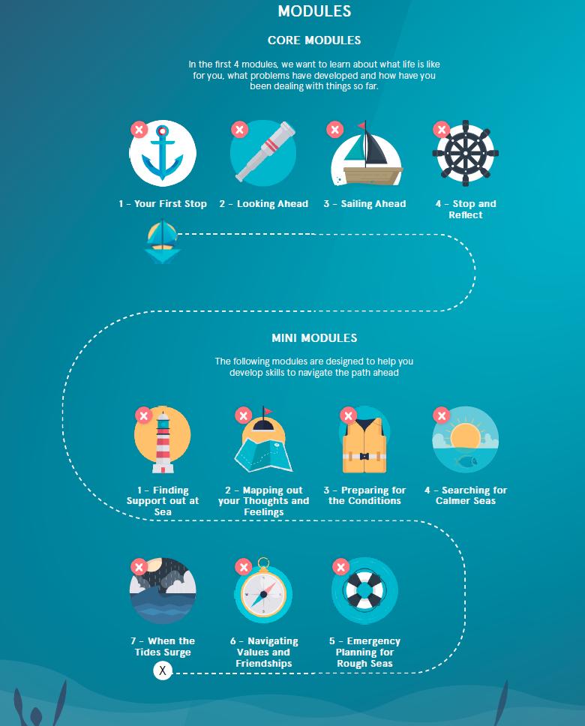
FFSP
Online Program
www.ffsp-aod.com.au
Notes:
Today I will be focusing on the AOD stream. – this launched in 2021, and is an online program for people who are supporting loved ones who is using AOD. It includes videos from clinical psychologists, and activities – to help people understand their needs and develop skills to help them weather the storm of caring for loved ones who are using AOD. There are four ‘core’ modules of the program only take 15-20 minutes to complete each and are designed to be completed first to help set the building blocks. The core modules are designed to be flexible, people can work through them in their own time, they can start or stop, bookmarking sections and coming back to them later. Once they have finished the core modules and hopefully identified some areas for improvement or where they might like to build skills– they can complete the mini modules.

Slide 6


Pilot Study
Evaluate the usability, acceptability and feasibility of AOD FFSP as an online support intervention for AFFM’s
Assess AFFM’s experiences of caring for a loved one using AOD across Australia
Notes:
The primary aim of this pilot study was to assess usability, acceptability, and feasibility of the program. A secondary aim was to capture a cross-sectional snapshot of family and friends’ experiences of caring for a loved one using AOD.

Slide 7
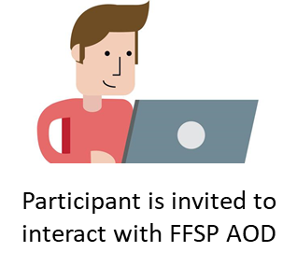
Methods
Recruitment:
Family members and friends supporting a loved one using AOD
Baseline Survey
Post Program Survey
(10 weeks post baseline)
Follow-Up Survey
(14 weeks post baseline)
Measurements:
Demographics
Kessler-10 (K10) and Adapted Short Questionnaire for Family Members (Affected by Addiction; SQFM (AA)) scales
Repeated baseline measurements + barriers to help-seeking + site usability and feedback questions
+
Optional: An additional in-depth interview with a research team member
Notes:
Participants across Australia were invited to completed three online cross-sectional surveys. The baseline survey assessed distress levels and the impact of caring for a loved one using AOD. Participants were then invited to interact with program modules over 10 weeks.
CLICK
Post program and follow up measures assessed usability and acceptability of the program as well as help-seeking barriers.
Semi-structured interviews were also conducted.

Slide 8
Results - Demographics
Baseline Survey
Post Program Survey
(10 weeks post baseline)
Follow-Up Survey
(14 weeks post baseline)
17 people (13%) said they had accessed FFSP between baseline and post program surveys
N = 131
N = 49
N = 32
Demographics:
Female (80.2%); 51±12.7 (STD) years
Notes:
A total of 131 participants completed baseline measures. Majority female and from metro areas.
At post-program, 17 participants reported accessing the program.

Slide 9
Results - Demographics
Notes:
The most common relationship of the loved one using AOD was a child (38.2%) and the most reported substance of concern was crystal methamphetamine (48.9%). Despite relatively low self-reported prevalence rates in the community, it’s interesting to note that crystal methamphetamine is one of the most stigmatized drugs and is also a drug with wide reaching impacts. Our sample reflects the finding from the most recent national Drug Strategy Household Survey that people were most likely to select methamphetamine use as the most serious concern for the community, reflecting its nomination as the most likely drug to be involved in ‘a drug problem’.

Slide 10
Results – Usability and acceptability
Average System Usability Scale score was 70 (STD 18, N = 17) which is above average compared to 500 other websites.
53.1% of participants felt that the activities were either somewhat, moderately, or very helpful.
71.5% of participants would recommend FFSP to others.
Notes:
From the 17 people who reported engaging with the program, the average usability score for the FFSP was 70 which is just above the average of 68 compared to 500 other websites. An average score indicates good usability but definitely room for improvement.
CLICK
More than half participants felt that the activities were either very or moderately helpful.
CLICK
The majority (71.5%) of participants rated that they would be likely recommend FFSP to others who might be in similar positions to them.

Slide 11
Results – Usability and acceptability
Notes:
The majority of participants felt it was easy to find the information they wanted and understand the information.

Slide 12
Results – Qualitative feedback
When asked for general feedback on the program
  More stories of what being a friend or family support person might involve.
[I accessed FFSP] to know that I am not alone and feel validated.
I found the content on the site quite good
It’s extremely comforting, for a while anyway, to find that there is somebody else who is just like you.
…learning to keep yourself in good shape so that you can help somebody else is extremely good
Those little vignettes of people's experience, they’re quite important
  There was just so much information, it required considerable time to work through.
Notes:
Feedback on the content of the program was generally positive, with people especially feeling their experiences validated and wanted more of from peer voices to overcome the feelings of isolation often accompanies their carer and support role. One specific area of improvement was the amount and density of content which can be a barrier for this population who are often time-poor and managing other life stressors.

Slide 13
Results – Qualitative feedback
Overcoming stigma and shame
  There is a big role for online support to play because it helps people not feel so bad ... half the problem is, people don’t tell anyone because it’s so shameful, particularly once they’re an adult
It’s extremely comforting, for a while anyway, to find that there is somebody else who is just like you.
Notes:
Particiapants also highlighted the need for programs like FFSP to address stigma and shame by validating their difficulties and normalising asking for help. For example, one participant said:
There is a big role for online support to play because it helps people not feel so bad ... half the problem is, people don’t tell anyone because it’s so shameful, particularly once they’re an adult

Slide 14
Discussion
Overall, FFSP seems to be an acceptable, useful and feasible way to provide accessible, evidence-based support to AFFMs
Limitations
Low engagement
High attrition
Reported barriers to accessing FFSP included
Perceived lack of need
Time restrictions
Other stressors
Technical difficulties
Notes:
Overall, participants found FFSP easy to use and provided them with relevant, helpful, and validating information in a format that is accessible, flexible and confidential.
CLICK
However, I’m sure you’ve already picked up on the low engagement rate and high attrition we had.
CLICK
This is likely due to perceived lack of need, time restrictions, other stressors such as illnesses.
We also know that online self-guided interventions often suffer from high drop out rates particularly in real-world settings. So these limitations are likely a pretty accurate reflection of how the program would are in the real world and reinforces the importance of considering how to make the program something people will actually engage with and benefit from amongst the other stressors and demands of life.
Despite this, participants highlighted the importance of just having this kind of tailored online support exist and its role in overcoming stigma and shame around supporting a loved one using AOD.

Slide 15
Future Directions
1. Use feedback to improve and refine the program
- Clinical and non-clinical support
- More lived experience stories
- Connect with local services
- Optimise for mobile
2. Conduct large-scale efficacy evaluation across the Family and Friend Programs
Notes:
We are in the process of using feedback from participants to further improve the program and enhance uptake and adherence.
And finally, we hope to use the learnings from this pilot study to guide a future large scale efficacy evaluation of the program.

Slide 16

Acknowledgments
Research team: Prof Frances Kay-Lambkin, Dr Dara Samson, Ms Jenny Geddes, Ms Lauren Rogers, Ms Bronte Speirs, Dr Steph Kershaw, Ms Maddy Keaveny, Prof Cath Chapman, Prof Maree Teesson, Prof Nickie Newton
Expert Advisory Group, project partners and collaborators: Prof Dan Lubman, Dr Rick Loos, Dr Milena Heinsch, Dr Jessica Wyllie, A/Prof Jamie Carlson, Ms Gill Velleman, Prof James Orford
Funding: Australian Government Department of Health, Disability and Ageing Care (development and implementation) and Alcohol and Drug Foundation (evaluation)
Notes:
I’d also like to acknowledge the amazing research team involved in this project and the original program development, as well as our collaborators. Including Department of Health and Aged Care and the Alcohol and Drug Foundation (ADF) who have funded the program and pilot study, respectively.

Slide 17

Acknowledgments
Thank you to the many family members and friends who have generously shared their stories and insights, as well as provided feedback on the program
Notes:
Importantly thank you to the many friends and family members who generously shared their unique experiences, stories and insights for this program and study.

Slide 18







Thank you!
Connect with us
Contact:
Postal Address:
The Matilda Centre, Level 6, Jane Foss Russell building (G02), The University of Sydney NSW 2006, Australia
  @TheMatilda_USyd
  @TheMatildaUSyd
  TheMatildaCentreUSyd
  @matildacentreusyd
  sydney.edu.au/matilda-centre
Visit FFSP:
www.ffsp.com.au
Read the full paper:

